Slide 1
WOLF CREEK DAM – CASE STUDY
Dave Paul, P.E.
Lead Civil Engineer
U.S. Army Corps of Engineers
Risk Management Center
David.B.Paul@usace.army.mil
Dam Safety Workshop
Brasília, Brazil
20-24 May 2013

Slide 2
Briefing Outline
Project Facts
Historical Problems
Current Problem
The Fix

Slide 3
The Project
Project | Project Authorization | Type | Ht (ft) | Age (yrs) | DSAC Class.
1. Barkley | Navigation, FC, Hydro | Combination | 157 | 43
2. Cheatham | Navigation, Hydro | Concrete | 75 | 55
3. Old Hickory | Navigation, Hydro | Combination | 98 | 55
4. Cordell Hull | Navigation, Hydro, Rec | Combination | 93 | 36
5. Wolf Creek | FC, Hydropower | Combination | 258 | 63 | 1
6. JP Priest | FC, HP, Rec | Combination | 147 | 42
7. Center Hill | FC, Hydropower | Combination | 250 | 58 | 1
8. Dale Hollow | FC, Hydropower | Concrete | 200 | 66
9. Laurel | HP, Rec | Rockfill | 282 | 36
10. Martins Fork | FC, Rec and WQ | Concrete | 120 | 31
Avg. Age 48.5 yrs

Slide 4
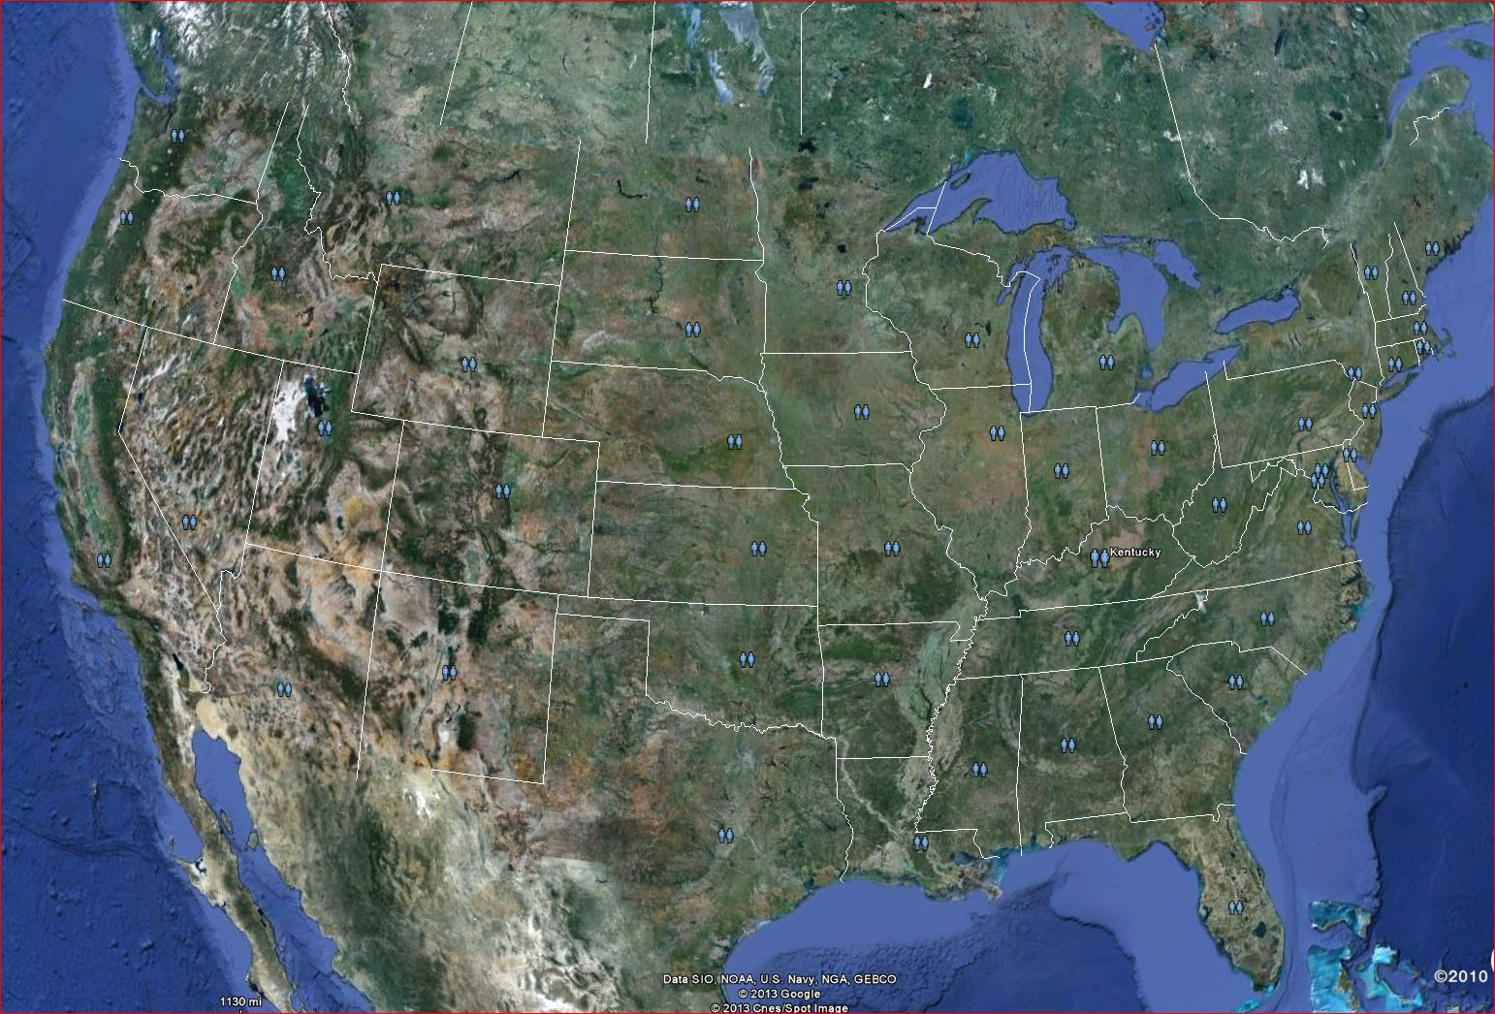
Wolf Creek Dam Location U.S.
Wolf Creek Dam

Slide 5
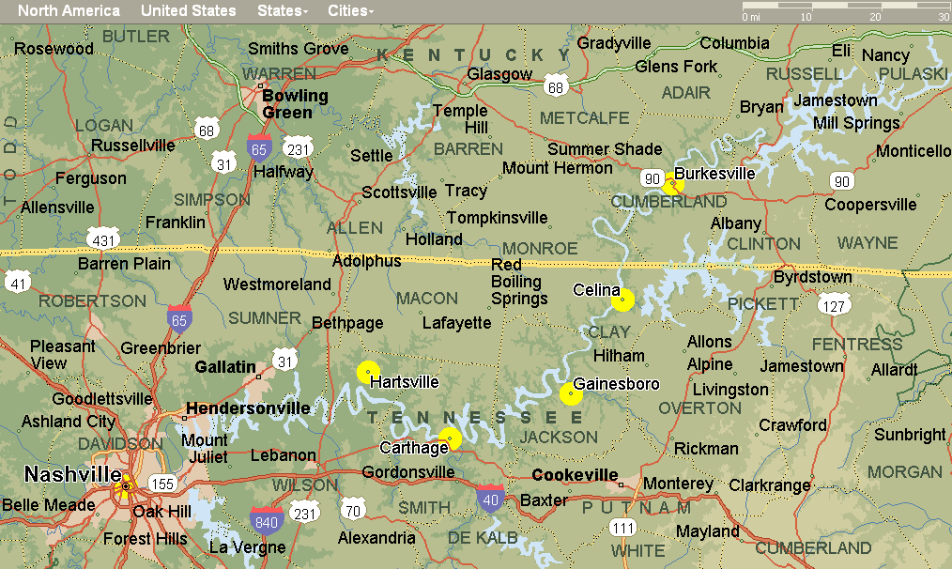
Location - States of Kentucky and Tennessee with Population Centers Downstream
Wolf Creek Dam

Slide 6
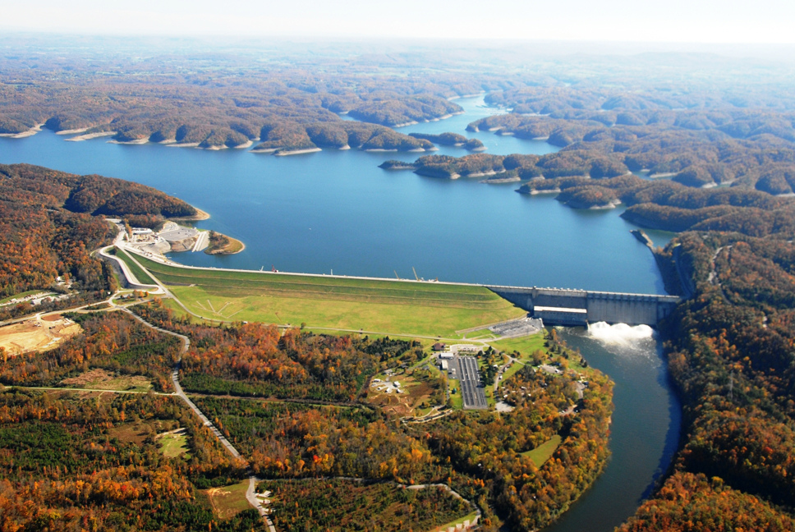
Wolf Creek Dam
Authorized for Flood Control, Hydropower, Recreation, Water Supply, Water Quality
Completed – Impounded 1951
Drainage Area – 15,000 sq. kilometers (5,789 mi²⁾
Total Volume – 751,000 hectare-meter (6,089,000 acre-feet)
Surface Area – 203 square kilometers (50,250 acres)
US Hwy 127
Concrete Gravity Dam
547 m (1,796’)
Embankment
1201 m (3,940’)
Powerhouse
Trout Hatchery
Switchyard

Slide 7
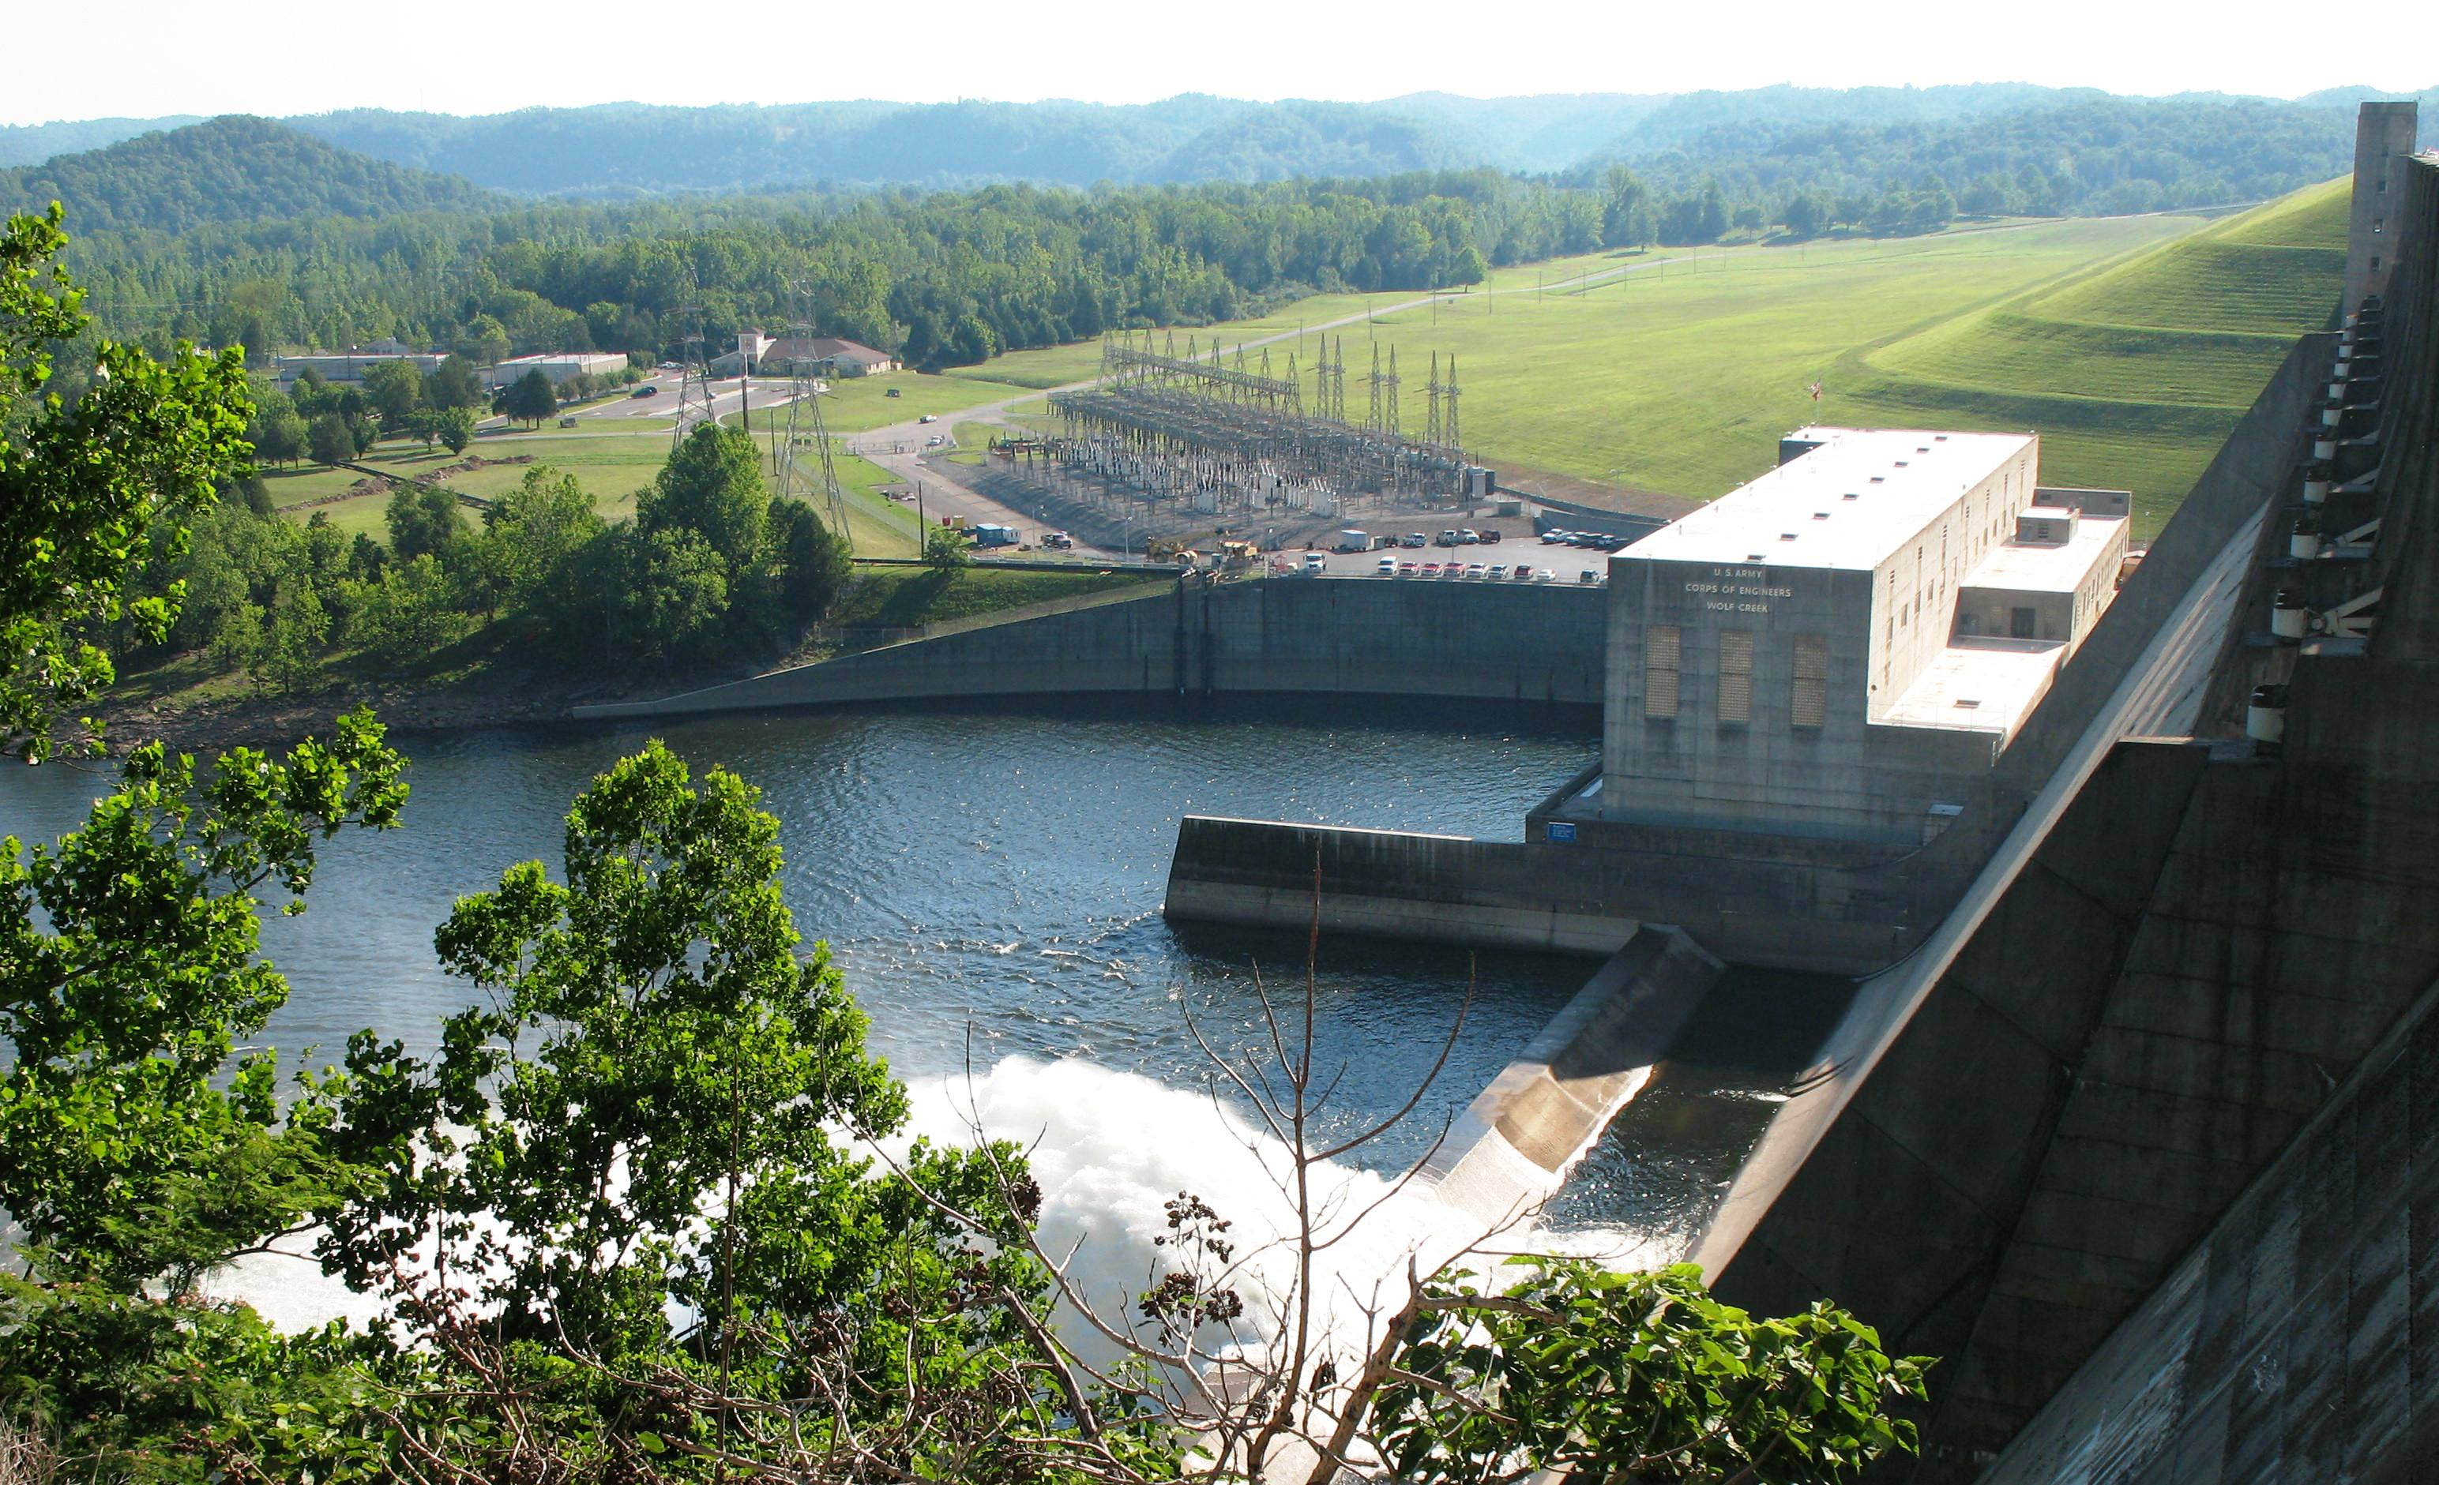
B
Project Benefits
Annual Flood Damages Prevented – B 1 Billion ($34 M)
Annual Hydropower Production
  800,000 MWH/year, B 2.3 Billion/year ($77 M/year)
Water Supply
  9 Municipalities - 75,700 m³/day (20 MGD)
  1 Coal fired plant – 844,000 m³/day (223 MGD)
  1 Fish hatchery – 49,210 m³/day (13 MGD)
Recreation
  5 M visits/year
  B 4.7 Billion to local economy ($159 M)

Slide 8
Lake Cumberland Significant Elevations
Elev. above MSL
ft. meters
Spillway gate
top of dam 773 235.6
top of flood control pool 760 231.6
pool of record 751.7 229
spillway crest 723 220.3
721 – 500-yr event (EL 680)
717 – 100-yr event (EL 680)
power pool 673 205
C_{L} penstock 621.9 189.6
Concrete Dam
78 m high
Sluice outlet
sluice gate invert 562 171.3
streambed 515 157
Cross Section through Concrete Dam

Slide 9
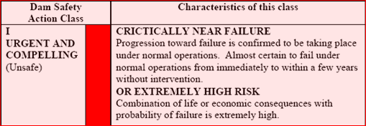
The Problem
Ranked in USACE highest risk category
High probability for embankment and foundation seepage and piping at normal pool levels

Slide 10

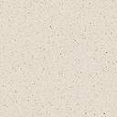
Generalized Section
Elev. 235.6 m
Top of Rock elev. 173 ±
Lake
Embankment
Cutoff Trench
Alluvial Soil Foundation
Karst Limestone Foundation

Slide 11



Embankment Plan
Lake Cumberland
Cutoff Trench
Critical Area
Concrete
Dam
Clay Embankment
Notes:
11
View looking down on the embankment shown in gray. Note the location of the cutoff trench running under the upstream portion of the dam and tying into the back of the concrete portion of the dam where the embankment wraps around the concrete section. This is a critical section and where we have a lot of the caves in the foundation
The cutoff actually followed a large channel in the rock that was intercepted during the construction of the cutoff trench. The designers decided to use this natural channel as the cutoff trench.

Slide 12
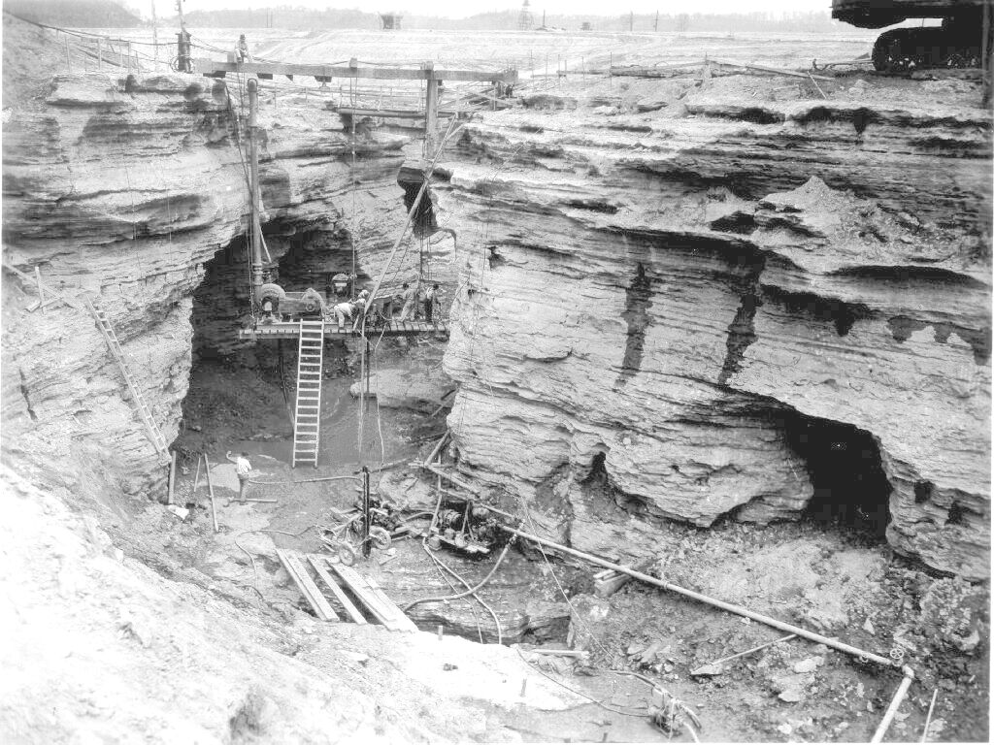
Foundation Treatment
Cave
Cutoff Trench
Caves
Solution Features Intercepting Cutoff Trench
Notes:
I have a series of Photos of the cutoff trench that illustrate the problems with the trench construction as well as an indication of the rock condition beneath the embankment.
Note size of twin caves in relation to workers.
Note other caves and small solution features
Seepage along bedding planes.
Tie in to monolith will be near top of picture

Slide 13
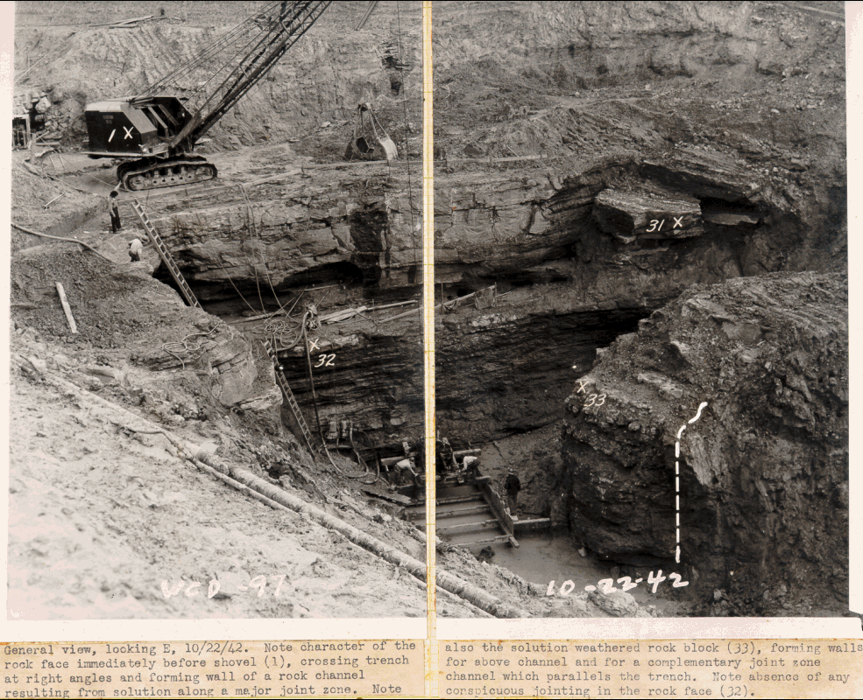
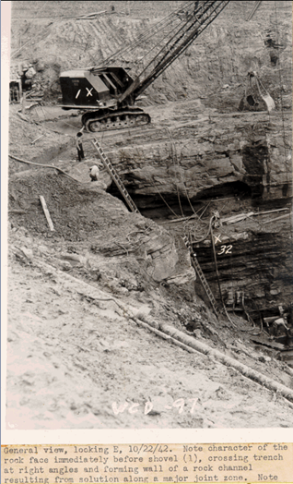
Solution feature crossing trench
Trench Line

Slide 14
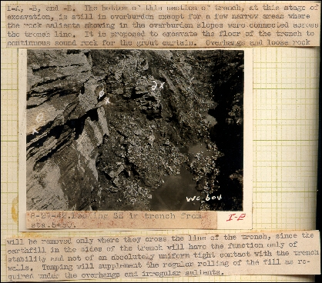
Cutoff Trench Backfill Design
Overhangs and loose rock will be removed only where they cross the line of the trench, since the earthfill in the sides of the trench will have the function only of stability and not of an absolute uniform tight contact with the trench walls. Tamping will supplement the regular rolling of the fill required under the overhangs and irregular salients.”
Notes:
View of cutoff trench at trench sta. 5+50, about 200 feet from where the trench ties into concrete Monolith 37
Note the text between the dots. Gives the philosophy adopted:
Not necessary to remove all overhangs or have smooth flattened surface to compact fill against
Only necessary to have a 10 foot width of compacted fill. Not necessary to have compaction of fill at edges against trench wall, under overhangs, or in intercepting solution features

Slide 15
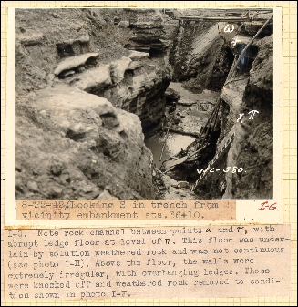
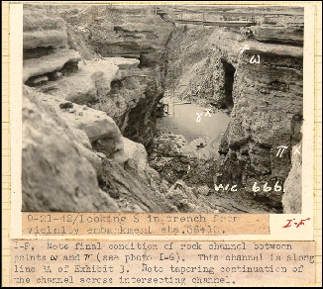
Cutoff Trench Treatment
Excavated trench before any sidewall treatment
Excavated trench after sidewall treatment
Notes:
View in the cutoff trench about 100 feet from where it ties into the monolith. Looking toward the direction of where the monolith will be located near the top of the picture.
This is a “before” and “after” shot of the same area intended to show improvements in the condition of the trench prior to fill placement. Not much improvement in the “after” condition as far as being able to compact fill and achieve a good cutoff.

Slide 16
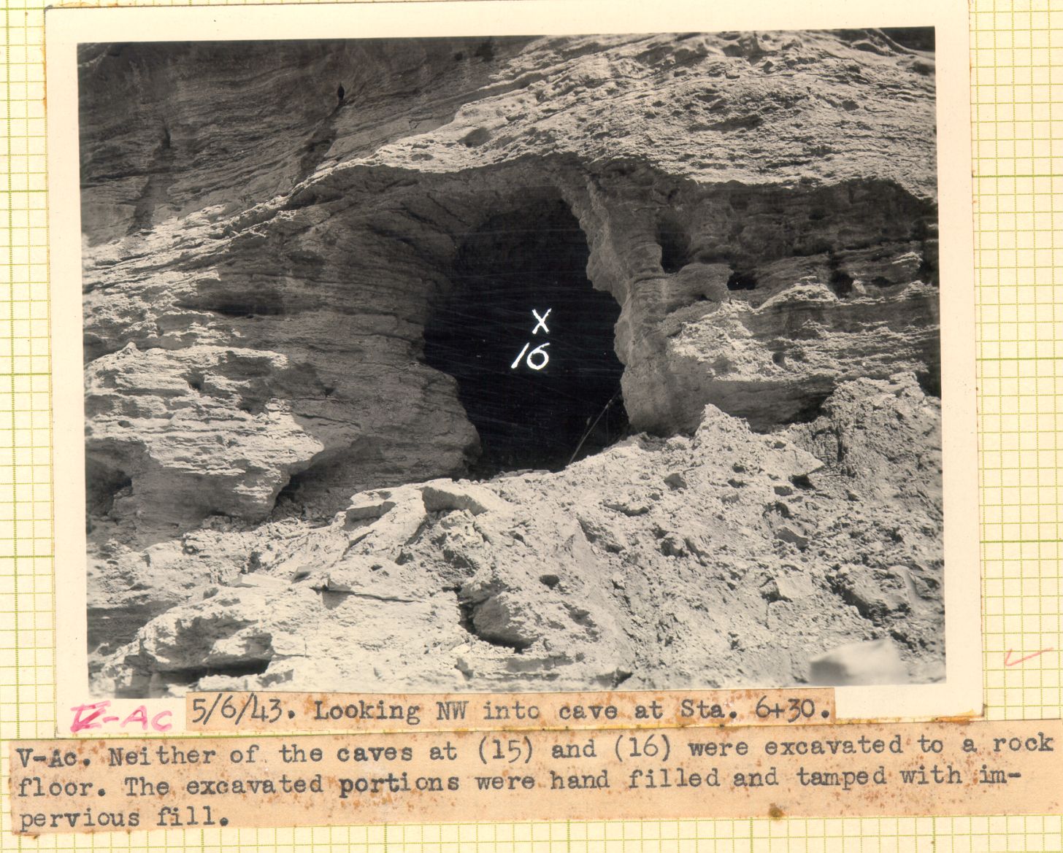
Cutoff Trench Treatment
13

Slide 17
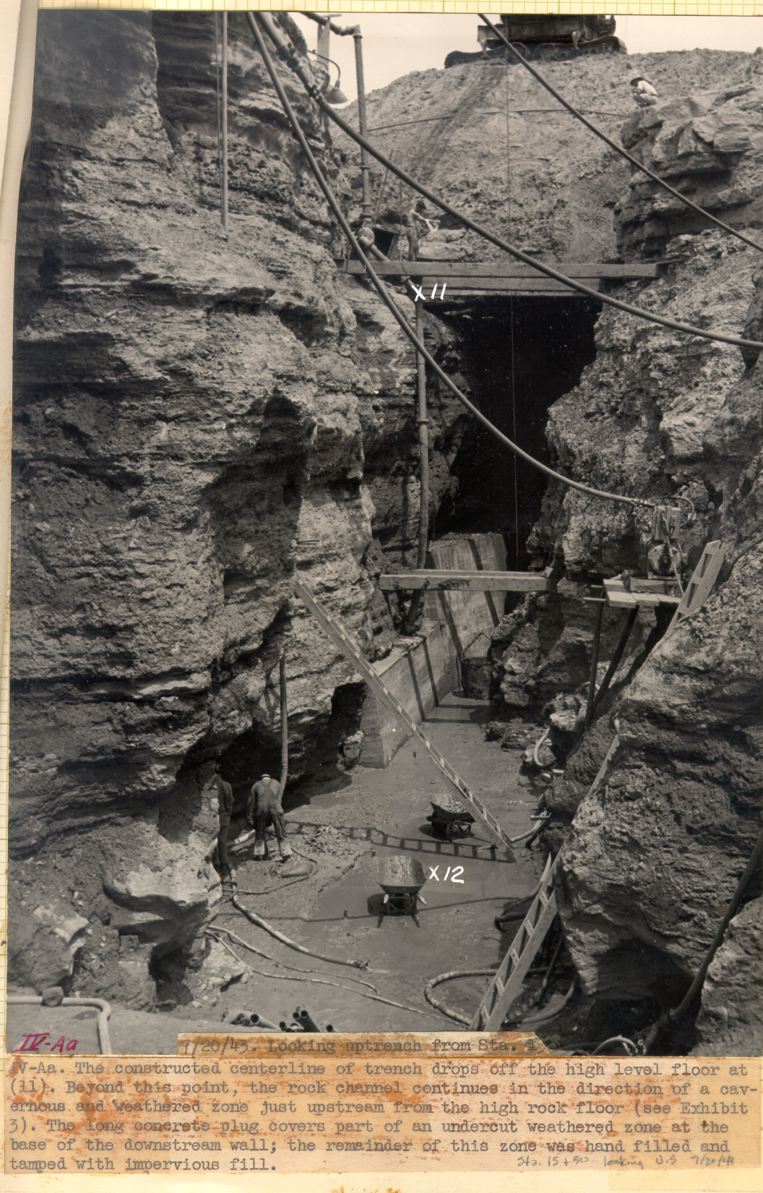
Floor of trench
Cave
Concrete filling beneath overhang
Hand placing soil filling beneath overhang
Floor of trench

Slide 18
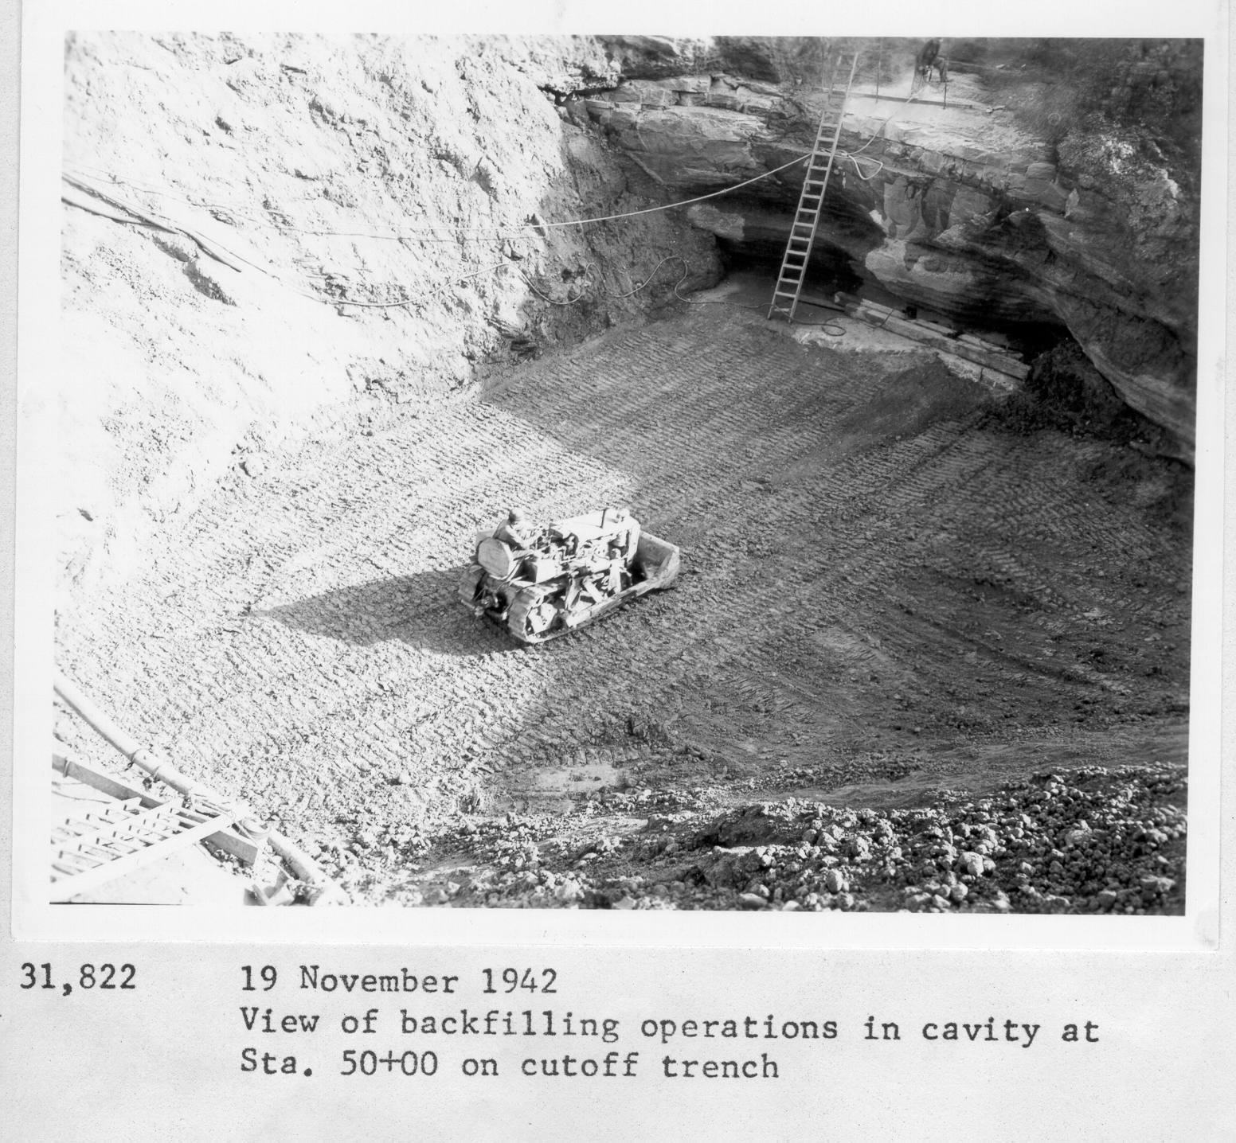
Foundation Treatment
Notes:
Another view of a solution feature crossing the trench at embankment sta. 50+00 which is close to the end of the existing wall. Material being pushed under overhangs with little or no compaction. Vertical, irregular face across trench.

Slide 19
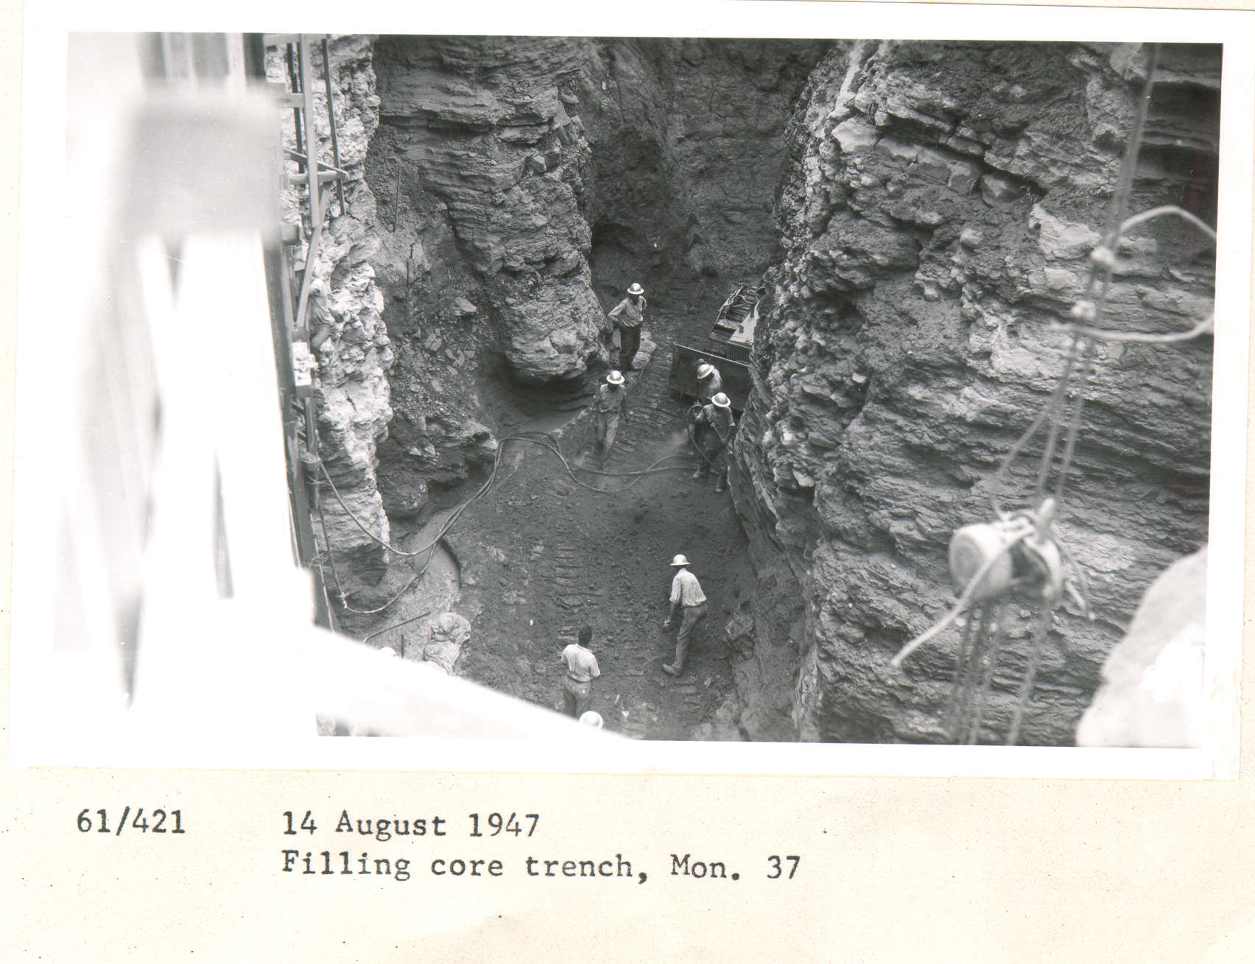
Foundation Treatment
Notes:
This large feature in the top of rock is located in Monolith 37. This is the monolith adjacent to the earth embankment. Because of the foundation treatment techniques used during this era, this is a potential source for seepage and the high PZ pressures under and in the adjacent embankment.

Slide 20
Conceptual Failure Mode
Elev. 235.6 m
Top of Rock elev. 173 ±
Lake
Embankment
Cutoff Trench
Alluvial Soil Foundation
Karst Limestone Foundation

Slide 21
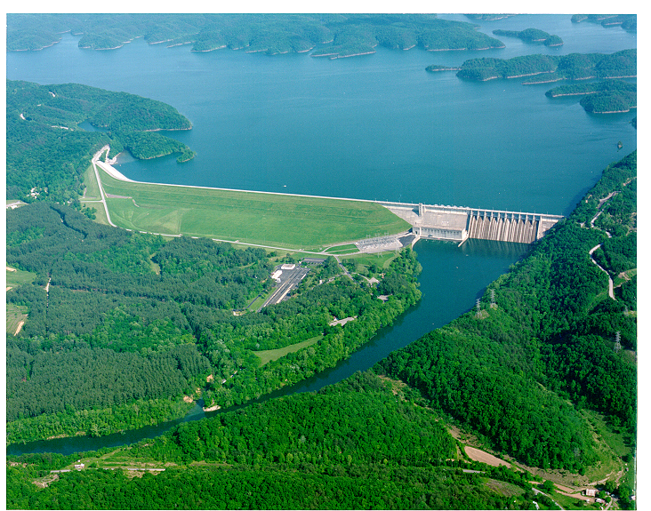
1960’S Problem Areas
Critical Area 1
Wet Areas
Sinkholes
Muddy Flow
Notes:
1
1
1

Slide 22
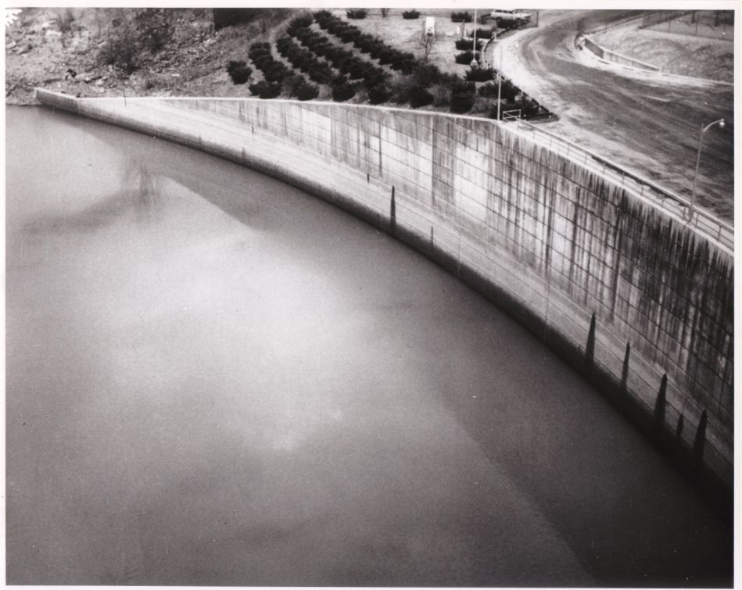
Muddy discharge in river below dam

Slide 23
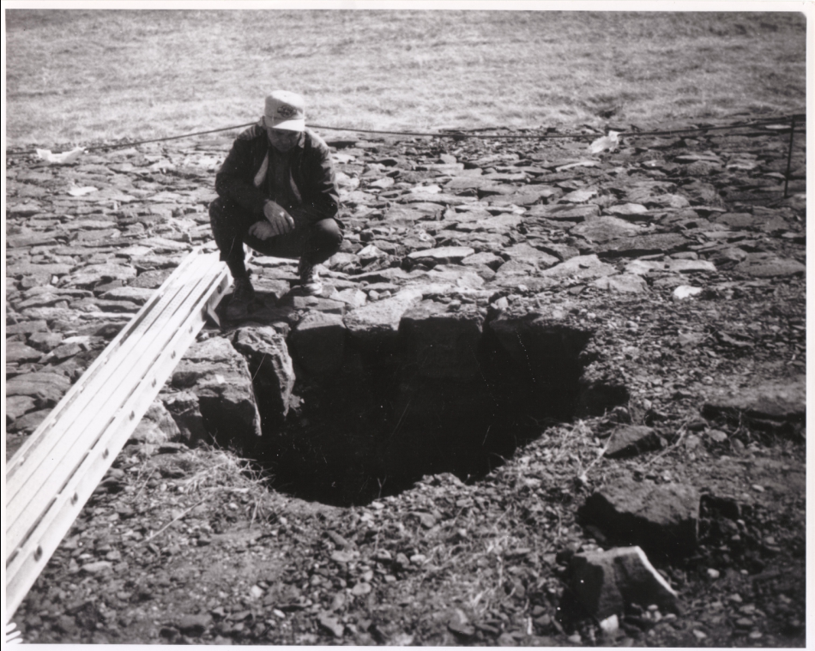

Slide 24
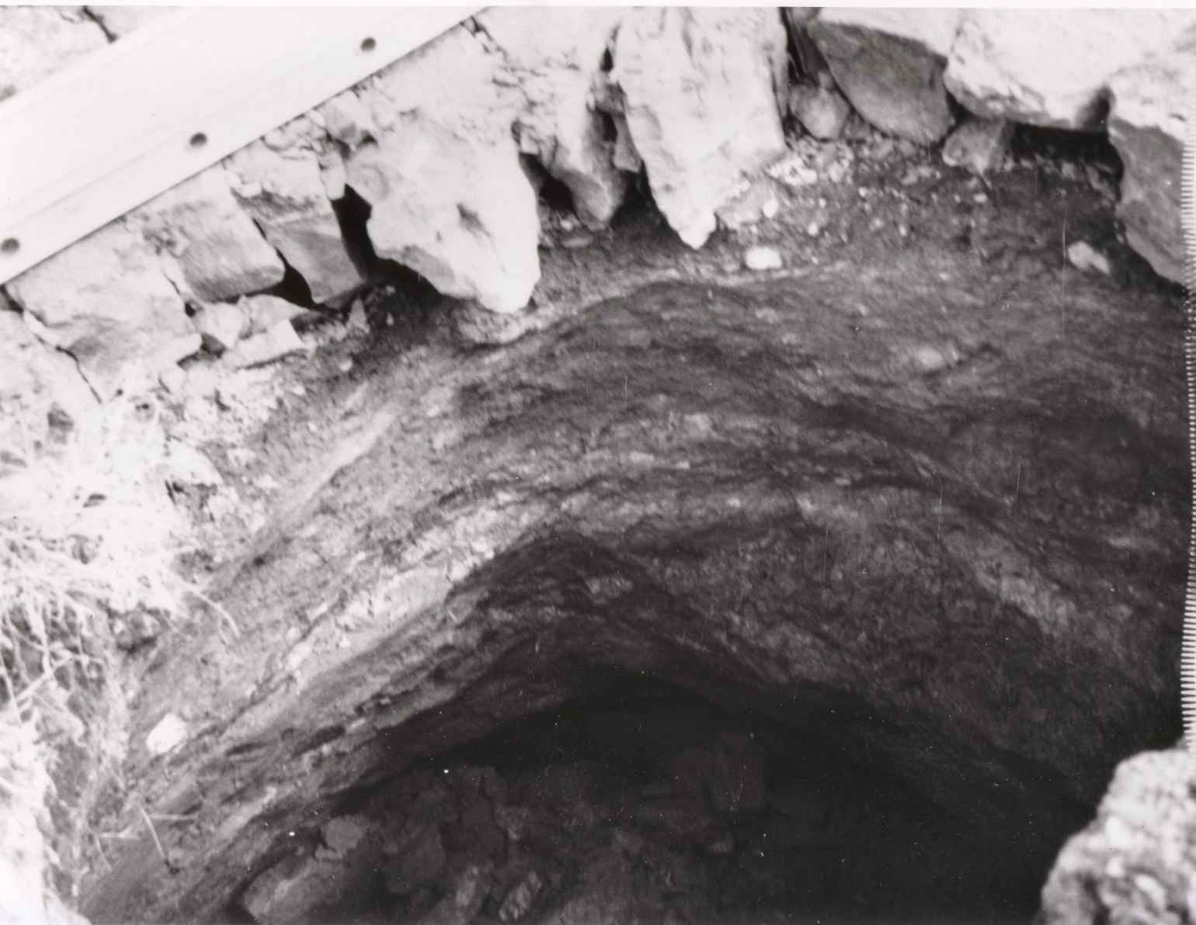

Slide 25
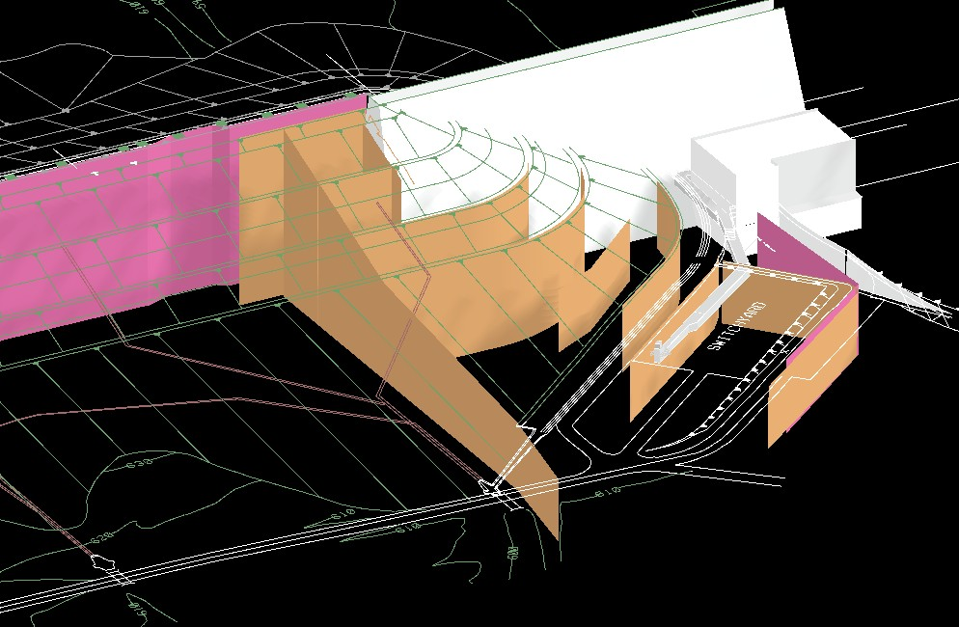
1960’s and 70’s Remedial Features
Barrier Wall
Switchyard Wall
Concrete Dam
Powerhouse
Barrier Wall
Earth Emb
Switchyard Wall
Grout Lines
Switchyard
Notes:
3-D view showing location of treatments of the 60’s and 70’s: diaphragm walls in pink and emergency grout lines in tan.
Point out the diaphragm wall installed around the switchyard primarily to halt the flushing action found to be occurring in features day lighting in the tailrace due to rapid pool fluctuations during generation. This wall appears to have served this purpose well. 300,000 cubic feet of grout solids were placed in the ground from 1968 to 1975.

Slide 26
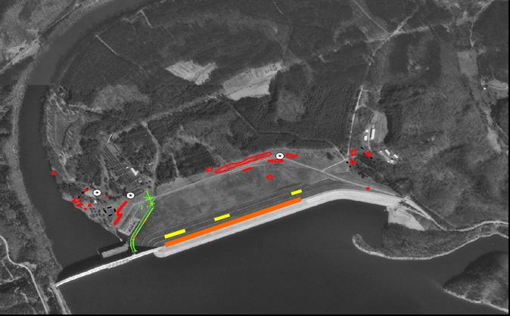
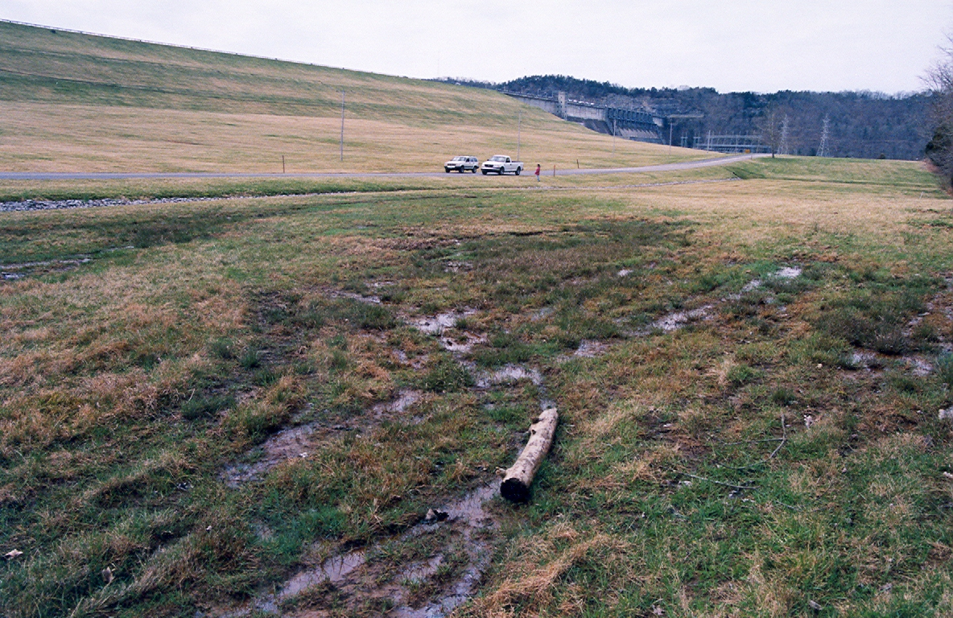
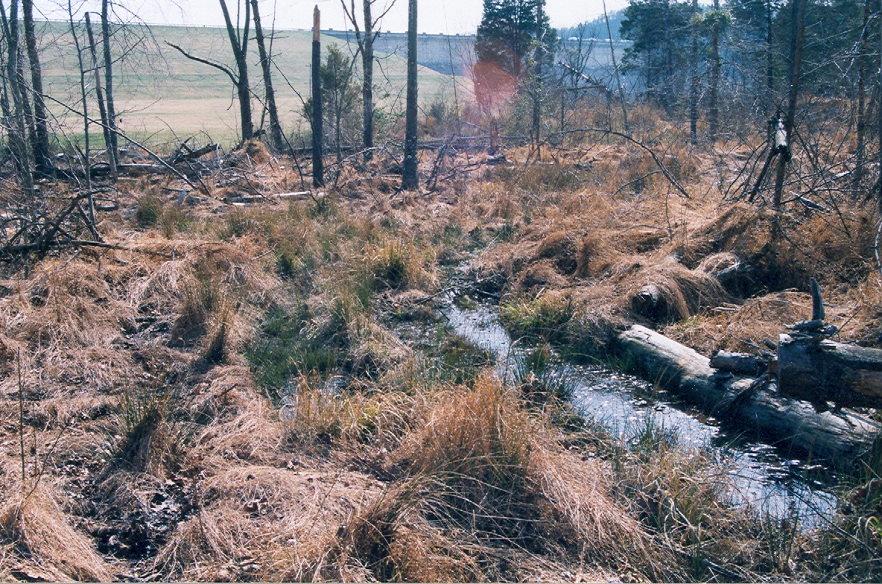
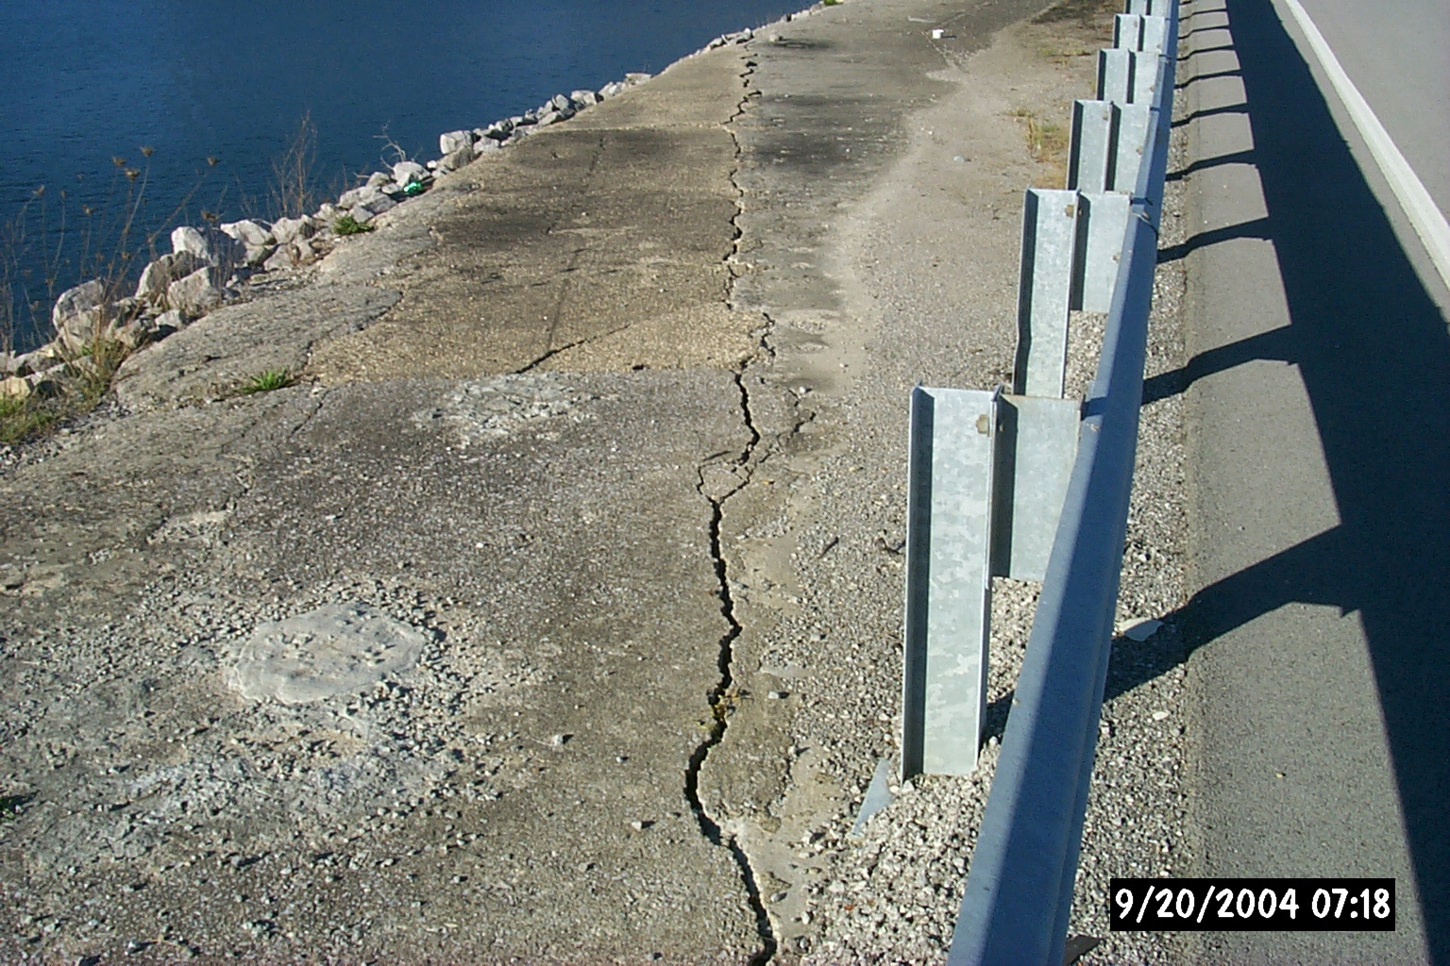
OBSERVATIONS 1995 -2005
Project is heavily instrumented and has had close surveillance in accord with our dam safety program
Instrumentation indicates increasing seepage in the foundation
Increasing size and number of wet areas
Settlement / Cracks along top of dam
Soft zones in the dam
Cold water in piezometers
2005 plans begun to rehabilitate the dam

Slide 27
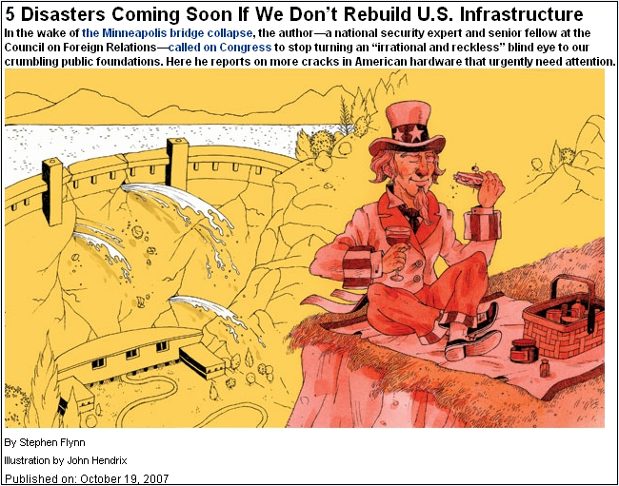

The
Interim

Slide 28
Estimated Loss of Life and Economic Damages
LOL: 6 to 44*
  Original life loss estimate was as high as 230. Emergency Action Planning reduced estimates
  For comparison, 26 lives lost in May 2010 floods (11 in Nashville)
Damages: B119 billion to B179 billion ($4B to $6B)*
(> B59.5 billion ($ 2 B), in Nashville May 2010 flood)
* Variables include Lake Level at Failure, Breach Development and Configuration, and Time of Day

Slide 29
Abbreviated History Channel Clip
Copy of history channel segment.wmv

Slide 30
Interim Risk Reduction Measures
Stockpile of emergency response materials
Siren warning system for campground
Communication Plan – 100+ Meetings with Public
and Stakeholder Groups
Dam Safety Training of Project Staff
Emergency Action Planning (dynamic)
  Updated flood mapping
  Coordination with emergency management community
  Revised notification procedures through NOAA
  Emergency exercises
Increased Monitoring
  24/7 monitoring
  Detailed monthly inspection
  Weekly / Daily instrumentation evaluation
Recognition
& Response

Slide 31
IRRM’s Cont’d.
Grouting
Lake Level Restrictions
  Mar. ’05, Jan. ’07 (dynamic)
Reduce P_{f}

Slide 32
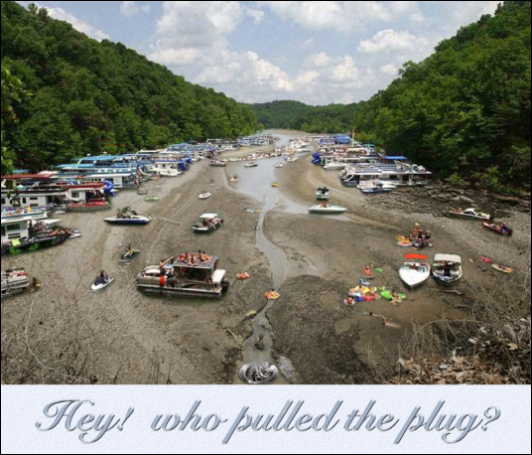

Slide 33
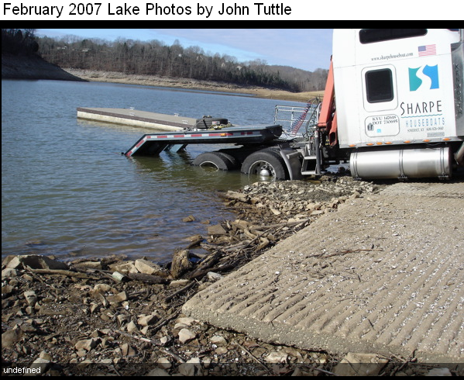

Slide 34
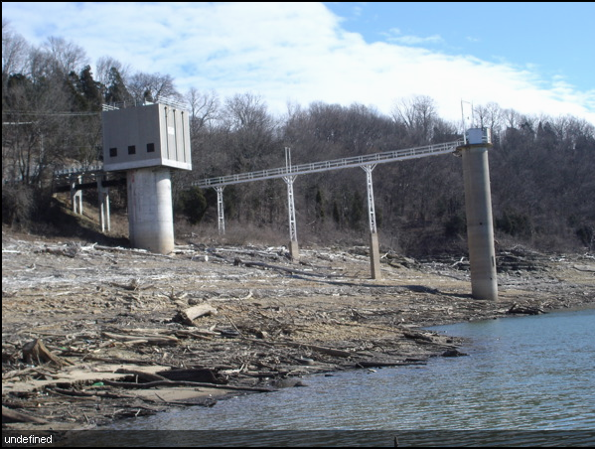

Slide 35
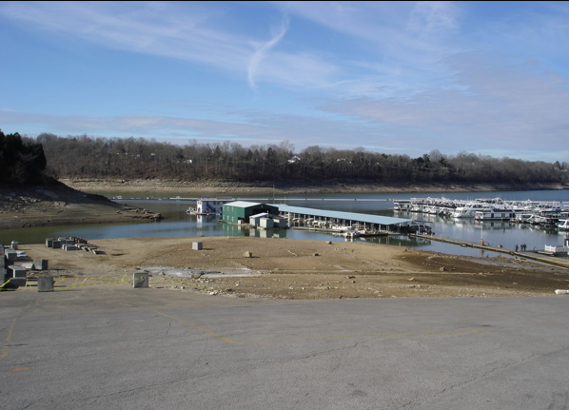

Slide 36

Wolf Creek Dam History Channel Video – 6 minute version

Slide 37
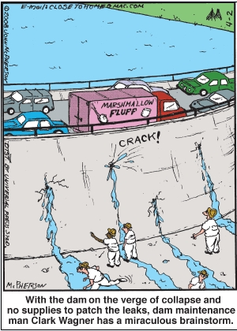
The Fix

Slide 38

Request for Proposal/Best Value Contract Used
Contract Awarded 23 July 2008
Contract Amount
B 10.1 billion
($341 million)
4 Year Contract Period

Slide 39
Barrier Walls
New Wall
Existing Wall
Notes:
1
1
1

Slide 40
Generalized Section
Elev. 235.6 m
Work platform elev. 229 m
Top of Rock elev. 173 ±
Existing wall
New wall
Grout curtains
84m
Elev. 168 m ±
Bottom wall elev. 145 m
Elev. 129 m
Notes:
New wall installed U/S of crest.
0.61 meters thick
84 meters deep at its deepest section, 30 meters into rock
U/S and D/S grout curtain

Slide 41


Existing and New Wall Profile
Embankment
Concrete Dam
Existing Wall
Bottom of Grout Curtain
New Wall Profile 91045 m²

Slide 42
Deep Slurry Wall Construction Methods
Secant Piles
P
S
P
S
P
Panel
P
S
P
Combined – “Dog Bone”
P
S
P
S
P

Slide 43
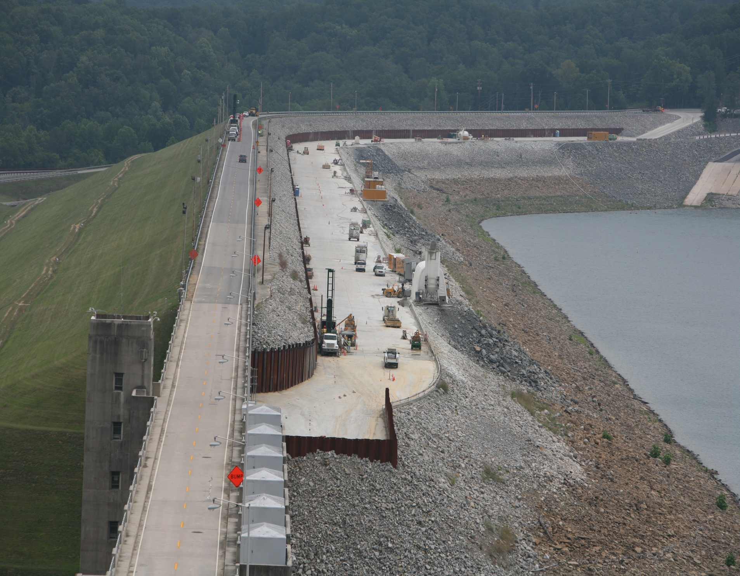
Work Platform

Slide 44
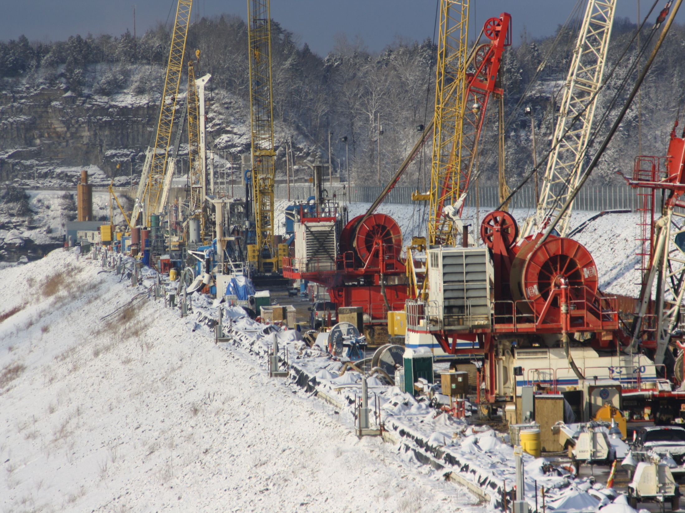
Work Platform

Slide 45
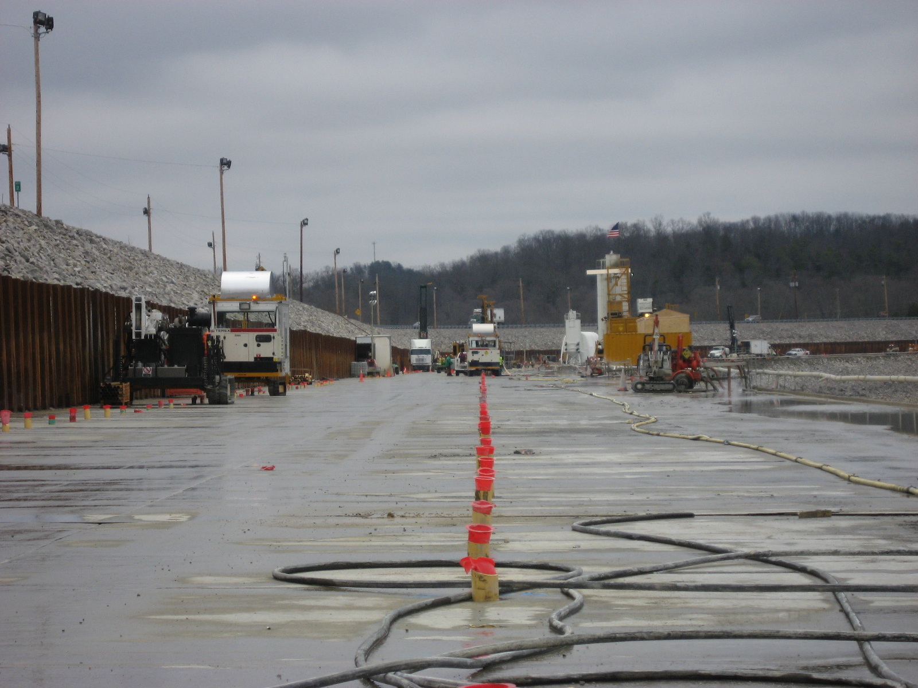
Upstream Grout Line
Angled at 15° toward the left
Downstream Grout Line
Angled at 15° toward the right
Barrier Wall Alignment

Slide 46
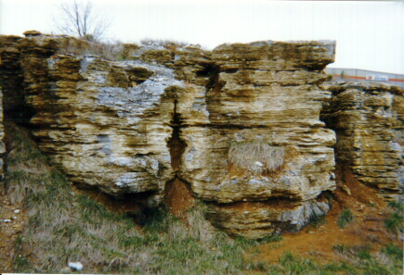
Pitfalls of Grouting in Karst Limestone

Slide 47
Pitfalls of Grouting in Karst Limestone

Slide 48
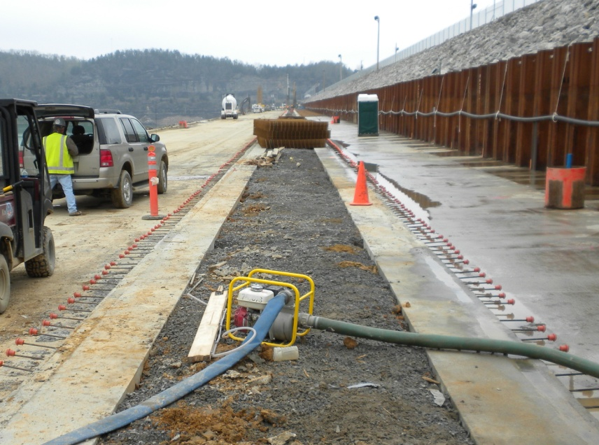
Guidewall

Slide 49
Protective Concrete Embankment Wall (PCEW)
1.83m x 2.8m Panel
EL 229m (750)
Embankment
P
S
P
Limestone
Bottom keyed 0.6m into top of rock
Notes:
Overlapping panels are approximately 2.8 m long by 1.83 m wide and extend through the embankment into top of rock.
Verticality determined by inclinometer which monitors mill position while excavating.
Later panel is also surveyed by KODEN ultrasonic device.
This panel protects the Embankment during drilling and allows the use of directional drills (water) and RCD secant water drills.
The panels are installed by excavating with a hydromill and backfilling with concrete.

Slide 50
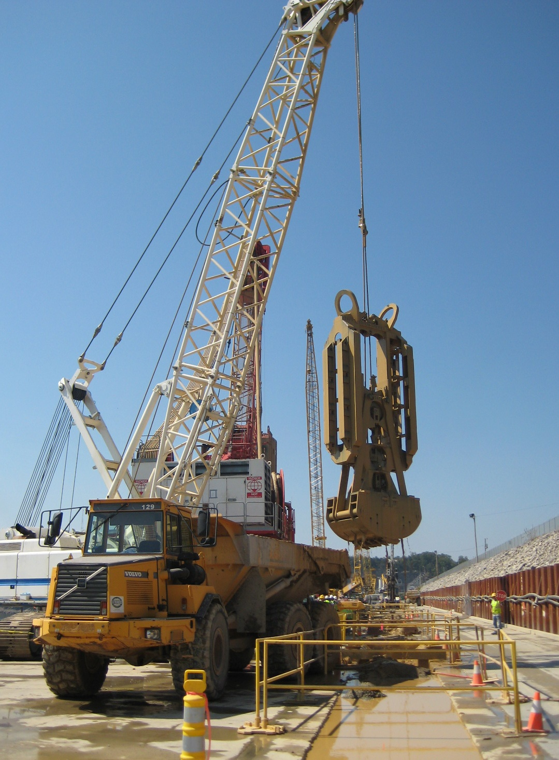
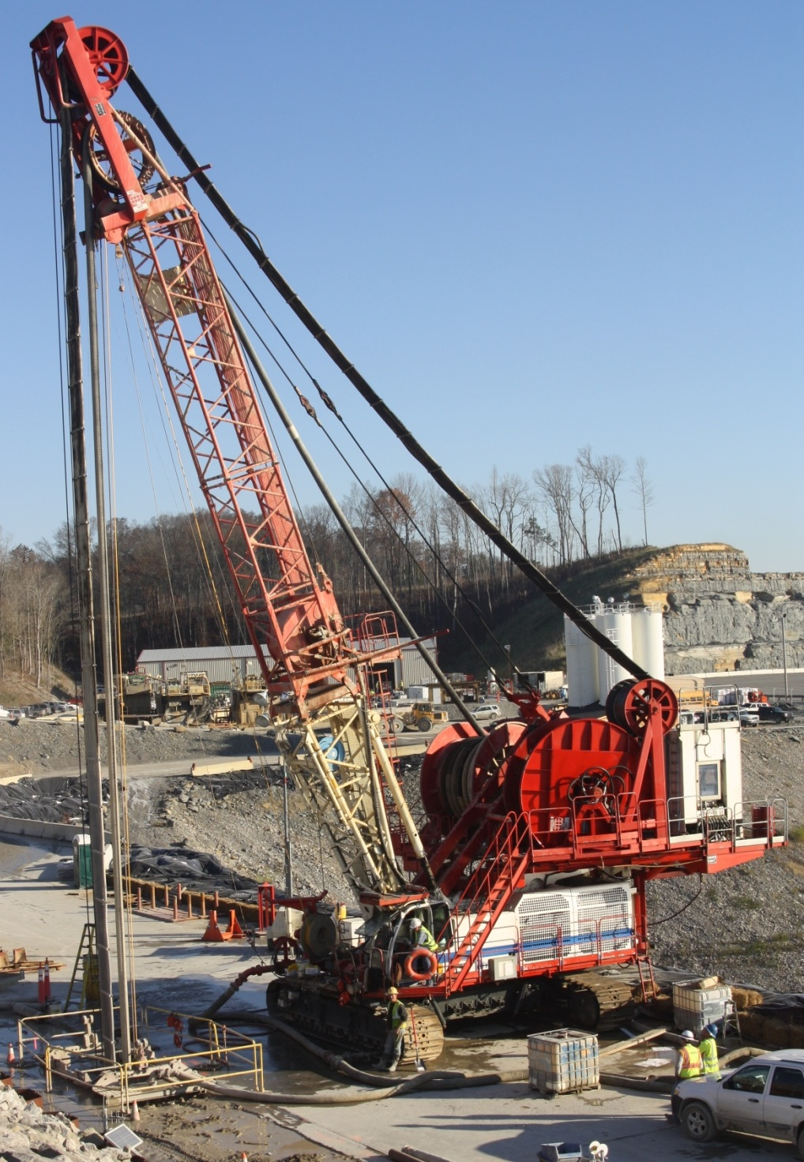
PCEW Equipment
Clamshell
Hydromill

Slide 51
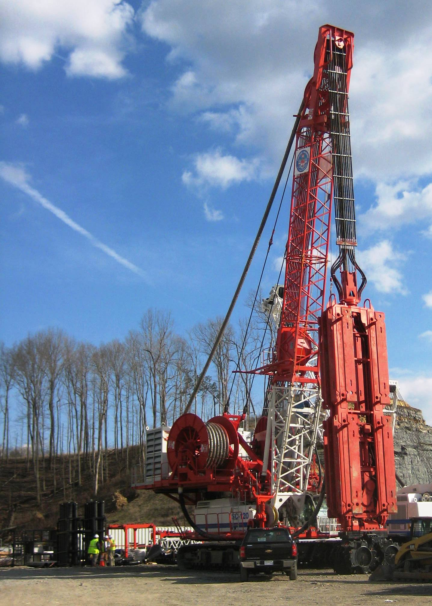
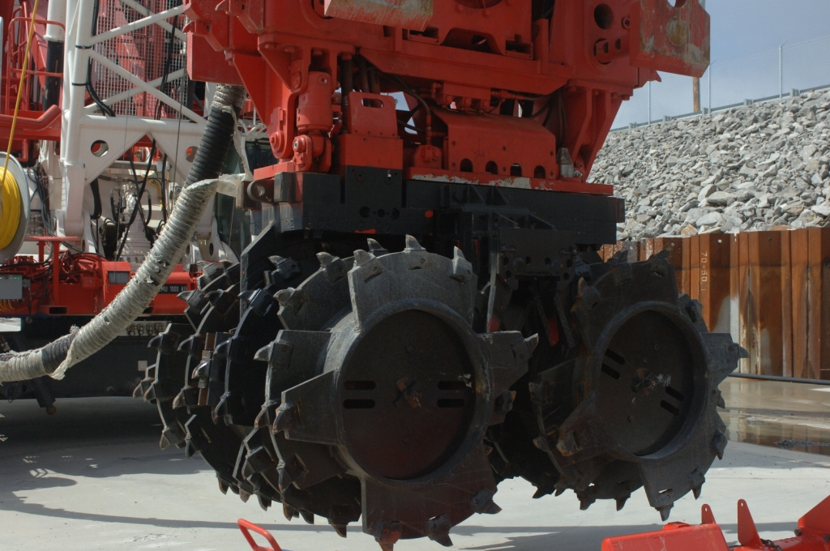
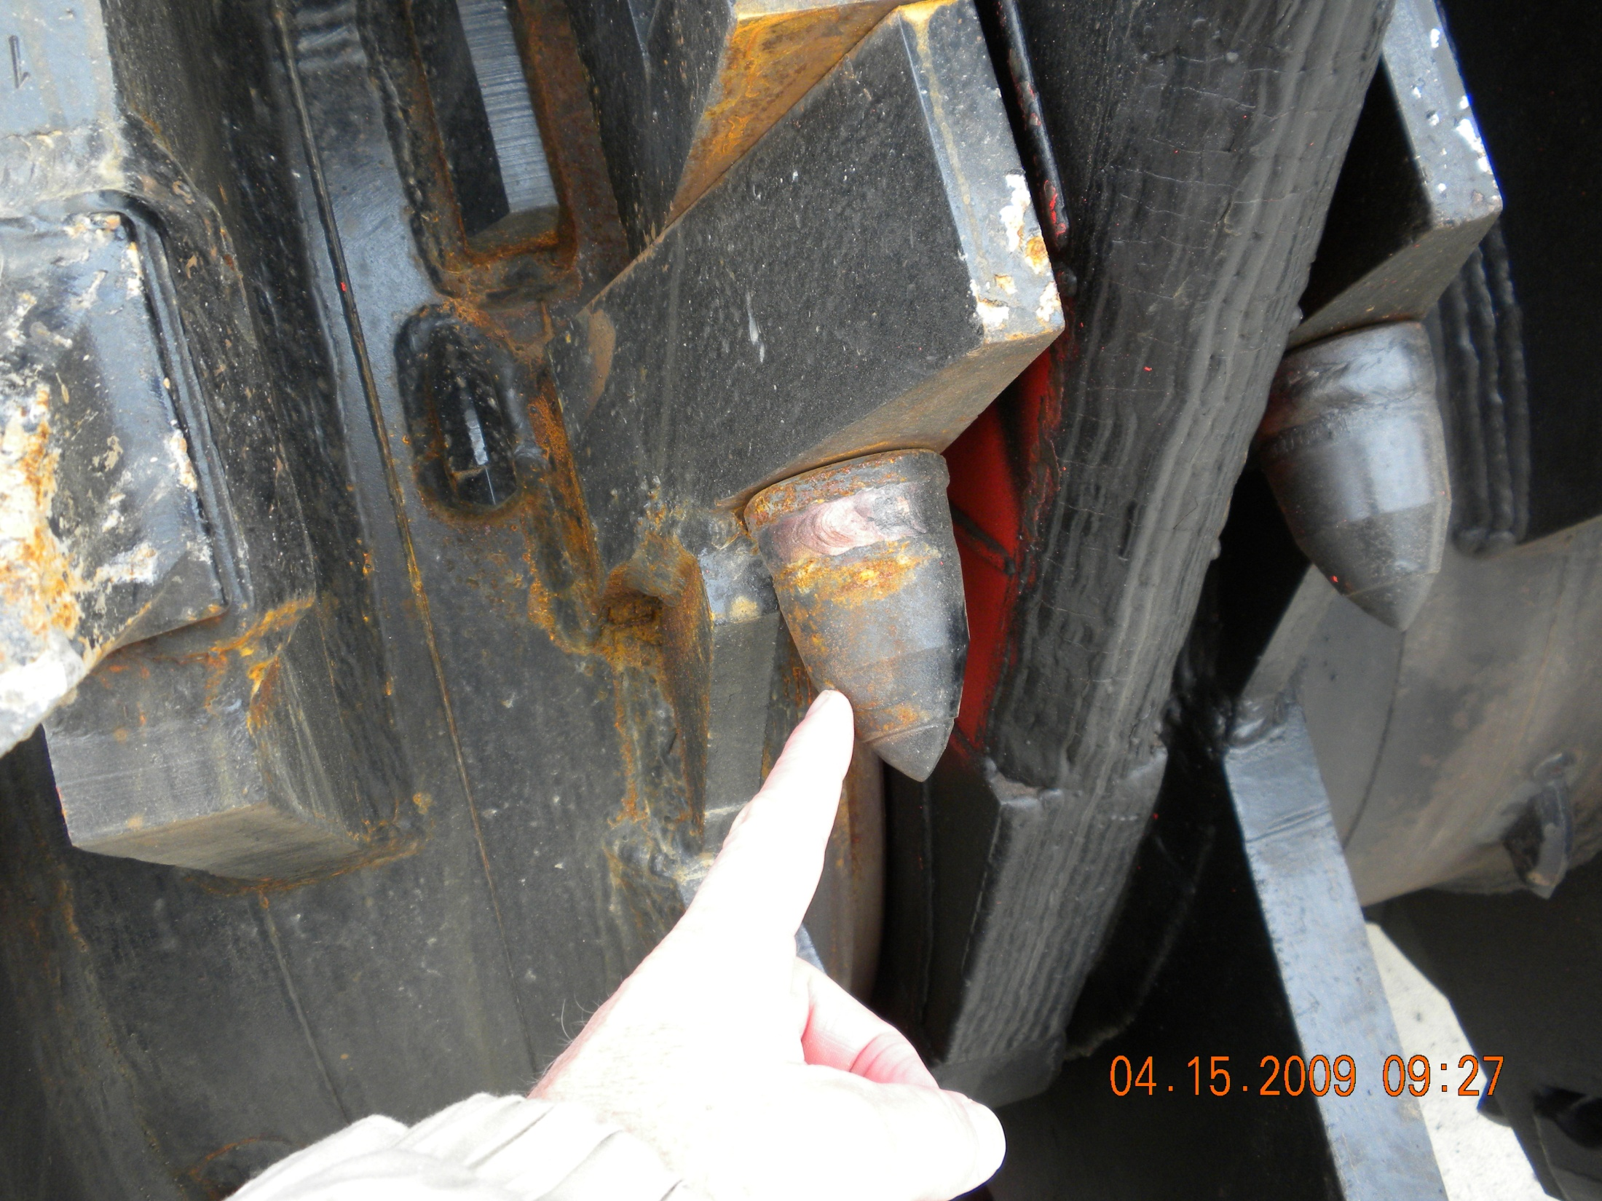
Hydromill
1.83 m
2.8 m

Slide 52
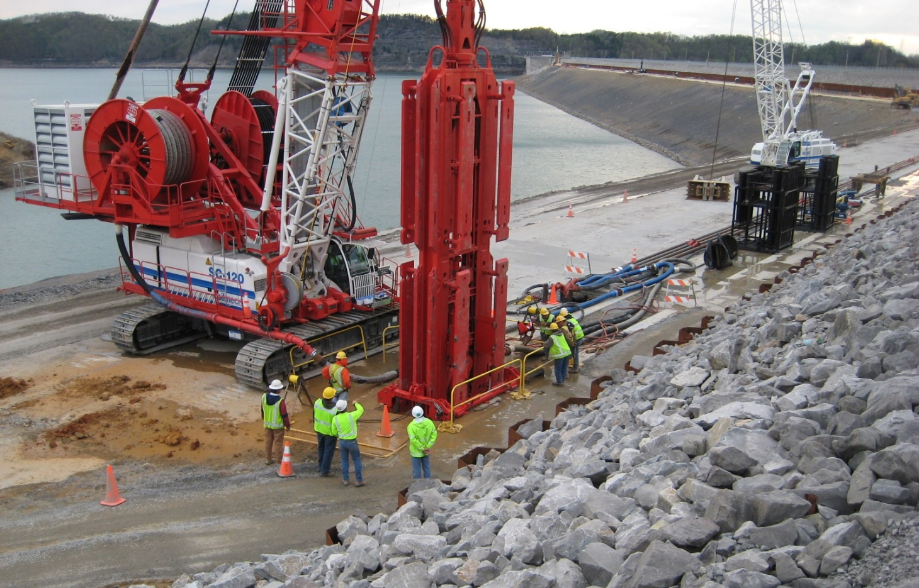
Hydromill
Notes:
Hydromill locked into guide frame attached to guide wall

Slide 53
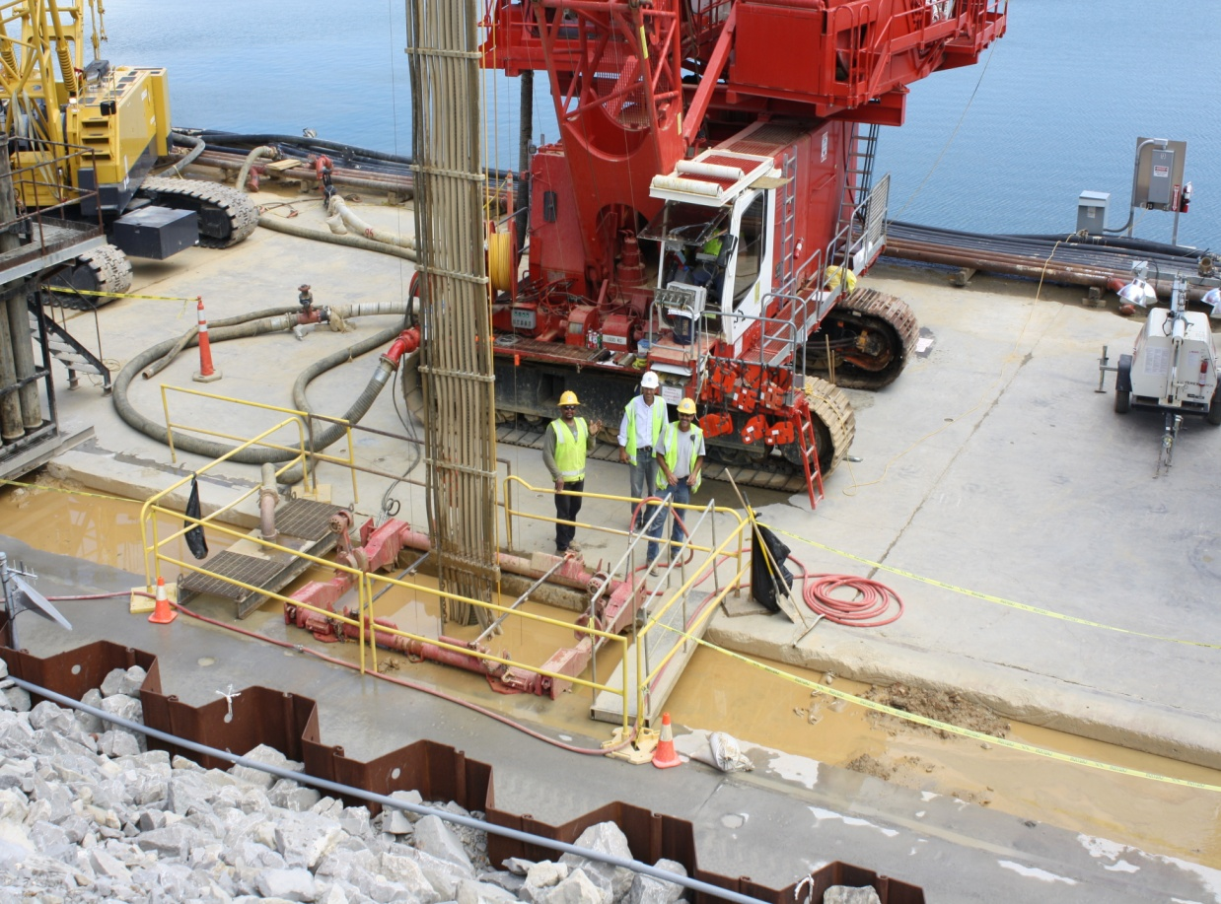
Hydromill Excavating in Embankment
Notes:
-

Slide 54
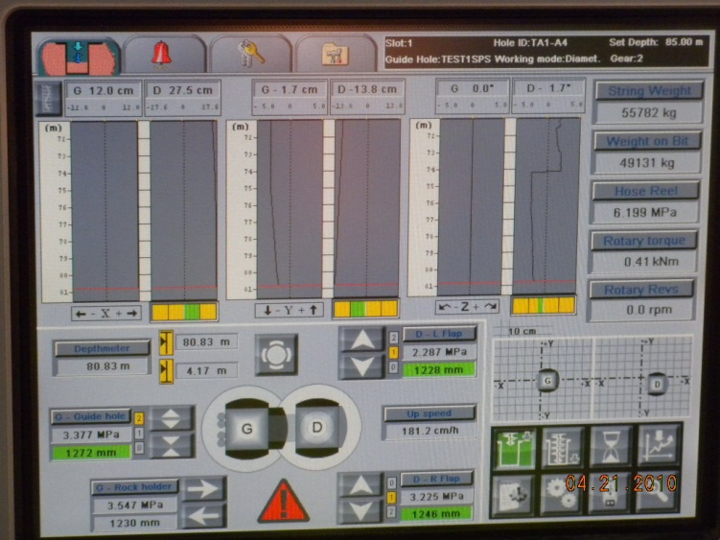
Verticality Readout Panel
Notes:
Computer readout in cab of hydromill monitors position of mill in the ground by measuring lateral deviation in orthogonal directions as well as rotation.

Slide 55
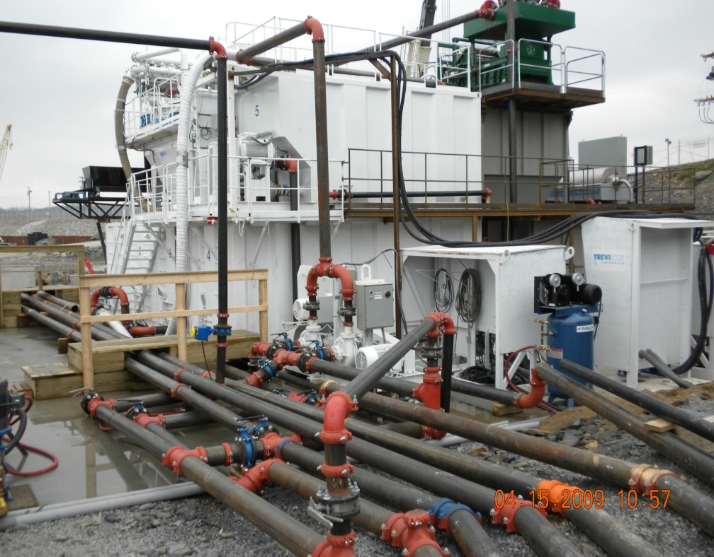
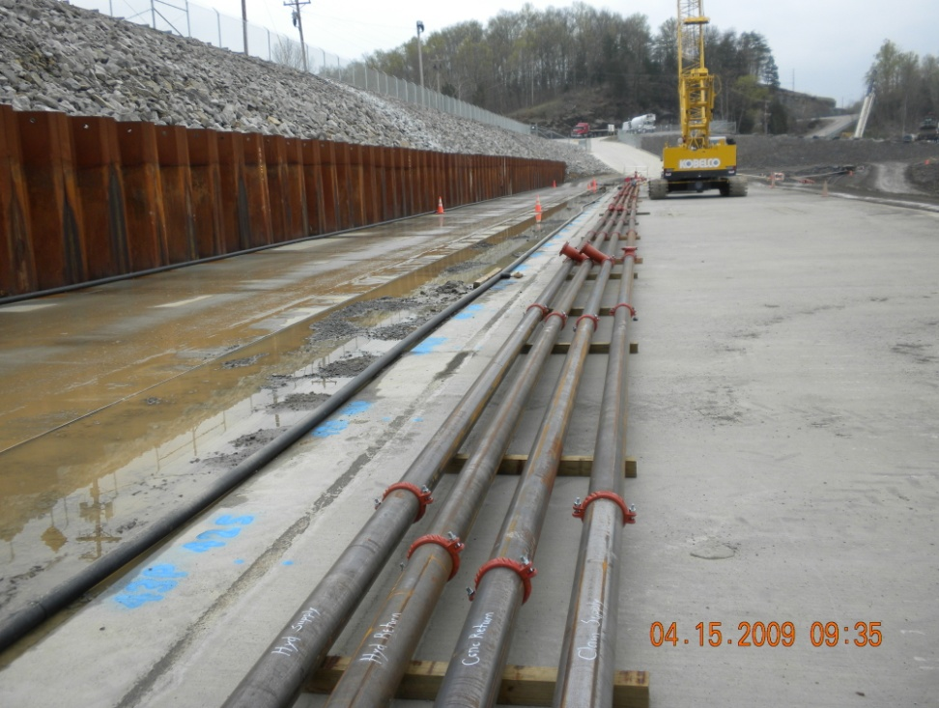
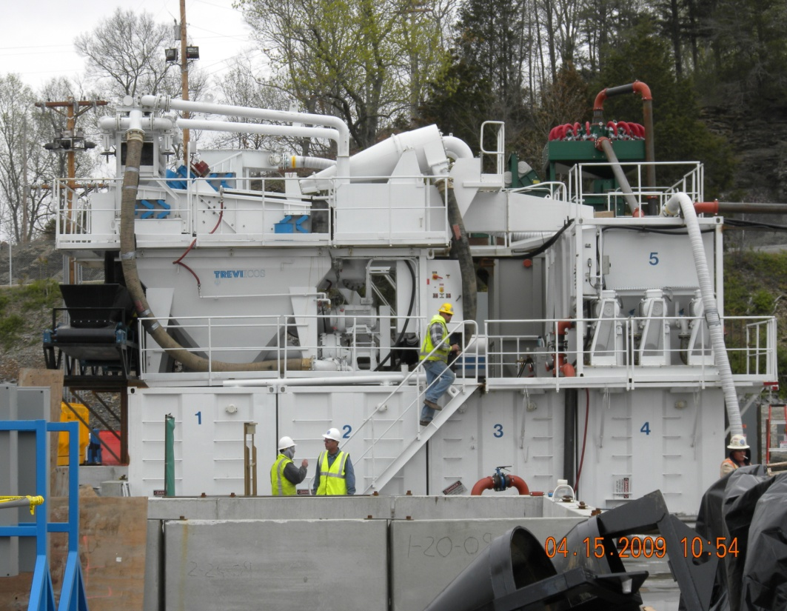
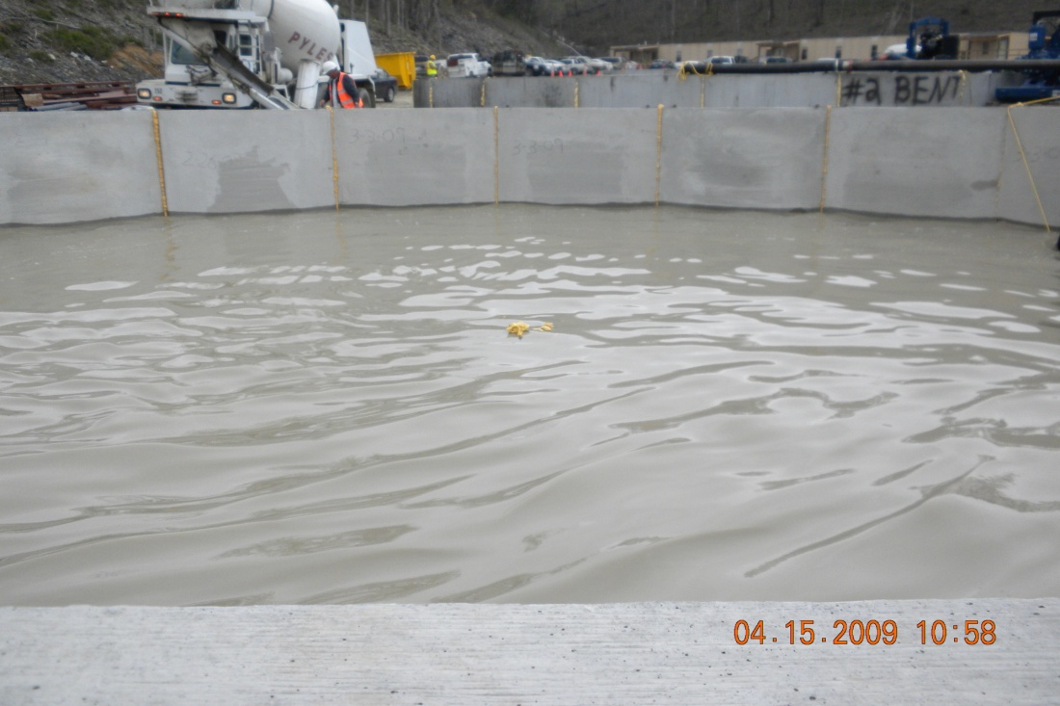
Desanding plant
Slurry transmission piping
Desanding plant
Fresh slurry tank

Slide 56
Drill 0.2m Ø Guide Hole
Embankment
P
S
P
0.2m Ø hole
0.9m c. to c. spa.
Limestone

Slide 57
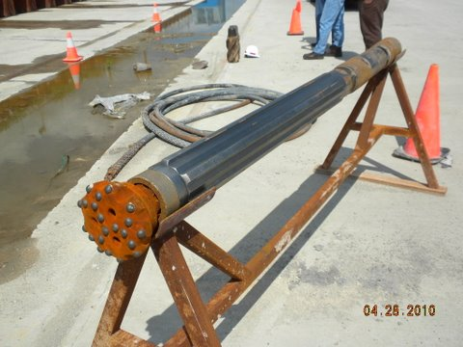
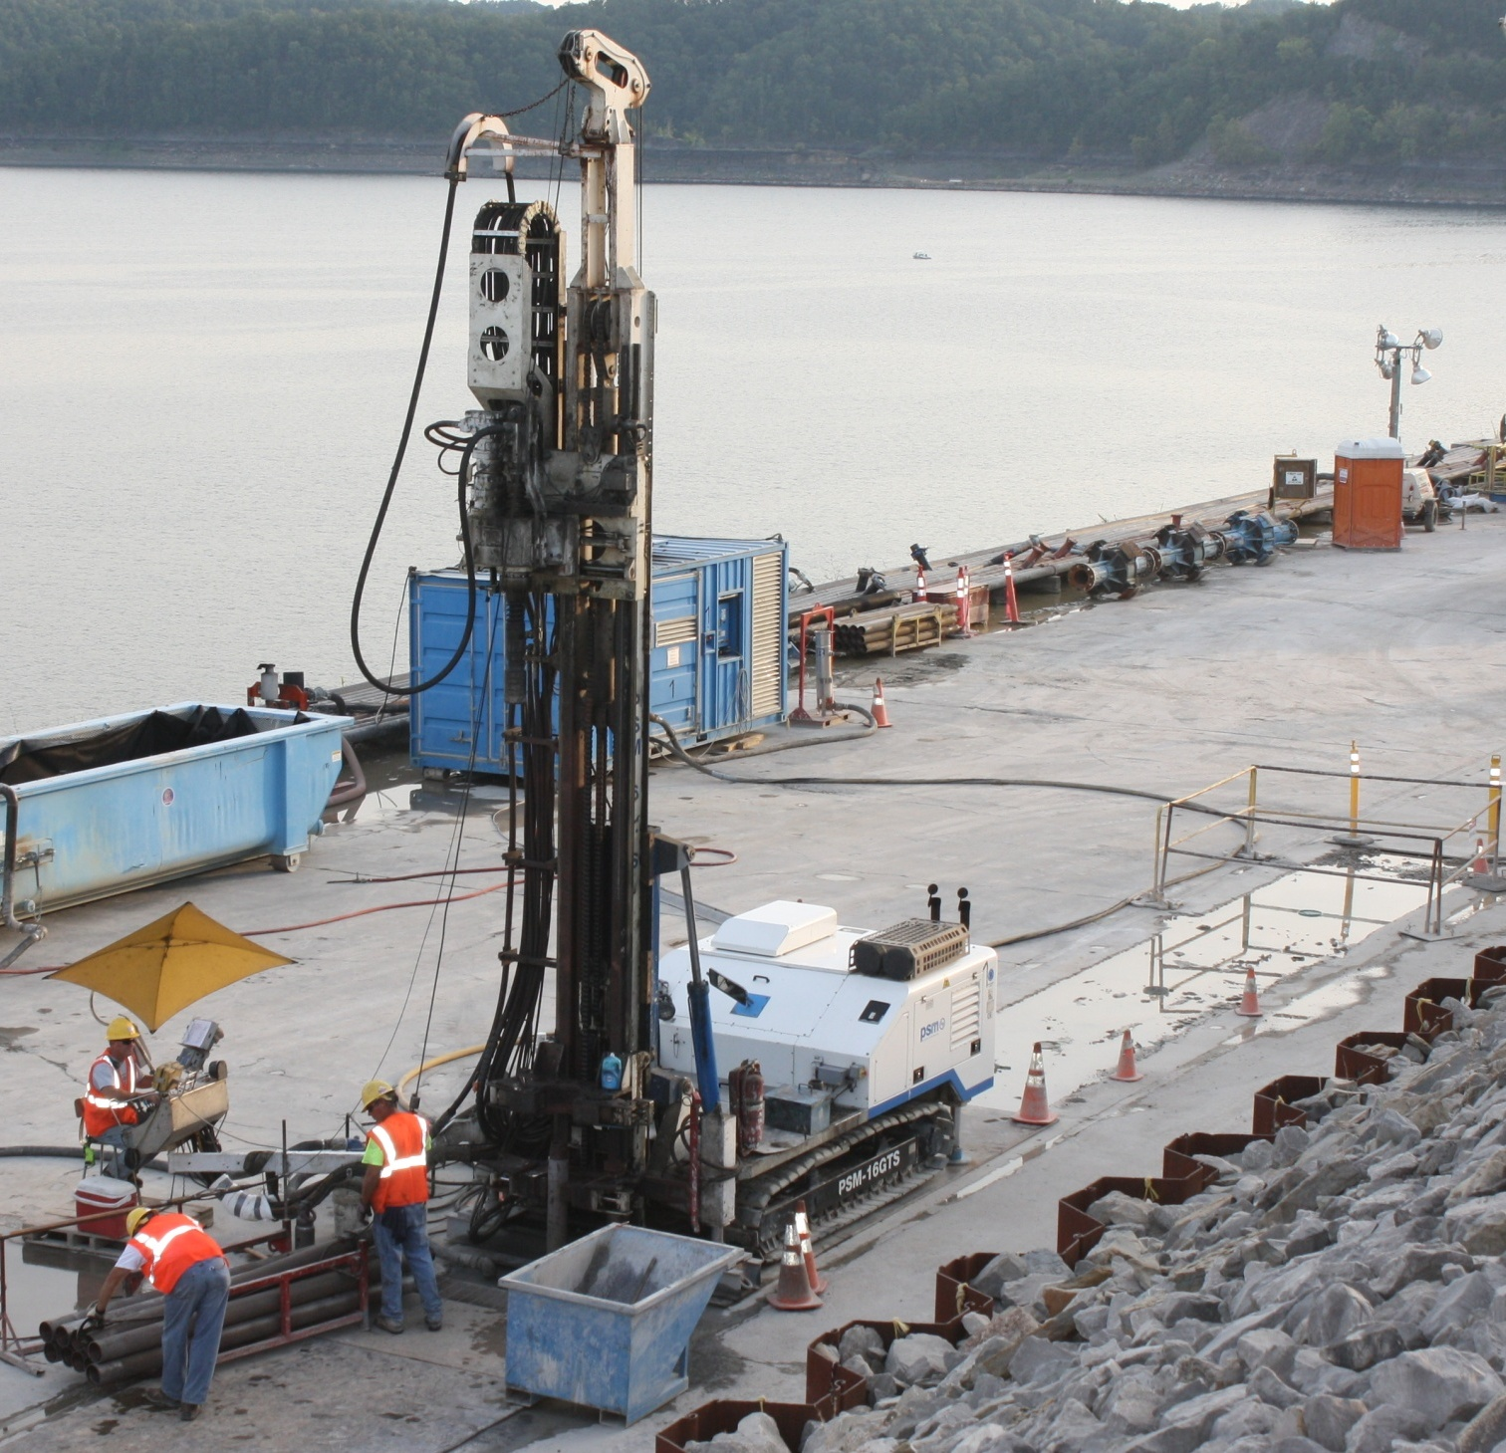





Guide Hole Drilling and Monitoring
Wassara Water Hammer Drill Bit
Drill Rig
Paratrac Verticality Tool
Deviation Plots

Slide 58
Drill 1.27m Ø Overlapping Piles
Embankment
P
S
P
Limestone
Notes:
Overlapping panels are approximately 9 feet long by 6 feet wide and extend through the embankment into top of rock.
This depth varies from about 60 feet to about 160 feet.
The panels are installed by excavating with a hydromill and backfilling with concrete.

Slide 59


Secant Pile Barrier Wall Equipment
Bottom Hole Assembly
1.27m
18.3m

Slide 60


Wirth Pile Drilling Rig

Slide 61


Slide 62



Slide 63
Proposed Barrier Wall Configuration
True Vertical
0.89m (35”) Design spacing
Maximum Allowable
Deviation
0.61m (24” min)
Spec. minimum overlap
0.91m (35.7”)
1.12m (44”)
Max. Allowable Deviation between pile centers = 0.23m (9”) over 84m depth
Notes:
Someone might say yea 1-inch is not much but is it possible.

Slide 64
PBW Continuity Statistics
Dimension | Min | Max | Avg (ft) | Spec (ft)
Wall Thickness | 0.58m (1.9ft) | 1.34m (4.4ft) | 0.98m (3.2ft) | 0.61m (2ft)
1.22
Notes:
Histogram doesn’t reflect the min wall thickness (i.e. 22.8 inches), but I will update the histogram once we receive an updated spreadsheet.

Slide 65
Barrier Wall Continuity
Total Number of Piles: 1197
Total Number of Joints: 1196
Linear Feet of Joint: ~ 288,000
Remedial Piles: 1 Pile Remediated due to Geometry
Total Number of CBW Elements: 52
Total Number of Joints: 104
Linear Feet of Joint: ~ 18,000
Remedial Piles: 0 Piles Remediated due to Geometry

Slide 66
Combined Barrier Wall
0.2m Guide Holes on 3.2m (10.5ft) spacing
0.79m (2ft-7in) x 2.79m (9ft-2in) Mill Panel
1.27m Ø Piles
Embankment
Limestone

Slide 67

Combined Barrier Wall (CBW)
Notes:
Dog bone – helps us avoid the need to form an edge overlap connection between single panels within the rock.
Middle piles – reduce the effort required of the hydromill. They are drilled to full depth and reduce the spacing to 63 in.
Middle panels achieved with a narrower cutting head.
3 types:
-no middle
-middle not backfilled (will lack a pile with homogenous material but will save concreting time.)
-middle backfilled (mill has three piles to excavate through full depth)(at reduced strengths)

Slide 68



Joint Cleaning Brush

Slide 69


Tremie Concrete Backfilling
Notes:
Concrete: If possible, eliminate the use of manufactured sand (i.e. limestone).
Tremie Process: Be sure your connections are sealed with a rubber gasket
High strength versus ductile concrete
Fill both hoppers and tremie lines simultaneously to maintain a level concrete surface in the excavation
Used a high density foam plug as a go devil
Used rubber gaskets and duct tape to seal joints in the tremie lines.
Tracking Arrival Times
Volume Placed versus theoretical (overbreak)
Tremie Pipe Depths
Concrete Depths
Tremie Embedment (min of 10-ft – max of 30-ft)

Slide 70

Questions?

