Slide 1
TETON DAM FAILURE – LESSONS LEARNED
Dave Paul, P.E.
Lead Civil Engineer
U.S. Army Corps of Engineers
Risk Management Center
David.B.Paul@usace.army.mil
Dam Safety Workshop
Brasília, Brazil
20-24 May 2013

Slide 2
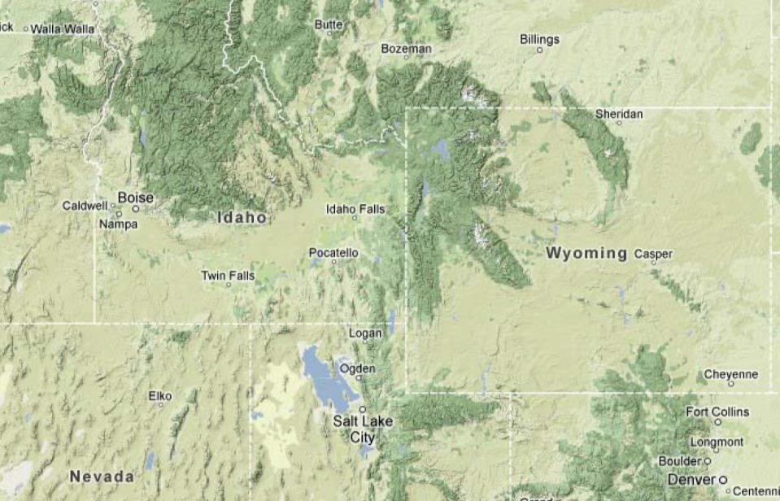
Location Map
Teton Dam

Slide 3
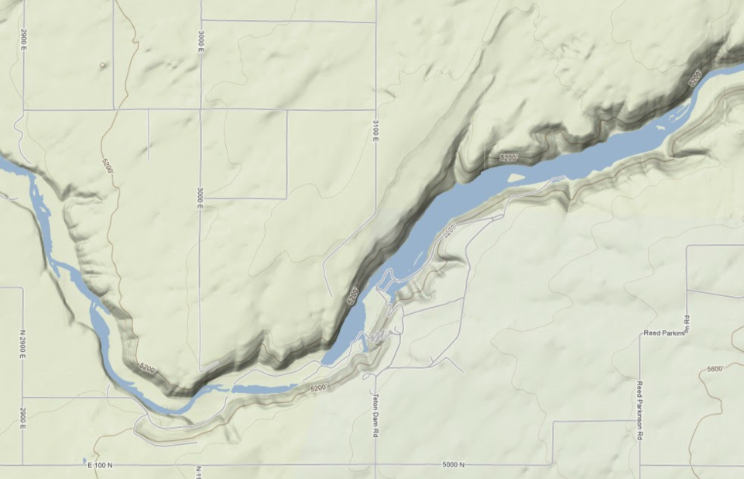
Location Map
Teton Dam

Slide 4
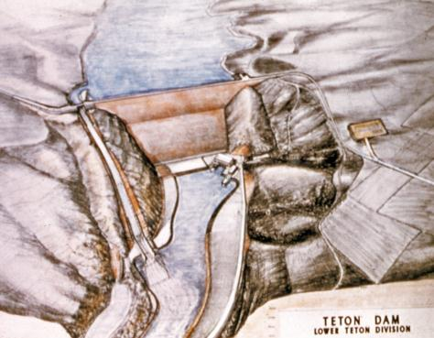
Background
Studies for a water storage site in the area date back to the 1930s
Both the Corps and Reclamation studied dam sites
Congress authorized construction in 1964
Environmental lawsuits in the early 1970s initially held up construction
Site clearing began in 1972; the embankment was completed by November 19751975

Slide 5
Background
First filling was spring of 1976
Dam failed catastrophically on June 5, 1976

Slide 6
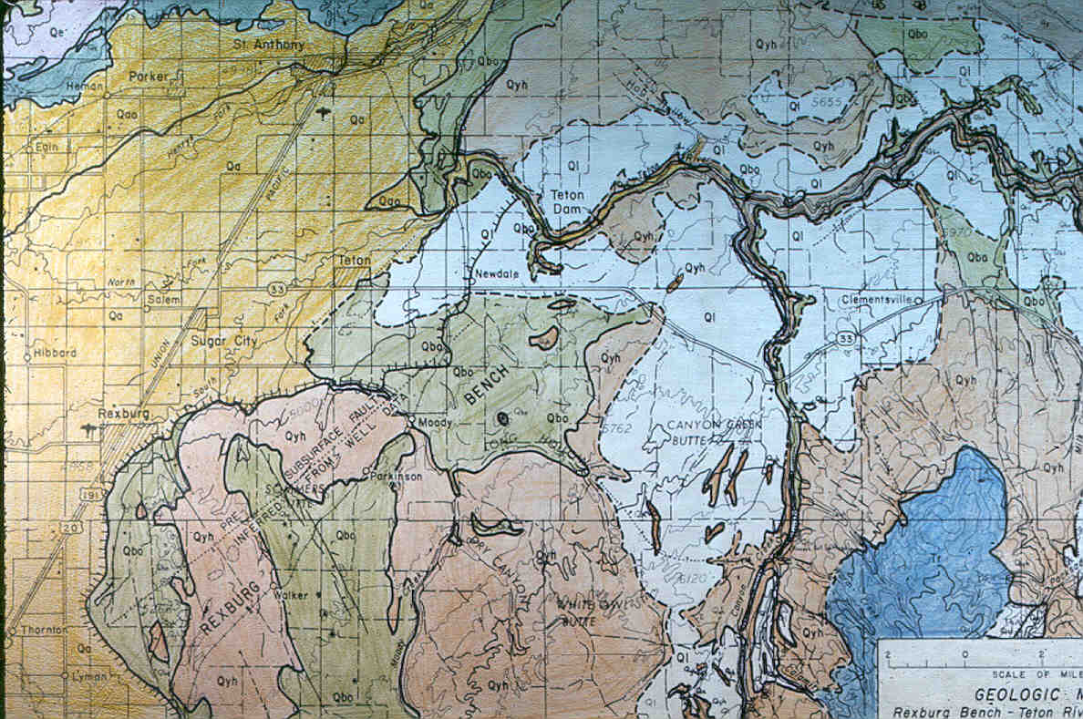
Regional Geology Map
Text
Teton Dam

Slide 7
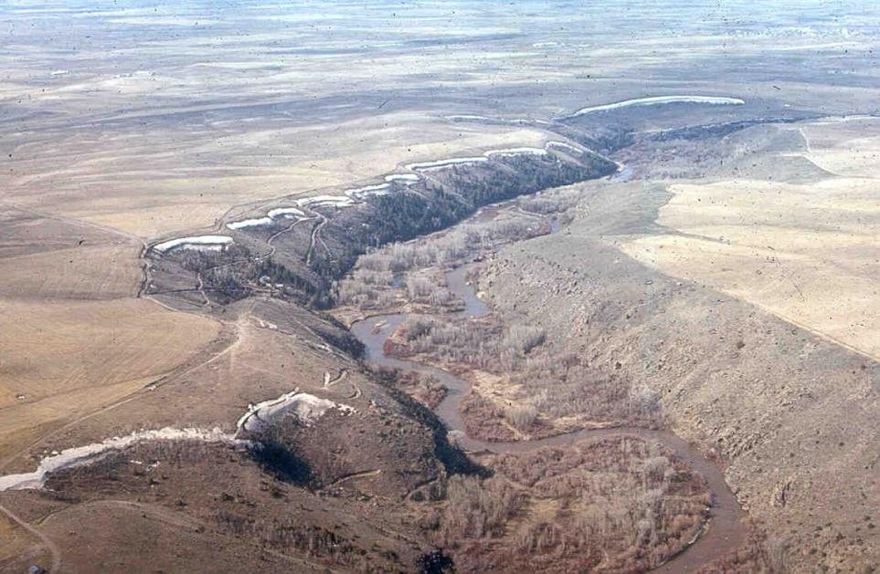
Pre-construction site
Aeolian sediments on plateau are about 30 ft. thick
Alluvium deposited in channel – about 100 ft. thick

Slide 8
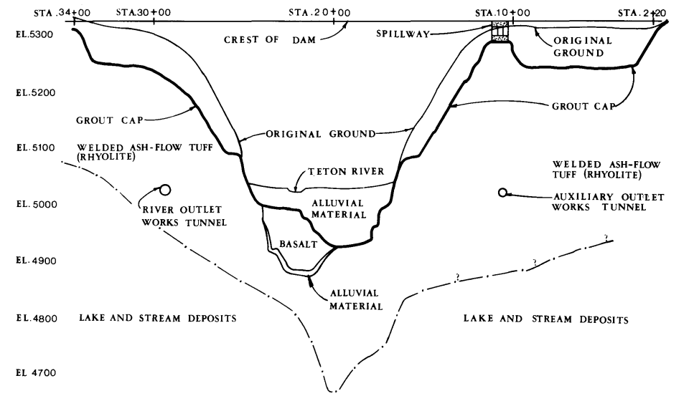
Site Geology

Slide 9
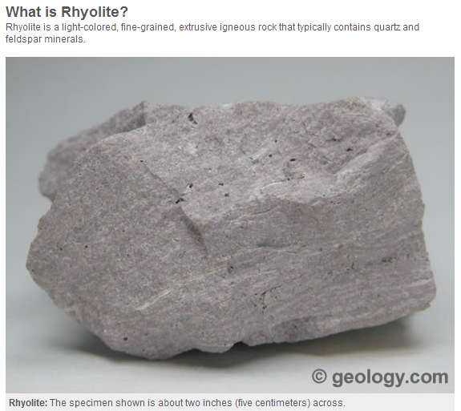
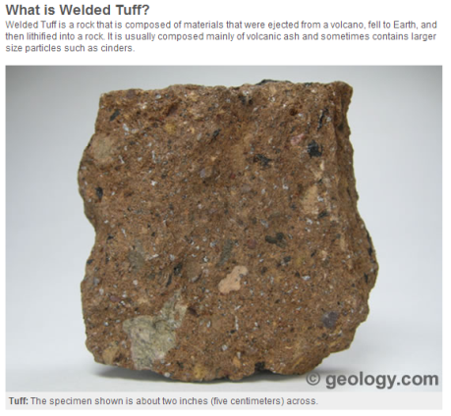
Site Geology
Terms “welded ash flow tuff” and “rhyolite” are used interchangeably in Teton reports – why?

Slide 10
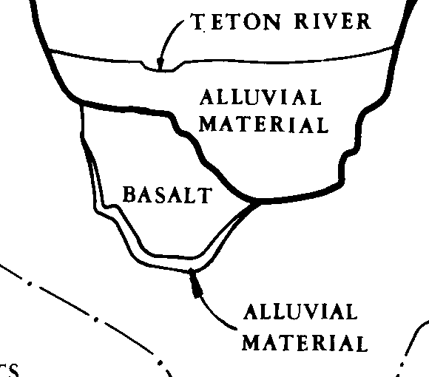
Basalt
Encountered beneath alluvium on the left side of the channel, but not the right.
Exposed in foundation for power plant and other various outcrops
Source of the basalt flow believed to be at the mouth of the Teton Canyon (d/s), and flowed upstream over a thin layer of alluvium covering the floor of the gorge to about elevation 5005 ft.
River subsequently eroded the basalt from the right side, but it remained on the left side

Slide 11
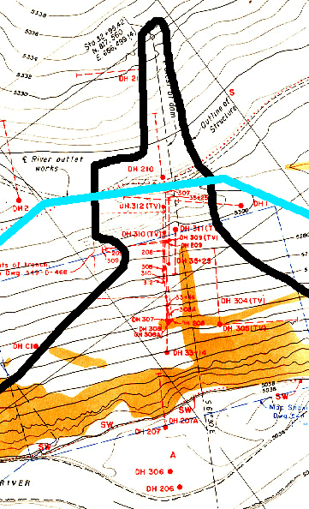
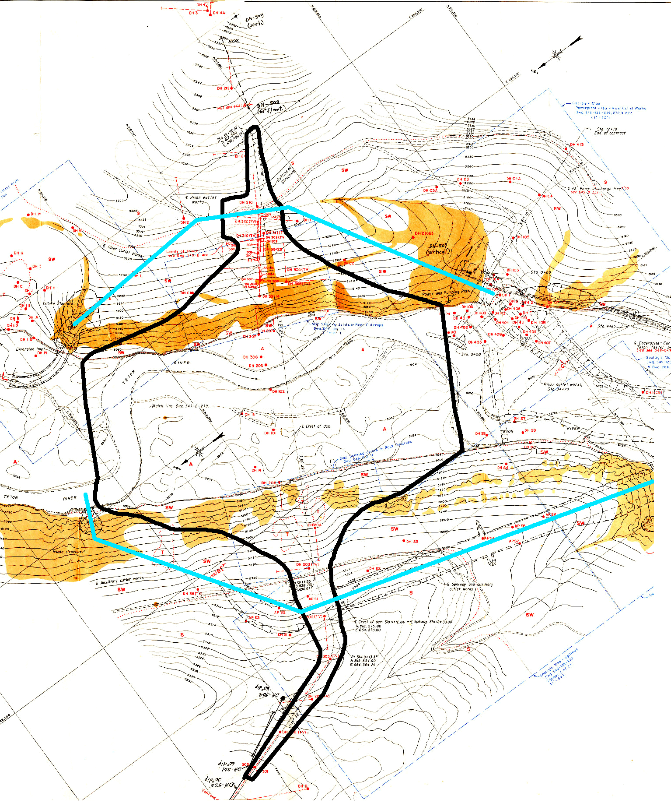
Geologic Investigations
Foundation exploration drilling program (many phases and drill holes ~ 20,000 ft.)
Geologic mapping
Pumping tests
Groundwater observations
Pilot grout program and follow up pressure testing

Slide 12
Geologic Investigations

Slide 13
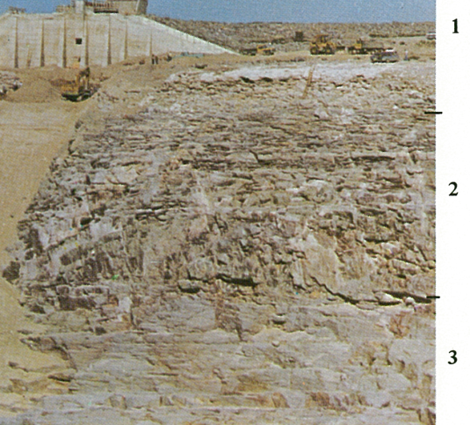
Welded ash-flow tuff
Unit 1 - uppermost – lenticular and tabular plates or slabs, mostly 2 to 6 inches thick, some up to 18 inches
  Plates/slabs nearly horizontal
  Openings between plates are ¼ to 2 inches, some filled with caliche and silt
  Very few high angle joints

Slide 14
Welded ash-flow tuff
Unit 2 – intermediate layer, below unit 1 with contact at about El 5250
  high angle joints at 10 to 20 ft. intervals dominate
  Minor random joints 1 to 2 ft. apart
  Most joints open 1/8 to 1 inches and coated or filled with calcium carbonate

Slide 15
Welded ash-flow tuff
Unit 3 – lower layer, below unit 2 with contact at about El 5185
  Contact marked by breccia zone, 6 inches to 2 ft. thick, rock fragments cemented with calcium carbonate
  Near vertical joints prominent, can be traced over 100 ft.
  Spacing 5 to 10 ft., with openings ¼ inch to 3 inches

Slide 16
Welded ash-flow tuff
Separation along the dominating low angle joint planes has led to benches along canyon wall
Transition between near-horizontal to near-vertical jointing occurs near the axis of the dam
Joints are mostly either flat-lying or steeply dipping

Slide 17
Embankment Design
What materials are available at the site?
What type of embankment dam would be best suited for the site? (e.g. homogeneous, zoned earth, central core rockfill, etc.)
How should the design address the problematic foundation geology that had been identified in the extensive site explorations?

Slide 18
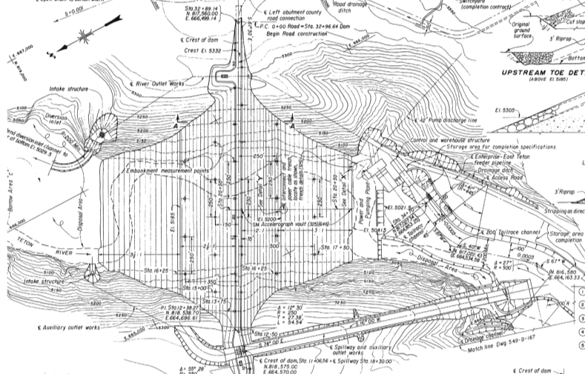
Embankment Design
Dam designed by the Division of Design in the Engineering and Research Center of the Bureau of Reclamation located in Denver

Slide 19
Embankment Design
What materials were available at the site?
  ML - eolian silts covering the uplands (millions of cubic yards available nearby)
  GP and GW - river deposits in the bottom of the Teton River canyon (quantities almost unlimited at the damsite)
  Basalt - could be quarried from exposed remnants of the intraflow (large quantities, but requiring a 4-mile haul)

Slide 20
Embankment Design
What type of embankment would be best suited for the site?
  Homogeneous ML embankment was considered; had the benefit of being an economical choice
  A zoned earthfill embankment was selected for several reasons:
    The ML soils contained a high percentage of caliche
    The brittle ML soils had a tendency to crack
    Cracking concern with 100 feet of alluvium; differential settlement; dam located in seismic area
    ML core should be surrounded by sand and gravel for earthquake crack protection
    A zoned embankment allowed more use of required excavated materials

Slide 21
Embankment Design
How should the design address the problematic foundation geology?
  Early on, the designers considered:
    Excavation to groutable rock
    Use of foundation treatment (slush grouting and dental concrete)
    Drains or blankets on downside of cutoff trench
    Downstream drain holes or tunnels
    Semi-pervious transitions upstream and downstream of the core
  Ultimately for apparent cost concerns, not all of these defensive measures were included in the design

Slide 22
1969 Pilot Grouting Program
Program consisted of drilling and grouting 23 holes
There were significant takes in several holes
Grout takes in 2 holes exceeded the amount estimated for the entire project – over 15,000 sacks of cement and over 17,000 cu.ft. of sand.
High takes at depths less than 70 feet
Grouting the upper 30 feet of curtain holes was abandoned since the cutoff was expected to go at least that deep

Slide 23
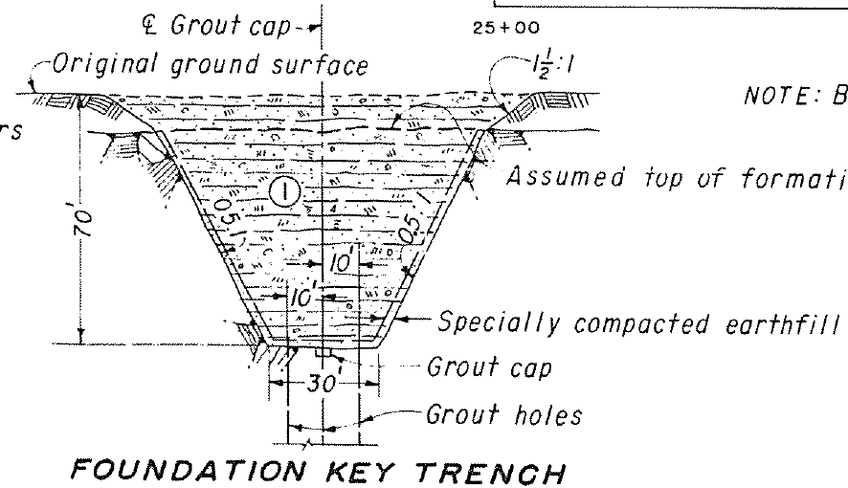
Critical Design Decision:
From review of drill logs and pilot grouting program, designers concluded it would be more economical to remove the upper 70 feet of the foundation than to conduct the grouting necessary to seal this rock
A foundation key trench 70 ft. deep was provided above El 5100 in both abutments, to remove the more open jointed rock, and reach a groutable, more sound rock.

Slide 24
Critical Design Decision:
There was no precedent for this design at Reclamation

Slide 25
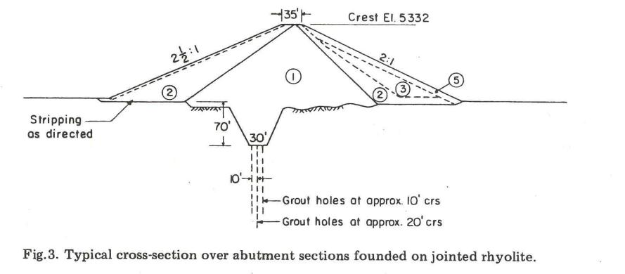
Foundation Design
By 1971 the foundation design philosophy was established
The seepage barrier on the abutments was to consist of:
  a 70 ft. deep key trench through the highly jointed rock on the abutments, and
  a three-row grout curtain

Slide 26
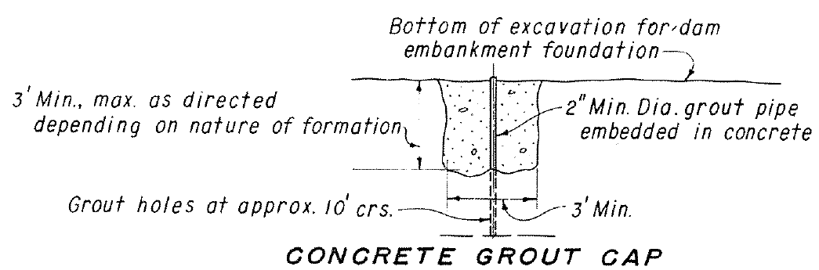
Foundation Design
To address cost concerns that the outer two rows of grout holes would accept extremely large quantities, and grout would travel large distances – the grout quantities in the outer two rows were limited
This resulted in a single row curtain installed through a central grout cap

Slide 27
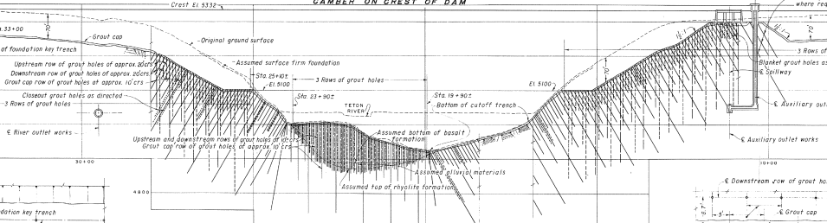
Foundation Design
Abutment key trenches were designed above elevation 5100
Angled and vertical grout holes, 260 feet deep
El. 5100

Slide 28
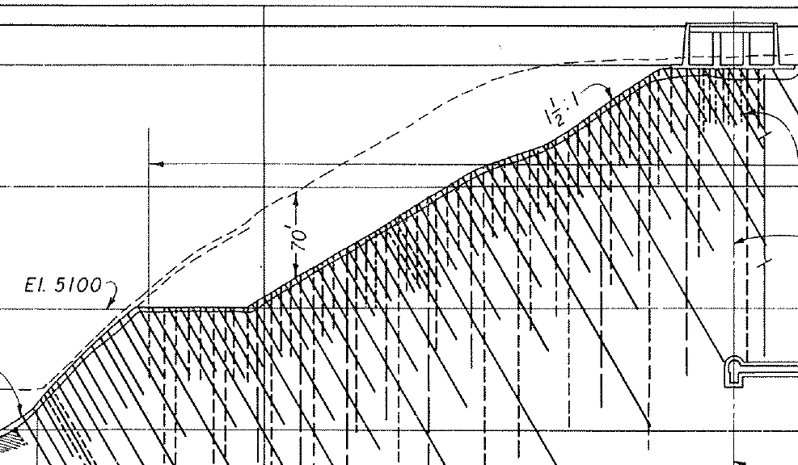
Foundation Design
Right key trench

Slide 29
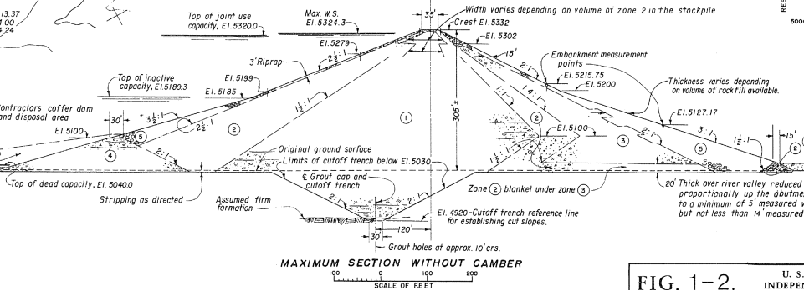
Foundation Design
In the main channel, 100 feet of alluvial materials were excavated to rock
Cofferdams and extensive dewatering used to protect the foundation work area

Slide 30
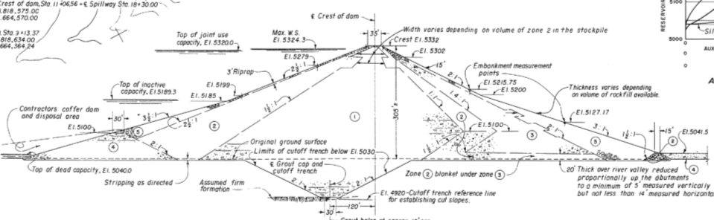
Embankment Design
Zoned earthfill embankment with a thick central core
Maximum height of 305 feet above the valley floor
405 feet above the lowest point excavated in the foundation

Slide 31
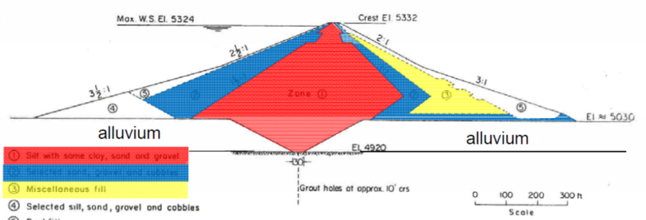
Embankment Design
Seepage reduction measures (shown in red):
  Wide impervious Zone 1 central core - eolian silty material, low plasticity ML soils
  Borrow area just north of right abutment
  Grout curtain

Slide 32
Material Properties – Zone 1
Average values from earthwork construction control tests:
D ratio | 98.2 %
Moisture content | 1.3% dry of optimum
Dry density | 99.5 %
Moisture content | 18.6 %
Post-failure lab test results (taken from zone 1 in right abutment key trench remnant):
Avg. LL | 26
Avg. PI | 3
Avg. moisture content | 22 %
Avg. fines | 80 %

Slide 33
Material Properties – Zone 1
Independent Panel post-failure observations:
  Zone 1 was compacted dry of optimum, was very brittle, and extremely susceptible to erosion by flowing water – these two characteristics were prime factors that contributed to the failure
  The relatively high strength of the zone 1 allowed piping channels to form without observable collapse of the fill (until very late in the process)

Slide 34
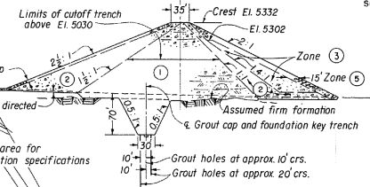
Embankment Design
Zoning was similar in the abutment sections
Major difference was the deep and narrow key trench as opposed to the cutoff trench in the valley section

Slide 35
Embankment Design
Seepage reduction measures (shown in red):
  In the abutments, the same Zone 1 material served as the seepage barrier
  Key trenches excavated in jointed rock
  Continuation of the grout curtain beneath the backfill

Slide 36

Embankment Design
Seepage control measures (Zone 2 shown in blue):
  Transition zone of sand and gravel upstream of the seepage barrier in the embankment, but not in the foundation (river valley or key trenches)
  Drainage or filter zone of sand and gravel downstream of the seepage barrier
  Zone 2 extended to the bedrock of the valley floor and extended as a horizontal blanket beneath a random zone and a downstream rockfill zone
  Zone 2 materials from the river valley, upstream

Slide 37
Material Properties – Zone 2
Average values from earthwork construction control tests:
Material type | GP / GW
Permeability | ~ 10⁻⁵ cm/sec
Plus 3 inch | 10-30 %
Plus No. 4 | 45-76 %, avg. 66%
Minus 200 | 2-12, avg. 4.5%

Slide 38
Material Properties – Zone 2
Independent Panel post-failure observations:
  Zone 2 was intended to serve as a chimney drain and horizontal blanket
  However, measured permeabilities during construction raise questions about its ability to serve as a drain – it may have been nearly as impervious as the Zone 1 core
  The Zone 2 thus probably prevented the seepage through the erosion channels developing in the Zone 1 core from making an earlier appearance on the downstream face

Slide 39

Embankment Zoning
Zone 3 was random fill downstream of Zone 2
Consisted of finer grained soils, particularly caliche-rich or cemented soils from the Zone 1 borrow area that were considered undesirable for use in the core
Compaction and material properties similar to Zone 1

Slide 40
Embankment Zoning
Zone 5 consisted of rockfill from required excavation (tunnel, powerhouse, embankment foundation and shaping, etc.)
Zone 5 placed on upstream and downstream exterior slopes, mainly as slope protection

Slide 41
Embankment Design
Key defensive design measures that were not included in the design:
  No transition zone between Zone 1 and the alluvium in the valley bottom
  No transition zone between Zone 1 and the fractured rock in the key trench, downstream of the grout cap
  No provisions for surface treatment (dental concrete or slush grouting)
  No drainage system was provided in either abutment
  No downstream piezometers or similar instruments were installed

Slide 42
Embankment Design
Independent Panel comments on design:
  The final design defense against seepage depended almost exclusively on the impervious core, the key trench backfill, and the grout curtain
  The only downstream defense against cracking of the core or concentrated leakage was the Zone 2 transition, and this zone did not extend into the key trenches
  Furthermore, the Zone 2 ability to serve as a drainage zone is questionable due to its low permeability

Slide 43
Foundation Construction
Curtain grouting – two outer “barrier” rows and center grout cap row
  Special emphasis placed during construction on grouting
  118,000 l.f. of grout holes
  Over 600,000 cf of cement, sand
The design required blanket grouting only “if required” to treat specific defects
  Limited blanket grouting was done
1971 Design Considerations called for open joints and cracks to be treated by cleaning with air, sealing the surface, and low pressure grouting
  Drawings and specs did not include this requirement
  Little of this type of treatment was actually done
  Instead – slurry concrete or slush grouting was performed

Slide 44
Why not shotcrete the cutoff trench?
After a site visit – Designers considered shotcreting the downstream face of the cutoff trench
Construction office subsequently developed the “bucket (slush) grouting” procedure
The construction office also agreed to put extra effort into “special compaction” in the cutoff trench
No official documentation of these decisions
Post-failure documentation in the IRG failure report

Slide 45
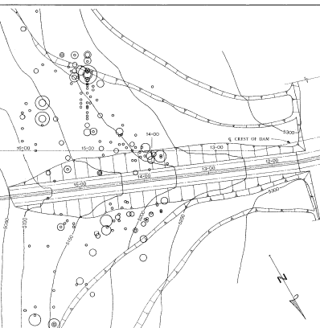
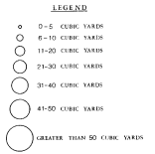
Slush Grouting
Design specs did not include “slush grouting” or any other way to treat the Zone 1 / bedrock interface when open joints were exposed
The construction office directed the placement of over 1800 cy. of slush grout
Accomplished by simply pouring slurry into open joints by gravity flow
Slush grouting discontinued above elevation 5205 because the joint size became too small to grout by gravity

Slide 46
What is “special compaction”?
Compaction of materials using special techniques, typically in thinner lifts with smaller hand operated equipment

Slide 47
Construction - 1972
Fall of 1972 – work began on the key trench mostly to the right of the spillway
Some grout cap excavation completed
Diversion tunnel construction

Slide 48
Construction - 1973
Spring / summer –right abutment key trench excavation continued – starting to take shape
Continued excavation of 100 feet of alluvium in the main channel between the cofferdams

Slide 49
Construction - 1973
In the channel, difficult rock conditions were encountered, including vertical faces and overhangs
Drilling and blasting was required to shape the rock

Slide 50
Construction - 1973
These photos show how the rock was shaped at 0.5:1 slopes with drilling and blasting
Foundation rock was cleaned
Also, the grout cap was installed – using steps in some places

Slide 51
Construction - 1973
By late 1973 foundation shaping was completed and the main channel cutoff was excavated

Slide 52
Construction - 1974
Throughout 1974, it became more apparent in the photo record that open joints, fissures, void were prevalent…..

Slide 53
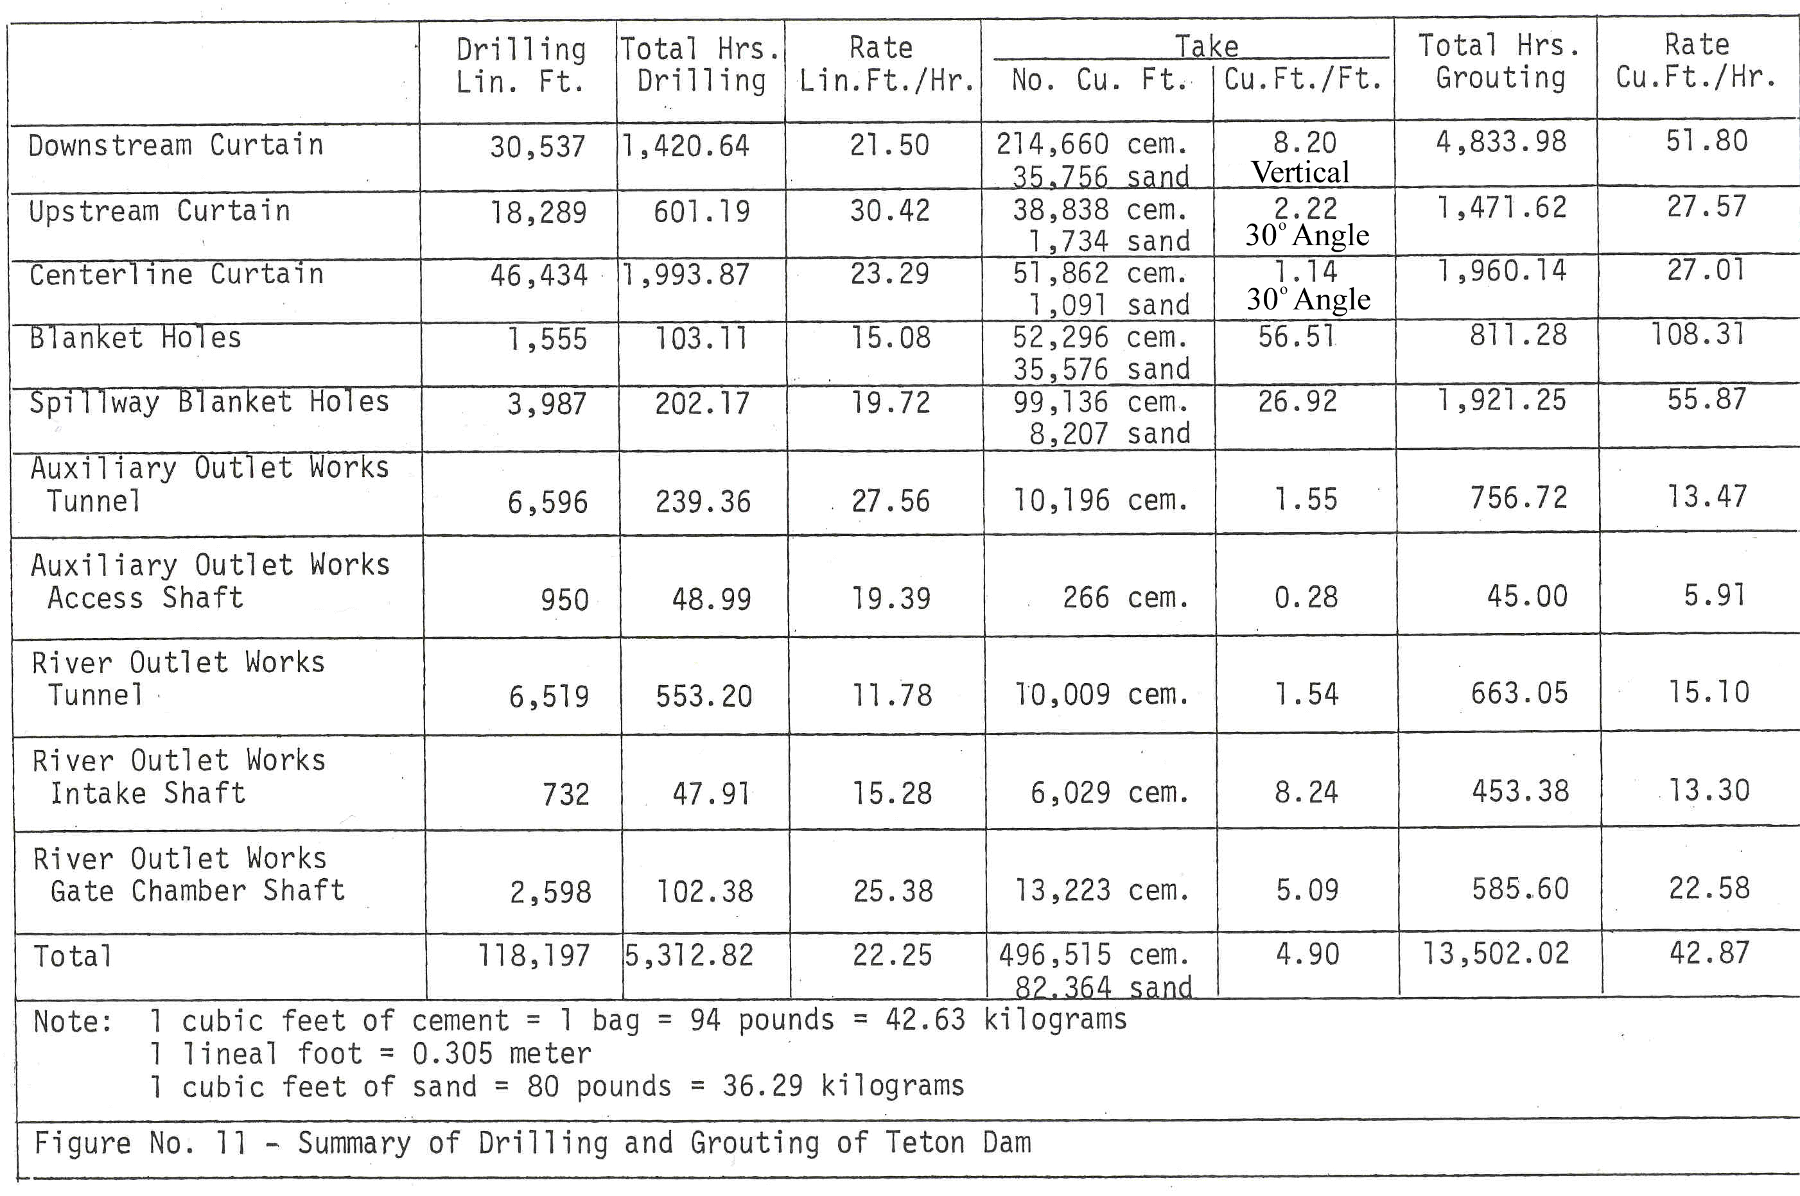
Construction - Grouting

Slide 54
Construction - 1975
Embankment placement went quickly in 1975

Slide 55
Construction - 1975

Slide 56
Construction ~ 1975

Slide 57
Reservoir Filling – Plan
Diversion through the river outlet works (~2400 cfs capacity) would stop on October 1 of the last construction season
Winter river flows would go through the auxiliary outlet works (~850 cfs capacity)
Seven months would be reserved for completion of river outlet works, making it fully operational by May 1 of the following year
May 1 date important, as at that time Teton River flows typically exceeded capacity of auxiliary outlet
“Unless adverse performance develops, unrestricted filling rates will be permitted to elevation 5200. Above elevation 5200 initial filling should not exceed 1 foot per day.”

Slide 58
Reservoir Filling – Actual
River outlet works were closed on October 3, 1975 (and never were completed, missing May 1 date)
Starting October 3, 1975 (and continuing to May 3, 1976), releases through the auxiliary outlet works were limited to required downstream flows (300 ft³/s), and all inflows in excess of that were stored in the reservoir
By March 3, 1976, the reservoir level had risen to elevation 5170 (or a depth of 135 feet), and the rate of rise had been approximately 0.2 ft./day

Slide 59
Reservoir Filling – Actual
However, the winter of 1975-76 had featured heavy snow in the Teton River watershed, with surveys indicating up to 230% of normal levels
On March 3, the Construction Engineer requested a relaxation of the 1 ft/day filling rate, citing the expected heavy inflows and noting all normal behavior to date
The Denver Office granted this request, allowing the filling rate to increase to 2 ft/day, agreeing with the expected high inflows and normal behavior

Slide 60
Reservoir Filling – Actual
Beginning in early April, river flows rose well above average, and continued well above normal until dam failure on June 5
During two periods, April 12-14 and May 17-23, the flows exceeded all previous flows
April and May 1976 runoff volumes were estimated to have return periods of about 6 years and 50 years, respectively.

Slide 61
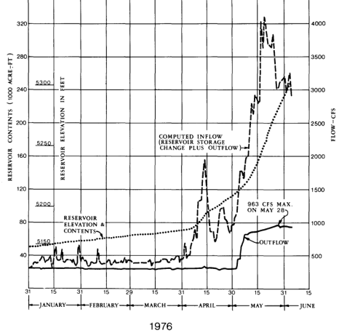
Reservoir Filling – Actual
Throughout April and up to May 10, the filling rate was no higher than 2 ft/day except for 3 days
From May 11 until June 5, the 2 ft/day requirement was exceeded with an average daily rise of 3.0 feet and maximum rise of 4.3 feet on May 18 (inflows ~4000 cfs)
From May 12 through June 5, the auxiliary outlet was discharging at a rate higher than its capacity of 850 cfs

Slide 62
Significance of Increased Filling Rate
At Reclamation, a maximum 1 ft/day filling rate criterion had been used for years:
  Considered a desirable rate for testing the abutments and the embankment
  Assuming structures were operational, also provided time to take remedial action if problems developed
Worthwhile to note that exceeding this filling rate was not unusual for a Reclamation reservoir:
  Initial reservoir filling criteria were increased in the initial filling of Reclamation reservoirs in 36 instances
  For eight of those, the reservoir filling rates exceeded the maximum Teton rate of 4.3 feet
  No problems were encountered in these cases

Slide 63
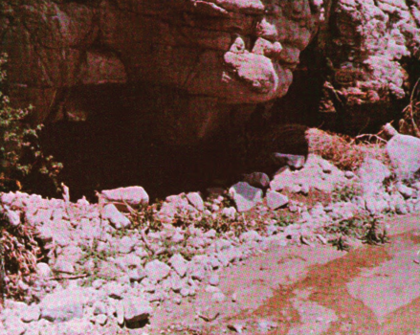
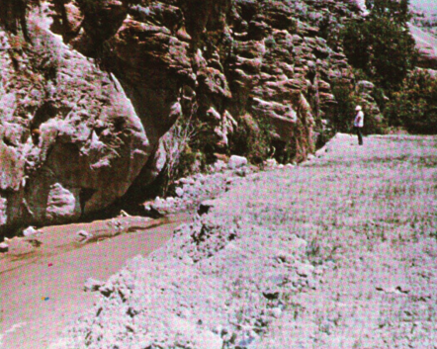
Initial Seepage – June 3 and 4
On June 3, project personnel inspecting the right abutment found two small seeps located 1,300 and 1,500 feet downstream from the toe of the dam
On June 4, a small seep was found at the right abutment about 150 to 200 feet downstream from the toe of the dam

Slide 64
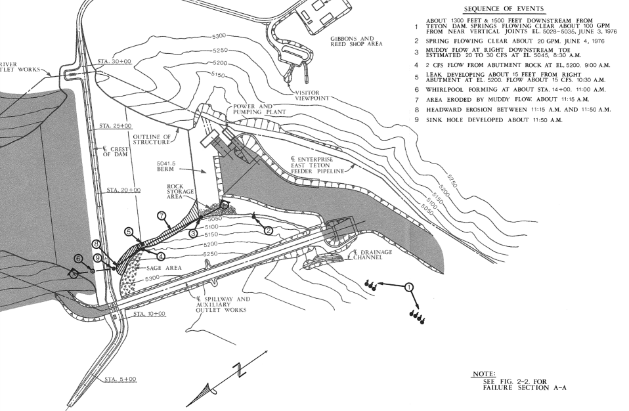
Initial Seepage – June 3 and 4
June 3 seeps
June 4 seep

Slide 65
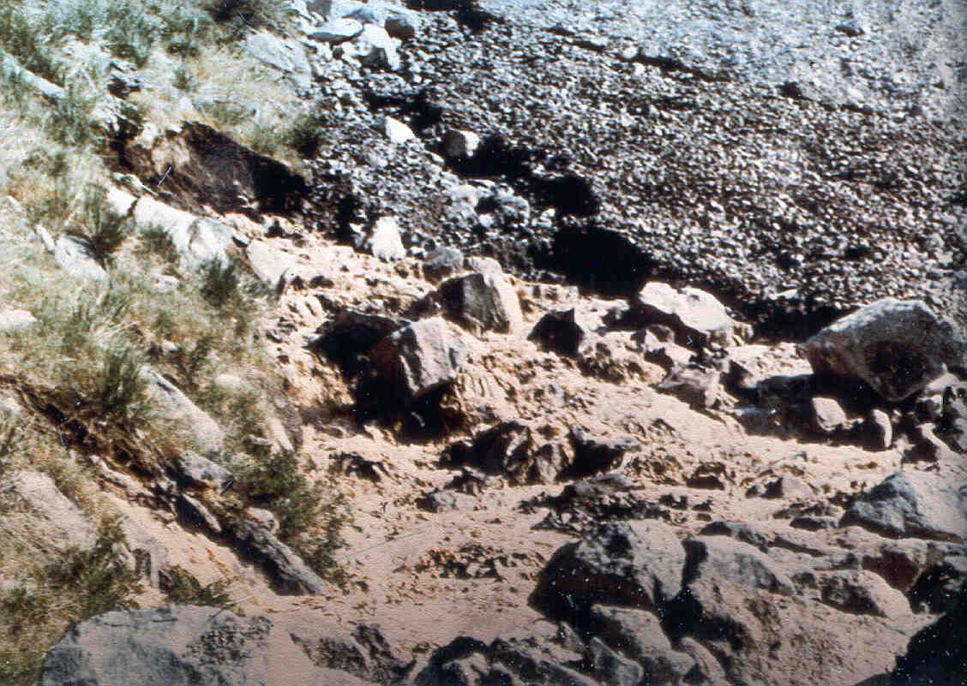
Increased Seepage in Groin

Slide 66
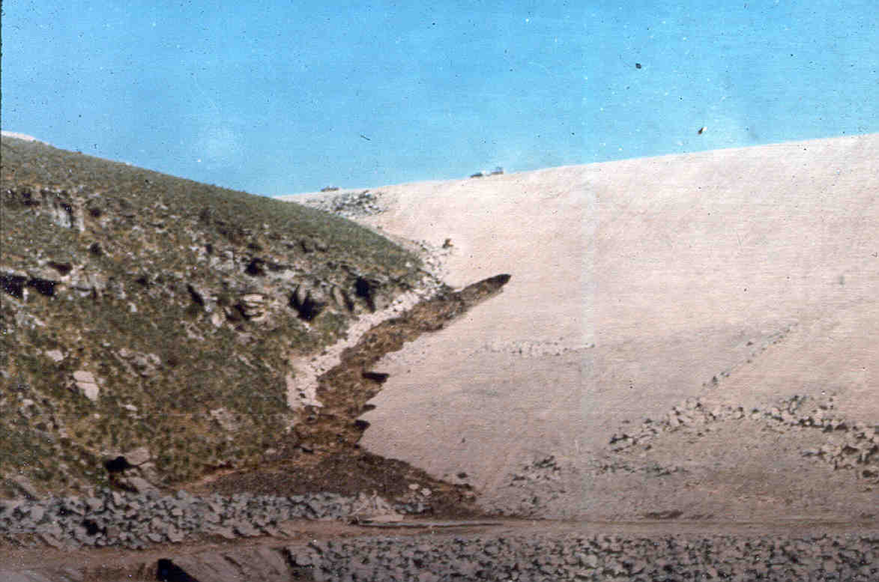
Seepage Moving Into Embankment
About 10:45 am, June 5, 1976

Slide 67
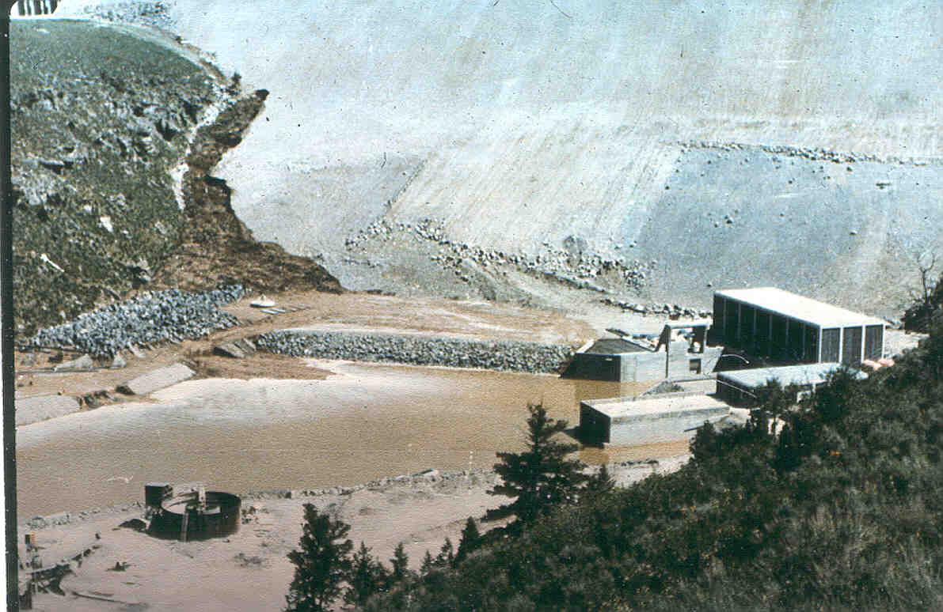
About 10:45 am

Slide 68
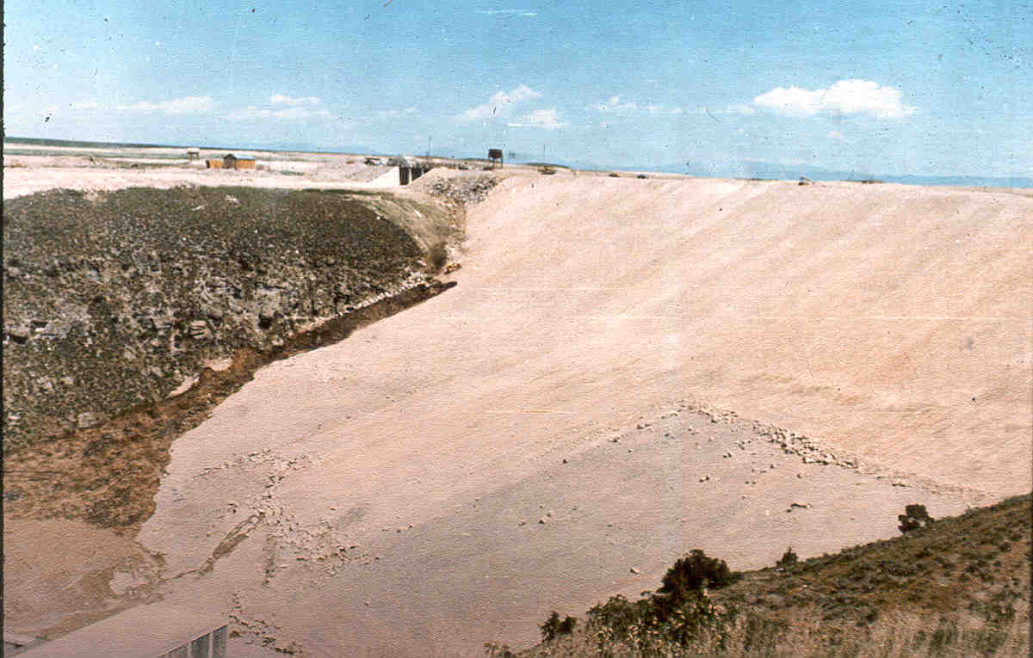
Flow Increasing, Dozers Sent to Fill Hole at Elevation 5200 about 10:45 am

Slide 69
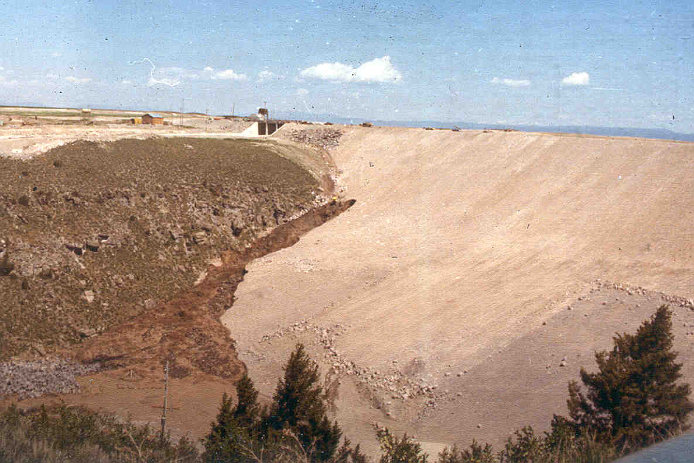
Dozers Lost In Hole About 11:20 am

Slide 70
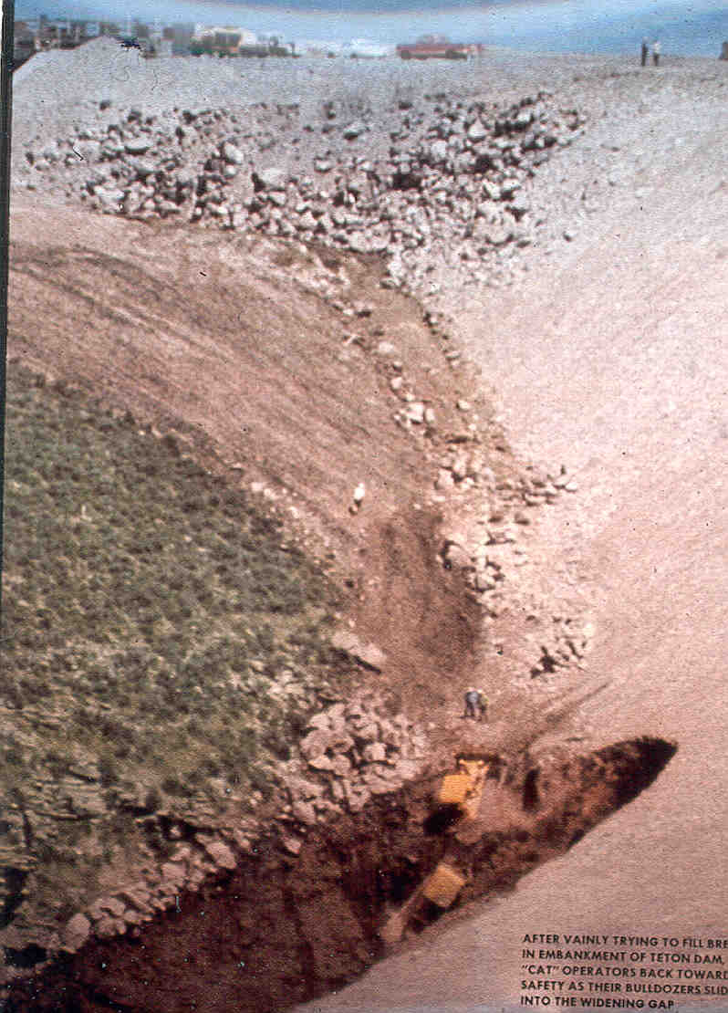
Dozers
Lost

Slide 71
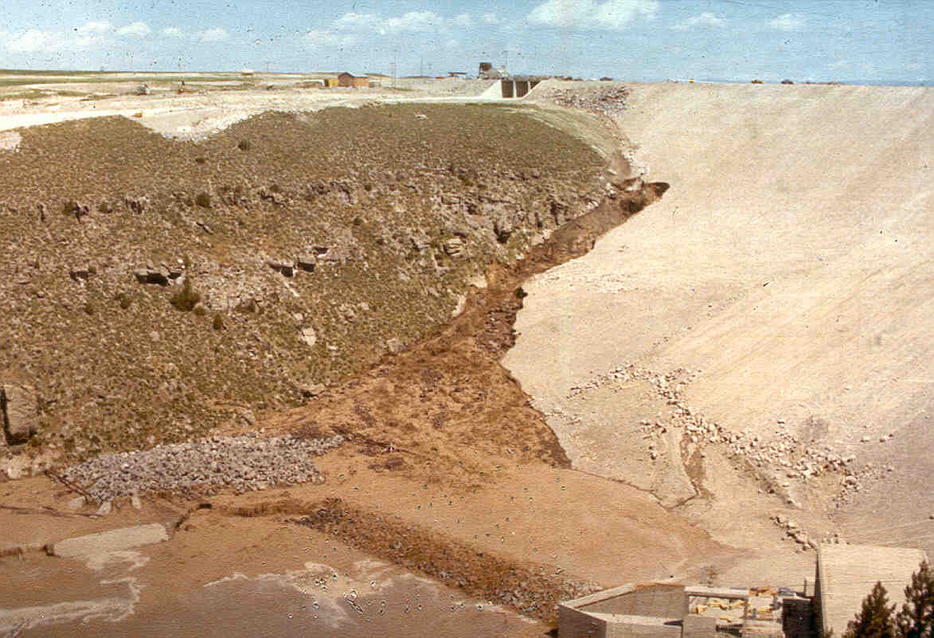
About 11:25 am, June 5, 1976

Slide 72
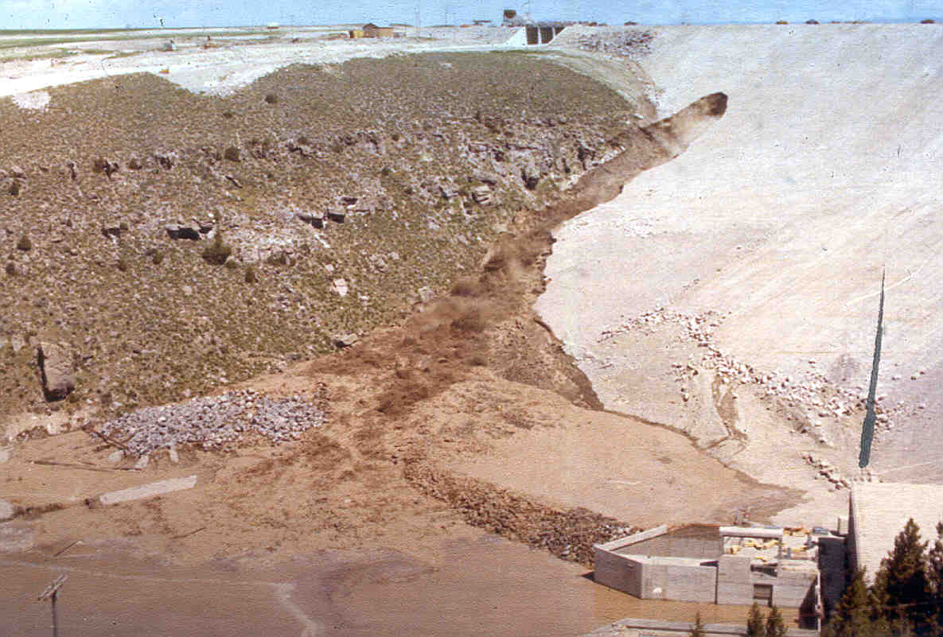

Slide 73
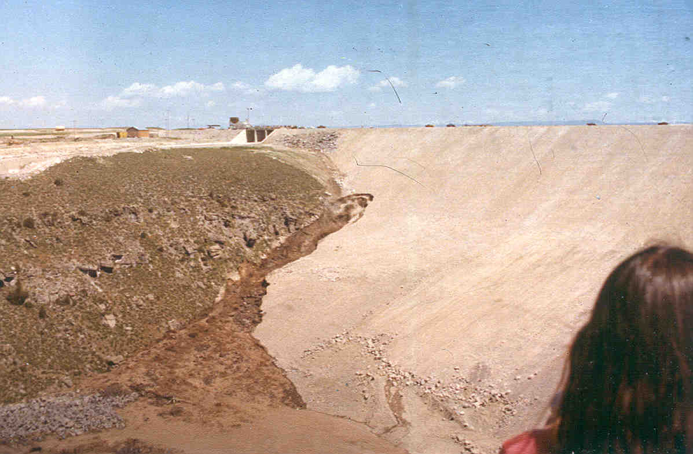
Flow Increasing

Slide 74
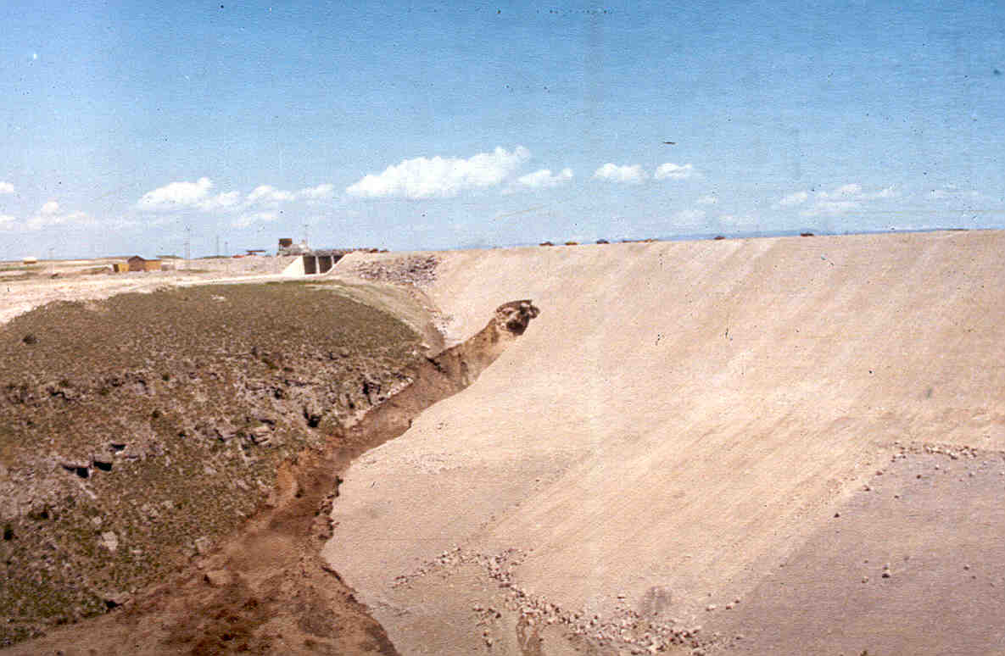
Increased Flows

Slide 75
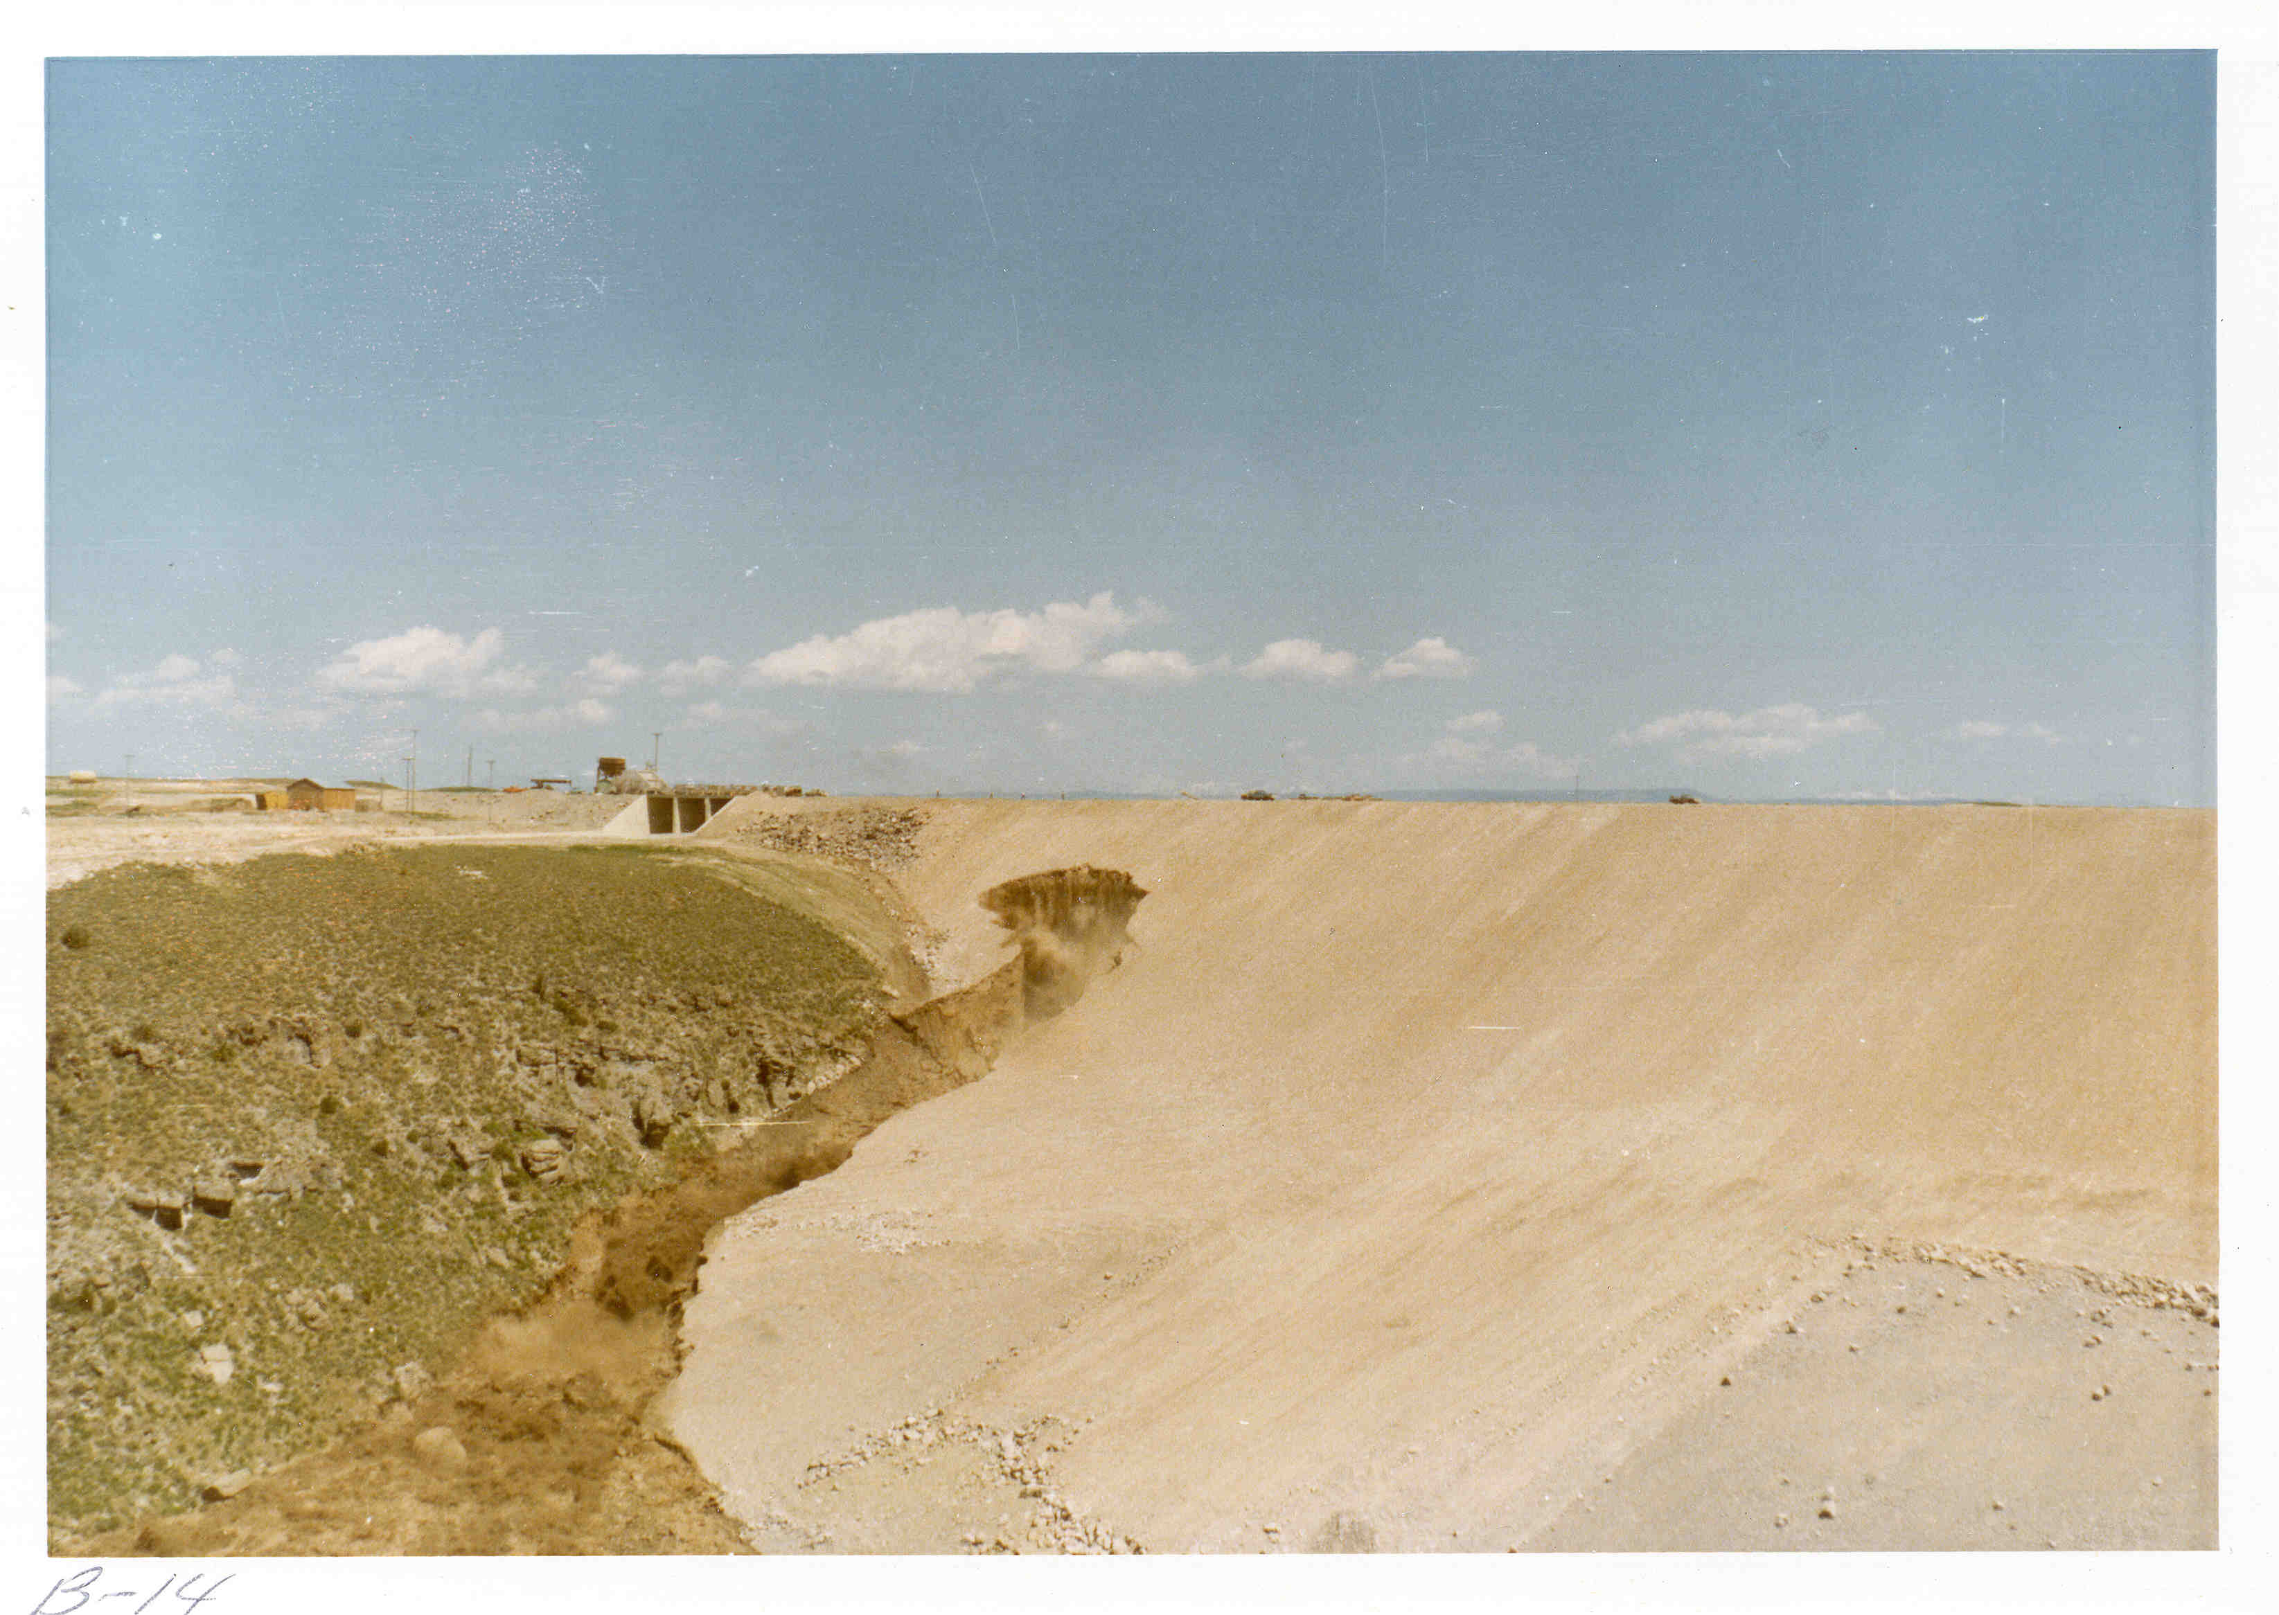
Approximately 11:30 am, June 5, 1976

Slide 76
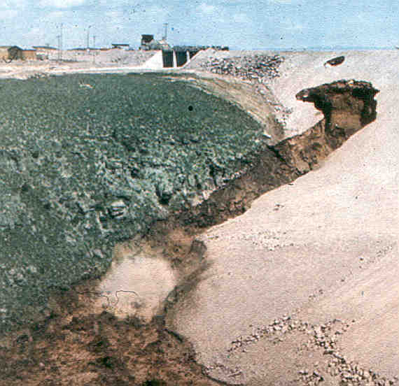
Second Hole in Dam about 11:32 am, June 5, 1976

Slide 77
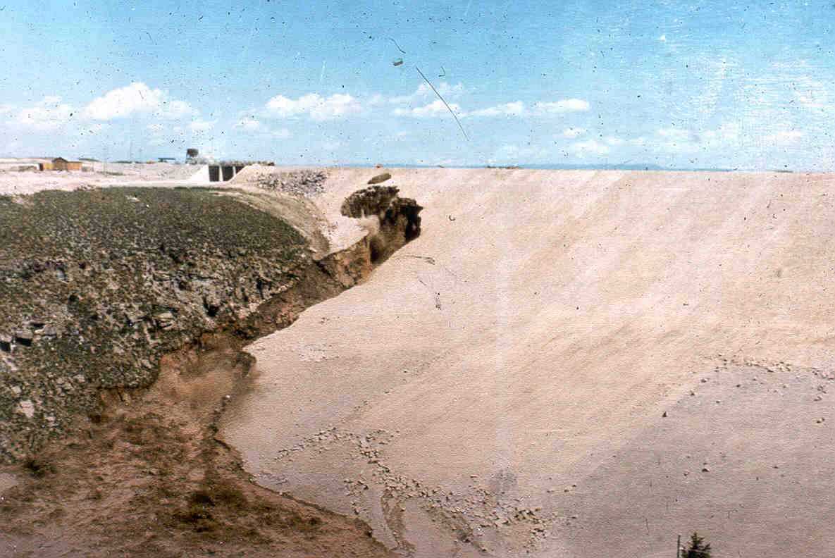
Tremendous Flow of Muddy Water

Slide 78
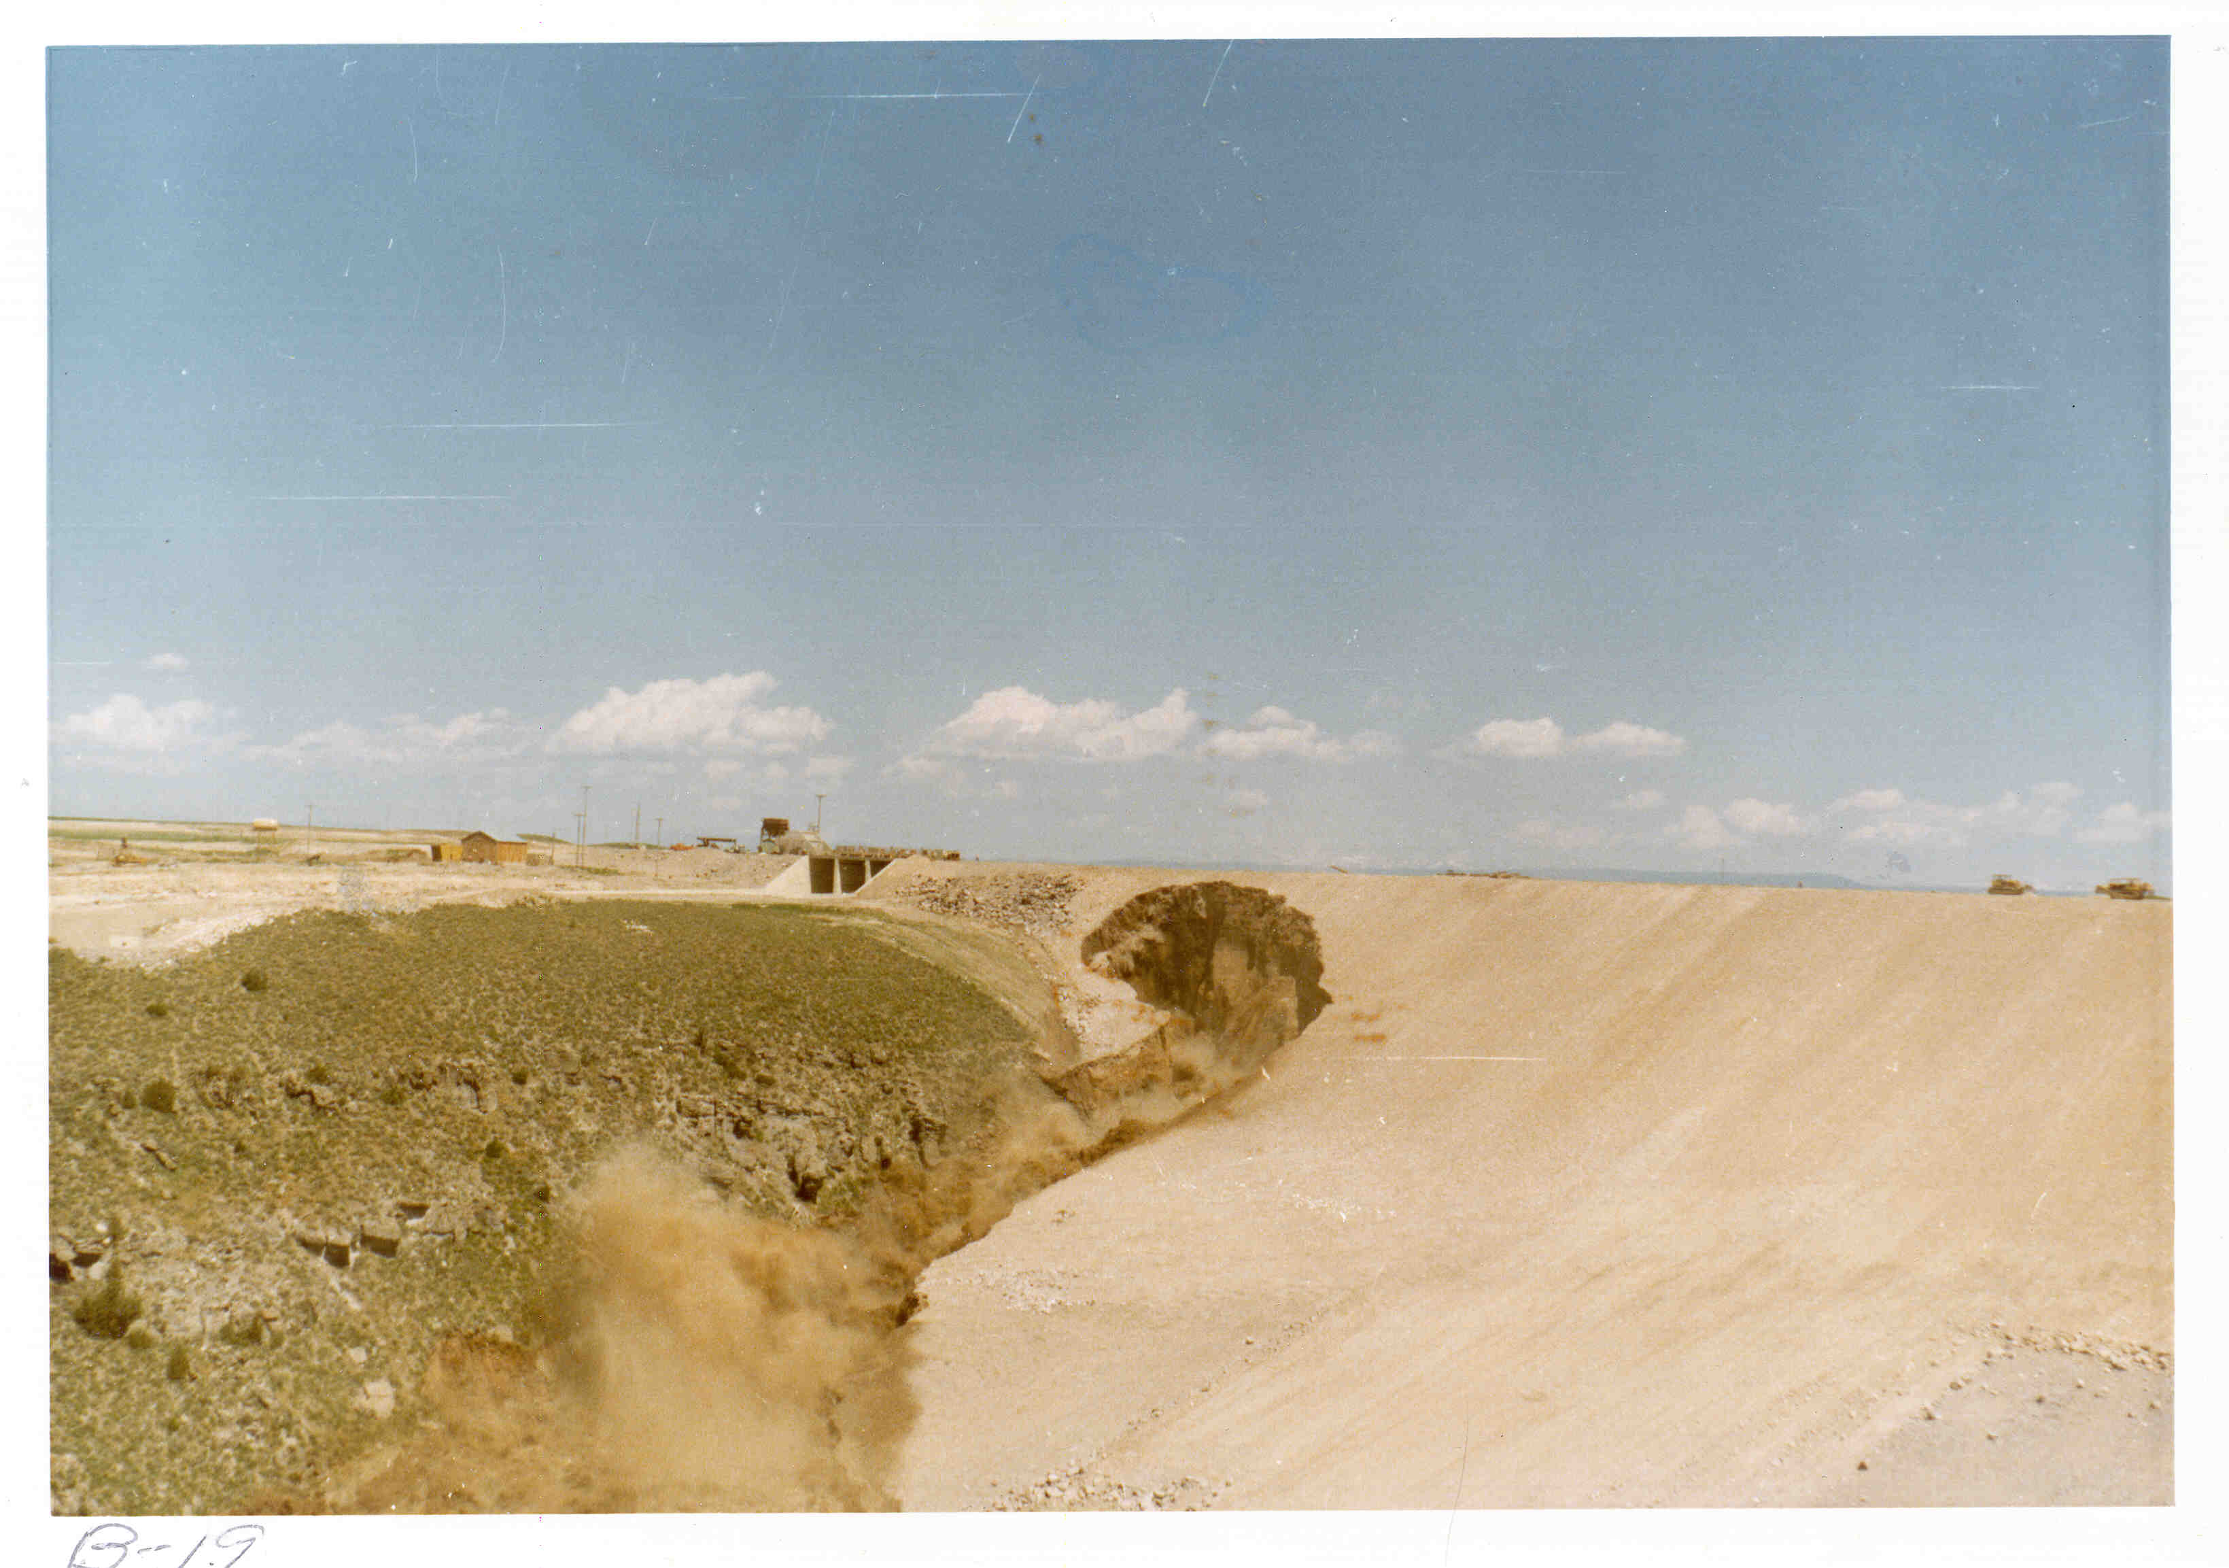
Large Masses of Dam Caving into Erosion Hole, about 11:50 am.

Slide 79
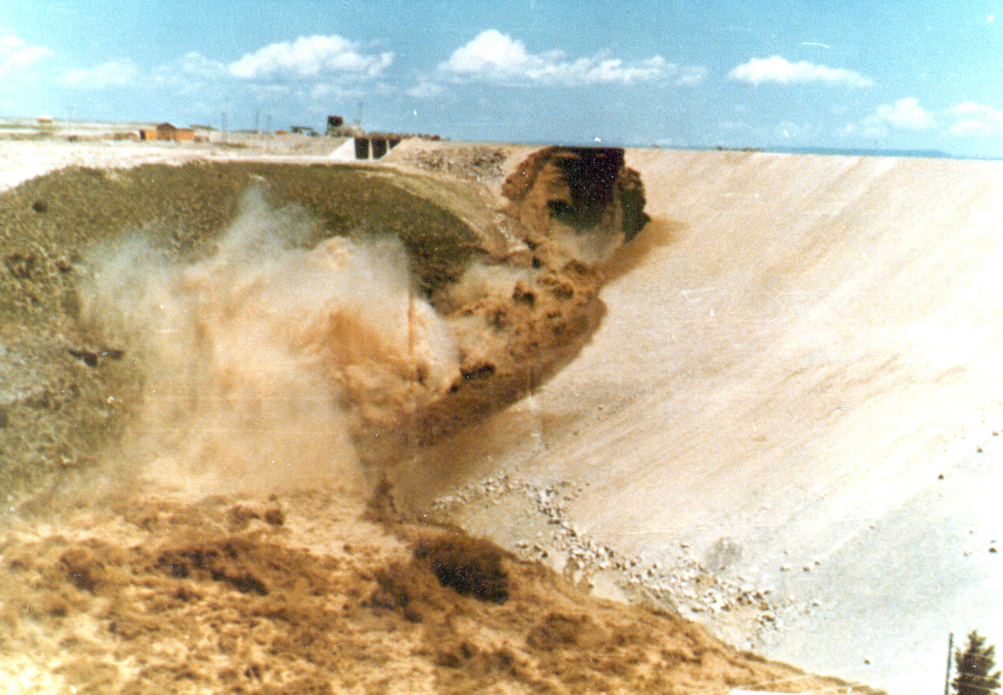
Dam Crest Breaching at 11:55 am, June 5. 1976

Slide 80
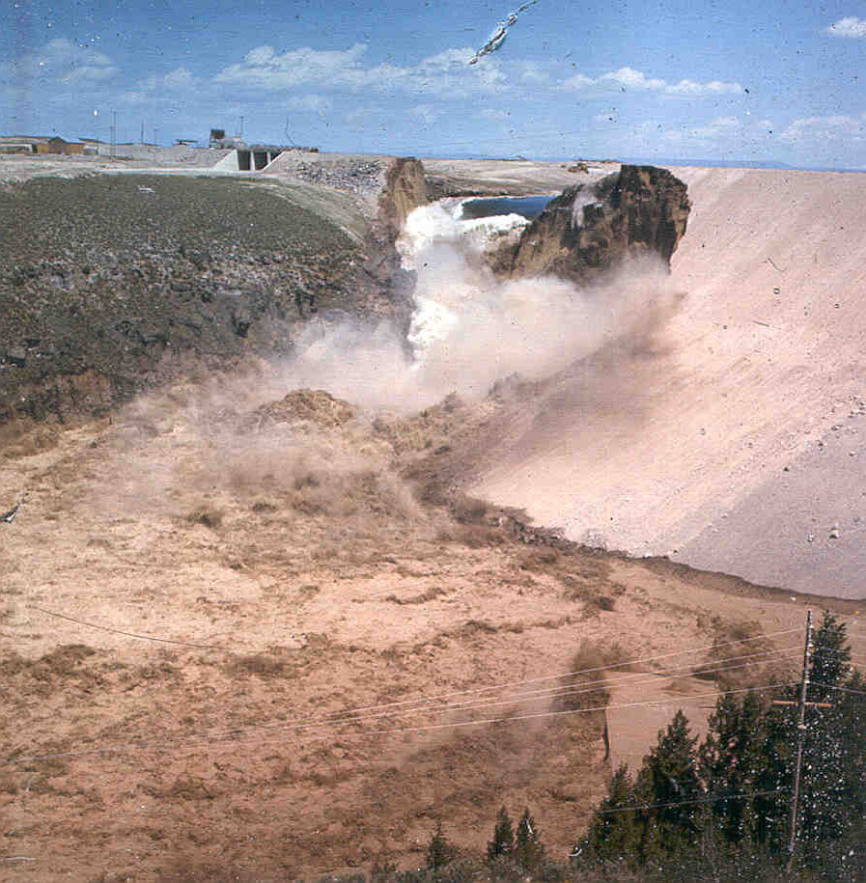

Slide 81
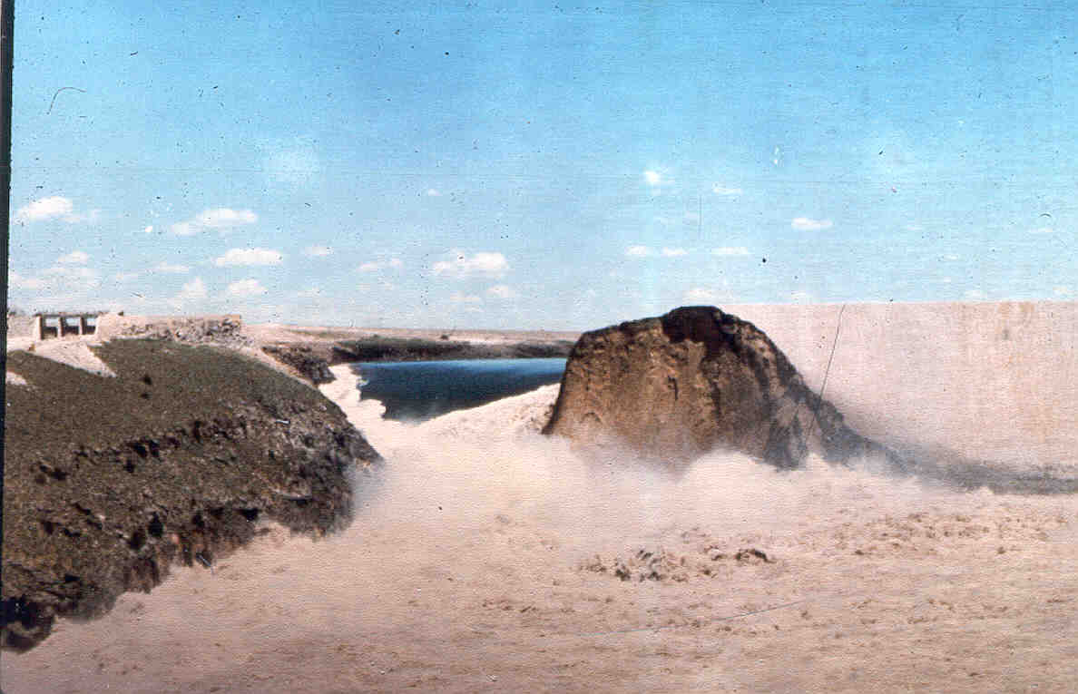

Slide 82
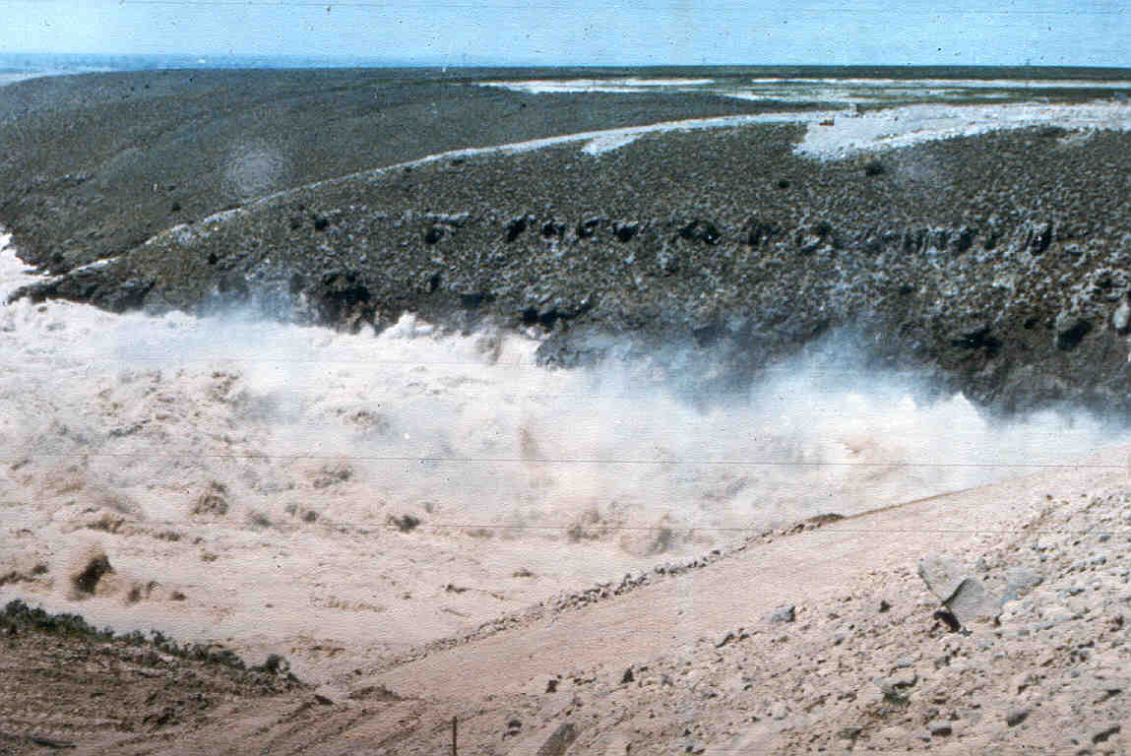
Looking Downstream

Slide 83
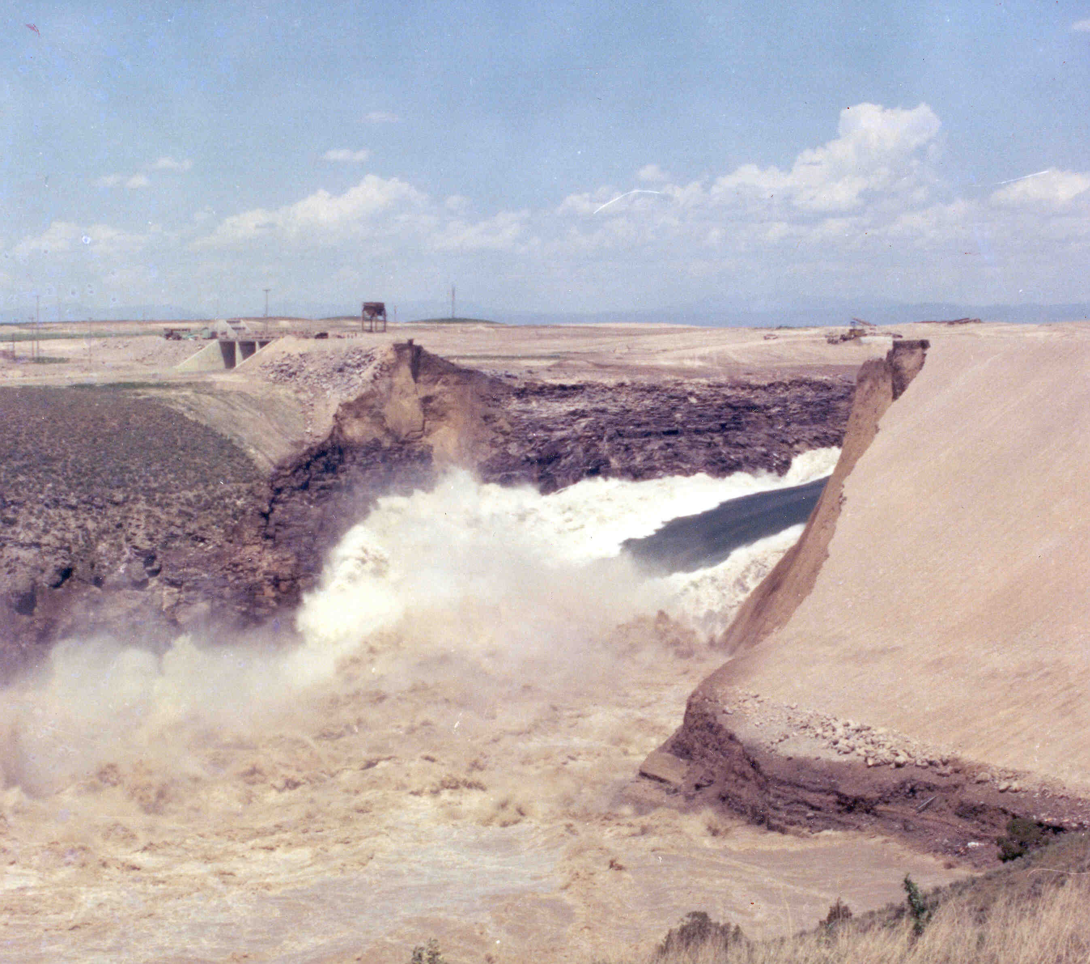
Early Afternoon, June 5, 1976

Slide 84
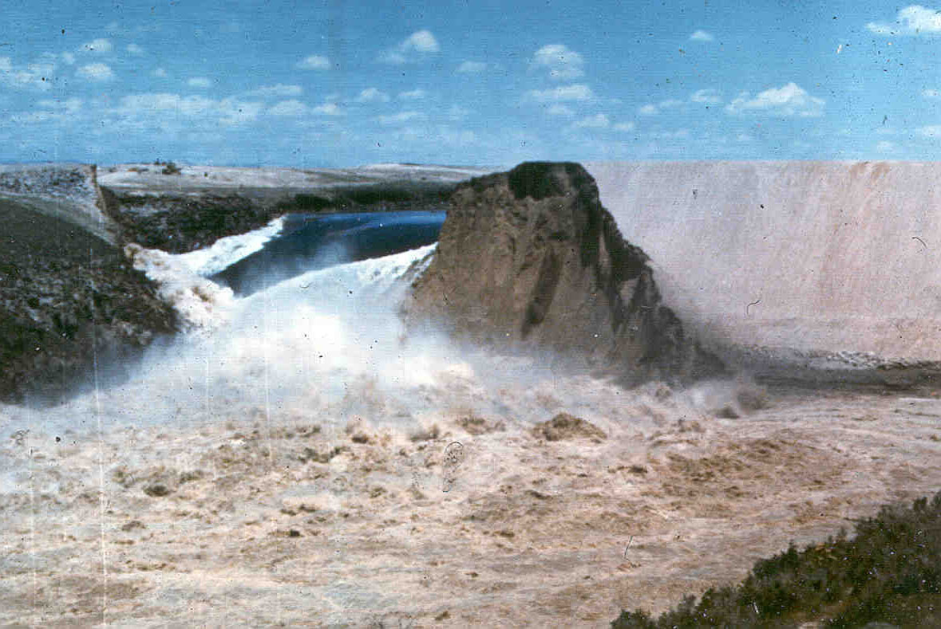
Maximum Flow about 1 Million cfs

Slide 85
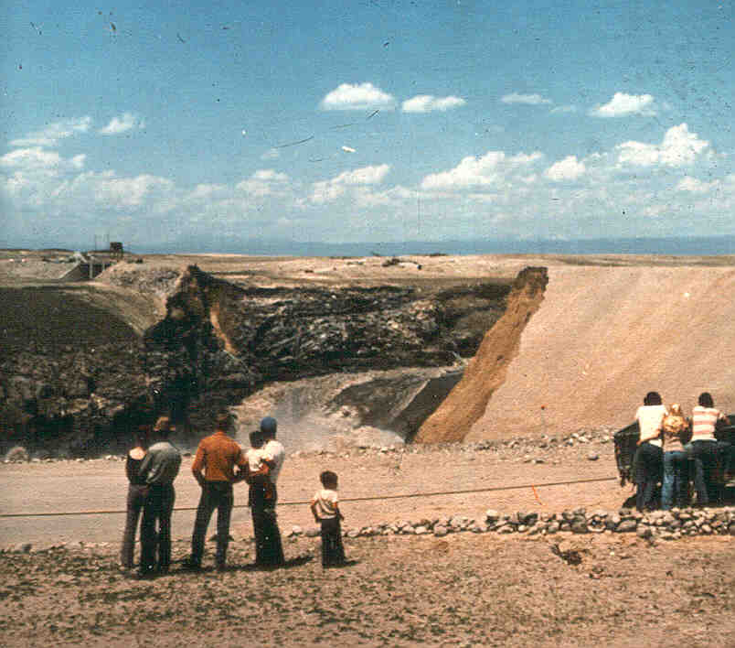
Mid-Afternoon June 5, 1976
Spectators Watching

Slide 86

Mid-Afternoon, June 5, 1976
Note Bank Storage

Slide 87


Slide 88

Downstream Canyon Flows

Slide 89

Rexburg, Idaho

Slide 90

Sad View

Slide 91

Late Afternoon, June 5, 1976

Slide 92


Slide 93

Right Abutment Erosion

Slide 94

Late June 5, 1976

Slide 95

Downstream Aggraded Channel

Slide 96

Upstream Rim Instability

Slide 97

Upstream View

Slide 98

June 8, 1976

Slide 99

June 8, 1976

Slide 100


Slide 101


Slide 102

Forensic Investigations

Slide 103

Right Abutment Remnant

Slide 104

Forensic SPT Tests

Slide 105

Block Sample

Slide 106

Keyway Forensic Investigations

Slide 107

Hand Excavation Adjacent to Rock

Slide 108

Forensic Mapping

Slide 109

Grouted Joint
June 15, 1976

Slide 110

Open Foundation Joint

Slide 111

Ponding Tests

Slide 112

Right Abutment Keyway
October 29, 1976

Slide 113

Grout Curtain Drilling

Slide 114

Forensic Drilling

Slide 115

Wet Seam

Slide 116

Wet Seam, Elev. 5115, October 17, 1977

Slide 117

Wet Seam Dennison Sampling
Sta. 24 + 50, October 14, 1977

Slide 118

Fracture Mapping

Slide 119

Fracture Documentation

Slide 120

Left Abutment Forensics - Elev. 5190
August 24, 1977

Slide 121
The fundamental cause of failure may be regarded as a combination of geologic factors and design decisions that, taken together, permitted the failure to develop.

Slide 122
GEOLOGIC FACTORS
Numerous open joints in the abutment rocks
Scarcity of more suitable materials for the impervious zone of the dam than the highly erodible and brittle windblown soils

Slide 123
DESIGN DECISIONS
Complete dependence for seepage control on a combination of deep key trenches filled with the windblown soils and grout curtain
Selection of a geometrical configuration for the key trench that encouraged arching, cracking and hydraulic fracturing in the brittle and erodible backfill

Slide 124
DESIGN DECISIONS CONT’D
Reliance on special compaction of the impervious materials as the only protection against piping and erosion of the material along and into the open joints, except some of the widest joints on the face of the abutments downstream of the key trench where concrete infilling was used

Slide 125
DESIGN DECISIONS CONT’D
Inadequate provisions for collection and safe discharge of seepage or leakage which inevitably would occur through the foundation rock and cutoff systems

Slide 126
POSSIBLE TRIGGER MECHANISMS OF FAILURE

Slide 127

Probable Path of Water in Early Stages of Leakage

Slide 128
POSSIBLE TRIGGER MECHANISMS OF FAILURE
Seepage under grout cap.
Piping through cracks caused from hydraulic fracturing or differential settlement.
Hydraulic separation between key trench fill and base of the trench (open joints).
Seepage through the key trench fill (open joints).
Seepage through soil at base of key trench by sloughing.
Collapse of dry seam in trench fill.
Wet seam (?).

Slide 129


Slide 130


Slide 131

Different Mechanisms of Erosion

Slide 132

First and Second Order Arching

Slide 133

ANALYSIS FOR HYDRAULIC FRACTURING

Slide 134


Slide 135


Slide 136
WET SEAM OR DRY SEAM

Slide 137
TETON DAM DYNAMICS
BEFORE TETON
AFTER TETON
Experience/
Expertise
INVESTIGATIONS
Experience/
Expertise
Peer Reviews
(Outside)
Independent
DESIGN
Education/
Training
Hubris
Bureaucracy
SOD
CONSTRUCTION
Team
Communication
Some
Communication

Slide 138
LESSONS LEARNED
Hubris engineering is detrimental.
Instrumentation database is very important for evaluation of dam performance.
Use more than one line of defense against seepage.
Flaws can occur in man-made structures.
Site geology and site design must be compatible.

Slide 139
LESSONS LEARNED CONT’D
Bring in appropriate consultants for technical reviews and field reviews.
In open-jointed, rock foundations treatment is important.
Slow first filling of reservoir.
Investigators, designers, and consultants work closely together, with timely onsite field trips.
Critique problem or controversial conditions.

Slide 140

Start of Dam Safety in the United States
Teton Dam Failure
A Review of the Technical Factors Contributing to the Failure

Slide 141

TETON DAM TODAY

