Slide 1
Dam Safety Periodic Inspections
Robert Taylor, P.E.
Regional Dam Safety Program Manager
U.S. Army Corps of Engineers
Great Lakes & Ohio River Division
Robert.E.Taylor@usace.army.mil
Dam Safety Workshop
Brasília, Brazil
20-24 May 2013

Slide 2
Overview
Inspection Purpose
Inspection Policy
Inspection Types
Inspection Procedures
Best Practices
Periodic Assessments

Slide 3
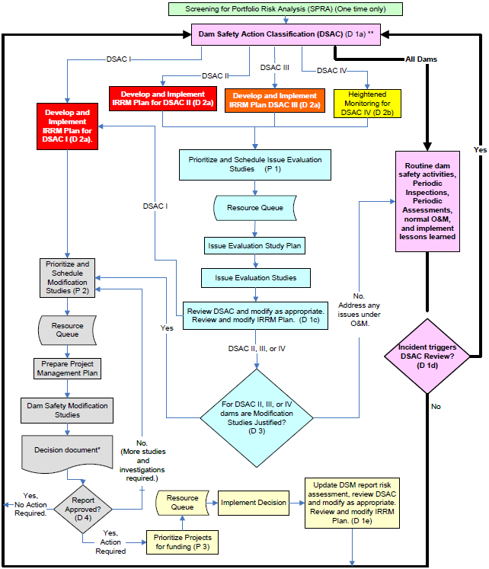
Cornerstone of the dam safety program
Note: It is important to update IRRMP any time understanding of project risk changes.
Notes:
The PA program is a routine dam safety activity that feeds the inner-loop activities.

Slide 4
Purpose of Inspections
Verify structural integrity of dam and appurtenant structures
Assure protection of human life and property
Disclose conditions which might disrupt operation or threaten dam safety in time to be corrected

Slide 5
Civil works structures whose failure or partial failure would endanger the lives of the public, cause substantial damage to property, transportation facilities, or utilities will be continuously evaluated to insure structural safety and stability, and operational adequacy.

Slide 6
Policy
Shall not be contracted
Licensed Professional Engineers
Hazard Potential reviewed/revised
Comply with PCA requirements
Inspect portions of non-Fed dams
Evaluate safety of U/S and D/S dams
Military installations
Inspections for others

Slide 7
Ancillary Benefits
Maintains institutional knowledge of project
Maintains technical expertise in dam safety
Provides lessons learned for other projects

Slide 8
INSPECTION TYPES
Operations Routine– During ordinary operations for unusual changes
Annual – In preparation for raising pool levels.
High Water – In accordance with O&M Manual.
Periodic – 5 year detailed Engineering Inspection.
Periodic Assessment – 10 year Risk Analysis of Project design and current parameters.
Special or Emergency– After major or unusual events or after report of distress.
Hydraulic Steel Structures—See ER 1110-2-8157
Notes:
There are five levels of inspections for all dams.
Daily – Conducted by the operations personnel on site.
Seasonal – Maybe conducted by either the operations staff, engineers, or both.
High Water – General the onsite operations staff; supplemented by engineering staff for extreme events.
Periodic – This is a detailed engineering inspection. The inspection is lead by the dam safety staff from district and support by the field office.
Special – These inspections occur as needed with the staff that is appropriate.

Slide 9
OPERATIONS ROUTINE INSPECTIONS
During normal operations of project, personnel should always be aware of Dam Safety items
Frequency is per O&M manual—could be daily, weekly, monthly, etc.
Conducted by Operations Personnel such as field engineers, maintenance workers, park rangers, etc.

Slide 10
ANNUAL INSPECTIONS
Once a year except during the same year as the Periodic Inspection (PI)
Conducted by Operations Personnel such as field engineers, maintenance workers, park rangers, etc., with appropriate Dam Safety engineers

Slide 11
HIGH WATER INSPECTIONS
When pools approach record levels or historical levels of concern
As pool approaches record level, project personnel inspect more frequently
If pool is expected to reach new record, Engineers are dispatched to project.
Frequency is case-by-case depending on project’s past performance, consequences, pool level, etc. Could be hourly, every 12 hours, or daily.
Prepare performance report after event

Slide 12
PERIODIC INSPECTIONS
Periodic Inspections
In addition to the visual inspection of the dam, should include the following:
Structural inspection of gates
Gate operability and capability inspection
Stilling basin inspection
Powerhouse inspection
Instrumentation inspection and evaluation including piezometers, relief wells, toe drains, settlement plates, structural instrumentation, etc.
Should include engineers from all appropriate disciplines
Geotechnical, structural, H&H, electrical, mechanical

Slide 13
PERIODIC ASSESSMENTS
Includes:
Comprehensive review of records, design, performance, etc.
Periodic Inspection
Potential Failure Mode Analysis
Semi-Quantitative Risk Assessment
Every 10 years

Slide 14
OTHER INSPECTIONS
Dewaterings
Installation of new equipment
Dam Modifications
Emergency Inspections
Report of significant distress
Report of accident
Special Inspections
After earthquakes, extreme floods, large releases and/or spillway discharges

Slide 15
Stilling basin dewatering – Dewey Lake, KY

Slide 16
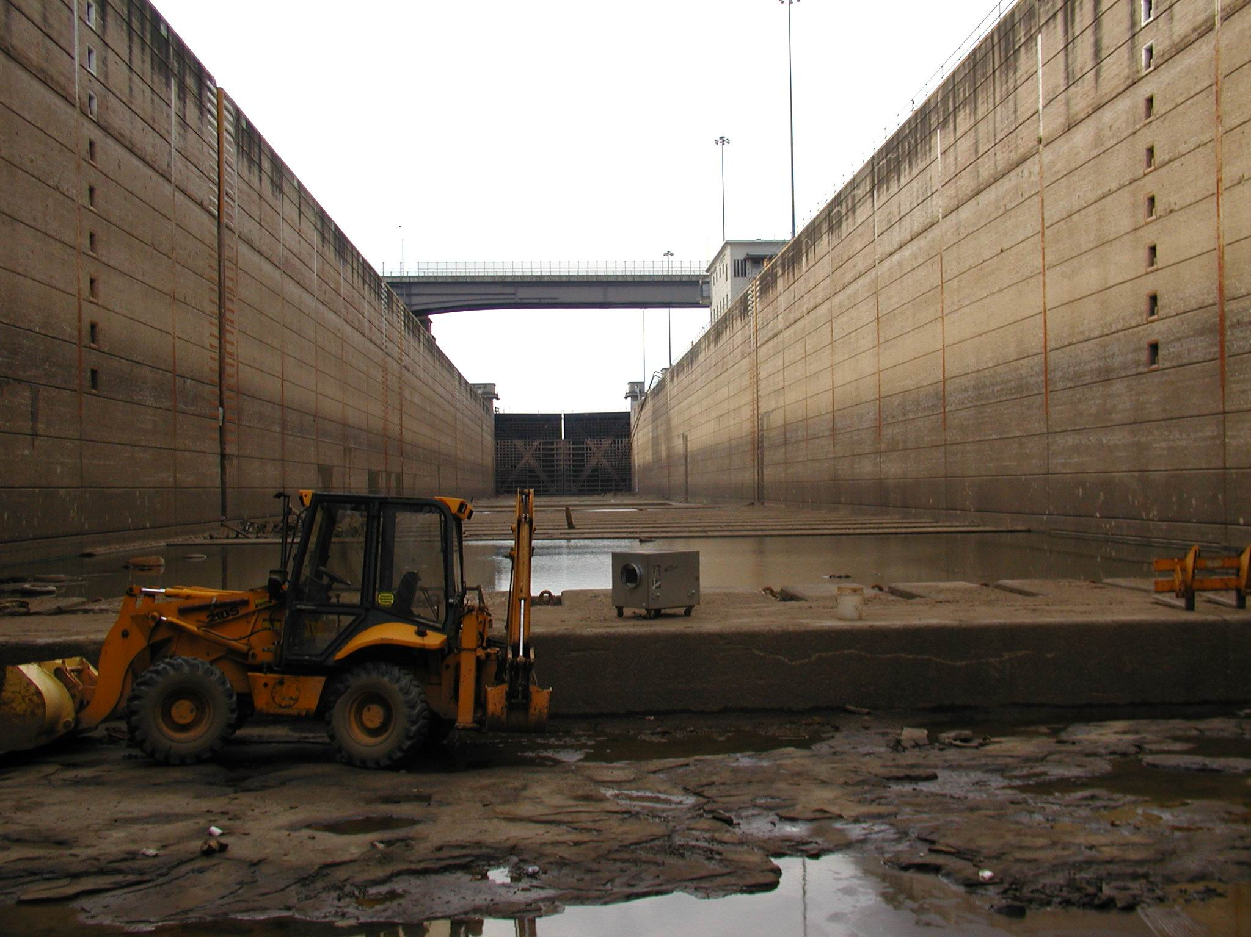
Greenup Locks and Dam – lock chamber dewatering
Lock dewatering – Greenup Locks and Dam, Ohio River - 2003

Slide 17
Special Post-Earthquake Inspections
Table 11.1 – Criteria for Post-Earthquake Inspections of USACE Dams
Earthquake Magnitude | Epicenter Distance From the Dam (Kilometers) (Inspect dam if epicenter is within this distance to the dam.)
4.5 | 16
5.0 | 80
6.0 | 120
7.0 | 200
8.0 | 320

Slide 18
FREQUENCY OF PERIODIC INSPECTIONS
New structures require more frequent inspections
Initial PI – After structure is complete but prior to impoundment
Second PI – No later than one year after impoundment is initiated
Subsequent Inspections
One year interval for next two inspections
Two year interval for next two inspections
Five years for all subsequent PI’s
Periodic Assessment every 10 years (PI with Risk Assessment)

Slide 19
Yatesville Lake - 1st inspection: March 1989 (1992, 1993, 1994, 1995, 1998,and 2003)

Slide 20
Pre-PI Procedures
Schedule and Funding
Coordinate with Ops and Programs
Notify sponsor, state, agencies
Evaluate instrumentation and monitoring data
Identify PI team and DQC team
Prepare “boiler plate”
Prepare Pre-Inspection Packet

Slide 21
Team Composition and Qualifications
Various disciplines as required
Minimum: Geotech, Structural, H&H, Ops
Others: Mechanical, Electrical
Experience and training
5 years recommended
OJT (3 previous PI), TADS, Confined Space
Team leaders must be registered PE or geologists w/ DS experience
Clerical/Admin assistance

Slide 22
Training Aids for Dam Safety
http://usasearch.fema.gov/search?query=609dvd&affiliate=fema
Preparing to Conduct a Dam Safety Inspection.
Documenting and Reporting Findings from a Dam Safety Inspection.
Inspection of Embankment Dams.
Inspection of Concrete and Masonry Dams.
Inspection of the Foundation, Abutments, and Reservoir Rim.

Slide 23
Training Aids for Dam Safety (cont’d)
Inspection of Spillways and Outlet Works.
Inspection and Testing of Gates, Valves, and Other Mechanical Systems.
Instrumentation for Embankment and Concrete Dams.
Identification of Material Deficiencies
Evaluation of Facility Emergency Preparedness.

Slide 24
Pre-Inspection Packet
Project access map, include GPS info
History of deficiencies and remedial measures
Technical summaries
Reservoir operations procedures
Written evaluation and plots of instrumentation data
Project data, layout and typical drawings
OMRR&R responsibilities
Subsurface soil profiles plots
Typical boring logs

Slide 25
Pre-Inspection Packet (cont’d)
List of project documents/engineering data
Checklists
Findings of annual inspections and status of recommended action items
Need for updating design parameters, e.g., hydraulic, seismic, structural, HSS
Summary of past performance
Summary of Bridge inspections
Status of seismic re-evaluations
Status of Hydrologic re-evaluations

Slide 26
Inspection Plan
Risk informed
Incorporate OCA
Include technical skills required, items of equipment to be operated, areas to be inspected, required support equipment
HSS
Concrete structures
Water passages
Embankments
Spillways
Instrumentation
Reservoir Rim

Slide 27
Pre-Inspection Briefing
Construction history and photos
Performance history
PFMA results
RA results
Interim Risk Reduction Measures
Results of any pre-inspections
Inspection plan
Checklists and ratings
Project staff input
Safety briefing and AHA

Slide 28
Inspection Procedures
Inspect/operate features related to safety and stability of structure and operational adequacy of project
Verify engineering data stored on site, EAP up to date and accessible, all personnel with DS training
Certain features may be inspected prior to PI, e.g., stilling basins, HSS
Notes:
Best practice: Circulate EAP and have each staff member sign off.
Where should EAPs be located?

Slide 29
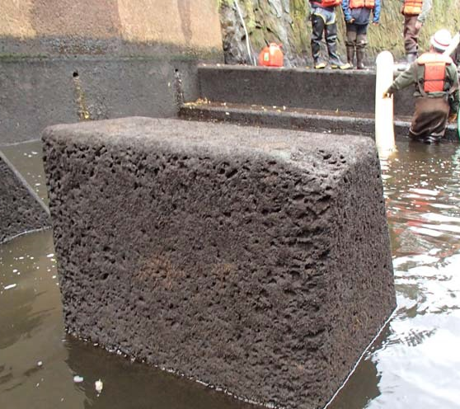
Inspections
Stilling Basins
At each PI if significant release
Diver or Hydro-Acoustic Survey
After significant release

Slide 30
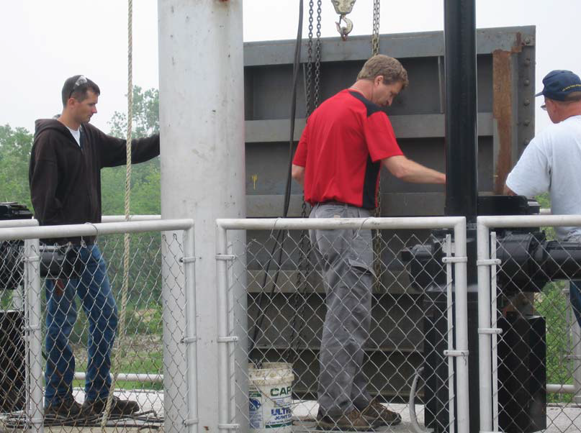
Inspections
Hydraulic Steel Structures
FCM every 5 years
All every 25 years
One of each type/PI

Slide 31
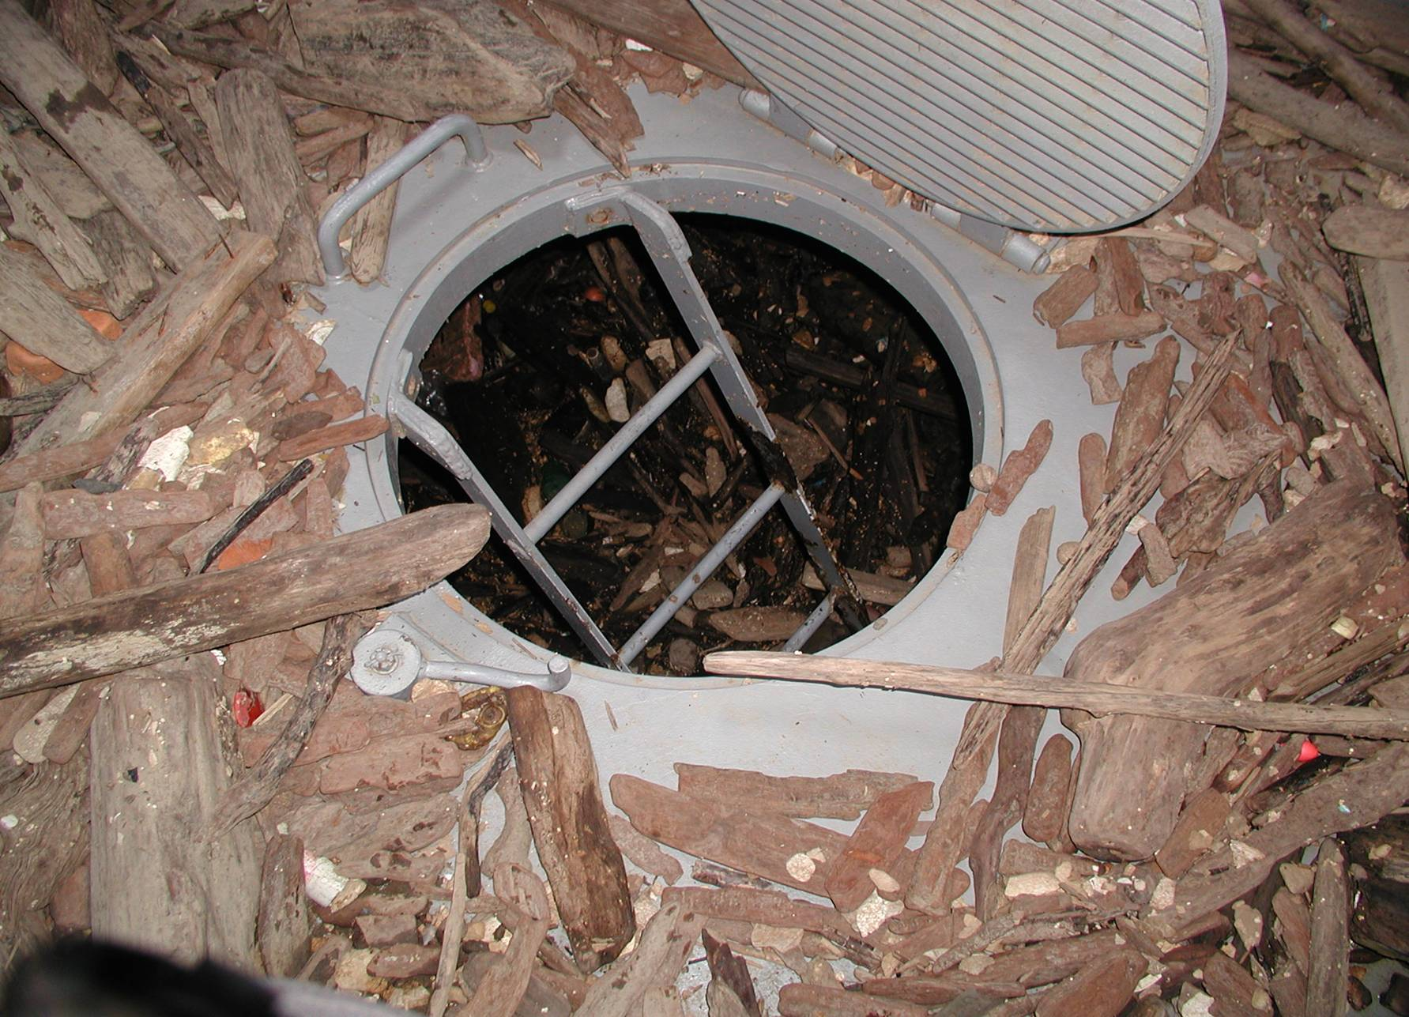
Tainter Gate Interior
Notes:
Many times tainter gates have several levels of compartments and the lower compartments get filled with debris. Debris needs to be cleaned out so that it can be properly inspected.

Slide 32
Reservoir Dams
Concrete dam or earthen embankments—All areas such as toes, abutments, crest, upstream and downstream face, etc.
Outlet Works—Intake Structure, all concrete, all gates, bulkheads, tunnel/conduit/sluices, transition area, stilling basin, outlet channel; Operate all mechanical and electrical equipment, all hydraulic equipment; Run emergency generator under load.
Spillway—All rock cuts / benches, concrete floor or sill, and walls. If a concrete chute – check all walls, chute, and stilling basin. Inspect the approach and the outlet area.
Other—Levees, pump stations, reservoir rim, etc.
Dams upstream—Assess affect and condition of upstream dam

Slide 33
Embankment - Components to inspect
Heel –upstream toe
Groin (abutment contact)
Upstream Face
Groin
Right Abutment
CREST
Left Abutment
Downstream Face
Groin
Groin
Toe

Slide 34
Grayson Lake, KY
Notes:
Got to walk the rip-rap.

Slide 35
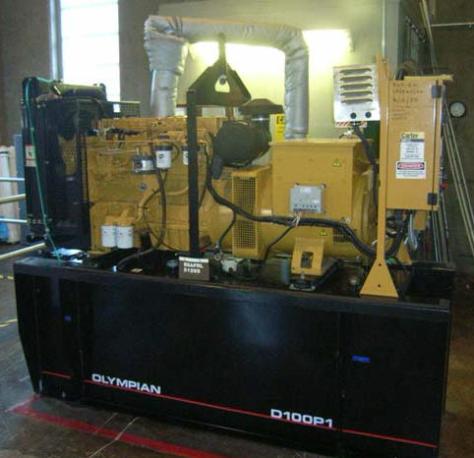
Inspection Procedures
All critical project features, including communication systems, to be operated under emergency conditions
Emergency generators tested under max power demand expected

Slide 36
Inspection Procedures
Critical water level gages will be identified and reviewed for redundancy and accuracy as an inspection item in DS inspections
Notes:
HQUSACE memo dated 15 Dec 2006: The verification that appropriate redundancy and accuracy of critical gage information is readily available for making water management and/or dam safety decisions will be included in the Dam Safety Program inspections. During the inspection, critical instrumentation will be identified and reviewed as an inspection item and discrepancies will be documented in the inspection report.

Slide 37
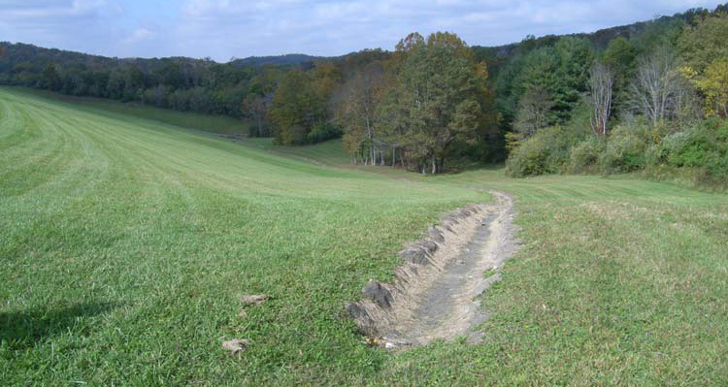
Inspection Procedures
Mark vegetation clearing limits
Mark winter, summer, and spillway crest elevations on D/S face
Notes:
Y.5.1 Mowing/ clearing limits for each dam shall be identified by dam safety
personnel within Engineering Division and documented on aerial photographs or plan
drawings, as part of the project Operations and Maintenance Manual. The limits shall be
site-specific and shall take into consideration the topography, phreatic surfaces within
the structure and abutments, foundation characteristics and any historical problems with
the structure.
Y.5.2 The horizontal limits of clearing shall not be less than the entrance width of the
spillway. In the vertical direction, no encroachment by woody vegetation of any kind can
be tolerated up to the elevation of the inflow design flood profile. Dam safety personnel
within Engineering Division shall establish specific clearing limits for spillways based on
project hydrological characteristics, and they shall be permanently and clearly marked in
the field.

Slide 38
Reservoir Rim
Ascertain if rim is still functioning as intended
Particular concern is slides
Inspect:
By boat
From adjacent areas
By air
By walking around (if reservoir is small)
Notes:
Land slides can send waves over embankment but main concern is that slide could block or damage appurtenant structures or could reduce storage..

Slide 39
Locks and Dams
All concrete portions of locks and dam - lock walls (both pool levels), galleries, crossovers, control houses, piers, bridge, etc.
All gates - tainter, roller, miter, any accessible bulkheads
Operate all equipment - cranes, start motors to all gates, run one tainter / roller gate to full open / closed, document that all dam gates will raise to full extent, filling and emptying system, miter gates, raise emergency gate in lock, set bulkhead in one gate bay of dam, run emergency generator under load
Other – riverbanks, dikes, etc.

Slide 40
Greenup Locks and Dam, Ohio River
Notes:
High ground to high ground

Slide 41
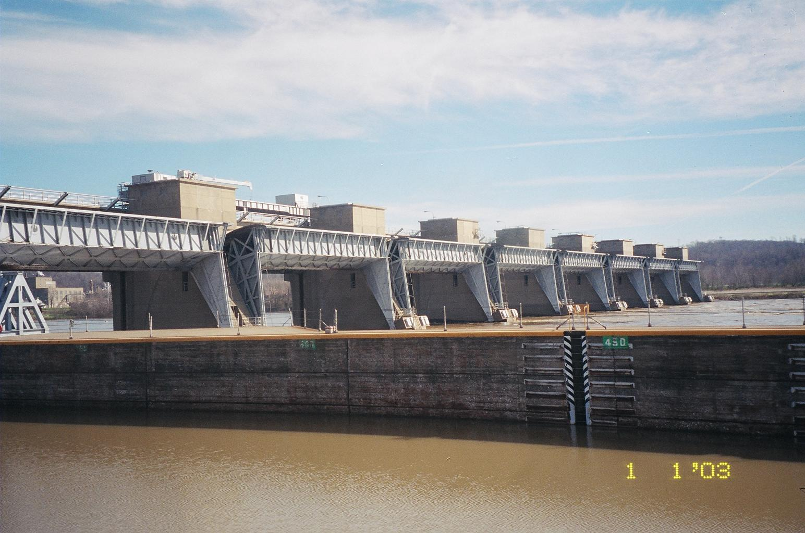
Document that all gates will raise to “full open”
High water event – Willow Island Locks and Dam

Slide 42
Post-Inspection Briefing
Project and Ops Staff present
Findings and Recommendations
Noted for record
Action items
OCA: A-F
DSPMT funding: 1-6
Evidence of distress to be reported immediately

Slide 43
Checklist and Ratings
Feature | Lead | Observations | Recommendations | Estimated Cost | Operational Condition Classification (A–F) | Action Priority (1 – 6)
Downstream Right Abutment | G
Downstream Right Abutment Ditch | G

Slide 44
Distress Signals
Evidence of Distress to Be Reported
Sloughs, settlement, or slides in embankments such as earth or rockfill dams, urban levees, and bridge abutments or slopes of spillway, channels, and dam abutments
Evidence of piping, muddy water boils in the areas of a structure such as embankments, abutments, or embankment-abutment contacts
Abnormal increase or decrease of flow from foundation drains, structural joints or relief wells

Slide 45
Distress Signals
Evidence of Distress to Be Reported
Any increase in seepage quantities through or under embankments or in abutments
Any significant change in pore-water pressure in either embankments or their foundations or abutments
Any significant change in uplift pressures under concrete structures
Unusual vertical or horizontal movement or cracking of embankments or abutments

Slide 46
Distress Signals
Evidence of Distress to Be Reported
Significant cracking of mass concrete structures, either during construction or after completion
Sinkholes or localized subsidence in the foundation of or adjacent to embankments or other pertinent structures critical to the safe operation of the project
Excessive deflection, displacement, or vibration of concrete structures (e.g., tilting or sliding of intake towers, bridge piers, training walls, or floodwalls)

Slide 47
Distress Signals
Evidence of Distress to Be Reported
Erratic movement, binding, excessive deflection, or vibration of outlet and spillway gates and large flow control valves
Significant damage to any structure (e.g., barge damage to bridge piers or lock walls or ice flow damage to intake towers and access bridge piers)

Slide 48
Distress Signals
Evidence of Distress to Be Reported
Significant damage to, or changes in, structures, foundations, reservoir levels, groundwater conditions, and adjacent terrain as a result of seismic events. Special inspections for damages should be made immediately following the seismic events.
Any other indications of distress or potential failure that could inhibit the operation of a project

Slide 49
PI Report
Uniform PI/PA report format
Omit PA sections until PA is performed
Review and reuse or revise previous PA sections
If DSAC I-III, can’t say, “Dam is in good or acceptable condition.”
Perform District Quality Control Review
Submit Executive Summary within 90 days
Submit report to MSC within 90 days
Submit searchable .pdf to ERDC library

Slide 50
Be Vigilant!
Be Safe! Essayons!

