Slide 1
Dam Safety Overview
Robert Taylor, P.E.
Regional Dam Safety Program Manager
U.S. Army Corps of Engineers
Great Lakes & Ohio River Division
Robert.E.Taylor@usace.army.mil
Dam Safety Workshop
Brasília, Brazil
20-24 May 2013

Slide 2
Corps of Engineers History
Founded in 1775
Civil Works Mission Established in 1800
First Dam Built in 1824
Newest Major Dam Completed in 2001
Nearing Completion of RCC Dam in Puerto Rico
Notes:
The Corps of Engineers goes back to Bunker Hill where the first fortifications were built.
Our Civil Works Mission was established in 1800. This year we are celebrating one of our first big projects. The Lewis and Clark expedition.
The first dam was built in 1824 to improve navigation.
Our newest dam was completed in 2001 – Seven Oaks.

Slide 3
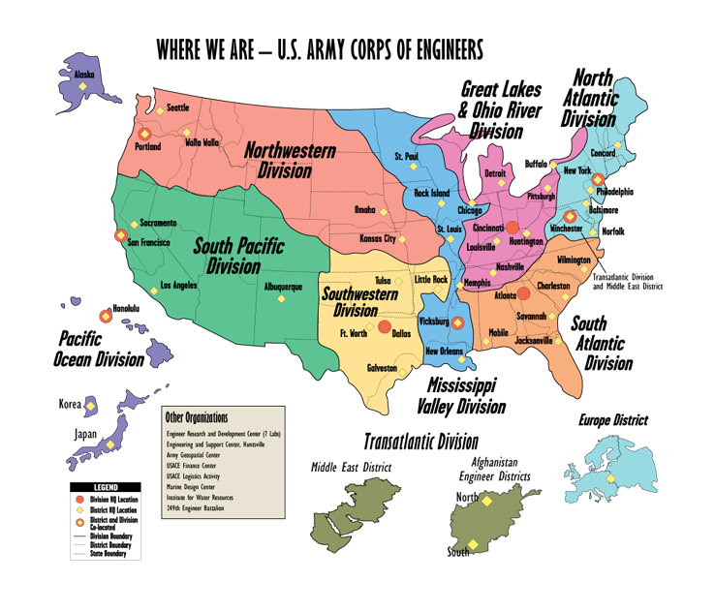
Notes:
4. DIVISION / DISTRICT BOUNDARIES
The Corps is divided into 8 divisions, 41 districts, 8 laboratories, 5 field operating activities and 2 centers.
The Great Lakes and Ohio River Division, oversees the work done by its seven districts with headquarters located at Buffalo, Detroit, Chicago, Huntington, Louisville, Nashville and Pittsburgh. Our area includes both the Great Lakes and Ohio River watersheds.
It encompasses 335,000 square miles, parts of 17 states, and 56 million people.
That means we work with 114 of Congressional colleagues and 34 Senators to give the American taxpayers the most economic and effective water resources projects.
Although we are not the largest geographic division in the Corps, we have the most subordinate districts. All 7 Districts work Civil Works missions while Louisville is the only district with both Civil Works and Military Construction responsibilities.

Slide 4
What is USACE?
HQUSACE
Organization
HQUSACE:
2%
Commander,
USACE
Division HQ:
3%
SES
06
Divisions
(8)
Engineering
R&D
Center
Centers*
(2)
FOAs
(4)
ERDC, Centers
& FOAs:
11%
Districts (41)
Military**
(31)
MILCON
(21)
Civil Works
(38)
Real Estate
(33)
OCONUS
(4)
Districts:
84%
Centers
of
Expertise
(31)
Area
Resident
Project Offices
(Approx 991)
Material
Test Labs
(1)
Civilians: 35,000
*MSC Centers=HNC,TAC **MIL=MILCON,DERP,RE FOAs=HECSA,IWR,MDC,UFC
Notes:
The Corps is a dynamic and diverse organization commanded by the Chief of Engineers and comprised of a headquarters, 8 Divisions (10 Major Subordinate Commands), 41 Districts, ERDC, 2 Centers, 4 FOAs (HECSA, IWR, MDC, UFC), and the 249th Engineer Battalion (Prime Power).
The districts contain 84% of the FTE distribution; ERDC, Centers and FOAs 11%; division headquarters only 3%; and HQUSACE just 2% of the total FTE allocation.
Currently, the Corps allocation of Full Time Equivalents (FTE) is 34,961 civilians and 610 authorized uniformed military personnel. Only 221 uniformed military are currently supported by a DA Officer Distribution Plan (ODP).
There are 41 districts. There are 21 districts with MILCON mission and an additional 10 with military work such as DERP or Real Estate.

Slide 5
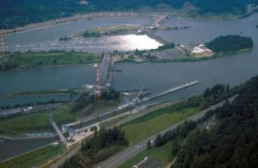
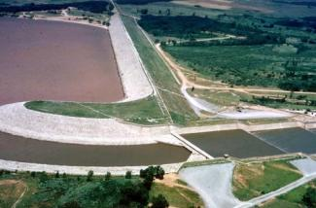
USACE Civil Works Dams
Corps owns 704 dams
embankment = 86 %
concrete = 7 %
combination = 7 %
Project purposes include: flood control,
navigation, hydropower, water supply,
fish & wildlife conservation, recreation
Average height: 112 feet
Average age: 54 years
High Hazard Potential dams: 77 %
Total storage capacity: 331 Million Ac-ft
All Corps structures, damages prevented in 2010: $28.1 billion. Average annual (2002-2010): $25.2 billion
Notes:
The Corps is in the business of owning, operating, and maintaining dams; BIG TIME. Tallest dam: Dworshak Dam, North Fork Clearwater River, ID, 717 ft.
However, our dams are getting older. Our oldest dams are over 160 years old and we have a total of 14 dams over 100 years old.
Last year the flood damages prevented were $21.2 billion. However, regardless of losses, let one of the dams fail and all the damages prevented will be forgotten.

Slide 6
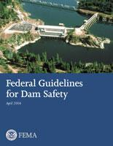
Federal Guidelines for Dam Safety
Initiated by President Carter in April 1977
Ad Hoc Interagency Committee
Published in June 1979
Provide the Standard for Federal
Agency Programs
Organization Management
Technical Management of Design
Technical Management of Construction
Technical Management of Operations & Maintenance
Notes:
The dam failure at Teton Dam in 1976 resulted in President Carter implementing a program to establish Federal guidelines to be used by all Federal Agencies involved in the design, construction, operation, and/or regulation of dams.
The guidelines were first published in June 1979 and include four main sections.

Slide 7
Army and Engineer Regulations
Military Dams
AR 420-1, Army Facilities Management
Dams covered in Chapter 7, Section VI
Civil Works Dams
ER 1110-2-1156, Safety of Dams, Policies and Procedures
Revised to include Risk Assessment and Risk Management
Combines several engineer guidance documents
http://www.usace.army.mil
Notes:
Army Installation Dams are covered by policy set in AR 420-1. Chapter 7, Section VI of that regulation deals with dams.
Civil Works Dams will be covered in a new ER 1110-2-1156, which was published in Oct 2011. This regulation has been under development for several years.

Slide 8
Current Issues
Transition to risk informed program
Safety Decision Making
Lead Engineer
Communicating Risks and Safety
Time Required to Achieve Safe Dams
Managing Consequences
Notes:
Here are some of the current issues with the Corps of Engineers Dam Safety program.
Our projects were designed and constructed based on engineering criteria of the day. As engineering profession and practice grew and matured, many of our projects don’t meet current criteria, not to mention the affects of age on the dams. Rather than merely analyzing factors of safety of various load cases, practice now uses probabilities of loading and response along with the consequences of failure also known as risk to help us prioritize our resources. This has caused a major shift in the way we look at and manage our portfolio of dams and has resulted in establishing new processes and procedures. We use the term “risk informed” instead of “risk based” because risk gives us information to aid us in our decision making rather than the risk analysis to make the decision for us. We don’t simply crank the numbers and then make decisions based on the output—we use engineering judgment informed by the risk analysis.

Slide 9
Transition to Steady State Risk Management
Screening Risk Assessments: 2005-2009
Dam Safety Action Classification 2007

Slide 10
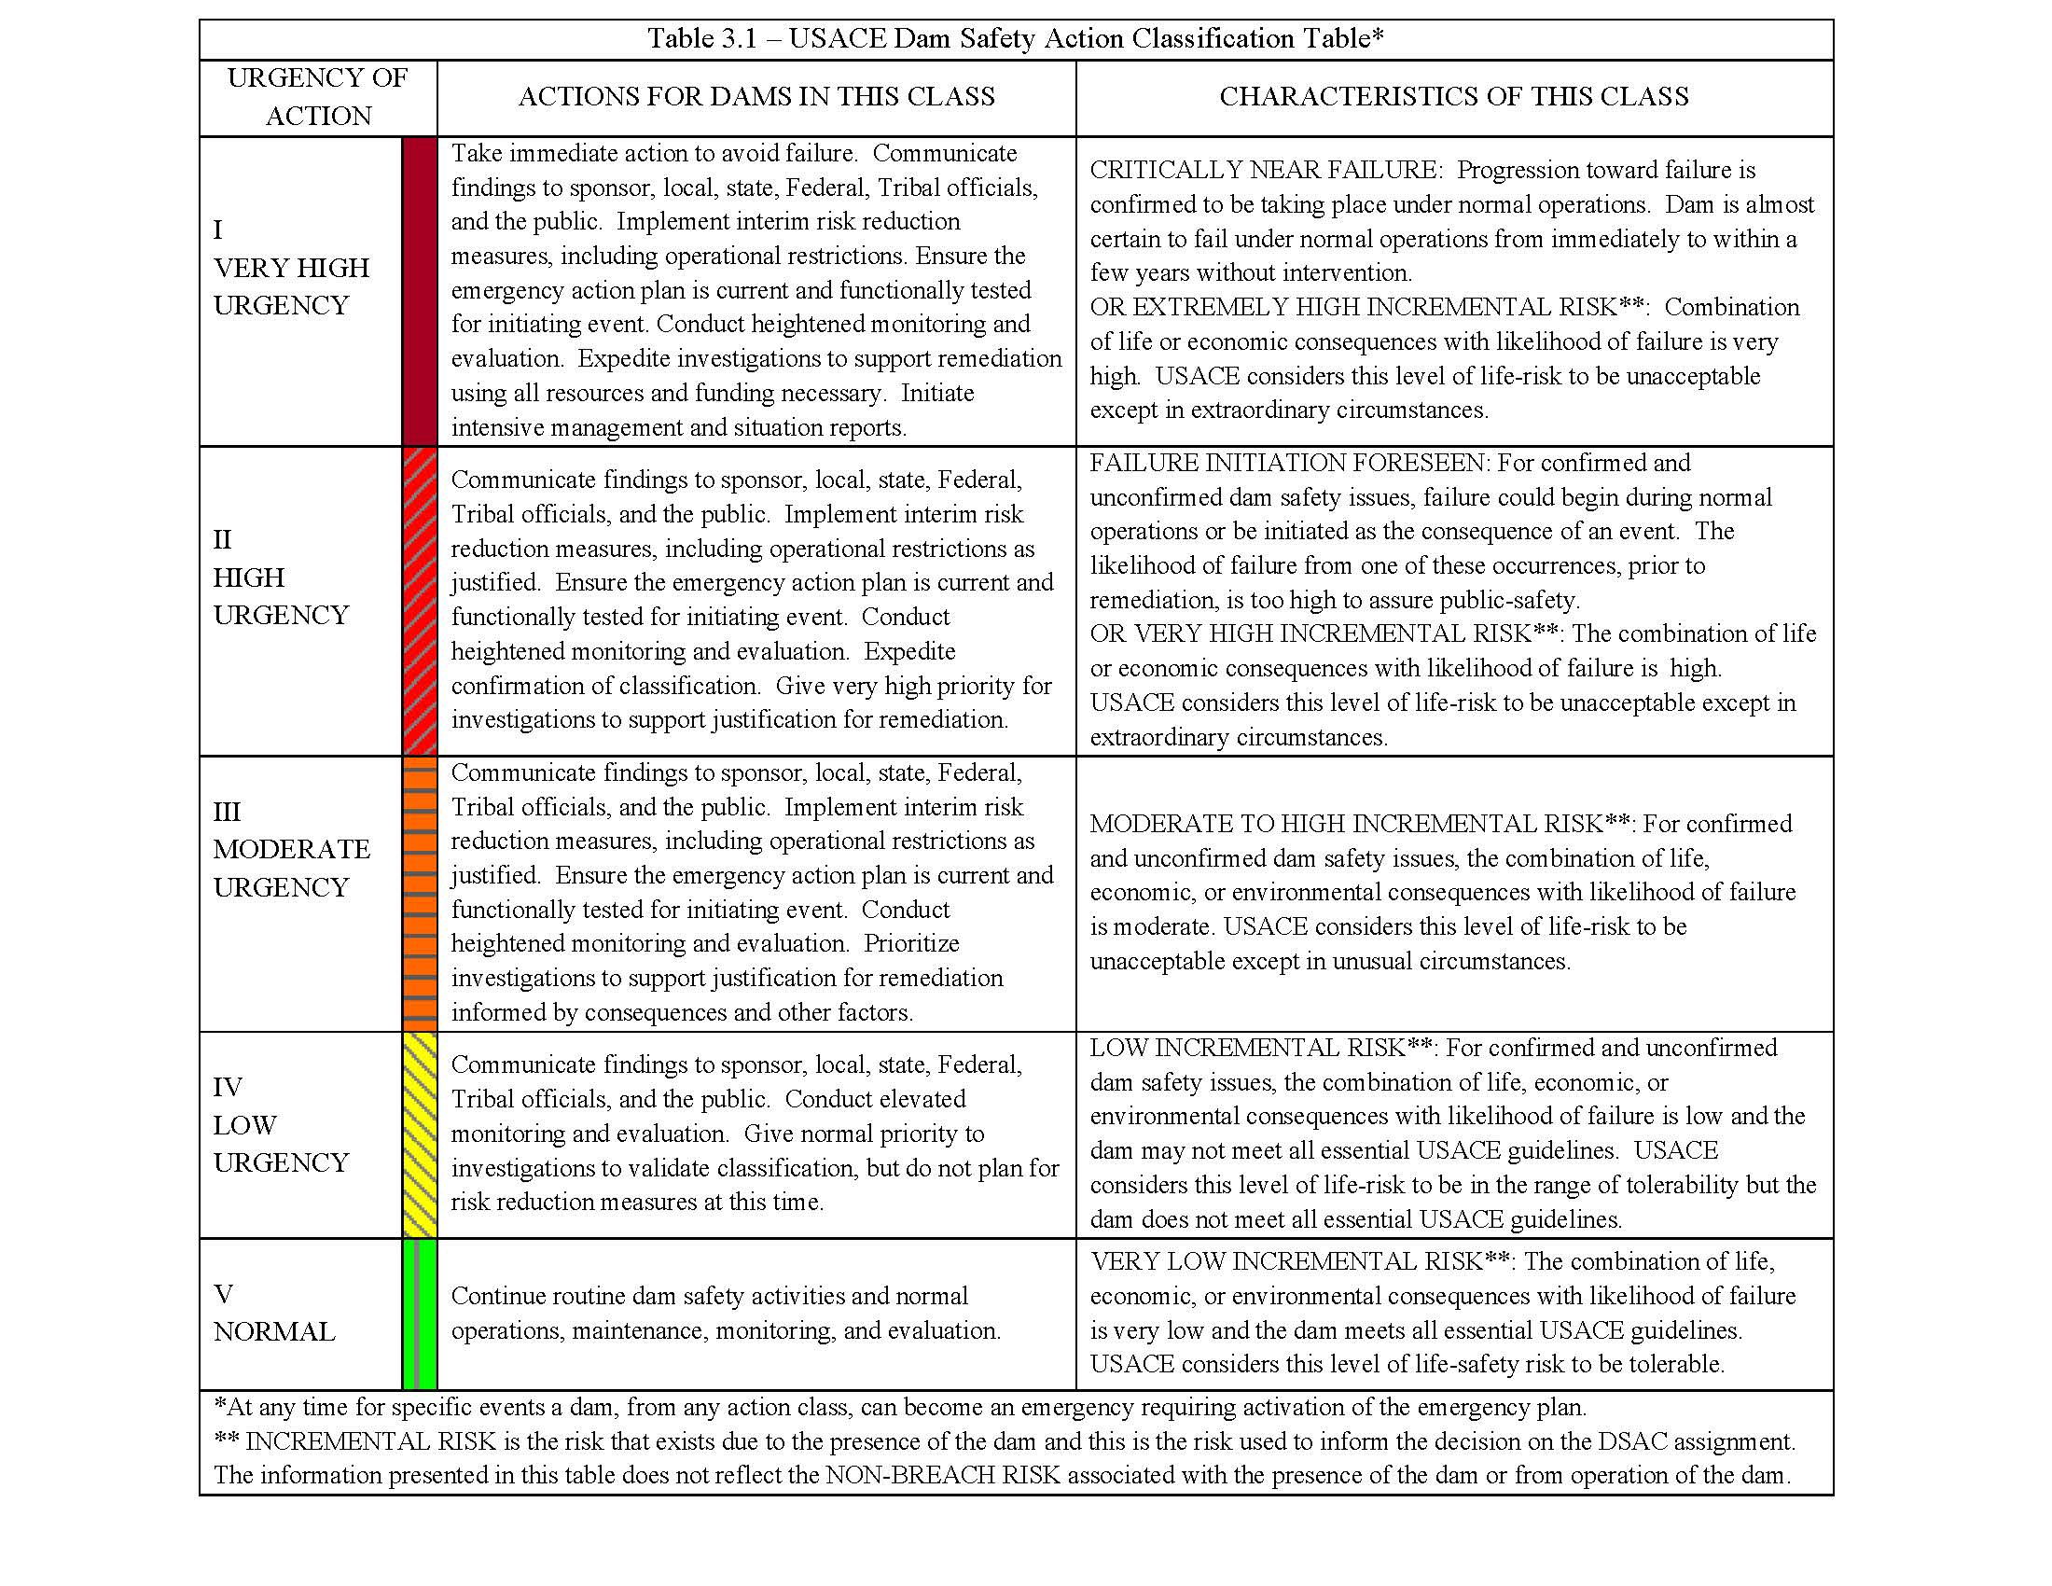
Notes:
Each dam in our portfolio was assigned a Dam Safety Action Classification number 1 thru 4 using SPRA. No 5’s were given because SPRA is such a blunt tool that we did not have enough info. The DSAC was based primarily on condition and consequences with DSAC 1 being the highest risk and “very high urgency for action”.

Slide 11
Transition to Steady State Risk Management
Screening Risk Assessments: 2005-2009
Dam Safety Action Classification 2007
Interim Risk Reduction Measures 2007
Issue Evaluation Studies 2008
Modification Reports
Periodic Assessments 2011
Comprehensive Policy (ER 1110-2- 1156) 2011

Slide 12
Safety Decision Making
Commanders:
Ultimately Responsible
Appoint Dam Safety Officers as Technical Authorities and Advisors
Make Safety Case First (1)
Consider all aspects: Safety, Political, Economic, Societal, Cultural (2)
Commanders
1
Site Specific
Judgment
Institutional
Judgment
Dam
Safety
Officers
Policies
And
Criteria
Politics
Higher
Safety
Economics
Societal
And
Cultural
2
Notes:
We are a part of the Army and each level (district, division, HQ) has commanders. They are ultimately responsible for the safety of their projects; however, realizing that many times these commanders aren’t dam engineers, they appoint and depend on Dam Safety Officers who are technical authorities and provide advise to commanders. The DSOs are to provide technical information considering life safety ahead of all other interests, some of which might be competing interests. Once the best action has been determined based on life safety, then other considerations and project purposes like economic and politics may be brought into the picture.

Slide 13
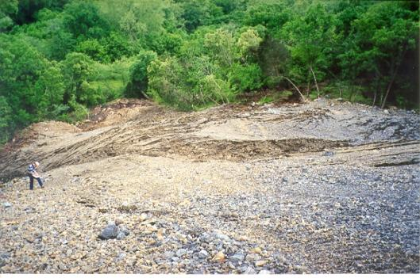
Safety in Relation to Other Project Purposes
Other Project Purposes:
Water Supply & Reallocation
Water Quality & Reoperation
Recreation & Hydropower
U/S Environmental Projects
D/S Environmental Interests
Not an “Either – Or” Proposition
Meet Safety Criteria First
Then Include Other Purposes
Notes:
On this slide you first see the failure in a road relocation fill being constructed in conjunction with a good spillway structure. This failure does not effect the safety of the dam.
It is presented as an example of pushing the envelope of the design values to the maximum in order to avoid a wetland area below the dam. The net result was too steep a slope, an failure in the slope, and damage to the wetland area anyway.
In working the EIS, FONSI, or Operating Environmental Plan, we must be careful to balance Engineering and the Environmental to avoid disasters.

Slide 14
Lead Engineer
A professional engineer, engineering geologist, or geologist, qualified through appropriate technical training and experience, assigned the responsibility to lead the technical team members of a product delivery team.
Should be same person throughout studies.

Slide 15
Communicating Risks & Safety
It is inconsistent and disingenuous to state that projects are “safe but require significant investment for repair”
As designers, constructors, and operators, engineers have a unique moral obligation to make judgments on safety because the general public does not have the experience and knowledge to do this.
Notes:
As dam engineers we must make the decisions for the public’s safety but it is also our job to communicate the risks to the public to help them understand their individual risks. All dams have some level of risk

Slide 16
What Does the Credible Owner While Deficiencies are Being Addressed? Interim Risk Reduction Measures (Chapter 7)
Our Response to Intolerable Risks within a Constrained Budget
IRRMs will be around for a long time
Notes:
Many of our dams are in DSC 1, 2, or 3, but we don’t have enough funds to go out and fix everything right now. Therefore, we have to implement measures to lower risks until they dams can be fixed with permanent measures. The term we use for this is IRRM.

Slide 17
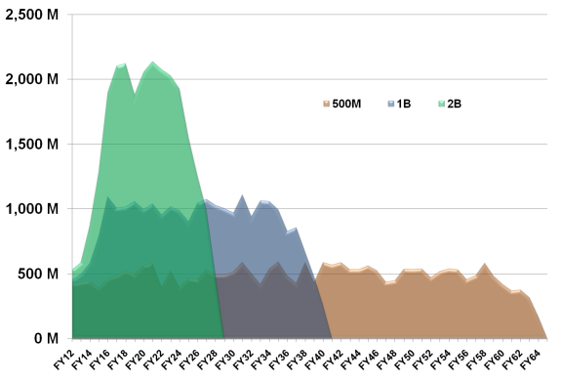
Dam Safety Investment Plan
Duration of Interim Risk Reduction Measures!
~ $26 Billion Investment to Repair 319 DSAC I, II & III Dams
Funding Scenario’s to Complete Investment:
$500M / year – 55 years (current)
$25 Billion/year in Benefits
Population at Risk is > 15 Million
Avoids $236 Billion in Direct Damages
Notes:
Based on what we found in the SPRA, we estimate that it will cost nearly $26 billion to fix the problems we know right now. We looked at various funding scenarios, $2B/year, $1B/yr, and $0.5B/yr. Right now we’re being funded close to $500 million so that will take us over 50 years to fix the deficiencies we know of today. Therefore, the IRRMs will have to stay in place for a long time.

Slide 18
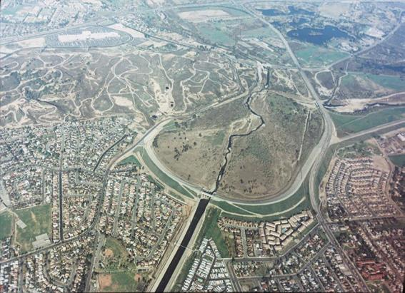
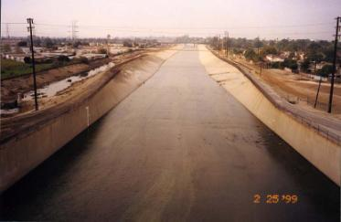
Managing Consequences: A Shared Responsibility
Development of Urban and Rural Areas
Lack of Flood Plain Management by Locals
Flood Storage to Accommodate
Uncontrolled New Development Downstream
Non-Structural Measures
EAPs & Inundation Maps
Risk Communication
Buy Outs
Notes:
Even if we’re not fixing the dam, we can do things to help manage the consequences.
Whittier Narrows Dam, Los Angeles County -- This is a dry dam with flood control storage. In the upper photograph the storage area is the only area without houses. The downstream channel is limited because it is a concrete channel.
This is only one example. Painted Rock Dam in Arizona had serious spillway erosion during a flood due to holding flows below outlet works capacity to save cabbage.
Below Oahe Dam, South Dakota, Congress has authorized a buy-out to restore channel capacity.
All dams should checked periodically for channel capacity.

Slide 19
An important action to reduce risk is:
Dam Safety Training
Notes:
An important part of any IRRM plan and a way to lower risks is to make sure your staff is fully trained in knowing what to look for and how to respond to DS issues.

Slide 20
Why Dam Safety Training?
Dams are unique structures
Must learn what is normal
Must learn to recognize problems
Know when to take action
Who takes action
What information is important
Goal is to be preemptive and avert disaster
Notes:
Dams aren’t something that fall into what we call common sense or common knowledge, and even though a person might have worked at one dam, a different project might be total different—foundation might be different, construction materials might be different, machinery might be different, a lot of factors might be different. So the training should be site-specific.

Slide 21
Who Gets Dam Safety Training?
Everybody who works with the Dam
All the Chief Inspectors
How often do you get Dam Safety Training?
Notes:
It’s important that everyone who works at the dam gets some level of training commensurate with their job.

Slide 22
What To Cover in Dam Safety Training?
Background in Dam Safety
How to recognize problems and know what is normal
Potential problems at all dams
Inspection Techniques

Slide 23
Let’s Get Specific in Dam Safety Training
How the dam is designed and how it works
Previous problems in construction and operation
Instrumentation data results
Reporting procedures

Slide 24
Attitudes to Instill in Dam Safety Training
YOU are the most important person in dam safety
Dams present some risk
Old problems never go away
New problems may require fast action
Don’t be afraid to report
Help is always available
We all need to care about Dam Safety as a crucial mission and responsibility

Slide 25
Recognize Problems
Know What To Do
Take Action
Notify

Slide 26
Resources for Dam Safety Training
Technical Literature
Films/Videotapes
The Dam itself
Training Aids for Dam Safety (TADS)

Slide 27
Dam Safety Literature
Corps of Engineers Home Page
http://www.usace.army.mil
“Find Corps Publications”
“Publications Library”
Choose the type of publication you want, there are many!!

Slide 28
Dam Safety Literature
Other Great Web Sites:
- Association of State Dam Safety Officials
http://www.damsafety.org
- U.S. Society on Dams
http://www.ussdams.org
- International Commission on Large Dams
http://www.icold-cigb.net
- Federal Energy Regulatory Commission
http://www.ferc.gov
- Dam Safety Interest Group
http://www.ceati.com/DSIG.php

Slide 29
Dam Safety Literature
More Great Web Sites:
- Federal Emergency Management Agency
http://www.fema.gov
- Mine Safety and Health Administration
http://www.msha.gov
- Natural Resources Conservation Service
http://www.nrcs.usda.gov
- Bureau of Reclamation
http://www.usbr.gov/ssle/dam_safety
- U.S. Geological Survey
http://www.usgs.gov

Slide 30
Dam Safety Literature
Associations
- International Commission of Large Dams
- United States Society on Dams
- Association of State Dam Safety Officials
Periodicals
- Hydro Review
- Dam Engineering
- International Water Power and Dam Construction
- Water Power
- Other (Civil Engineering, Water Resources Research, etc.)

Slide 31
Our Third Century Brings
Challenges:
Aging infrastructure
Shrinking budgets
Changing State of the Art
Population Growth & Climate Change
Opportunities:
New Risk-Informed methodologies
Telling the Story
Taking Risk Reduction Action
A Demand for Water
Notes:
Challenges --
Aging Infrastructure -- Must continue to push for funding to maintain and/or update
Shrinking Budgets -- Must more actively promote the program
Changing Technical Criteria -- Must balance the old with the new – tempered with logic
Opportunities --
Continue the commitment – And actively promote importance of the Program.
Recruit top-notch people -- Dam Design is becoming Dam Rehabilitation and Modernization
Seek out new ways for accomplishing the mission within aforementioned constraints.
Embrace Risk-based methods at the proper level to help emphasize importance.

