Slide 1
Issue Evaluation Studies
Robert Taylor, P.E.
Dam Safety Program Manager
Great Lakes and Ohio River Division
Brasilia, Brazil
21-24 May 2013

Slide 2
ER 1110-2-1156 Chapter 8 Issue Evaluation Studies
Purposes of Issue Evaluation Study
Justify need to pursue or not pursue Dam Safety Modification Study
Identify significant Potential Failure Modes
Review current DSAC Rating
Guide selection and gauge the effectiveness of IRRM’s
Assist with prioritization and scoping of Dam Safety Modification Studies with respect to the national USACE portfolio

Slide 3
Issue Evaluation Studies (IES)
IES are used to determine the nature of the safety issue or concern, and the degree of urgency for action.
Informs senior leaders on the significant PFM’s and incremental risk of the project
Allows for comparison of the risk with USACE Tolerable Risk Guidelines
Provides credible and consistent information for prioritizing studies and actions

Slide 4
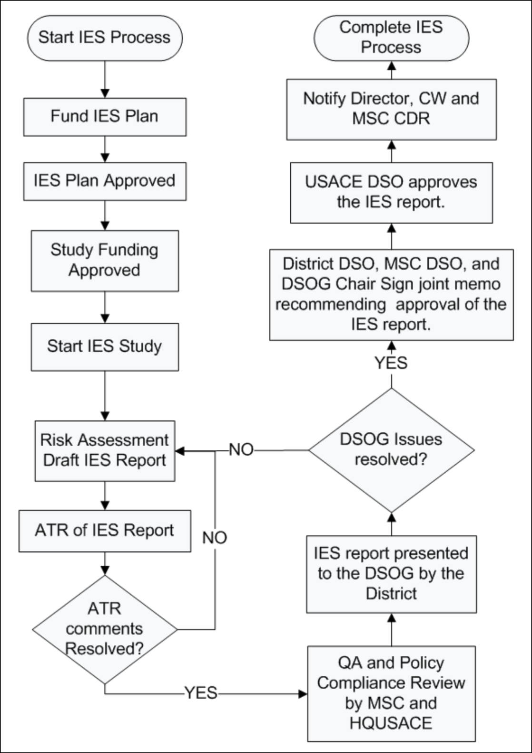
ER 1110-2-1156 Chapter 8 Issue Evaluation Studies
Study Process Flowchart
Fig 8.3

Slide 5
ER 1110-2-1156 Issue Evaluation Studies
Start IES Process
HQ and RMC have prioritized projects for IES based on SPRA results, Periodic Assessment findings, knowledge of the portfolio, and unsatisfactory performance issues that have been communicated to us.
RMC notifies the district that an IES study should be initiated and provides technical resources and funding to perform the risk assessment.

Slide 6
ER 1110-2-1156 Issue Evaluation Studies
Fund IES Study Plan
The Dam Safety and Seepage/Stability Correction Program (Wedge Funds) is the funding source for Issue Evaluation Studies.
The RMC manages the WEDGE for the HQ Dam Safety Team
Typical Project Team:
District PDT & Project Manager
RMC Senior Advisor and Technical Advisor
Regional RMC Risk Cadre
Consequence Team
Vertical Team
DSPC & DSMMCX

Slide 7
ER 1110-2-1156 Issue Evaluation Studies
IES Study Plan Approved
Contents of IES Study Plan:
Project Description and purpose
Overview of previous risk analysis, findings and reasons for current DSAC rating
Description of Dam Safety issues of concern.
IRRMs that have been implemented to address the issue(s) of concern.
Proposed scope of the effort, listing of project team members, baseline budget estimate, and baseline projecyt schedule.
Project Review Plan
Lead Responsibility for Submittal of Study Plan:
District PM and PDT

Slide 8
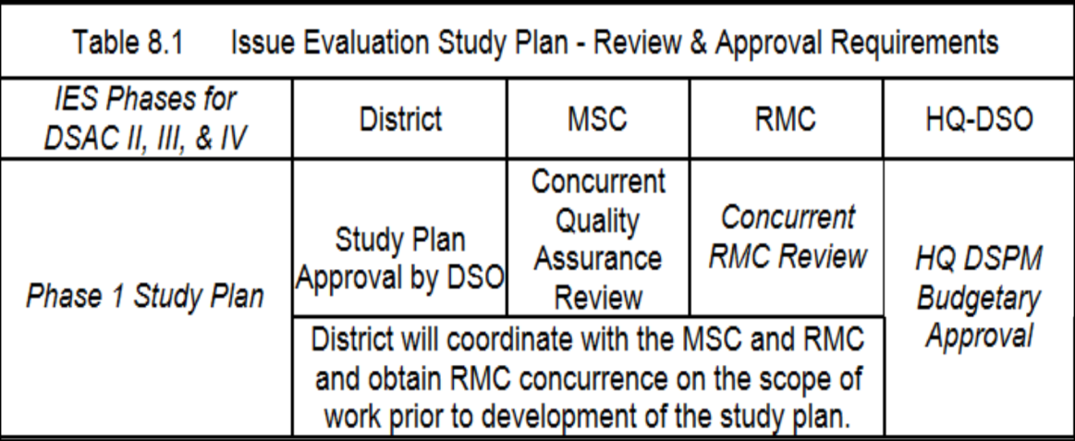
ER 1110-2-1156 Issue Evaluation Studies
IES Study Funding Approved
Submit e-copy for MSC DSO, HQ USACE DSPM & RMC review.
Upload FINAL copy of Approved Study Plan to RADS II data repository.

Slide 9
ER 1110-2-1156 Issue Evaluation Studies
Start IES Study
Phase 1 IES – Based on existing data
Phase 2 IES – Based on limited and incremental collection of additional data as needed.
Regional RMC Risk Cadre and District PDT participate in the PFMA and Elicitation Processes. A Project Operations staff member from the dam must attend the PFMA and RA activities.
The Regional RMC Risk Cadre is responsible for documentation of the risk assessment and pertinent report sections.
The District PDT is responsible for coordinating and compiling input from the project team, preparing the Issue Evaluation Report, and coordinating review activities.

Slide 10
ER 1110-2-1156 Issue Evaluation Studies
IES Study – Scope of Work
Dams with a Risk Assessment
Dams without a
Risk Assessment
Projects having a risk assessment using current guidance:
Periodic Assessment
IES / DSMS
Post Construction RA
New dam safety issue is identified
IES focuses on the new issue(s) of concern.
Project Risk Assessment is updated based on this new performance information.
Most projects do not have a risk assessment using current guidance.
IES focuses on all significant PFM’s identified during the PFMA.
Perform a Semi-Quantitative Risk Assessment. If project is judged low risk, complete Risk Assessment Report.
If failure probabilities or consequences are high, perform Quanitative Risk Assessment.

Slide 11
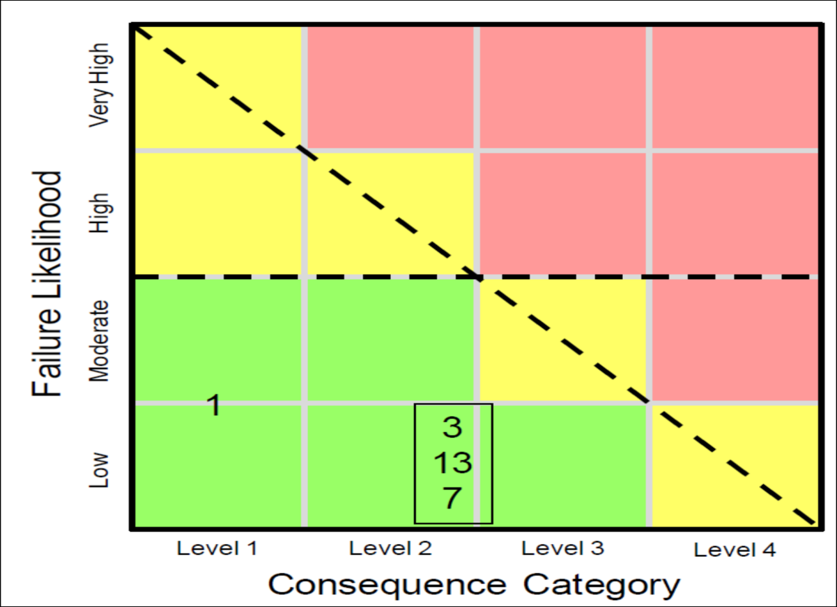
ER 1110-2-1156 Issue Evaluation Studies
Risk Assessment & Draft IES Report
Semi-Quantitative Risk Assessment uses same risk methodology as is used for Periodic Assessment.
If ALL PFM’s are believed to have a Low to Moderate likelihood of failure and result in Level 1 or Level 2 consequences, then the Issue Evaluation Study can be concluded by documenting the Risk Assessment
If ANY PFM’s are believed to have a high or very high likelihood of failure OR result in Level 3 or Level 4 consequences, then a quantitative risk assessment shall be conducted and documented in an Issue Evaluation Report

Slide 12
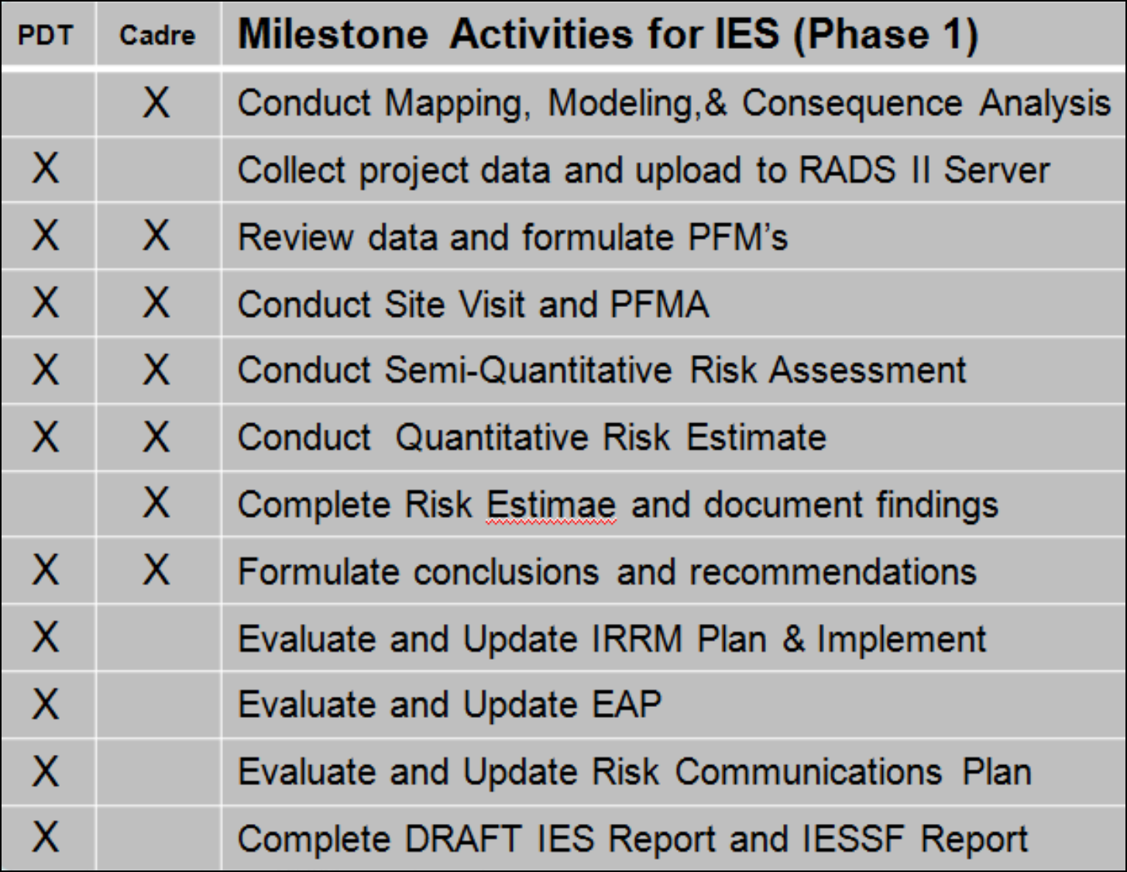
ER 1110-2-1156 Issue Evaluation Studies
Risk Assessment & Draft IES Report

Slide 13
ER 1110-2-1156 Issue Evaluation Studies
When does a IES Phase 1 become a Phase 2 ?
IES Phase 1 based on existing data and documentation.
Insufficient data may result in significant uncertainty in the Risk Estimate.
The Risk Estimate is needed to support decisions on the need for DSM Studies.
Risk Team shall conduct parametric (sensitivity) studies to determine what influence the data has on load response probabilities.
Risk Team shall evaluate what improvements in the confidence of the risk estimate can be gained by from additional expenditures of time and resources.
IES Phase II Studies are justified when it can be clearly demonstrated that the additional data or analysis will reduce the uncertainty or provide a greater level of confidence in the decision.

Slide 14
ER 1110-2-1156 Issue Evaluation Studies
How is the need for a Phase 2 effort determined ?
Decision for incremental Phase 2 requirements typically can occur at 3 different milestones.
The RMC Advisors and Risk Cadre determines during Phase 1 that there is insufficient data to compute the Risk Estimate
QCC Panel recommends additional efforts based on high degree of uncertainty in Risk Estimate.
DSOG determines if the level of confidence in the Risk Estimate is insufficient to support the recommended actions.

Slide 15
ER 1110-2-1156 Issue Evaluation Studies
IES Phase 2 Study Plans
Limited, Incremental, approach to reducing uncertainty.
District is typically responsible for performing the additional studies, analyses, and investigations based on the guidance and scope provided by the Risk Cadre.
Study Plan Addendums must be submitted by the District PM to request funding for each additional incremental level of study or investigation.
Format and content of IES Phase 2 Study Plans are identified in EC 1156; Chapter 8, Section 8.9.
Activities and actions must be fully collaborated with the RMC Risk Cadre and supported by the RMC.

Slide 16
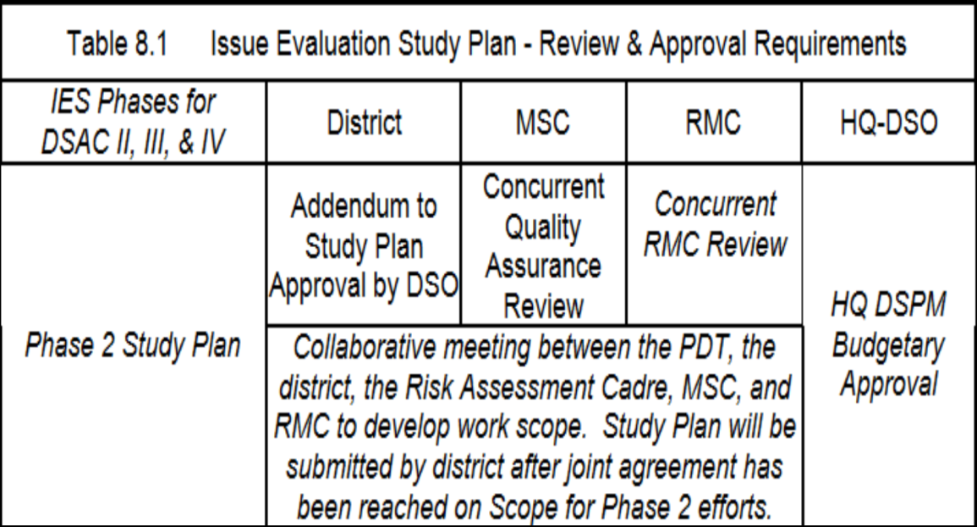
ER 1110-2-1156 Issue Evaluation Studies
IES Phase 2 Approval
Submit e-copy for MSC DSO, HQ USACE DSPM, & RMC review.
Upload FINAL copies of Approved Phase 2 Study Plans to RADS II data repository.

Slide 17
ER 1110-2-1156 Issue Evaluation Studies
Alternate IES Study Pathways
8.8.4 At anytime during the conduct of an Issue Evaluation Study, if a finding of major concern or evidence is identified requiring an “urgent and compelling” need for action, such as if the dam is judged to be in the failure continuum, the project should immediately be moved to the expedited process as outlined in Chapter 9, Dam Safety Modification Studies and Documentation.
8.11.1 Objective: …In the event that a Dam Safety Modification study is not justified, or the issues can be remediated under the major maintenance funding criteria, the Issue Evaluation Study is concluded, and project is assigned to the routine O&M processes as defined in Figure 3.1. At the minimum, a semi-quantitative risk assessment will be conducted. The IES document shall include information that provides the rationale for the decisions presented in the report and shows how this dam does or does not comply with the tolerable risk guidelines, and describes the recommended plan and why it is justified.

Slide 18
ER 1110-2-1156 Issue Evaluation Studies
Issue Evaluation Study Documentation
Flood Inundation Risk Fact Sheet
Communication tool for media and general public. (IE: public affairs pamphlet)
Issue Evaluation Study Summary of Findings (IESSF) Report
Stand alone document used to inform and assist Senior Leaders with making dam safety decisions.
Suitable for release to local sponsors, stakeholders, resource agencies, etc.
Level of detail not intended for media and general public.
Issue Evaluation Study (IES) Report
Background data
PFMA and Expert Elicitation Notes
Risk Assessment Computations
Supporting documentation for conclusions and recommendations
Used as Technical Reference for the IESSF
FOUO – Not for public release
Reference Appendix P for reporting requirements and format

Slide 19
ER 1110-2-1156 Issue Evaluation Studies
ATR Review
The Risk Management Center is responsible for coordinating and managing ATR in accordance with EC 1165-2-214.
The RMC selects ATR members, manages the review efforts using DR Checks, and funds the review activities.
QCC Reviews have been incorporated into the review process and are now conducted as part of the ATR. The reviews are typically conducted concurrently but can be separated.

Slide 20
ER 1110-2-1156 Issue Evaluation Studies
What is Quality Control and Consistency (QCC) Review ?
The Risk Management Center has implemented an internal review process to assure the quality and consistency of our Risk Assessments.
QCC Panel consists of recognized experts in the field of Risk Analysis for Dams
The ATR Lead attends the QCC discussion and is a member of the panel.
RMC Cadre Lead presents report findings and defends the recommended actions.
District DSO, DSPM, Lead Engineer, and MSC DSPM typically attend.
RMC Director and DSO determine path forward following the panel discussion.

Slide 21
ER 1110-2-1156 Issue Evaluation Studies
Quality Assurance and Policy Compliance Review
QA Review conducted by MSC and HQUSACE as per mission requirements.
Typically occurs concurrently with DSOG Review

Slide 22
ER 1110-2-1156 Issue Evaluation Studies
Dam Senior Oversight Group
(DSOG) Review
District DSO and Cadre Lead present risk assessment results, conclusions, and recommendations to the DSOG.
DSOG provides technical and policy recommendations to the HQUSACE DSO for appropriate action and DSM Study prioritization if warranted.

Slide 23
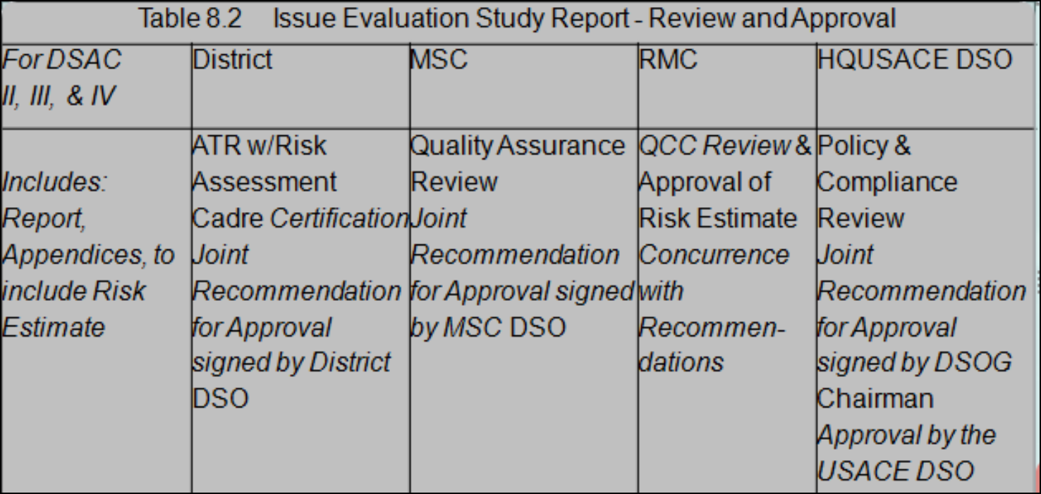
ER 1110-2-1156 Issue Evaluation Studies
Joint Approval of IES Report
District DSO, MSC DSO, and DSOG Chairman sign joint memorandum recommending approval of the IES.
USACE DSO approves the IES Report

Slide 24
ER 1110-2-1156 Issue Evaluation Studies
Notification of MSC Commander
DSOG Chair notifies the MSC Commander via formal Memorandum that the Issue Evaluation Report has been approved by the USACE DSO.
Informs MSC of change in DSAC if applicable
Identifies future actions
Note: District DSPM
Make sure any change in DSAC is reflected in the DSPMT

Slide 25
ER 1110-2-1156 Issue Evaluation Studies
Issue Evaluation Study Complete
For projects where a Dam Safety Modification Study is justified;
project is prioritized based on risk and enters study queue for DSMS funding.
Districts will be funded in advance to prepare a comprehensive Project Management Plan including a technical work plan.
Interim Risk Reduction Measures are the most important line of defense during the study, design, and construction phases.
IRRM’s are funded by O&M.

Slide 26
ER 1110-2-1156 Issue Evaluation Studies
Issue Evaluation Study Complete
For projects where a Dam Safety Modification Study is not justified;
Project DSAC is typically adjusted
Project returns to the routine Dam Safety Activity processes.
Evaluation of the residual risk and compliance with Essential Agency Guidelines should be conducted in accordance with Chapter 5.

Slide 27
Questions ?

