Slide 1
Dam Safety Inspections
Robert Taylor, P.E.
Regional Dam Safety Program Manager
U.S. Army Corps of Engineers
Great Lakes & Ohio River Division
Robert.E.Taylor@usace.army.mil
Dam Safety Workshop
Brasília, Brazil
20-24 May 2013

Slide 2
Inspections
Planning
Equipment
Inspection Procedures
Deficiency Identification
Documentation
Notes:
Getting away from specifically HSS and moving to inspection of all structural items, preparation for inspections includes proper planning, stc.

Slide 3
Planning Inspections
Review Previous Inspection Reports
Review Stability
Review Materials Data, Construction Records, Operations Records, Maintenance Records,
Review Instrumentation Data, Crack Survey
Prepare Checklist

Slide 4
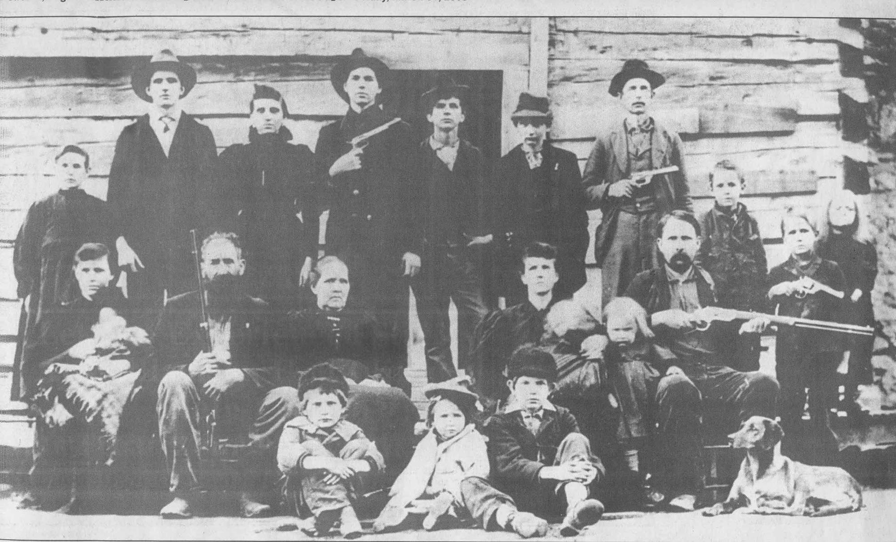
Inspection Team
Notes:
Assemble team appropriate for inspection.

Slide 5
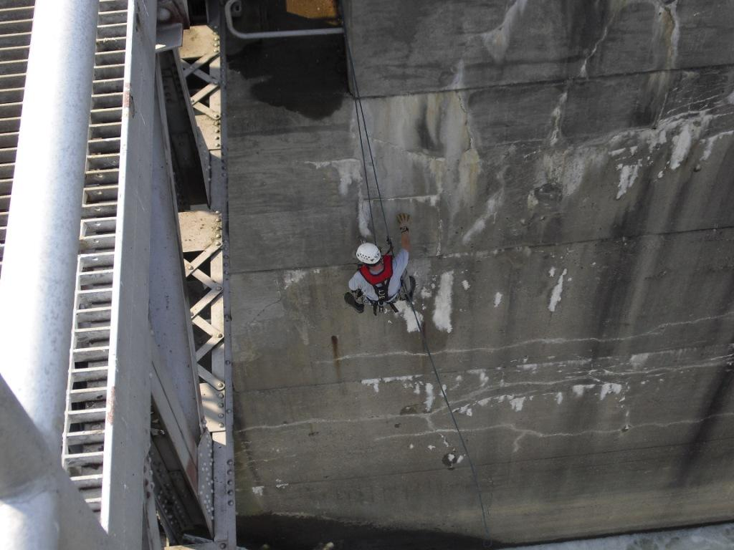
Service Bridge
Notes:
Climb teams can be used to inspect piers and other otherwise inaccessible areas.

Slide 6
Inspection Equipment
Safety Gear, Climbing Harness
Rain Gear, Rubber Boots
Rock Hammer, Pocket Knife, Probe
Flashlight
Field Glasses
Camera
Measuring Tape, Crack Gauge
Crack Survey, Checklist, Notebook
Remotely Operated Vehicle
Notes:
Field glasses can help with visual inspections of inaccessible items.

Slide 7
Inspection Procedures
Talk to Project personnel
Sight from distance & along alignment
Hands On (Up Close and Personal)
Systematic, Thorough
Visual, Sound, Smell, Touch
Safety First!
Notes:
Ops personnel can give important info that can aid you in inspection.

Slide 8
Documentation
Keep it SMPL
    Sketch the deficiency
    Measure the deficiency
    Photograph the deficiency
    Locate the deficiency
Notes:
To locate deficiency, identify monolith numbers.

Slide 9
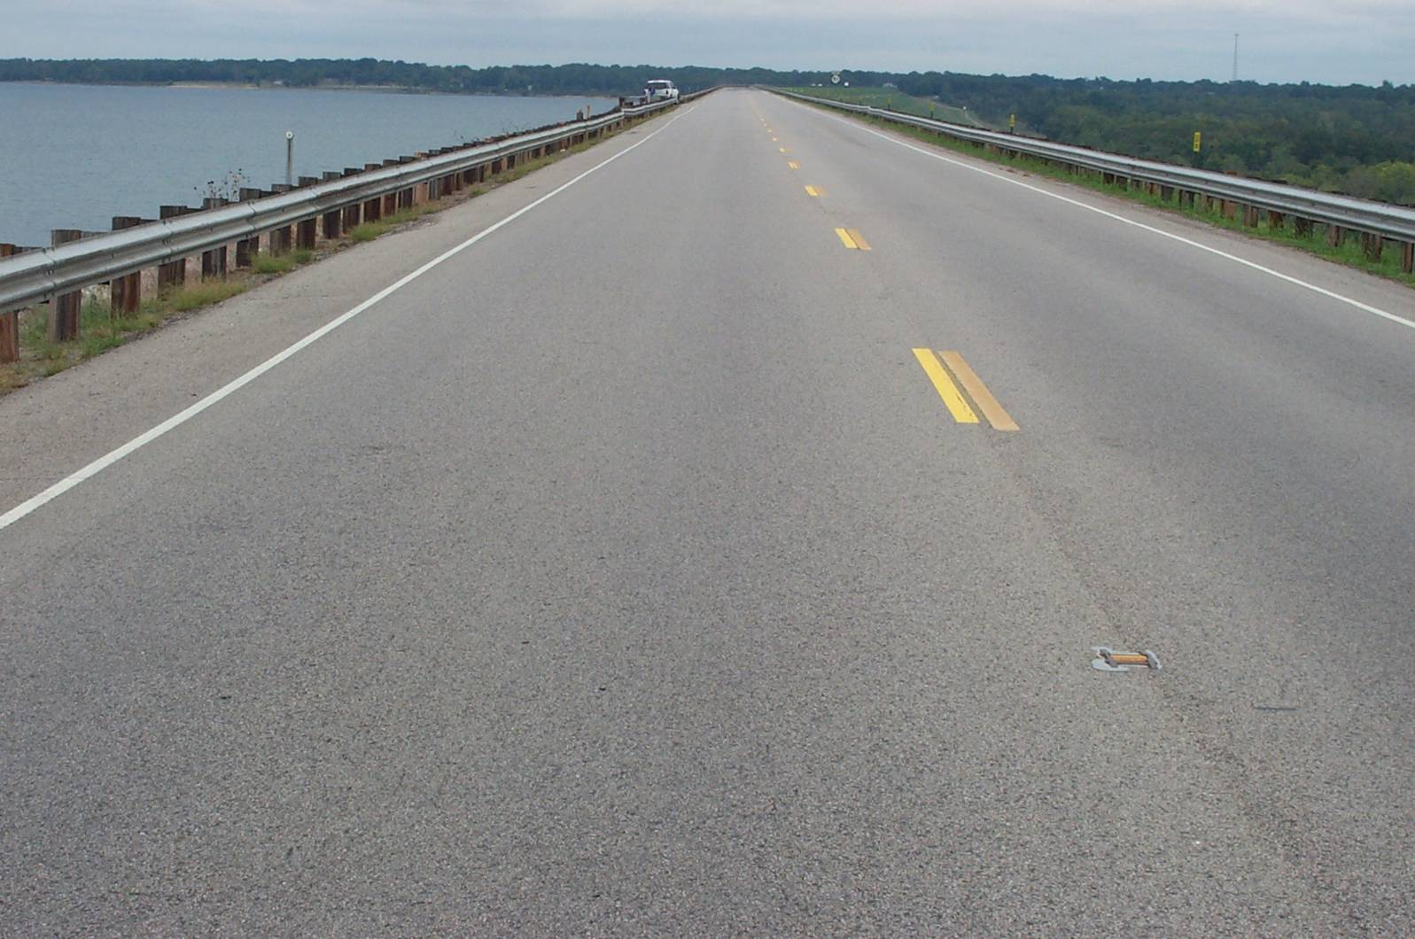
Crest

Slide 10
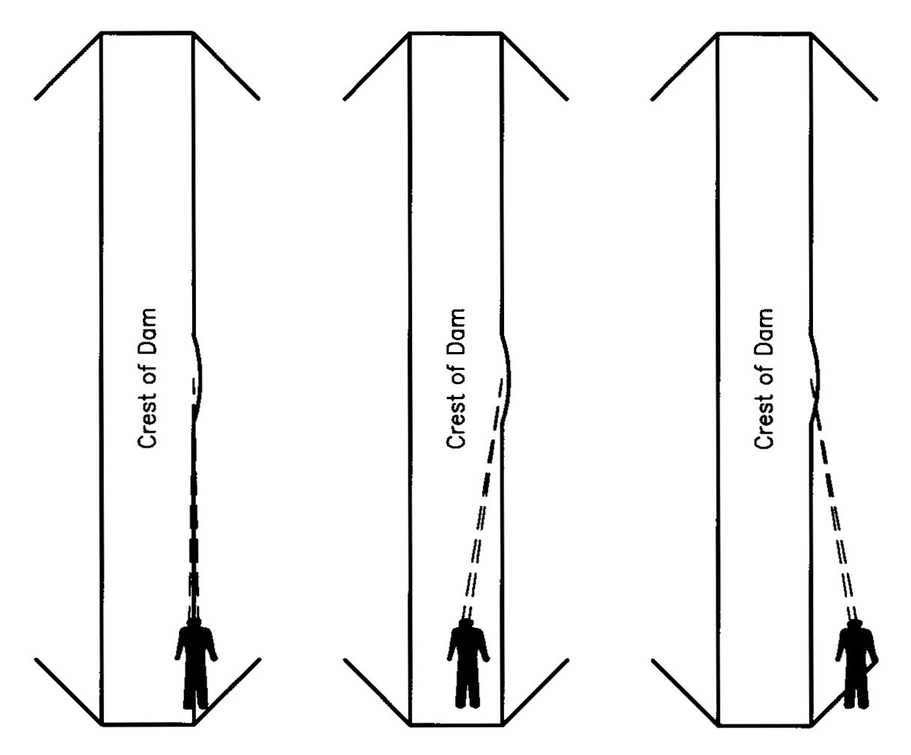
Sighting Crest for Movement

Slide 11
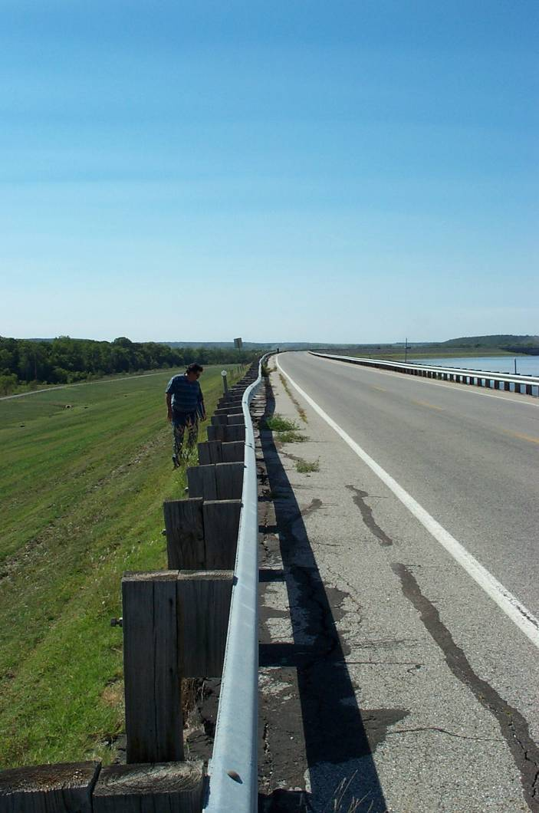
Sight along Guardrails

Slide 12
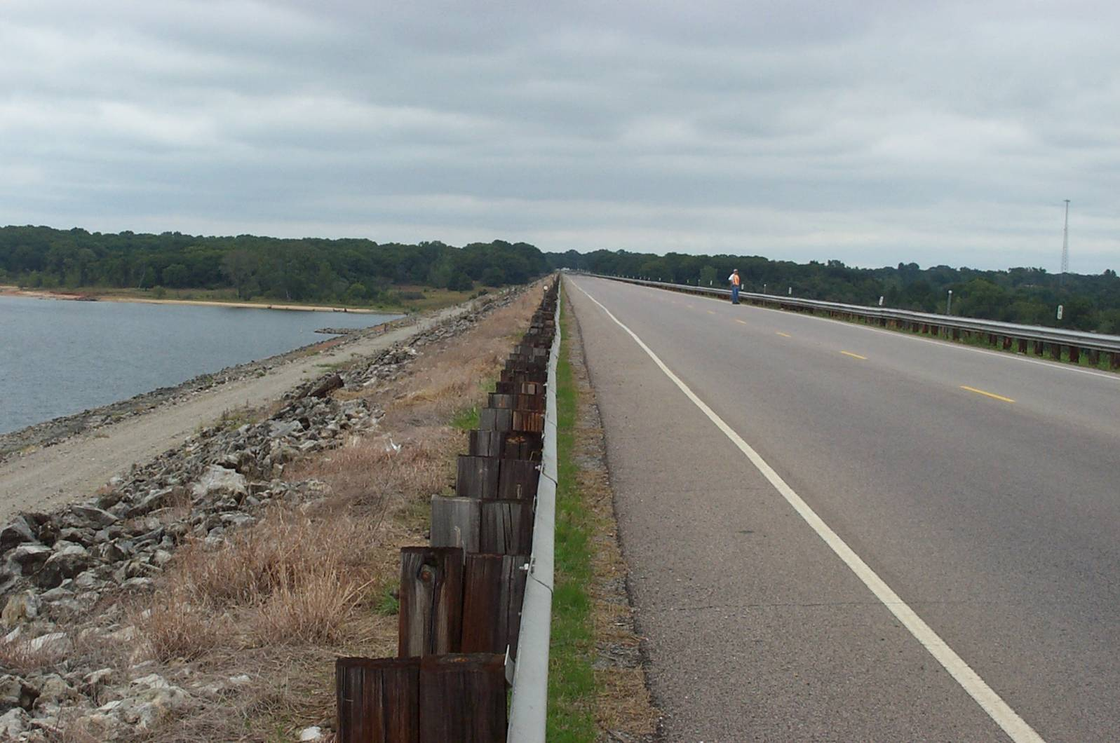
Upstream Slope and Crest

Slide 13
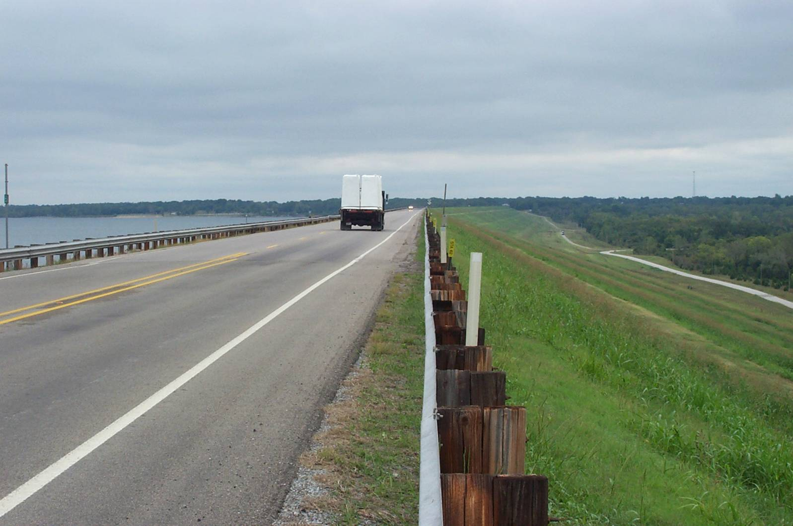
Downstream Slope and Crest

Slide 14
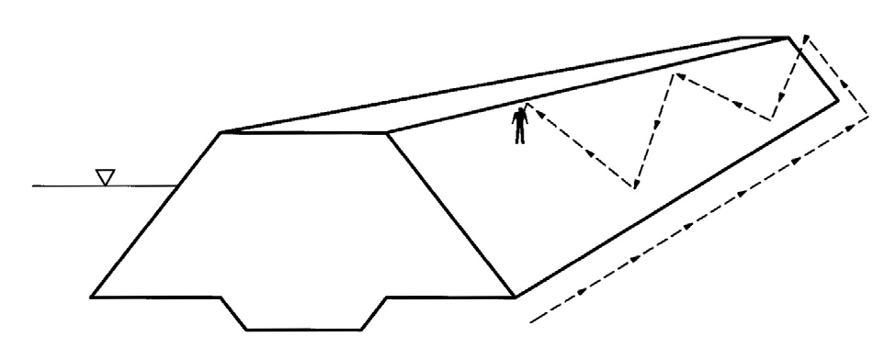
Zig-Zag Pattern of Inspecting Slope
Notes:
Good for short dams and slopes not too steep.

Slide 15
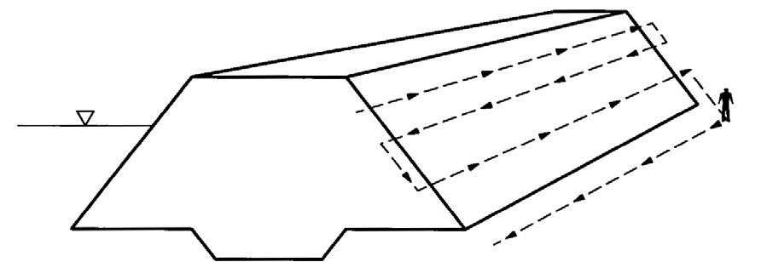
Parallel Pattern of Inspecting Slope

Slide 16
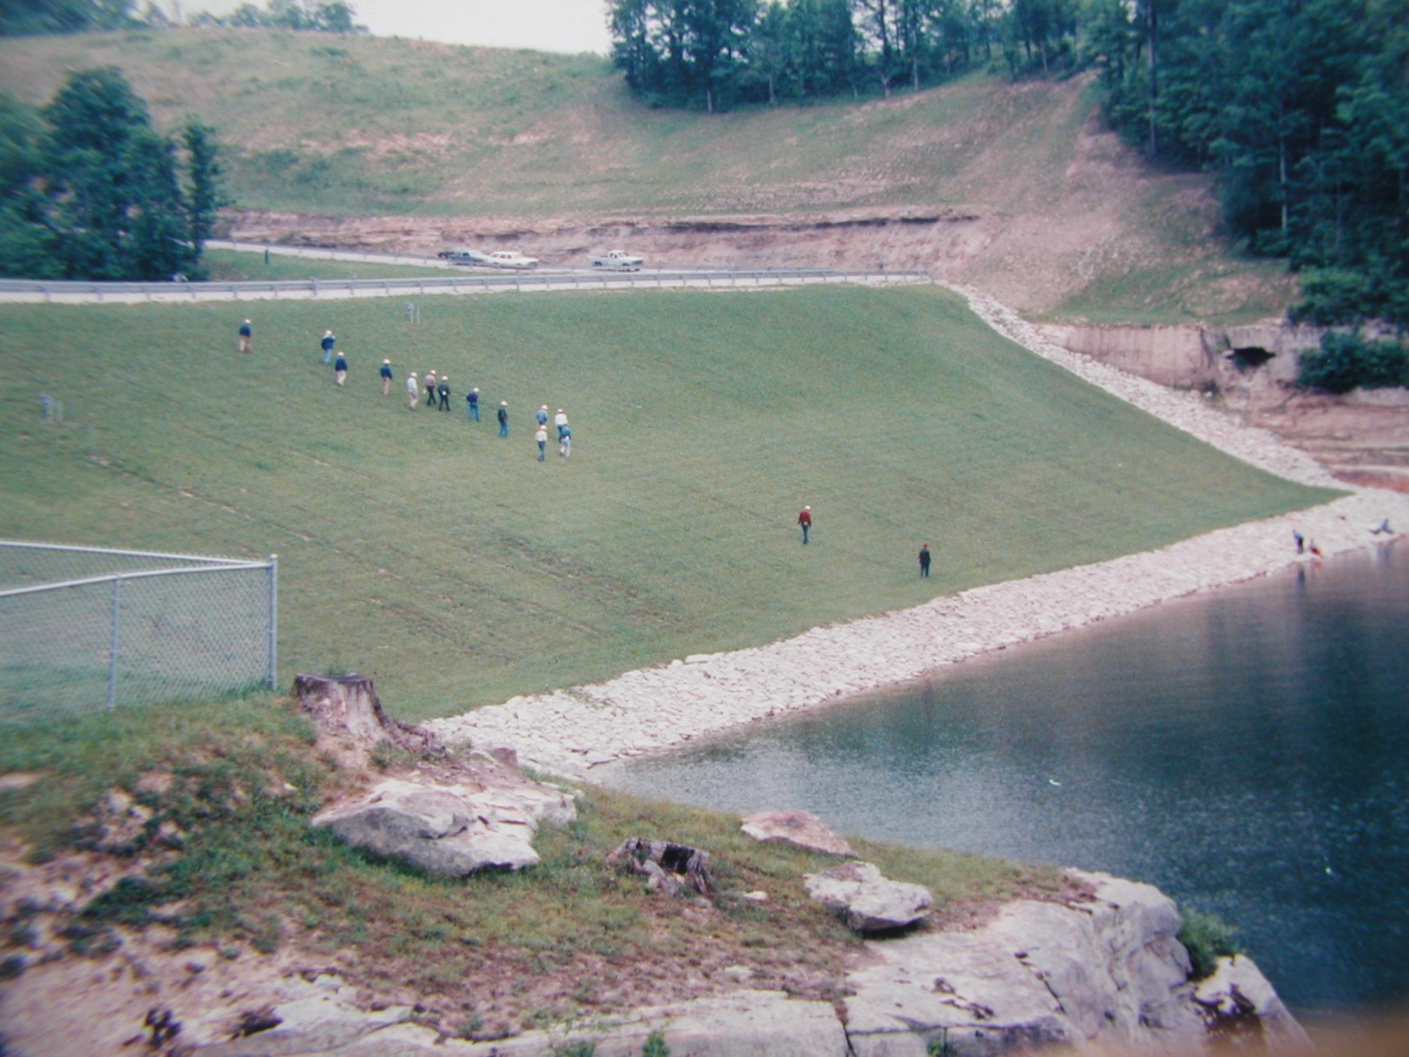
Slope Inspection

Slide 17
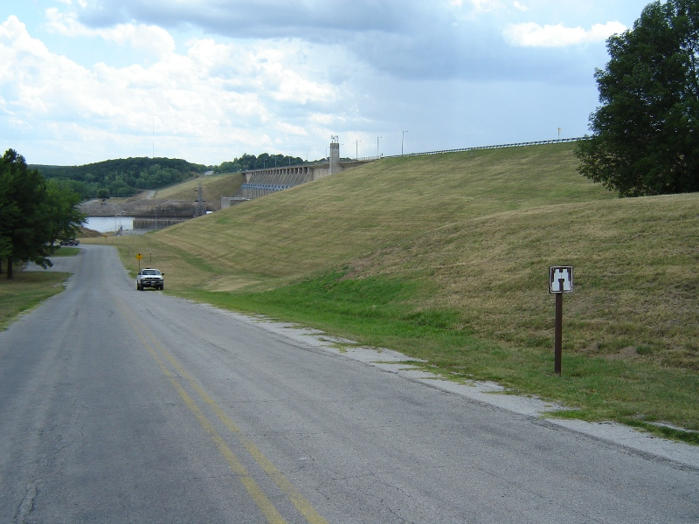
Abutment Seepage
Notes:
Note green grass (seepage in D/S left abutment.)

Slide 18
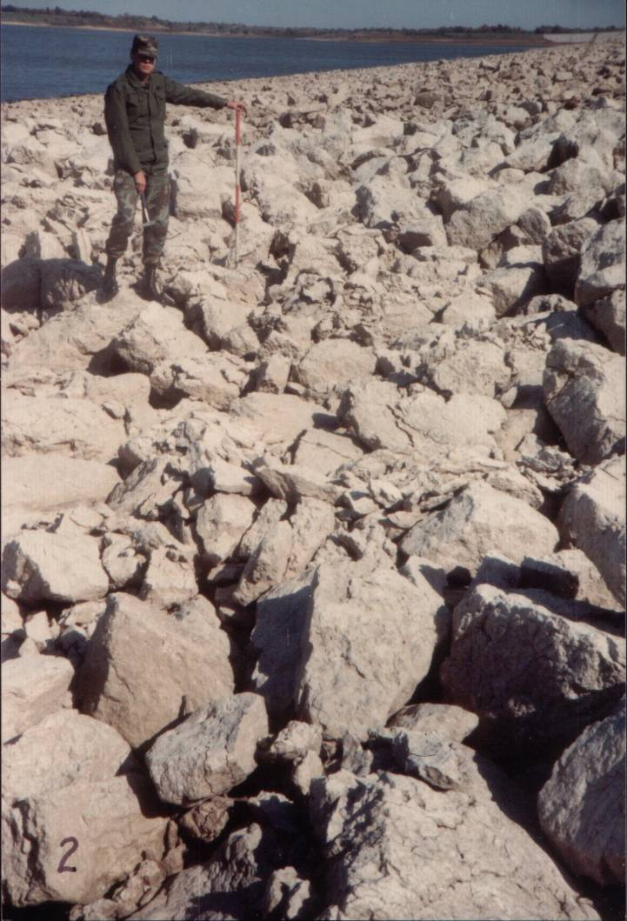
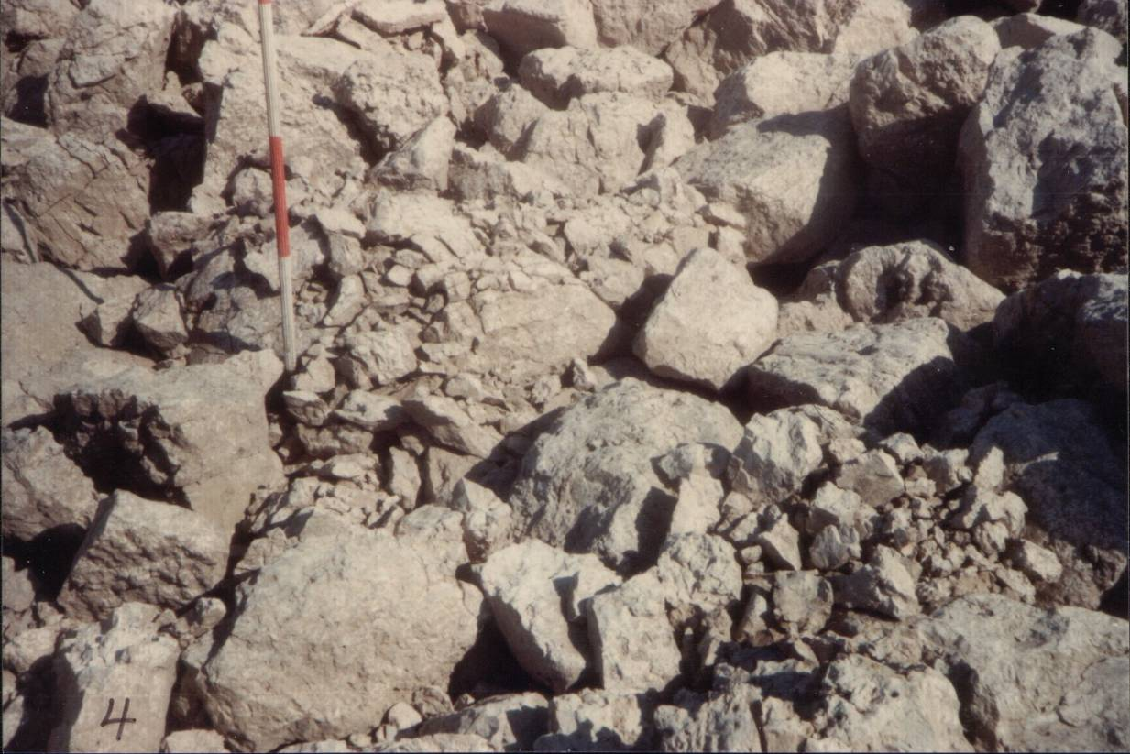
Rip Rap Deterioration

Slide 19
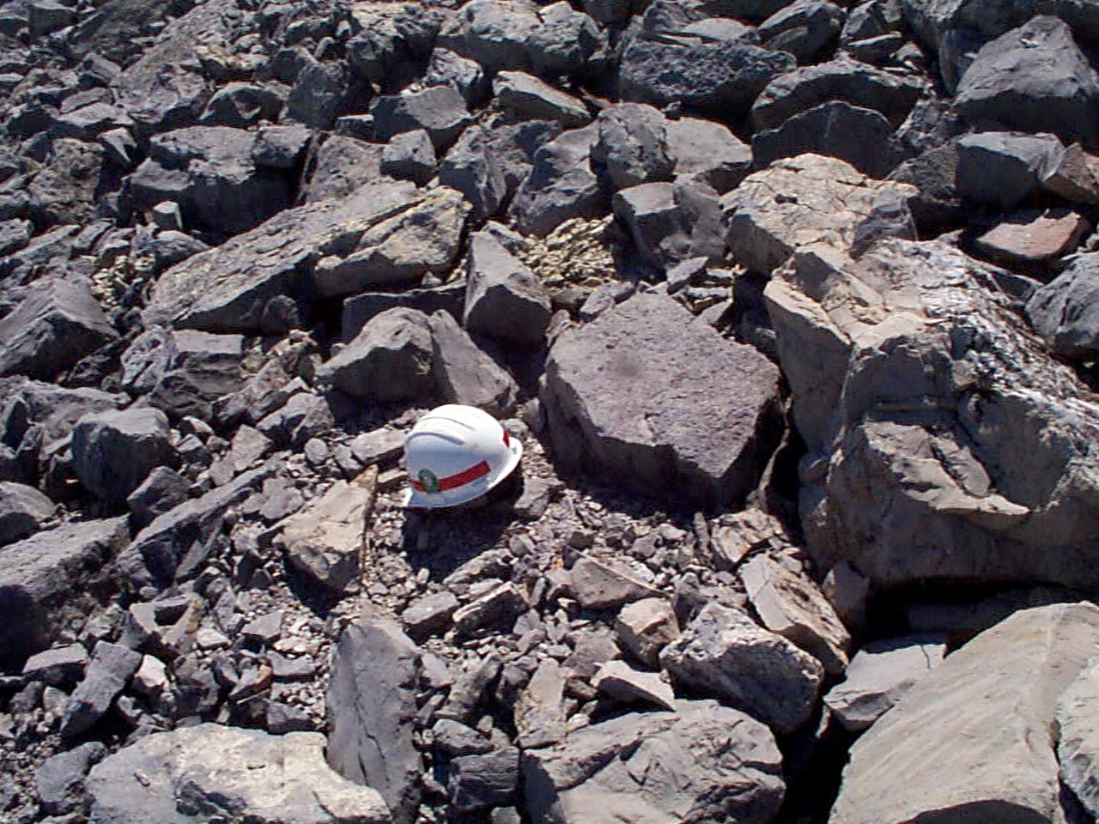
Rip Rap Deterioration

Slide 20
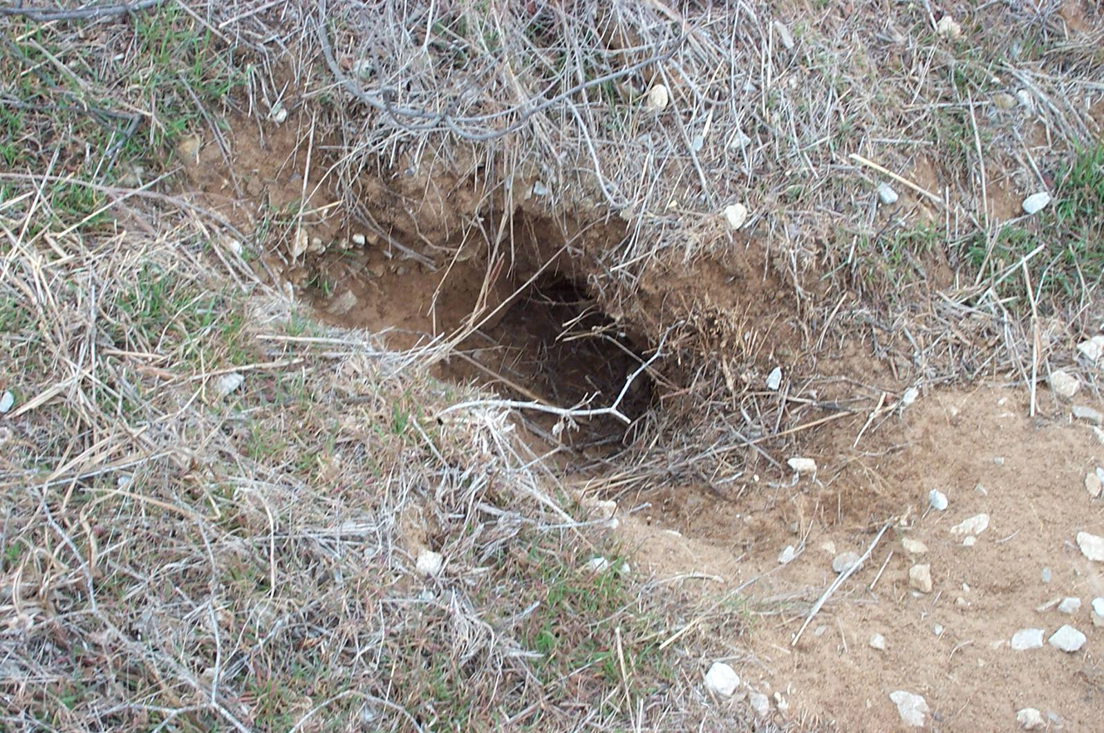
Rodent Holes

Slide 21
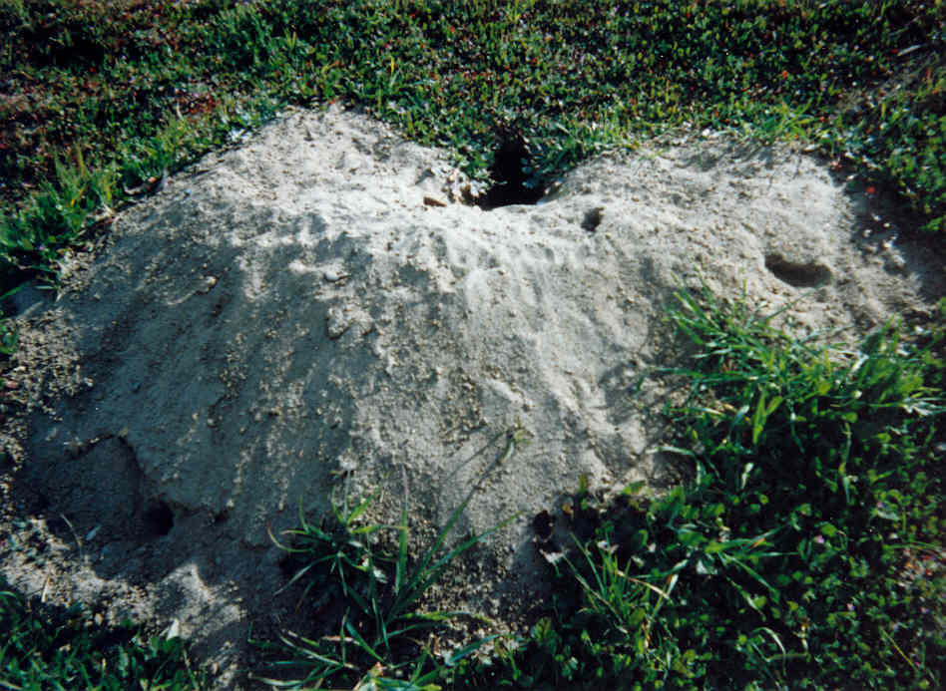
Rodent Holes

Slide 22
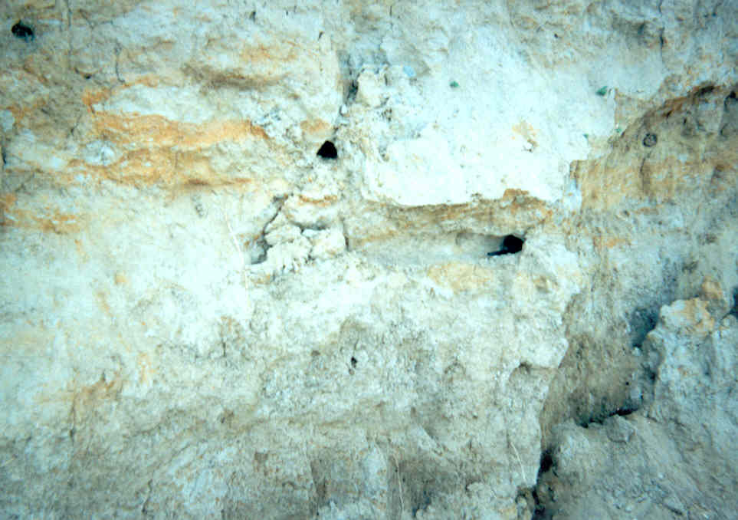
Rodent Holes

Slide 23
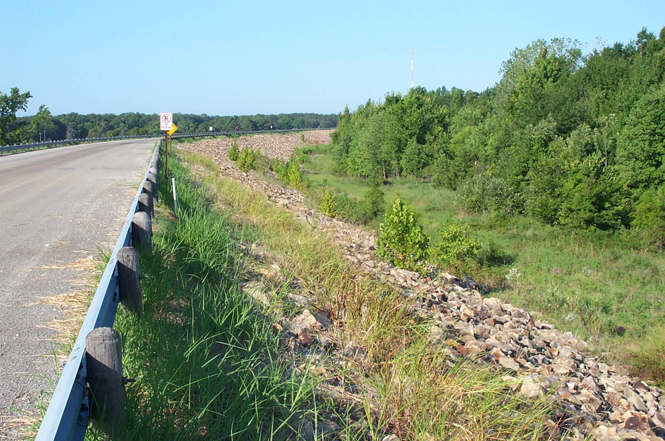
Tree Growth on Embankment

Slide 24
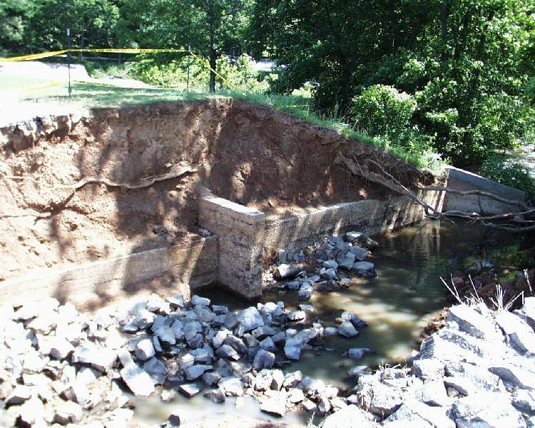
Tree Growth on Embankment

Slide 25
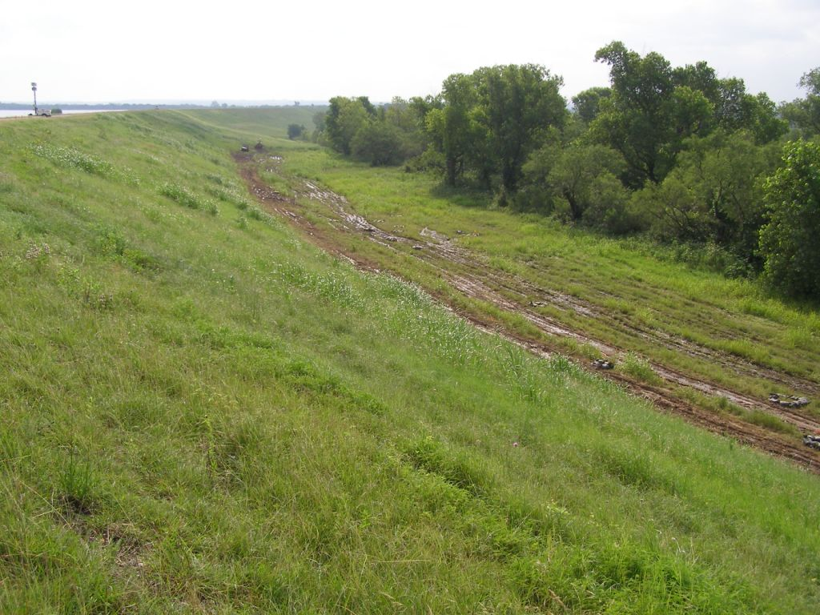
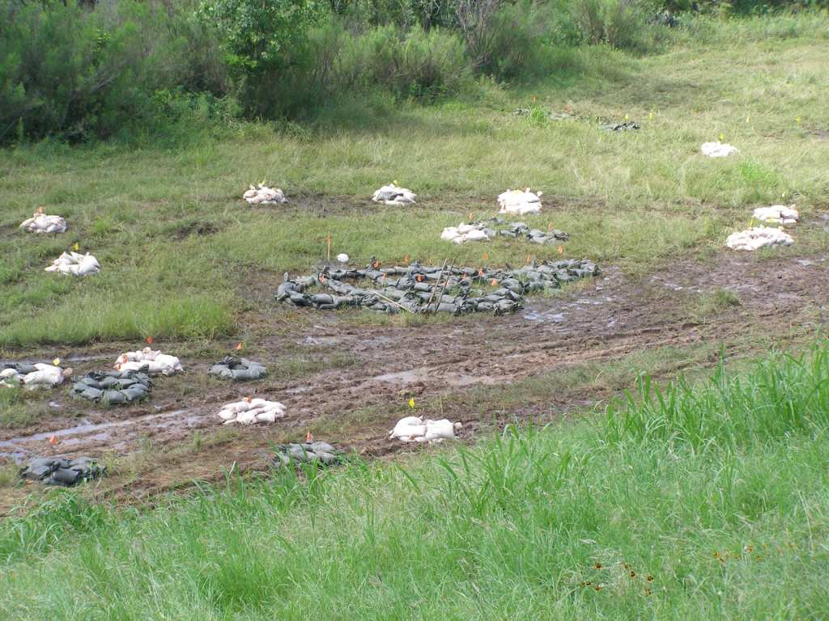
Access to D/S Toe

Slide 26
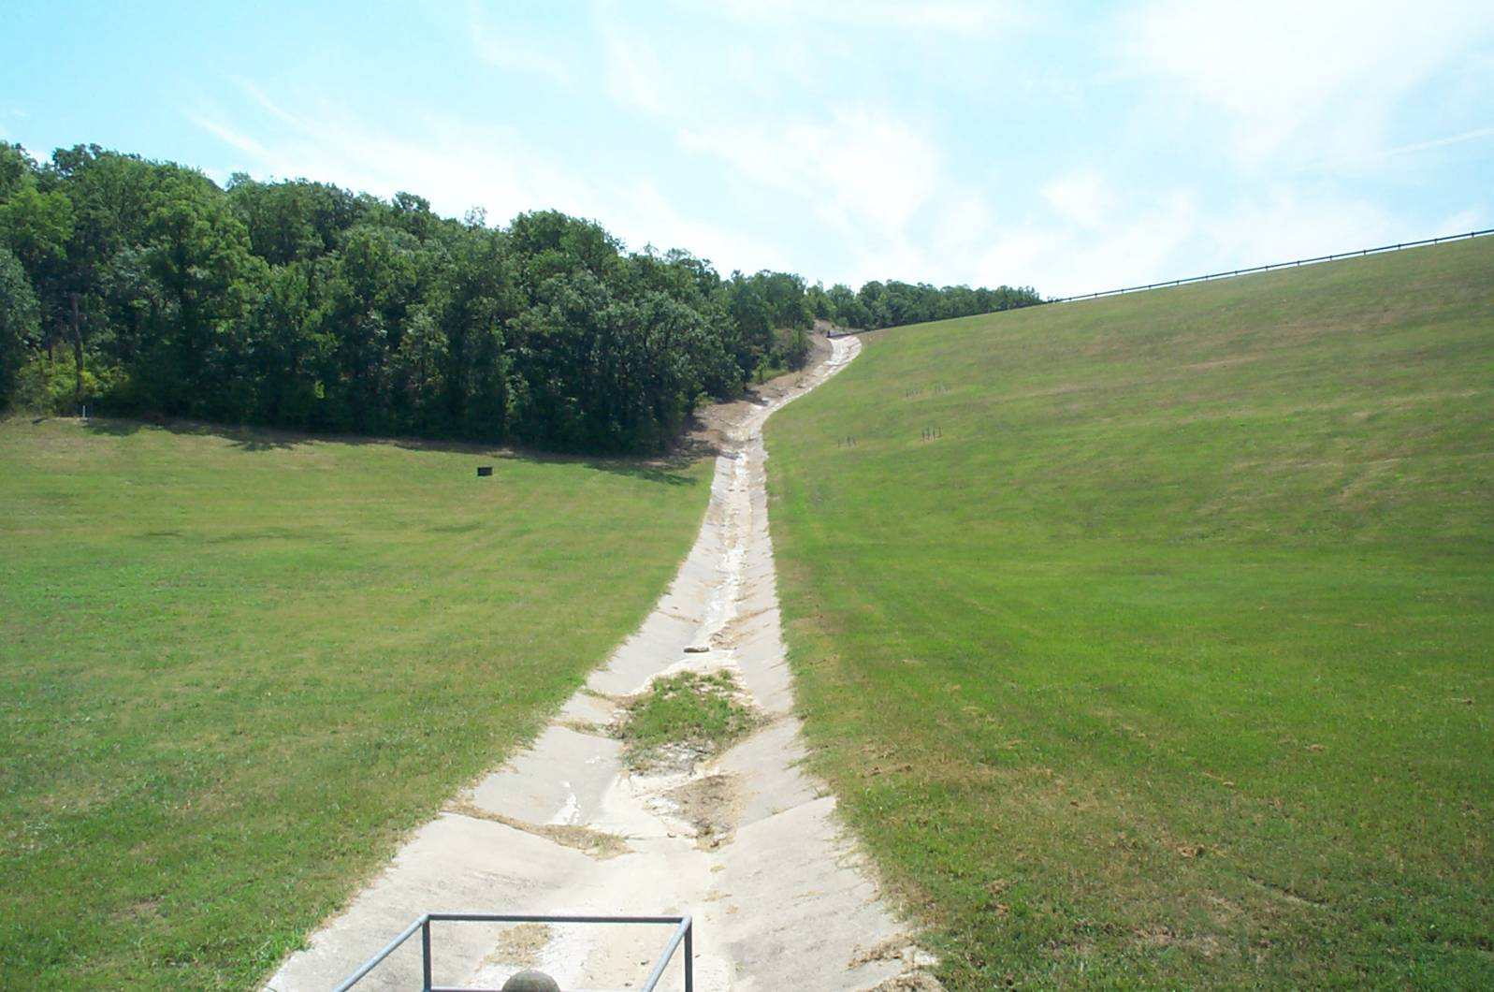
Groins

Slide 27
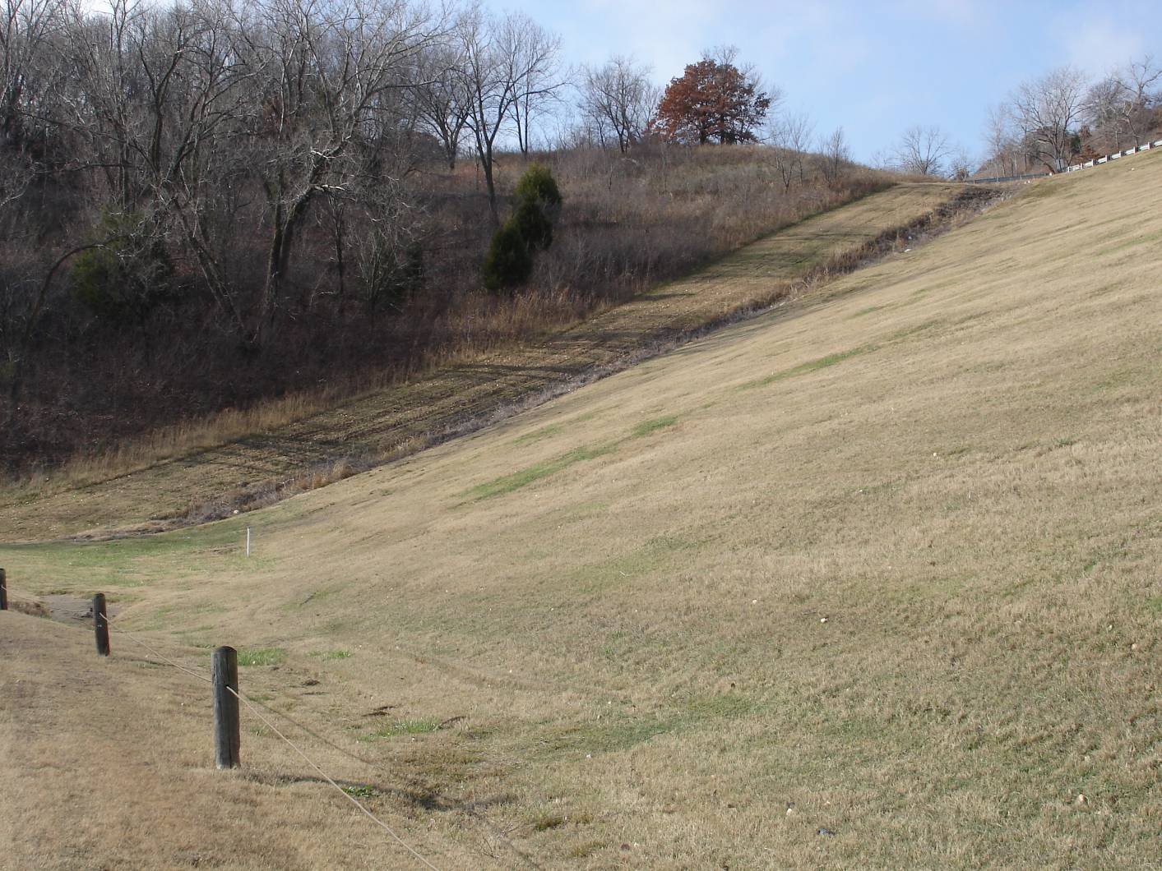
Tree Growth on Abutment

Slide 28
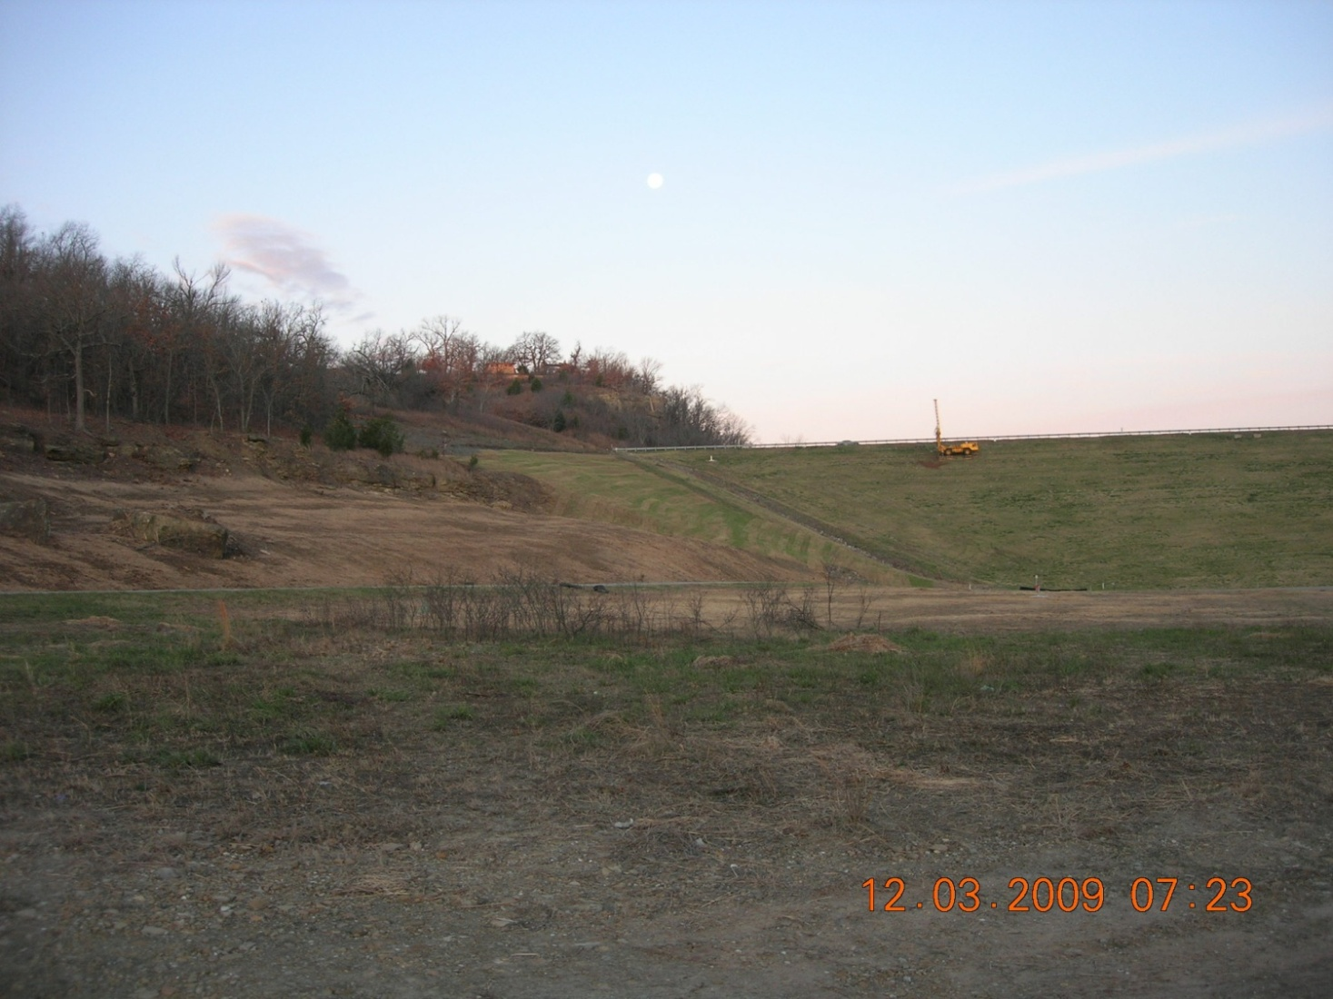
Tree Growth on Abutment

Slide 29
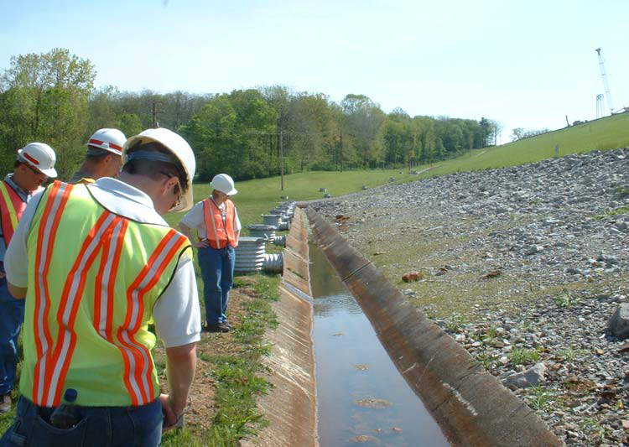
Check Relief Wells
Notes:
Relief wells are designed to help control seepage pressures that could lead to piping or instability by collecting seepage and discharging it safely downstream. Visually check whether flow is occurring. Determine if a flow should be present based on previous readings and current reservoir level. Measure flow rate with weir, flume, or bucket and stopwatch and compare with expectations. Check turbidity.

Slide 30
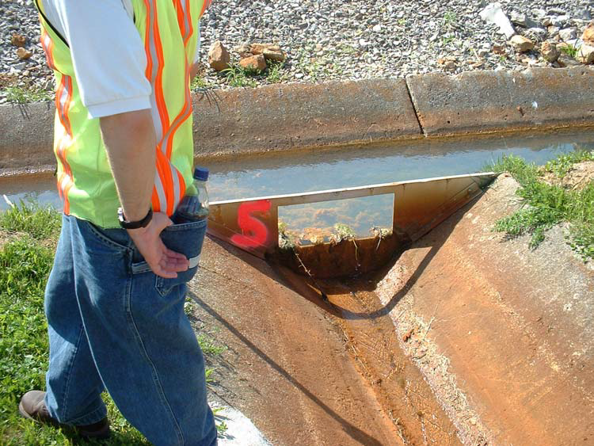
Weir to Measure RW Flow

Slide 31
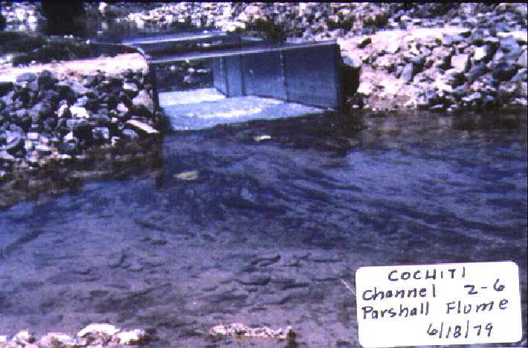
48” Parshall Flume

Slide 32
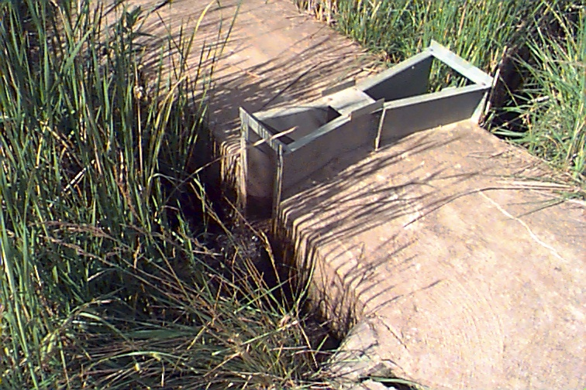
Parshall Flume

Slide 33
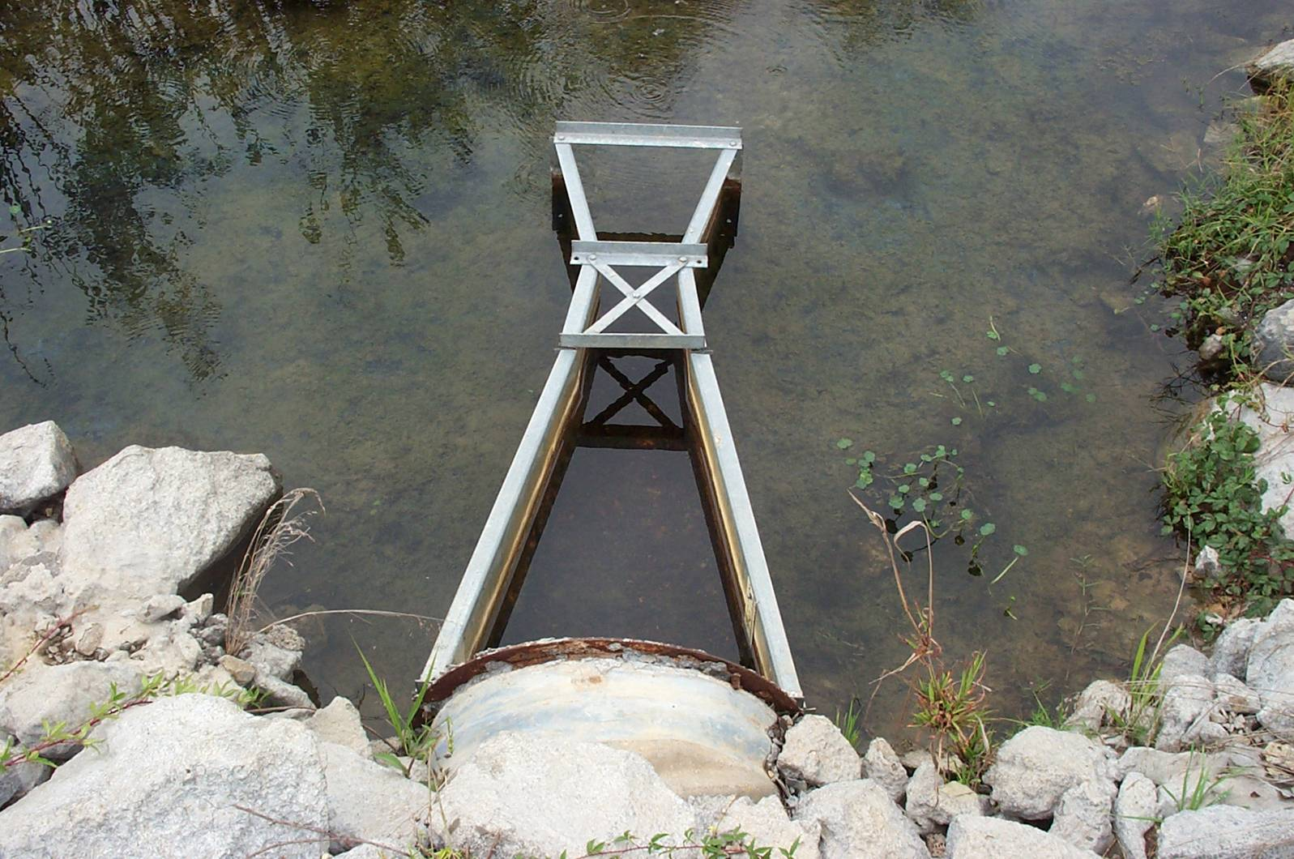
Parshall Flume

Slide 34
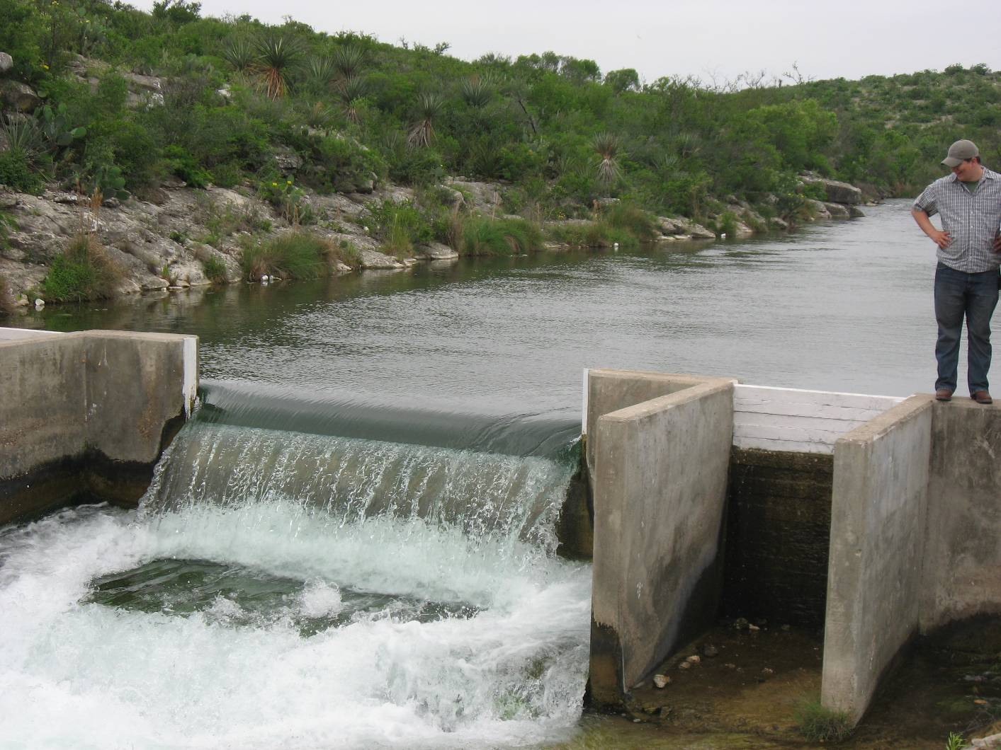
Broadcrested Weir

Slide 35
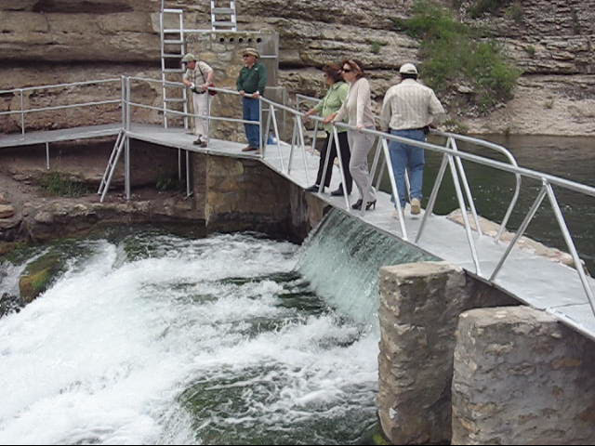
Broadcrested Weir

Slide 36
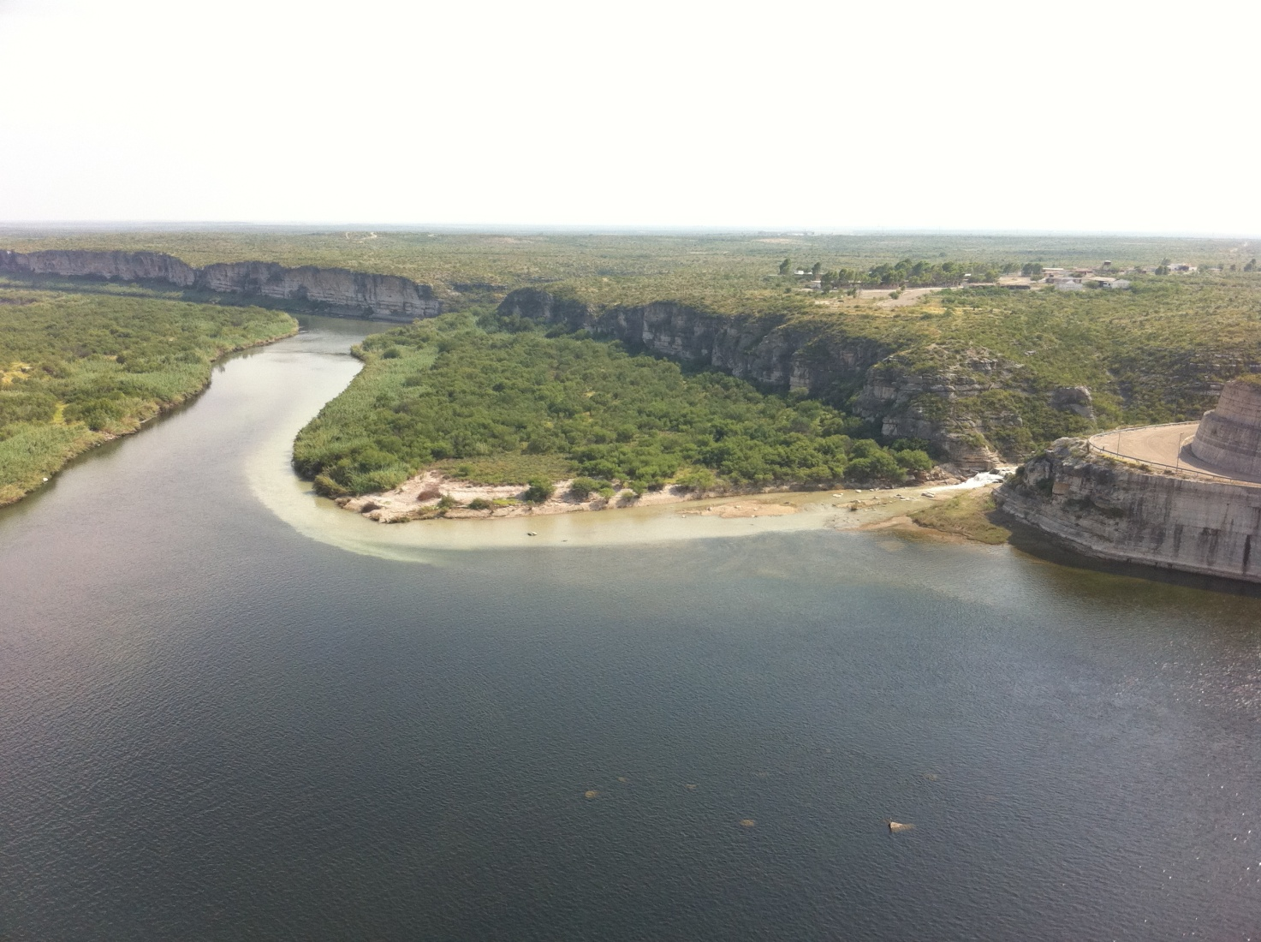
Broadcrested Weir

Slide 37
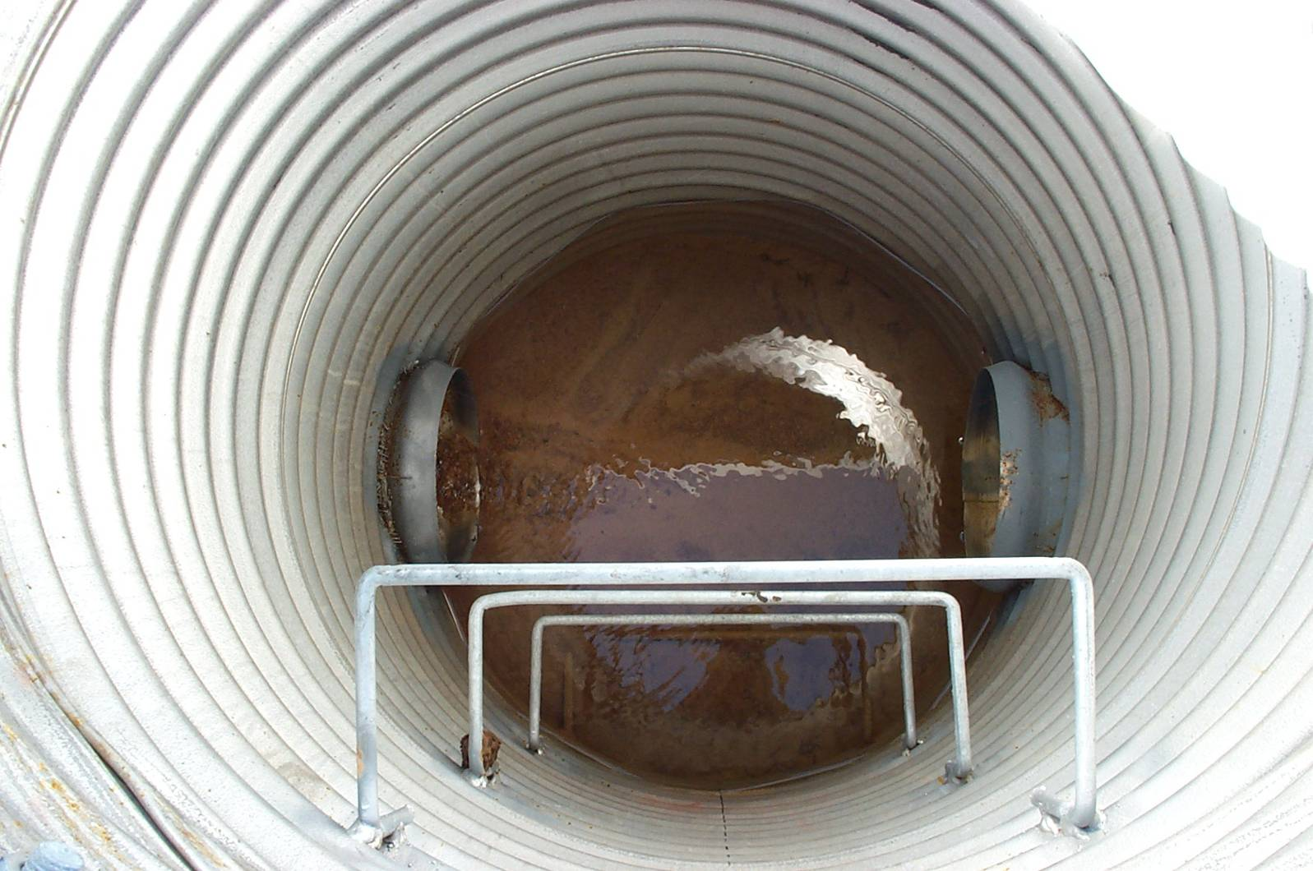
Toe Drains

Slide 38
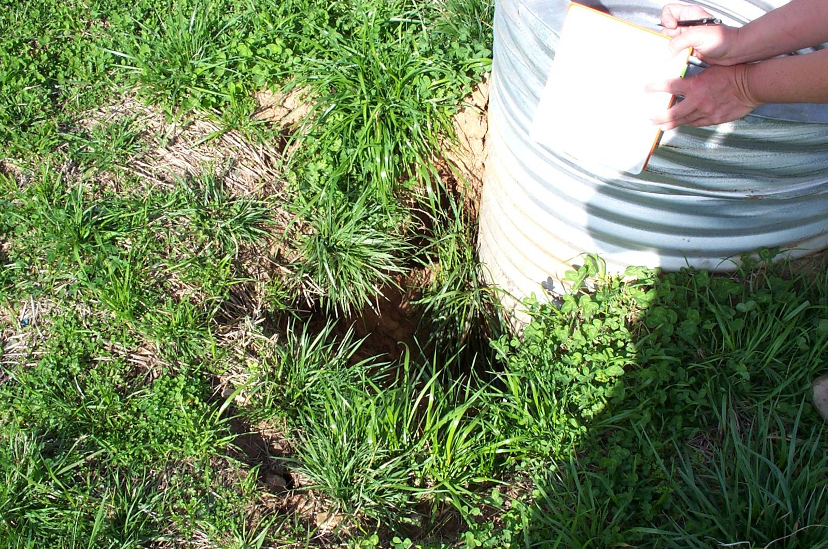
Toe Drains

Slide 39
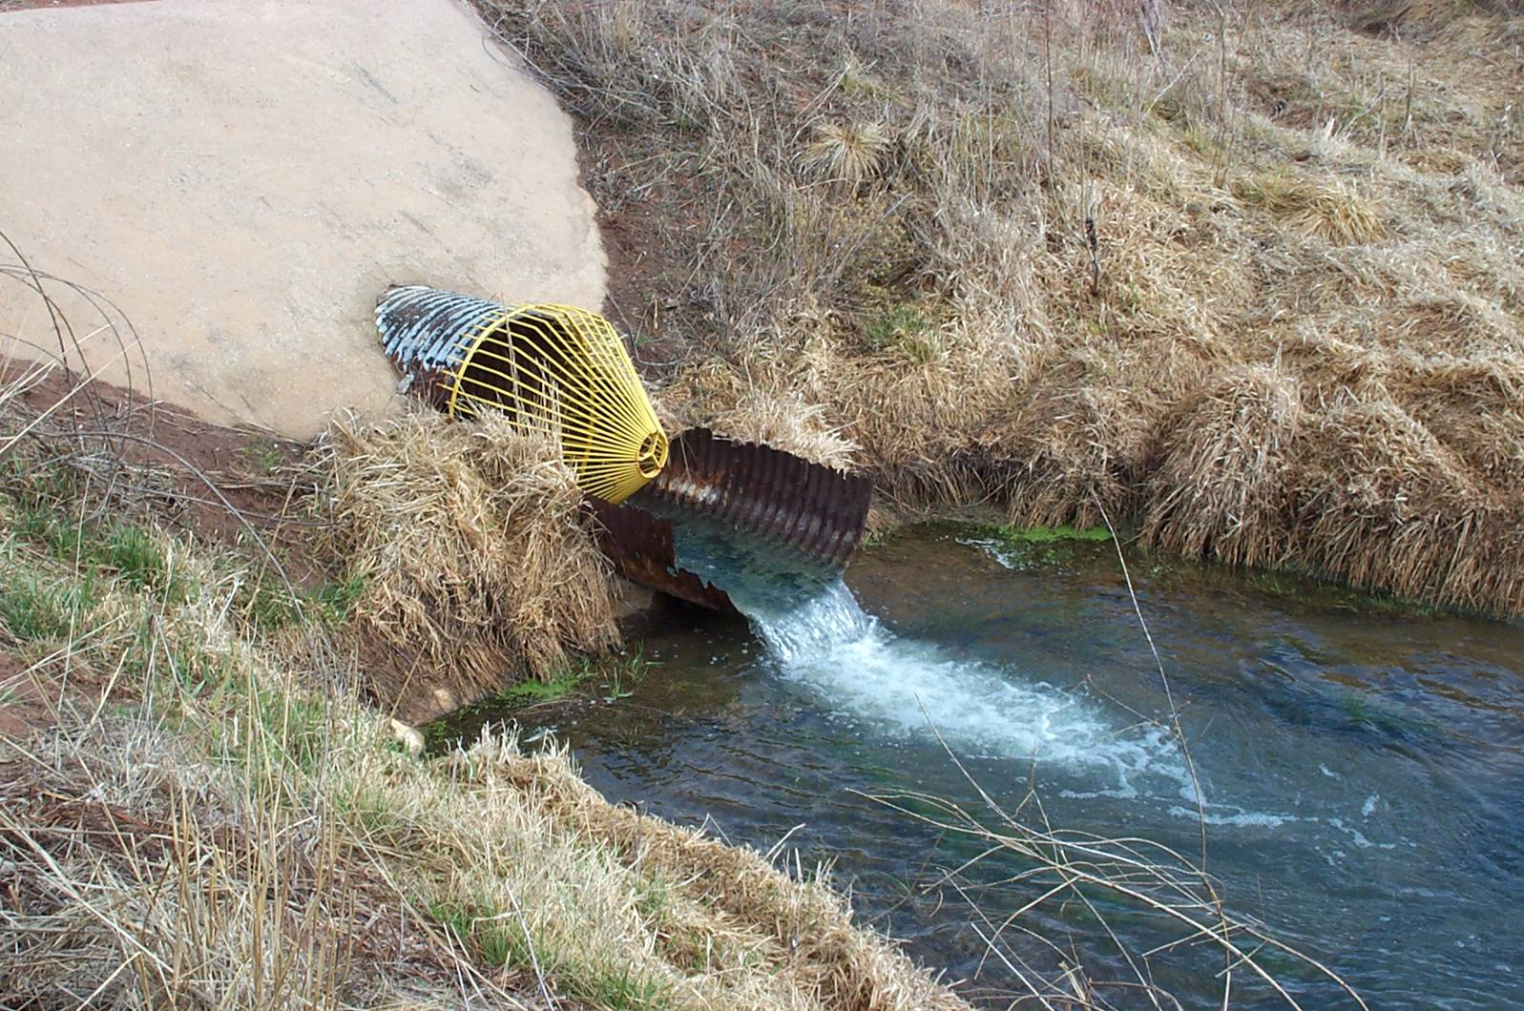
Toe Drains

Slide 40
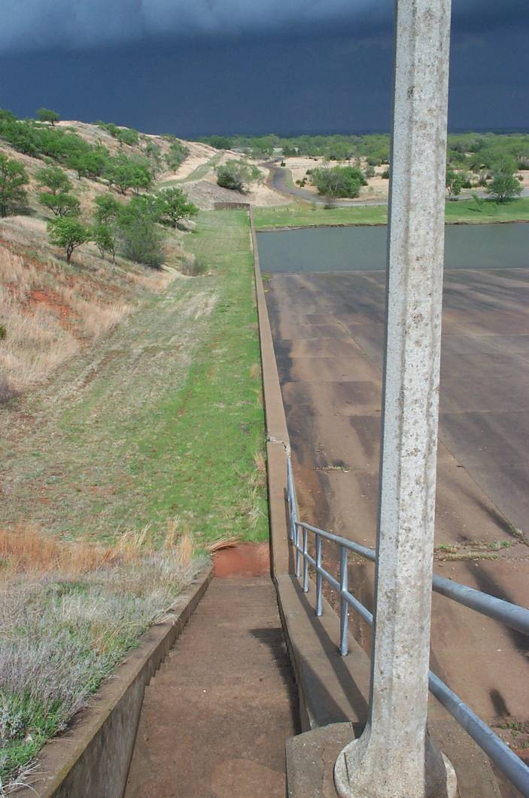
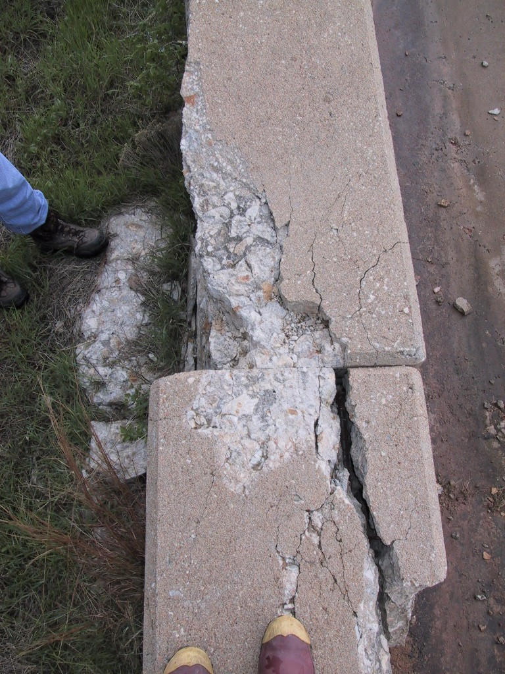
Vertical Wall Movement

Slide 41
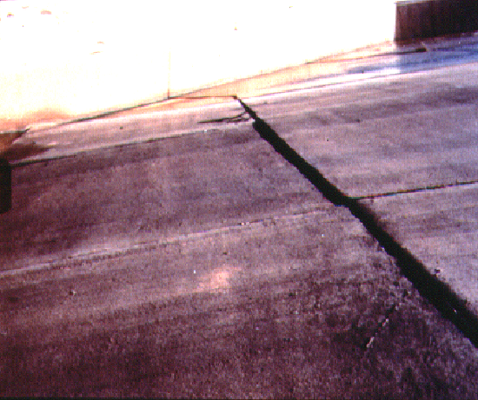
Spillway Displacement

Slide 42
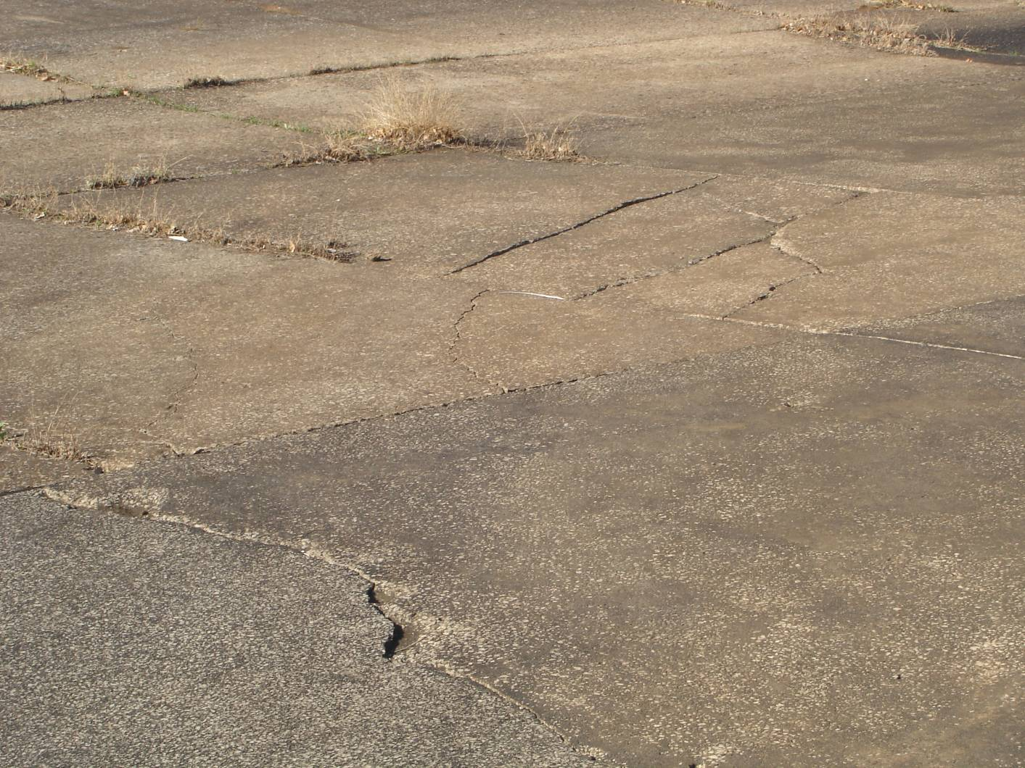
Spillway Displacement

Slide 43
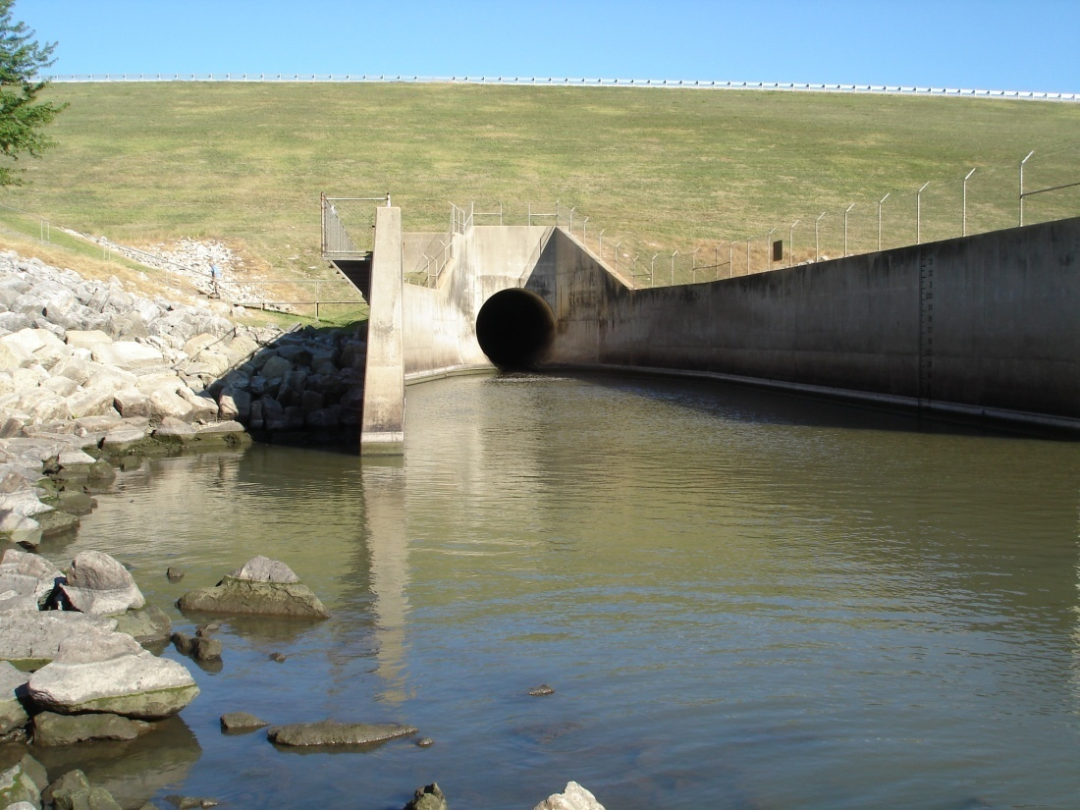
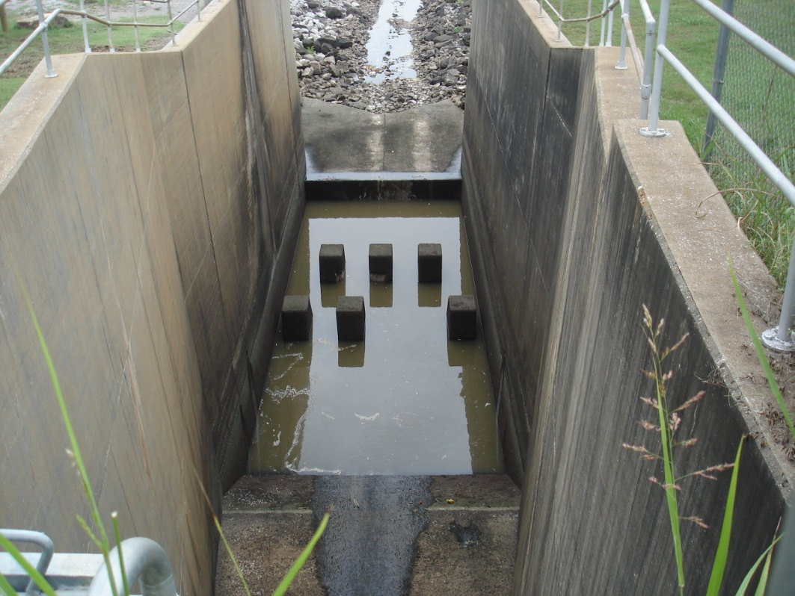
Conduits and Stilling Basins

Slide 44
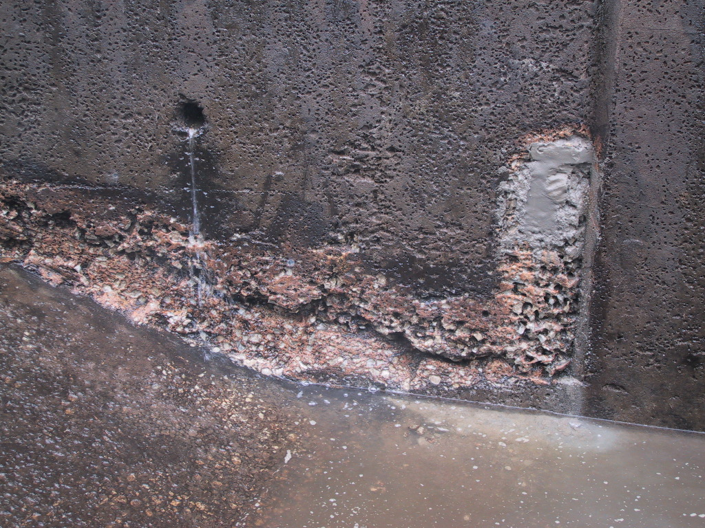
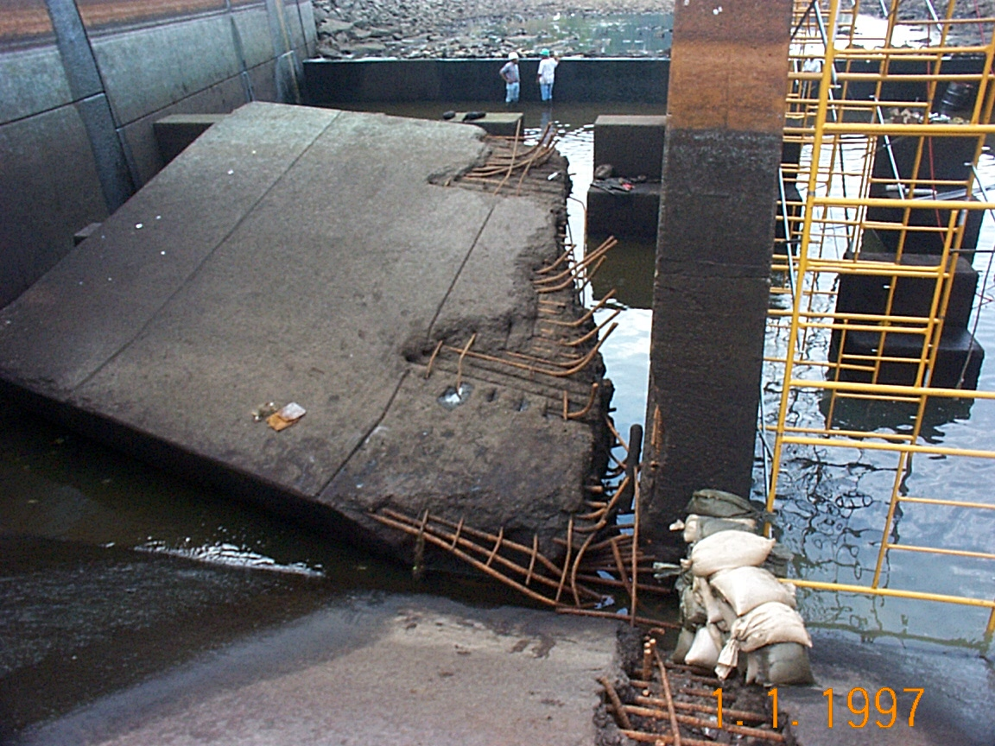
Conduits and Stilling Basins

Slide 45
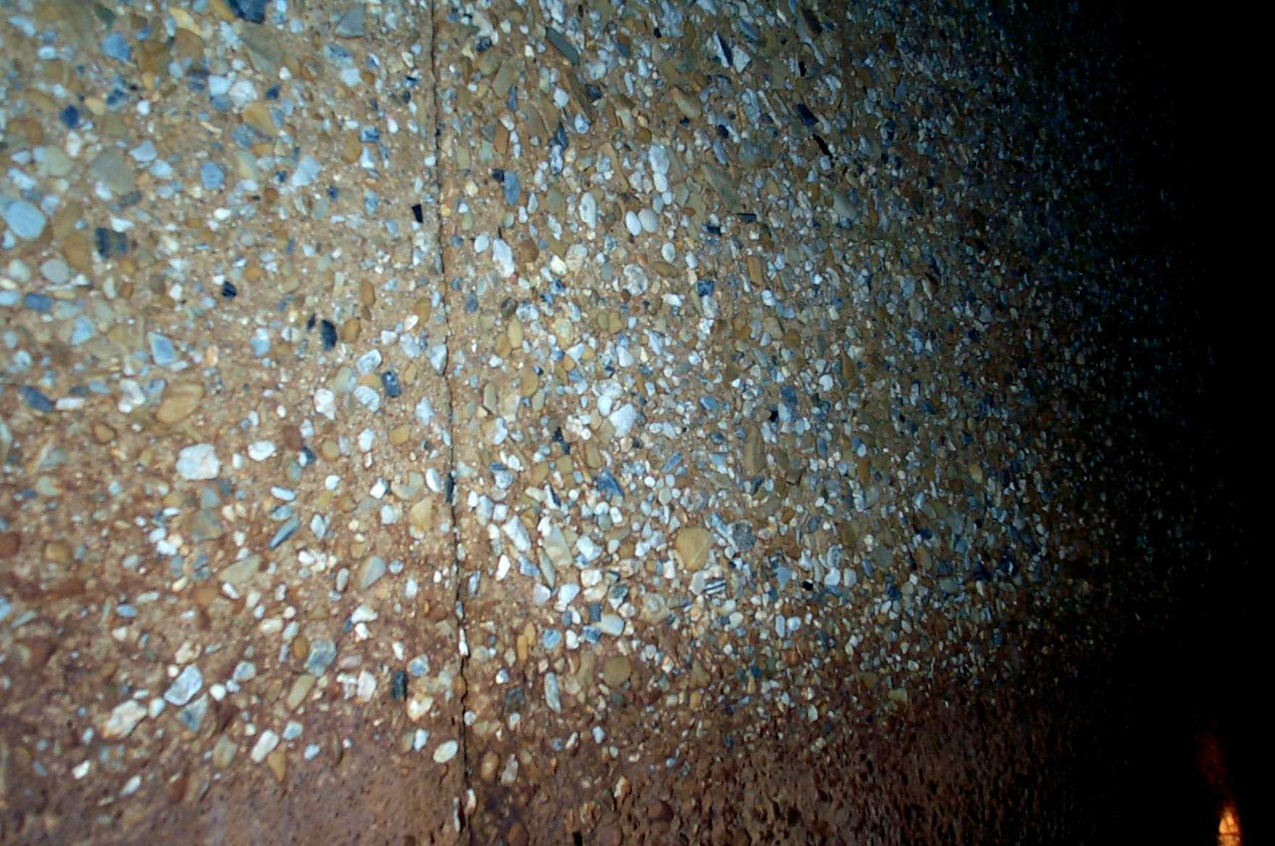
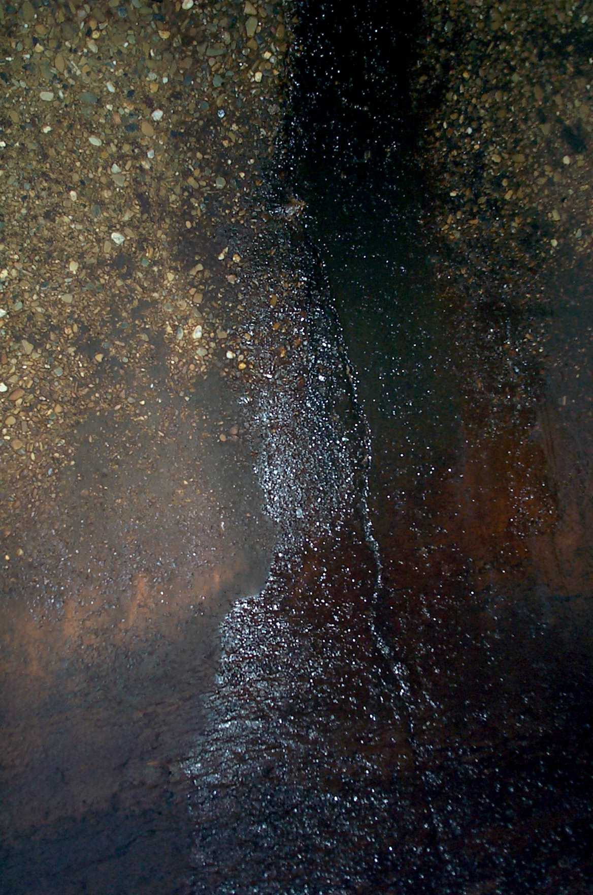
Conduits and Stilling Basins
Loss of Cement in Concrete
Leaking Cracks in Conduit

Slide 46
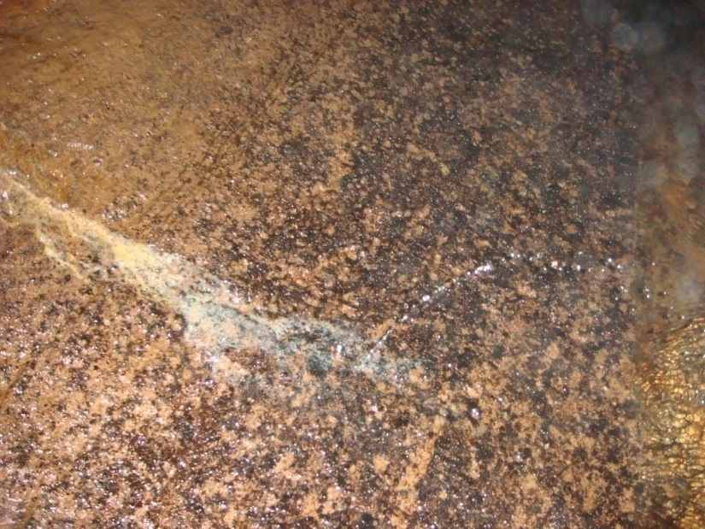
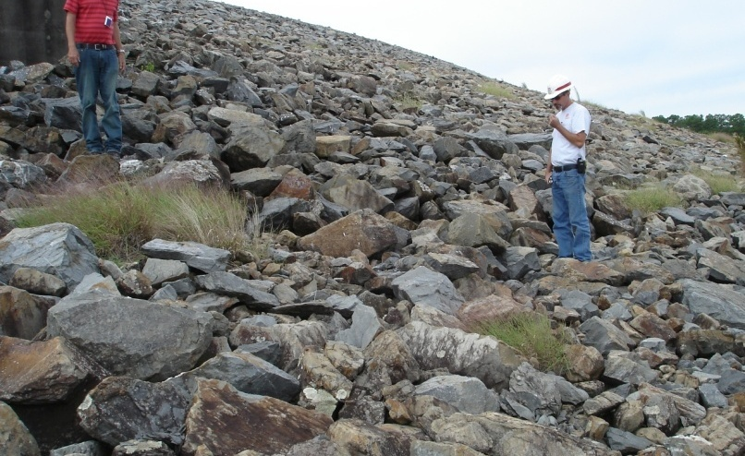
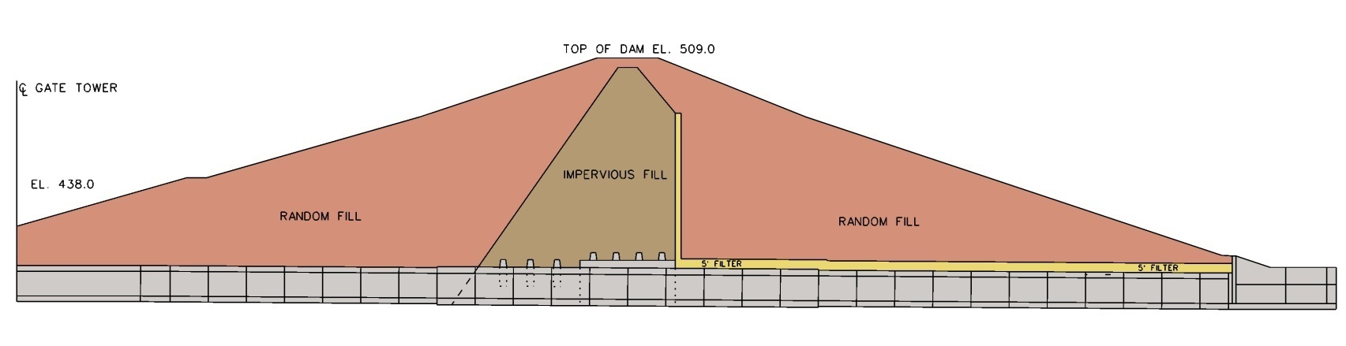
Conduits and Stilling Basins
Pine Creek
Notes:
Periodic Inspections of the dam revealed a slight depression on the upstream slope and leakage through conduit joints, and movement of fine sand from the downstream slope during major maintenance activities.

Slide 47
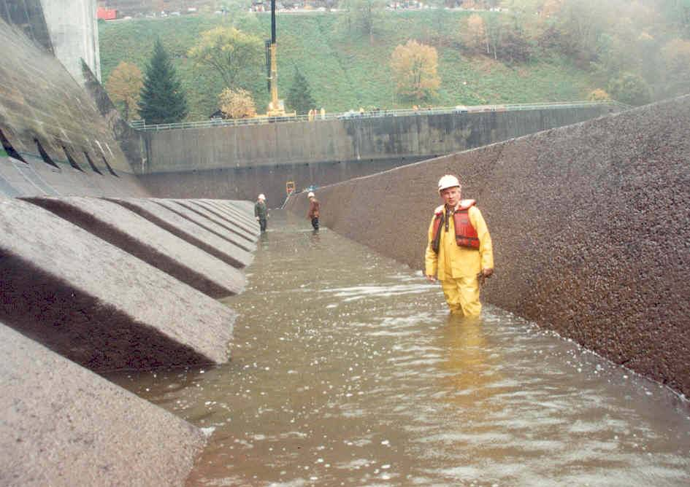
Stilling Basin Inspection

Slide 48
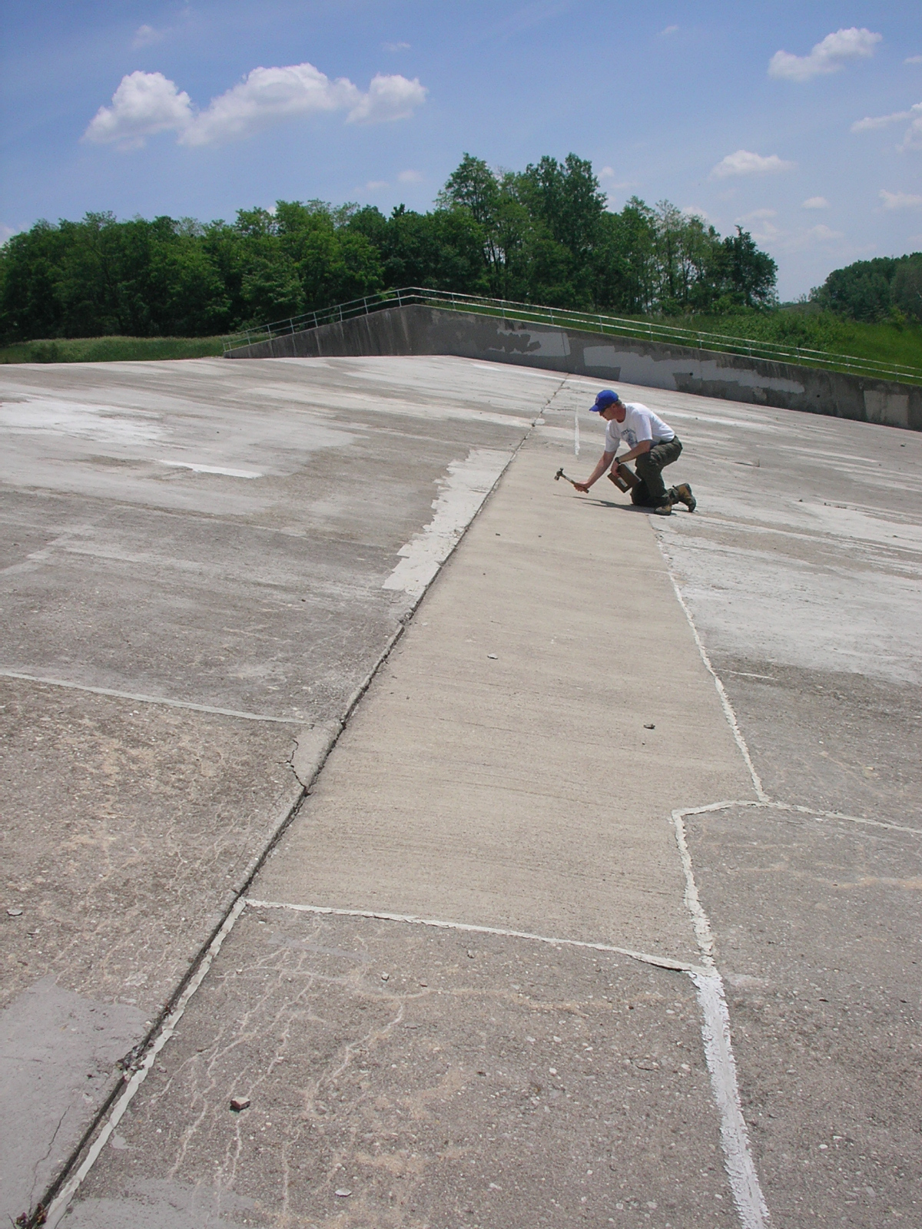
Sounding Concrete
CJ Brown Lake
Notes:
Sounding with hammer is a method of determining quality of concrete. Hollow sound indicates failed concrete. High sound indicates good concrete. Also can use chain drag method.

Slide 49

Jack Stands for Safety

Slide 50

Inspect the downstream sides & operating equipment of the tainter gates for rust, corrosion, bent member, etc.

Slide 51

Crack located just upstream of trunnion anchorage in piers.

Slide 52




Rust stains are coming out of piers at tie-back beam level and out the backs of the piers. Possible source is joints in piers just upstream of gates.

Slide 53



Tie-back beams that hold gates in place have laminated rust inside piers.

Slide 54




Laminated rust on critical arm.
Laminated rust in middle of girder.
Holes rusted through bottom.
Rusty trunnion girders.

Slide 55





Cracks in rib & stiffener welds on Gate 2.
Crack in rib weld Gate 1.
Crack in rib weld Gate 2.
Pack rust between rib & girder.

Slide 56




Gate 4’s right strut arm is slightly twisted.
Flaw in Gate 4 bottom girder.
Crack in Gate 5 rib.

Slide 57



Chains are very rusty, develop pack rust between members, kinks catch in hoists, and/or retaining rings pop off allowing links to fall apart.
Anchor bolts that hold the hoist platforms to the tops of the piers are failing due to pack rust. Loose too many & can pull platforms into water.

Slide 58



Flat wire ropes have several strands rusted through since last inspection.

Slide 59


Gates
Inspect Gates and Seals

Slide 60

Birch Stem Guide

Slide 61


Roller Chains

Slide 62

Tainter Gate Interior
Notes:
Many times tainter gates have several levels of compartments and the lower compartments get filled with debris. Debris needs to be cleaned out so that it can be properly inspected.

Slide 63
Questions?

