Slide 1
Dam Safety Modification Studies
Robert Taylor, P.E.
Dam Safety Program Manager
Great Lakes and Ohio River Division
Brasilia, Brazil
21-24 May 2013

Slide 2
ER 1110-2-1156 Chapter 9 Updates Dam Safety Modification Studies
Focus
This briefing is for communication purposes only. It does not supersede the currently approved ER 1110-2-1156.
The proposed revisions may change prior to final approval. Always consult to approved version of ER 1110-2-1156 for official guidance.

Slide 3
ER 1110-2-1156 Chapter 9 Updates Dam Safety Modification Studies
DSM Reports are decision documents used to address the associated risks of a dam and identify and recommend an alternative risk management plan that supports the expeditious and cost effective reduction of risk.
DSM Report replaces:
Major Rehabilitation Reports
Dam Safety Assurance Reports
Project Operations – Partners and Support (Work Management Studies)

Slide 4
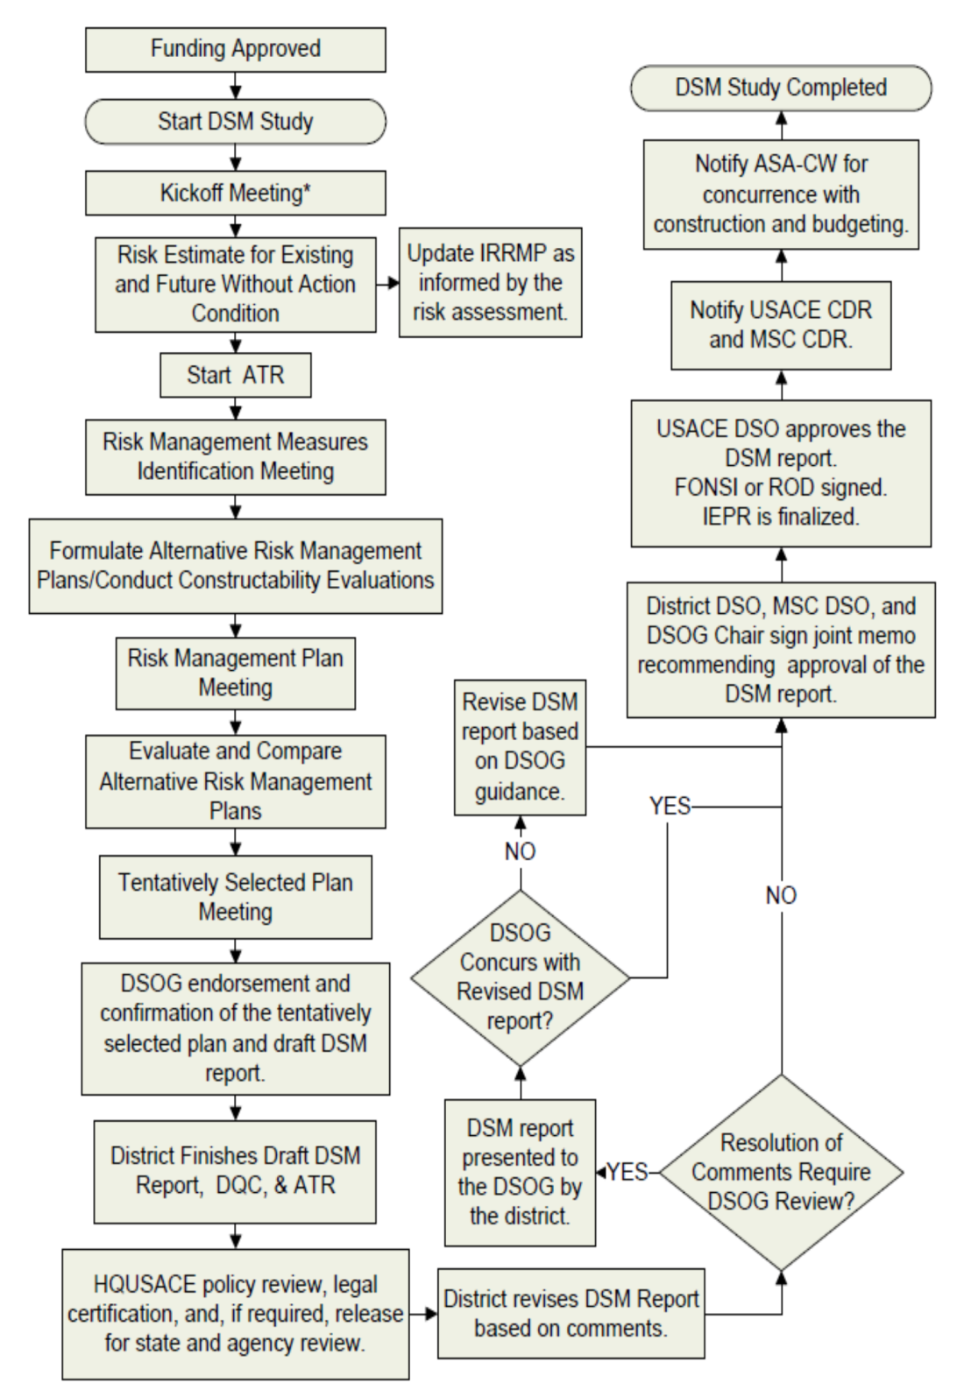
ER 1110-2-1156 Chapter 9 Updates Dam Safety Modification Studies
Study Process Flowchart

Slide 5
Dam Safety Modification Study ER 1110-2-1156 Updates
Funding Approved
DSM projects are prioritized by the DSOG based on the DSAC rating and an assessment of the baseline risk.
Study funds provided by the Dam Safety & Seepage/Stability Correction Program (WEDGE).
The RMC manages the study queue and the funding based on DSOG prioritization.

Slide 6
Dam Safety Modification Study ER 1110-2-1156 Updates
Start DSMS
DSMS Scope:
Encompasses all structural and non-structural project modifications needed to address dam safety.
Exception: Potential operational failures identified by risk assessment that do not directly impact life safety or catastrophic failure are generally not addressed in a DSM Report.

Slide 7
Dam Safety Modification Study ER 1110-2-1156 Updates
Start DSMS (cont.)
Start-Up Actions / General Roles & Responsibilities:
District manages and executes the study, formulates and manages the PDT, assigns a PM, prepares the PMP and RP, and coordinates in-progress reviews
DSMMCX provides oversight by participating on Vertical Teams, provides technical assistance through PED and Construction, and establishes and executes ATR in coordination with RMO and PCX
DSPC ensures appropriate Technical PDT members and Lead Engineer are assigned to project and prepares the DSM Report

Slide 8
Dam Safety Modification Study ER 1110-2-1156 Updates
Kickoff Meeting
District PDT hosts Kickoff Meeting w/ Vertical Team:
Regional DSPC, MCX, MSC, RMC, HQ, others …
Kickoff Meeting Purpose:
Discuss proposed PMP prior to approval by the DSO (includes DSPM and RIT) and acts as official start of the DSMS.
Review comments must be submitted to the District within 30 days or district may proceed with submitted plan.
Upload approved PMP to RADS.

Slide 9
Dam Safety Modification Study ER 1110-2-1156 Updates
Estimate Existing and Future w/out Action Risks
RMC assigns a Risk Cadre to perform a new or update an existing risk assessment.
Risk Cadre ensures that all significant failure modes have been properly evaluated during the PFMA and are carried forward into the DSMS.
Cadre estimates existing and future without action risks.
Cadre evaluates effectiveness of IRRM’s and recommends plan revisions if necessary.

Slide 10
Dam Safety Modification Study ER 1110-2-1156 Updates
Start ATR of Risk Assessment
The District, in coordination with the DSPC will prepare a Review Plan in accordance with EC 1165-2-214.
This plan includes all levels of review from DQC, ATR, DSOG, through IEPR.

Slide 11
Dam Safety Modification Study ER 1110-2-1156 Updates
Risk Management Measures Identification
District hosts in-progress review meeting with Vertical Team after Baseline Risk has been established.
Purpose of meeting is to brainstorm and identify the most appropriate Risk Management Measures to carry forward into the development of alternatives.

Slide 12
Dam Safety Modification Study ER 1110-2-1156 Updates
Formulate Alternative Risk Management Plans
PDT is responsible for the overall development of alternatives; both non-structural/structural measures are to be given equal consideration.
Preliminary E&D work must be conducted during this step to provide a comparable “level of detail” for all alternatives.
Consider the constructability and cost of each alternative and the amount of relative risk reduction.

Slide 13
Dam Safety Modification Study ER 1110-2-1156 Updates
Formulate Alternative Risk Management Plans (cont.)
Minimum Required Alternatives to consider are:
No Action Alternatives (existing and future conditions)
Meeting full Tolerable Risk Guidelines including ALARP
Achieving only Tolerable Risk Limit for Life Safety
Making the IRRM’s permanent
Removing the structure
Replacing the structure

Slide 14
Dam Safety Modification Study ER 1110-2-1156 Updates
Risk Management Plan Meeting
Lead Engineer briefs Vertical Team on the various risk reduction alternatives and the initial screening of alternatives are presented and discussed.
Each plan is compared to the Future Without Action Condition
Outcome will be an agreement on those alternatives that will be carried forward and the appropriate level of design, cost estimates, economic, and environmental impacts of each.

Slide 15
Evaluate Alternative Risk Management Plans
Risk Cadre works closely with PDT to evaluate and compare the various risk reduction plans, (including the No Action plan).
Evaluation factors based on life safety, annual Pf, and relationship to TRG’s, ALARP considerations, and essential engineering guidelines.
Risk Reduction Plans are compared to each other resulting in a ranking of plans based on incremental risk reductions and associated cost.

Slide 16
Dam Safety Modification Study ER 1110-2-1156 Updates
Tentatively Select the Recommended Plan
Risk Management plan selected from all alternatives using ranking as a guide.
Vertical Team meets to confirm that the selected plan meets applicable laws, statutes, Executive Orders, regulations, and current policy.
Opportunity to identify and resolve any legal or policy concerns that could delay approval of the final report and release of the NEPA document to the public.

Slide 17
Dam Safety Modification Study ER 1110-2-1156 Updates
DSOG Endorsement of Tentatively Selected Plan and the ‘Draft’ DSMR
Lead Engineer and District DSO present all the Alternatives and the Tentatively Selected Plan to the DSOG prior to finalizing ATR.
They also present the major ATR comments, how they were resolved, and any unresolved issues.

Slide 18
Dam Safety Modification Study ER 1110-2-1156 Updates
District finishes ‘draft’ DSMR,
DQC, and ATR/QCC (cont.)
District must complete DQC review prior to start of ATR.
The RMC is the responsible RMO for coordinating and managing ATR in accordance with EC 1165-2-214.
The MCX will primarily establish ATR teams and execute ATR in coordination with the RMO and appropriate PCX in accordance with ER 10-1-51.
The RMO ensures that the DSPC is included in Technical Evaluation.

Slide 19
Final DRAFT Deliverables
Inundation Risk Fact Sheet
Communication tool for media and general public. (IE: public affairs pamphlet)
Dam Safety Action Decision Summary (DSADS)
Stand alone document used to inform and assist Senior Leaders with making dam safety decisions.
Suitable for release to local sponsors, stakeholders, resource agencies, etc.
Level of detail not intended for media and general public.
DSMR Documentation
The decision document that contains both the technical alternative evaluation, preliminary design work, and risk assessment documentation.
DSMR of FOUO and not intended for public release.

Slide 20
Dam Safety Modification Study ER 1110-2-1156 Updates
HQ conducts Policy Compliance Review
HQ conducts Agency Policy Compliance Review as per mission requirements.
HQ DSPM provides the RIT with copies of the DSMR and will log the report in with the Office of Water Project Review indicating the appropriate recommended reviewers.
Policy Compliance Review typically occurs concurrently with DSOG Review.

Slide 21
Dam Safety Modification Study ER 1110-2-1156 Updates
Draft DSM Report Revisions
Policy, Legal, and Technical issues must be resolved prior to presentation to DSOG.
If the district is unable to resolve Policy, Legal, or technical issues, they should first work thru their Vertical Team and RIT for resolution.
If resolution cannot be obtained, a DSOG Review can be requested.

Slide 22
Dam Safety Modification Study ER 1110-2-1156 Updates
Dam Senior Oversight Group
(DSOG) Review
District DSO and Lead Engineer present report findings and technical justification for implementing the recommended risk reduction plan to DSOG.
DSOG provides technical and policy recommendations to the HQUSACE DSO

Slide 23
Dam Safety Modification Study ER 1110-2-1156 Updates
Are Risk Reduction Actions Justified ?
DSOG and DSO determine path forward (approve or revise) following the briefing and discussion.
DSOG determines nature and priority of actions with respect to national portfolio

Slide 24
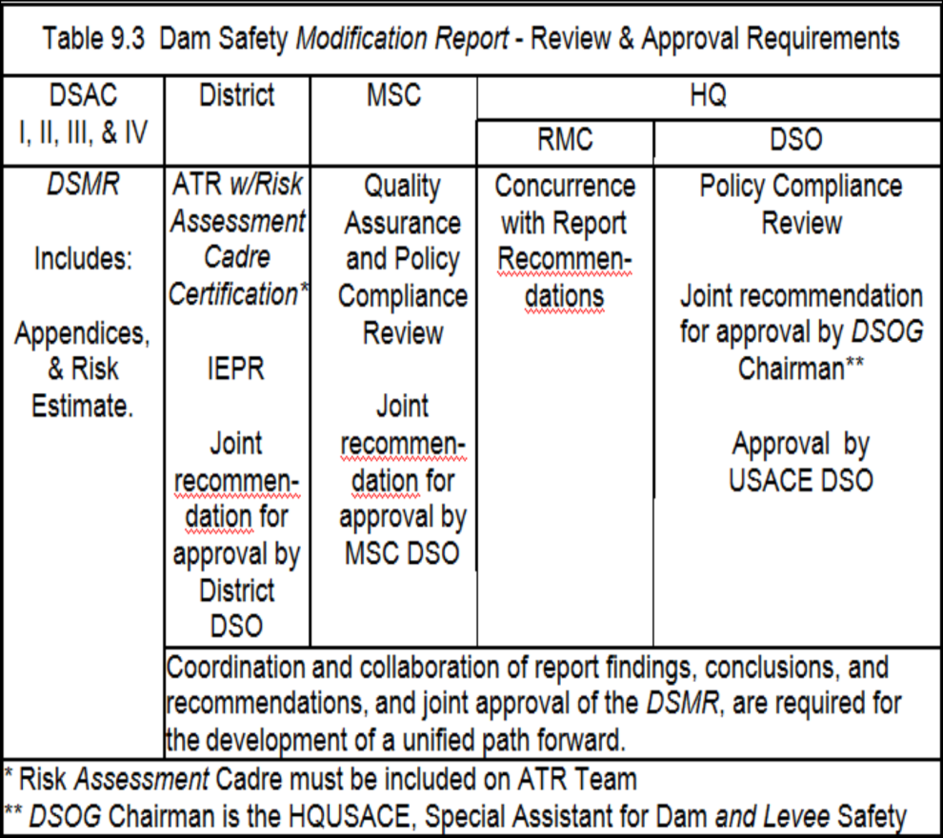
Dam Safety Modification Study ER 1110-2-1156 Updates
DSMR Recommended for Approval
District DSO, MSC DSO, and DSOG Chair sign joint memorandum recommending approval of the proposed modification plans.

Slide 25
Dam Safety Modification Study ER 1110-2-1156 Updates
Approval of DSM Report
USACE DSO has been delegated approval authority from ASA-CW and is the responsible approval official for DSM reports.

Slide 26
Dam Safety Modification Study ER 1110-2-1156 Updates
Notify USACE & MSC Commanders
DSOG Chairman notifies the ASA-CW, USACE Commander, and the MSC Commander, via formal Memorandum, that DSM Report has been approved.

Slide 27
Dam Safety Modification Study ER 1110-2-1156 Updates
Notify USACE & MSC Commanders
DSOG Chairman notifies the ASA-CW, USACE Commander, and the MSC Commander, via formal Memorandum, that DSM Report has been approved.

Slide 28
Dam Safety Modification Study ER 1110-2-1156 Updates
ASA-CW Concurrence
DSOG Chairman notifies the ASA-CW via formal Memorandum, that DSM Report has been approved.
Memo requests concurrence for Civil Works budgeting as construction CG line Item.
ASA-CW often requests additional briefings and coordination.
Districts may have to provide technical support for these requests.

Slide 29
Dam Safety Modification Study ER 1110-2-1156 Updates
DSM Study Complete
USACE DSPM enters project funding request into budget cycle for CG appropriations.
During 2-year budget cycle, WEDGE funds can be used to advance preconstruction engineering and design (PED) activities until the project receives a line item in the CG budget appropriation.
PED cannot begin without ASA-CW concurrence

Slide 30
Questions?

