Slide 1
Dam Safety Modification Case Study
Robert Taylor, P.E.
Regional Dam Safety Program Manager
U.S. Army Corps of Engineers
Great Lakes & Ohio River Division
Robert.E.Taylor@usace.army.mil
Dam Safety Workshop
Brasília, Brazil
20-24 May 2013

Slide 2
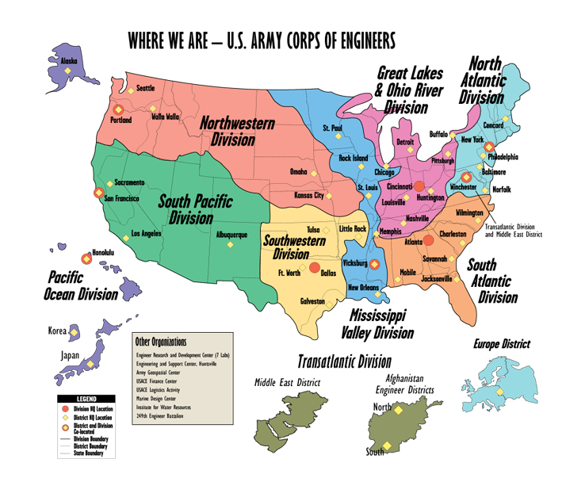
Notes:
4. DIVISION / DISTRICT BOUNDARIES
The Corps is divided into 8 divisions, 41 districts, 8 laboratories, 5 field operating activities and 2 centers.
The Great Lakes and Ohio River Division, oversees the work done by its seven districts with headquarters located at Buffalo, Detroit, Chicago, Huntington, Louisville, Nashville and Pittsburgh. Our area includes both the Great Lakes and Ohio River watersheds.
It encompasses 335,000 square miles, parts of 17 states, and 56 million people.
That means we work with 114 of Congressional colleagues and 34 Senators to give the American taxpayers the most economic and effective water resources projects.
Although we are not the largest geographic division in the Corps, we have the most subordinate districts. All 7 Districts work Civil Works missions while Louisville is the only district with both Civil Works and Military Construction responsibilities.

Slide 3
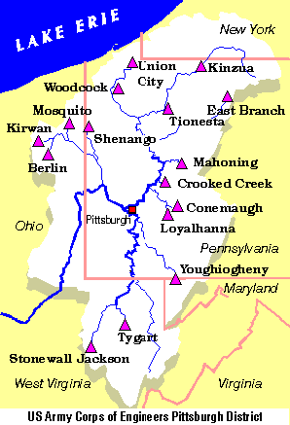
East Branch Dam
Location
Northwestern PA
210 km NE of Pittsburgh, PA
Authorized Purposes
Flood Control
Low Flow Augmentation
Water Quality
Recreation
3

Slide 4
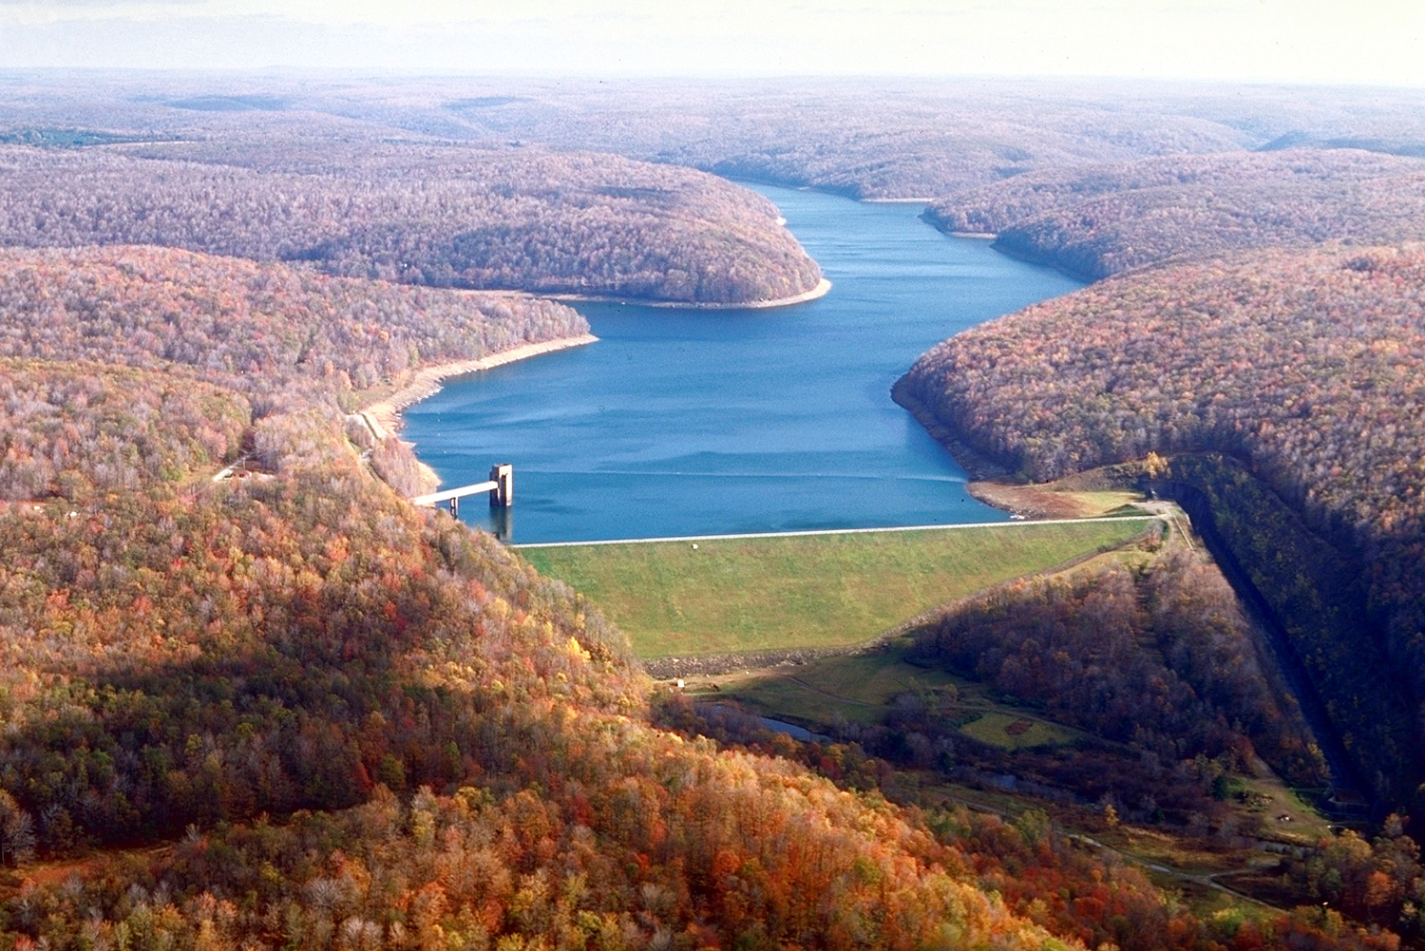
Zoned Embankment
56 Meters High
526 Meters Long
Outlet Works
Gated Control Tower
Concrete Lined Tunnel
Stilling Basin
Spillway
Concrete Lined Channel
Side-Channel Inlet
EAST BRANCH DAM
Elk County, Pennsylvania

Slide 5




Typical Embankment Cross-Section
Construction: 1947 - 1952
Embankment Cross Section
at Maximum Height = 56 meter
Flow
Crest El 1707
Record Pool El 1685.6
Summer Pool El 1670.0
X-Section Location
Winter Pool El 1651.0
Impervious
Random
Min Pool
El 1555.0
Random
Stream Bed El 1523
Drain
Overburden
Rock

Slide 6
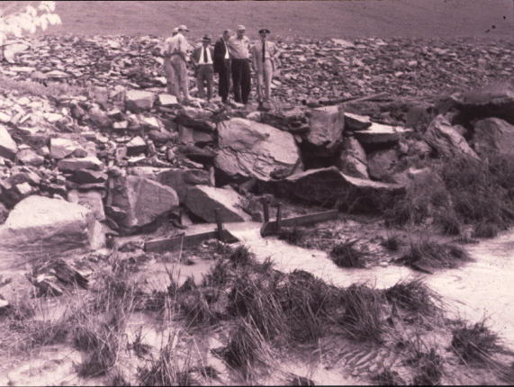
1957 Seepage Incident
08 May 1957
Dam Tender reported muddy seepage at toe of dam
No signs of slope distress on embankment
Installed temporary weir for
Continuous monitoring
Started exploratory drilling
10-18 May 1957
9 meter pool drawdown
Temporary Weir

Slide 7
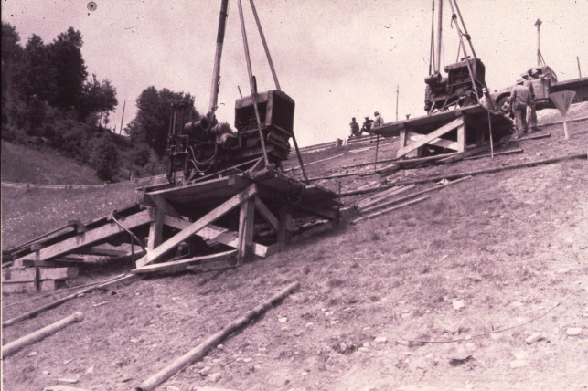
Emergency Exploratory Drilling
Government Drill Rigs Mobilized
Exploratory Drilling proceeded over the next two week period to find the source of the seepage
Auger holes in embankment found no signs of voids
Core drilling in downstream right abutment contact lost drill water in 3 holes
Dye added to holes did not appear in the muddy seepage at the downstream toe

Slide 8
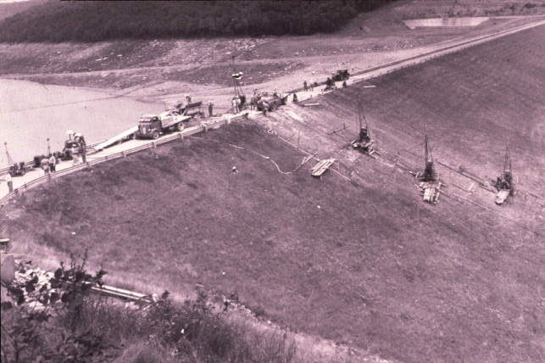
Locating Voids
30 May – 4 June
6 meter Drawdown
(15 meters total)
10 June 1957
First void was found in embankment near Sta 8+50 above the grout cap
18 June 1957
Additional voids were found by borings
19 June 1957
Decision to drain the pool additional 18 meters

Slide 9
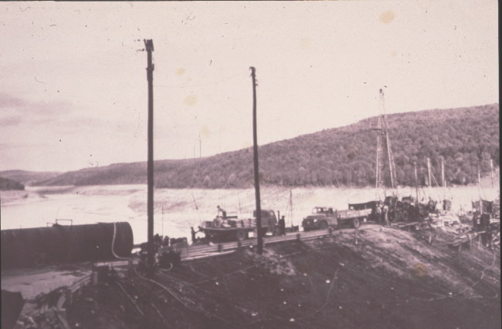
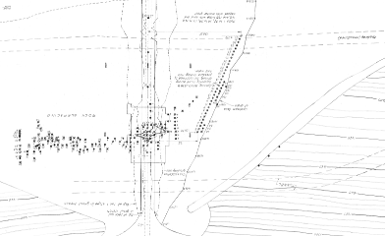
Grouting of Voids in Embankment
19 – 28 June
Final 60 ft pool drawdown
(110 ft total)
21 June 1957
Extensive grouting program began to fill void in embankment
June to November 1957
Repairs consisted of filling void with grout and consolidation grouting in areas surrounding the void
Grouting of embankment and foundation did not stop muddy flows near Sta 8+30
Two-foot drill hole was primed with large gravel and then grouted to form what the contractor called a “Cork”.

Slide 10
Interpretation of Void Location from
Boring Records and Grout Takes
Flow
Overburden
Rock
Sta 8+30

Slide 11
1957 Incident Review
Possible Causes
Foundation Treatment
Geometry of Cut-Off
Construction Practices
Haul Road
Springs

Slide 12
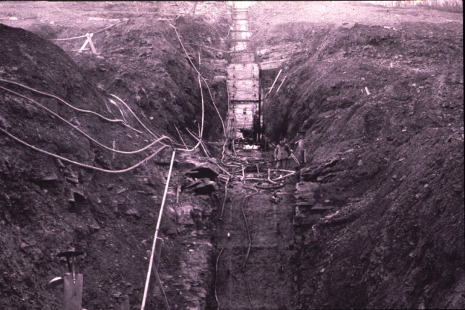
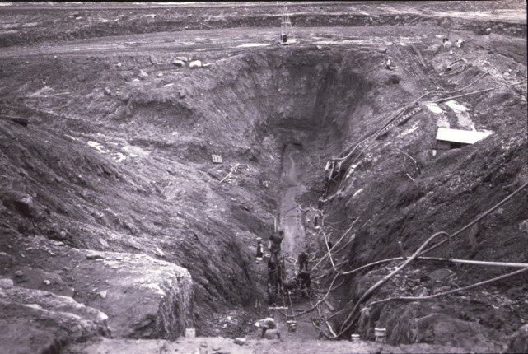
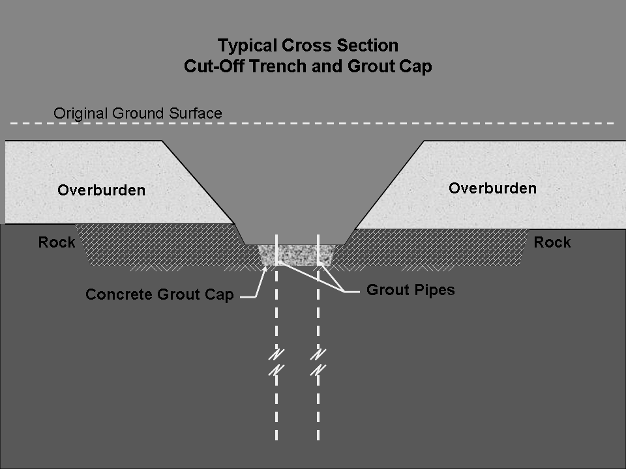
Foundation Treatment
Embankment soils placed directly against the fractured rock foundation
Geometry of Cut-off Trench
Abrupt changes in slope

Slide 13
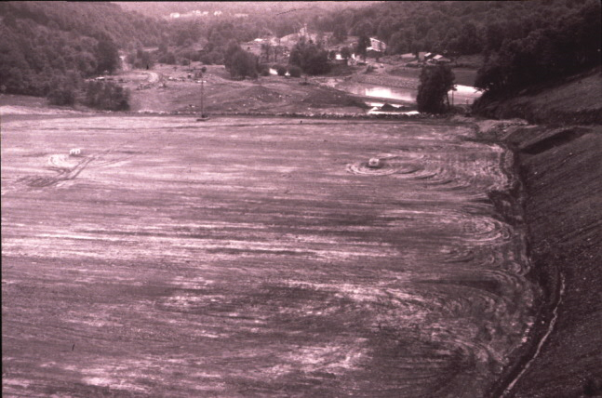
Construction Practices
High potential for poor compaction at critical contact areas due to tight turning radius of compaction equipment
Springs
Excessive drainage from springs and seeps along the right (east) abutment
Drainage ditch consisted of 150 mm pipe bedded in filter material

Slide 14
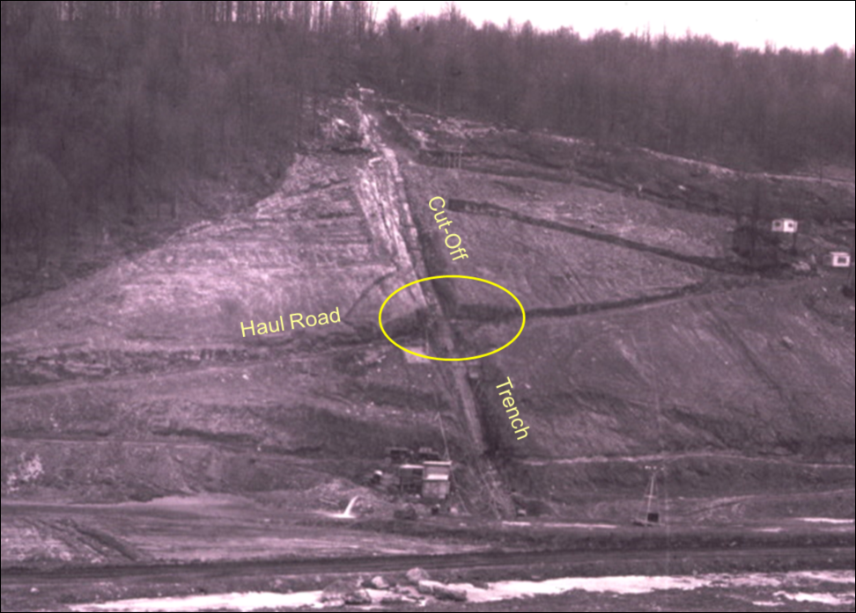
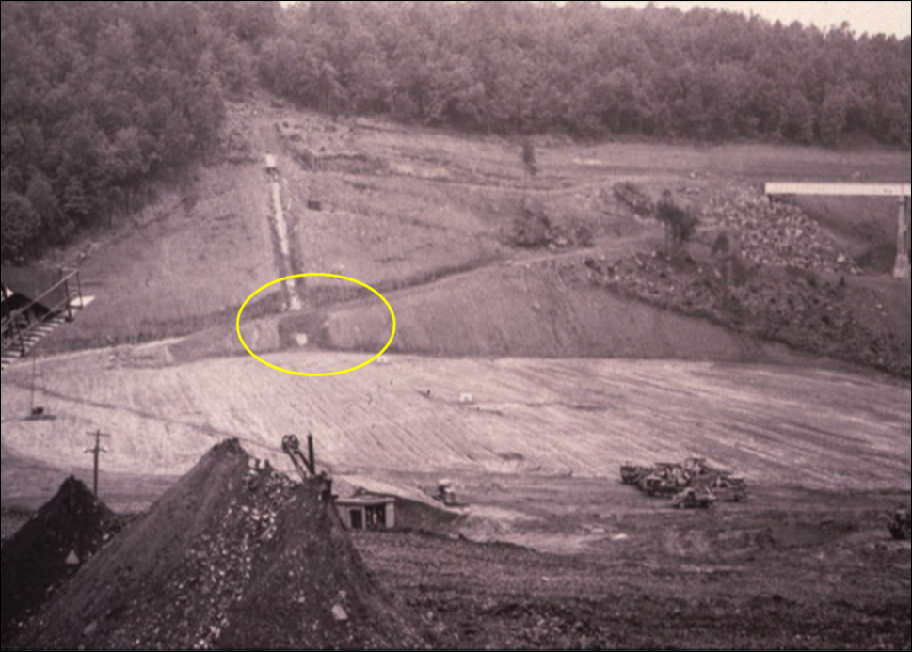
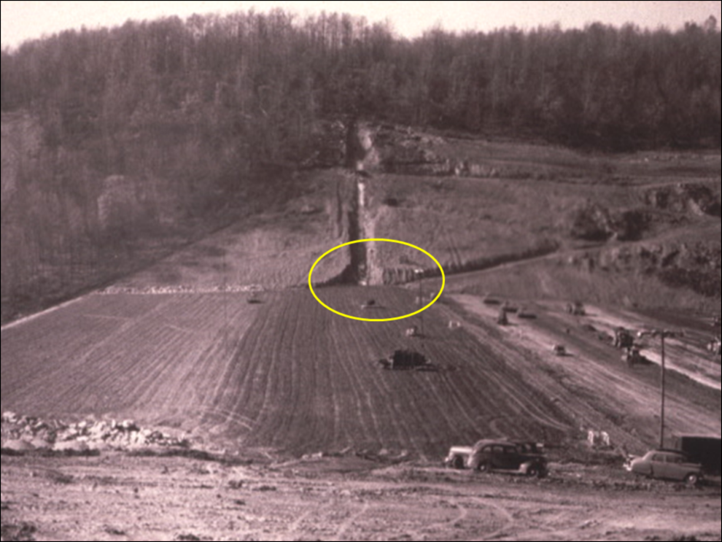
Construction Haul Roads
No clear records of what was done to address abrupt changes in slope geometry
Interference between haul trucks and compaction equipment

Slide 15
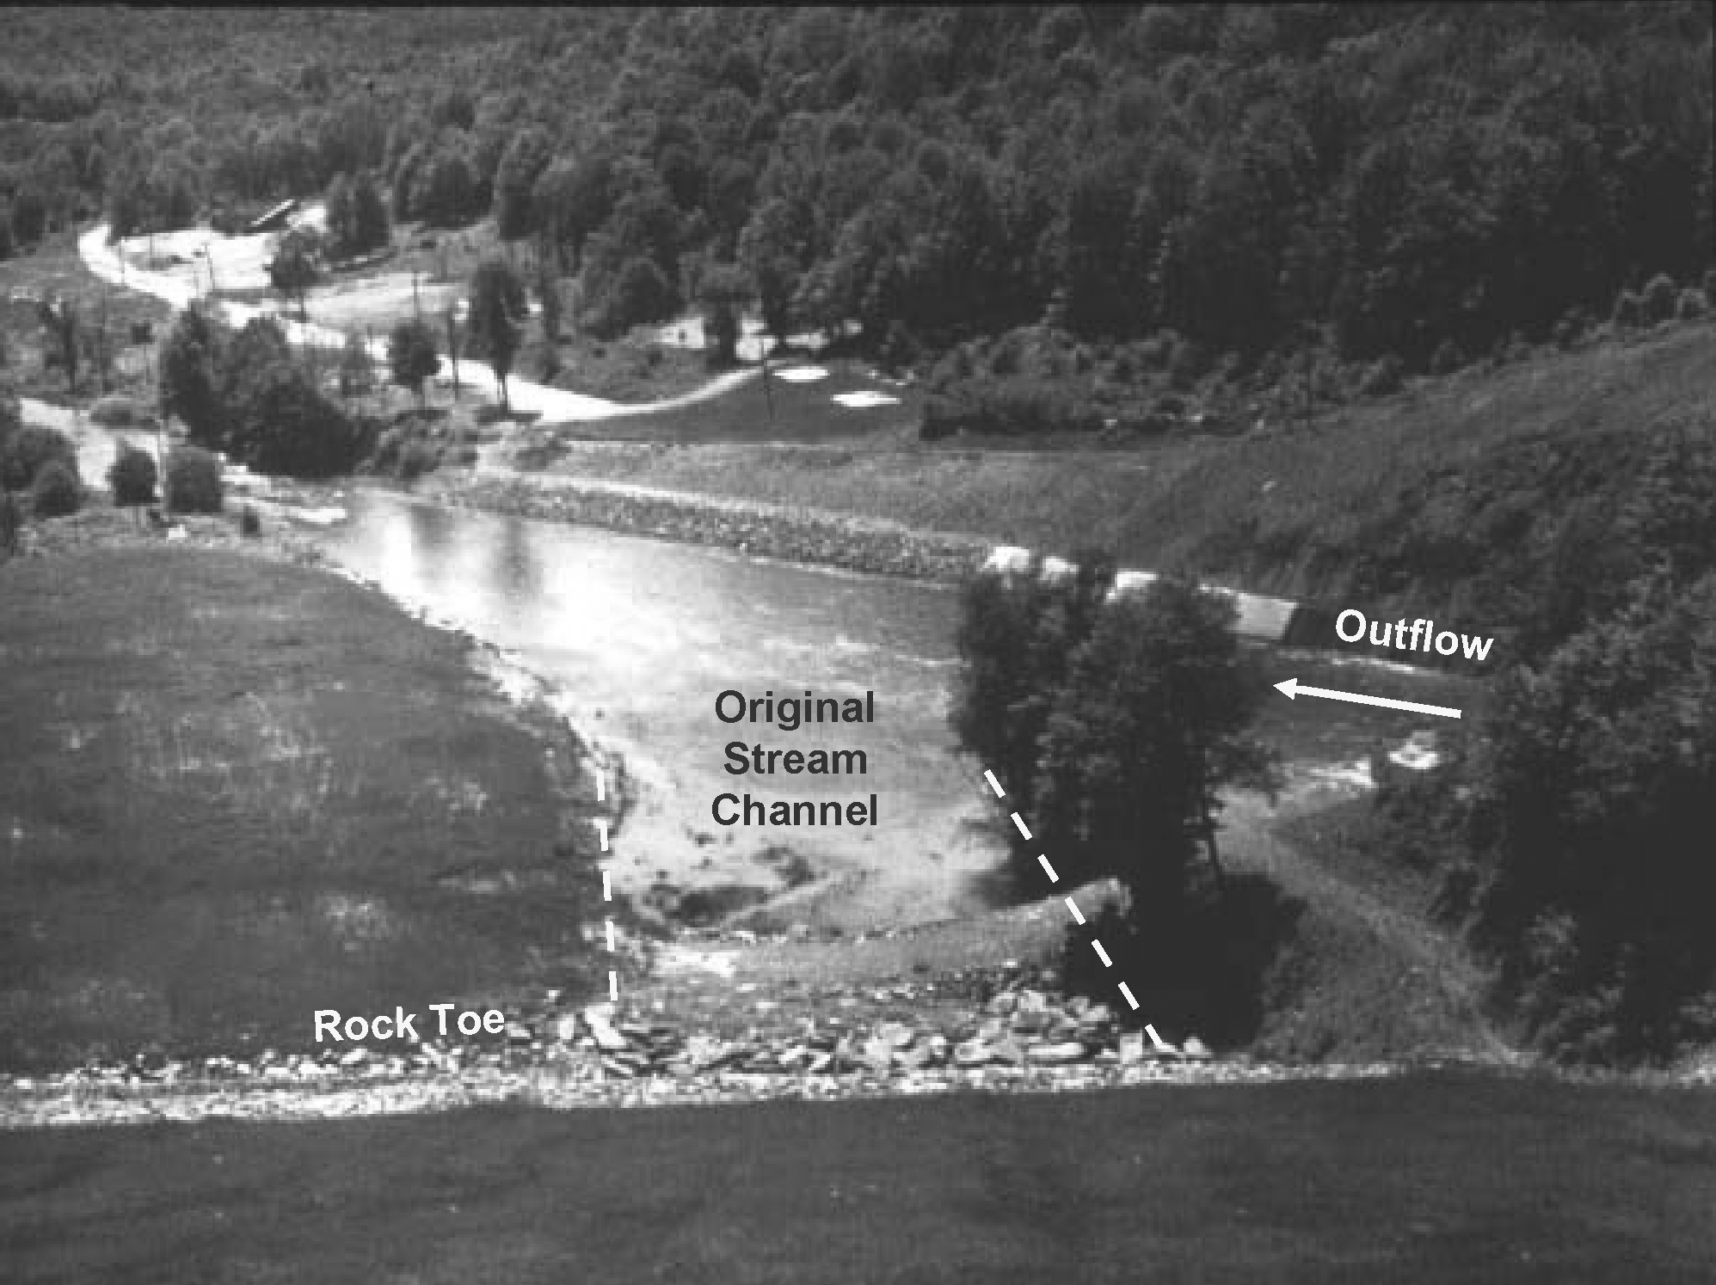
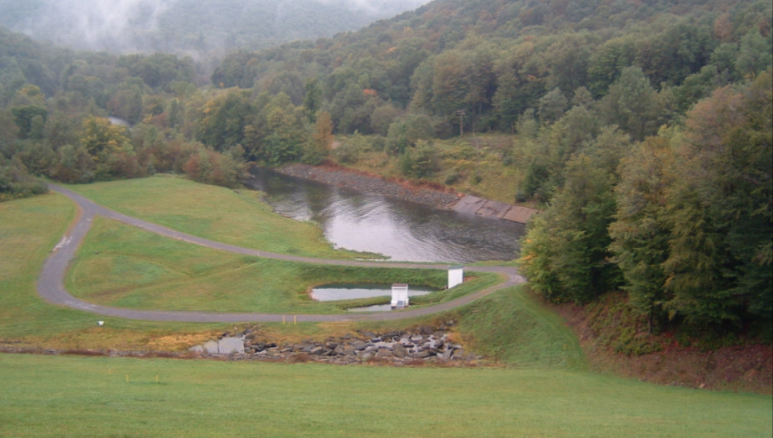
Results of Incident Review were Inconclusive
Embankment Performance
1958 – Present
District Commander nicknamed the dam “Leaky”
Constructed dike and gauge house across original stream channel to facilitate monitoring of toe seepage
Implemented Monitoring & Surveillance, Instrumentation, & Inspection Programs
Dam loaded above Spillway Crest in 1972 (Hurricane Agnes)
No physical signs of distress since repair was completed
Routine investigations, analyses, and remedial work over the last 50 years.

Slide 16
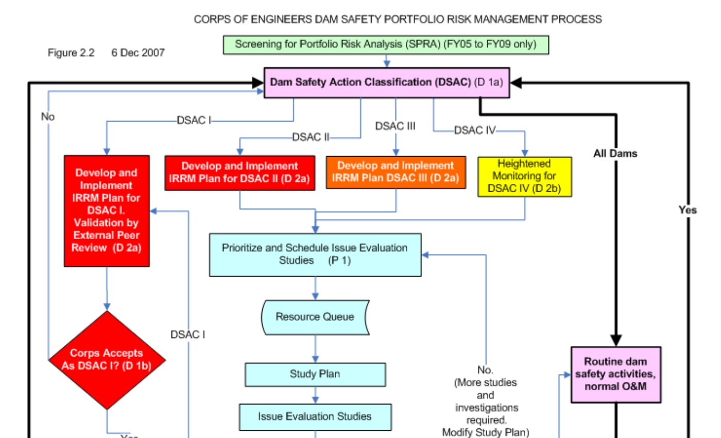
2005 – SPRA Data Call for the “Bad Boys” in the portfolio.
SPRA - 2006
East Branch was submitted in the 2nd year of SPRA
2006

Slide 17
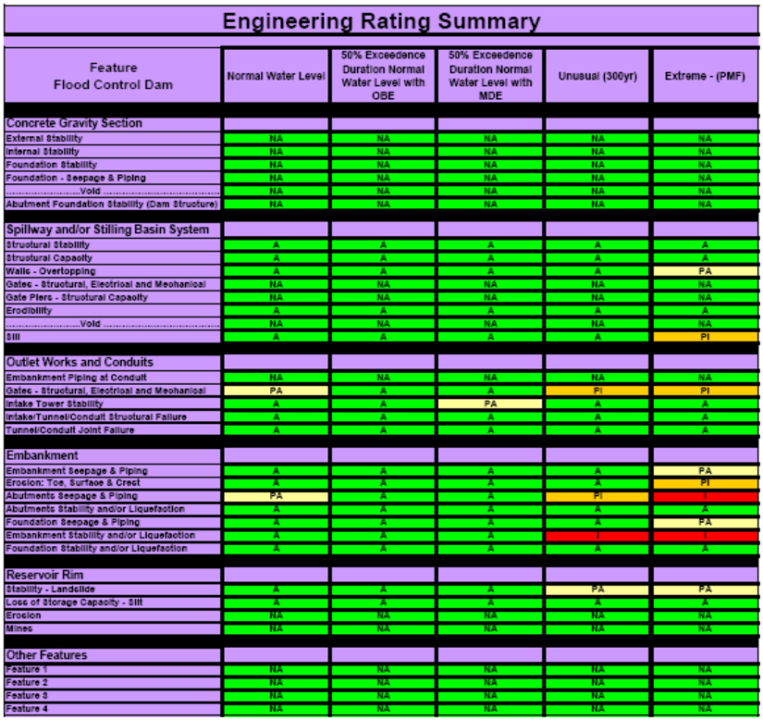
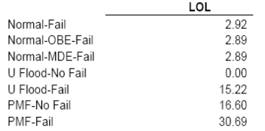
SPRA - Results
SPRA Conducted in May 2006 – 8 Hr Effort
Results:
Emb Erosion, Toe-Surf-Cr PI @ Extreme
Emb – Abutment S&P PI @ Un; I @ Extreme
Emb – Stability I @ Un & Extreme
Recommendations:
Update EAP; Monitor Seepage; Initiate studies leading to more positive cut-off/grout curtain
EAST BRANCH – Plotted as DSAC III
sPRA Identified $3.5 M for Dam Safety Studies and Modifications

Slide 18
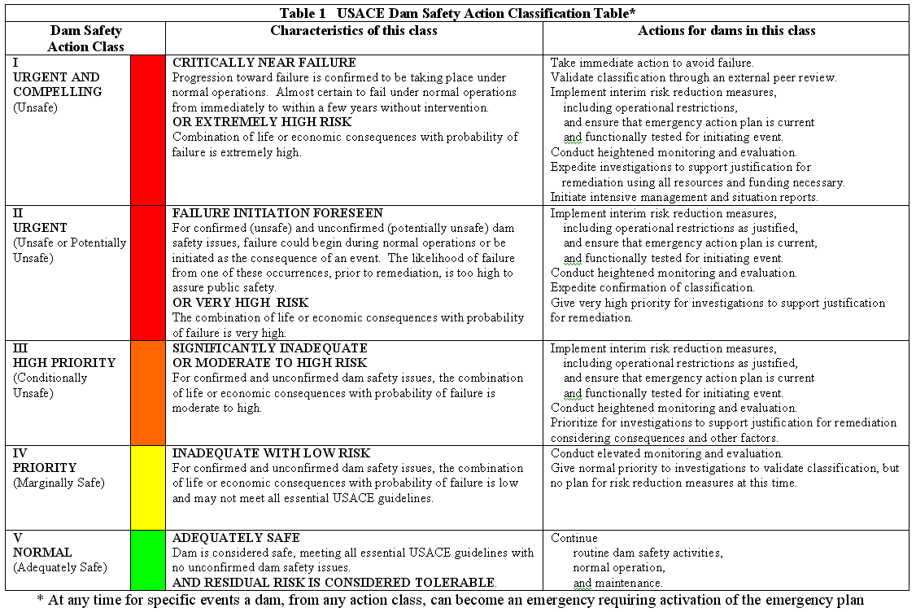
SOG Rated as DSAC II
    1957 internal erosion incident/incomplete grout repair
    Strong Evidence of continuing seepage problems

Slide 19
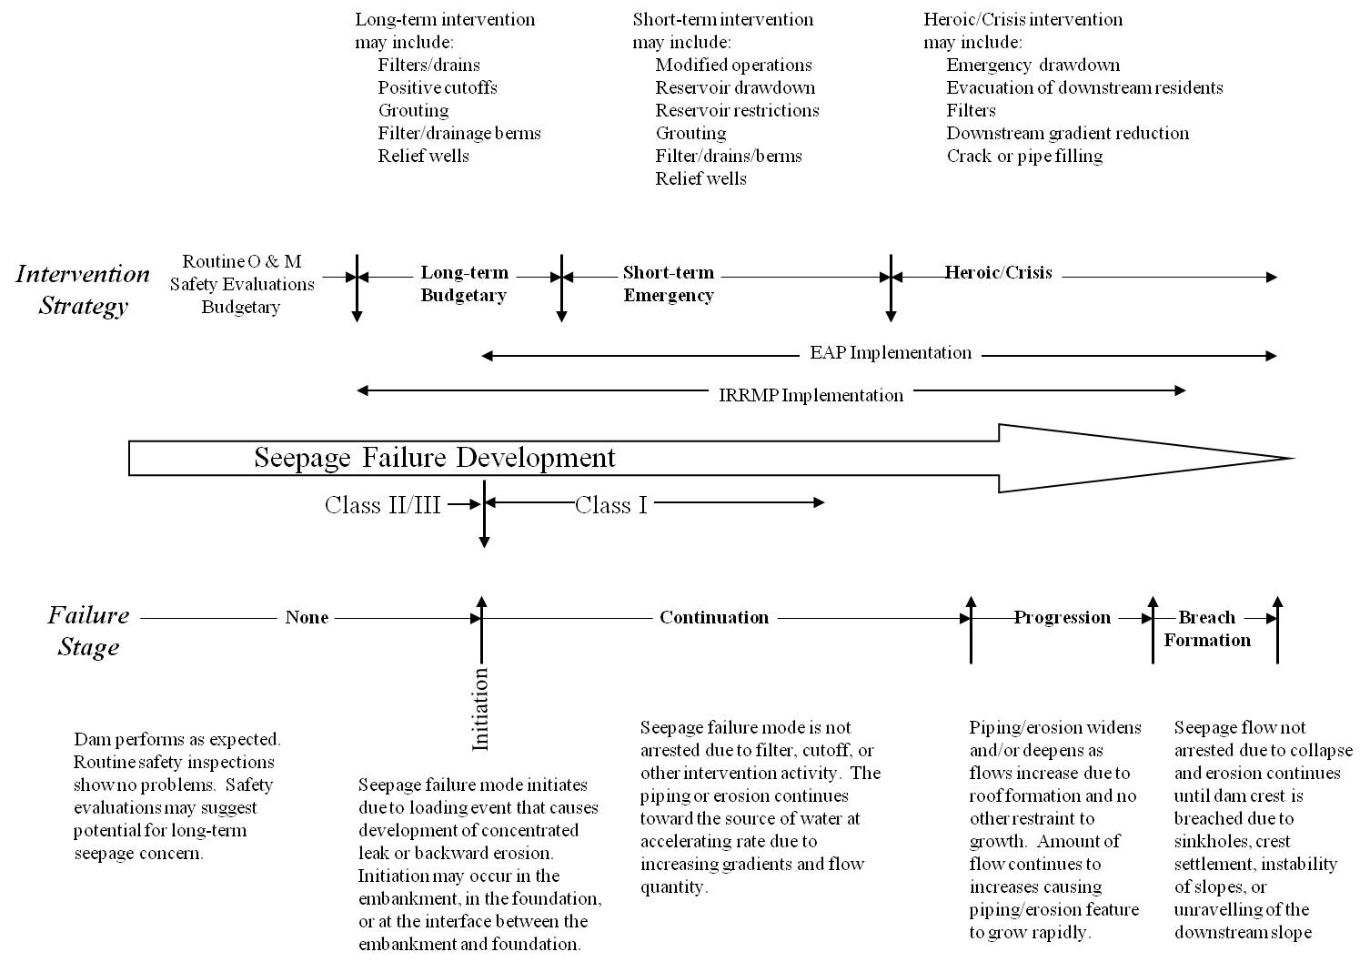
Failure Continuum
East Branch 1957 Crisis
East Branch 1957-2008
(After Grout Repair)
19

Slide 20
Issue Evaluation Study Queue
2006
SPRA Cadre
IRRM’s 2007
US Bureau of Reclamation
Partnering Opportunity
January 2008

Slide 21
Issue Evaluation Study
January 2008
EAST BRANCH DAM
Issue Evaluation Study
by US Bureau of Reclamation
COE-USBR INTERAGENCY AGREEMENT
Collaboration & Training
2008 Funding for IES
USBR – Lead Agency $90 k
CELRP – Technical Support & Review $70 k
$ 160 k

Slide 22
Issue Evaluation Study Plan
US Bureau of Reclamation
4 Basic Steps (Phase I)
Perform a facilitated PFMA and Risk Estimate.
  Existing Design & Construction Documentation Review
  Potential Failure Mode Analysis
  Estimate Conditional Probabilities of Failure for critical failure modes
  Estimate Consequences of Failure (Annualized LoL)
Analyze Results with respect to the USBR Public Protection Guidelines. (USACE Tolerable Risk Guidelines had not yet been formulated)
Use the results and guidelines to recommend appropriate Dam Safety Actions.
Document Findings, Conclusions, and Actions

Slide 23
Key Findings from Document Review
Piezometers in Former Cavity Area Confirm High Gradients Across Grouted Zone
High Potential for Seepage, Piping, and Internal Erosion on Right and Left Abutments
Flow
Overburden
Rock
Sta 8+30
Note: At Record Pool the Spillway Crest El 1685
was overtopped by 183 mm in June 1972

Slide 24
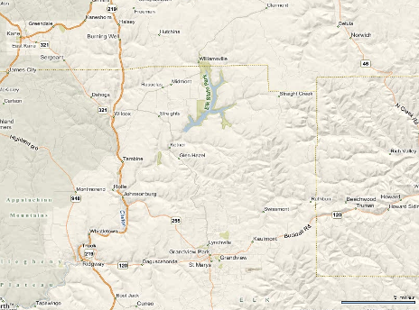
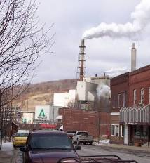
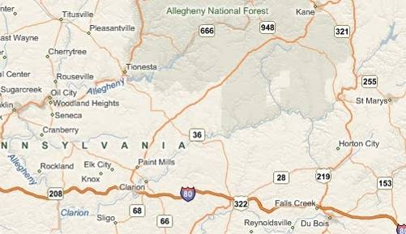
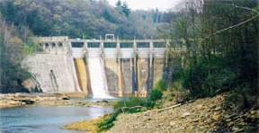
East Branch Dam
Consequence Analysis – USBR Method by Wayne Grahm
East Branch Dam
Glen Hazel
1.6 km Downstream
Population 100
Johnsonburg
12 km Downstream
Population 3,000
Johnsonburg Paper Mill
Johnsonburg
Paper Mill
Ridgway
24 km Downstream
Population 4,500
Johnsonburg o
Economic Losses $200M+
Population at Risk 8,800
Estimated Loss of Life 10 to 130
Ridgway o
Piney Dam – 132 km
sPRA LoL @ 3 - 30
Mouth of Clarion River – 175 km

Slide 25
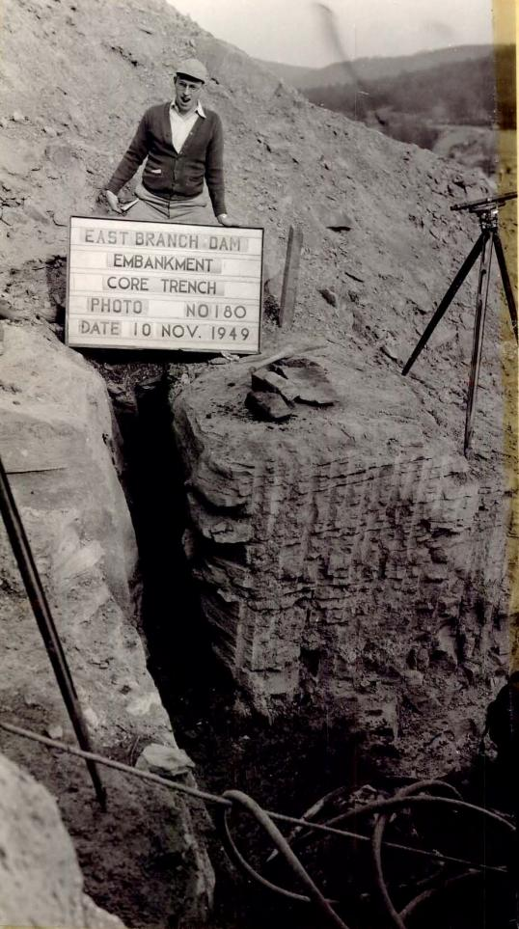
“Smoking Gun”
Untreated rock joints in cut-off trench
Photo evidence at Sta 8+40 discovered by Risk Cadre during review of data housed at the Federal Archives in Philadelphia.
This was a key piece of evidence
Notes:
Vertical sidewalls left untreated in cutoff trench.
Large joints in upstream side of cutoff trench near Station 8+56 were not treated.
Dam constructed with soil cutoff trench into rock (right abutment only) with untreated joints
Dam composed of highly erodible soils
High potential for erosion of soil into joints under water pressure from reservoir

Slide 26
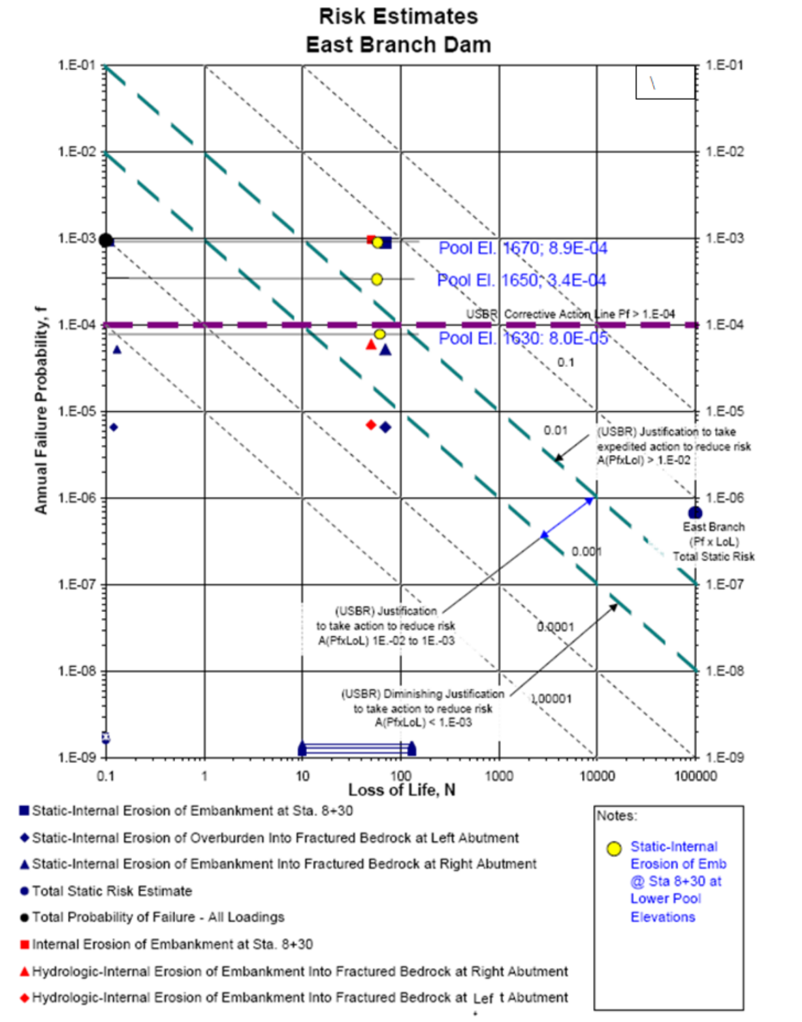
USBR Risk Analysis Results
(Public Protection Guidelines)
Confirmed SPRA findings that the project posed unacceptable high risk
Expedited Actions were justified

Slide 27
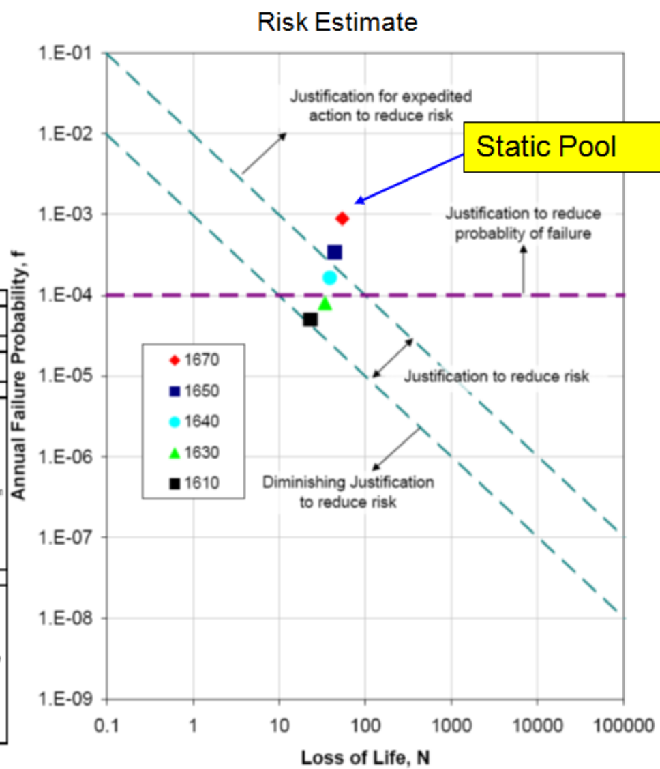
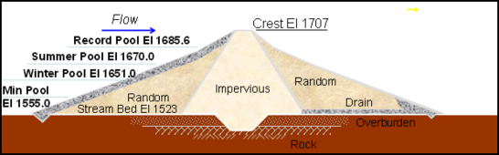
IRRM
Interim Water Control Plan for
Pool Restriction
CELRP District Commander directed immediate pool restrictions as IRRM
Risk Cadre evaluated pool elevation that would achieve risk guideline
Decision made to implement El 1650 pool restriction and implement additional non-structural IRRM’s

Slide 28
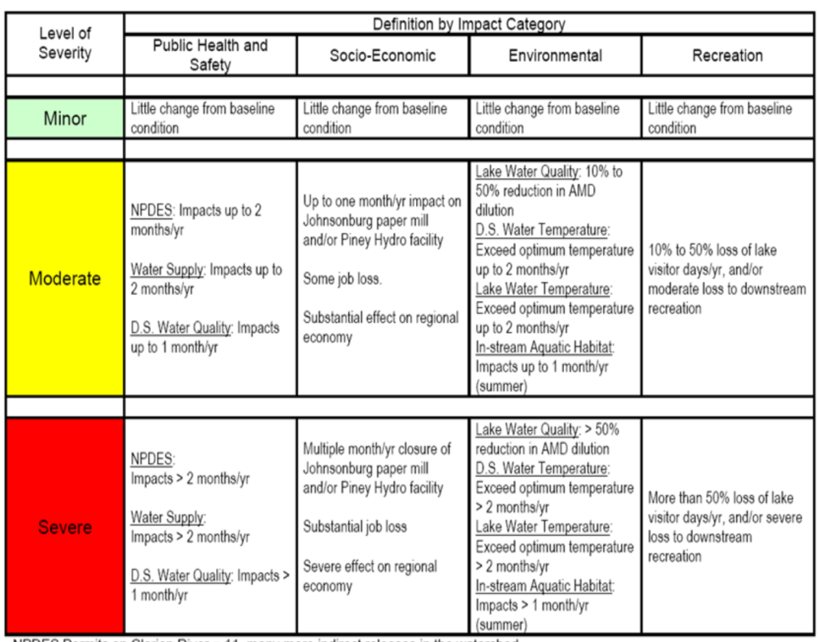
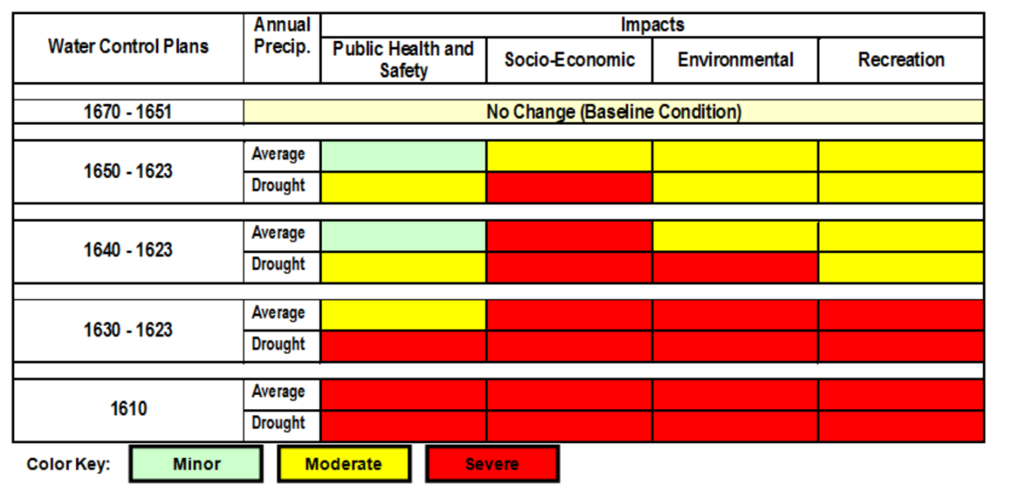
Non-Risk Impact Considerations for selection of pool restriction
Findings used as basis for Environmental Assessment
District chose to implement operating restrictions (lower summer pool elevation) and additional IRRMs
HQ and RMC had numerous concerns with this approach.
“Public Safety is Paramount”

Slide 29
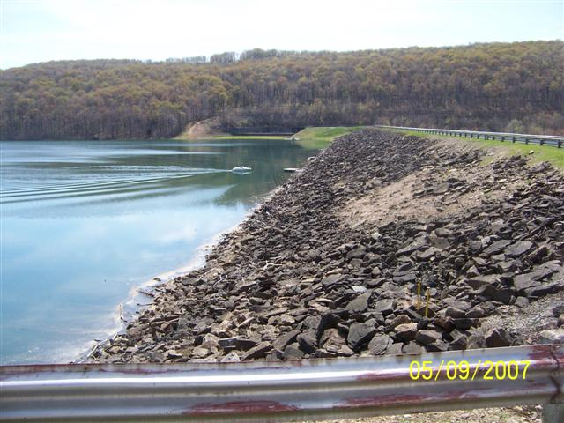
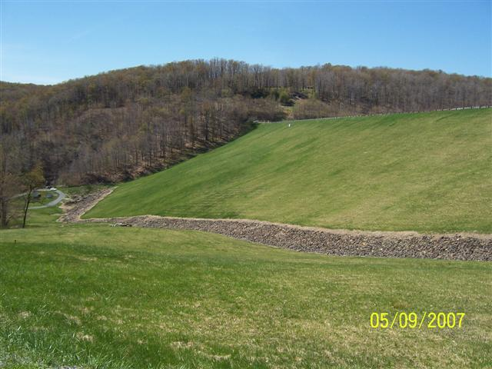
Interim Risk Reduction Measures
Additional instrumentation/more frequent monitoring
Cross-train regional staff
24-hour surveillance at dam
Update Emergency Action Plan and calling tree
Develop new inundation mapping
Conduct drills and exercises
Monthly Public meetings and media coordination
Pre-position contracts/materials
Restricted operation of reservoir:
    Summer Pool – EL 1650
    Winter Pool – EL 1623

Slide 30
Failure Continuum
East Branch 2008 to Present
w/ IRRMs
1957 Seepage Incident
East Branch
1957-2008
(After Grouting Repair)

Slide 31
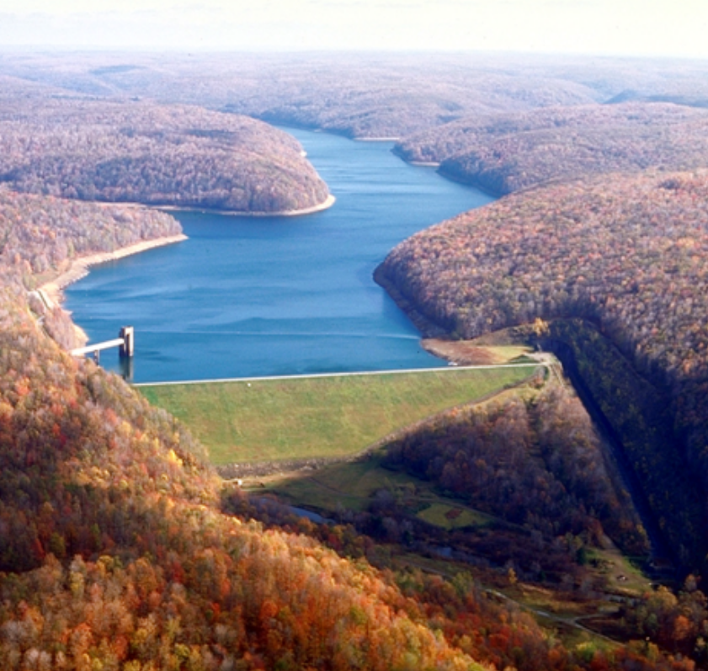
East Branch Dam
Dam Safety Modification Study
Started October 2009
Guidance from RMC to Cadre & District
  Be flexible as we finalize policy, procedures, and methodology
  Use DRAFT ER 1156
  Risk Cadre – New Tools (Risk Methodology, Toolboxes, etc)
  District PDT – New Rules (DSA & MRR DSMS, ATR, IEPR)

Slide 32
Dam Safety Modification Study Process
Estimate Baseline Risk of Project based on all significant failure modes
Identify structural and non-structural alternatives to reduce risk
Formulate risk reduction alternatives by combining relevant risk reduction measures to achieve a recommended plan that meets tolerable risk guidelines, ALARP, and essential USACE guidelines.
Periodically coordinate review efforts and study findings with RMC, SOG, and Vertical Team (MSC, ATR, HQ).
CELRP hired an A-E panel of independent advisors to provide input and guidance during alternative selection.

Slide 33
East Branch Dam
Dam Safety Modification Study
USBR IES methodology
  Identify primary risk drivers
  3 Seepage & Piping failure modes @ 3 static pool elevations
ER 1156 Chapter 9 DSMS
  Consider all significant PFM’s in baseline risk estimate
  RMC Cadre identified 10 significant failure modes
QCC Findings
  Failure modes identified are very concerning; corrective actions are justified
  Seepage & Piping Toolbox results appear high
  RMC required reanalysis using Expert Elicitation
In Progress Review
  RMC and SOG required evaluation of additional alternatives
  Independent panel of experts could not be used for IEPR

Slide 34
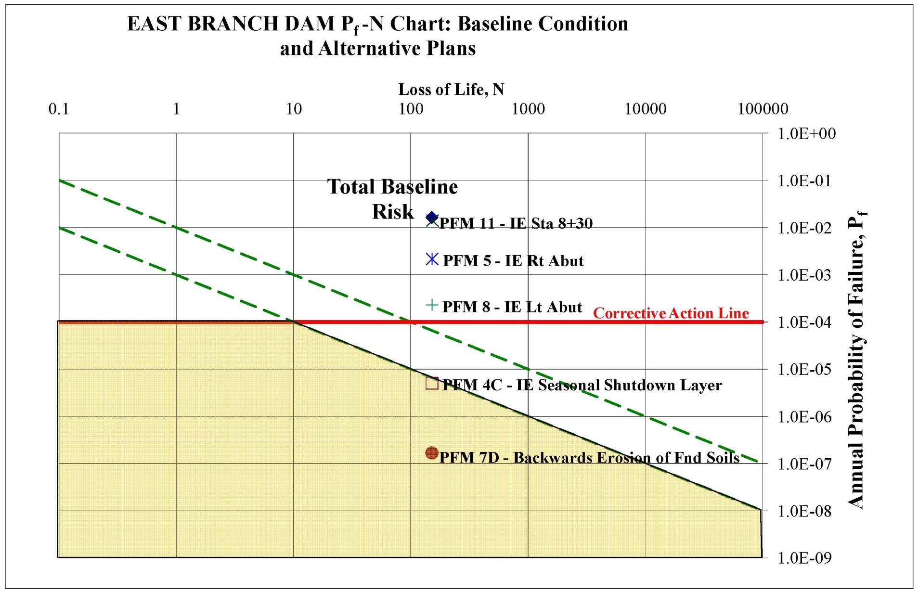
Results of Baseline Risk Assessment
Risks above Tolerable Levels and Justifying Expedited Action
Tolerable Risk Limits

Slide 35
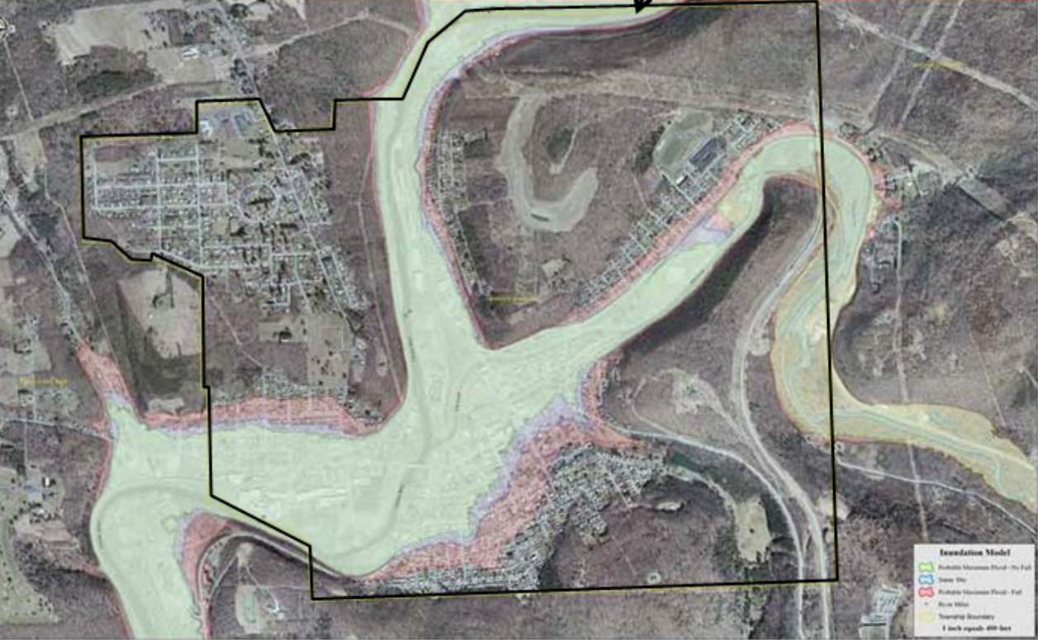
Baseline Risk Assessment
Consequences of Dam Failure
Estimated Loss of Life – 227 people
Economic Damages – $1.04 Billion (including physical damages, loss of dam and loss of attendant benefits)
Annual lost benefits = $83 M
SPRA : 3 – 30
USBR IES: 10 - 130

Slide 36
East Branch Dam – Alternative Remedial Plans
S1 – Partial Length Cutoff
S2 – Full Length Cutoff in Soil, Grouting of Bedrock
S3 – Full Length Cutoff in Soil and Rock
S4 – Embankment Extension with D/S Cutoff
S5 – Concrete Gravity Structure
S6 – Remove Dam
NS1 – All IRRMs permanent (El 1650 Summer Pool)
NS2 – NS1 + Spillway Modifications
NS3 – Permanently Open Flood Gates (Dry Reservoir)
Note: Plans S1-S5 would restore normal summer pool El 1670

Slide 37
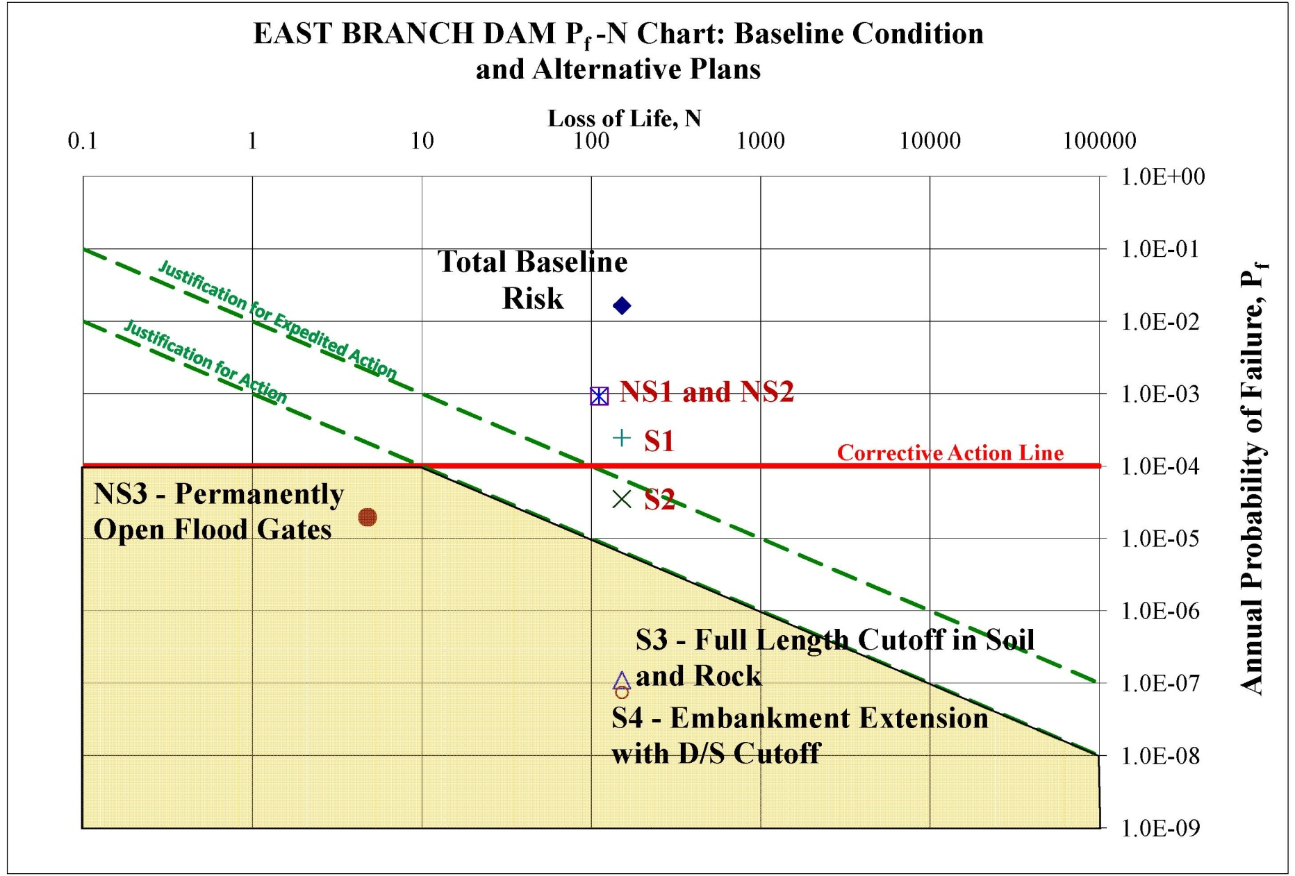
Dam Safety Modification Study Process
4. Risk Evaluation of Alternative Plans

Slide 38
Dam Safety Modification Study Process
Evaluation of Alternative Plans
S1 – Partial Length Cutoff
S2 – Full Length Cutoff in Soil, Grouting of Bedrock
S3 – Full Length Cutoff in Soil and Rock
S4 – Embankment Extension with D/S Cutoff
S5 – Concrete Gravity Structure
S6 – Remove Dam
NS1 – All IRRMs permanent
NS2 – All IRRMs permanent + Minor Spillway Mods.
NS3 – Permanently Open Flood Gates

Slide 39
Dam Safety Modification Study Process
Evaluation of Alternative Plans
Plans S5, Concrete Gravity Structure – No explicit risk assessment performed. Considered risk-acceptable, since construction would be in accordance with current standards.
Plan S6, Remove Dam – Eliminates possibility of catastrophic dam failure. (Downstream public subject to increased risk associated with more frequent flooding)

Slide 40
DSM Study Process
Risk-Acceptable Alternative Remedial Plans
S3 – Full Length Cutoff in Soil and Rock
S4 – Embankment Extension with D/S Cutoff
S5 – Concrete Gravity Structure
S6 – Remove Dam
NS3 – Permanently Open Flood Gates

Slide 41
DSM Study Process
Risk-Acceptable Alternative Remedial Plans
S3 – Full Length Cutoff in Soil and Rock
S4 – Embankment Extension with D/S Cutoff
S5 – Concrete Gravity Structure
S6 – Remove Dam
NS3 – Permanently Open Flood Gates
Would Result in Loss of Most or All of Authorized Purposes

Slide 42
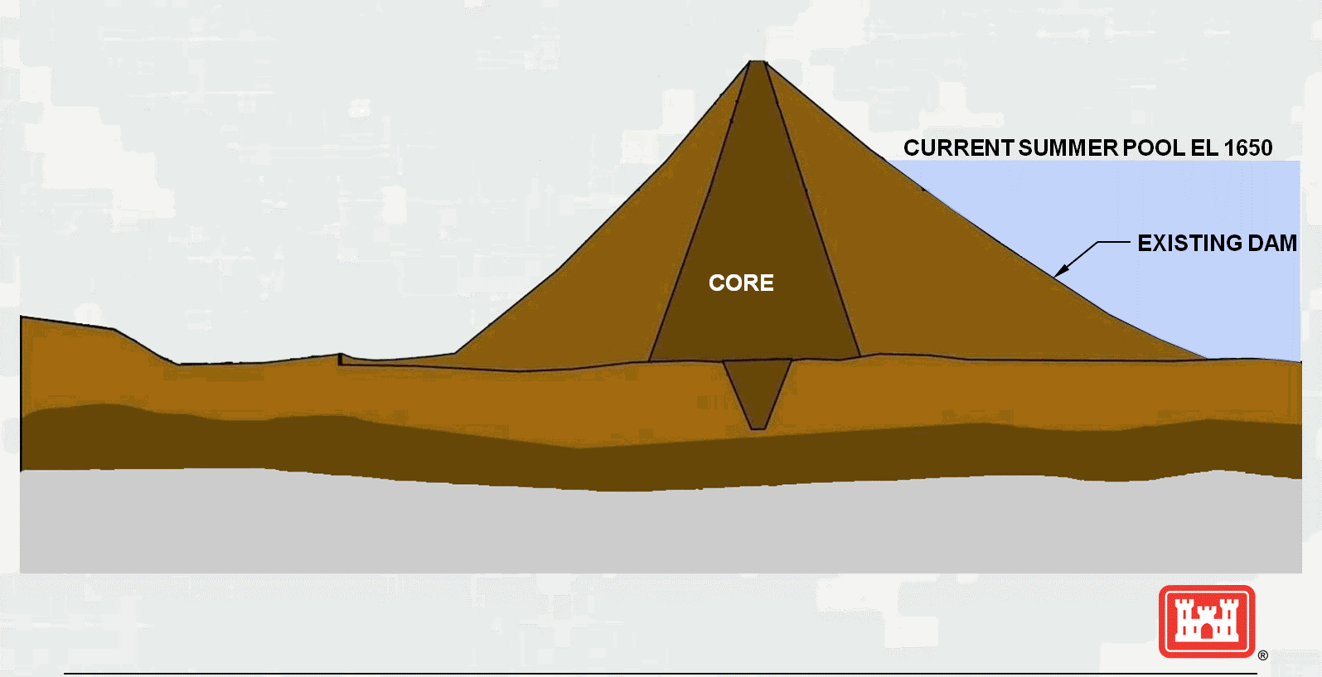
S3 – Full Length Cutoff in Soil and Rock

Slide 43

S3 – Full Length Cutoff in Soil and Rock

Slide 44
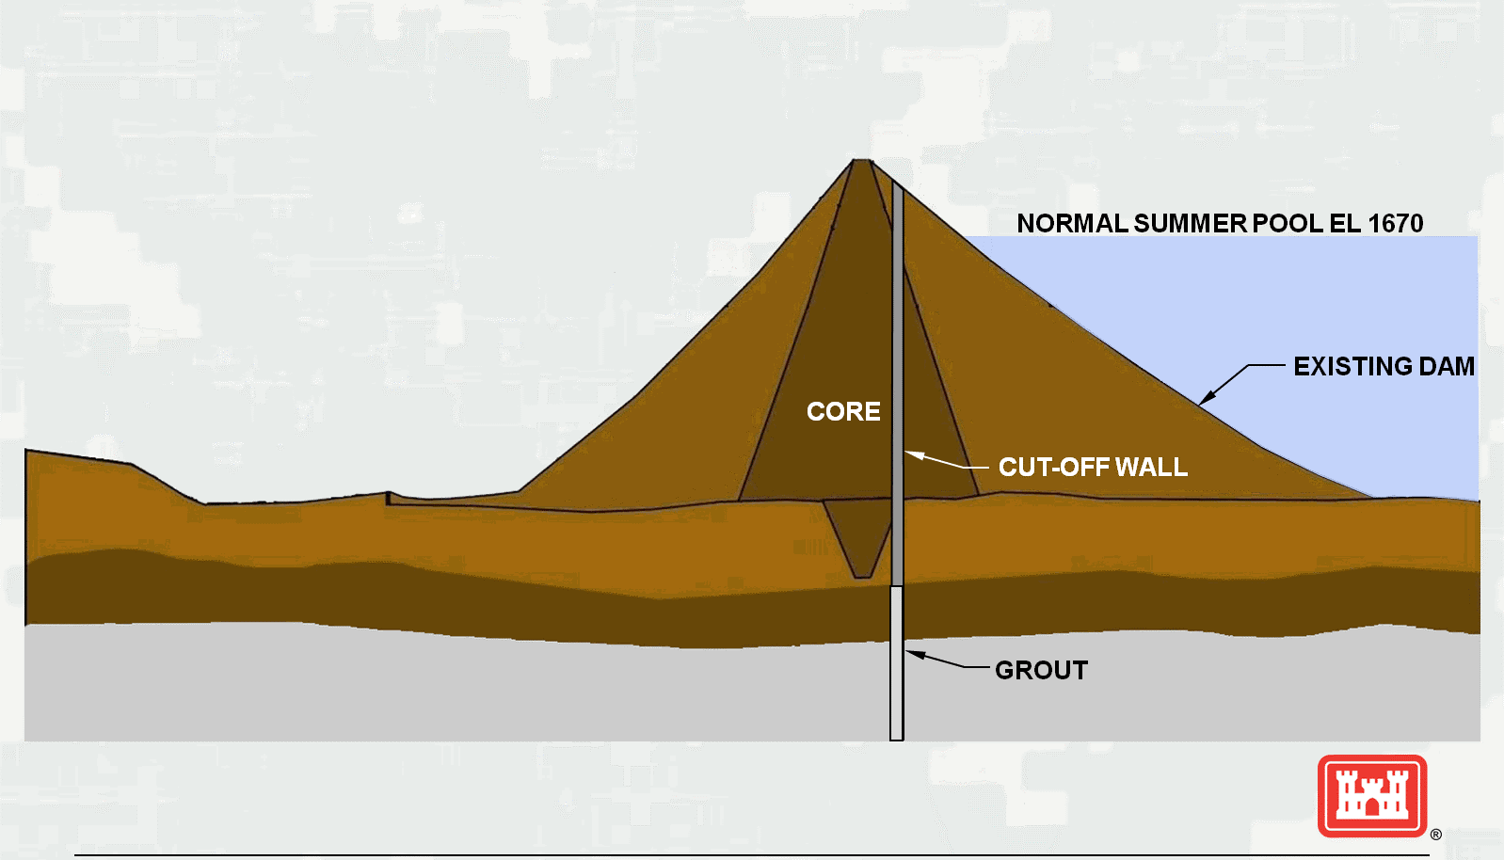
S3 – Full Length Cutoff in Soil and Rock

Slide 45
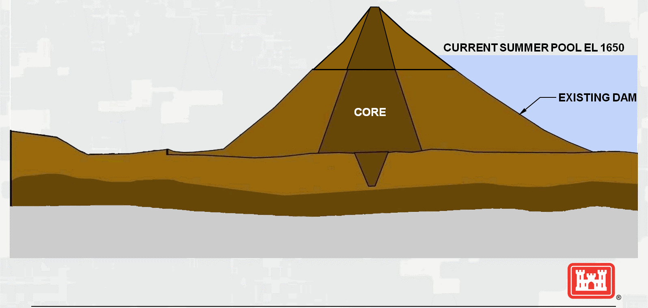
S4 – Embankment Extension with D/S Cutoff

Slide 46

S4 – Embankment Extension with D/S Cutoff
CUTOFF WALL

Slide 47
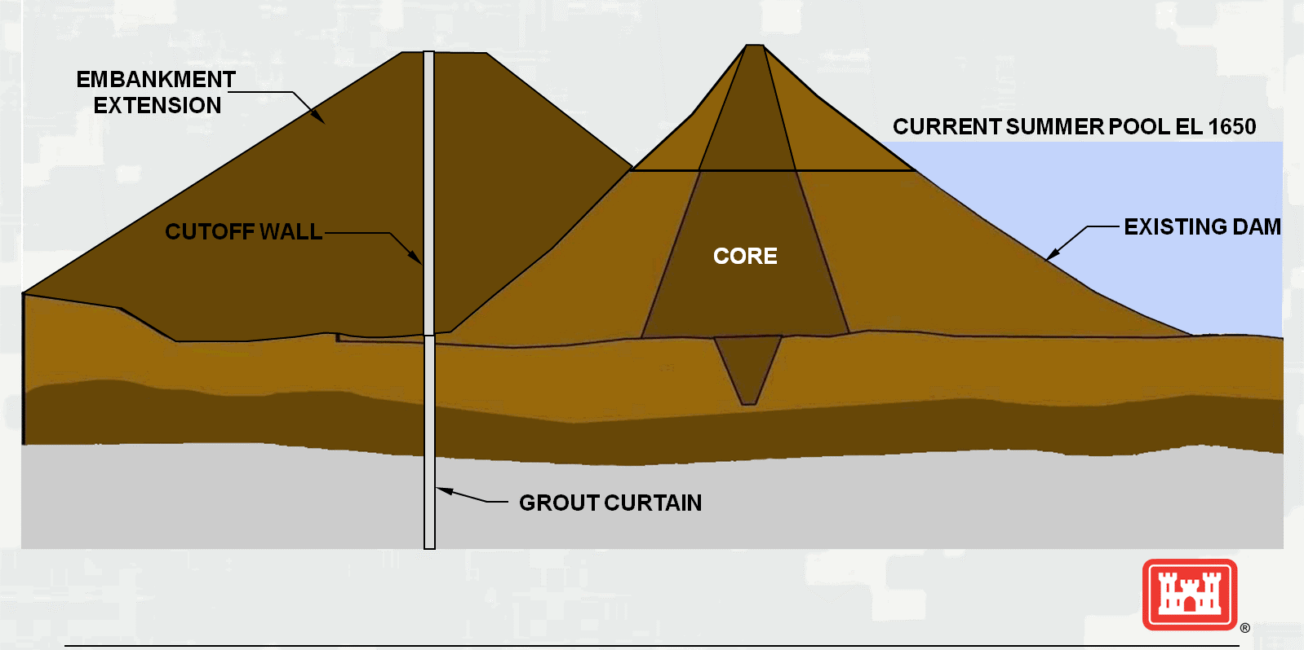
S4 – Embankment Extension with D/S Cutoff

Slide 48
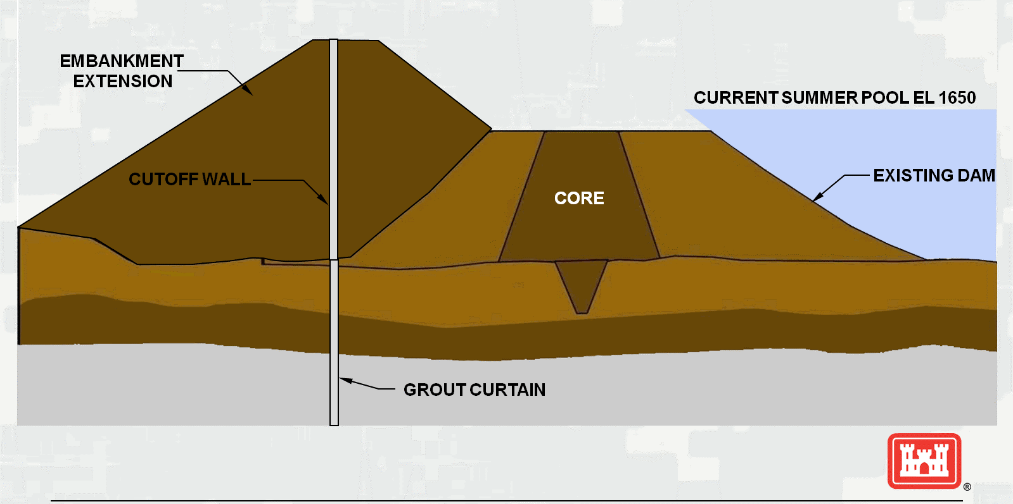
S4 – Embankment Extension with D/S Cutoff

Slide 49
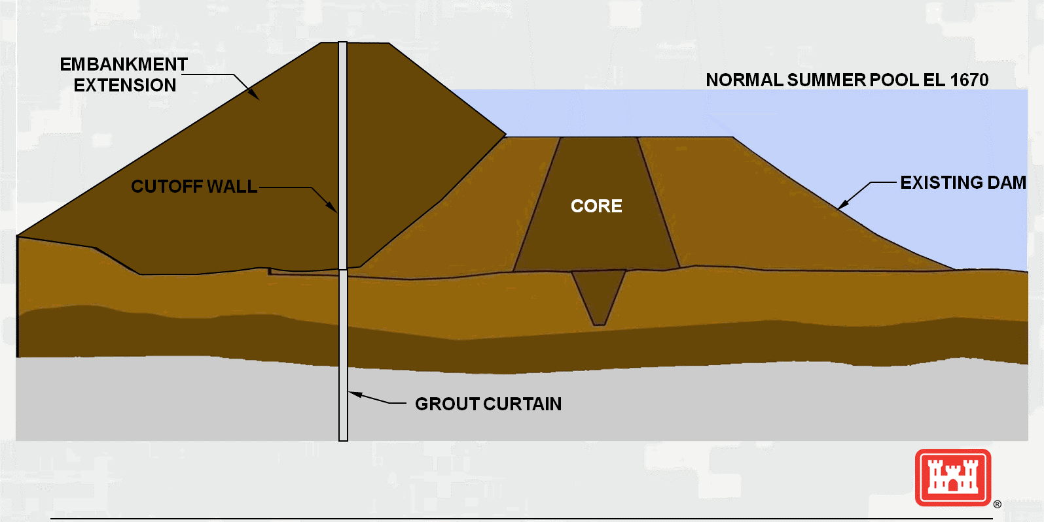
S4 – Embankment Extension with D/S Cutoff

Slide 50
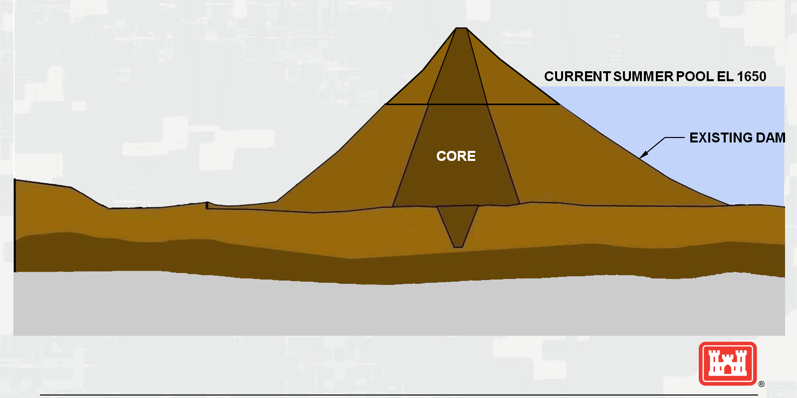
S5 – Concrete Gravity Structure

Slide 51

S5 – Concrete Gravity Structure

Slide 52
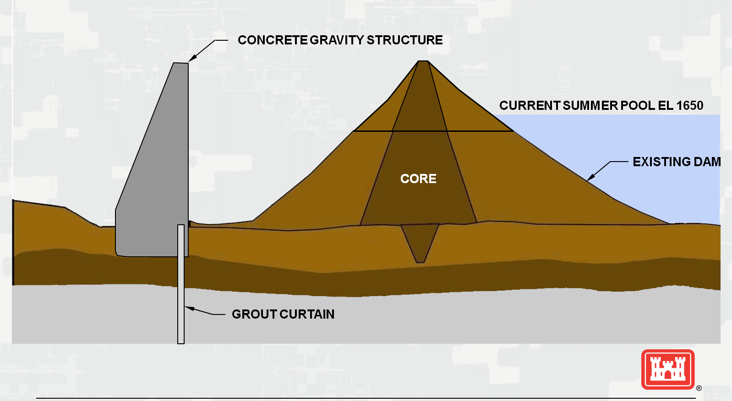
S5 – Concrete Gravity Structure

Slide 53
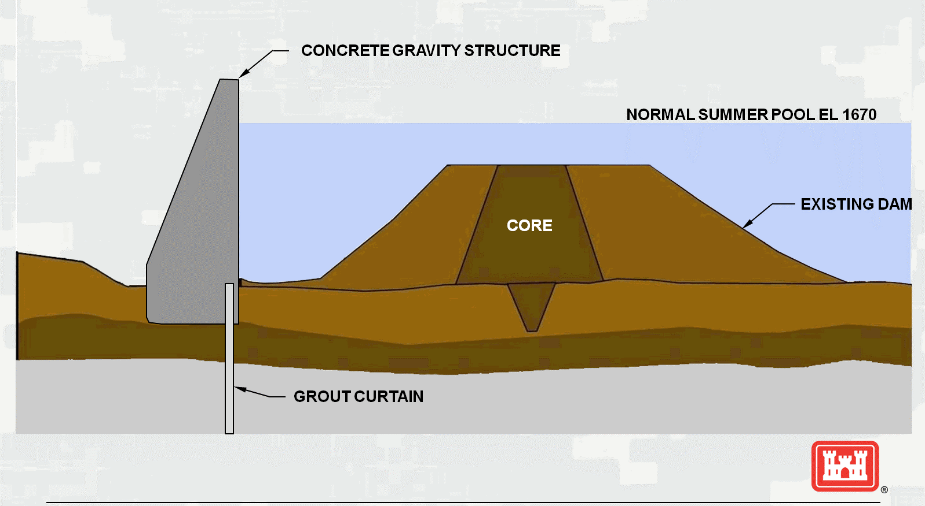
S5 – Concrete Gravity Structure

Slide 54
Dam Safety Modification Study Process
5. Key Comparison Factors
Authorized Purposes (S3, S4 and S5 sustain all)
Environmental Impacts (S3 slightly more favorable during and after construction)
Economic Impacts (S3, S4 and S5 roughly equal, each cause some impacts during construction)
Screening Level Costs
  S3 - $284 M
  S4 - $450 M
  S5 - $639 M
54

Slide 55
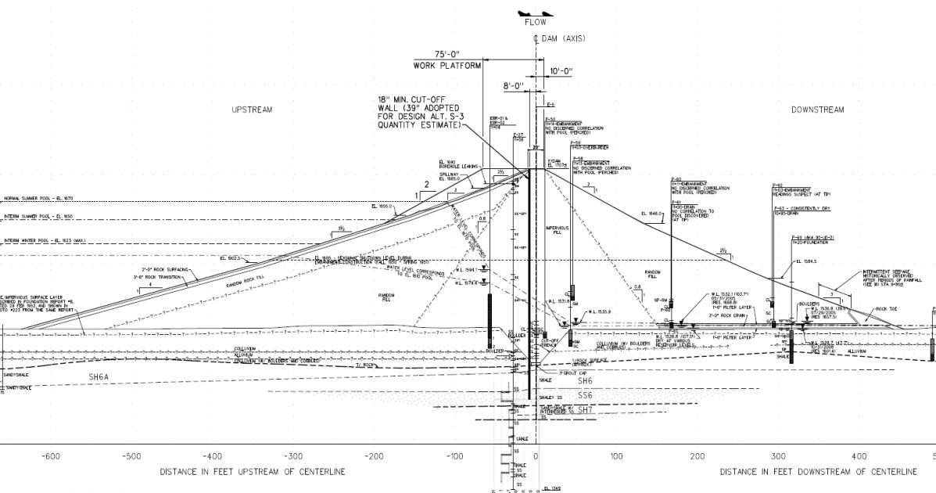
Recommended Alternative S-3
Full Depth, Full Length Cut-Off Wall
Work Platform
Cutoff Wall
FOUNDATION SOIL
BEDROCK
Selected plan developed to 60% design level

Slide 56
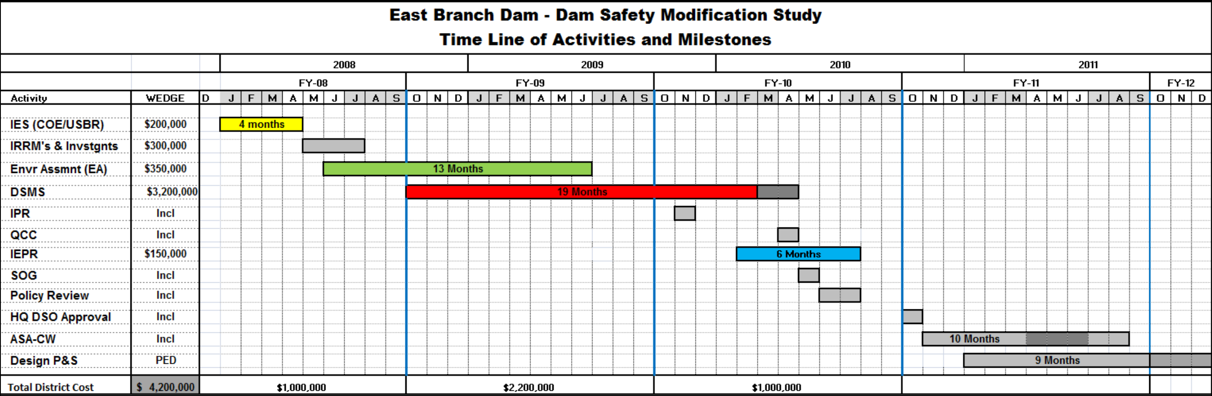

Slide 57
Lessons Learned
East Branch and other DSMS Projects
Identification of high risk projects is not always intuitive. East Branch was not identified in the first SPRA data call for BAD BOYs. Each level of risk analysis made the case for corrective actions more compelling.
Do not go into the process with preconceived solutions. Many risk reduction alternatives on other projects have not required cut-off walls.
Monthly meetings with the Vertical Team and ATR team is essential.
The baseline risk estimate must be reviewed and approved by the RMC and QCC panel prior to formulation of alternatives.
Formulation of alternatives must include vertical team, RMC and SOG.
Screening level alternative designs can have high uncertainty in cost estimates. All final alternatives shall be developed to a consistent design level and supported with a cost and schedule risk analysis.
Selection of recommended plan must include vertical team, RMC and SOG representatives
IEPR Type 1 should be conducted concurrently with SOG Panel Review, with final IEPR comments submitted after SOG review.

Slide 58
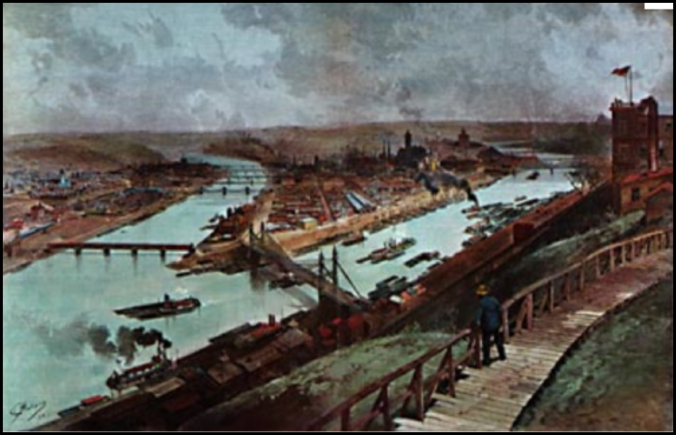
QUESTIONS ?
Pittsburgh Circa 1850

