Slide 1
TABLE ROCK DAM SLIDE – CASE STUDY
Dave Paul, P.E.
Lead Civil Engineer
U.S. Army Corps of Engineers
Risk Management Center
David.B.Paul@usace.army.mil
Dam Safety Workshop
Brasília, Brazil
20-24 May 2013

Slide 2
Purpose
Provide real-life application for reporting distress
Review project conditions and distress reporting timeline
Stress Dam Safety training and communication
Emphasize the importance of partnering with regional experts

Slide 3
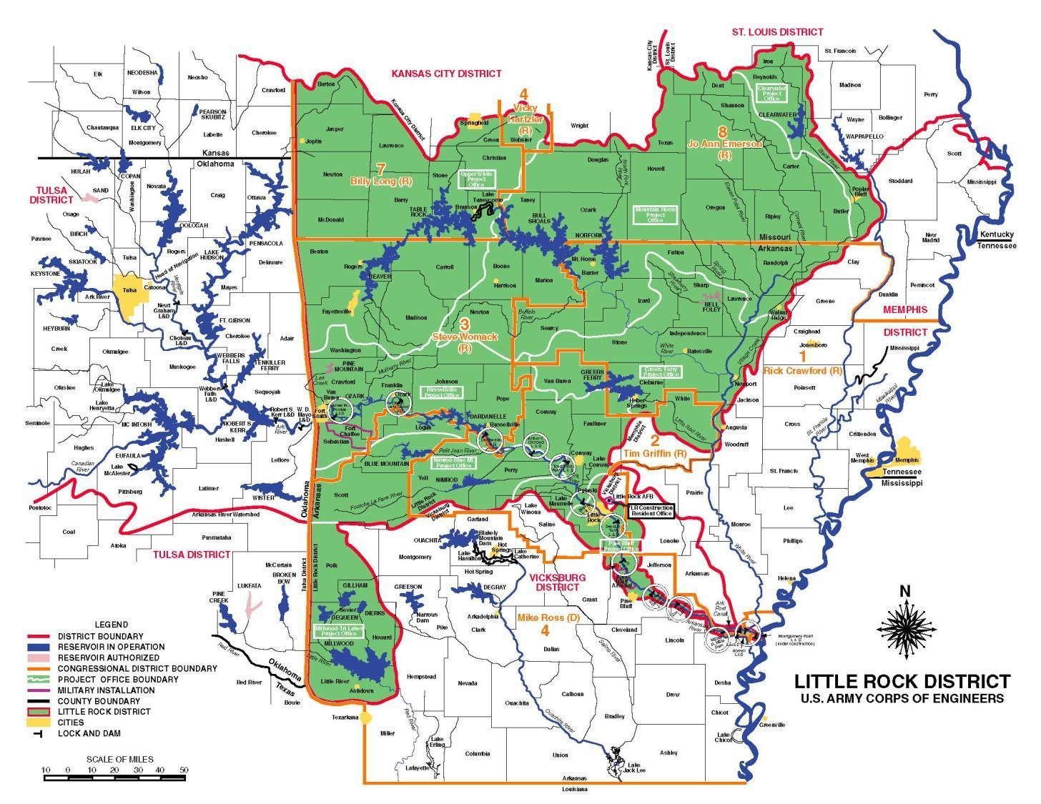
Event Background
Notes:
SWL operates 6 flood damage reduction lakes in the White River Basin
Drains 28,000 sm across southern Missouri and Arkansas
Empties into the Mississippi River near Tichnor, AR
SWL operates 13 navigation locks and dams and 2 flood damage reduction lakes in the Arkansas River Basin in Arkansas.
The entire basin, which originates in the Rocky Mountains of CO, drains 160,000 sm before joining the White River and emptying into the Mississippi River.

Slide 4
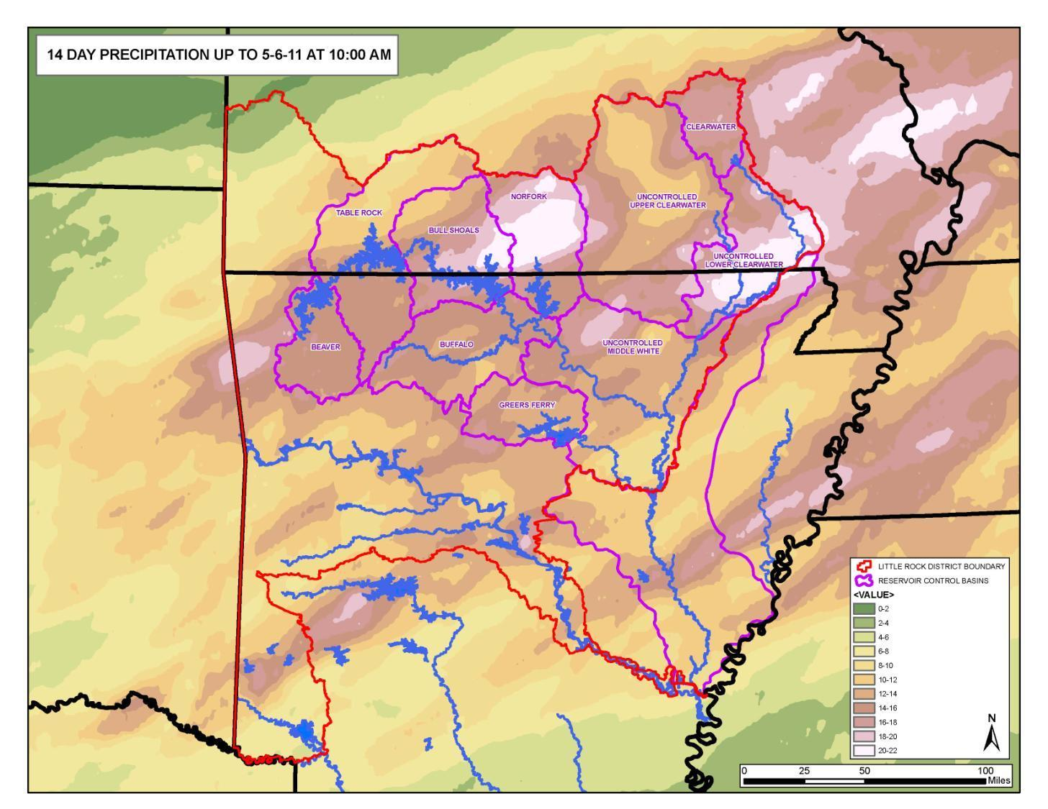
Notes:
The map shows the 14 day total rainfall.
Most of the rainfall occurred in a 72-hour period from 4/24 to 4/27.
A Majority of the rainfall fell in north Arkansas and south Missouri.
By May 6, up to 22 inches of rain had fallen in large portions of the White River Basin.

Slide 5
Rainfall Comparison
Average Rainfall Rainfall Rainfall
DAM April Rain 22-28 April April 2011 April 2008
Beaver 4.5 in 11.57 in 15.1 in 9.16 in
Table Rock 4.1 10.43 13.6 7.90
Bull Shoals 3.9 12.06 15.3 7.90
Norfork 4.1 13.23 16.8 8.15
Greers Ferry 4.9 7.4 10.6 9.21
Clearwater 4.5 11.31 14.01 9.16
Notes:
Largest release did not exceed the largest inflow
The map shows the 14 day total rainfall.
Most of the rainfall occurred in a 72-hour period from 4/24 to 4/27.
Lake Basin Ave April 4/2011 22-28 Apr 11 3/2008 4/2008
BV 4.5” 15.1” 11.57” 11.77” 9.16”
TR 4.1 13.6 10.43 10.04 7.90
BS 3.9 15.3 12.06 12.85 7.90
NF 4.1 16.8 13.23 15.06 8.15
GF 4.9 10.6 7.40 10.33 9.21
CW 4.5 14.01 11.31 11.77 9.16

Slide 6
Rainfall Comparison
Average Rainfall Rainfall Rainfall
DAM April Rain 22-28 April April 2011 April 2008
Beaver 4.5 in 11.57 in 15.1 in 9.16 in
Table Rock 4.1 10.43 13.6 7.90
Bull Shoals 3.9 12.06 15.3 7.90
Norfork 4.1 13.23 16.8 8.15
Greers Ferry 4.9 7.4 10.6 9.21
Clearwater 4.5 11.31 14.01 9.16
Notes:
Largest release did not exceed the largest inflow
The map shows the 14 day total rainfall.
Most of the rainfall occurred in a 72-hour period from 4/24 to 4/27.
Lake Basin Ave April 4/2011 22-28 Apr 11 3/2008 4/2008
BV 4.5” 15.1” 11.57” 11.77” 9.16”
TR 4.1 13.6 10.43 10.04 7.90
BS 3.9 15.3 12.06 12.85 7.90
NF 4.1 16.8 13.23 15.06 8.15
GF 4.9 10.6 7.40 10.33 9.21
CW 4.5 14.01 11.31 11.77 9.16

Slide 7
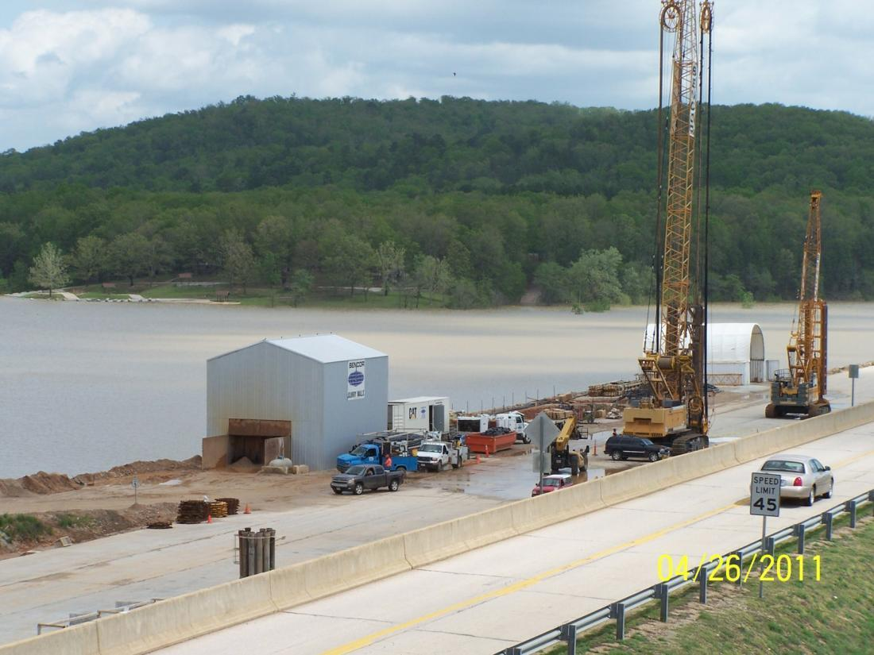
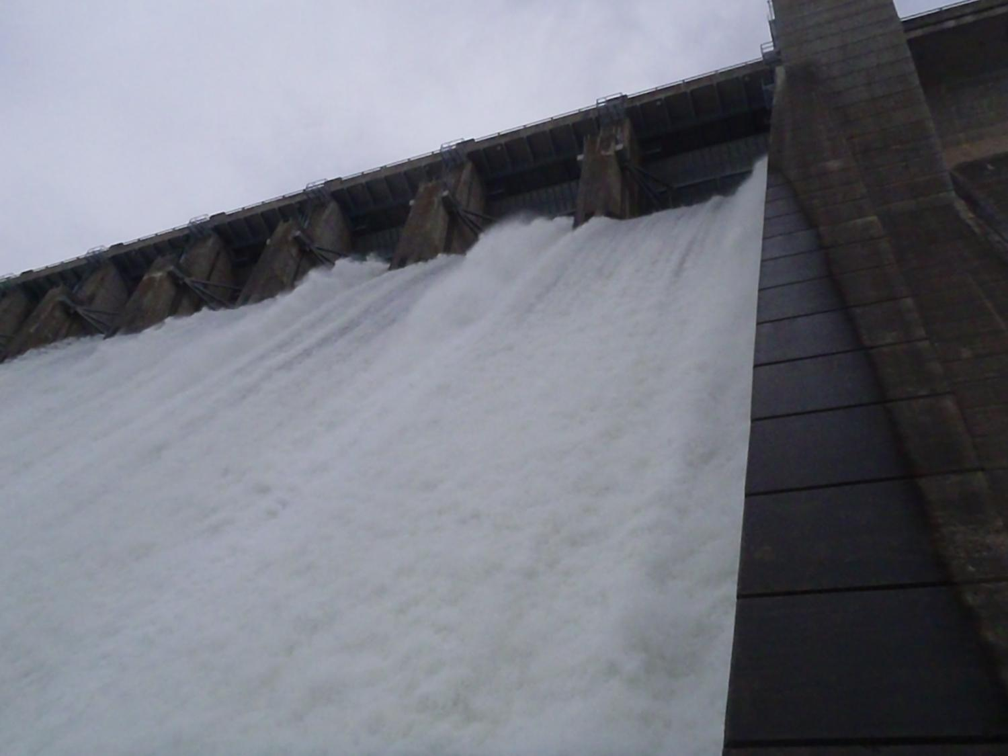
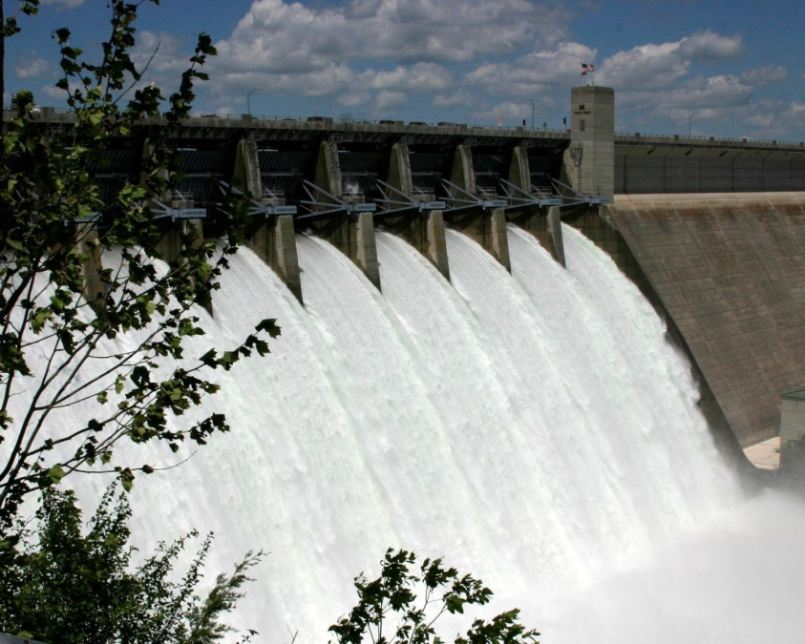
CHALLENGES
Dams
Notes:
Clearwater is a DSAC I dam with a Water Action Plan that requires a technical staff on site during higher pools to make decisions on releases. Historic Seepage area at Clearwater where dry, indicating the grouting and ongoing cut-off are successful.
Bull Shoals set a new crest of record El 696.51…Conservation Pool is 657.0…Over 39 foot difference.
Also, highest release of record at 58,000 cfs (5-27-11)
Table Rock Lake set a new pool of record of 935.47…..Cons. Pool is 917…over 17 foot difference.
Beaver (El 1131.8), Clearwater (El 566.6) and Norfork Lakes (El 579.4) reached their second highest pool of record.

Slide 8
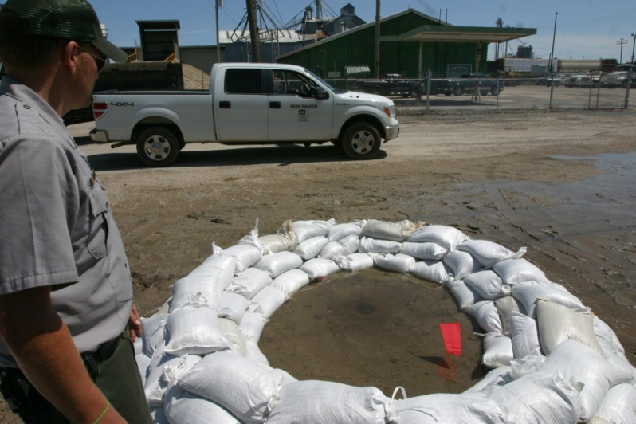
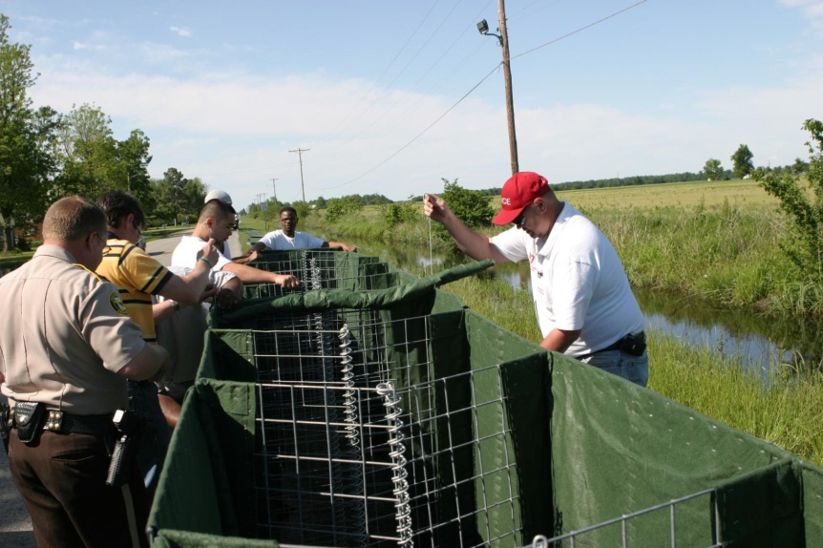
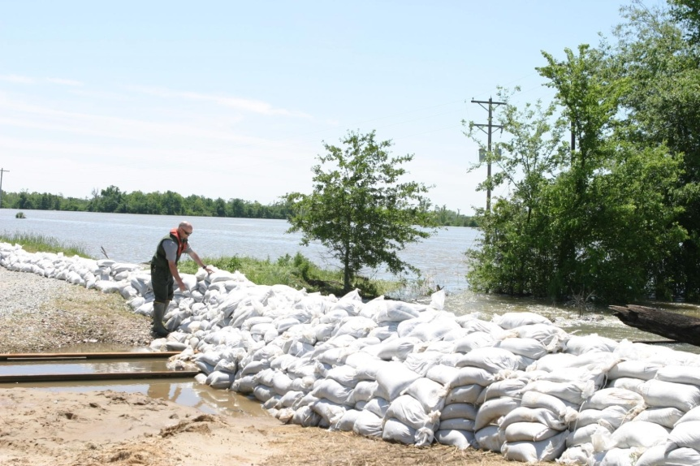
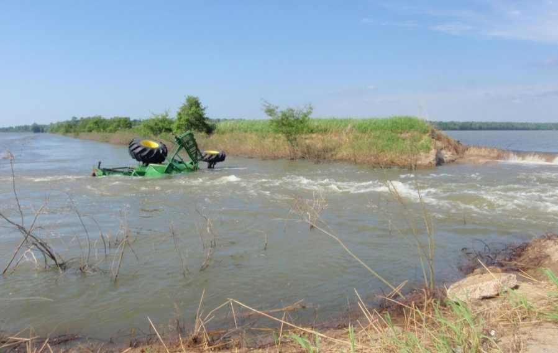
CHALLENGES
Levees
Notes:
Corps personnel placed sandbag ring around boils and monitor condition.
The Corps was asked by the Arkansas State Emergency Management Office and local officials and first responders to provide technical assistance, recommendations and materials to better combat flood waters.
The Corps is considered to be the expert during times of natural disasters.
Should continue to develop relationships and foster trust….BE THERE WHEN CALLED UPON.
Corps personnel provide assistance in evaluation and placement of sandbag closure structures for a railroad spur encroachment.
Over 458,000 sandbags were distributed to various communities within the Little Rock District during this event.
Multiple levee failures occurred at several locations in SE Missouri and NE Arkansas

Slide 9
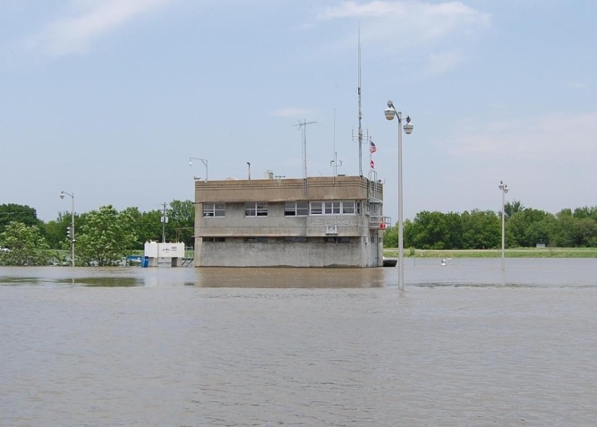
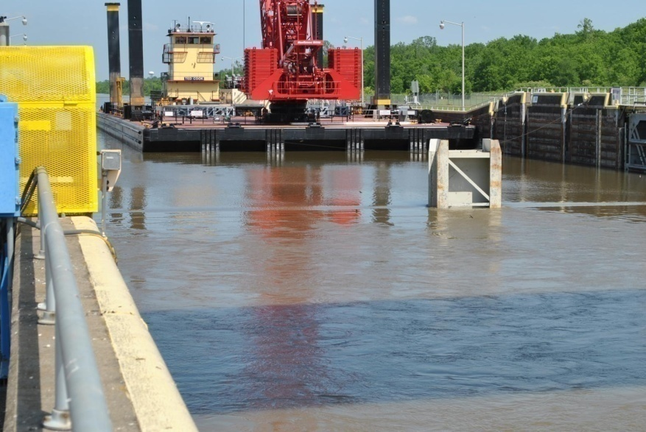
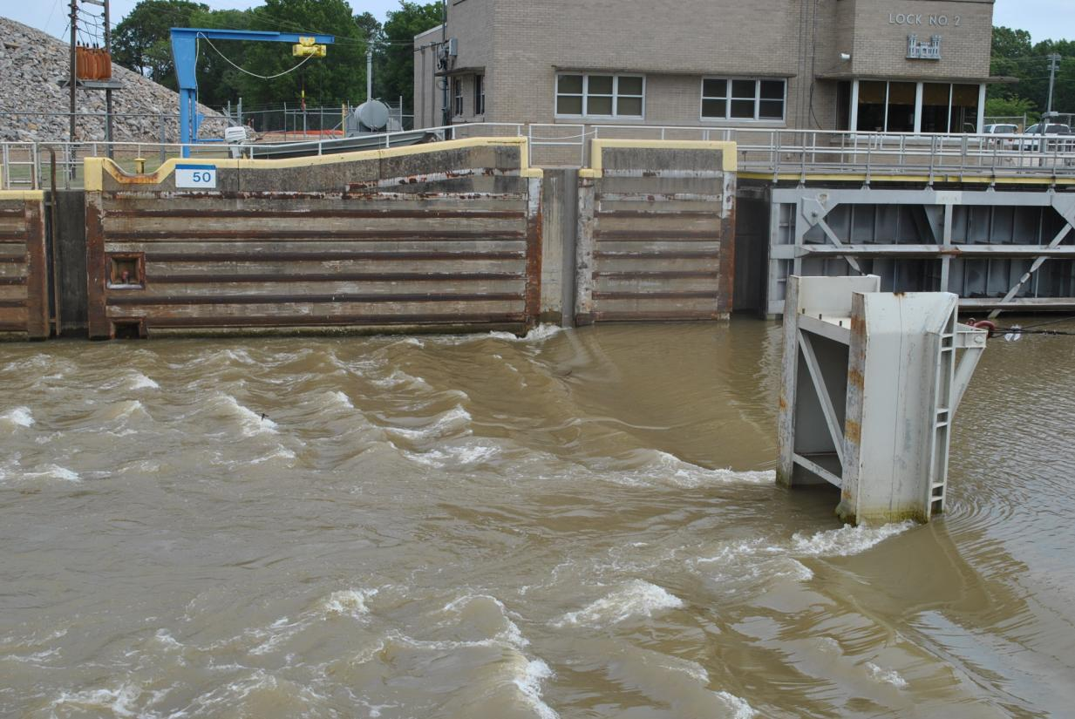
CHALLENGES
Navigation System
Notes:
Mississippi River rose to such a level that flow was running up and into the Arkansas River Navigation channel.
Norrell Lock and Dam No.1, bottom floor under water.
Barge crane at Lock No. 2 after setting stoplogs.
First time that stop logs were placed in Lock No. 2 in an effort to limit damages.
Completed stoplog structure and water flowing upstream.

Slide 10
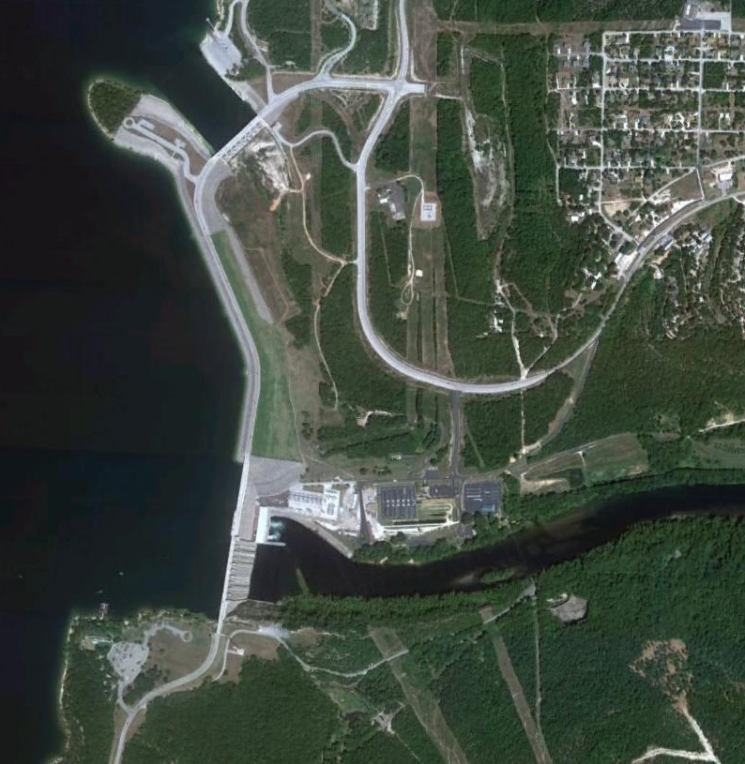
Table Rock Lake Dam
Notes:
Pertinent data for the Table Rock Dam is:
Feature Elevation (ft)
Top of Dam 947.0
Maximum Pool 942.0
Top of Original Gates and
Flood Control Pool 933.0
Conservation Pool 915.0
Spillway Crest 896.0
Previous Pool of Record (April 2008) 933.25
New Pool of Record (April 2011) 935.47
Original Tainter gate Spillway – 10 gates with height = 206-ft.
Auxiliary Tainter Gate Spillway – 8 gates
Original Embankment – 3,800-ft.
New Embankment – Right = 755-ft., Left = 377-ft.

Slide 11
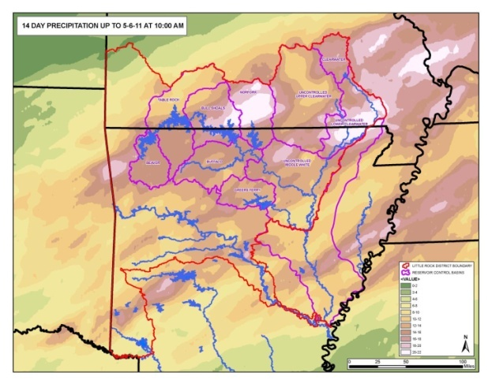
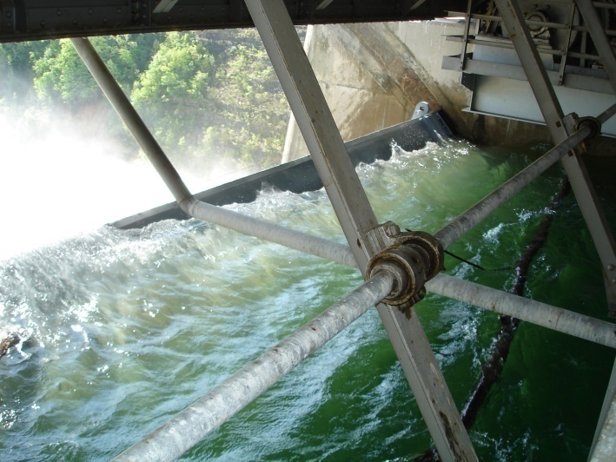
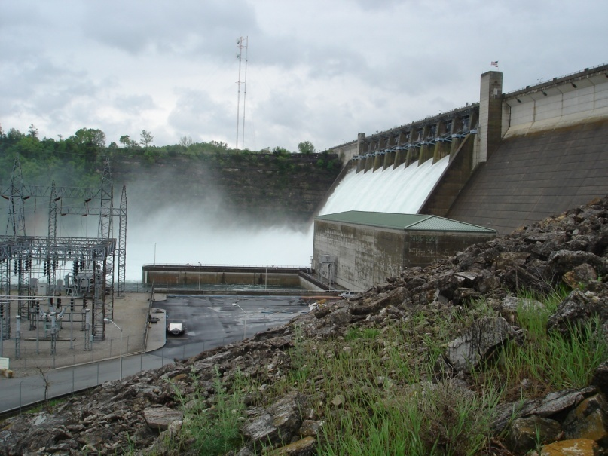
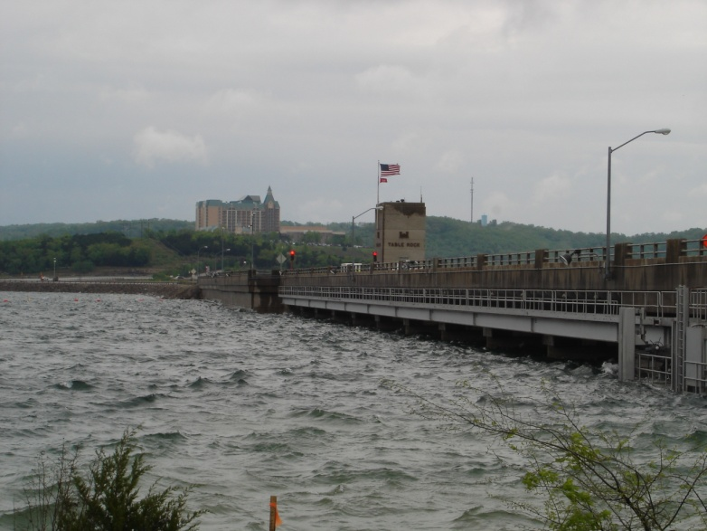
Records at Table Rock Dam
RECORD RAINFALL
RECORD INFLOW
RECORD RELEASE
RECORD POOL
Notes:
During the event of April 2011, an incident began to develop at Table Rock Dam.
The near record rainfall led to record inflow, a record release, followed by a record pool. All of that was topped of with a slide on the downstream slope.
Record Rainfall = 10” in 72+ hours
Record Inflow = 290,000 cfs
Record Release = 68,000 cfs (previous record = 45,000 cfs)
Record Pool = 935.37-ft.

Slide 12
Distress Reporting Timeline
DSO Engages Tech Team
Discovery
OPM Calls DSO
Media Outlets Contacted
DSO/DSPM Upward Reports
Tech Team Dispatched to Site/Evaluation
Emergency Contract
In-Place and Repairs Completed
Normal Operation and Follow-up Inspection
Tech Team Makes Stability / Repair Decisions
Notes:
The issue is discovered in the field,
OPM calls DSO,
DSO engages technical staff to make determination of problem,
staff is dispatched to the site,
media outlets are contacted to explain situation and to tell about road closure,
team is on-site making repair/stability decision and getting emergency contract in place,
DSPM concurrently reports evidence of distress to HQ because it fits the categories we mention above,
distress is repaired and project functions normally.

Slide 13
Distress Reporting Timeline
DSO Engages Tech Team
Discovery
OPM Calls DSO
Media Outlets Contacted
DSO/DSPM Upward Reports
Tech Team Dispatched to Site/Evaluation
Emergency Contract
In-Place and Repairs Completed
Normal Operation and Follow-up Inspection
Tech Team Makes Stability / Repair Decisions
Notes:
The issue is discovered in the field,
OPM calls DSO,
DSO engages technical staff to make determination of problem,
staff is dispatched to the site,
media outlets are contacted to explain situation and to tell about road closure,
team is on-site making repair/stability decision and getting emergency contract in place,
DSPM concurrently reports evidence of distress to HQ because it fits the categories we mention above,
distress is repaired and project functions normally.

Slide 14
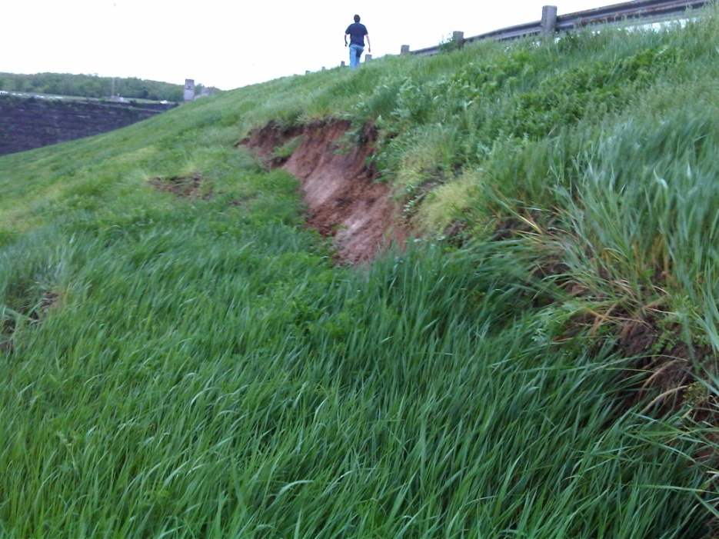
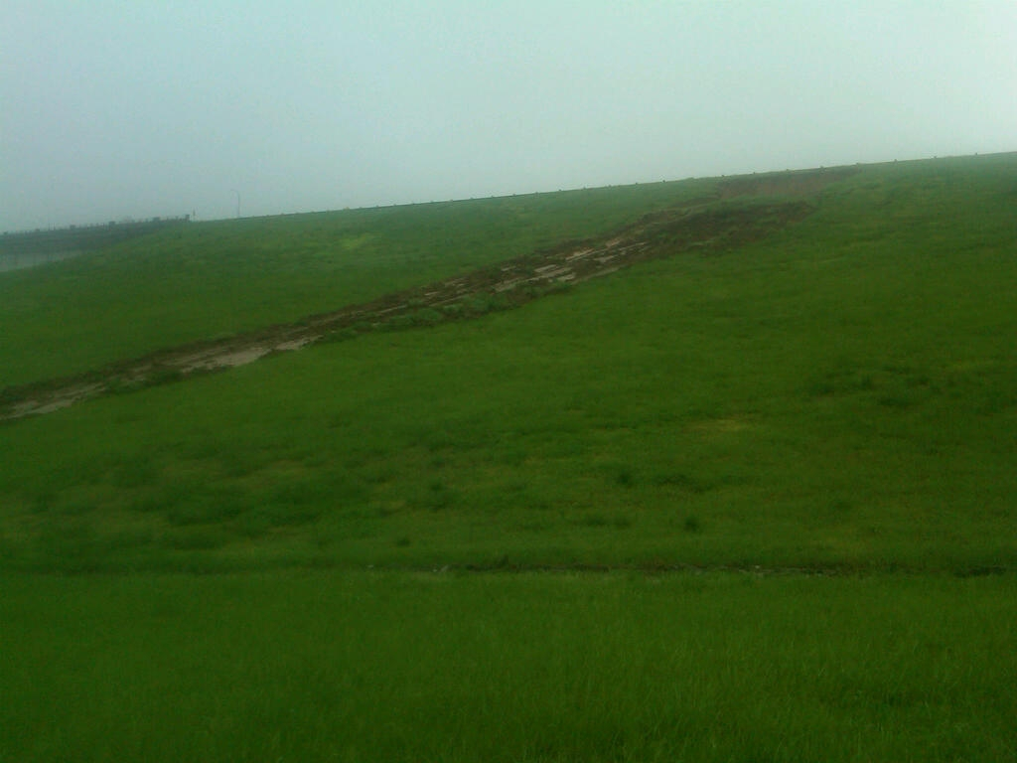
Table Rock Slide
Notes:
As the pool continued to rise, a slide was detected by the Project Office personnel on the downstream slope near the top of the dam.
Project personnel immediately notified Engineering Division and the DSO.

Slide 15
Table Rock Slide
Notes:
Video of the slide taken by project personnel.

Slide 16
Distress Reporting Timeline
DSO Engages Tech Team
Discovery
OPM Calls DSO
Media Outlets Contacted
DSO/DSPM Upward Reports
Tech Team Dispatched to Site/Evaluation
Emergency Contract
In-Place and Repairs Completed
Normal Operation and Follow-up Inspection
Tech Team Makes Stability / Repair Decisions
Notes:
The issue is discovered in the field,
OPM calls DSO,
Confusion (Which is it? sinkhole on upstream, sinkhole on downstream, slide on downstream)
Need photos
DSO engages technical staff to make determination of problem,
Quick stability analysis
No immediate evacuation or extreme releases required
staff is dispatched to the site,

Slide 17
Tulsa Tech Team
Little Rock Tech Team
Notes:
The DSO, Tony Batey, had sent many SWL geotechnical engineers to observe Clearwater, a DSAC I dam, with rising water as well.
Little Rock Engineer was sent from Little Rock, AR (3.5 hr drive).
He quickly called his counterpart, SWT DSO Clif Warren, for geotechnical support.
Geotechnical engineer team from Tulsa sent to Table Rock immediately (3.5 hr drive).
While on the drive there, I received several phone calls stating there were now 2 slides, they were growing, and had reached the crest of the dam and the pool had exceeded the elevation of the base of the slide.
Operations and Water Management were considering an increase in releases to prevent further increase in pool.
Once we arrived at the site, it was dark and raining but we evaluated the slide, discussed it with the DSO, reviewed as-built drawings (in the warm and dry powerhouse), and eventually decided the dam was not at risk of failure and operations could continue in accordance with the Water Control Manual for such an extreme event. Increased releases to control the rise in pool for embankment stability concerns were not required.

Slide 18
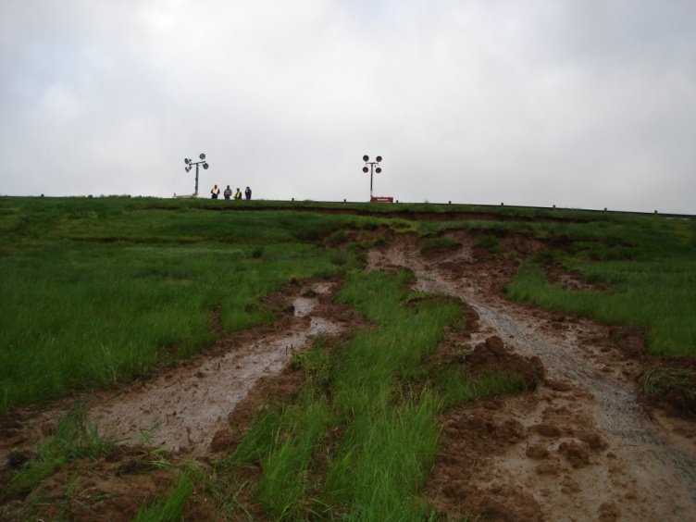
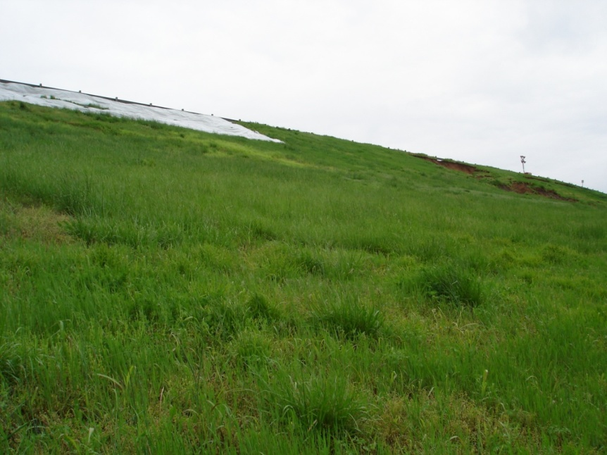
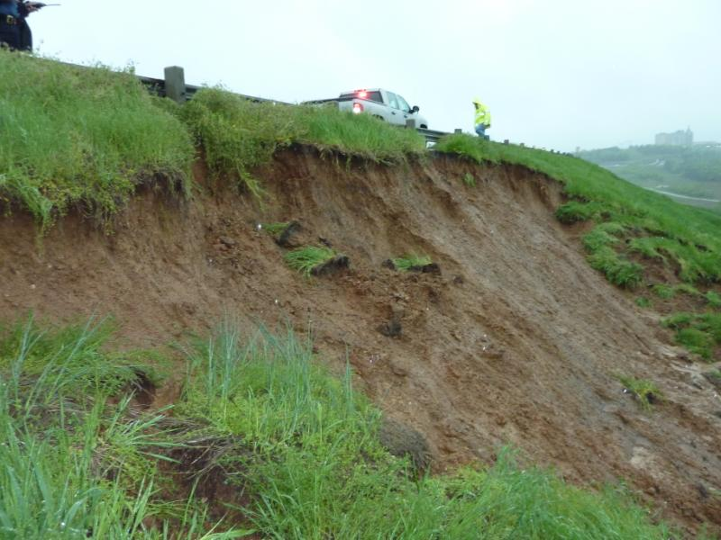
24-Hour Observation
Notes:
24-hour surveillance was instituted and continued until the situation was stabilized.
Left – Main slide area had 2-slides with mud flow to the downstream toe – just above the powerhouse.
Middle – A 3rd slide developed overnight due to continued rain and saturation of the slope. Plastic visqueen was place over the slide to reduce rainfall from entering the slide.
Right – Scarp of main slide near the crest was estimated to be 13-feet.

Slide 19
Distress Reporting Timeline
DSO Engages Tech Team
Discovery
OPM Calls DSO
Media Outlets Contacted
DSO/DSPM Upward Reports
Tech Team Dispatched to Site/Evaluation
Emergency Contract
In-Place and Repairs Completed
Normal Operation and Follow-up Inspection
Tech Team Makes Stability / Repair Decisions
Notes:
media outlets and state police are contacted to explain situation and to tell about road closure,
High visibility
Road closure for traffic safety
Lessened public angst
DSPM concurrently reports evidence of distress to HQ because it fits the categories we mention above,

Slide 20
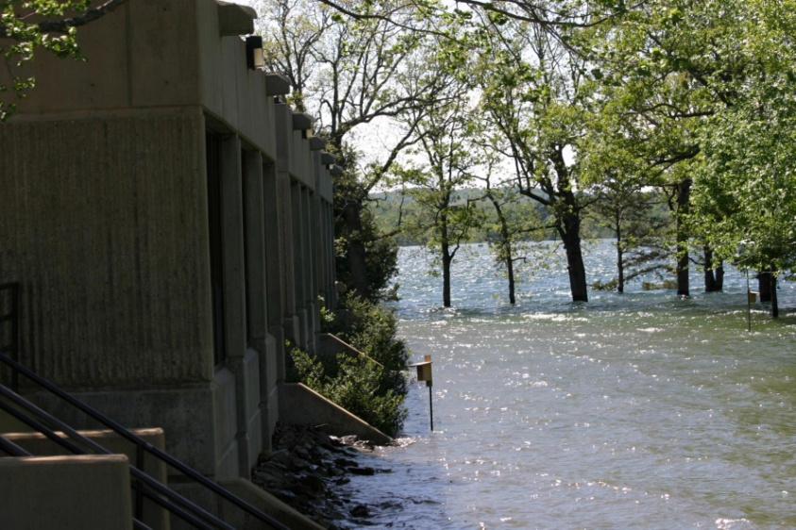
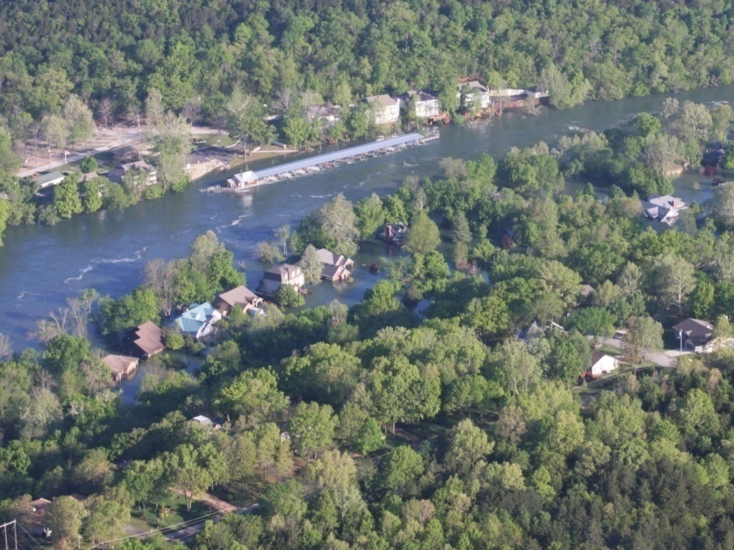
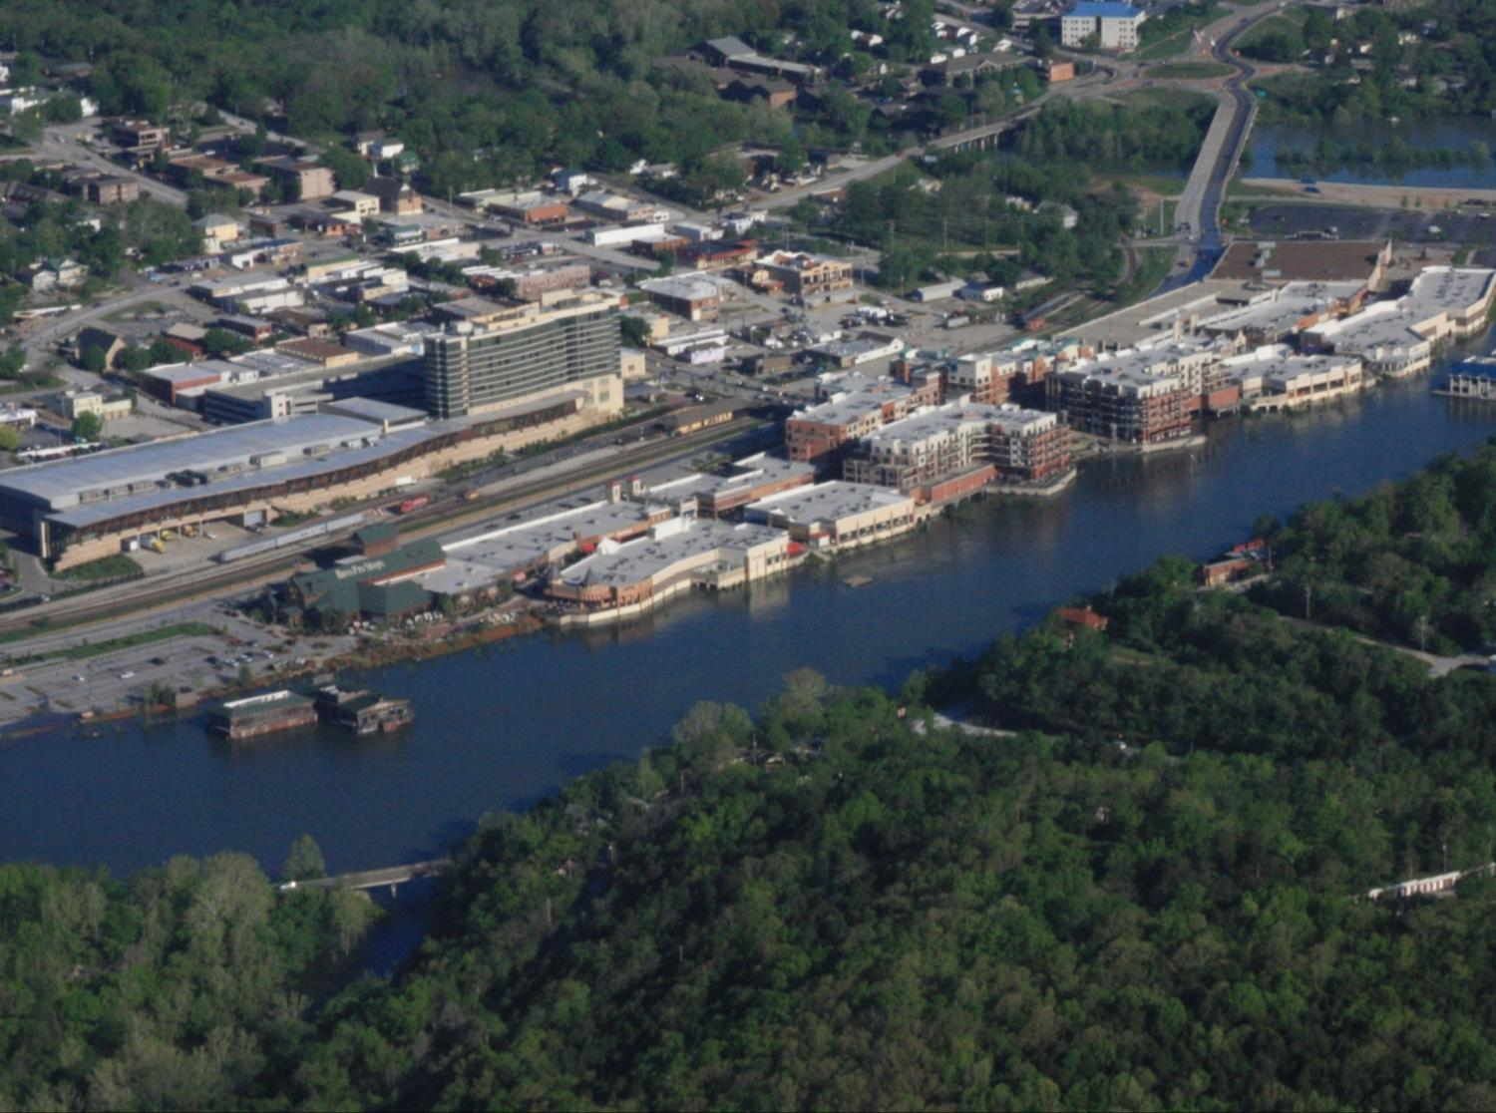
Table Rock Event
Notes:
The left photo is the Table Rock office. The water is typically several yards from the project beyond the trees in the foreground.. It eventually rose to within 1-2 feet deep adjacent to the office.
The middle photo is from the right abutment of the dam showing the releases and homes immediately downstream.
The bottom right photo is of downtown Branson, MO. Several business along the river were inundated. Several homes along the River and Lake Taneycomo where flooded downstream

Slide 21
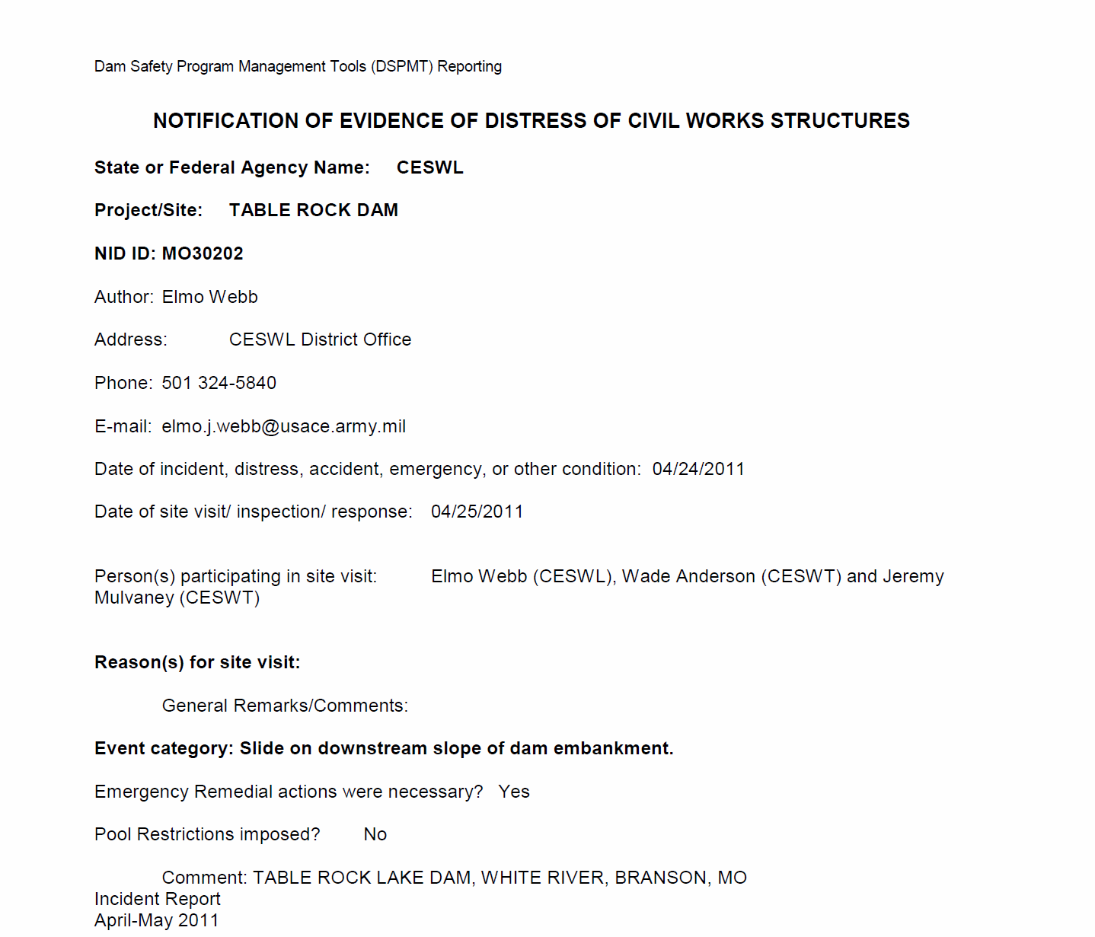
DSPMT Reporting
Notes:
DSPMT is an important web based site that is used to consolidate critical dam safety data for the USACE inventory.
Questionnaire for notification of distress involves project specific data.
Experience and knowledge of DSPM is very important
Report does not have to be lengthy but should include:
A concise summary of the issue/distress
Where it is located
Appropriate actions being taken
Photographs of the distress
Plan forward
Sketches of planned remediation

Slide 22
Distress Reporting Timeline
DSO Engages Tech Team
Discovery
OPM Calls DSO
Media Outlets Contacted
DSO/DSPM Upward Reports
Tech Team Dispatched to Site/Evaluation
Emergency Contract
In-Place and Repairs Completed
Normal Operation and Follow-up Inspection
Tech Team Makes Stability / Repair Decisions
Notes:
The issue is discovered in the field,
OPM calls DSO,
DSO engages technical staff to make determination of problem,
staff is dispatched to the site,
media outlets are contacted to explain situation and to tell about road closure,
team is on-site making repair/stability decision and getting emergency contract in place,
DSPM concurrently reports evidence of distress to HQ because it fits the categories we mention above,
distress is repaired and project functions normally.

Slide 23
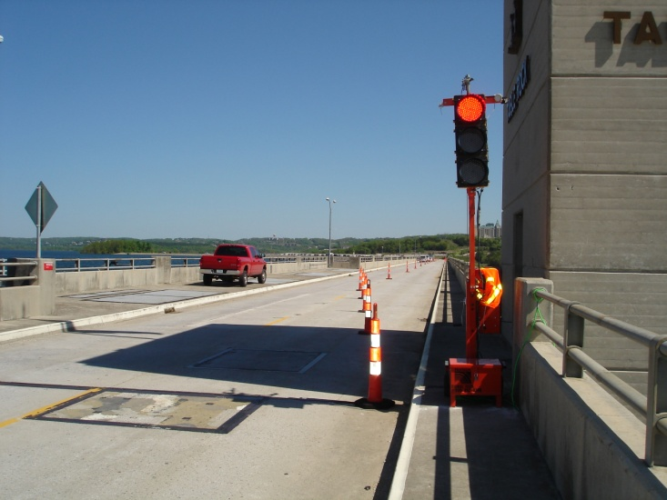
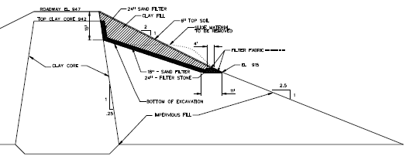
Emergency Repair
Notes:
The State Highway on top of the dam was closed to traffic for 2 days. The upstream lane was then opened until the Contractor began work which closed both lanes again for 2 weeks.
The emergency repair consisted of:
Excavation and Removal of the slide
Placement of an 18-inch sand filter against the existing core and bottom of the excavation (Use of sand was minimized since sand was not readily available – turned out not to be an issue)
A gravel zone at the base of the sand to allow drainage of any embankment seepage or infiltrated water
Backfill with compacted clay soil and top soil
Emergency plans and specs were completed within three days of the slide.
Four pages of specs and one drawing became 70 pages of contract documents.
Two local contractors were invited to the site to discuss the repairs. Some modifications were made based on their comments. Contractors were given 24 hours to submit a bid. Both submitted a bid on time. The contract was awarded the same day.

Slide 24
Distress Reporting Timeline
DSO Engages Tech Team
Discovery
OPM Calls DSO
Media Outlets Contacted
DSO/DSPM Upward Reports
Tech Team Dispatched to Site/Evaluation
Emergency Contract
In-Place and Repairs Completed
Normal Operation and Follow-up Inspection
Tech Team Makes Stability / Repair Decisions
Notes:
The issue is discovered in the field,
OPM calls DSO,
DSO engages technical staff to make determination of problem,
staff is dispatched to the site,
media outlets are contacted to explain situation and to tell about road closure,
team is on-site making repair/stability decision and getting emergency contract in place,
DSPM concurrently reports evidence of distress to HQ because it fits the categories we mention above,
distress is repaired and project functions normally.

Slide 25
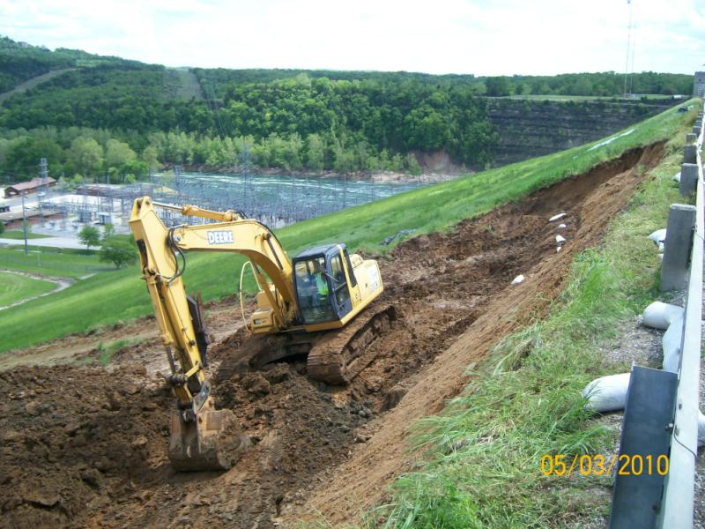
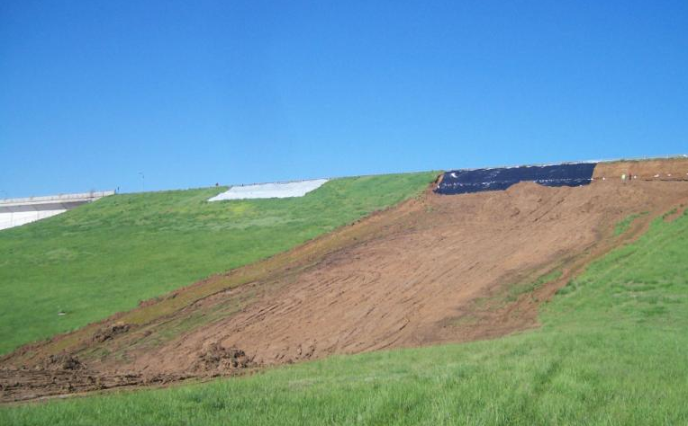
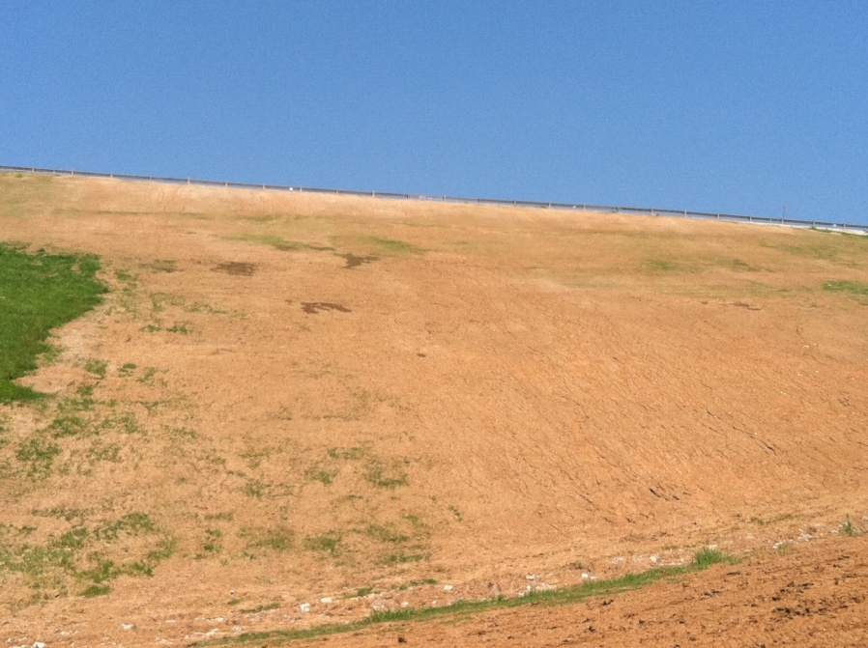
Repair
Notes:
Removal of slide is shown in left photo. As the excavation progressed, additional rainfall occurred. The contractor protected the excavated slope with a thin geomembrane, as shown in photo on the right. As the excavation progressed, it was discovered the removal depth of 15-feet was not sufficient. Engineers completed estimates of excavated slope stability and recommended the excavation could safely proceed to a depth of 19-feet. Once the rain ceased and excavation proceeded, a maximum depth of 17-feet was required to remove the soft and wet slide material.
Approximately 7,000 cy of compacted fill was placed.
Construction was completed within 2 weeks of award.
Total cost of slide repair was about $120,000 (pending modification to add more seeding/turfing).

Slide 26
Distress Reporting Timeline
DSO Engages Tech Team
Discovery
OPM Calls DSO
Media Outlets Contacted
DSO/DSPM Upward Reports
Tech Team Dispatched to Site/Evaluation
Emergency Contract
In-Place and Repairs Completed
Normal Operation and Follow-up Inspection
Tech Team Makes Stability / Repair Decisions
Notes:
The issue is discovered in the field,
OPM calls DSO,
DSO engages technical staff to make determination of problem,
staff is dispatched to the site,
media outlets are contacted to explain situation and to tell about road closure,
team is on-site making repair/stability decision and getting emergency contract in place,
DSPM concurrently reports evidence of distress to HQ because it fits the categories we mention above,
distress is repaired and project functions normally.

Slide 27
Lesson’s Learned
District and technical team reacted well
Anticipate the unexpected
Project challenges
Performance may change
Resources will be thin
Plan for backup DSO
Dam safety training is critical
It works – project personnel noted the distress
Notes:
THIS IS A SUCCESS STORY!! Everyone is well trained and knows their roles
In the middle of a flood fight, resources will be stretched thin

Slide 28
Lesson’s Learned
Communication
Project Personnel to DSO
DSO to Engineers/DSPM
Engineers on Site to DSO/DSPM
DSO/DSPM to MSC and HQ
OPM/Lake Manager and PAO to Public and Media
Constantly educate the public
Purpose and Value of Projects
Consequences without Projects
Consult regional dam safety engineers
Notes:
I can basically sum up this page with the word: RELATIONSHIPS!
Never underestimate the need for PAO support and a solid communications plan (RELATIONSHIPS)
Build a climate where the project personnel are comfortable in calling.
There is great value in regional assistance…particularly when hard calls have to be made.

Slide 29
QUESTIONS?

