Slide 1
RISK FRAMEWORK, RISK MANAGEMENT AND TOLERABLE RISK GUIDELINES
Dave Paul, P.E.
Lead Civil Engineer
U.S. Army Corps of Engineers
Risk Management Center
David.B.Paul@usace.army.mil
Dam Safety Workshop
Brasília, Brazil
20-24 May 2013

Slide 2
Origins
US Bureau of Reclamation performed initial deterministic studies for all of its dams. A way to look after the dams long term.
Previous teams had tried to develop “minimum instrumentation requirements”, but could not agree on what they should be.
Team was formed to develop a process to address the long term monitoring issues.
The Probable Failure Mode Analyses (PFMA) process was developed.

Slide 3
Learning Objectives
Dam Safety Portfolio Risk Framework
  Understand the Process of Assessment and Decision Making
  Aware of the Changes in the Dam Safety Action Classification
Dam Safety Risk Management Prioritization
  Be conversant in Roles, Responsibilities, Philosophy and Implementation of Agency Priorities in Dam Safety Including:
    Action Queues
    Decision Factors
Tolerable Risk Guidelines
  Understand the Concepts of the Tolerability of Risk
  Understand the Visualization of Risks in f-N Charts
  Be Familiar with the ALARP Principles

Slide 4
Dam and Levee Safety Defined
“Dam and levee safety is the art and science of ensuring the integrity and viability of dams and levees such that they do not present unacceptable risks to the public, property, and the environment.
It requires the collective application of engineering principles and experience, and a philosophy of risk management that recognizes that a dam or levee is a structure whose safe function is not explicitly determined by its original design and construction.
It also includes all actions taken to identify or predict deficiencies and consequences related to failure, and to document, publicize, and reduce, eliminate, or remediate to the extent reasonably possible, any unacceptable risks”
Federal Guidelines for Dam Safety, Glossary of Terms (FEMA 148), April 2004

Slide 5
Risk Framework
Office of Management and Budget, 1995 and 2007
Risk Assessment
Analytically Based
Risk Management
Policy & Preference Based
Risk Communication
Interactive Exchange

Slide 6
Remember Past Dam Failures
Johnstown, PA – May 1889
Austin, TX – 1900
St. Francis, CA – March 1928
Buffalo Creek, WV – February 1972
Teton, ID – June 1976
Kelly Barnes, GA – November 1977
Taum Sauk, MO – December 2005
Ka Loko & Waiakalau, HI – March 2006
New Delhi, IA – December 2010
Notes:
List of Dam Failures
Video – “One Saturday Morning”

Slide 7
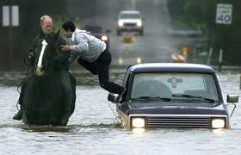
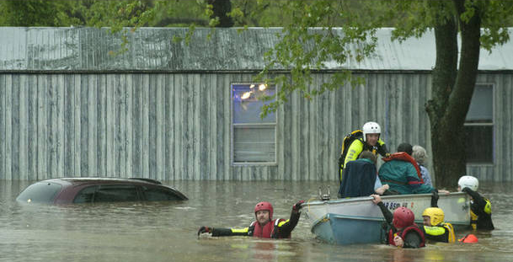
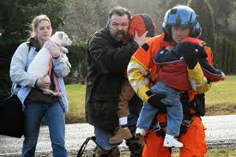

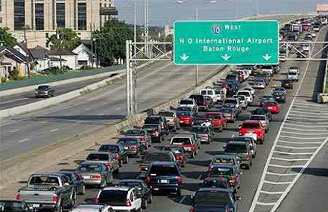
Life Safety is Paramount
Protecting People, Not Dams
Notes:
Overall point 1: Focus is on protecting people, not levees

Slide 8

Risk
Informed
Notes:
Overall point 4: Clarify on funding-when, how, etc.

Slide 9
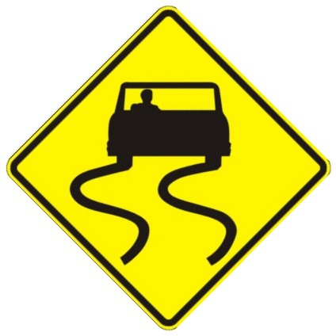
Clear
Concise
Transparent
Useful
Notes:
Overall point 2: Risk communication-keep it simple, useful, and transparent

Slide 10
Let’s Change the Dialogue!

Slide 11
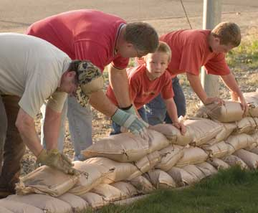
Shared Risks, Shared Responsibility
Notes:
Shared Responsibility
And shared responsibility. That doesn’t mean transferred responsibility. In fact, an important thing we heard was the need to take on more ourselves.
This picture also represents the generational change happening at the corps

Slide 12

Systems Approach
Notes:
Overall point 5: Federal Alignment

Slide 13


Periodic and
Continuing

Slide 14

First, Do No Harm…
Notes:
Do no harm

Slide 15
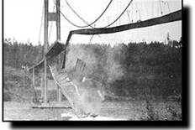
Understand
Potential Failure
Modes!
Notes:
Failure modes

Slide 16

Critical Thinking
Institutionalize Lessons in Policy…
…Add Critical Thinking in all Cases
Be Decision Oriented
Notes:
Critical thinking

Slide 17
IMPROVING THE USACE DAM
SAFETY PROGRAM
In September 2001, the ASDSO Peer Review Team issued a Draft report, stating:
“USACE has a marginally acceptable dam safety program.”
The Peer Review Team issued 17 recommendations on how the Corps could regain leadership in the Dam Safety field

Slide 18
THE USACE DAM AND LEVEE
SAFETY PROGRAM
Established National Dam Safety Steering Committee
Established Special Assistant for Dam and Levee Safety in HQ
Established Policy and Procedures Team
Established Risk Management Center
Established Senior Oversight Group (Chaired by Special Assistant for Dam and Levee Safety)
Revised ER 1110-2-1156 based on risk management principles
An ER being developed for Levee safety

Slide 19
THE USACE DAM AND LEVEE
SAFETY PROGRAM
Established Mapping Modeling Consequence Center as part of the RMC (update and improve inundation mapping production)
Developed tool boxes to facilitate risk evaluations (more than 10 discipline-specific tool boxes available for PA and IES)
Established closer coordination with sister federal agencies (USBR, TVA, FERC, and NRCS) to ensure consistent policy where applicable
Completed inventory of levee systems and established the databas

Slide 20
Transition to a Risk Informed Dam Safety Program
Moving from a solely standards based approach to a dam safety portfolio risk management approach
Standards based or essential guidelines approach is included in the risk informed approach
One of the bases for a risk informed decision is achievement of tolerable risk guidelines
Other non-quantitative factors will influence risk management decisions
Notes:
USACE is moving from a solely standards based approach for its dam safety program to a dam safety portfolio risk management approach. The standards based or essential guidelines approach is included in the risk informed approach to the dam safety program and dam safety program decisions will now be risk informed. One of the bases for a risk informed decision, and prioritization of the work, is a consideration of the achievement of tolerable risk guidelines following implementation of risk reduction measures. In addition, it should be recognized that other non-quantitative factors will influence practical decision making for the dam safety program.

Slide 21
Management Initiatives:
Principles of Decision Making
Old Approach
New Approach
Locally Led
Locally Decided
Balance Safety with Other Benefits
First Come, First …
Politics Drive Decisions
Every District for Themselves
DSA and Major Rehab
Nationally Led
Jointly Decided
Safety Paramount
Risk Informed
Politics Supports Decisions
Cooperation Key to Survival
DS Modification Report

Slide 22
Dam Safety Risk Framework
Notes:
Risk assessors vs. Risk Managers
It is the risk assessor’s job to assess and convey the extent and significance of uncertainty in the technical aspects of a decision process. It is the risk manager’s job to weight its importance in the decision.
The safety case for justifying the choice of a specific risk management option must be made explicit, transparent, and based on a shared responsibility for the choice made. The effectiveness of a specific option and any residual, transformed or substitute risks must be recognized. The actions individuals may take to reduce personal risk should be carefully communicated as a part of the risk management alterative that is chosen.

Slide 23
Portfolio Risk Management Process
Credible Way to Address 3000 Elements of Infrastructure
Effort & Funding Commensurate with Decision to be Made
There is Always Residual Risk to be Managed

Slide 24
Dam Safety Regulation
ER 1110-2-1156
Risk Based/Failure Modes
Lead Engineer Concept
Emphasis on Total/Design Construction Process
Total Design and Construction Oversight
Emphasis on Government Oversight

Slide 25
DSAC – Dam Safety Action Classification; a categorization scheme ranging from ‘Urgent and Compelling’ to ‘Normal’ that depicts the degree of urgency in taking safety-related actions
IRRM – Interim Risk Reduction Measures; measures that are to be formulated and undertaken for dams that are not considered to be tolerably safe intended as interim until more permanent remediation measures are implemented.
Notes:
This is a simplified flow chart of the dam safety risk management portfolio process that is used by USACE and Reclamation. FERC is considering implementing this type of process – the current process used by FERC is similar but does have differences.
This process meets the requirements of being continuous, iterative, systematic, and scalable. It can be modified to fit the details and requirements of each federal agency.

Slide 26
Risk Management Process
Instrumentation
Risk
Reclassified?
Periodic
Inspections
Routine Activities are Decentrally Managed
Non-Routine Activities are Centrally Managed:
  Priorities
  Queues
  Staging
  Investments
Routine
Inspections
Rehab
Construction
Modification
Report
Periodic
Assessments
Remedial
Action?
Safety
Concern?
Routine &
On-Going
Issue
Evaluation
And IRRM
Incident or
Special
Event

Slide 27
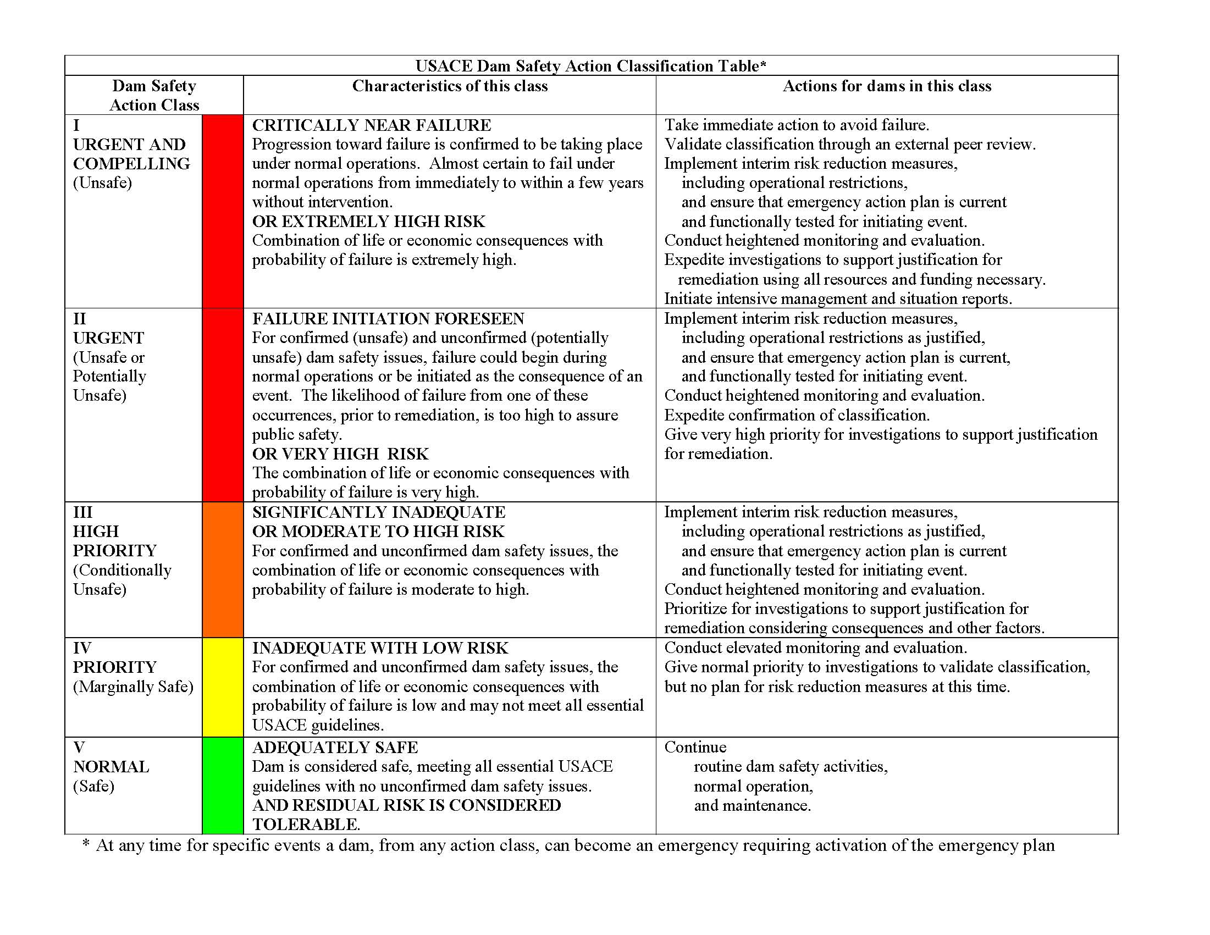
Decision Levels
Actions Required
Description
Urgency & Risk
Description
General Description

Slide 28
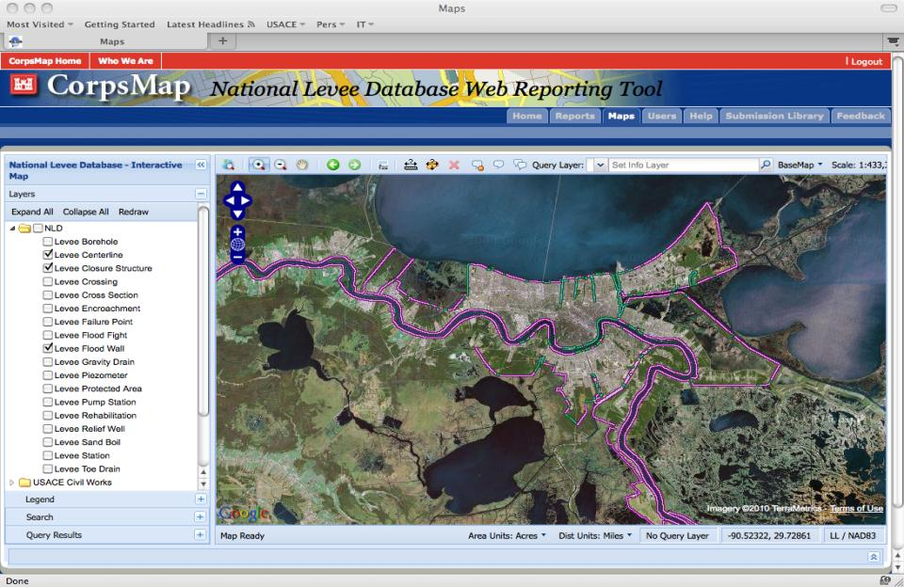

National Levee Database Public View https://nld.usace.army.mil
Continue to website through certificate notices
>2,774 Segments and >2,105 systems
Known miles today = 14648.65
Miles Completed = 13099.88 = 89%
Miles under contract = 1391.77 = 10%
Waiting contract award = 157.00 = 1%
Notes:
Zoomed in to New Orleans

Slide 29
29

Slide 30
Levee Risk Classification Process
Decision
LSOG recommends LSAC to
USACE LSO
USACE LSO approved LSAC
assignment
District
HQ Levee Safety Officer
Sponsor or non-Federal owner
Input to Screening
Execution
Levee screening
Communicate LSAC to sponsor/non-Federal owner and stakeholders
Division
Levee Senior Oversight Group
National Quality Assurance Team
National Roll-Up
National consistency
Quality assurance
Provides preliminary LSAC for LSOG
Provides comments and guidance to the Districts
Dashed lines represent reports on levee systems being sent back down for more work.
Solid lines represent formal transmittal of reports and decisions.

Slide 31
USACE Dam and Levee Safety
Community of Practice
Steve Stockton, Chief, Civil Works
James Dalton, Chief, Engineering & Construction
Eric Halpin, Special Assistant for Dam Safety
Barb Schuelke, National Dam Safety Program Manager
Tammy Conforti, National Levee Safety Program Manager
IWR
Policy &
Proc.
Risk
Cadres
Dam Safety Officer and Dam Safety Program Manager at every organizational level

Slide 32
Roles and Responsibilities Overview
Most roles and responsibilities of key dam safety personnel remain essentially the same as before. Major difference is creation of Risk Management Center.
Commanders at each level of USACE still have the ultimate responsibility for dam safety within their commands.
Commanders exercise this responsibility through officially designated Dam Safety Officers at each level.
Personnel in key dam safety positions (DSO, DSPM, Special Assistant, etc…) require professional registration, experience in dam safety as well as demonstrated leadership and management capabilities.

Slide 33
Roles and Responsibilities
Overview
Special Assistant for Dam and Levee Safety
  Acts for DSO in execution of program
  Represents USACE DSO in budget submissions
  Chairs key committees (DSSC, SOG, etc..)
  Advises Risk Management Center on DS priorities and provides direction to RMC Director

Slide 34
Risk Management Center – Roles and Responsibilities
Monitors and provides QA to entire DS program performance
Manages DSAC resource queues (sets priority in close conjunction with Special Assistant and SOG)
Provides consistency in technical review and oversight (IRRMPs, IE Reports, etc…)
Maintains dam safety technology programs (i.e. consistency/efficiency of database management)
Maintains dam safety technical competencies
Manages risk rankings and all supporting data

Slide 35
Risk Management Center – Roles and Responsibilities
Updates DS lessons learned, policy and procedures guidance
Establishes and tracks program metrics
Supports ITR process and budget development
Acts as liaison to national peer review panels
Coordinates the efforts of special working groups (e.g. Policy & Procedures)
Maintains 10 year plan for dam safety

Slide 36
Organizational Roles and Responsibilities
Decisions on priorities in these queues will be risk informed and done at the national level.
Risk Management Center will make recommendations to the SOG.
SOG and HQUSACE will make the final decision on priorities.

Slide 37
DSAC Class and Priority
Highest DSAC class being given the highest priority.
Dams will be prioritized within their DSAC class.
DSAC I dams, Life Loss risk, will automatically be given first priority for DSM studies and will not require an issue evaluation study.
Lower risk dam may be funded ahead of a dam with higher risk when it is cost effective and expeditious risk management of the portfolio.

Slide 38
Responsibility for Corps of
Engineers Dam Safety
The Commander (the Chief of Engineers) is responsible for Dam Safety for the Corps.
  The Chief of Engineers has appointed Mr. James C. Dalton, P.E., as the Corps Dam Safety Officer
At the MSC (Division) level, the Commander is responsible.
At the District level, the Commander is responsible.
At the dam site, the Operations Manager is responsible.
Notes:
The Corps of Engineers can be defined as four levels from the Headquarters at Washington to the individual dams.
At each level where there is a military officer position designated as a Commander, that individual is responsible for dam safety. Below the District commander, there are a number of organizational structures; however, the operations manager in charge of a dam is the individual that is responsible for dam safety at the dam.

Slide 39
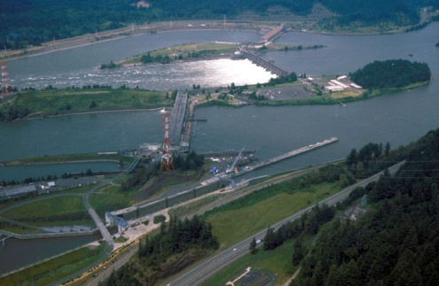
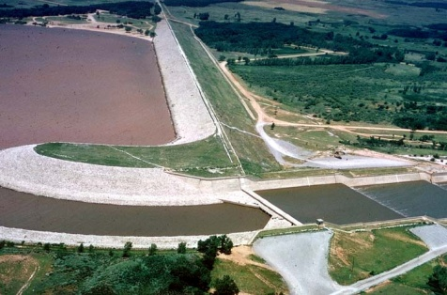
Our Civil Works Dams
Corps owns over 700 dams, Nationwide and in P.R.
  embankment = 86 %
  concrete = 7 %
  combination = 7 %
Project purposes include: flood control,
navigation, hydropower, water supply,
fish & wildlife conservation, recreation
Median height: 93 feet
Mean height: 112 feet
Average age: 55 years
High Hazard dams: 77 %
Total storage capacity: 331 Million Ac-ft
Notes:
The Corps is in the business of owning, operating, and maintaining dams; BIG TIME.
However, our dams are getting older. Our oldest dams are over 160 years old and we have a total of 14 dams over 100 years old. The median age of the dams is 44 years old.
Last year the flood damages prevented were $21.2 billion. However, regardless of losses, let one of the dams fail and all the damages prevented will be forgotten.

Slide 40
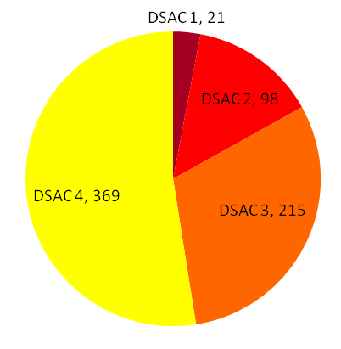
USACE Dam Safety Action Classification
Dam Portfolio Distribution
DSAC I, 19
Count as of Sep 2012 is 702 dams at 556 projects
Sep 2011 was 698 dams at 559 projects.
DSAC chart is for all dams. Does not include one newly constructed dam that does not have a DSAC value.
Data Source: DSPMT, 4 Sep 2012
Notes:
Our current total inventory for Sep 2012 is 704 structures at 556 projects compared to 698 structures at 559 projects in Sep 2011.
In Sep 2011, there were 698 structures at 559 projects. During the last year, we deleted one dam (Elk Creek) and reassigned 5 dams to separate structures. These 5 structures were incorrectly identified as main dams, when they are really separate structures to other dams. We also added 2 dams to the inventory: Woonsocket Falls and Indiana Harbor CDF. One dam, Green River Lake Dam, was incorrectly identified as a separate structure so we fixed to show as a main project. So 6 dams were removed and 3 were added to make the difference 3 (559 --> 556).
The separate structure number is still changing as we improve and modify the database. In Sep 2011, there were 139 appurtenant structures included in the USACE inventory. During the last year, we removed 17 structures because they had the same consequences as the main dam and reassigned one separate structure to be a main dam (incorrectly labeled). Total of 18 appurtenant structures removed. We also added 22 separate structures and reassigned 5 dams to separate structures for a total addition of 27. So the difference is an additional 9 structures. In Sep 2012, there are 148 appurtenant structures in the USACE inventory.
There is the potential to remove 35 appurtenant structures and add 4 for a total loss of 31. Our project number is more steady but could still change with the possible addition of 4 dams (Daguerre Point Dam, Brown Lake Dam WES, Black Rock Lock, Depoe Bay Sediment Dam) that were screened during SPRA but are not currently included in the DSPMT. There are also two dams currently under construction: Portugues Dam and Ten Mile Creek Water Preserve Area.

Slide 41
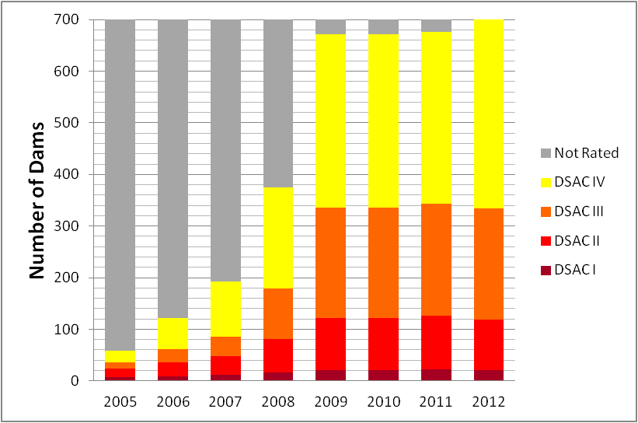
Dam Safety Action Classification (DSAC) Trend
Not Classified

Slide 42
FY 2012 Dam Safety Budget Summary
 | Budget | % of Dam Safety Budget
DS IRRM in O&M | $14,226,000 | 2.9%
DS Construction | $432,700,000 | 86.7%
DS Wedge (Construction) | $37,000,000 | 7.4%
DS Program Management (O&MRI) | $15,000,000 | 3.0%
Dam Safety Budget Total | $498,926,000

Slide 43
FY 2013 Dam Safety Budget Summary
 | Budget | % of Dam Safety Budget
DS IRRM in O&M | $2,947,000 | 0.7%
DS Construction | $362,550,000 | 85.6%
DS Wedge (Construction) | $47,750,000 | 11.3%
DS Program Management (O&MRI) | $10,000,000 | 2.4%
Dam Safety Budget Total | $423,247,000
Notes:
Increment 1, 2 and most of 3 were funded.
FY12 IRRMs $14,226,000 (funded)
FY13 IRRMs $2,947,000 (funded)
FY13 IRRMs $5,573,000 (increment 1, 2, 3)

Slide 44
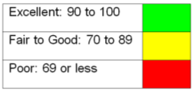
USACE Dam Safety Program Scorecard
Points for Routine Activities, Per dam
As of 3 Aug 2012
Total Points % Average % Average all dams High Hazard Potential
Staffing and Funding Adequacy 2 39 40
Inspections and Evaluations 30 88 88
Project Instrumentation 18 88 88
Project Response Preparedness 10 92 96
Agency & Public Response Preparedness 15 74 78
Interim Risk Reduction Measures 25 80 82
100 83 85
High Hazard Potential – 396 (71%)
All USACE projects - 554

Slide 45
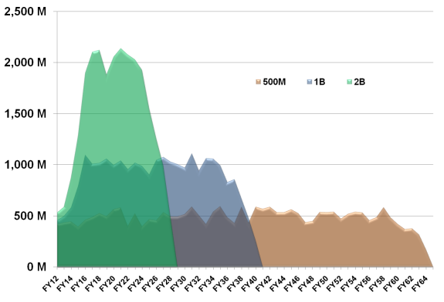
Dam Safety Investment Plan
Duration of Interim Risk Reduction Measures!
~ $26 Billion Investment to Repair 319 DSAC I, II & III Dams
Funding Scenario’s to Complete Investment:
  $500M / year – 55 years (current)
$25 Billion/year in Benefits
Population at Risk is > 15 Million
Avoids $236 Billion in Direct Damages

Slide 46
Federal Guidelines for Dam Safety
Initiated by President Carter in April 1977
Ad Hoc Interagency Committee
Published in June 1979
Provide the Standard for Federal Agency Programs
  Organization Management
  Technical Management of Design
  Technical Management of Construction
  Technical Management of Operations & Maintenance
Notes:
The dam failure at Teton Dam in 1976 resulted in President Carter implementing a problem to establish Federal guidelines to be used by all Federal Agencies involved in the design, construction, operation, and/or regulation of dams.
The guidelines were first published in June 1979 and include four main sections.

Slide 47
New Decision Processes
Outside Loop: Routine Processes
Inside Loop: Remedial Processes
Centrally Managed Processes:
  Queues
  Priorities
  Classifications
  Policy
Decentrally Executed Processes:
  IRRMs
  Routine
  Modifications
Jointly Executed:
  Studies
  Risk Assessments

Slide 48
Policy Development
Screening Risk Assessments: 2005-2009
Interim Risk Reduction Measures 2007
Dam Safety Action Classification 2007
Issue Evaluation Studies and Tolerable Risk Guidelines 2008-beyond
Modification Reports
Periodic Assessments 2009-2010
Comprehensive Policy (ER 1110-2- 1156) 2010

Slide 49
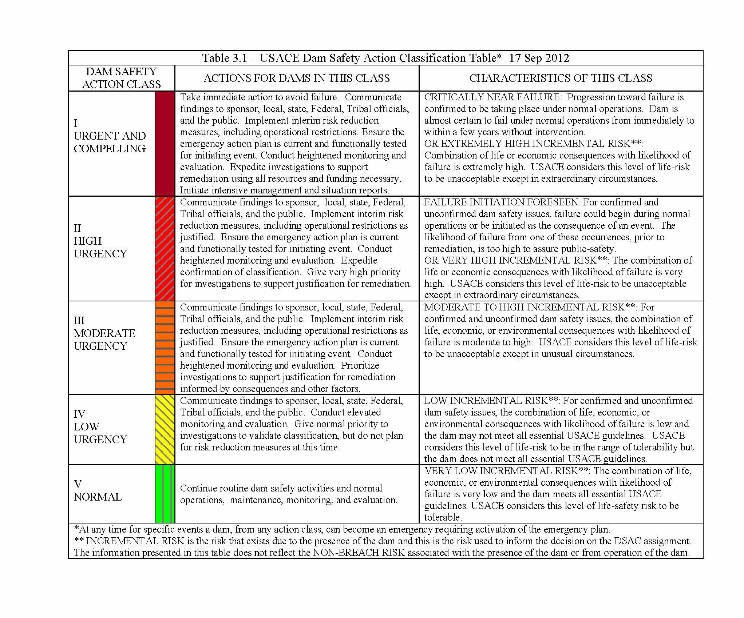
Removed “safe” words.
Focus on Urgency
Revised Colors
Moved Actions to Center
For Emphasis
Uses Context of Tolerable
Risk Guidelines in Risk Description
Provides Context for
Incremental Risk and
Non-Breach Risks

Slide 50
$26 Billion Investment Plan Based on What We Know Today
Currently Investing
At ~$500M/Year
Interim Risk Reduction
Measures in Place
For Next 55 Years
Next Challenge: Communication of Non-Breach Risks!

Slide 51
Tolerable Risks:
Bottom Line Up Front
Risk justifies Priorities, but better decisions must also be driven from:
  Understanding of what is Tolerable (tolerability limits & essential standards)
  What is achievable, (As Low As Reasonably Practicable Considerations)
  and the Urgency of Action (proximity to tolerability)
…which is why Tolerable Risk Guidelines are needed!

Slide 52
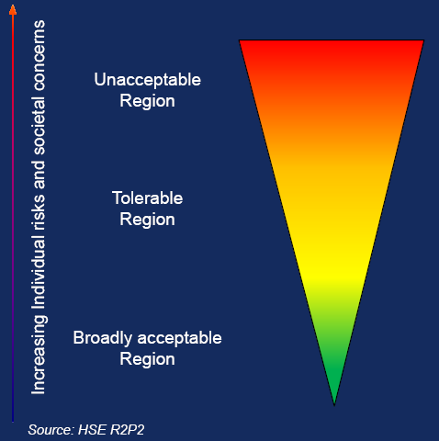
Tolerable Risk Framework
Risk cannot be justified except in extraordinary circumstances
Dams
People and society are prepared to tolerate risk in order to secure benefits
Risk regarded as negligible with little or no effort to review, control, or reduce the risk
Notes:
“Broadly acceptable risk” is contrasted with tolerable risk. "Risks falling into this region are generally regarded as insignificant and adequately controlled. The levels of risk characterising this region are comparable to those that people regard as insignificant or trivial in their daily lives. They are typical of the risk from activities that are inherently not very hazardous or from hazardous activities that can be, and are, readily controlled to produce very low risks." (HSE, 2001) By the nature of the hazard that dams pose it is inappropriate to attempt to manage them as a broadly acceptable risk and therefore the concept of the broadly acceptable risk level or limit does not apply to dams.
5.2.1.3. Definition of Tolerable Risk Range. Figure 5.1 shows how in general tolerable risk is a range between unacceptable, where the risk cannot be justified except in extraordinary circumstance, and broadly acceptable, where the risk is regarded as negligible. (Adapted from HSE, 2001). This figure illustrates the point at which the residual risk for a specific dam is tolerable within the general range of tolerability as defined by meeting the as-low-as-reasonably-practicable (ALARP) considerations.

Slide 53
Tolerable Risk Defined
“Risk within a range that society can live with so as to secure certain net benefits.
It is a range that we do not regard as negligible or as something we might ignore,
but rather as something we need to keep under review
and reduce it still further if and as we can.”
Risk Assessment in Dam Safety Management: A Reconnaissance of Benefits, Methods and Current Applications (ICOLD 130), 2005
Notes:
Definition of Tolerable Risk. Tolerable risks are:
risks that society is willing to live with so as to secure certain benefits,
risks that society does not regard as negligible (broadly acceptable) or something it might ignore,
risks that society is confident are being properly managed by the owner, and
risks that the owner keeps under review and reduces still further if and as practicable. (Adapted from HSE, 2001)

Slide 54
Tolerable Risk Principles & Considerations
Equity (Principle)
  “The right of individuals and society to be protected, and the right that the interests of all are treated with fairness”
Efficiency (Principle)
  “The need for society to distribute and use available resources so as to achieve the greatest benefit”
As Low as Reasonably Practicable (ALARP) (Considerations)
  Existing good practice
  Cost effectiveness
  Disproportionality
  Societal concerns
Risk Assessment in Dam Safety Management: A Reconnaissance of Benefits, Methods and Current Applications (ICOLD 130), 2005
Notes:
Two fundamental principles, from which tolerability of risk guidelines are derived, are described as follows in ICOLD (2005):
.
Equity: The right of individuals and society to be protected, and the right that the interests of all are treated with fairness, with the goal of placing all members of society on an essentially equal footing in terms of levels of risk that they face; and
Efficiency: The need for society to distribute and use available resources so as to achieve the greatest benefit.

Slide 55
Equity
Notes:
There can be conflict in achieving equity and efficiency. Achieving equity justifies the establishment of maximum tolerable risk limits for individual and societal risk. Efficiency is defined by the risk level where marginal benefits equal or exceed the marginal cost. Equity requires that a tolerable risk limit should be met regardless of the lack of economic justification or the magnitude of the cost. Equity implies the need for this limit even if efficiency does not support reducing risks to meet the maximum tolerable risk limit. There is, therefore, a need to obtain an appropriate balance between equity and efficiency in the development of tolerable risk guidelines. In general, society is more averse to risks if multiple fatalities were to occur from a single event and hence impact on society as a whole, creating a socio-political response. In contrast, society tends to be less averse to risks that result from many individual small loss accidents involving only one or two fatalities, even if the total loss from the sum of all of the small loss accidents is larger than that from the single large loss accident. This leads to the notion that tolerable risk should consider both societal and individual risks as an integral part of the framework for managing risks.

Slide 56
Efficiency

Slide 57
Tolerable Risk Guidelines
Performance (Annual Probability of Failure)
and
Individual Life Safety
Societal Life Safety (Annual Life Loss)
Notes:
Annual probability of failure guideline
5.3.3.1. Annual probability of failure will be evaluated based on Reclamation’s value for its annual probability of failure (APF) Public Protection Guideline applied to the total estimated annual probability of failure from all failure modes associated with all loading or initiating event types.
5.3.4.2.4. Individual risk should be checked below the main and each auxiliary dam to verify that the person or group, which is most at risk, is provided a level of protection that satisfies this individual incremental life safety tolerable risk guideline.
5.3.4.2.5. The probability of individual life loss, which is used in the evaluation of individual incremental life safety risk, is not necessarily the same as the probability of failure that is used in the evaluation of the APF guideline, which is described in Section 5.3.3. The probability of life loss is based on the probability of failure, a consideration of exposure factors to characterize the day-night, seasonal, or other exposure scenarios, and the conditional of life loss given exposure to the dam failure flood. The level of detail that is appropriate for characterizing exposure factors should be “decision driven.”
5.3.4.4 Annualized Incremental Life Loss (ALL) Public Protection Guideline. Annualized Life Loss (ALL) guideline is the expected value (average annual) of incremental potential life loss resulting from dam failure as shown in the f-N chart.
5.3.4.4.1. Annualized incremental societal life loss will be evaluated based on the limit values as shown in the ALL guideline (Figure 5.6). This should be applied to the total estimated annualized incremental life loss from all failure modes associated with all loading or initiating event types and considering all exposure conditions associated with life loss.

Slide 58
Tolerable Risk Guidelines
Individual Life Safety (Probability of Life Loss)
Societal Life Safety (Probability Distribution of Life Loss)
Special Consideration for High Consequence Projects (Life Loss > 1000)
Notes:
5.3.4.2 Individual Incremental Life Safety Tolerable Risk Guideline. The individual risk is represented by the probability of life loss for the identifiable person or group by location, that is most at risk. This is combined over all modes of failure with due regard for non-mutually exclusive failure modes, for the purpose of tolerable risk evaluation.
Probability Distribution of Potential Life Loss. The societal risk is represented by a distribution of the estimated annual probability of potential life loss from dam failure for all loading types and conditions and all failure modes and all population exposure scenarios. This is displayed as an F-N chart which is a plot of the annual probability of exceedance (greater than or equal to) of potential life loss (F) vs. incremental potential loss of life (N)[1] due to failure compared to the no failure condition. Thus, the F-N chart displays the estimated probability distribution of life loss for a reservoir encompassing all failure modes and all population exposure scenarios for a particular dam.
5.3.4.3.7. Except in Exceptional Circumstances. The qualifier “except in exceptional circumstances” refers to a situation in which government, acting on behalf of society, may determine that risks exceeding the tolerable risk limits may be tolerated based on special benefits that “the dam brings to society at large”. "The justification for tolerating such high risks is the wider interests of society. Risks, which would normally be unacceptable, can be tolerated on account of the special benefits, which the dam brings to society." (ANCOLD, October 2003). This is an example of the conflict between the fundamental principles of equity and efficiency. Specifically, the maximum risk level that satisfies equity considerations can be at the expense of reducing efficiency. The equity consideration might be relaxed because of special benefits are deemed to outweigh the increased residual risk. This exception might be made where the residual potential life loss and economic consequences are large, but where the probability of failure is very low and state of the practice risk reduction measures have been implemented. For dams in this area on Figures 5.4.b and 5.5.b USACE will look critically at the confidence in the estimate of the risk. Full compliance with essential guidelines will be expected. The adequacy of potential failure modes analysis and risk assessment will be carefully examined. The USACE is to demonstrate that risks are ALARP. HQUSACE would reach a decision based on the merits of the case.
[1] In probability textbooks a cumulative (probability) distribution function (CDF) is defined to have probability “less than or equal to” on the vertical axis and a complementary cumulative (probability) distribution function (CCDF) is defined to have probability “greater than” on the vertical axis. Although similar to a CCDF, an F-N chart is subtly, but in some cases importantly, different because it has probability “greater than or equal to” on the vertical axis rather than “greater than” as in the CCDF.

Slide 59
“As-low-as-reasonably-practicable” (ALARP)
The “as-low-as-reasonably-practicable” (ALARP) considerations include a way to address efficiency aspects in both individual and societal tolerable risk guidelines.
The ALARP consideration states that risks lower than the tolerable risk limit are tolerable only if further risk reduction is impracticable or if the cost is grossly disproportional to the risk reduction. (Adapted from ICOLD)
Determining that ALARP is satisfied is a matter of judgment.
Notes:
“As-low-as-reasonably-practicable” (ALARP)
The “as-low-as-reasonably-practicable” (ALARP) considerations include a way to address efficiency aspects in both individual and societal tolerable risk guidelines. The ALARP consideration applies to the tolerable risk region of slide 12 between the tolerable risk limit and the broadly acceptable risk level. The ALARP consideration states that risks lower than the tolerable risk limit are tolerable only if further risk reduction is impracticable or if the cost is grossly disproportional to the risk reduction. ALARP only has meaning in evaluating risk reduction measures – it cannot be applied to an existing risk without considering the options to reduce that risk. ALARP is an explicit consideration under ANCOLD (2003) tolerable risk guidelines.
Determining that ALARP is satisfied is a matter of judgment. In making a judgment on whether risks are ALARP, the following should be taken into account (ANCOLD 2003):
• The disproportion between the sacrifice (money, time, trouble and effort) in making the safety improvement and the risk reduction that is achieved.
• The cost-effectiveness of safety improvement options;
• Any relevant recognized good practice; and
• Societal concerns as revealed by the owner’s or proponent’s consultation with the community and other stakeholders.

Slide 60
ALARP Considerations
Cost effectiveness (CSSL)
  Cost to save a statistical life
Disproportionality (CSSL / WPT)
  Willingness to pay to prevent a statistical fatality
Essential USACE guidelines and best practices
Consultation with stakeholders
Notes:
60
In making a judgment on whether risks are ALARP, the USACE shall take the following into account: the level of risk in relation to the tolerable risk limit and the broadly acceptable risk level (not applicable to dams); the disproportion between the sacrifice (money, time, trouble and effort) in implementing the risk reduction measures and the subsequent risk reduction achieved; the cost-effectiveness of the risk reduction measures; compliance with essential USACE guidelines; and societal concerns as revealed by consultation with the community and other stakeholders.
1. The level of risk in relation to the tolerable risk limit: When the estimated life safety risk has been reduced to the tolerable risk limit the ALARP consideration leads to the question, "How far below that limit is the level of risk to be reduced?" The further below the tolerable risk limit the weaker the ALARP justification for further risk reductions.
2. The cost-effectiveness of the risk reduction measures and
3. The disproportion between the sacrifice (money, time, trouble and effort) in implementing the risk reduction measures and the subsequent risk reduction achieved.
This entails the use of the following two measures: 1) a cost effectiveness measure called, the "cost-to-save-a-statistical-life" (CSSL); and 2) a "willingness-to-pay-to-prevent-a-statistical-fatality" (WTP), commonly referred by the Office of Management and Budget (OMB 2003) and other federal agencies as the "value-of-statistical-life" (VSL). VSL is used by OMB, the United States Department of Transportation (USDOT) and other federal agencies to evaluate the case for regulating risk or investing in life-saving risk reduction measures. The risk measure for disproportionality is the ratio of the adjusted CSSL divided by WTP. The quantitative ANCOLD (2003) guidance is based on estimating the incremental CSSL for any risk reduction options that could reduce the risk below the limit values, starting at or below the limit values, and assigning a “strength of ALARP justification” to proceed with the risk reduction measure based on the magnitude of the estimated CSSL. This approach has it roots in work by the Health Safety Executive, United Kingdom (HSE 2001) and by Bowles and Anderson (2003). CSSL calculations are shown in Appendix K .
The ANCOLD approach has been adapted for application to USACE dams as represented in Tables 5.1 and 5.2 that show the disproportionality ratio of the CSSL to the WTP.
Disproportionality ratio = CSSL/WTP

Slide 62
Dam Safety Risk Framework
Risk Assessment
Analytically based
Risk Management
Policy and preference
based
Tolerable
Risk
Guidelines
Risk Communication
Interactive exchange of information, opinions,
and preferences concerning risks
Notes:
Risk assessment is a systematic, evidence based approach for quantifying and describing the nature, likelihood, and magnitude of risk associated with the current condition and the same values resulting from a changed condition due to some action.
Risk management is the process of problem finding and initiating action to identify, evaluate, select, implement, monitor and modify actions taken to alter levels of risk, as compared to taking no action
Risk Communication is the open, two-way exchange of information and opinion about hazards and risks leading to a better understanding of the risks and better risk management decisions.

Slide 63
Why Tolerable Risk?
…Begin with the End in Mind
Identify infrastructure that poses greatest risk
To what extent does risk need to be reduced? (tolerability)
Understanding shared responsibilities
Which infrastructure should be addressed first? (priority/sequence)
How do we balance the desire to reduce risk with the availability of resources? (urgency)
Improve Risk Communication
….BETTER DECISION MAKING

Slide 64
General Philosophy on
Risk Management
Optimize Risk Reduction in Time and Investment Within:
  Portfolio
  Decision Queues
  Individual Modifications
Do so in a Credible and Transparent Manner
Do So Nimbly and Flexibly
Life Safety is Paramount

Slide 65
How Risk is Used at Portfolio Level?
Within the Portfolio of all +700 Dams:
  DSAC Used to Consistently:
    Characterize the Portfolio
    Communicate Risk
    Take Action
  Generally, Rank Priority from DSAC I as Priority

Slide 66
How Risk is Used in Decision Queues?
Priority Within Each DSAC Category at Each Decision Queue of Process –
  Annualized Loss of Life Risk
  Probability of Failure
Understand the Nature and Severity of Risks
  Risk Understood?
  More Information Needed?
Exceptions:
  Legacy Projects Already in the Queue
  “Ready to Go” Lower Risk Projects
  Regionally Directed O&M Funded Activities
Key Current Restraint: Progress on Modification Reports!

Slide 67
How Risk is Used in Within Dam Modifications?
Better Understand the Effectiveness of Risk Reduction Measures
Make Decisions on Selected Alternatives
Priority of Modifications Entering Construction

Slide 68
Why Risk Management?
“ That engineers have moral and legal obligations beyond those of the ordinary citizen is well accepted. This is because trained engineers can perceive and evaluate hazardous conditions that ordinary persons are not aware of. This is especially true for man-made hazards, because engineers are often involved in making them ... In more basic ethical terms, the moral obligation of the engineer arises from the general philosophy that it is part of a natural relationship between human beings to warn and protect one another from hazards as far as they can be known. Because of his knowledge, therefore, an engineer has a higher moral obligation than one who is not knowledgeable in the field.”
        Unattributed

Slide 69
Examination of Past Failures and their Causes
It is interesting to note that post-Teton dam safety laws were targeted toward changes in the state-of-the-art, seismic loading, and floods, the latter two of which could be analyzed, and the first being difficult to define.
Teton Dam failed by internal erosion, but this failure mode was not directly mentioned.
Yet, data suggests that most large dam failures (in the Western U.S.) were the result of internal erosion.
Standards based analyses are not the complete dam safety picture.

Slide 70
Percent Failures by Type of Failure
United States Earth Dams
Height | Category | Overtop | Found. | Piping | Sliding | Structural | Spillway | E.Q.
All Dams | Eastern | 42 | 12 | 23 | 4 | 8 | 11 | 0
 | Western | 45 | 5 | 34 | 3 | 9 | 1 | 3
Dams > 50 ft | Eastern | 20 | 16 | 20 | 12 | 16 | 16 | 0
 | Western | 20 | 0 | 60 | 8 | 4 | 0 | 0
Dams < 50 ft | Eastern | 46 | 11.5 | 23.5 | 2.5 | 6.5 | 10 | 0
 | Western | 57 | 4 | 21 | 0 | 12 | 2 | 4
Notes:
Data was developed as part of the original risk analysis effort, John Wilson put this together using ICOLD 1975, letters to states, and Corps data base. Point out that piping has historically been a major failure mode but doesn’t lend itself to analysis. It is interesting to note that post-Teton dam safety laws were targeted toward changes in the state-of-the-art, seismic loading, and floods, the latter two of which could be analyzed, and the first being difficult to define.

Slide 71
Definitions
Risk – the probability of adverse consequences
  P(load) x P(failure) _{given the load} x Consequences _{given failure}
Risk Analysis – A quantitative calculation or qualitative evaluation of risk
Risk Assessment – The process of deciding whether risk reduction actions are needed

Slide 72
Dam Safety Risk Analysis is New?
“The possibility of failure must not be lost sight of. To sum up in a concrete manner, it is my judgment that the chances of failure with the water at varying elevations will be substantially as follows:
In case of failure, while there might be no loss of life, yet the loss in time, in property, in money and in prestige would many times over exceed the cost of even an entirely new structure.”
Thaddeus Merriman, New York, February 21, 1912
ELEVATION | CHANCES
3795 | 1 in 5000
3800 | 1 in 2000
3805 | 1 in 500
3810 | 1 in 100
3815 | 1 in 10
LIKELIHOOD
SEQUENCES

Slide 73
Why Risk Analysis?
Following the failure of Teton Dam in 1976, US Bureau of Reclamation was asked to begin developing risk analysis methodology for dams (risk is mentioned in dam safety legislation)
USACE recognized need to implement risk analysis following failure of levees in New Orleans during Hurricane Katrina
Need to improve and balance risk reduction benefits with limited budget (e.g. upgrading a few dams to pass the PMF vs. using available budget to reduce risk at many dams)
More transparency and justification for dam and levee safety decisions was desired

Slide 74
Guiding Principles
Risk analysis procedures, although quantitative, do not provide precise numerical results. Thus, the nature of the risk evaluation needs to be advisory, not prescriptive, such that site specific considerations, good logic, and all relevant external factors could be applied in decision making, rather than reliance on a ‘cookbook’ numeric criteria approach.
The numbers, while important, are less important than understanding and clearly documenting what the major risk contributors are and why.

Slide 75
Building Blocks
Seismic and Hydrologic Hazard Assessments
Failure Mode Analysis and Screening
Event Trees and System Response Curves
Probabilistic Analysis and Models
Subjective Probability and Expert Elicitation
Consequence Evaluation

Slide 76

FIRST -
“DO NO HARM”
Modifications to Existing Dams

Slide 77
Dam Safety Modification Studies

Slide 78
USACE Dam Safety Portfolio Risk Management Process Flowchart
Dam Safety Modification Study Process (gray)
Dam Safety Modification study
replaces
Major Rehabilitation Evaluation report for Dam Safety
and
Dam Safety Assurance Evaluation reports.

Slide 79
Purpose
Guidance and procedures for:
    Develop Safety Case
    investigation and studies,
    risk assessment,
    development of alternatives,
    evaluation,
    justification,
    approval, and
    documentation
in support of modifications for dam safety issues at completed Corps of Engineers projects.

Slide 80
DSAC, DSM Study & Staged Fixes
DSAC I with Life Loss risk
  highest national priority.
Expedited process for all DSAC I and II
Address other failure modes that can be expeditiously and cost effectively addressed
Other failure modes that are shown to contribute risk will be dealt with as risk informed priorities and funding allow.

Slide 81
Risk Assessments
Baseline risk assessment for all failure modes (PFM) that have been determined to significantly contribute to the risk for that dam. (performed by National Risk Cadre – reviewed by different National Risk Cadre)
  That means assess the PFM that drove the DSAC Classification plus all the other credible PFM.
  Address life safety, economic, and environmental consequences associated with all credible PFM.
Risk assessment to determine risk reduction achieved by the alternatives, including potential staged implementation options. (Performed by District Risk Assessment Team - review by National Risk Cadre)

Slide 82
Basic Approach and Principles for Execution of a DSM Study to Develop “Safety Case”
Identifying Dam safety issues and opportunities;
Baseline risk condition;
Formulate alternative risk reduction plans
Evaluate alternative risk reduction plans
Compare alternative risk reduction plans; and
Select a risk reduction plan.

Slide 83
Dam Safety Issues And Opportunities
Study framed in terms of the
  USACE dam safety program objectives,
  Identified dam safety issues (significant potential failure modes).
  Tolerable risk and essential USACE engineering guidelines.
  Other considerations.

Slide 84
Baseline Risk Condition
Baseline condition - quantitative and qualitative description of current and future risk conditions
Baseline risk condition, “without IRRM” condition, provides the basis from which alternatives are formulated and assessed.
Consequence analysis - existing and future population at risk and threatened population for fatality estimates.
Identify key assumptions and sources of uncertainty
Each failure mode assessed must be shown to lead to a plausible failure of the dam.

Slide 85
Formulating Alternative Risk Reduction Plans
Risk reduction plans formulated to achieve dam safety objectives.
At least one risk reduction alternative must meet the tolerable risk guidelines.
Need to consider dam removal.

Slide 86
Evaluating Alternative Risk Reduction Plans
Compare risk reduction alternatives with the baseline condition.
Necessitates risk assessment be performed for all alternatives.
Characterize beneficial and adverse effects by magnitude, location, timing and duration.
Identify the plans that will be considered, dropped or reformulated in the DSM study process.

Slide 87
Comparing Alternative Risk Reduction Plans
Each plan (including the no permanent risk reduction action plan) is compared against each other and ranked with respect to:
  Tolerable risk guidelines
  Residual risk compared to baseline risk
  Cost effectiveness
Beneficial and adverse effects of each plan must be compared.

Slide 88
Selecting A Risk Reduction Plan
A single risk reduction plan will be recommended and defended against:
  No action
  The other alternatives developed.
The primary evaluation factors for plan selection, but not the only factors, are:
  Residual risk in relation to tolerable risk guidelines
  ALARP considerations to include essential USACE guidelines

Slide 89
Initial Dam Safety Modification Study Actions
Project management plan - Begin with the end in mind.
Review and concurrence of the PMP prior to start of the DSM study.
Review Plan – prepared and approved
Vertical team coordination meetings
  Kickoff and In-Progress-Reviews
  HQUSACE, Dam Safety Risk Management Center, RIT, MSC, and others as needed.
Baseline risk assessment to assure all significant failure modes are addressed in the DSM study

Slide 90
Summary Observations
Program is leading the way with national risk informed prioritization and production centers
Foundation of the Safety Program is improving;
  New PA process improves ability to track portfolio over time and will be mechanism to modify DSAC
  ER 1156 update and QMS will improve consistency
Scorecard confirms progress continues
  Although small percentage of dams are fully funded. The major routine components continue to be accomplished.
The “bottleneck” for the entire program is senior level dam engineers – specifically geotechnical engineers and geologists
Notes:
Significant and Low hazard potential dam activities secondary for funding and schedule.
The current senior-level group (approximately 100+ individuals) is less than half of what the Corps needs to support dam safety (USBR – 80 for 1/3 as many dams and no levees)
These individuals are generally the technical all-stars of their District
Consultant firms can help with some things, but reliance on them is not a successful long-term strategy
RMC and the regions are currently working effectively to balance senior resources
These individuals are being driven extremely hard
Funding exists to support more of them

Slide 91

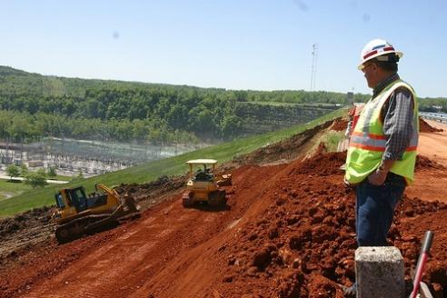

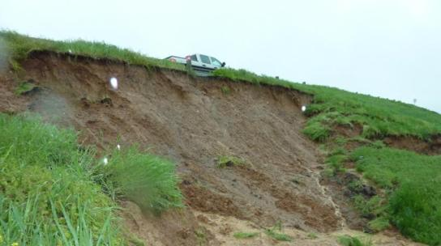

Questions?
US Army Corps of Engineers
BUILDING STRONG®
Notes:
Pic Table Rock Dam 2011 slide during high water event and repair

