Slide 1
POTENTIAL FAILURE MODE ANALYSIS
Dave Paul, P.E.
Lead Civil Engineer
U.S. Army Corps of Engineers
Risk Management Center
David.B.Paul@usace.army.mil
Dam Safety Workshop
Brasília, Brazil
20-24 May 2013

Slide 2
Best Practices in Dam and Levee Safety Risk Analysis
Potential Failure Mode Analysis
Dave Paul, P.E.
Lead Civil Engineer
US Army Corps of Engineers
Risk Management Center

Slide 3
Origins
US Bureau of Reclamation performed initial deterministic studies for all of its dams. A way to look after the dams long term.
Previous teams had tried to develop “minimum instrumentation requirements”, but could not agree on what they should be.
Team was formed to develop a process to address the long term monitoring issues.
The Probable Failure Mode Analyses (PFMA) process was developed.

Slide 4
Examination of Past Failures and their Causes
It is interesting to note that post-Teton dam safety laws were targeted toward changes in the state-of-the-art, seismic loading, and floods, the latter two of which could be analyzed, and the first being difficult to define.
Teton Dam failed by internal erosion, but this failure mode was not directly mentioned.
Yet, data suggests that most large dam failures (in the Western U.S.) were the result of internal erosion.
Standards based analyses are not the complete dam safety picture.

Slide 5
Percent Failures by Type of Failure
United States Earth Dams
Height | Category | Overtop | Found. | Piping | Sliding | Structural | Spillway | E.Q.
All Dams | Eastern | 42 | 12 | 23 | 4 | 8 | 11 | 0
 | Western | 45 | 5 | 34 | 3 | 9 | 1 | 3
Dams > 50 ft | Eastern | 20 | 16 | 20 | 12 | 16 | 16 | 0
 | Western | 20 | 0 | 60 | 8 | 4 | 0 | 0
Dams < 50 ft | Eastern | 46 | 11.5 | 23.5 | 2.5 | 6.5 | 10 | 0
 | Western | 57 | 4 | 21 | 0 | 12 | 2 | 4
Notes:
Data was developed as part of the original risk analysis effort, John Wilson put this together using ICOLD 1975, letters to states, and Corps data base. Point out that piping has historically been a major failure mode but doesn’t lend itself to analysis. It is interesting to note that post-Teton dam safety laws were targeted toward changes in the state-of-the-art, seismic loading, and floods, the latter two of which could be analyzed, and the first being difficult to define.

Slide 6
Definitions
Risk – the probability of adverse consequences
  P(load) x P(failure) _{given the load} x Consequences _{given failure}
Risk Analysis – A quantitative calculation or qualitative evaluation of risk
Risk Assessment – The process of deciding whether risk reduction actions are needed

Slide 7
Dam Safety Risk Analysis is New?
“The possibility of failure must not be lost sight of. To sum up in a concrete manner, it is my judgment that the chances of failure with the water at varying elevations will be substantially as follows:
In case of failure, while there might be no loss of life, yet the loss in time, in property, in money and in prestige would many times over exceed the cost of even an entirely new structure.”
Thaddeus Merriman, New York, February 21, 1912
ELEVATION | CHANCES
3795 | 1 in 5000
3800 | 1 in 2000
3805 | 1 in 500
3810 | 1 in 100
3815 | 1 in 10
LIKELIHOOD
CONSEQUENCES

Slide 8
Why Risk Analysis?
Following the failure of Teton Dam in 1976, US Bureau of Reclamation was asked to begin developing risk analysis methodology for dams (risk is mentioned in dam safety legislation)
USACE recognized need to implement risk analysis following failure of levees in New Orleans during Hurricane Katrina
Need to improve and balance risk reduction benefits with limited budget (e.g. upgrading a few dams to pass the PMF vs. using available budget to reduce risk at many dams)
More transparency and justification for dam and levee safety decisions was desired

Slide 9
Guiding Principles
Risk analysis procedures, although quantitative, do not provide precise numerical results. Thus, the nature of the risk evaluation needs to be advisory, not prescriptive, such that site specific considerations, good logic, and all relevant external factors could be applied in decision making, rather than reliance on a ‘cookbook’ numeric criteria approach.
The numbers, while important, are less important than understanding and clearly documenting what the major risk contributors are and why.

Slide 10
Building Blocks
Seismic and Hydrologic Hazard Assessments
Failure Mode Analysis and Screening
Event Trees and System Response Curves
Probabilistic Analysis and Models
Subjective Probability and Expert Elicitation
Consequence Evaluation
Remainder of course will focus on these and their application to specific potential failure modes, as well as how to convey the results

Slide 11
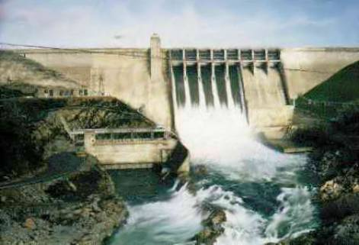
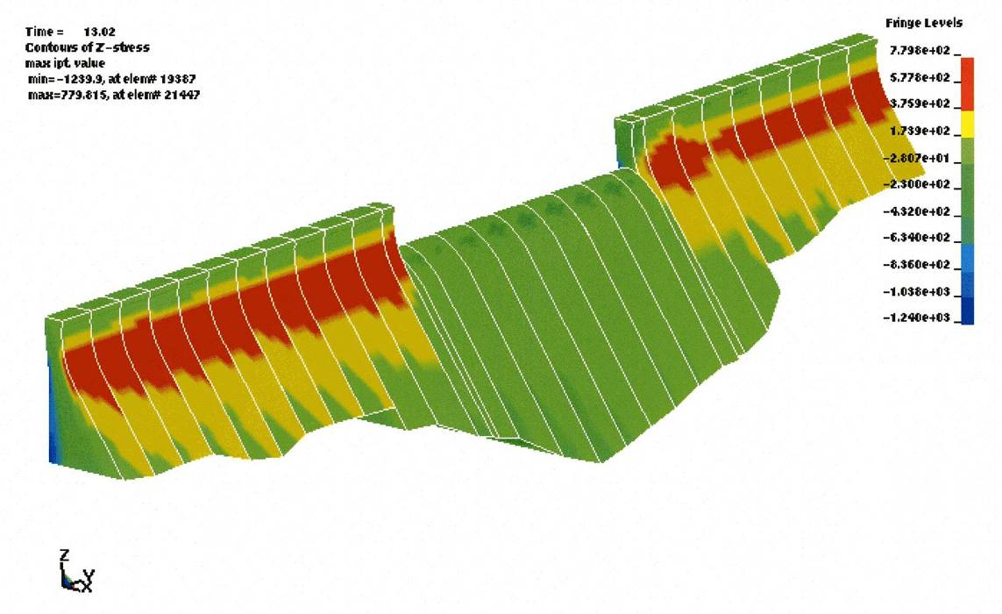
Example to Illustrate Process
MCE Analysis
Red – tensile stresses exceed strength

Slide 12
Failure Mode Description
Unedited (insufficient detail): Failure of the concrete dam during an earthquake
Edited: (1) As a result of strong earthquake ground shaking during a period of high reservoir elevation, (2) cracking initiates at the change in slope on the downstream face of the concrete gravity dam at about elevation 3514. Due to cyclic “rocking” of the structure, the dam cracks completely through monoliths on either side of the spillway. Sliding initiates during the shaking, perhaps causing enough displacement to dilate the sliding plane and offset and shear the formed drains. This potentially leads to an increase in uplift on the cracked section and post-earthquake instability. (3) The dam breaches by sudden sliding of several monoliths down to elevation 3514.

Slide 13
Event Tree
Can use system response curves to define conditional response nodes
Sliding Disrupts Drainage
Post E.Q. Instability
Seismic Load Ranges
Section Cracks Through
Reservoir Load Ranges
Post E.Q. Instability
Lower load range is threshold

Slide 14
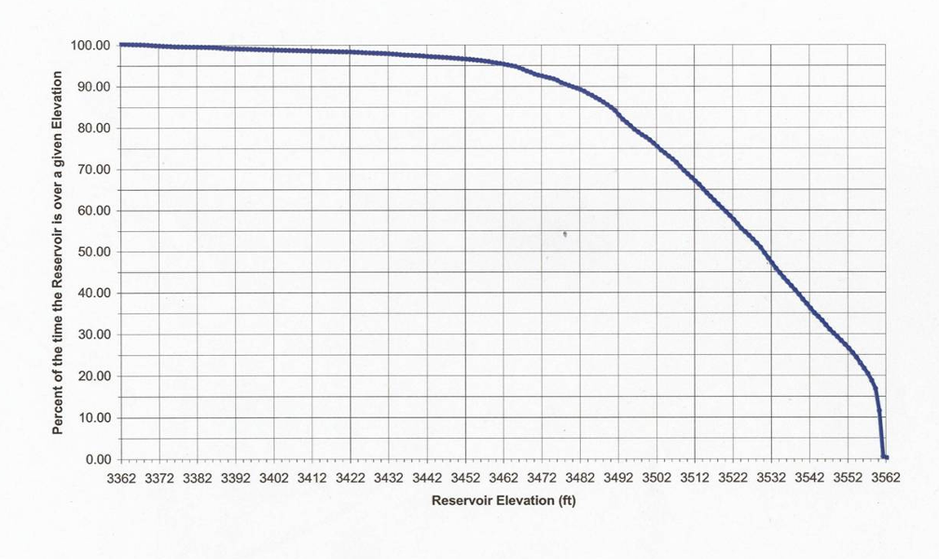
Reservoir Exceedance Curves
0.68
0.68 – 0.55 = 0.13
0.55

Slide 15
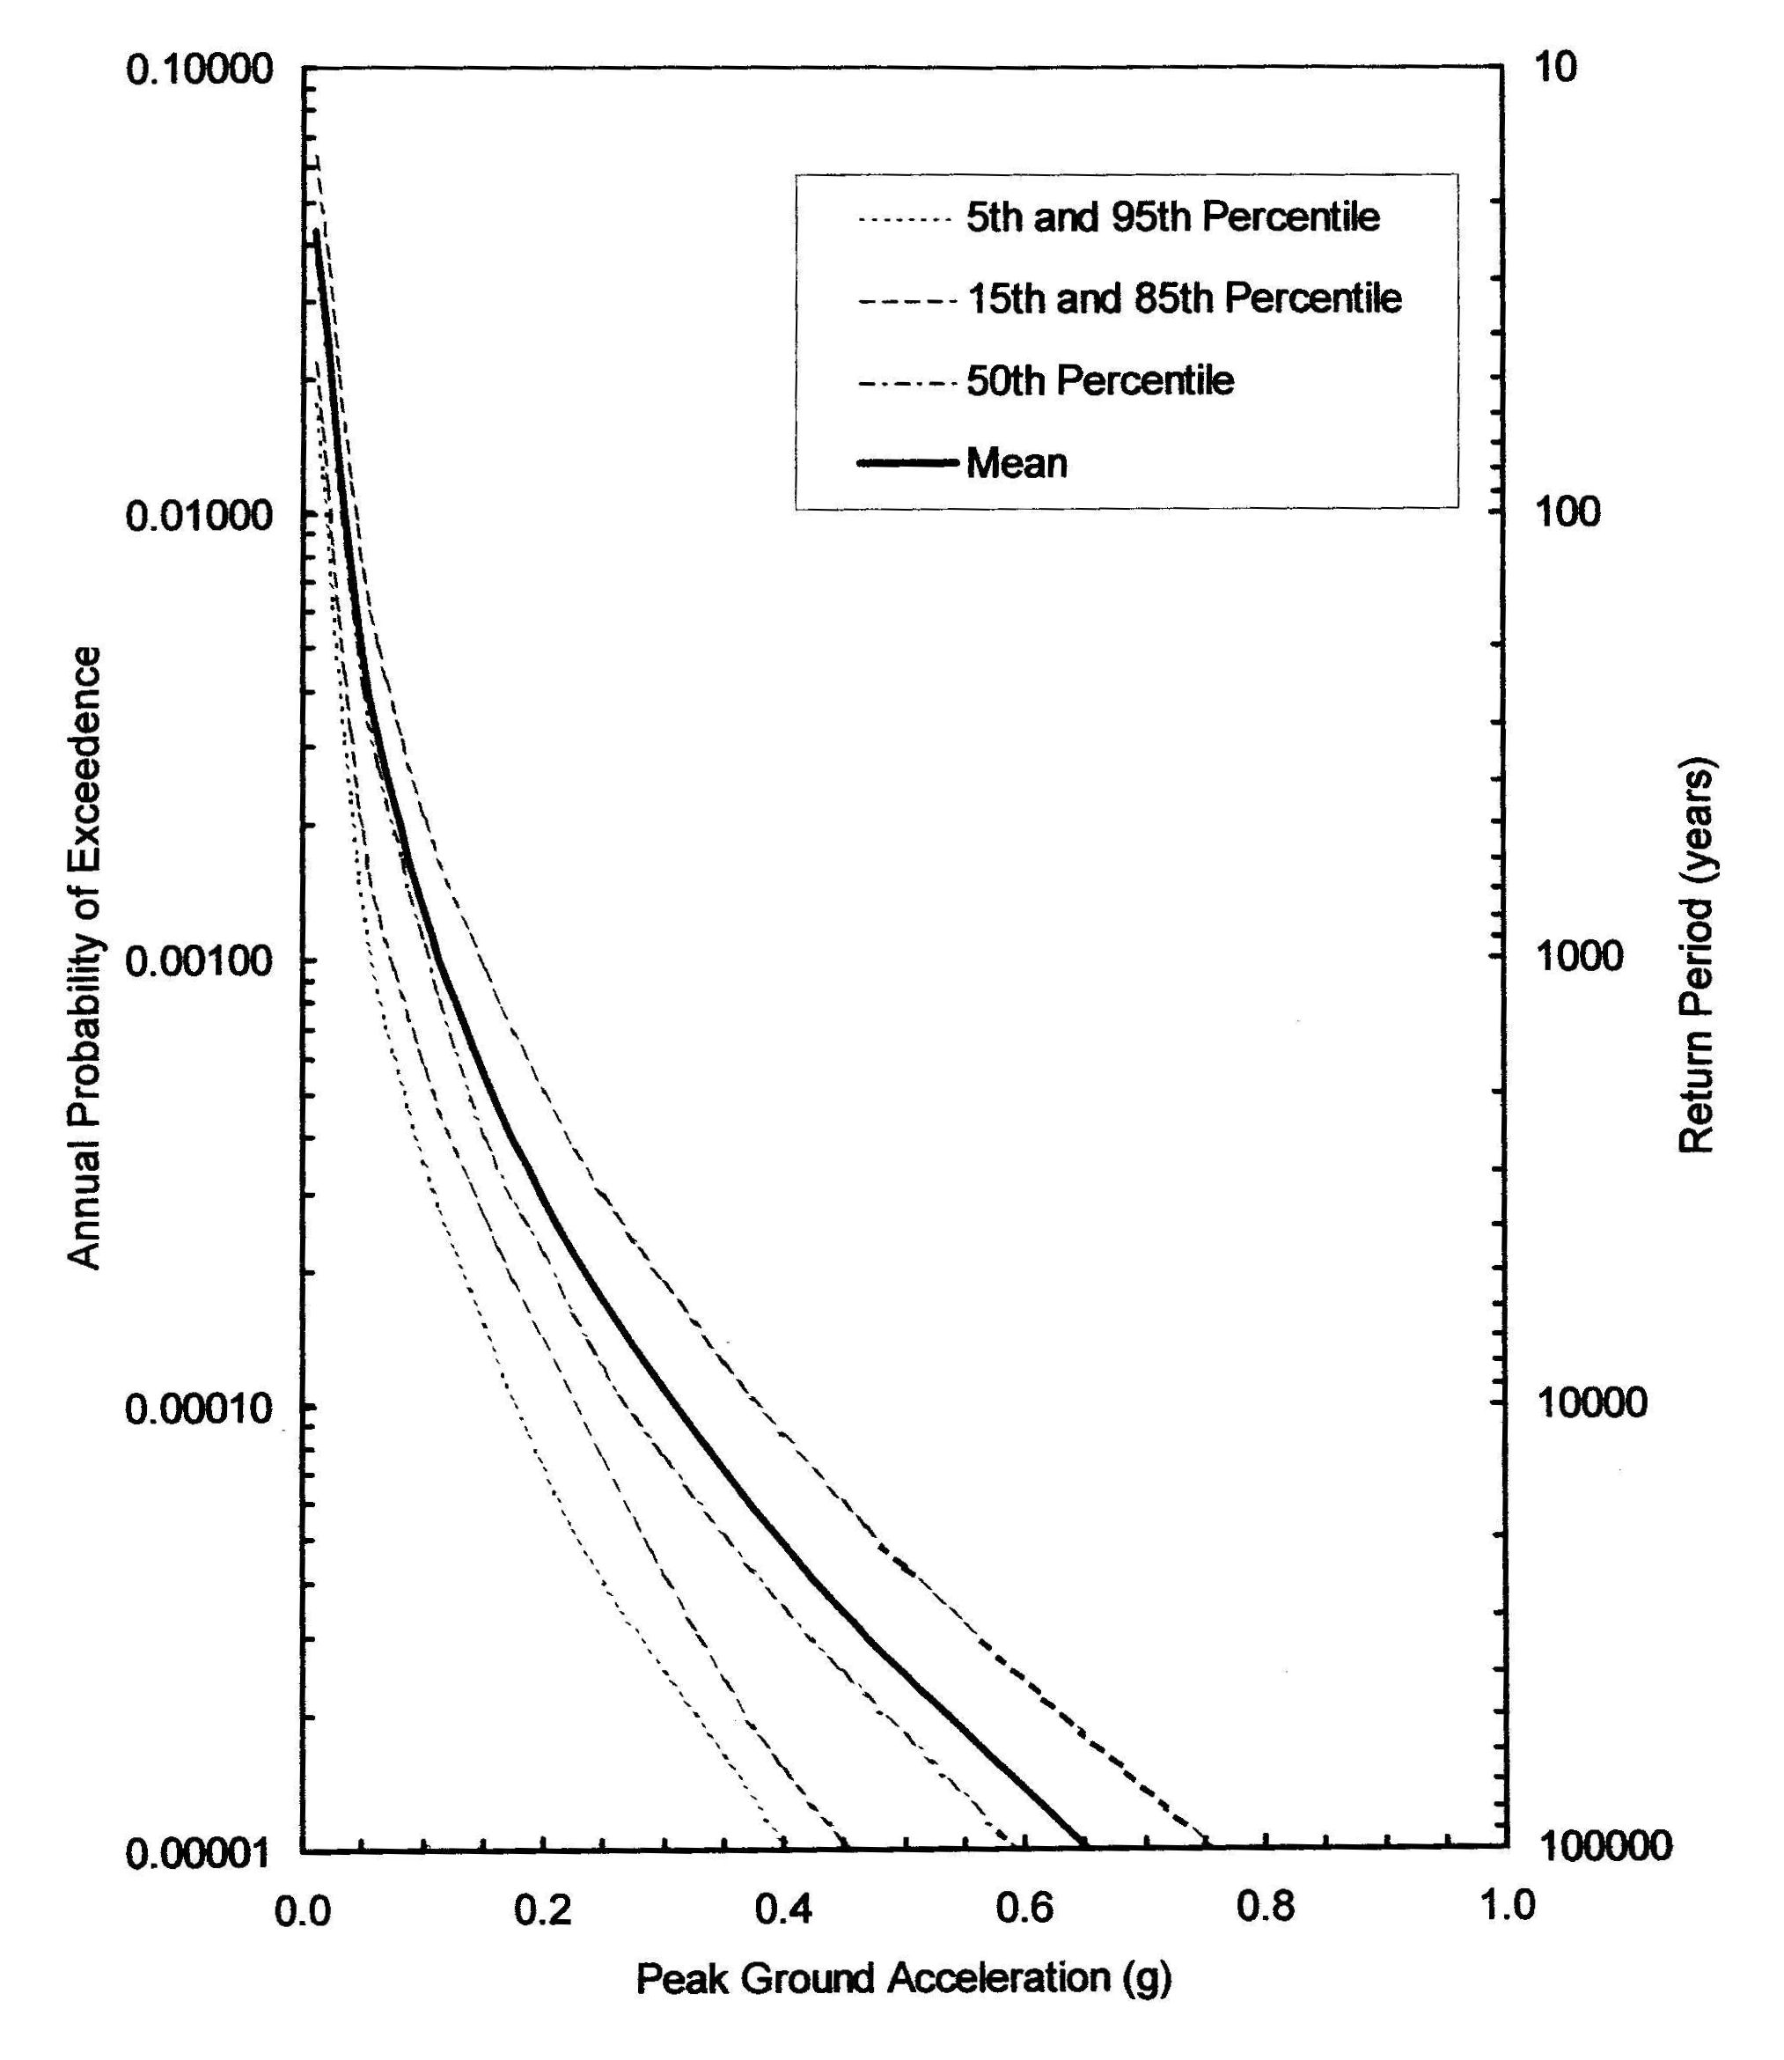
Load Ranges
To obtain a mean load range probability, subtract the probability of the lower load from the probability of the upper.
0.20g
P = 0.0003
P = 0.000255
0.40g
P = 0.000045

Slide 16
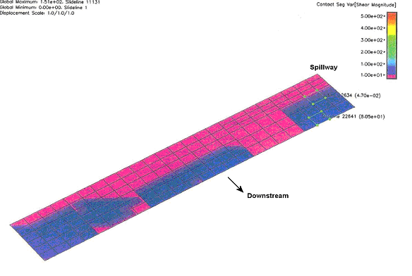
Likelihood of Cracking Through
Series of analyses using representative ground motions for each ground motion range

Slide 17
Likelihood of Cracking Through
Adverse Factors
  Tensile stress on u/s face exceeds estimated dynamic tensile strength for load ranges 5-6
  Cracks may propagate more readily than nonlinear analysis accounts for
Favorable Factors
  Tensile stress on u/s face is less than estimated dynamic tensile strength for load ranges 2-4
  Coring showed good bond at lift joints
  Nonlinear analysis showed only one monolith would crack through at load range 6

Slide 18
Verbal Descriptors
Descriptor | Associated Probability
Virtually Certain | 0.999
Very Likely | 0.99
Likely | 0.9
Neutral | 0.5
Unlikely | 0.1
Very Unlikely | 0.01
Virtually Impossible | 0.001*
*Use sparingly – Reagan’s research showed that people are not well calibrated below about 0.01

Slide 19
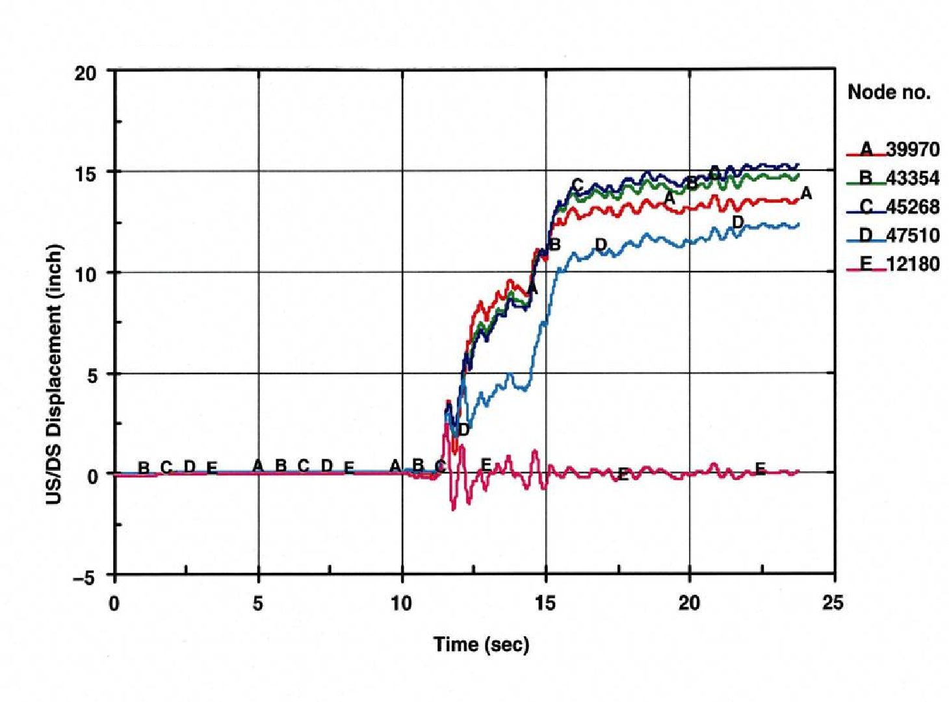
Likelihood of Displacing Drains/ Increasing Uplift

Slide 20
Likelihood of Displacement/ Increase in Uplift
Adverse Factors
  Nonlinear analysis showed displacements greater than drain diameter at seismic load range 6.
  Dilation on sliding plane could increase uplift without displacing drains
Favorable Factors
  Nonlinear analysis showed displacements less than ½ the drain diameter at seismic load ranges 2 – 5
  Nonlinear analysis assumed lift was cracked at beginning of E.Q. when in fact it is bonded
  Nonlinear model did not include embankment wrap-around which could reduce sliding at ends, causing rotation and binding at contraction joints

Slide 21
Likelihood of Post E.Q. Instability Probabilistic Stability Analysis Methodology
Program “deterministic” analysis in Microsoft Excel
Use @Risk – commercially available Macro add-in
Instead of defining input parameters as single values, define them as distributions
Perform “Monte-Carlo” analysis using @Risk to calculate many factors of safety by sampling input distributions
Use the output distribution of safety factor to determine the probability of unsatisfactory performance (e.g. probability of F.S.<1.0)
Prob F.S.<1.0 = (Number of F.S.<1.0) / (Total No. F.S.)

Slide 22
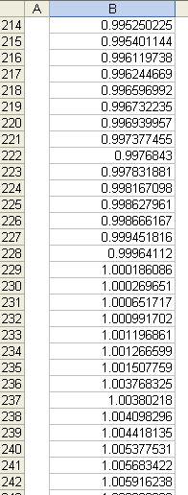
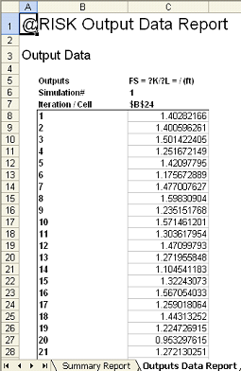
F.S. Output
(10,000 iterations)
Prob. F.S. < 1.0 = 228/10,000 = 0.0228

Slide 23
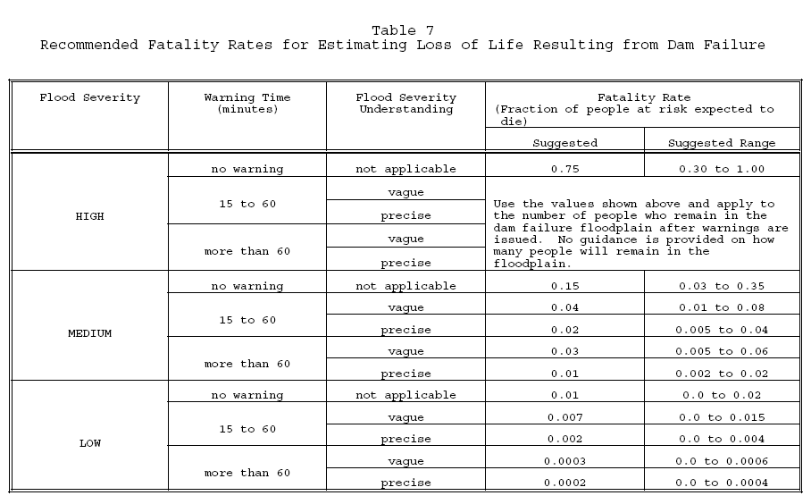
Consequences
Graham, 1999 – 50 case studies. Does not include large populations and long warning times

Slide 24
Consequences

Slide 25
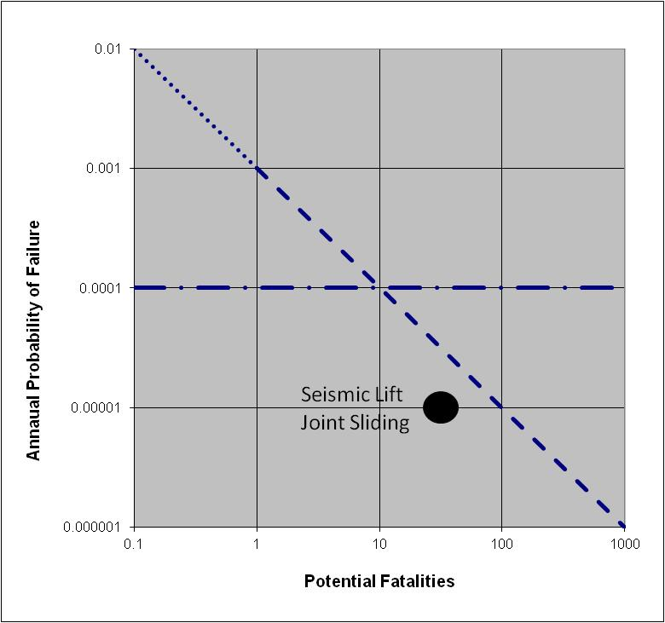
Risk Guidelines

Slide 26
Build the Case
Claim:
  The lift joints near the spillway crest are well bonded and have significant strength. This leads to a low likelihood (0.1 or less) of cracking through the section at 1/10,000 AEP or smaller ground motions.
Evidence:
  All lift joints near the spillway elevation were recovered intact in core drilling
  There were a large number of tests indicating high tensile strength across joints (report numbers)
  Construction control procedures were excellent (describe)
  Stresses are less than estimated strength (enumerate)

Slide 27
Key Concepts
Collect all relevant background material
Take a fresh look, (group dynamics)
Review background material diligently (by more than one qualified engineer)
Perform site examination with eye toward potential vulnerabilities
Involve operating personnel in the potential failure modes discussions
Think beyond traditional analyses

Slide 28
Identifying
Done in team setting with diverse group of qualified personnel
Facilitator (or Senior Engineer) elicits candidate potential failure modes based on team’s understanding of vulnerabilities
Facilitator (or Senior Engineer) makes sure each potential failure mode is understood and described thoroughly
Post large size scale drawings/sections and sketch out the failure modes (as appropriate)

Slide 29
Describing
Three elements of a potential failure mode description are:
  The Initiator (e.g. Reservoir load, Deterioration/ aging, Operation malfunction, Earthquake)
  The Failure Mechanism (including location and/or path) (Step-by-step progression)
  The Resulting Impact on the Structure (e.g. Rapidity of failure, Breach characteristics)

Slide 30
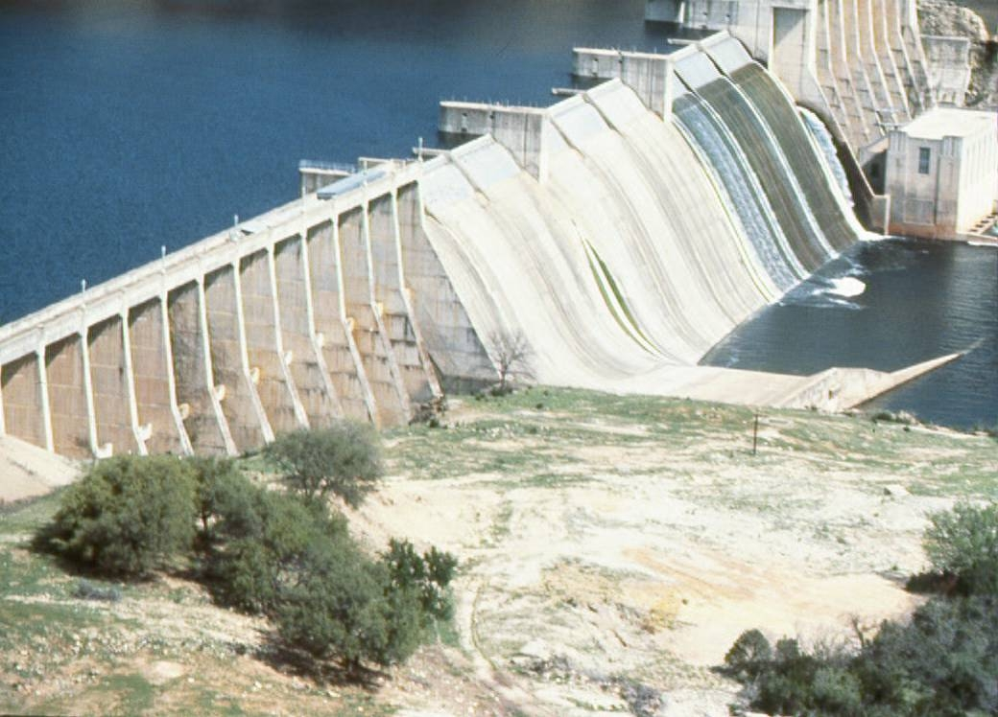
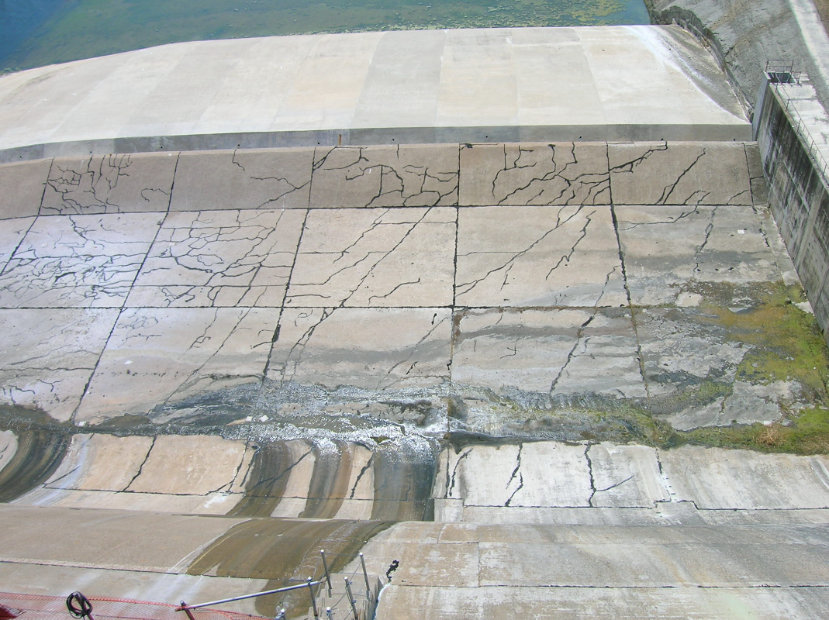
Example
Review of geology indicated dam is founded on horizontally-bedded shale and clay seams
Surveying results indicated the dam had moved several inches since monitoring began

Slide 31
Example (cont.)
Unedited (insufficient detail): Sliding of the concrete dam foundation
Edited: As a result of high reservoir levels and (1) a continuing increase in uplift pressure on the old shale layer slide plane, or (2) a decrease in shearing resistance due to gradual creep on the slide plane, sliding of the buttresses initiates. Major differential movement between two buttresses takes place causing the deck slabs to be unseated from their simply supported condition on the corbels. Breaching failure of the concrete dam through two bays quickly results followed by failure of adjacent buttresses due to lateral water load.

Slide 32
Review Consequences of Failure
If the Dam were to breach by this mechanism, at risk would be a highway, a railroad, two bridges, farmhouses, a gas pumping station, an aggregate plant, a barley mill, a transmission line, and the town of Ledger. There is little recreation activity downstream of the dam. The total population at risk is estimated at about 1400.
The embankment is constructed of silty material with a low PI and the alluvium is mostly cohesionless sand, a rapid erosion breach would likely occur down to bedrock.
(But, don’t rule out a potential failure mode with low consequences if it has a high likelihood of occurrence)

Slide 33
Analysis
For each potential failure mode:
List adverse or “more likely” factors
List favorable or “less likely” factors
Flesh them out so they can be understood by others and years down the road (ask, “why did we say that?,” and write down the answer)
Perform an evaluation of the potential risk – suggest using semi-quantitative approach described in next section.

Slide 34
Adverse “More Likely” Factors
The gravel alluvium in contact with the embankment core on the downstream side of the cutoff trench is similar to the transition zones which do not meet modern “no erosion” filter criteria relative to the core base soil.
The gravel alluvium may be internally unstable, leading to erosion of the finer fraction through the coarser fraction and even worse filter compatibility with the core.
The reservoir has never filled to the top of joint use; it has only been within 9 feet of this level; most dam failures occur at high reservoir levels; the reservoir would fill here for a 50 to 100-year snow pack (based on reservoir exceedance probability curves from historical operation).
The core can sustain a roof or pipe; the material was well compacted (to 100 percent of laboratory maximum), and contains some plasticity (average Plasticity Index ~ 11).
There is likely a significant seepage gradient from the core into the downstream gravel foundation, as evidenced by the hydraulic piezometers installed during original construction (and since abandoned).
It is likely that all flow through the foundation cannot be observed due to the thickness and pervious nature (transmissivity) of the alluvium.

Slide 35
Favorable or “Less Likely” Factors
Very little seepage is seen downstream; the weir at the downstream toe, which records about 10 gal/min at high reservoir when there is no preceding precipitation, indicating the core is relatively impermeable; these flow rates may be too small to initiate erosion.
The core material is well compacted (to 100 percent of laboratory maximum) and has some plasticity (average Plasticity Index ~ 11), both of which reduce its susceptibility to erosion.
No benches were left in the excavation profile that could cause cracking and the abutments were excavated to smooth slopes less than 2H:1V.
If erosion of the core initiates, the gravel alluvium may plug off before complete breach occurs (see criteria for “some erosion” or “excessive erosion”, Foster and Fell, 2001).

Slide 36
Screening
The risk for each potential failure mode can be screened at this point using the semi-quantitative approach described in the next section.

Slide 37
Potential Failure Mode Considerations
Reduced spillway capacity (debris, gate malfunction, orifice flow under gates, fuse plug fails to erode, etc.) leads to overtopping erosion
Mis-operation due to faulty instrumentation
Stagnation pressure or cavitation failure of spillway chutes or linings
Overtopping of spillway walls leading to erosion
Failure of large spillway gates releasing life-threatening flows (inadvertent opening from communications problem or drum gate lowering, buckling of radial gate arms (seismic or friction))

Slide 38
Potential Failure Mode Considerations (cont.)
Piping of alluvial material from beneath concrete dams
Internal erosion of embankments
  Along vulnerable paths including adjacent or into conduits or walls and into drains
  Through flaws caused by differential settlement, arching, poor construction, etc.
  Into geologic defects such as open joints or open-work gravel
  From low permeability layer at toe of embankment perhaps leading to heave or blow-out

Slide 39
Potential Failure Mode Considerations (cont.)
Differential deformation leading to stresses exceeding the structural capacity
Sliding on weak lifts in buttress dams
Plugging of drains or unprecedented reservoir loads perhaps leading to the following:
Sliding along weak discontinuities in the foundation of concrete dams
Sliding on poorly bonded lift joints in concrete gravity dams

Slide 40
Potential Failure Mode Considerations (cont.)
Seismic failure of spillway piers and loss of gates
Seismic failure of spillway walls and embankment erosion
Seismic liquefaction, deformation exceeds freeboard or seepage erosion through cracks
Seismic cracking/ sliding of concrete gravity dams or buttress dams
Seismic cracking/ displacement of concrete arch dams
Seismic failure of dam buttresses due to cross canyon loading

Slide 41
INTERIM RISK REDUCTION MEASURES
Dave Paul, P.E.
Lead Civil Engineer
Risk Management Center
With Acknowledgments to:
Jacob Davis, P.E., Geotechnical Engineer w/ RMC
Jeff McClenathan, P.E., Senior H&H with RMC

Slide 42
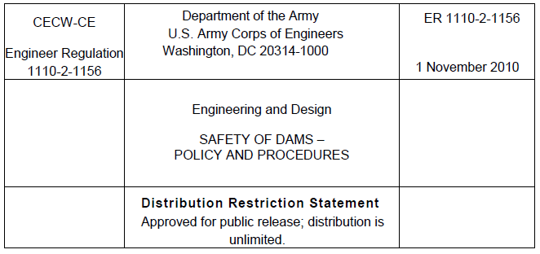
Guidance
Notes:
Chapter 7 of the New dam safety guidance will address the Interim Risk Reduction Measures Plans.

Slide 43
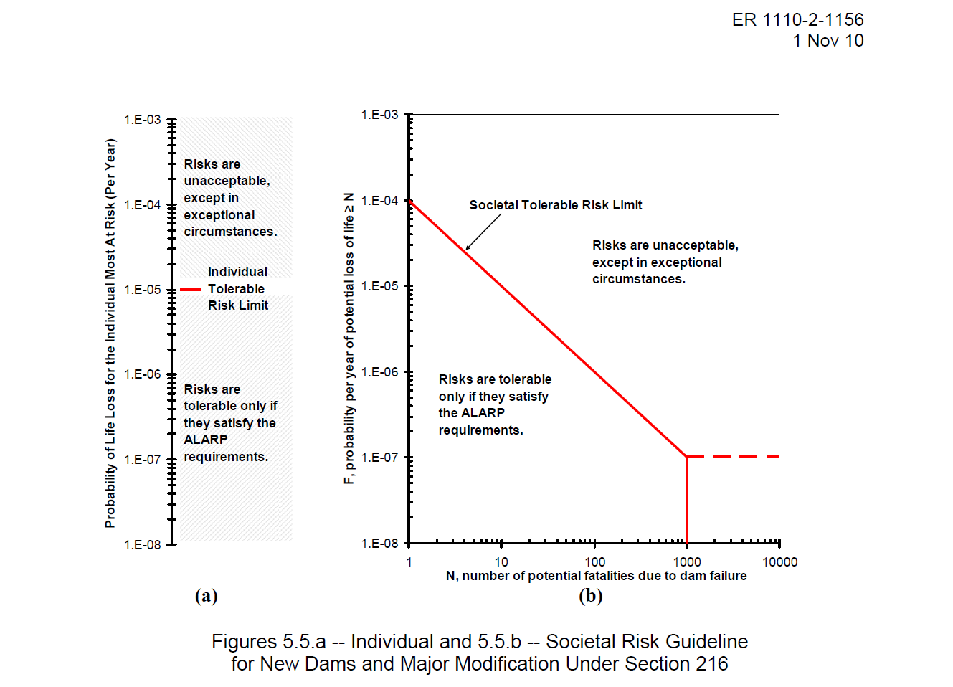
Risk Definition
Risk = (Load Probability)(Failure Probability|Load)(Consequences of Failure)
Notes:
To reduce risk, you have to alter one of three things.
You can reduce the probability of a load occurring.
You can reduce the probability of the dam failing given a specified load.
You can reduce the consequences of the failure (in most cases life loss).
If you address structural failure modes only, it is possible to not change your risk from the project due to consequences downstream.
In many cases, it would be more effective from a cost and consequence standpoint to do non-structural alternatives for a lower cost, higher benefit result.

Slide 44
IRRMP Objective
The IRRMs are a short-term approach to reduce Dam Safety risks while long-term solutions are being pursued.
IRRMs should lower the probability of failure and associated consequences to the maximum extent reasonable.
Some IRRMs may have longer durations than others based on national risk prioritization queue.
Notes:
Interim Risk Reduction Measures are meant to be expedient actions to reduce dam safety risk.
They are not to be considered the final long term solution for a dam deficiency.
Although they are not the final solution the time frame for their application can extend to years while long term final solutions are pursued.
It might be that a final solution for a project is known but that there are other priorities for the existing funding.
The IRRM should lower the risk presented by a dam.

Slide 45
IRRM Principles
“…it is not appropriate to refer to balancing or trading off public safety with other project benefits. Instead, it is after public safety tolerable risk guidelines are met that other project purposes and objectives will be considered. Dam Safety Officers are the designated advisors and advocates for life safety decisions.”
Notes:
In USACE Public Safety is the preeminent objective.
This means that consideration of the congressionally authorized purposes for the project are secondary to Life and Public Safety.
There is some balancing of priorities at these projects how much water to release, whether recreation is supportable etc.
But when Life and Public Safety are thrown into the mix they trump all other considerations.

Slide 46
IRRM Principles
Decisions are risk-informed and not risk-based.
Risk-informed decisions integrate traditional engineering analyses and judgment.
General public safety responsibility requires USACE to assure our projects are adequately safe from catastrophic failure that results in uncontrolled release of the water in the reservoir.
Notes:
USACE is an engineering organization with highly competent staff that are knowledgable in all areas of dam safety;
as such USACE uses risk assessments as one tool to inform decisions on dam safety.
Risk plus other information is used to assist USACE Decision makers prioritize and make decisions.

Slide 47
IRRMP Principles
Timely – Will the measure be implemented in a timely manner to reduce risk?
Cost – Is the cost of the measure within budgetary threshold for major maintenance or O&M as outlined in the current budget EC?
No new risk – Does the measure increase the overall risk from the dam to the downstream public?
Notes:
These questions are meant to determine validity of a proposed IRRM.
Interim Risk Reduction Measures are meant to be expedient actions to reduce dam safety risk.
They are not to be considered the final long term solution for a dam deficiency.
Although they are not the final solution the time frame for their application can extend to years while long term final solutions are pursued.
It might be that a final solution for a project is known but that there are other priorities for the existing funding.
IRRM’s should be tied in with a potential failure mode, or documented area of concern for the project.

Slide 48
IRRM Principles
Do no harm: The principle of ‘Do no harm’ should underpin all actions intended to reduce dam safety risk. Applying this principle will ensure that proposed IRRM implementation would not result in the dam safety being compromised at any point in time or during IRRM implementation
Notes:
Or by increasing overall risk downstream – some items may increase overall risk downstream – early high releases, lowering spillway crests, etc.

Slide 49

FIRST -
“DO NO HARM”
Modifications to Existing Dams

Slide 50
IRRM Plans
Long-term life-safety guidelines should be met by IRRM’s wherever available non-structural and appropriate structural measures exist.
Chapter 7 provides risk guidance for when IRRM’s should be implemented faster.
Chapter 7 provides suggestions on evaluating proposed IRRM’s for implementation
Notes:
The Interim Risk Reduction Measures plans are discussed in chapter 7 of the New Dam Safety Guidance.
The Chapter provides guidance on the implementation of the measures including guidance on when the interim risk reduction measure implementation should be accelerated.
The chapter also provides suggestions for evaluating the efficacy of the measures that are being proposed for a project.

Slide 51
IRRM Plans
IRRM’s should be tied to a documented area of concern or a potential failure mode.
IRRM’s should not be a continued standard maintenance action, or following an established procedure.
IRRM’s need to specifically state how a plan reduces the overall risk by decreasing loading, consequences or likelihood of failure.
A study by itself is not an IRRM, and does nothing to reduce risk. If a study is referenced in an IRRM, there needs to be information on how it is to be used to lower the risk.
Notes:
Give some examples:
If the only area of concern for a project is spillway erosion, or overtopping of the embankment, then installation of 20 pizeometers along the toe of the embankment to measure seepage, or replacement of a outlet gate would not be justified as an IRRM.
Continued monitoring of the embankment in accordance of the operations manual, or mowing the grass when it gets over 12 inches would not be IRRM’s. These are supposed to be normal practice and fall under standard project O&M. There are exceptions to this though.

Slide 52
IRRM Plans
Pool restrictions must be given serious consideration and explain why not being implemented. Very. Specific. Reasons.
Water Control Plans need to support IRRM Plans
NEPA should be involved early and often in the process and should be discussed in the IRRM plan
Notes:
Having the reasoning is important to allow what may trigger it to be considered in the future if conditions worsen – Also that a pool cannot be restricted below a specific elevation for all inflow events….
May want to consider making this an operational change and not just pool restrictions….
When a project is a DSAC I, a DSAC II or a DSAC III serious consideration must be given to restricting the pool; additionally, on these projects consideration of raising the pool levels for water reallocation should not be a consideration.
Water Management Plans need to complement the Interim Risk Reduction Measure Plans.
It is highly likely that restricting a project pool will have an impact on the environment either upstream or downstream.
Upstream because pools could be lower and affect the environment along the border of the pool.
Downstream we may require more water releases. The districts should be aware that they will need to prepare NEPA documentation…

Slide 53
Components of an IRRMP
Overall project description, brief construction history, operational history and purposes.
Overview of identified PFM’s from SPRA, PFMA, etc…
General Consequences associated with each PFM.
Structural and Non-Structural IRRM’s considered to reduce probability of failure or consequences.
Discussion on predicted reduction of probability of failure and consequences, impact on project purposes, economic and environmental impacts.
Recommendations and justifications for IRRM’s.
Schedules and Costs for each IRRM.
DQC Comments and Resolutions.
Hyperlink to the most current EAP and is updated to show schedule of emergency exercises.
Communications Plan.
Notes:
The full requirements are detailed in chapter 7, section 5. The requirements for the EAP coordination exercises are provided in chapter 16, and are based on the DSAC rating for the project. The Communications plan is discussed in Chapter 10.
When developing an IRRMP the district is supposed to use the most current information available. If a PFMA has been performed, that would supersede the SPRA analysis.

Slide 54
IRRM Plans
IRRMP’s are Living Documents. They should be revised when conditions change, new information is acquired, studies are performed, or after completion of remediation phase.
IRRM Plans should focus on “significant” risks when identified as part of an PA, IES, DSMS
Notes:
Do not need to consider every item mentioned in the SPRA document.
The Interim Risk Reduction Measures Plans is a living document.
Plans should be modified to address changes in the condition of the structure or even the knowledge of the structure that the districts have.
As the potential failure modes of a project are confirmed to be significant through the Periodic Assessment, Issue Evaluation Studies or the Dam Safety Modification Studies interim risk reduction measures should be developed to address them.

Slide 55

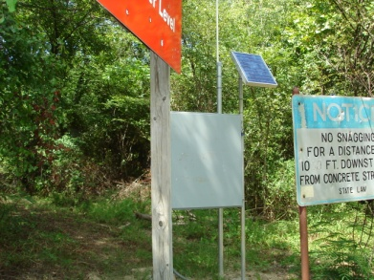
Surveillance & Monitoring
Provides potential for earlier detection of problem
Potentially allows more time to implement EAP and reduce consequences
Should be focused on failure modes
Do NOT just use existing monitoring schedule
Notes:
If surveillance and monitoring is to be used as an IRRM, there needs to be specific issues tied in with the failure modes they are to address.
If additional surveillance and monitoring is used, the Interim Operations Plan or EAP needs to note the changes and they need to be documented and published.

Slide 56
Potential Reasons for Rejection of IRRM Plans
Inadequate consideration for pool restriction, or justification for no restriction
Automated early warning systems with automatic public notification
Pool releases based on rain forecasts
Inadequate description of consequences
Got Boils? Better have emergency stockpiles.
“Copy and Paste”
Waiting for studies . . .
Notes:
The use of an automatic system for monitoring that is connected to an alarm system is not recommended. Need some judgment and not a direct connection to the public here.
Pool restriction – if not recommended, state all that was considered and justify why action is not needed. IRRM Plans are meant to be living documents and should be updated as new information becomes available, especially if project conditions change and in a few years a District may need to implement pool restrictions. If the reasoning/justification is included in the IRRM plan, it makes updating the document easier.
“Copy and Paste – just copying the IRRM’s and not tailoring specifically for the dam - THIS IS THE TIME TO THINK INDIVIDUALLY ABOUT THE DAM AND WHAT IS KNOWN.
Why is a study needed to set up a monitoring surveillance plan specific for current knowledge of the dam. Base it on current knowledge – adjust as this knowledge changes
Needing a study to identify stockpile items for the potential failure modes for the dam could be grounds for non-concurrence.

Slide 57
IRRM Plans: Bad
Develop a Communication Plan. This plan will have to be developed. Once developed, it will reduce the consequences of failure through education of the public and Emergency Management Agencies.
Notes:
If you do not have a Communications Plan, the IRRMP will not pass.
Future promises of a Communications Plan do not work.

Slide 58
IRRM Plans: Good
Reservoir Restriction - A reservoir restriction was evaluated and determined to be unnecessary at this time. The project is designed and operated as a dry dam with infrequent loading and flashy storage during extreme events. This leads to the embankment being loaded for short detention periods. Due to the way the system is operated, it is not possible to alter reservoir stages or lower the pool, since it is a pass through system that is designed to detain water for a brief period to provide relief to downstream systems.
Notes:
Not only does this say why a pool restriction is not needed, it provides the reasoning also. So this shows it was considered, evaluated and ruled out.

Slide 59
IRRM Plans: Bad
Flood Fighting. Emergency flood fighting materials should be provided and located at accessible location but not in the way of normal operation areas of the dam. Such materials may include soils and rock like materials that would be useful to control or reduce seepage from the embankment, if it occurs. Existing District construction service or maintenance contracts could be utilized to provide emergency equipment and personnel. Such services would enhance emergency response and carry out measures such as seepage control.
Notes:
This IRRM as written is missing many parts.
The wording in the IRRM is passive and probabilistic.
It does not state that materials will be provided, just that they should.
There is no reference to any quantities that are known, or of an effort being made to identify the quantities.
It does not say how the materials will be moved.
It is unclear if the district has equipment, or the personnel.
If the district has no equipment or personnel, an effort should be made to identify local sources to determine if they are even available.
There is also no cost or schedule associated with this IRRM.

Slide 60
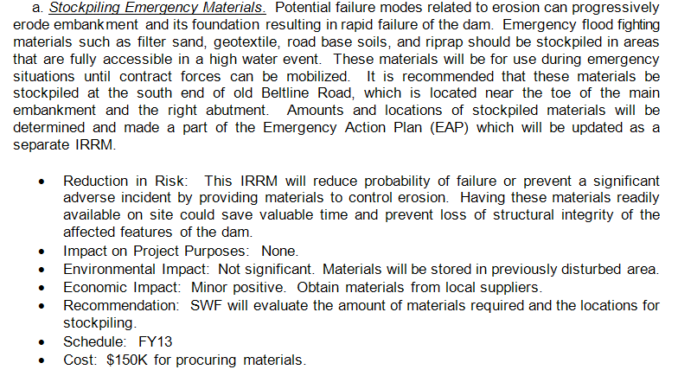
IRRM Plans: Good
Notes:
This is a good IRRM.
It specifically states what they are going to do.
It says how and where they are going to do it.
It says how the IRRM is going to reduce risk.
It provides a schedule and a dollar amount to implement.
They address the environmental impacts of the stockpile.

Slide 61
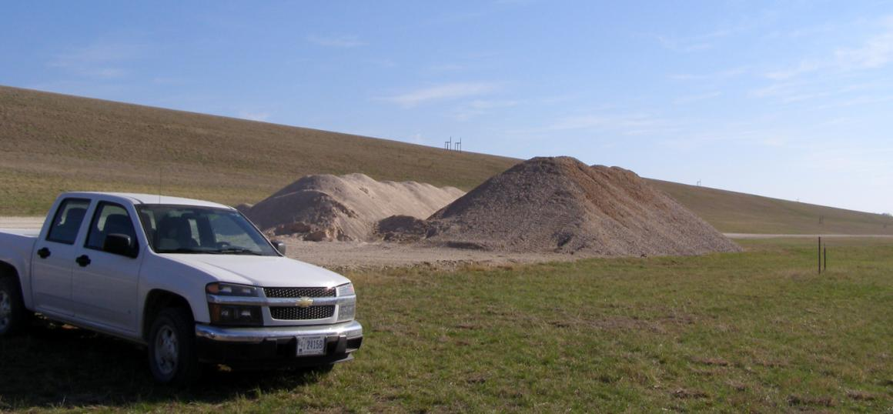
IRRM Example: Stockpiling
Proctor Dam (SWF)
Thanks to: Ronald Gardner, Jose Hernandez, Carla Burns, Tommy Schmidt
Notes:
Note that the piles are free of vegetation, they appear to have access to the piles where they can get equipment in.

Slide 62
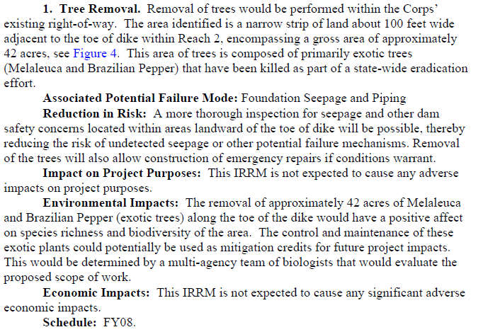
IRRM Plans: Good
Notes:
Note that this is a vegetation removal item, which should have been performed under standard O&M.
However, the problem was so severe a special effort was required to remove the vegetation so the project could be inspected which would be an IRRM.
After the tree removal is complete, the IRRMP should be updated to show the work is complete, and the continued maintenance of the embankment should be under O&M and not be included as part of this IRRM.
They address the environmental impacts of the tree removal.

Slide 63
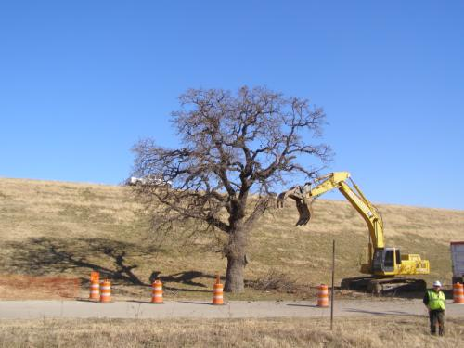
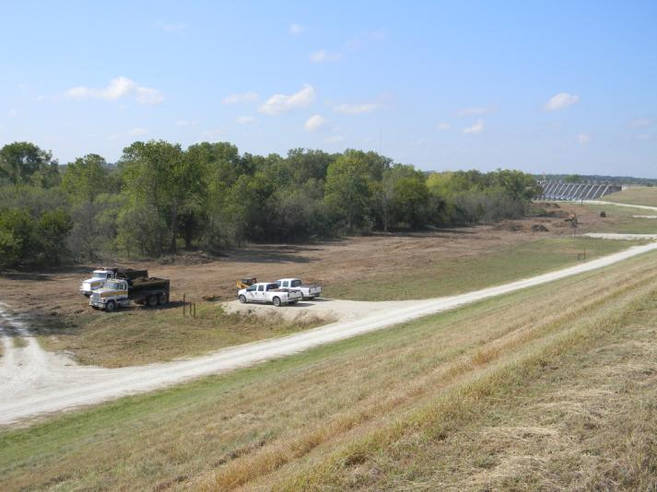
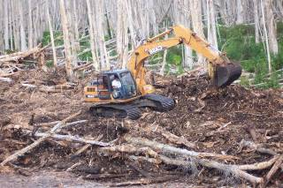
IRRM Examples: Vegetation Removal

Slide 64
Closing Remarks
IRRM plans meant to be living documents
Closer scrutiny with future IRRM plan reviews
Preparing a sample template for use
IRRM Examples can be provided upon request. Can contact Jacob Davis or Martin Falmlen with the RMC with data requests.
Notes:
Changes need to be made to the IRRMP’s as project information changes.
Documents from earlier than the current year, should be altered to show changes to the IRRM’s based on their schedules.
There are some IRRM’s and formats that can be provided as good examples.

Slide 65
Questions?
Thank you for your attention.
Martin.r.falmlen@usace.army.mil

Slide 66
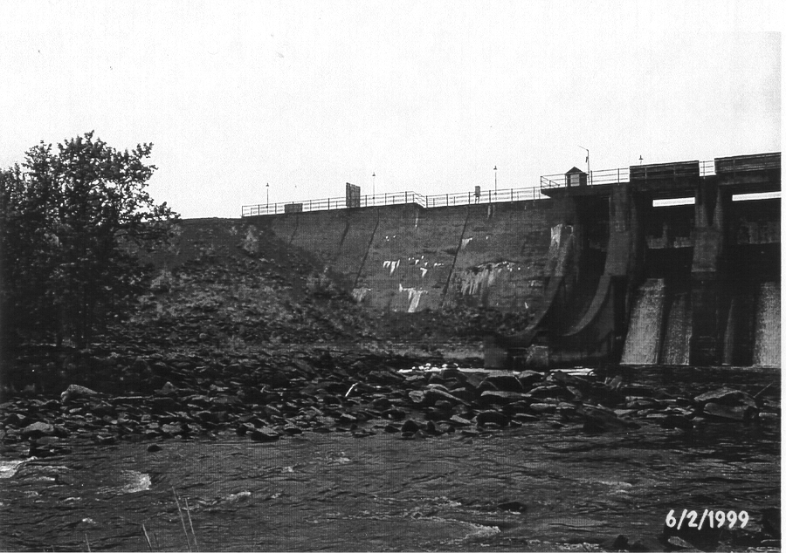
Example 1
Notes:
Dam at the head of a river system (storage dam). Every day someone looked at the (water gage on) concrete dam, but not the earth dam. The earth dam foundation consisted of three types: concrete cutoff wall, sheet pile cutoff wall, cutoff trench.

Slide 67
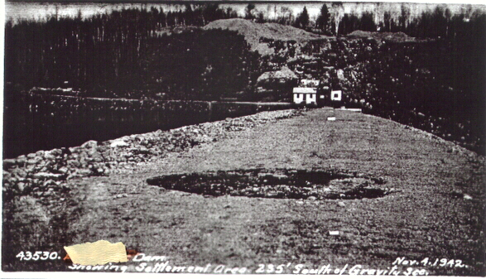
Example 1 (cont.)
Notes:
Eight safety inspections @ 5 year intervals only mention settlement on first filling. This propagated through all the reports. Need to read the material again. This photograph of the “settlement” was in the files.

Slide 68
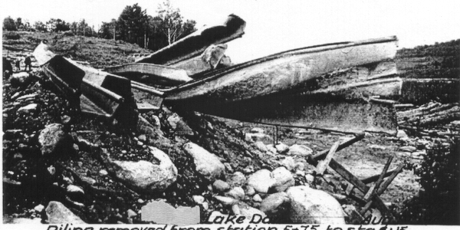
Example 1 (cont.)
Notes:
Sheet piling at the same stationing as the sink hole. This is sheet piling they tried to install, but had trouble driving and pulled it out, and then supposedly re-installed it. After the sink hole, they drove sheet piling into and through embankment at the hole, then filled in on either side.

Slide 69
Example 1 (cont.)
Unedited (insufficient detail): Piping from the embankment into the foundation
Edited: During a period of high reservoir elevation, piping of the embankment core initiates at the gravel foundation interface in the shallow cutoff trench near Station 2+35 (where problems with the sheet pile and sinkhole occurred). Material might or might not exit at the toe of the dam. Backward erosion occurs until a “pipe” forms through the core exiting upstream below the reservoir level. Rapid erosion enlargement of the pipe occurs until the crest of the dam collapses into the void, and the dam erodes down to the rock foundation.

Slide 70
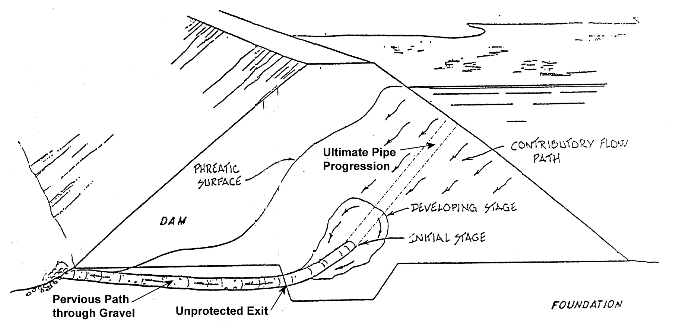
Example 1 (cont.)

Slide 71
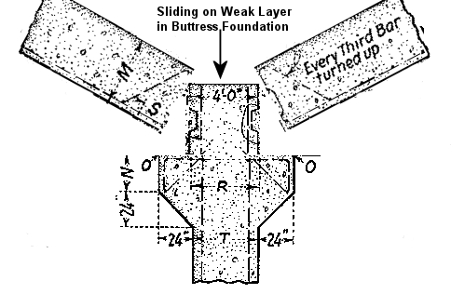
Example 2 (cont)

Slide 72
Example 3
An embankment dam has a gated spillway crest for passing flood flows. Of the four gates, one can be remotely operated from the power control center to pass normal flows. The remaining three gates must be operated manually from a control house on top of the spillway hoist deck. If a single gate is opened completely, the main access road is inundated. A limit switch keeps the remotely operated gate from opening more than half way without on-site intervention. The limit switch failed in 1994 and the road was washed out. The only other access to the spillway gate deck is a rough 4-wheel-drive road from the reservoir side that becomes muddy and treacherous when it rains.

Slide 73
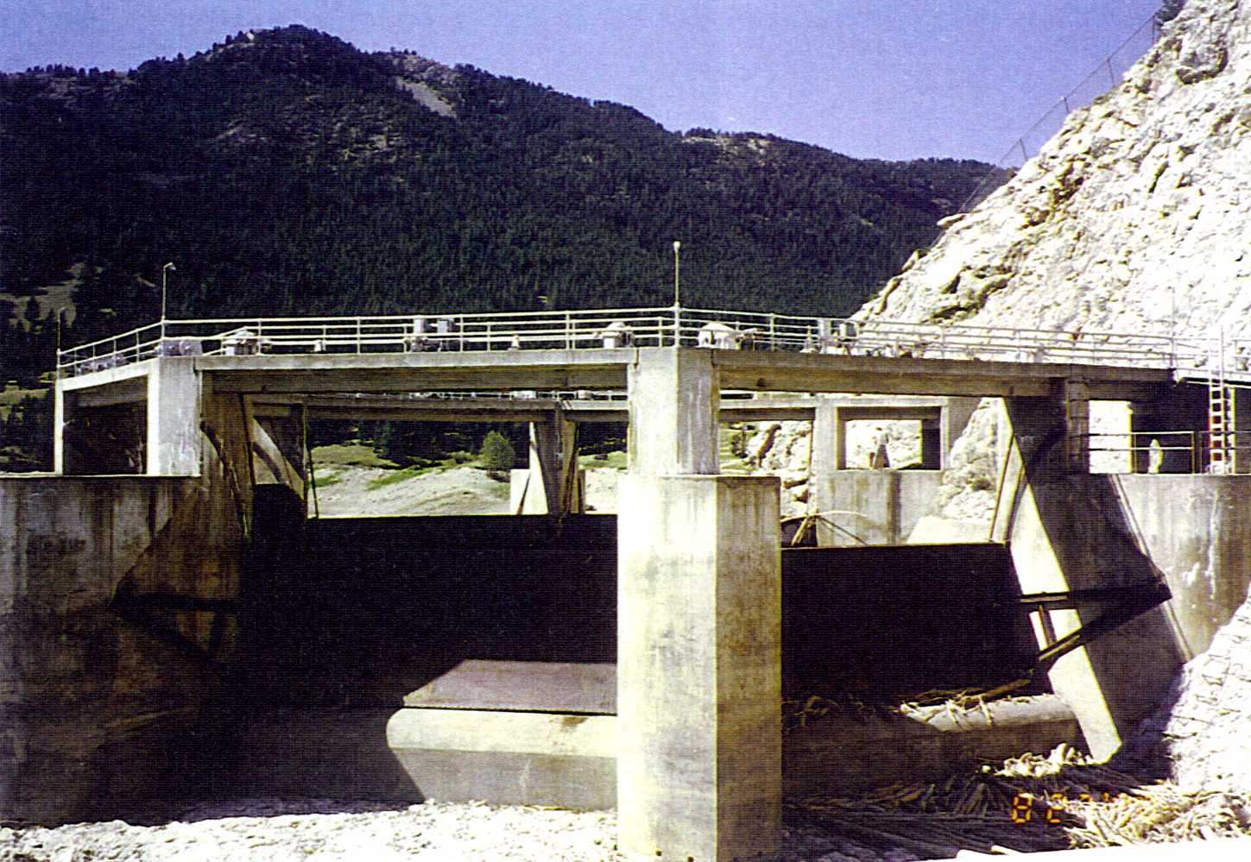
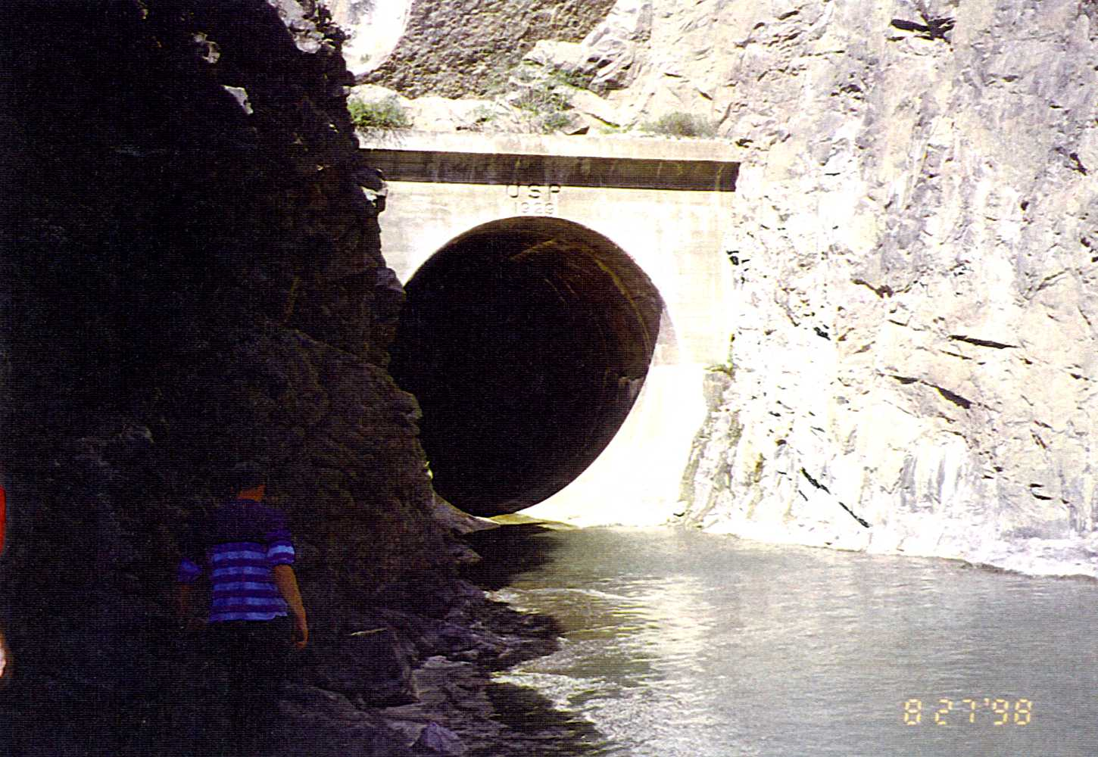
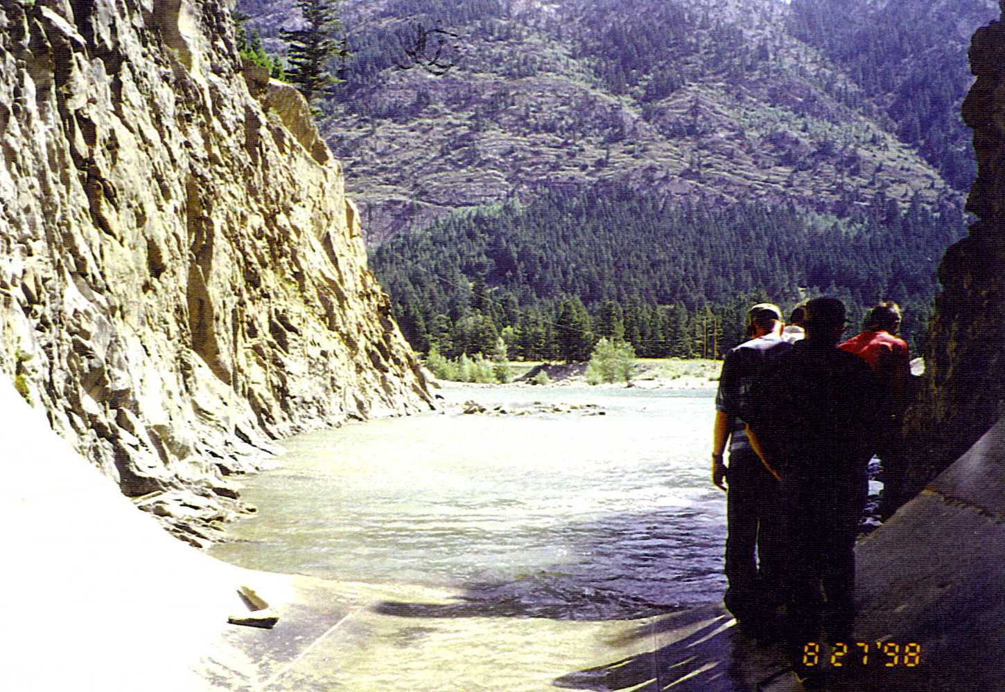
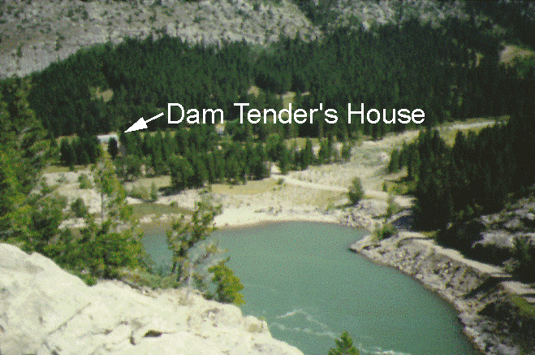
Example 3 (cont.)
Access Road
Spillway Discharge

Slide 74
Example 3 (cont.)
Unedited (insufficient detail): Dam overtopping due to gate operation failure
Edited: During a large flood, releases in excess of those that can be passed through the automated gate are required. The limit switch on the automated gate fails (occurred in 1994) due to a loss in communications and the gate opens fully wiping out the only access road. An operator is deployed to the site, but cannot make it to the gate operating controls. The release capacity of the single automated gate is insufficient and the dam overtops, eroding down to the stream level.

Slide 75
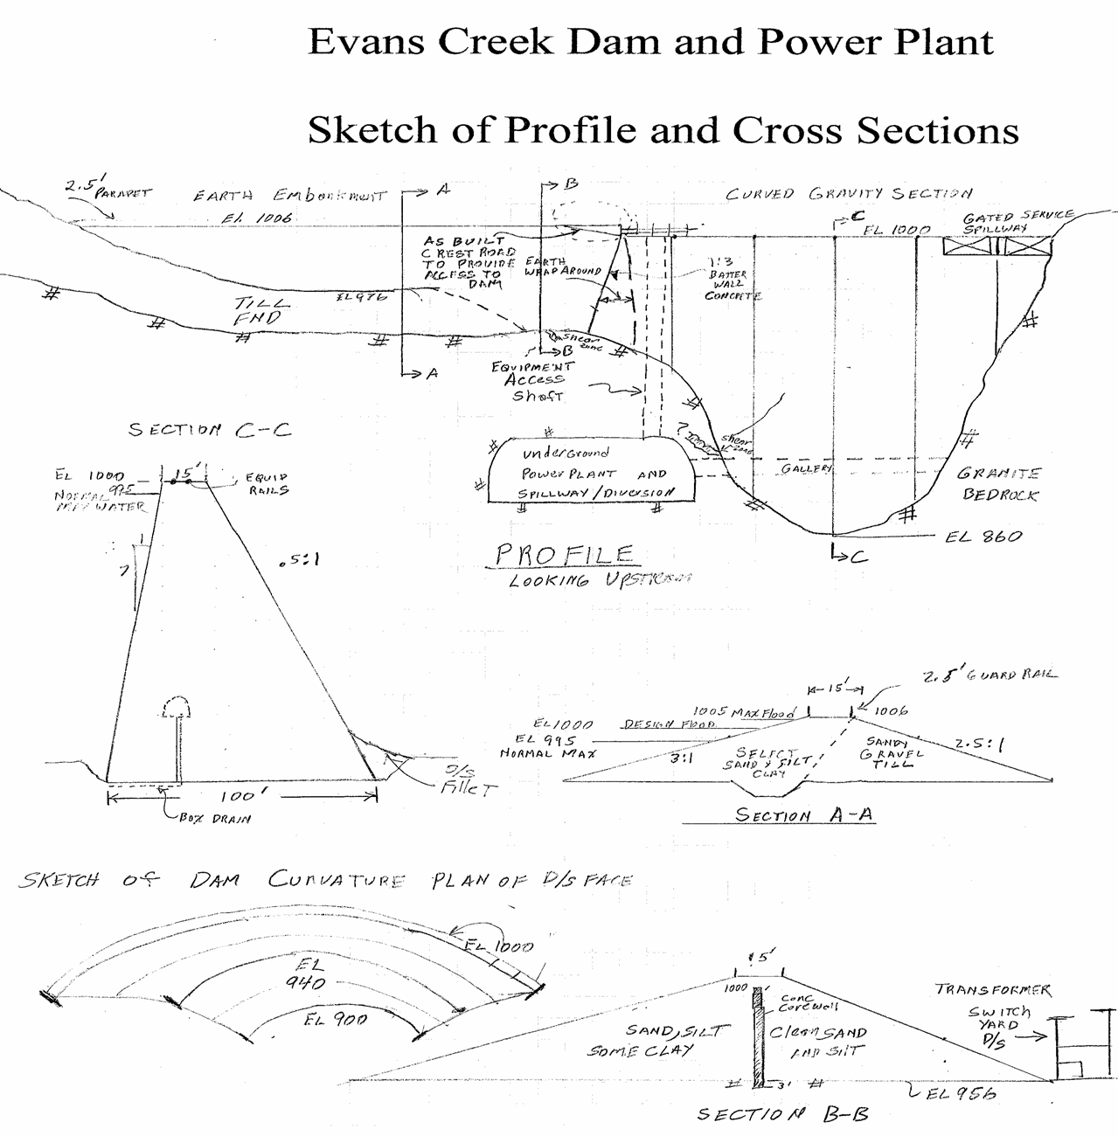
Use Evans Creek example if audience is mostly interested in dam safety rather than levee safety

Slide 76
Practice Session 1 - Identify and Describe a Potential Failure Mode
1. Read hand out material and examine sketch
2. In Groups of two or three propose possible failure modes - agree on a viable / credible candidate mode
3. Develop a potential failure mode description that can be clearly understood by a reader in 5 years

Slide 77
Practice Session 2 – Failure Mode Analysis
For the potential failure mode you previously described:
Identify More Likely / Adverse and
Identify Less Likely / Favorable Factors

Slide 78
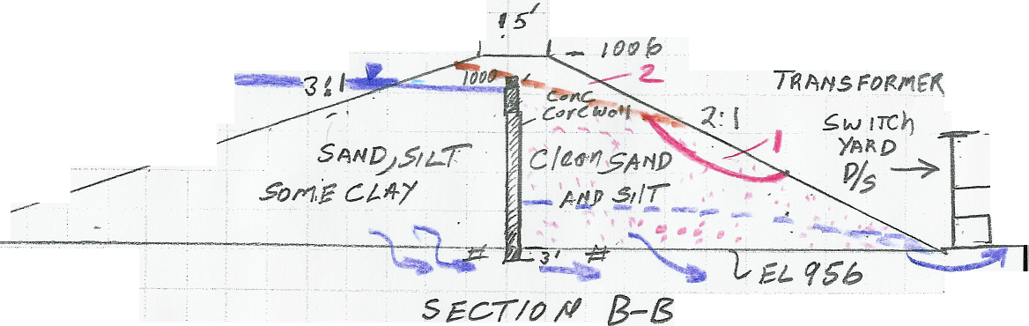
Evans Creek
Potential Failure Mode 1 - Piping of sand and silt from embankment founded on rock

Slide 79
Evans Creek
Potential Failure Mode 1 - Piping of sand and silt from embankment founded on rock
Seepage from beneath the section to the left of the core wall gradually washes out the sand at the embankment contact, and causes periodic slumping and steepening of the downstream face, reducing the embankment cross section and allowing a slide to take place under a high water condition that leads to loss of freeboard and overtopping erosion and breach to the rock foundation.

Slide 80
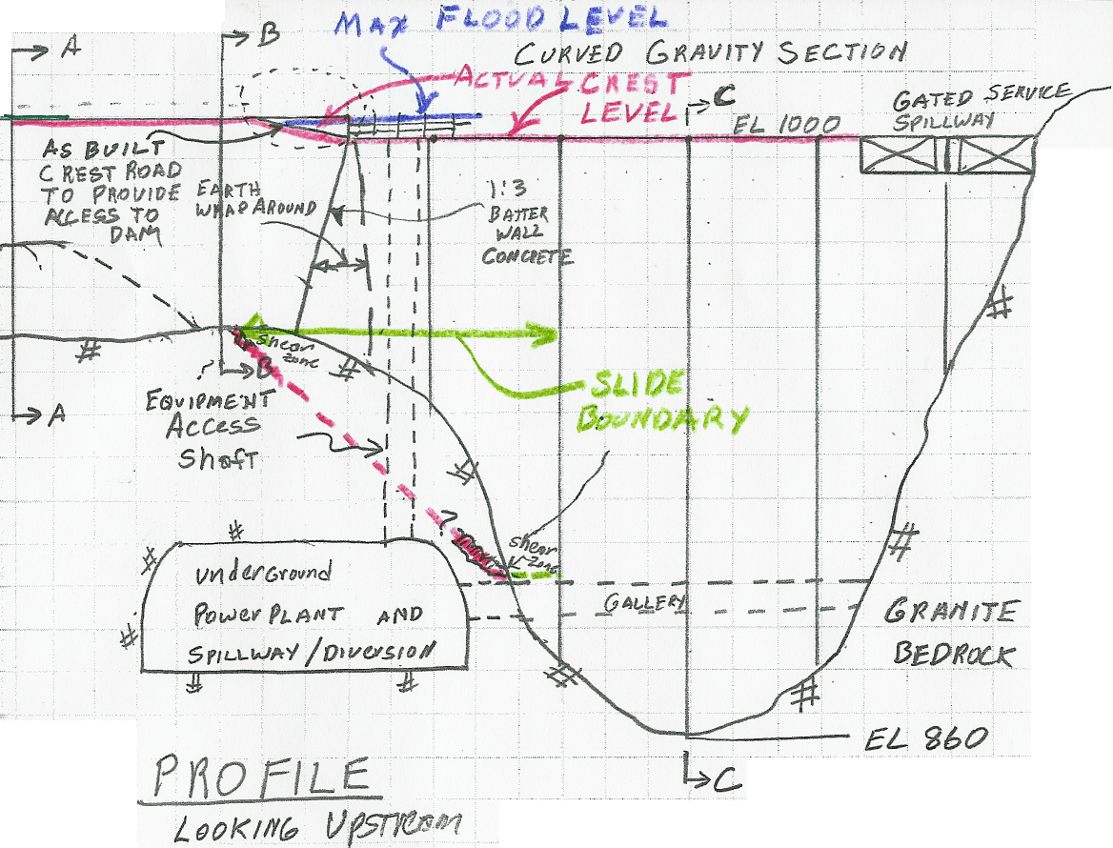
Evans Creek
Potential Failure Mode 2 - Overtopping of the embankment dam

Slide 81
Evans Creek
Potential Failure Mode 2 - overtopping of the embankment dam due to major floods in excess of the gated spillway capacity or a lesser flood with debris blockage
When floods in excess of the gated spillway capacity (or lesser with debris blockage of spillway) begin to overtop the concrete dam, they would also overtop the edge of the embankment section where the crest road was cut down to provide vehicle access to the spillway. The downstream shell would begin to erode. Flow over this section would cause loss of transmission capability and thus loss of the capability of plant to pass 5000 cfs discharge leading to more overtopping erosion. Support for the core wall would be lost, and the embankment would breach.

Slide 82
Evans Creek
Potential Failure Mode 3 - Concrete Dam Foundation Wedge Failure

Slide 83
Evans Creek
Potential Failure Mode 3 - Wedge failure of concrete gravity dam due to slide of upper right abutment.
A potential foundation wedge exists under the right two blocks of the concrete gravity dam. The plunge of the intersection of the shear zone and a vertical joint is up towards the d/s and into the right abutment (or into the structure). Increased uplift and increased driving forces from a sustained high water condition or earthquake could initiate wedge sliding and rupture of the dam as it moves downstream with the wedge, rapidly releasing the reservoir down to about the dam gallery level.

Slide 84
Evans Creek
Potential Failure Mode 1 - Piping of sand and silt from embankment founded on rock
Adverse/More Likely Factors Favorable/Less Likely Factors
- Unprotected seepage exit -Seepage flow monitored
- Fines not captured by flume -No visual evidence of collapse noted to date
- Seepage flow is significant -Water level must be high
    - Piping sand through
    granite joints not likely
    - No visual evidence of
    fines seen to date
    - Potential slip plane shallow

Slide 85
Evans Creek
Potential Failure Mode 2 - overtopping of the embankment dam due to major floods in excess of the gated spillway capacity or a lesser flood with debris blockage
Adverse/More Likely Factors Favorable/Less Likely Factors
- Overtopping at rel. low flows - Crest Road is paved
- Debris could block spillway - Concrete core wall delays failure develop
- Sand / gravel fill erodible - Small zone, mitigation or intervention possible
- Transmission yard can fail

Slide 86
Evans Creek
Potential Failure Mode 3 - Wedge failure of concrete gravity dam due to slide of upper right abutment.
Adverse/Likely Factors Favorable/Not Likely Factors
Discontinuities defining - Curved shape of
block exist Dam will inhibit sliding
Water above shear - No indication of
indicated any movement on rail
Crack occurred at the shear - Good quality side plane
location on first filling
No analysis of condition
performed to date

Slide 87
Levee Example
Cobb Creek Levee

Slide 88
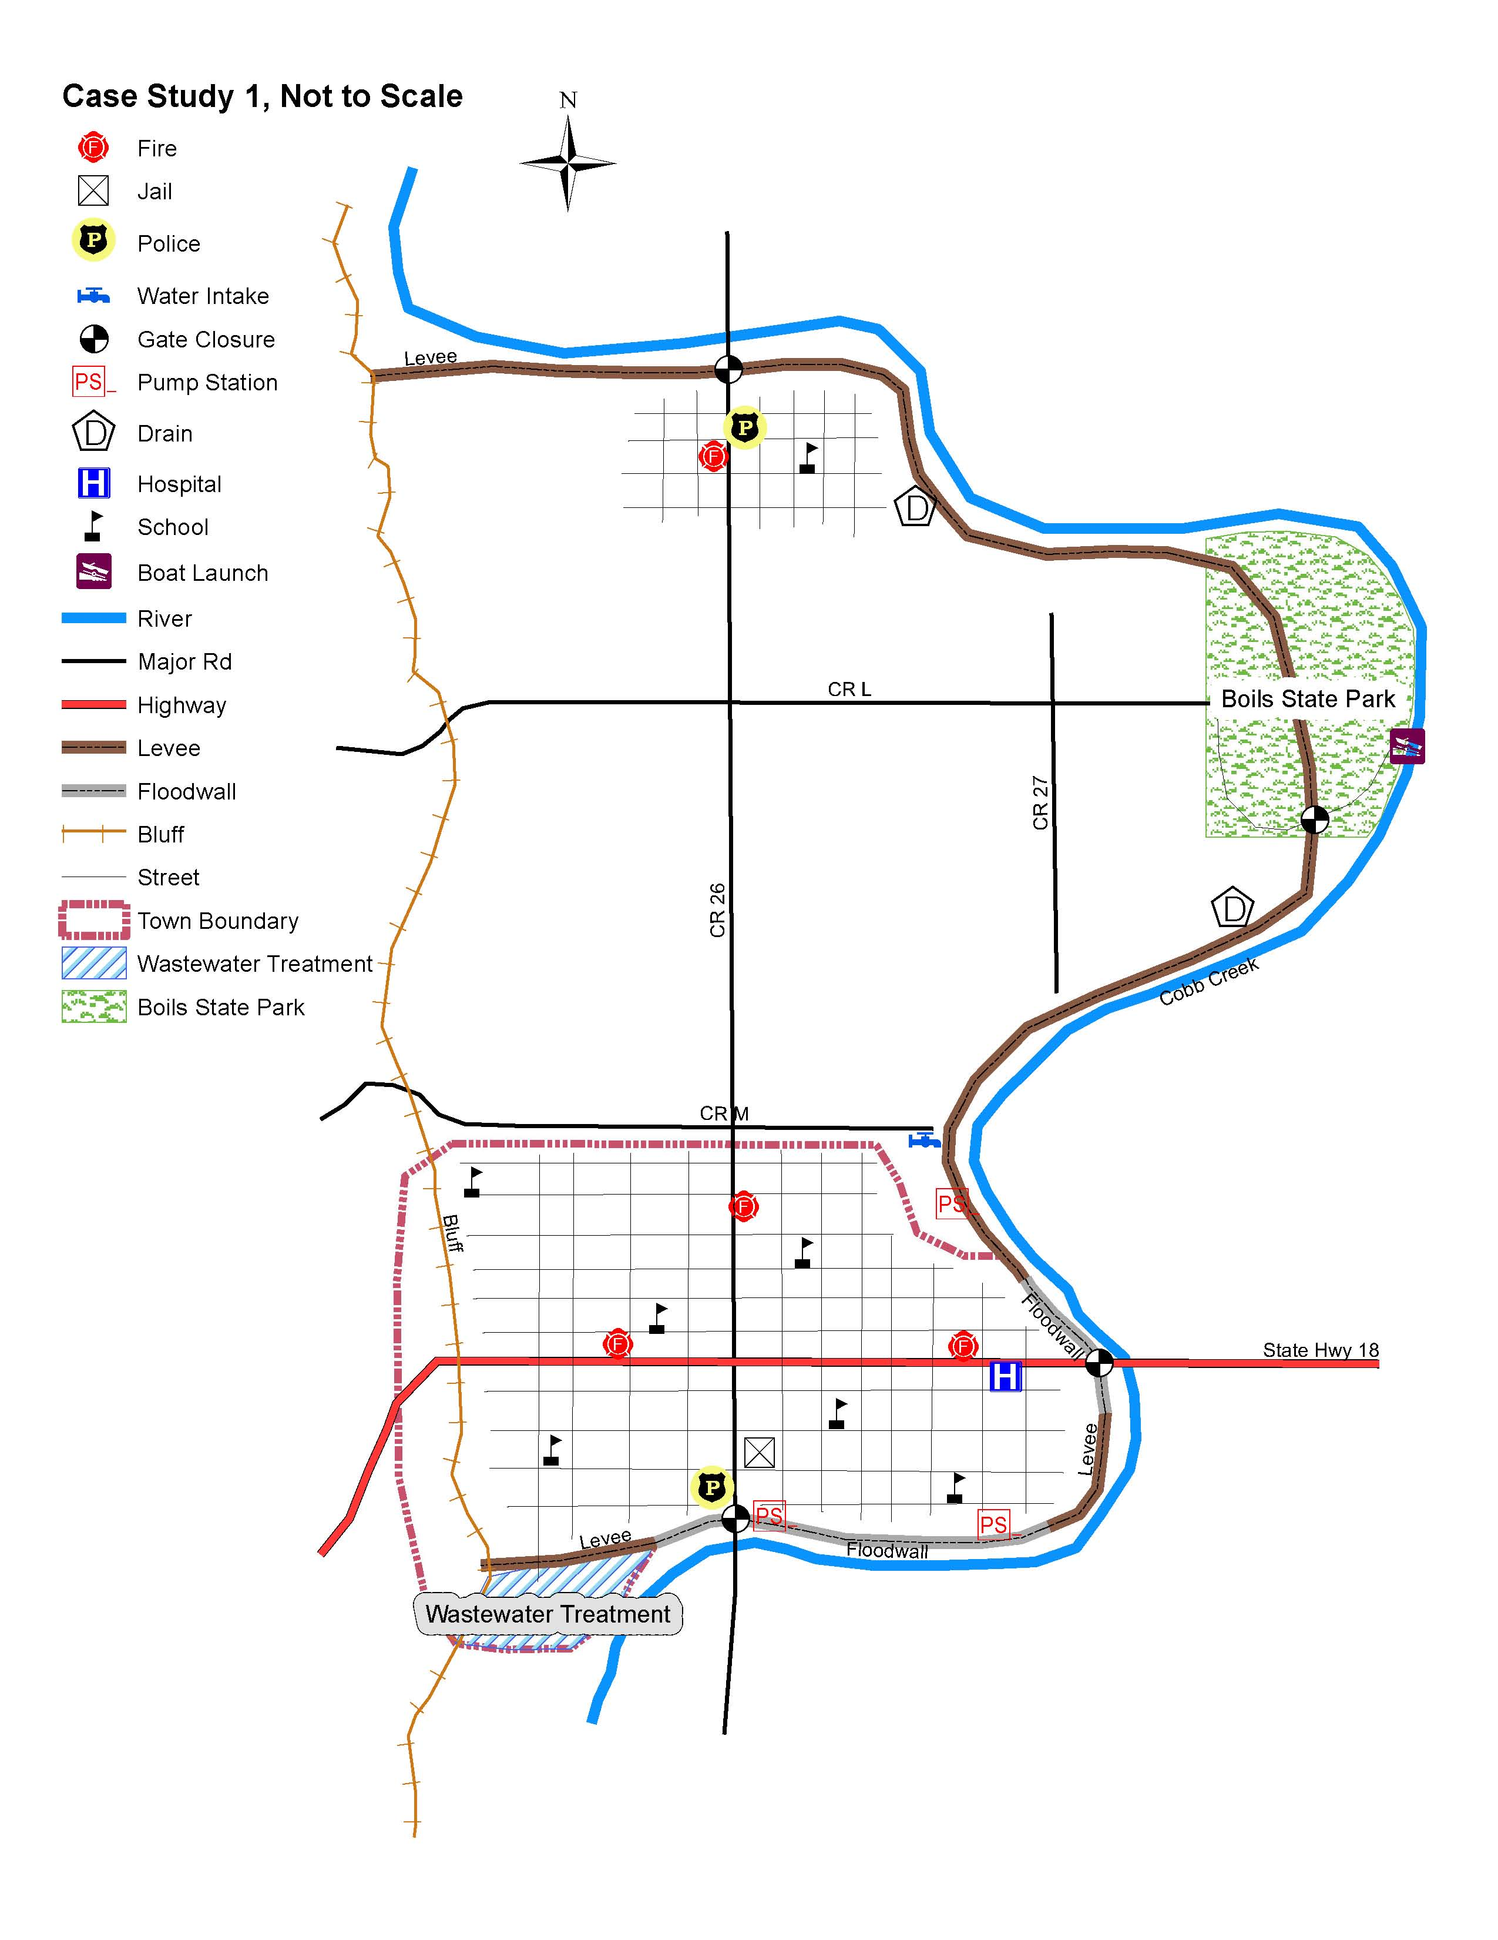
Cobb Creek Levee
Use Cobb Creek example if audience is primarily interested in levee safety rather than dam safety

Slide 89
Cobb Creek
PFM 1 – Piping of sand and silt from foundation at Boils State Park
Seepage from existing boils continues during a flood. The seepage becomes dirty carrying sand and silt. Backward erosion continues, and the clayey levee acts as a roof. The backward erosion continues until a pipe is formed and breaks through to the river side of the levee forming a continuous pipe. Gross enlargement of the pipe continues until the roof collapses and the crest of the levee degrades and the levee is overtopped.

Slide 90
Cobb Creek
PFM 2 – Operational Failure of the Highway 17 Closure
It has been 17 years since the post and panel structure was set in place. Flood water rise rapidly and the pieces cannot be found to set into the closure structure. By the time this is realized there is no time for sand bagging because of the width of the opening and the rapid rise of the flood waters. The flood water begins flowing through the opening in the flood wall and inundating eastern Ernieton. OR
It has been 17 years since the post and panel structure was set in place. The city workers with experience in setting the floodwall in place have retired and moved out of the area or they have passed away. The post and panel closure structure across highway 17 is set in time, but the workers are unfamiliar with the pieces and important braces are not installed properly. The flood water rises to about four feet up on the closure structure when it suddenly collapses. A wave of flood water quickly inundates the eastern part of Ernieton.

Slide 91
Cobb Creek
PFM 3 – Collapse of the CMP Drainage Pipe
Collapse of the CMP drainage pipe due to corrosion leads to an open pipe through the embankment exposed to soil. River water rises to the level of the opening. The open erosional pipe enlarges and collapses, leading to degradation of the levee crest and overtopping.

Slide 92
Cobb Creek
PFM 4 – A large flood exceeding the 1/1,000 AEP flood occurs
A large flood exceeding the 1/1,000 event occurs and overtops the levee by more than1.5 feet. The levee is too long to sand bag its entire length, and the floodwall cannot be sandbagged along its crest. Burtville experiences flood depths of up to 2 feet along most streets, with occasional areas with depth of up to 3 feet near storm drain inlets. Ernieton experiences severe flooding with floodwaters up to 15 feet deep.

Slide 93
Cobb Creek
PFM 1 – Piping of sand and silt from foundation at Boils State Park
Adverse/ “More Likely” Factors | Favorable/ “Less Likely” Factors
Evidence of past seepage and piping initiation (Sand boils exist) Buried channels with fine sand and silt are likely below the levee The levee has only been loaded to 60 percent of its height Sand boils have occurred at other locations Vegetation obscures the toe of the levee | Sand boils have occurred in the past without failure Sand boils can be flood fought The locals are familiar with fighting sand boils most recently in 1995

Slide 94
Cobb Creek
PFM 2 – Operational Failure of the Highway 17 Closure
Adverse/ “More Likely” Factors | Favorable/ “Less Likely” Factors
It has been 17 years since the structure was set Operational directions for setting the structure may have been lost The river is flashy with a small drainage basin which reduces the time to react The closure structure would likely need to be set during a rain storm The pieces of the structure are stored across town | Post and panel systems are relatively easy and quick to setup People may have time to evacuate from Ernieton if the closure structure is not installed People will work heroically to save their town The closure structure will likely show signs of distress prior to failure, allowing time for warning and possibly bracing the structure

Slide 95
Cobb Creek
PFM 3 – Collapse of the CMP Drainage Pipe
Adverse/ “More Likely” Factors | Favorable/ “Less Likely” Factors
Heavy corrosion noted in the last inspection Previous sinkhole adjacent to the pipe, with unknown backfill The CMP is > 50 years old The drain pipe is in a rural area and the collapse may not be noticed prior to a flood The pipe has not been video inspected | The pipe is in a rural area which is far from town and will allow time for evacuation or other means to deal with the flooding The pipe is near the upstream end of the basin The levee is inspected prior to or early during every flood event, which could allow time for flood fighting The locals have flood fought before and are familiar with sand bagging The pipe is only 48 inches in diameter

Slide 96
Cobb Creek
PFM 4 – A large flood exceeding the 1/1,000 event occurs
Adverse/ “More Likely” Factors | Favorable/ “Less Likely” Factors
The drainage system is small and a large stalled storm can dump sufficient rain in the drainage basin in less than 24 hours to cause overtopping of the levee The drainage basin is considered flashy | Large storm allows time for evacuation Rare storm event (more remote than 1/500 event) to overtop the levee

