Slide 1
PERIODIC ASSESSMENTS
Dave Paul, P.E.
Lead Civil Engineer
U.S. Army Corps of Engineers
Risk Management Center
David.B.Paul@usace.army.mil
Dam Safety Workshop
Brasília, Brazil
20-24 May 2013

Slide 2
Outline
Purpose
Overall workflow
Risk assessment process
Report
Review process
Responsibilities
Schedule
Funding

Slide 3
Purpose

Slide 4
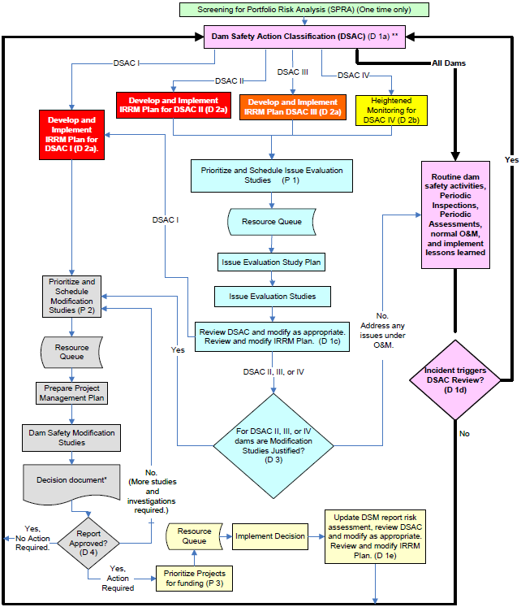
Cornerstone of the dam safety program
Note: It is important to update IRRMP any time understanding of project risk changes.
Notes:
The PA program is a routine dam safety activity that feeds the inner-loop activities.

Slide 5
Periodic Assessment
A routine dam safety activity consisting of an inspection, typically a Periodic Inspection (PI), a Potential Failure Mode Analysis (PFMA) and risk assessment.
  Based on existing data and limited development of estimated consequences.
  Completed by a facilitated team consisting mostly of district personnel (i.e., this is not a cadre activity).
  Chance to evaluate the design, analysis, construction, and condition of a dam project, and the results of the SPRA or previous risk assessments in more detail.

Slide 6
Outcome and Purpose
Evaluate the project vulnerabilities and associated risks, including non-breach risks.
Reevaluate the DSAC, possibly recommend a change.
Review and revise the IRRM plan, if necessary.
Identify O&M, monitoring, emergency management, training, and other ongoing needs.
Identify and prioritize any data collection, analyses, and study needs.
Provide a better understanding of vulnerabilities and a basis for future dam safety inspections and activities.

Slide 7
The Dilemma
PA’s will normally be conducted for all dams on a 10-year cycle, but more frequently as justified.
With a very large inventory of dams, more than 1 PA would need to be completed each week on average.
  PI’s and PA’s shall not be contracted.
  Limited staff and budget.
It was necessary to develop a streamlined process for ultimate inclusion in ER 1110-2-1156.

Slide 8
Guiding Principles
Apply a higher level of rigor than SPRA to further identify and refine project risks, assess the DSAC, and recommend prioritization of activities.
Perform the PA in conjunction with a PI for economy.
Perform the majority of work on-site or at district office.
Team is mostly comprised of district staff supplemented by facilitator and as needed with regional subject matter experts.
Assess risks in a qualitative or semi-quantitative manner.
Prepare a complete, concise and focused draft report before the team disbands (~7-8 days on-site).

Slide 9
Overall Workflow

Slide 10
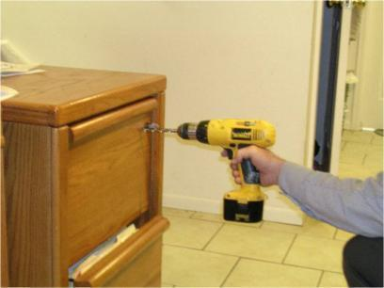
Advanced Preparation:
File-Drilling by District
Compile all available design documentation reports including as-built drawings, construction records and photographs, foundation reports, design memoranda, seismic studies, special investigations, PI reports, Water Control Manual, Emergency Action Plan, etc.

Slide 11
Drawings and Information
Location of all exploration and instrumentation drill holes and test pits
Construction Foundation Geology mapping of joints, bedding, shears, weathering, solutioning, etc.
Grout lines and takes
Location of all geologic cross sections
Location of all design features, especially those constructed after original “as-builts”

Slide 12
Drawings and Information
Embankment zones, filters, design features, etc
Geologic contacts (queried), rock descriptions
Foundation treatment
Rock fracture data and soil classification, visual or lab
SPT, BPT, CPT data if available (N1⁶⁰)
Water Loss Zones and Perm values
Piezometer influence zones and levels (date and res el.)
Concrete data and construction methods
Photos of key features and samples

Slide 13
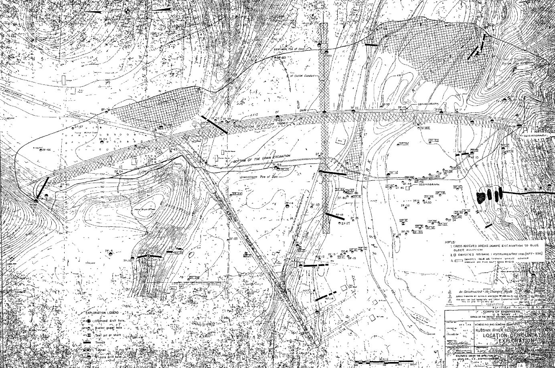
Available Maps and Sections

Slide 14
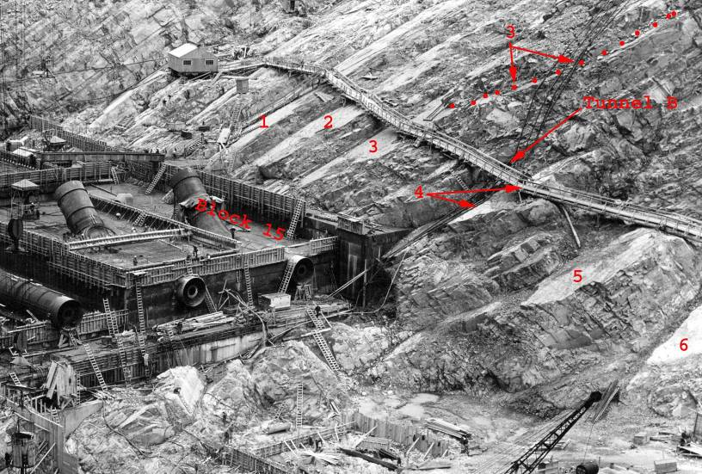
Photographs are a critical part of the geology package
Notes:
6 BEDDING PLANES WERE IDENTIFIED EARLY ON AS POTENTIAL SLIDE PLANES. Though there are many, many other bedding planes.
CONTINUITY APPEARS OBVIOUS, BUT POTENTIAL VARIATION IN STRENGTH REQUIRED EXPLORATION.
Taking the photos is not enough, we must annotate what we understand on these
Example of great collaboration, Gregg Scott, Chris Powell, Barb Mills-Bria, Larry Nuss all coming together.
Spent an entire week going through every single sampled bedding plane making sure we had it right and understood properties and correlated with geophysics

Slide 15
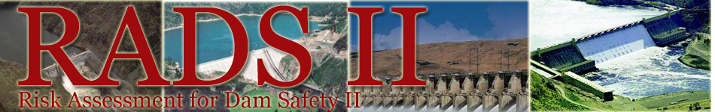
Advanced Preparation:
Electronic Archiving by District
Scan and upload all background data to RADS II website for access and electronic archival purposes.
  Provide descriptive filenames indicative of content (i.e., not a data dump).
  Compile a reference list of all background data.

Slide 16
Advance Report Section Presentation
District will draft some of the report sections describing background information ahead of time (described later).

Slide 17
Risk Assessment Process

Slide 18
Overview of Process
Review all available background information.
Conduct a brief site visit focused on vulnerabilities.
Review loading conditions and baseline consequences.
Brainstorm potential failure modes.
  Categorize as risk-drivers or non-risk-drivers.
Discuss, evaluate, and classify risk for risk-drivers.
  Document justification for non-risk-drivers.
Evaluate the DSAC, IRRM, and data/analyses needs.
Document major findings and key background information (i.e., “build the case”).

Slide 19
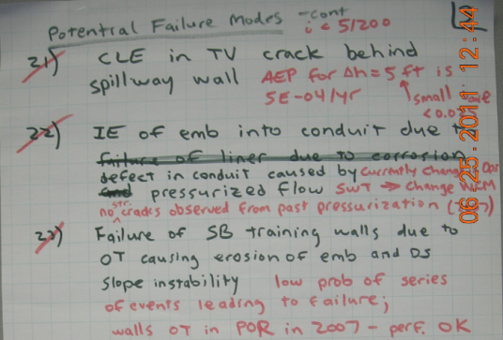
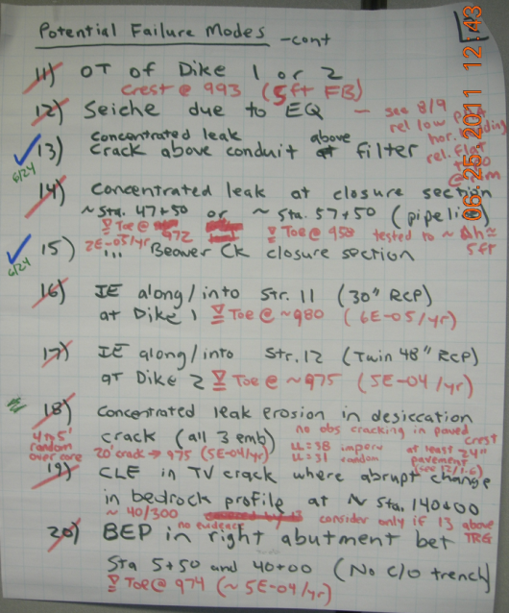
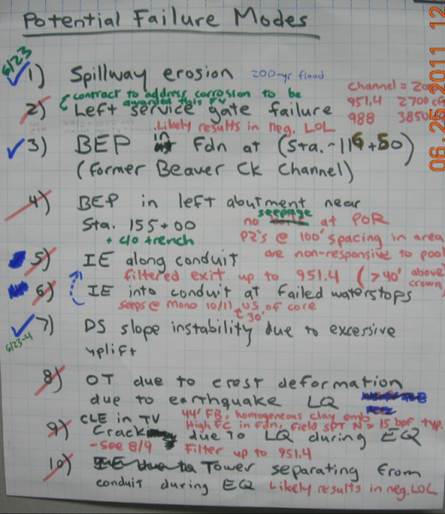

Brainstorming

Slide 20
Discussion of Risk-Driver PFMs
Fully describe from initiation to uncontrolled release.
Document “more likely” and “less likely” factors.
Assign classification for likelihood of failure and provide rationale and confidence.
Assign classification for consequences and provide rationale and confidence.
Discuss possible recommendations for additional monitoring, risk-reduction, data, or analysis.

Slide 21
Potential Failure Mode Description
Three elements of a potential failure mode description:
  The initiator (e.g., flood or earthquake loading, deterioration/aging, or misoperation or malfunction)
  The failure mechanism (including location and/or path and step-by-step progression)
  The resulting impact on the structure (e.g., rapidity of failure and breach characteristics)

Slide 22
Failure Mode Description
Unedited (insufficient detail): Overwash erosion.
Edited: The reservoir rises above 1950 feet NGVD 29, and sustained wind/wave action intermittently overtops the crest of the dam. The overwash discharge is sufficient to initiate erosion, and the duration is sufficient to initiate a headcut through the crest to the reservoir. Reservoir overtopping flows ensue. The dam erodes to the base of the embankment, and the breach widens during drawdown.

Slide 23
More and Less Likely Factors
Provide pertinent background information on the loadings, conditions, and events that make this potential failure mode “more likely” or “less likely” to occur.
More Likely Factors | Less Likely Factors
Freeboard deficiency Wind and wave setup is significant for this project. There are some low spots on the dam that have settled by about 1 foot. Design wind/wave height is in the range of 6 to 8 feet. Highly erodible embankment material with fairly steep side slopes DS slope does not have sufficient grass protection for erosion control. Difficult to flood fight for length of embankment Crest may be softened due to surface water infiltration; previous road repairs indicated material was soft. | Current estimate of PMF indicates it would not overtop the dam (approximately 2.2 feet below dam crest without considering settlement). Short duration PMF This failure mode would require an extreme flood event. Shorter fetch for left abutment

Slide 24
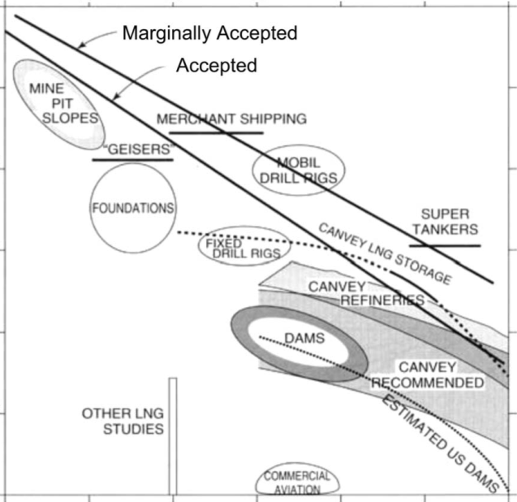
Historical Failure Rates
10⁰
10⁻¹
10⁻²
10⁻³
10⁻⁴
10⁻⁵
10⁻⁶
APF ~ 1 in 10,000/year
Whitman and Baecher (1981)
Von Thun (1985)
Hatem (1985)
M.K. Engineers (1988)
Foster et al. (1998)
Douglas et al. (1998)
Annual Probability of “Failure”
LIVES LOST 1 10 100 1,000 10,000
CONSEQUENCES OF FAILURE

Slide 25
Failure Likelihood Categories
Very High: Has initiated and/or is likely to occur in near future; flood or earthquake more frequent than 1 in 1,000/yr to cause failure.
High: Conditions exist; key evidence is weighted more heavily toward likely than unlikely; flood or earthquake between 1/1,000/yr and 1/10,000/yr to cause failure.
Historical failure for dams is approximately 1 in 10,000/yr.
Moderate: Conditions exist; key evidence is weighted more heavily toward unlikely than likely; flood or earthquake between 1 in 10,000/yr and 1in 100,00/yr to cause failure.
Low: Cannot be ruled out, but no compelling evidence; flood or earthquake more remote than 1 in 100,000/yr to cause failure.
Remote: Several unlikely events needed for failure. Negligible likelihood or non-credible.

Slide 26
Consequence Categories
Level 0: No significant impacts to the downstream population other than temporary minor flooding of roads or land adjacent to the river.
Level 1: Although life threatening flows are released and people are at risk, loss of life is unlikely.
Level 2: Some life loss is expected (1 to 10).
Level 3: Large life loss is expected (10 to 100).
Level 4: Extensive life loss is expected (> 100).

Slide 27
Navigation Projects
Loss of navigation could have significant economic consequences but little to no flood inundation risk (i.e., life safety or out-of-bank flooding due to breach).
  Assess the failure likelihood category but do not “categorize” economic consequences like life loss.
  Describe the economic consequences in the report.

Slide 28
Confidence
High: Confidence in the estimated category is high.
  It is unlikely that additional information would change the assigned category.
Low: Confidence in the estimated category is low.
  Key additional information could very well change the assigned category.
Moderate: Confidence in the estimated category is in between High and Low.

Slide 29
Incremental Risk Matrix Relative to Tolerable Risk Guidelines

Slide 30
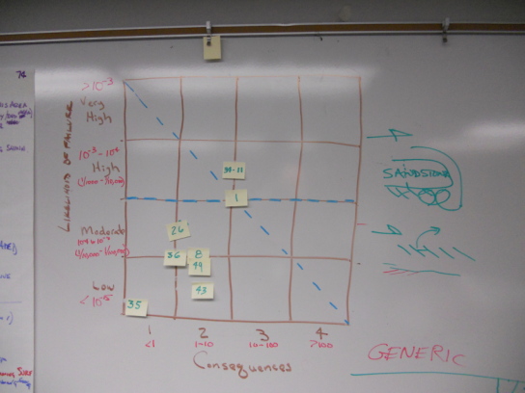
Example

Slide 31
Incremental Risk
Non-Breach Risk
Breach Prior to Overtopping
Spillway Flow without Breach of the Dam or Overtopping without Breach
Overtopping with Breach
Assess, consider, and communicate both the incremental and non-breach risks associated with the dam.
The incremental risk informs the DSAC.
Component Malfunction
or Misoperation

Slide 32
Non-Breach Risk
Frequency of the flood and consequences for:
  Maximum releases and freeboard that would occur during the Inflow Design Flood (IDF) if the dam is not overtopped.
  Threshold flood prior to overtopping if the IDF cannot be passed.
Frequency of the flood that would overtop downstream levees and consequences (without levee failure).

Slide 33
Non-Breach Risk Matrix
Downstream Channel Capacity
3,000 cfs
Flood Loading
SDF (Spillway Design Flood)
Freeboard: 6.1 feet
Overtopping Threshold for Downstream Structures
Hartford Levee does not overtop, and John Redmond Dam can safely pass SDF.
Very High
High
Likelihood of Flood
Hartford Levee and
John Redmond Dam
Council Grove Dam
Moderate
Low
Level 1
Level 2
Level 3
Level 4
Consequence Category
Notes:
Enter downstream channel capacity.
Enter discharge at which downstream levees overtop if levees are present or select none if there are no downstream levees.
Select IDF if the dam is not overtopped and indicate the actual freeboard and required freeboard (3 or 5 feet)
Select TF if the dam overtops and indicate the threshold flood as a percentage of the PMF and the required freeboard (3 or 5 feet).
Copy/edit/move flood loading shown on non-breach risk matrix. The flood loading should be shown as a range using a shaded box instead of a single point.
Copy and paste this figure into Chapter 1: Major Findings.
Using the left mouse button, draw a box over the entire non-breach risk matrix.
Right-click over the selected objects and then select “Copy” or click on Copy icon from the Ribbon or Quick Access Toolbar; or hit Ctrl+C to copy.
In the Word Document, select “Paste Special...” and then “Picture(Enhanced Metafile)” at the location for the figure.
A flood likelihood category and consequence category were assigned to normal operational releases. A risk matrix is used to portray the non-breach risk associated with normal operational releases, with likelihood of the flood on the vertical axis and non-breach consequences on the horizontal axis. The non-breach risk matrix is similar to the incremental risk matrix described above, except that there are no dashed lines delineating tolerable risk guidelines which are not applicable to non-breach risks.

Slide 34
Report

Slide 35
Introduction
The district is responsible for preparing and assembling the report and appendices.
Typically, the PI material is integrated into the PA report.
  One is not an appendix to other; or separate reports.
  Naming convention for routine PA (not out-of-cycle):
    John Redmond Reservoir
    Grand (Neosho) River, Kansas
    KS00004
    Embankment, Spillway, and Hartford Levee
    Periodic Inspection No. 11
    Periodic Assessment No. 1
    March 2011

Slide 36

Report Format
A draft report will be provided by the district’s PA team to their DSPM before the team is disbanded and the facilitator leaves the district office.
Chapters are concise and prepared in a modular format (i.e., separate files) with minimal formatting to facilitate report assemblage into the district’s preferred format.
  Templates include examples and instructions.

Slide 37
Report Outline
Chapter 1: Major Findings (prepared on-site)
  Recommended DSAC and justification
  Risk assessment results (i.e., incremental risk matrix)
  Discussion of non-breach consequences and risk
  Significant findings from the risk assessment and periodic inspection

Slide 38
Advanced Preparation:
Draft Report Chapters by District
Chapter 2: Description of Dam and Operations
  Typically obtained from introduction to previous PI report or brochure
Chapter 3: Previous Risk Assessments
  Initially obtained from SPRA report, but may be from IES or DSMS
Chapter 5: Hydrologic Loading
  Develop pool-frequency curve including PMF and pool-duration curve
Chapter 6: Seismic Loading
  Obtained from USGS information or site-specific probabilistic studies
Chapter 7: Consequences
  Typically utilizes MMC products prepared prior to the PA
Note: Report Format under Revision by PPT
Templates and examples will be provided.

Slide 39
Report Outline (cont.)
Chapter 4: Periodic Inspection (prepared on-site)
  Traditional PI findings
  Make sure PI findings and recommendations are consistent with PA

Slide 40
Report Outline (cont.)
Chapter 8: Risk-Driver Potential Failure Modes (prepared on-site)
  Complete description from initiation to breach
  Pertinent background and performance data
  More likely and less likely factors
  Failure likelihood category, rationale, and confidence
  Consequence category, rationale, and confidence
  Key pieces of evidence to help build the case (e.g., photographs, drawings, instrumentation data)

Slide 41
Report Outline (cont.)
Chapter 9: Conclusions and Recommendations
  Complete list of findings and understandings
  Complete list of recommendations
    Modifications to existing surveillance, monitoring, and inspection plan and/or IRRM plan
    Additional data, studies, or analyses
    O&M, EAP, training, and other recurrent needs

Slide 42
Report Appendices
Appendix A: Excluded Potential Failure Modes
Appendix B: Monitoring and Instrumentation Data
Appendix C: Summary of Intermediate Inspections
Appendix D: Periodic Inspection Photographs
Appendix E: Periodic Inspection Notes or Trip Reports
Appendix F: References
Appendix G: DQC and RMC Review Documentation
Other?
Note: Format will change with new update to
ER 1110-2-1156

Slide 43
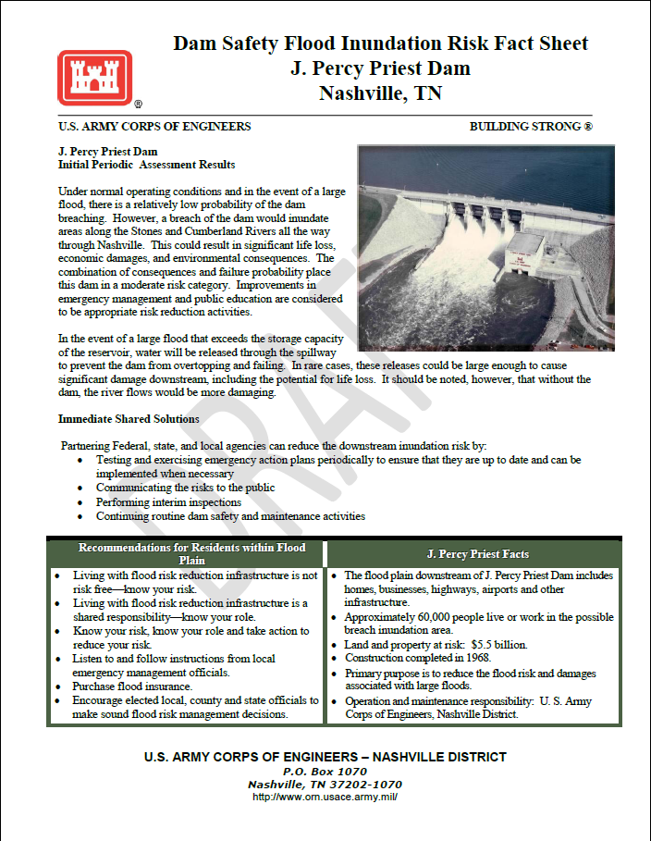
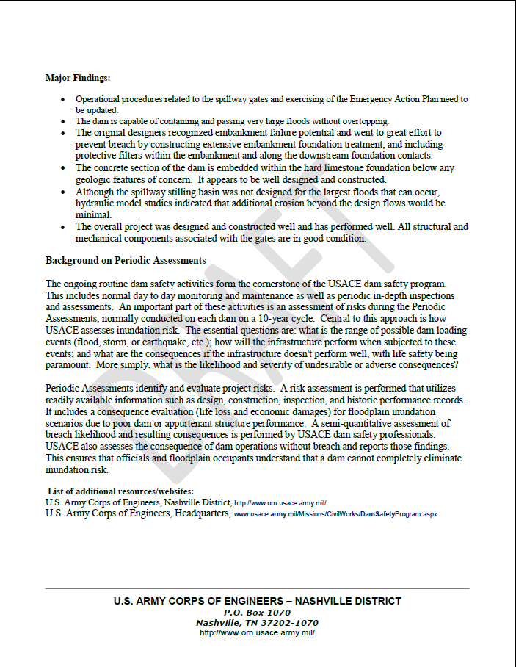
Flood Inundation Fact Sheet
Format still under development

Slide 44
Review Process

Slide 45
Technical Review
Does not impact normal review process any more than is necessary.
Perform DQC and submit report to MSC DSO for approval within 90 days as normal.
  Include facilitator review and certification within the 90-day report submission period.

Slide 46
Consistency Review
PA reports completed between SOG meetings are reviewed concurrently for “corporate” consistency with respect to their evaluations, recommendations, and documentation before presenting the results to the SOG.
May occur outside 90-day period per SOG schedule.
Revisions may be requested based on consistency or SOG review.

Slide 47
SOG and HQUSACE Review
PA team performs a DSAC review and recommends any changes along with justification to the SOG.
District team leader or DSPM or facilitator ? will typically present results to the SOG via web meeting (~5 to 10 minutes).
  District DSO is welcome to present the results to the SOG in controversial cases.
SOG recommends a DSAC to the HQUSACE DSO for decision.

Slide 48
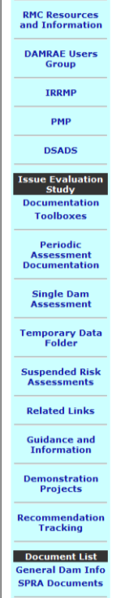

Electronic Archiving of Report
Upload a PDF copy of the final approved PA report to the RADS II website for access and electronic archival purposes.

Slide 49
Responsibilities

Slide 50
District’s PA Team Leader
Leads the PA team and coordinates with the facilitator and any other technical experts needed from outside the district to accomplish the completion of the PA.
Coordinates data retrieval and upload.
Coordinates travel logistics.
Coordinates the DQC review and SOG presentation.
Coordinates report completion.

Slide 51

District’s PA Team: Who?
Appropriate experts from engineering and operations who will participate in the PFMA and risk assessment.
  Staff most knowledgeable of the dam, dam safety, and technical disciplines.
Other dam experts from outside the district may also be called upon to participate.
A note-taker to capture key points of discussion, not just transcribe flip chart sheets.
Observers to learn how to complete the PFMA and risk assessment portions of the PA.

Slide 52
District’s PA Team: What?
Compiles all background data and uploads to RADS II.
Prepares some draft report chapters prior to the PFMA.
Reviews the background data prior to the PFMA.
Participates in the PFMA and risk assessment.
  PA team leader or DSPM conducts the out-briefing.
Finalizes the report upon completion of the risk assessment and draft chapters completion.
Incorporates the PI findings.
Resolves any comments from DQC, consistency, and SOG reviews.

Slide 53

MMC Production Center
Provides baseline consequence estimates, warning time sensitivities for life loss estimates, and inundation mapping products.
Uploads mapping products to MMC web application.
Provides Consequence Assessment Report describing modeling assumptions.
Provides CTS spreadsheet with results.

Slide 54

Facilitator
Verifies appropriate district staff is assigned to PA team.
Coordinates with district’s PA team leader on logistics and scheduling site visit, PFMA, and risk assessment.
Facilitates the PFMA and risk assessment.
  Mentors district staff and facilitator trainees.
Participates in the DQC review and certifies the report to document the PA team’s concurrence.

Slide 55
Risk Management Center
Helps identify dams for PA’s each year.
Coordinates with the MMC Production Center.
Assigns facilitators and conducts facilitator training.
Coordinates a consistency review of PA reports.
Coordinates PA presentations to SOG.
Prioritizes non-routine recommendations from PA reports related to Wedge funding on a national level considering DSAC rating as well as other important factors.
  In most cases, this involves first performing an IES.

Slide 56
District’s Dam Safety Officer
Recommends PA report for MSC DSO approval.
Coordinates with PPPMD and Operations Divisions to develop schedules and any funding prioritization for routine PA recommendations.
Coordinates with RMC for prioritization and funding of non-routine (Wedge-funded) PA recommendations.
Uses PA process to educate staff.

Slide 57
SOG and HQUSACE
SOG reviews the PA results and recommended DSAC and justification.
SOG recommends DSAC to HQUSACE DSO for decision.
The project is placed in a DSAC queue and depending on the outcome, recommended actions are prioritized within inventory.

Slide 58
Schedule

Slide 59
Implementation
Will transition to the new process
Complete implementation by FY 2015

Slide 60
Advantages to Using New Process
First priority for inundation mapping and MMC products.
DSAC review and adjustment, if appropriate.
Better understanding of risks.
Projects with completed PA are higher priority for IES.
Training and experience for district personnel.
Facilitator cadre assigned to new process PA’s first.
RMC coordinates facilitator assignments.
Facilitators will be trained on dams undergoing new process (greater good of USACE).
Product will meet current standards.

Slide 61
Sequencing
Proper scheduling and sequencing of the PA activities by the PA team lead will be critical.
  Need to engage and coordinate with the facilitator, engineering and other technical staff, operations/field personnel, and MMC Production Center.
The duration of the PI and proximity of the projects to the district office can vary greatly.
  It may not be practical to schedule site visit, PFMA, and risk assessment in conjunction with the PI.

Slide 62

General Schedule
Scheduling PA’s and facilitators will be a challenge.
It is essential that districts keep PI and PA schedules updated in DSPMT.
  Used for scheduling projects, MMC, and facilitators.
Generally, a PA will be performed once every 10 years.
  Unless the MSC DSO in coordination with the RMC recommends a more frequent schedule.
  Intervals in excess of 10 years require approval by the USACE DSO.

Slide 63
Exceptions
Projects that have an active IES or DSMS in progress may be excluded from a PA.
  Intermediate assessments may be required.
Dams under construction for risk-reduction actions may be excluded from a PA.
  Additional intermediate inspections are required.

Slide 64
Out-of-Cycle PA’s
PA can be performed outside the normal PI/PA schedule to accommodate unusual performance issues or other issues that need to be evaluated further to verify or re-establish priorities.
Beginning 1 October 2012, DSAC reevaluations will no longer be based on reevaluating SPRA ratings.
  The new PA process will be required for all DSAC reevaluations, including those projects that are out of the normal PA cycle (district-funded except for facilitator).

Slide 65
Preparation and On-Site
Scanning all background data, uploading to RADS II, and preparation of Chapters 2, 3, 5, 6, and 7 of the draft PA report should be prepared by the district at least 30 days prior to the site visit.
The overall on-site duration of the PA will depend on the level of complexity of the project.
  Typically 7 to 8 days to complete the inspection, PFMA, risk assessment, and draft PA report.

Slide 66
Typical PA Budget
Cost varies depending upon quality of existing data, district preparation, and complexity of project.
Larger costs are typically associated with additional travel costs when site is distant from district office.
Excludes costs associated with traditional PI.
Assumes site visit performed in conjunction with PI.
Background Data (Scanning and Uploading to RADS) | $5,000 | to | $10,000
Report Preparation (Chapters 2, 3, 5, 6, and 7) | $5,000 | to | $10,000
PFMA and Risk Assessment | $15,000 | to | $45,000
(Chapter 8, portions of Chapters 1 & 9, Appendix A)
Technical Review | $1,000 | to | $6,000
Total | $26,000 | to | $71,000

Slide 67
Questions, Comments, or Discussion
Thank you for your attention.

