Slide 1
O&M ASPECTS OF DAM SAFETY AND REPORTING OF DISTRESS
Dave Paul, P.E.
Lead Civil Engineer
U.S. Army Corps of Engineers
Risk Management Center
David.B.Paul@usace.army.mil
Dam Safety Workshop
Brasília, Brazil
20-24 May 2013

Slide 2
“Rigorous and continuous vigilance, checking, and inspection, for as long as the dam is operational, are necessary for dam safety…”
Notes:
The number one duty of dam safety engineers (DSPM’s and DSO’s) is to protect life and property.
One of the best ways we can ensure that this critical task is accomplished is by being vigilant and proactive about performing continuous observations and inspections. This is true during any construction process as well as normal operation of a project.

Slide 3

FIRST -
“DO NO HARM”

Slide 4
Objective
Define items of distress
Outline reporting procedures
Identify criteria that provides upward reporting guidance

Slide 5
Critical Project Requirements and Resources
O&M Manual
Geotechnical and Concrete Materials Completion Report
Instrumentation and Monitoring
  Dam safety training is imperative
Notes:
The O&M manual contains a summary of the projects critical features. It should be prepared during construction and updated as project elements are completed.
The Geotechnical and Concrete Materials Completion Report contains documentation of the as-built features of the project (including modifications). This report should be scheduled and resourced in the PMP.
Well designed and maintained instrumentation enables proper monitoring and evaluation of the structure (construction AND operation).
Record data such as: hydrostatic pressure, embankment and abutment seepage, foundation underseepage, and displacement of major features. Accelerometers should be installed in/on structures near seismic regions.
Data is only as good as the design and maintenance of the instrumentation. That is why dam safety training is critical.
These documents and data should be at the fingertips of the DSPM and Project personnel and should be reviewed periodically.

Slide 6
Operation and Maintenance Program
Operations Activities
  Listed in O&M Manual
Maintenance
  Recurring maintenance for Dam Safety
  Major maintenance for Dam Safety
    Exceeds $2,000,000
Establishment, maintenance and control of vegetation
Notes:
Routine operations activities: instrumentation, daily monitoring, routine equipment testing and other work items that are included in the O&M Manual as routine operations

Slide 7
What is Distress?
dis·tress [dih-stres]
noun
  1. great pain, anxiety, or sorrow; acute physical or mental suffering; affliction; trouble.
  2. a state of extreme necessity or misfortune.
  3. the state of a ship or airplane requiring immediate assistance, as when on fire in transit.
  4. that which causes pain, suffering, trouble, danger, etc.
  5. liability or exposure to pain, suffering, trouble, etc.; danger
Notes:
‘Distress’ is a very simple 2 syllable word that could have various meanings…but when it comes to dam safety…it could lead to suffering and trouble.
Note all the underlined adjectives in the definitions.
Does a DSPM/DSO have to worry about ‘liability of exposure’ for his/her project dams?
BOTTOM LINE: ENGINEERING AND DAM SAFETY JUDGEMENT IS REQUIRED.

Slide 8
How Dams Fail
USBR Study (200 dam failures)
Overtopping - 40
  Inadequate hydrologic capacity
  Operations and maintenance
Seepage through the embankment - 80
Seepage through the foundation - 24
Damage to spillways and outlet works - 16
Slides in the embankment or abutments - 20
Structural - 20
Notes:
This study was conducted by the Bureau of Reclamation on larger dams (200 dams over 50’ high).
You can notice that the most common cause of failure is due to seepage through the embankment (40%).

Slide 9
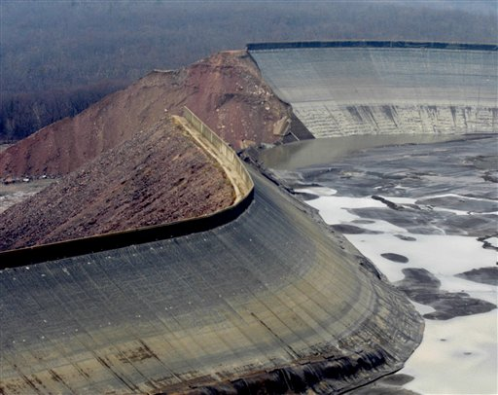
Overtopping
Notes:
Why am I showing a dam failure?….we are supposed to be discussing DISTRESS.
Tom Sauk hydro-electric reservoir in Southeast Missouri.
Overtopping caused by remote operations and bad instrumentation data.
Instrumentation design and maintenance is critical. If issues or anomalies are not recognized and corrected…disaster could occur!

Slide 10
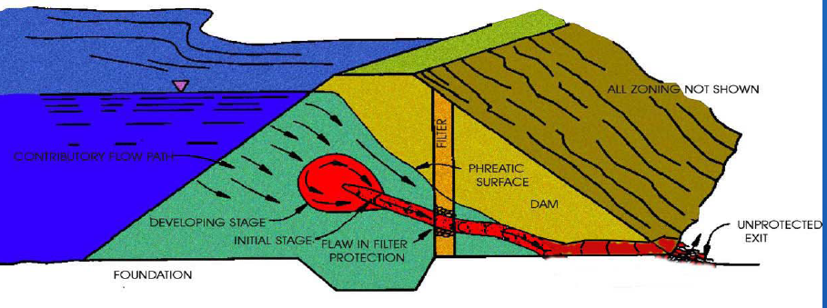
Internal Erosion
Notes:
This is a rough sketch of a typical internal erosion failure mechanism:
The pool rises
Erosion initiates
Piping develops
There is no structural means to limit flow
An unprotected exit is present
Bottom line: Failure may be occurring prior to visible evidence or observation.
So what does distress look like: “I can’t describe it but I’ll know it when I see it!”

Slide 11
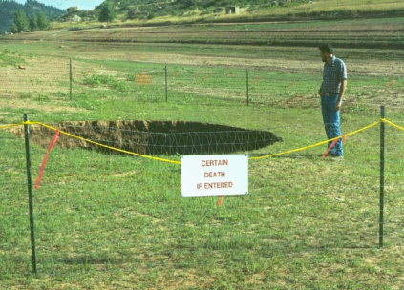
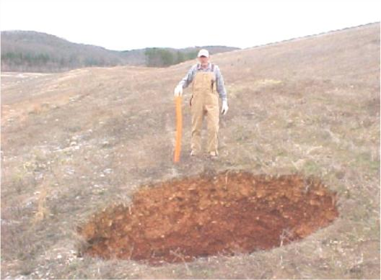
Sinkholes
Notes:
Sinkholes within or near an embankment represent evidence of major damage occurring within the embankment or foundation.

Slide 12
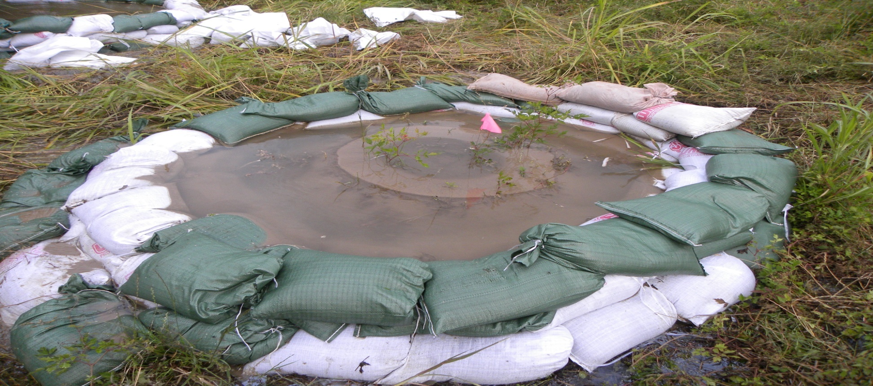
Operational & Maintenance Aspects of Dam Safety
Keys to a Successful Dam Safety Program
Maintenance
Sand Boils
Successful ways of controlling sand boils
Notes:
Sometime good turf management pays for itself.

Slide 13
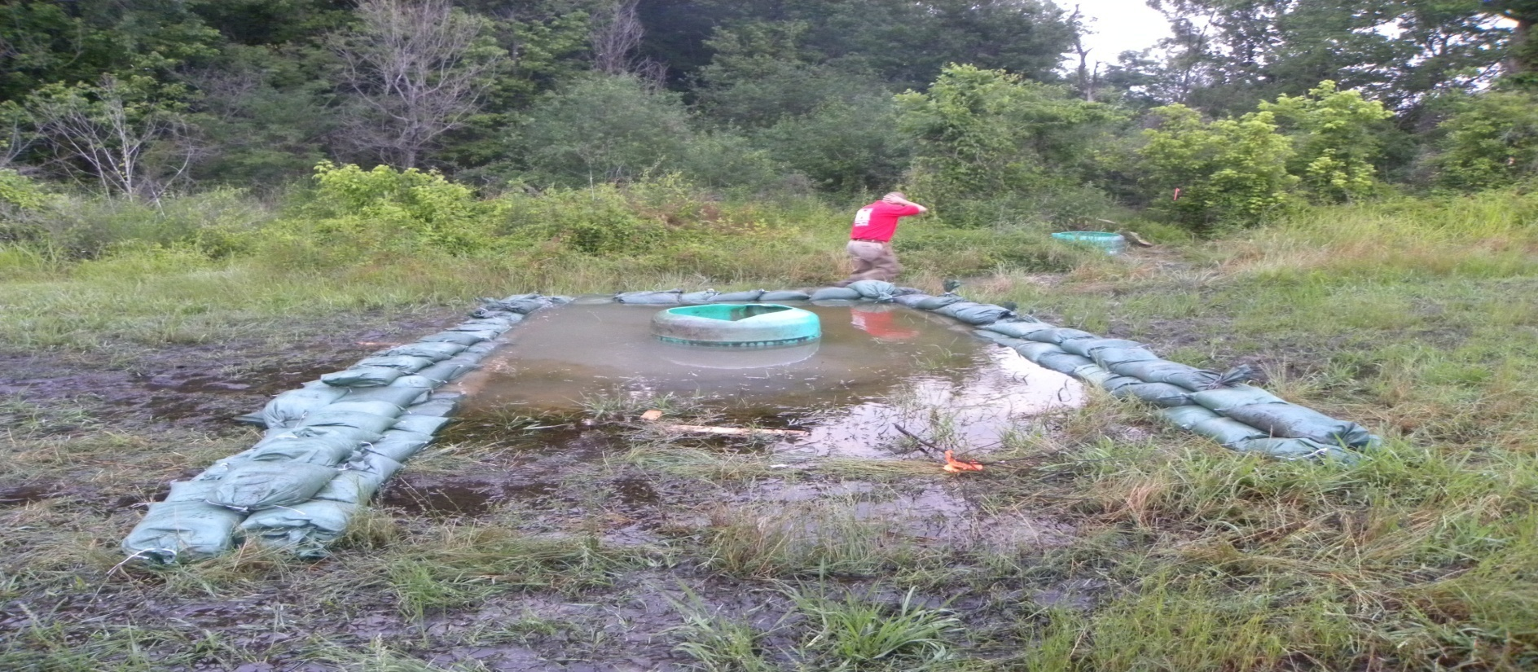
Operational & Maintenance Aspects of Dam Safety
Keys to a Successful Dam Safety Program
Maintenance
Sand Boils
Successful ways of controlling sand boils
Notes:
Sometime good turf management pays for itself.

Slide 14
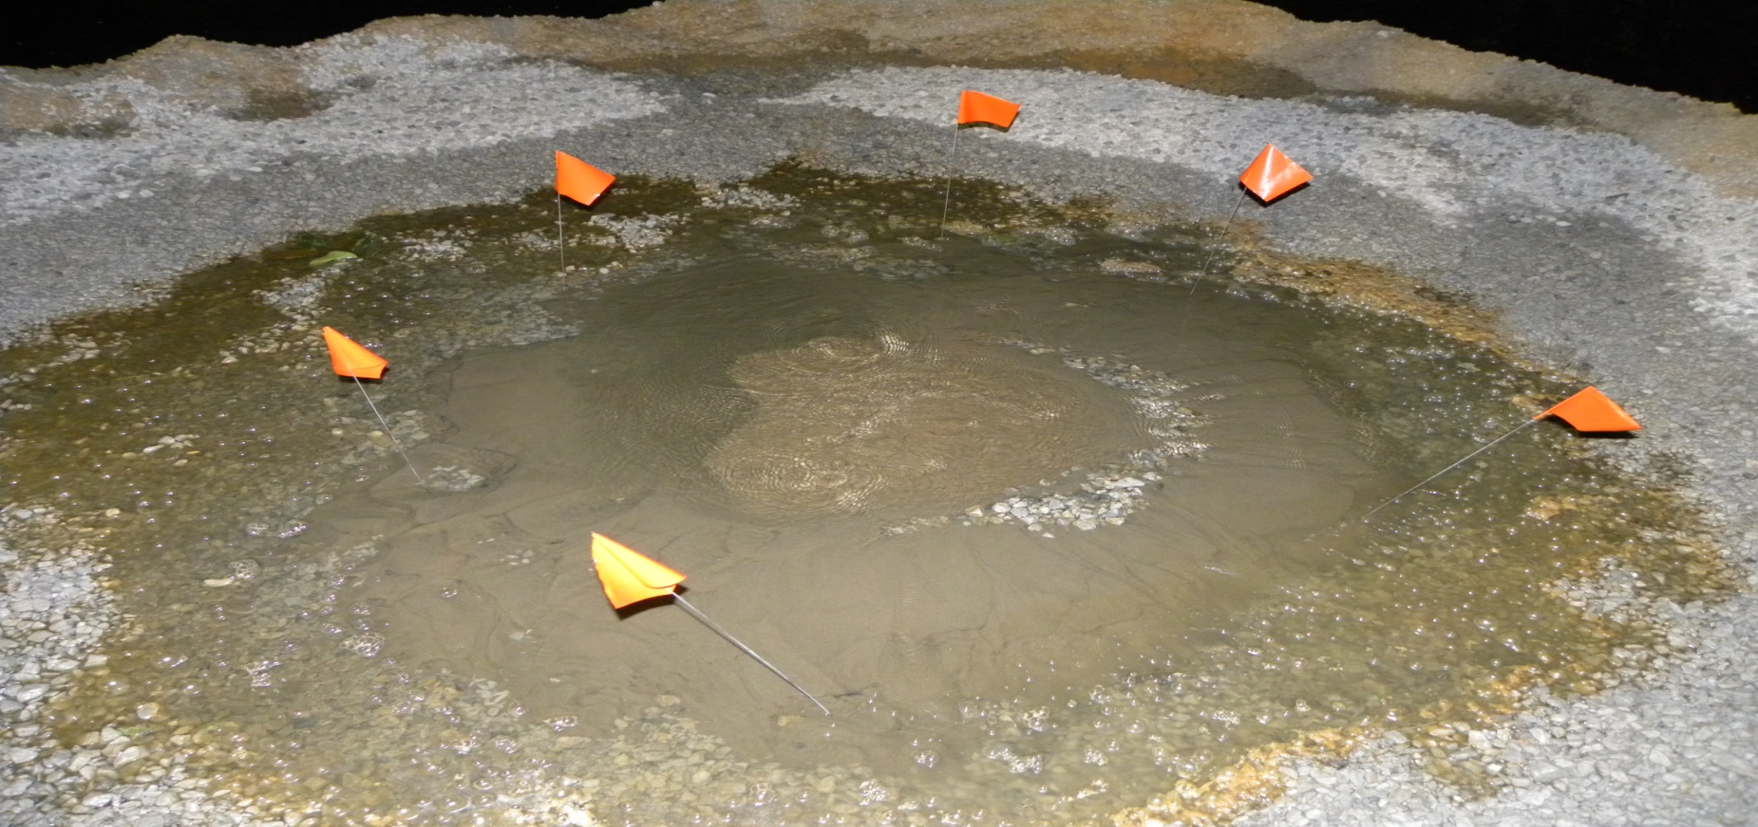
Operational & Maintenance Aspects of Dam Safety
Keys to a Successful Dam Safety Program
Maintenance
Sand Boils
Successful ways of controlling sand boils
Notes:
Sometime good turf management pays for itself.

Slide 15
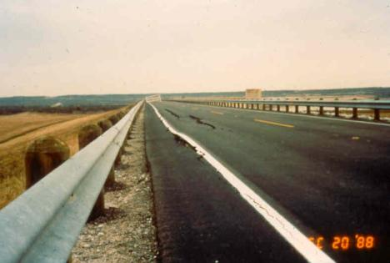
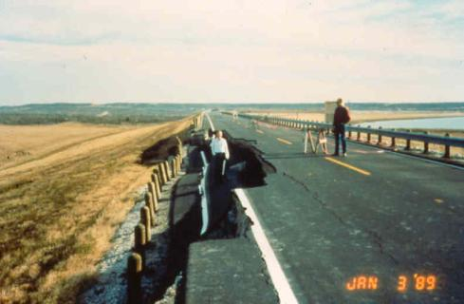
Cracks in Embankment
Before
After
Notes:
Cracks in an embankment may become visible.
Left unreported or unrepaired these cracks could rapidly progress to major damage to the dam.

Slide 16
Slope Slides
Notes:
These are shallow surface slides at Pat Mayse. The soils are highly plastic clays that shrink and swell with changes in moisture. The shallow slides often occur after long dry periods followed by some rainfall that fills the cracks formed during the dry time. The increase the weight of the slope, pressurizes the crack, and lubricates the soil. The slides are nto a threat to the dam unless left un-repaired and allowed to continue to the crest.

Slide 17
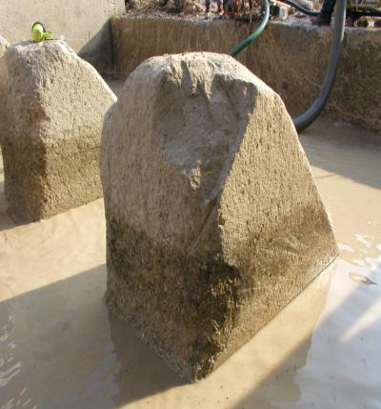
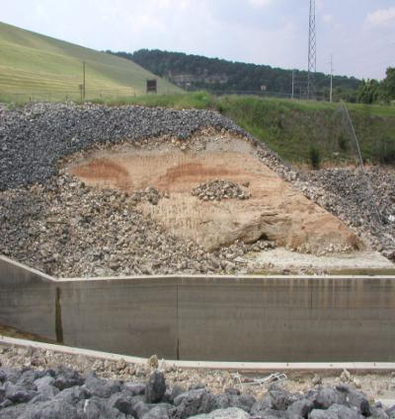
Slope Protection Damage
Baffle Block Damage
Notes:
Damage could occur any time upon large releases are made.
It is critical that timely investigations and remediation measures are completed.

Slide 18
Other Typical Signs of Distress
Increase in seepage through or under embankments.
Significant change in uplift pressures under concrete structures.
Unusual vertical or horizontal movements or displacements.
Significant cracking of mass concrete structures.
Any damage due to seismic event.
Notes:
Constantly review piezometer data and weir flows.
Note changes in uplift pressures.
Maintain a strict program for measuring displacements.
Visual inspections are crucial each time you walk the dam.
Special inspections required after seismic events. These are described in ER 1110-2-1802 (reference A.55).

Slide 19
Typical Signs of Distress, cont.
Excessive vibration, binding, unusual noises, movements, or deflections of gates or mechanical equipment.
Hydraulic equipment operating in excess of 125% of the normal operating pressure.
Wire rope lifting cables or lifting chains having broken strands or deformed, worn, or severely corroded links.
Frequent power interruptions.
‘Any other indications of distress or potential failure that could inhibit the operation of a project or endanger life and property.’

Slide 20
Ways That USACE Detects Distress
Normal operation of the project
Annual Inspections
Periodic Inspections
Unique Event Outside of Routine Inspection
Notes:
Ch 12 and 13 of ER 1156 are primarily concerned with ‘unique events outside of routine inspection’ that require immediate remedial action and upward notification.

Slide 21
Criteria for Distress That Requires Immediate Action
Are a legitimate threat to the dam
May lead to lead to large loss of life and economic consequences
Do not allow project to function as intended
Occur during times of extreme events/conditions
Have heightened political and news visibility
Notes:
…AND REPORTING!
Examples of distress that may not fit this criteria:
Temporary problem with a lift chain binding.
Small sinkhole located several hundred feet downstream of the dam that may not be related to seepage (i.e. old tree stump, previous excavations).

Slide 22
Process
DSO is informed of distress
  Distress is evaluated
  MSC/USACE DSO shall be notified
  Recorded in the Dam Safety Program Management Tools (DSPMT).
An after-action report shall be submitted to MSC AND HQUSACE
Notes:
Reporting distress is emphasized because it is listed in Ch 12 as well as all of Ch13.
DSO determines if an engineering evaluation or remedial measures are required.
DSO informs the MSC and USACE DSO. The USACE Dam Safety Officer shall notify the Director of Civil Works, the Deputy Commander for Civil Works and Contingency Operations, and the USACE Commander, if necessary.
Follow the notification sequence shown in the HQUSACE Dam Safety Notification Plan. This plan is updated annually (January) by the USACE DSPM.
Operational restrictions may be required.
The primary focus must always remain on taking all necessary emergency measures with the appropriate notification.

Slide 23
Distress Reporting Timeline
DSO Engages Tech Team
Discovery
OPM Calls DSO
Media Outlets Contacted
DSO/DSPM Upward Reports
Tech Team Dispatched to Site/Evaluation
Emergency Contract
In-Place and Repairs Completed
Normal Operation and Follow-up Inspection
Tech Team Makes Stability / Repair Decisions
Notes:
The issue is discovered in the field,
OPM calls DSO,
DSO engages technical staff to make determination of problem (EVALUATION),
staff is dispatched to the site,
media outlets are contacted to explain situation and to tell about road closure,
team is on-site making repair/stability decision and getting emergency contract in place,
DSPM concurrently reports evidence of distress to HQ because it fits the categories we mention above,
distress is repaired and project functions normally.

Slide 24
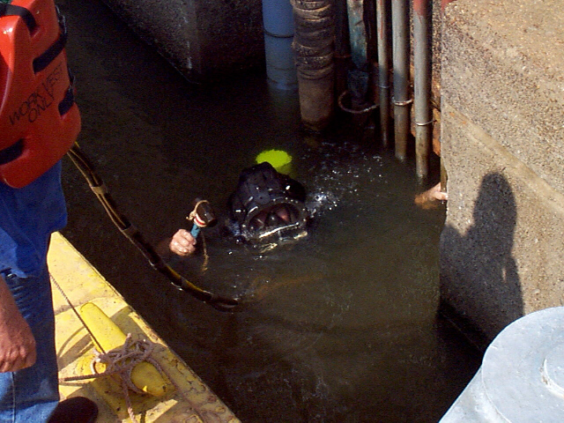
Operational & Maintenance Aspects of Dam Safety
Keys to a Successful Dam Safety Program
Maintenance
Underwater Repair and Maintenance
On occasions features of the dam and other structures must be approached underwater.
Experienced Corps divers are available for this activity.
Notes:
But there is a solution. Don’t be fooled by the fancy diver wear, cotton T’s and jeans make a fine Cajon wetsuit.
The Dive Team from Monroe LA. Is experienced and available to inspect your underwater facilities at a nominal cost.
We utilized their services in 2002 to locate and remove a dislodged log-catcher from the front of the Intake structure. The fear was that if this 20 foot ton of steel moved into the #1 gate well and we would never be able to fully close the gate. However, the Monroe Dive Team was able to locate the log-catcher, by feel only and tie off a cable for mechanical extraction by our O&M Staff. An underwater inspection of the Intake structure was included in this activity.
Relevant Facts:
1. Dive in front of the Arkabutla intake structure and determine general condition of the structure. Dive will be in 30 feet of water (gates closed). Estimated dive time is 4 hours.
Anticipate day 1 being a travel day to Sardis Lake with site investigation and coordination. Day 2 would include dives in front of the intake structure and outlet channel work. Day 3 would be spillway dive. Day 4 would be dive at Arkabutla intake structure and return home.
Approximate Cost $14,500.
Funding to be provided by Sardis Project Management Office.

Slide 25
Operational & Maintenance Aspects of Dam Safety
Keys to a Successful Dam Safety Program
Maintenance
Underwater Surveying and Monitoring
Multi beam sonar survey
Gives detailed elevations and contours of underwater features
Useful tool for monitoring scour/energy holes

Slide 26
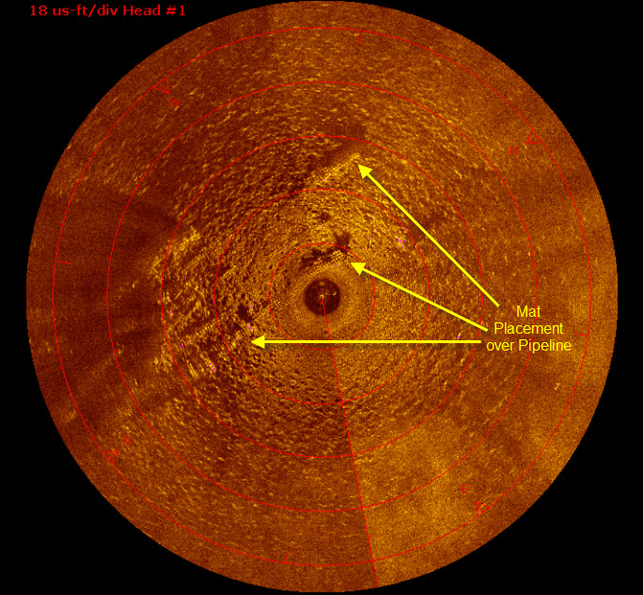
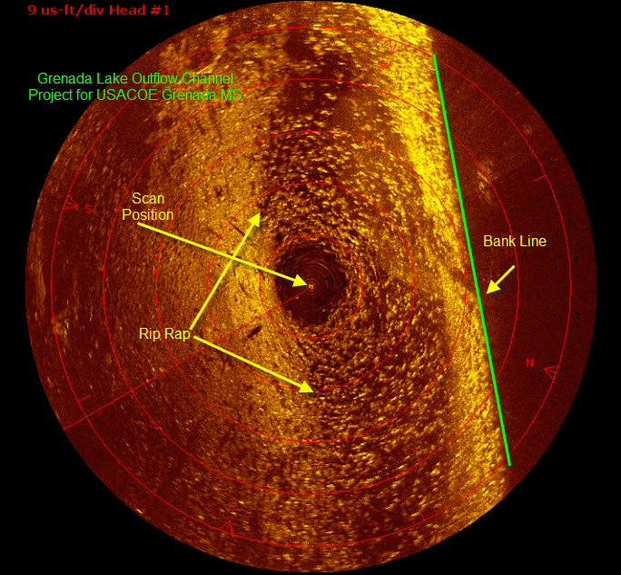
Operational & Maintenance Aspects of Dam Safety
Keys to a Successful Dam Safety Program
Maintenance
Underwater Surveying and Monitoring
Mesotech 360 degree side scan sonar
Provides and detailed underwater picture.

Slide 27
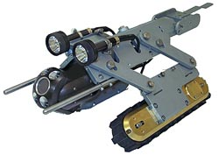
Remote Controlled Video Inspections
Remotely controlled video inspection equipment can be configured for most:
Pipe diameters
Invert slopes
Conditions

Slide 28
Equipment
Parallel System – VersaTrax
Steerable
For pipe diameters 16” +
Tether: 1000 feet
Depth rating: 100 feet
Max speed: 30 ft/min
Weight: 70 lbs

Slide 29
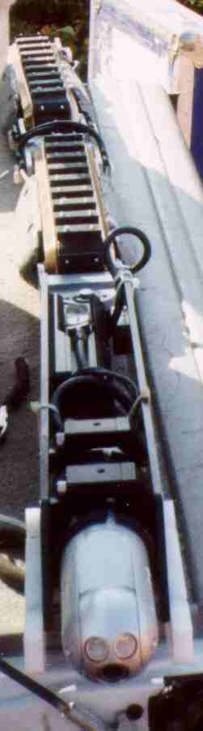
Equipment
MiniTracs In-line System
For pipe diameters 6 to 15”
Tether: 1000 feet
Depth rating: 100 feet
Max speed: 30 ft/min
Weight: 60 lbs

Slide 30
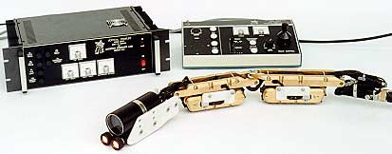
Equipment
MicroTracs In-line System
For pipe diameters 4 to 6”
Tether: 500 feet
Depth rating: 100 feet
Max speed: 30 ft/min
Weight: 50 lbs

Slide 31
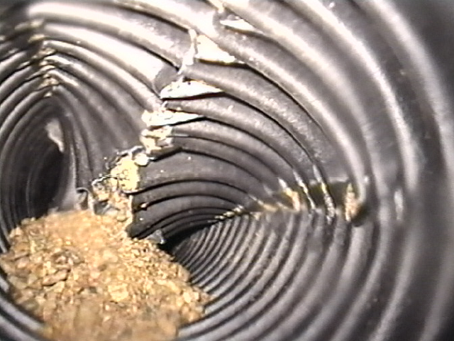
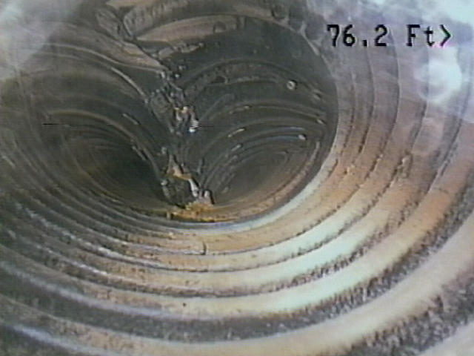
Structural integrity
Davis Creek Dam, NE
Toe drain – HDPE
Crown collapse
San Justo Dam, CA
Toe drain - HDPE
Crown collapse

Slide 32
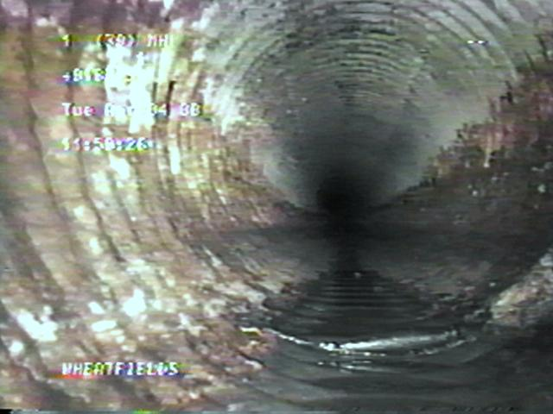
Structural integrity
Wheatfields Dam, AZ
Outlet works conduit - CMP
Corrosion

Slide 33
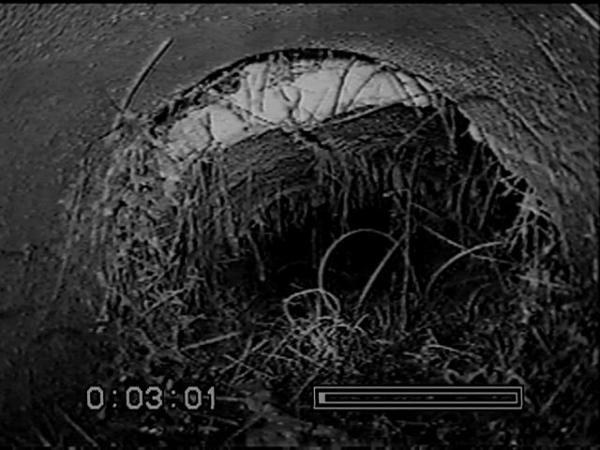
Structural integrity
Wheatfields Dam, AZ
Toe drain – Clay tile
Crown failure

Slide 34
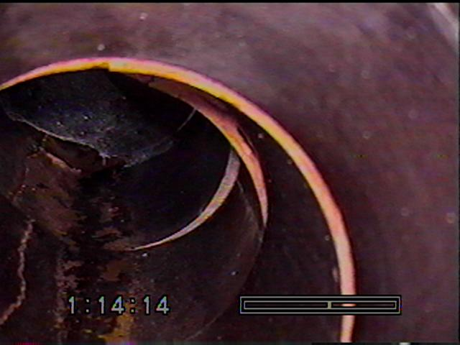
Structural integrity
Echo Dam, UT
Toe drain – Clay tile
Joint offsets

Slide 35
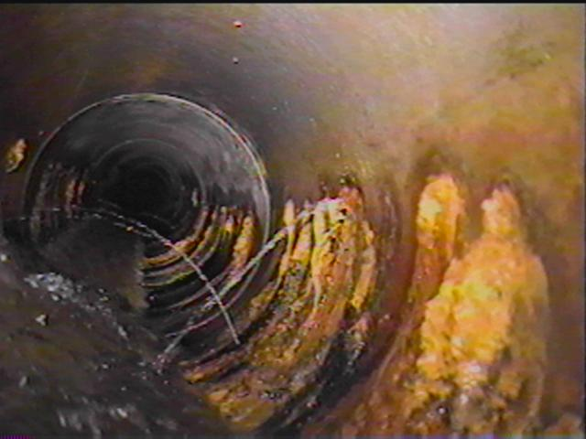
Obstructions
Sherman Dam, NE
Toe drain – Asbestos cement
Perforation plugging

Slide 36
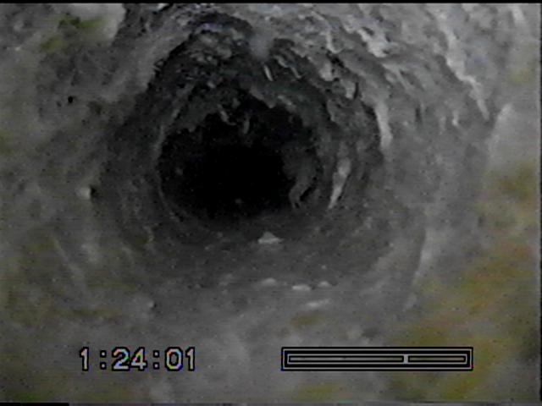
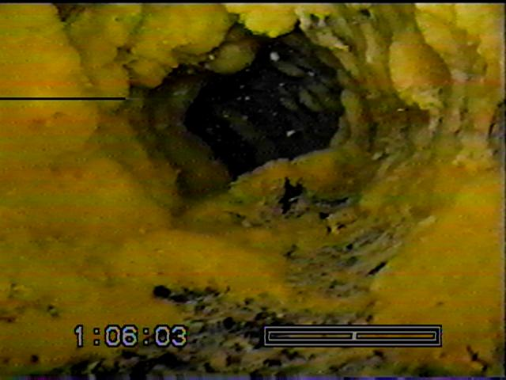
Obstructions
Pablo Dam, MT
Toe drain - HDPE
Iron related and slime forming bacteria

Slide 37
Drain Cleaning
Relief Wells
Toe Drains
Uplift Drains

Slide 38
Reasons for Drain Cleaning
Maintains a Key Feature in Structure/Foundations
Maintains Stability of Structure/Fdn
Drains Can Permanently Lose Effectiveness w/Time
Delayed Maintenance - Eventual Cleaning More Difficult

Slide 39
Benefits of Drains
Reduce Uplift Pressure (Improve Stability)
Defensive Design Measure
Collect and Transport Seepage
Provide Filter Mechanism
Aesthetic Benefits

Slide 40
Uplift – Shasta Dam

Slide 41
Embankment Dam - Toe Drain

Slide 42
Drain Plugging Mechanisms
Calcium Carbonate
Iron Bacteria
Deposition of Fines/Sands or Gravels
Collapse of Drain
Roots from plants or bushes

Slide 43
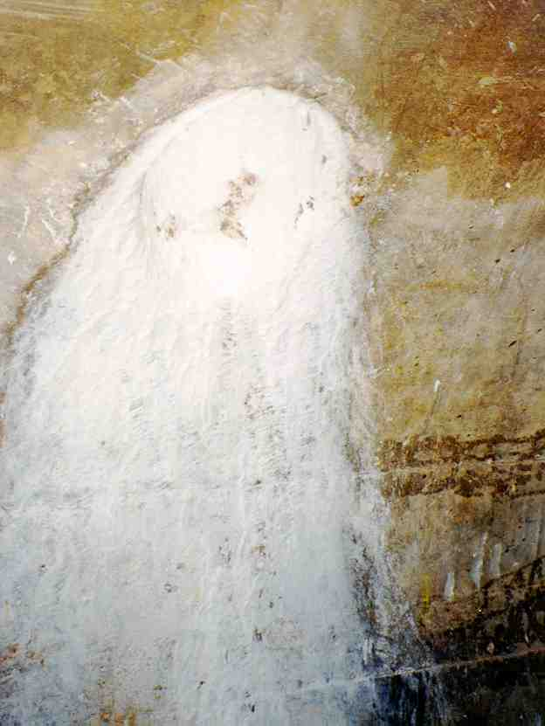
Calcium Carbonate Deposit

Slide 44
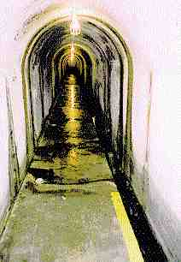
Iron Bacteria Deposits

Slide 45
Drain Cleaning Methods
Flushing
Chemical Treatments
Temperature Treatments
Over pumping
Surge Block Technique
High Pressure Water Jetting
Excavation and Replacement

Slide 46
Operational & Maintenance Aspects of Dam Safety
Keys to a Successful Dam Safety Program
Maintenance
Relief Wells & Drains
Must remain efficient
Must be airlifted and chemically treated periodically
Always check for evidence of sand
Take sounding before and after airlifting
Notes:
Efficiency - Relief wells must remain efficient in order to relieve hydrostatic pressures below and around structures
Chemical treatment - The must be airlifted and chemically treated frequently with Oxalic acid to clear the screens of deposits. Chemical treatment must be performed annually in some cases depending on the content and make-up of the water. Extreme caution must be exercised when treating the relief wells not to damage the screens. Proper appliances should be utilized for this task. Example: do not tape a pipe wrench on the end of the air-hose as a weight. Best results come from placing the air hose inside of a length of PVC pipe.
Sand - Relief wells must frequently be checked to insure that sand is not being produced. Once this occurs the well becomes more of a liability than a safety valve and voids can and will occur. Inefficient wells will eventually require replacement. Retrofitting old vertical relief wells can present a challenge. In the photo to the far right you can see how a long reach trackhoe is utilized as a press to insert the sleeve. This was accomplished entirely by signals as the operator could not visually see the job site below.
___________________________________________________________________________
SUBJECT: ARKABUTLA OUTLET/CONDUIT RELIEF WELL CHEMICAL REHABILITATION ESTIMATE
ESTIMATE
Crew, Equipment, PE, Office (Al) $4,000/Day
4 Days @ Site/ 2 Days Mob/De-mob $24,000
Travel/ 6 days @ $400/Day $4,300
Administrative $1,500
PE Work (Directive/Report) $3,000
Total Without Oxalic Acid $32,800
-----------------------------------------------------------
Oxalic Acid Cost
38 sacks @ $30.00/sack= $1,140
-----------------------------------------------------------
Total w/Oxalic Acid= $33,940

Slide 47
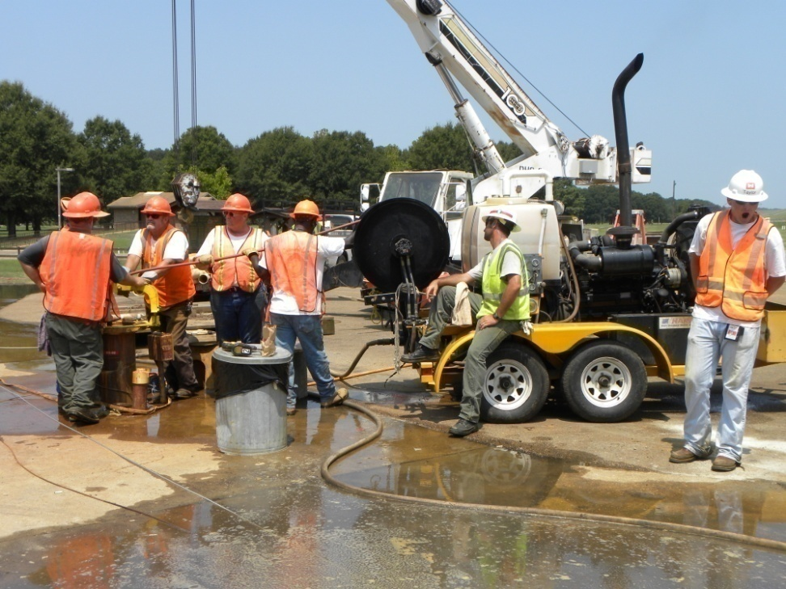
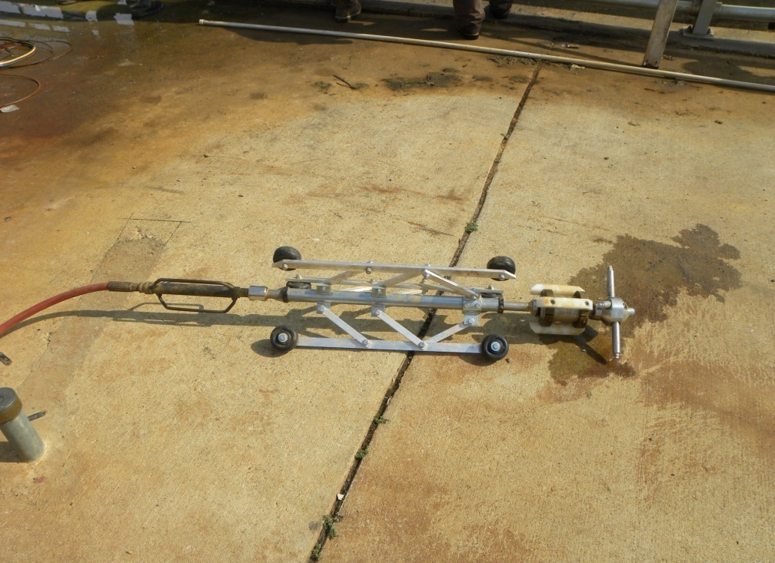
Operational & Maintenance Aspects of Dam Safety
Keys to a Successful Dam Safety Program
Maintenance
Relief Wells & Drains
Pressure jetting
Well surging
Major problem at Grenada Lake (biofouling discussion)
Notes:
Efficiency - Relief wells must remain efficient in order to relieve hydrostatic pressures below and around structures
Chemical treatment - The must be airlifted and chemically treated frequently with Oxalic acid to clear the screens of deposits. Chemical treatment must be performed annually in some cases depending on the content and make-up of the water. Extreme caution must be exercised when treating the relief wells not to damage the screens. Proper appliances should be utilized for this task. Example: do not tape a pipe wrench on the end of the air-hose as a weight. Best results come from placing the air hose inside of a length of PVC pipe.
Sand - Relief wells must frequently be checked to insure that sand is not being produced. Once this occurs the well becomes more of a liability than a safety valve and voids can and will occur. Inefficient wells will eventually require replacement. Retrofitting old vertical relief wells can present a challenge. In the photo to the far right you can see how a long reach trackhoe is utilized as a press to insert the sleeve. This was accomplished entirely by signals as the operator could not visually see the job site below.
___________________________________________________________________________
SUBJECT: ARKABUTLA OUTLET/CONDUIT RELIEF WELL CHEMICAL REHABILITATION ESTIMATE
ESTIMATE
Crew, Equipment, PE, Office (Al) $4,000/Day
4 Days @ Site/ 2 Days Mob/De-mob $24,000
Travel/ 6 days @ $400/Day $4,300
Administrative $1,500
PE Work (Directive/Report) $3,000
Total Without Oxalic Acid $32,800
-----------------------------------------------------------
Oxalic Acid Cost
38 sacks @ $30.00/sack= $1,140
-----------------------------------------------------------
Total w/Oxalic Acid= $33,940

Slide 48
Cleaning of Toe Drains
High pressure water jetting equipment has been used successfully
Pressures have to be controlled and nozzles adjusted to clean effectively without damaging the pipe
Slots and perforations can be cleaned
Envelope around drain can be cleaned using well development techniques

Slide 49
Drain Cleaning Methods
Concrete and Rock Drains
Rodding
Flushing/Air Lifting
Reaming/Hole Enlargement
Drilling New Holes
Rotary Tube Cleaners or Mechanical Abraders
High Pressure Water Jetting

Slide 50
Yellowtail Dam
Thin arch concrete dam located on the Bighorn River in south-central Montana.
Drain cleaning program was initiated for foundation drains in 1998.
Uplift gauge pressure readings had been increasing.
Inspection indicated drains were plugged with clay, iron bacteria, and calcium carbonate.

Slide 51
Yellowtail Dam
153 drains in dam foundation and 20 drains in powerplant foundation were cleaned.
Drains were cleaned with high pressure water jetting equipment.
Pressures between 8000 and 10,000 psi were used.
Flows were between 14 and 16 gpm.
Jets were adjusted to achieve best cleaning.

Slide 52
Yellowtail Dam
Rotating cleaning head was advanced at rate of 2 to 4 feet/minute.
Cleaning was effective in removing all of clay and iron bacteria and most of calcium carbontate.
Cleaning was effective in removing deposits in cracks and joints.
Costs - $4.86/foot

Slide 53
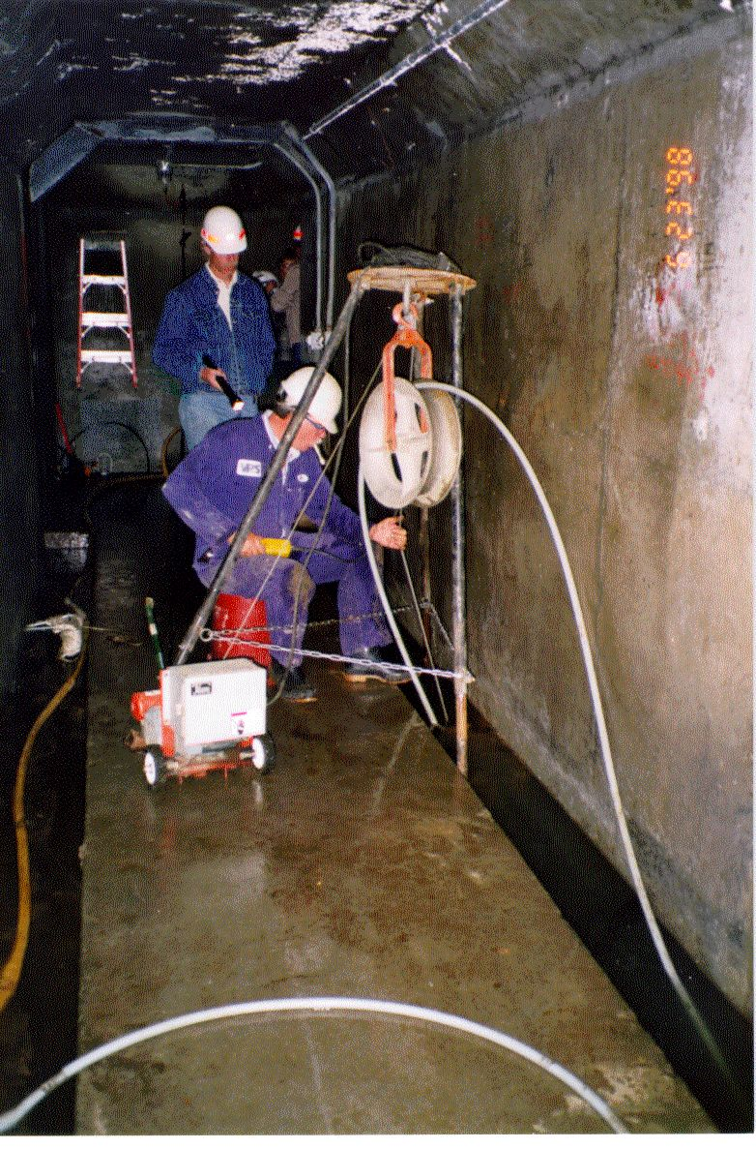
Drain Cleaning
High pressure water jetting equipment

Slide 54
Yellowtail Dam
Dam drain flows increased by about 33 percent after cleaning.
Powerplant drain flows increased by about 450 percent after cleaning.
Uplift pressures decreased – up to 50 feet in one upstream gauge and 2 feet or less in some of the downstream gauges.

Slide 55
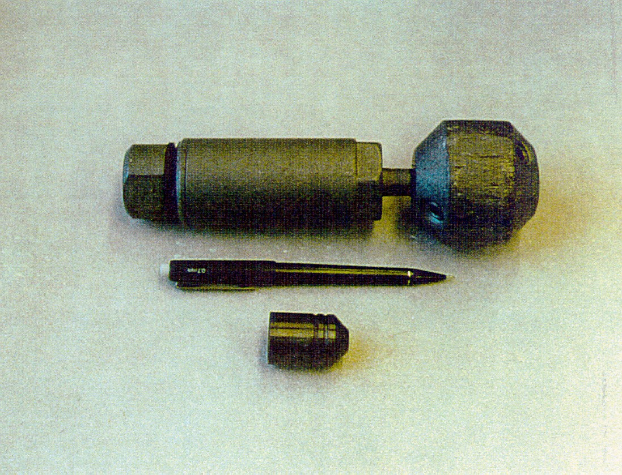
High Pressure Water Jetting
Cleaning Head

Slide 56
Dam Drain Manual
Conclusions
Drains are important features at dams that enhance stability.
Drains have not always received proper attention because of lack of visual evidence, cost of cleaning drains and lack of awareness.
Tools are now available to inspect drains and effectively clean them.
Reclamation has developed a manual on drains for dams and associated structures.

Slide 57
Animal Burrows

Slide 58
Truckee Main Canal Breach
Fernley Nevada

Slide 59
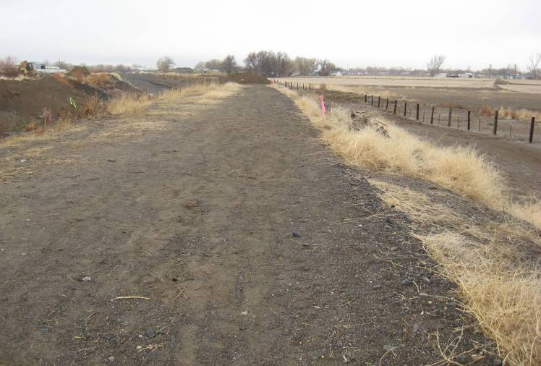
Truckee Canal Embankment Through Fernley

Slide 60
Canal Breach
Prior to January 4, 2008 TCID had been diverting water through the canal at an average daily rate of 370 ft³/s.
A January 4, 2008 storm event with 1.9 inches of precipitation
At 4:30 AM January 5, 2008 the canal flow peaked at 751 ft³/s.

Slide 61
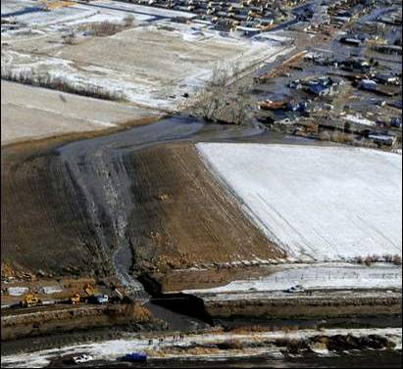
Truckee Canal Breach

Slide 62
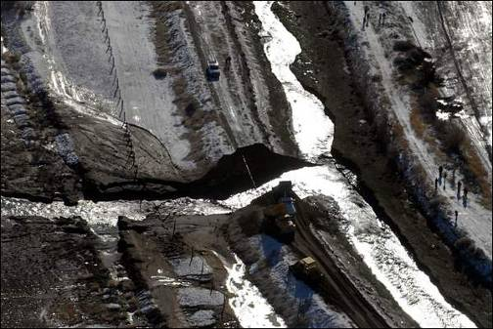
Truckee Canal Flood

Slide 63
Truckee Canal Flood
590 homes were flooded
138 homes suffered moderate to severe damage

Slide 64
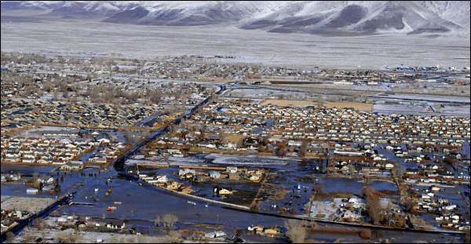
Flooding Within Fernley

Slide 65
Potential Failure Modes
Overtopping
Piping due to rodent activity
Piping due to other types of flaws
Blowout then piping of foundation
Embankment instability
Seismic Activity
Sabotage

Slide 66
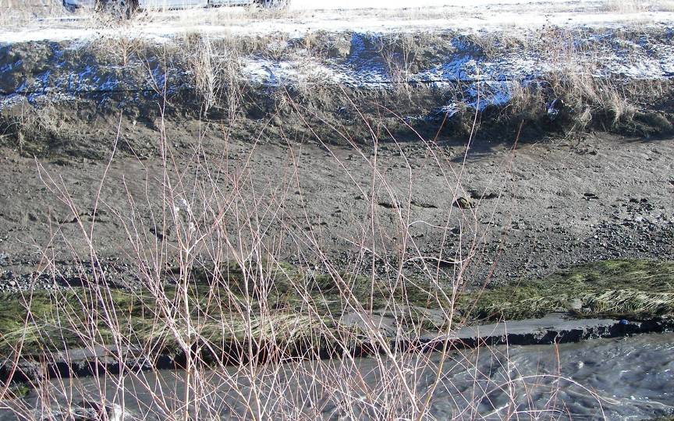

Slide 67
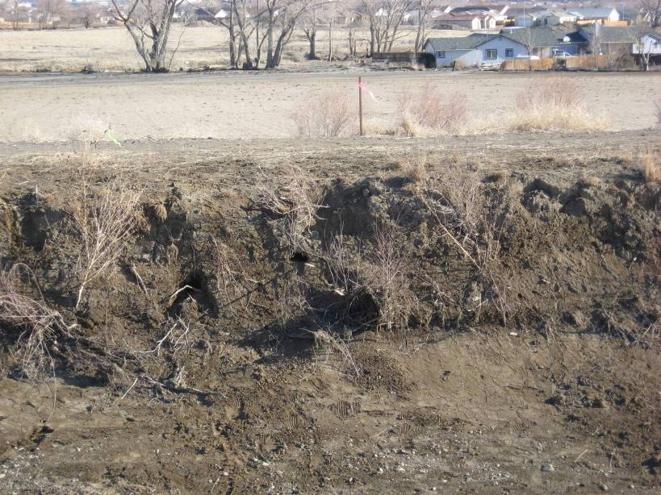
Collapse
Feature
Muskrat
Burrows

Slide 68
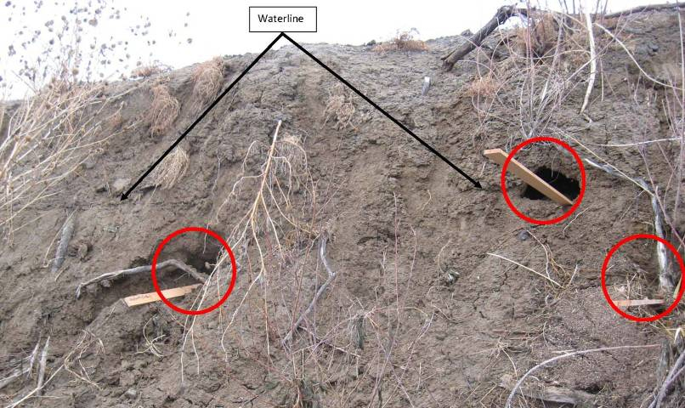
Muskrat Borrows in Canal Prism

Slide 69
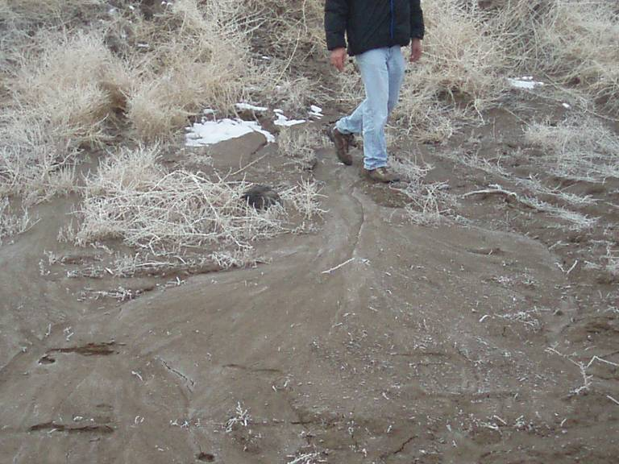

Slide 70
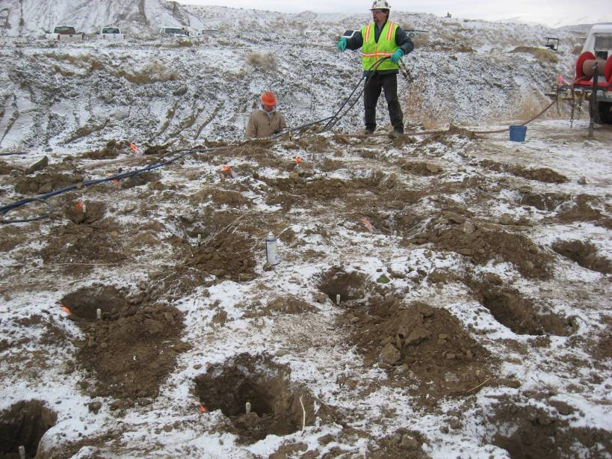

Slide 71
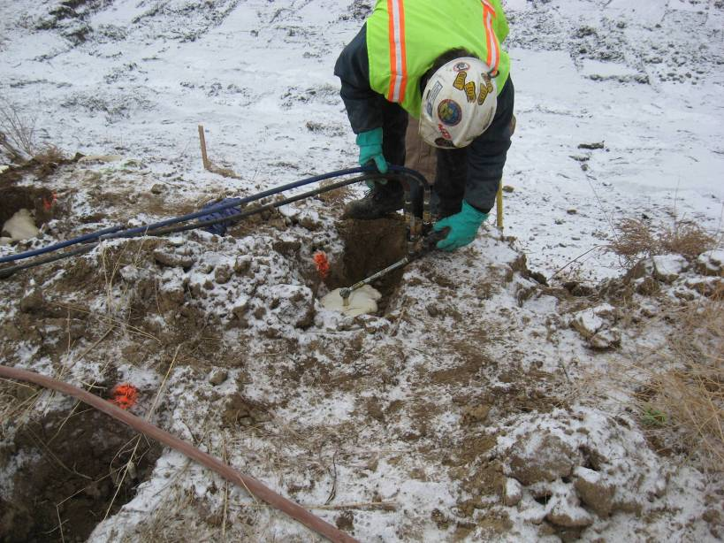

Slide 72
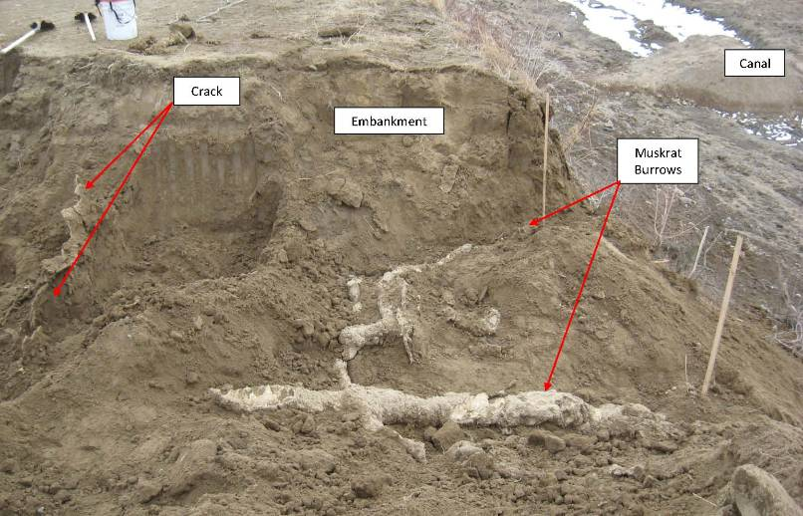
Investigative Casts of Muskrat Borrows

Slide 73
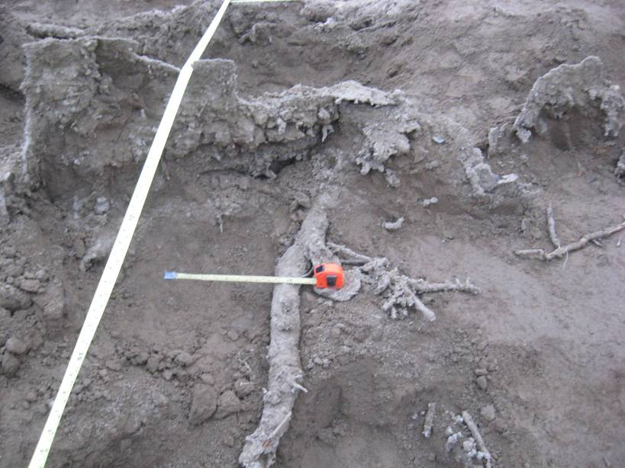
Large vein 13 feet
in from the canal.
Muskrat Burrow 15 feet in from the canal.
Casts of a network of small open structures.

Slide 74
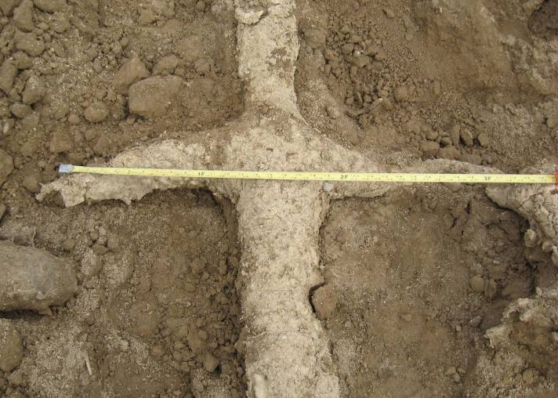
Investigative Casts of Muskrat Borrows

Slide 75
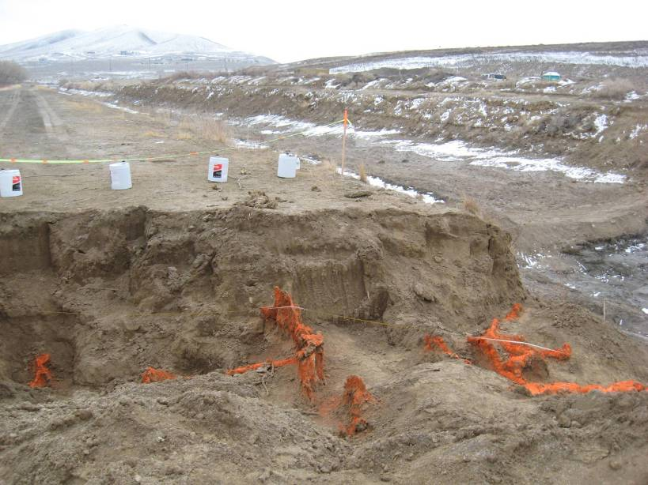

Slide 76
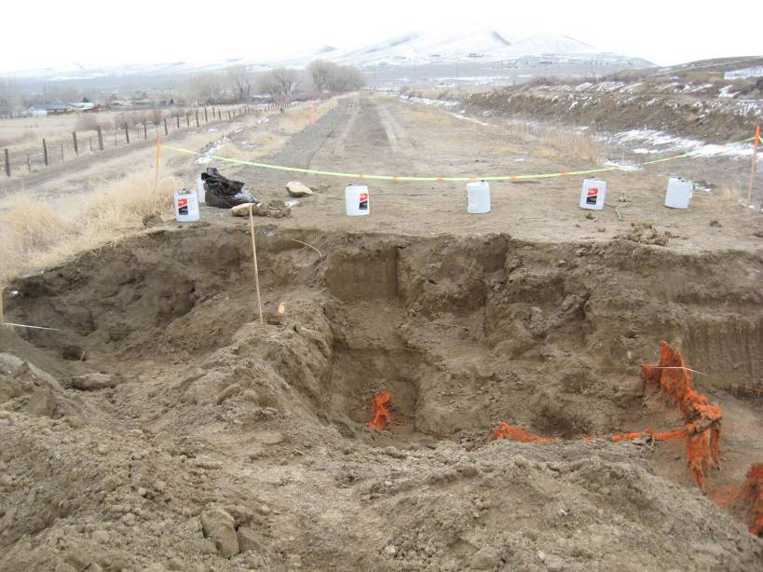
Collapse
Feature
Pipeline

Slide 77
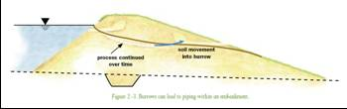

Slide 78
Vegetation

Slide 79
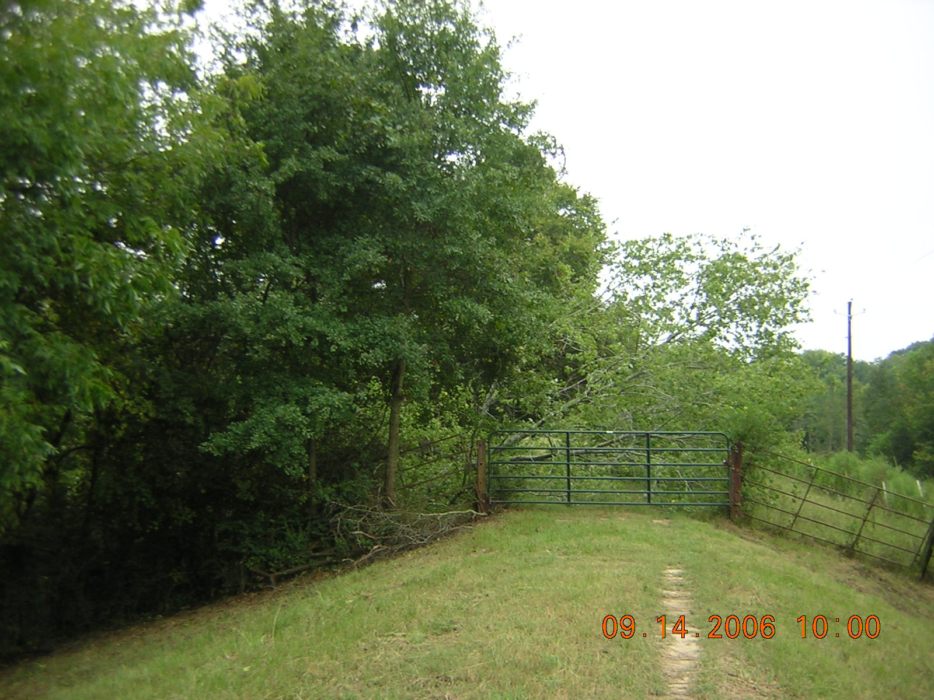
UNCLASSIFIED
Same Levee
Two Levels of Care
US Army Corps
of Engineers
One Corps Serving The Army and the Nation

Slide 80
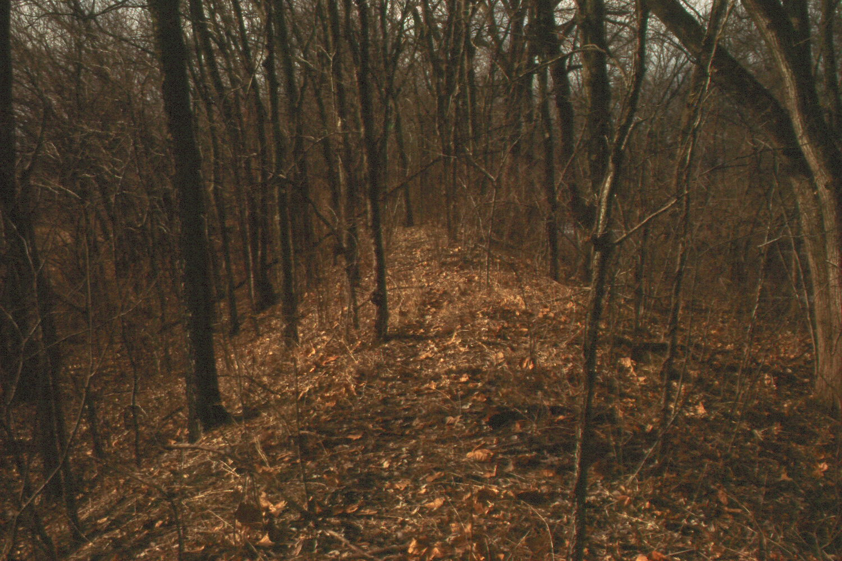

Slide 81
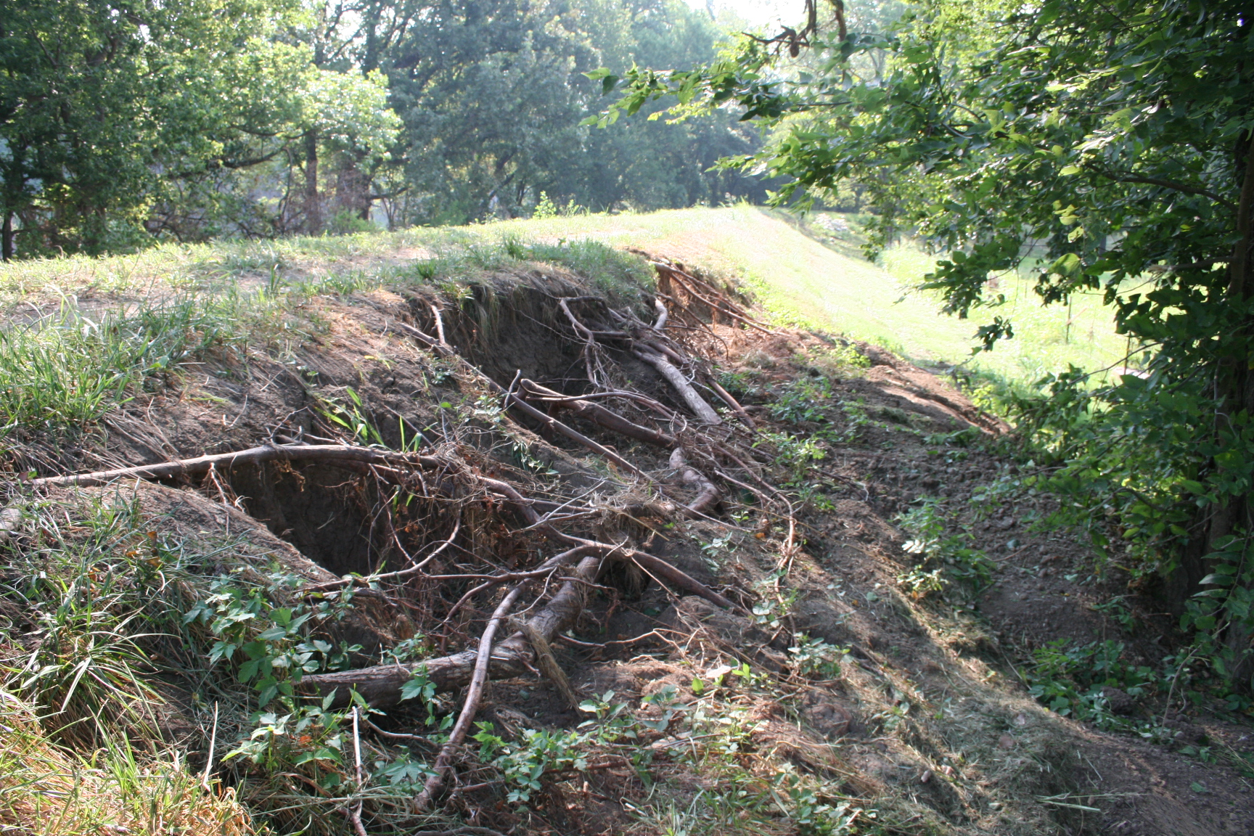
UNCLASSIFIED
Repair Evaluation Maintenance and Rehabilitation Research Program (REMR)
US Army Corps
of Engineers
One Corps Serving The Army and the Nation

Slide 82

Tree Roots
Danube Dike 1988

Slide 83

Tree Roots
Dykes with woody vegetation
in Bavaria/Germany
Design, experiences and research
Levee Vegetation Symposium
Sacramento (California)
28./29. August 2007
No. 83
Dike breaches
Dike at River Mulde 2002

Slide 84
Dykes with woody vegetation
in Bavaria/Germany
Design, experiences and research
Levee Vegetation Symposium
Sacramento (California)
28./29. August 2007
No. 84
Windthrow
Thrown row of poplars at the landside dyke toe (Source: StMUVG)

Slide 85

August 28-29, 2007

Slide 86
Operational Instrumentation

Slide 87
Project Description
The Taum Sauk Project is located on the East Fork of the Black River approximately 90 miles southwest of St. Louis, Missouri.
Taum Sauk is a pumped storage project owned by AmerenUE. It was the first large pumped-storage project to begin operation in the U. S.
The project includes an upper reservoir, a shaft/tunnel water conduit, a 450-MW PH with two pump-turbine units, and a lower reservoir.

Slide 88


Location Map
.......
google earth map

Slide 89

Taum Sauk Upper Reservoir
photo
N

Slide 90
FAILURE

Slide 91

Taum Sauk
Breach Photo

Slide 92
Failure – Just the Facts
The Upper Reservoir of the Taum Sauk Pumped Storage Project was overtopped during the final minutes of the pumping cycle on the morning of Dec. 14, 2005. Data indicate that pumping stopped at 5:15 AM with the initial breach forming at about the same time. Once overtopping began, erosion started at the downstream toe of the 10’ high parapet wall. Erosion progressed below the parapet wall, likely causing instability and resulting in the initial loss of one or two parapet wall sections.

Slide 93
Failure – Just the Facts
Subsequent erosion and breach of the rockfill embankment formed a breach about 656’ wide at the top of the rockfill dam and 496’ at the base of the dam. The peak discharge from breach was about 273,000 cfs which occurred within 10 minutes of the initial breach. The complete evacuation of the reservoir occurred within 25 minutes.

Slide 94
Beginning of Overtopping
From Rogers

Slide 95
Photo of Erosion
From Rogers

Slide 96

Progression 1
From Rogers

Slide 97

Progression 2
From Rogers

Slide 98
Progression 3
From Rogers

Slide 99
Final
From Rogers

Slide 100
Consequences
The consequences from the failure could have been far worse had it occurred at a different time of year.
The failure occurred around 5:15 AM with flood waters quickly reaching the park.
Fortunately, the campground was empty during the middle of December, resulting in no deaths.
Hundreds of sleeping campers may have perished in the state park campground had the failure occurred on a busy summer weekend.

Slide 101
Outlet Works Deterioration
Addicks and Barker Dams (Houston)
Lake Sherburne Dam (Montana)
Deer Flat Dam (Idaho)

Slide 102

Improving the Safety and Performance of Outlet Works Conduits Through Embankment Dams
Non- Pressurized Outlet Works Conduits –

Slide 103
Pressurized Conduits Constructed Through Embankment Dams
“Avoid pressurized conduits through impervious embankment dams, unless the pressure conduit is placed in a larger conduit.” FEMA TM 484, Conduits through Embankment Dams

Slide 104



Flawed Pressurized Conduit
Addicks Dam
Open Expansion Joints

Slide 105

Addicks Dam
Leaking Conduit Expansion Joint
Leakage between conduit expansion joints

Slide 106
Lake Sherburne Dam
Glacier National Park
Montana

Slide 107


Slide 108
Lake Sherburne Dam
Located near Glacier National Park in Montana
Principal component of USBR Milk River Project
Completed in 1921
Provides irrigation water to 110,300 acres
Crest raised 16 feet in 1982 utilizing Reinforced Earth walls

Slide 109


Slide 110


Slide 111


Slide 113


Slide 114


Slide 115


Slide 116


Slide 117


Slide 118
SILICA FUME CONCRETE MIX DESIGN
Cement 720 lbs
Fly ash 90 lbs
Silica fume 90 lbs
HRWA 2.7 lbs
Air 0.04 lbs
Sand 1,007 lbs (dry)
3/8 inch Gravel 1,090 lbs (dry)

Slide 119


Slide 120
Deer Flat Dam
Nampa Idaho

Slide 121


Deer Flat Dam-Caldwell outlet (2004)
Caldwell Outlet Works – seepage and material entering conduit through floor.

Slide 122


Slide 123


Slide 124

Separated Joint

Slide 125


Slide 126


Slide 127


Slide 128


Slide 129


Slide 130


Slide 131


Slide 132


Slide 133


Slide 134


Slide 135


Slide 136


Slide 137


Slide 138
Conclusions
Training personnel is vital
Ensure communication lines are good
Distress issues that requires immediate action and reporting:
  Are a legitimate threat to the dam
  May lead to large loss of life and economic consequences
  Do not allow project to function as intended
  Occur during times of extreme events/conditions
  Have heightened political and news visibility
Each situation/project is different

Slide 139
QUESTIONS?

