Slide 1
Dam Terminology
José Hernández, P.E.
Regional Geotechnical Engineer
U.S. Army Corps of Engineers
South Atlantic Division
Jose.Hernandez@usace.army.mil
Dam Safety Workshop
Brasília, Brazil
20-24 May 2013

Slide 2
Dam Terminology
Classification
Parts of a Dam
Seepage Control Measures
Instrumentation
Features of a Dam
Issues Leading to Dam Failure
Risk Terminology

Slide 3
Dam Classification
Applications
Purpose
Construction Materials
Hydraulic Design
Dam Safety Regulation
Hazard Potential

Slide 4
Dam Classification
Purpose
Storage
  Water supply
  Irrigation
  Hydropower
  Recreation
Diversion
  Supply irrigation canals
  Transfer water to storage for municipal/industrial use
Detention
  Flood control
  Mine tailings
  Trap sediments or wastes
Multi-Purpose. Pool level depends on main purpose.
  Detention (Flood Control). Lowest possible pool level, then release water quickly according to downstream channel capacity.
  Storage and Diversion. Efficient and economic operation requires highest possible pool level. Releases should be limited to intended user only, such as hydropower or water supply.

Slide 5
Dam Classification
Construction Materials
Concrete
  Gravity
  Arch
  Buttress
  RCC
Embankment
  Earthfill
  Rockfill
  Earth and rockfill
Composite
  Concrete and embankment

Slide 6
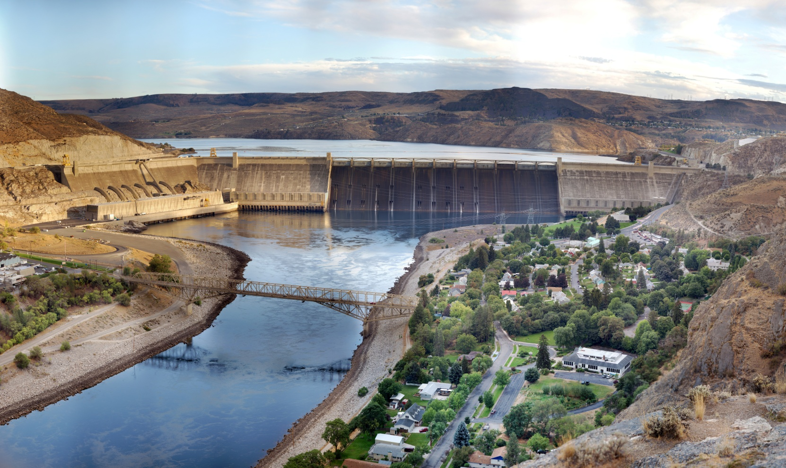
Gravity Dam
Depends on its weight and shape to support the loads and transfer them to the foundation.
Seepage uplift pressures can lead to overturning or sliding failure.
Grand Coulee Dam

Slide 7
Gravity Dam
Top of Dam
Axis of Dam
Water Pressure
Foundation
Drains
Flow
Groundline
Weight
Water
Pressure
Inspection Gallery
Grout
Curtain
Top of Rock
Base
Uplift Pressures
Notes:
Shown here is a typical section of a concrete gravity dam. Also shown are the forces acting on the dam. Basically, a concrete gravity dam’s ability to stay in place is based on the fact that the weight of the dam provides frictional resistance that balances all other forces acting on it. Drains which extend into the foundation and outlet into a drainage gallery are typically used in concrete gravity dams to control, collect and safely outlet the seepage that occurs through the foundation.

Slide 8
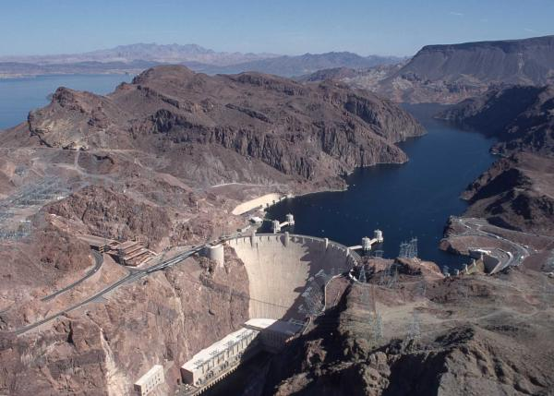
Arch Dam
Most of the loads are transferred to the canyon walls by arch action.
Because these dams are thin, overstressing of the concrete is a more critical factor.
Hoover Dam

Slide 9
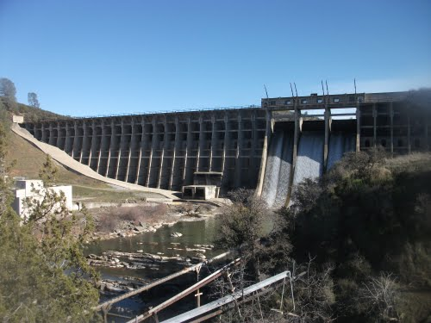
Buttress Dam
Watertight upstream face supported by a series of buttresses that transfer the loads to the foundation.
Construction of these dams has declined over the years due to high labor costs.
Stony Gorge Dam

Slide 10
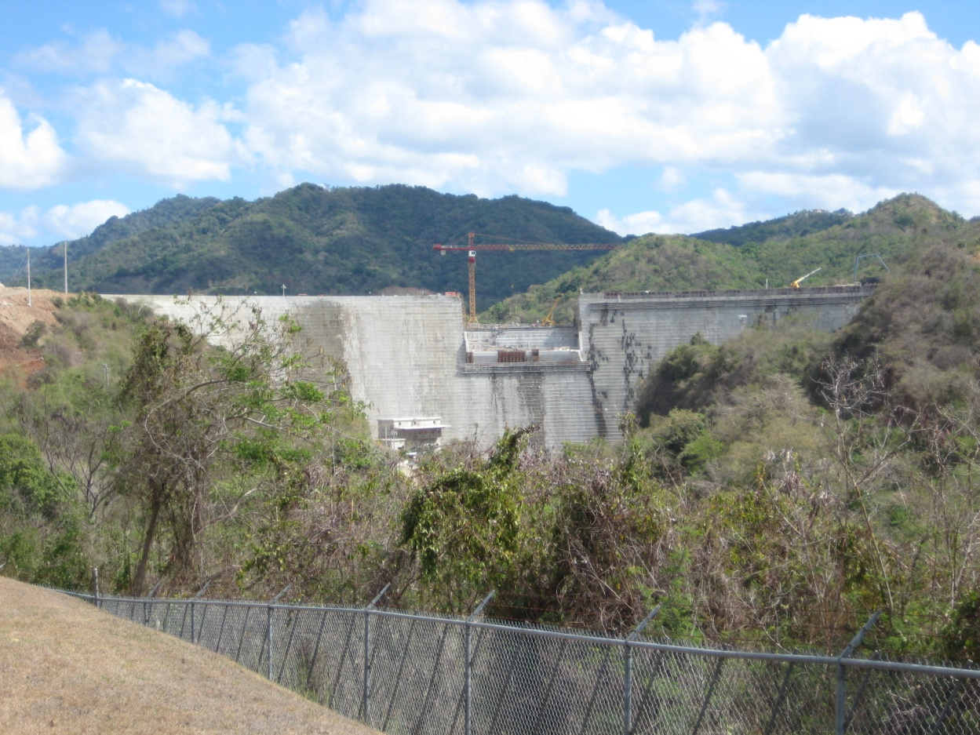
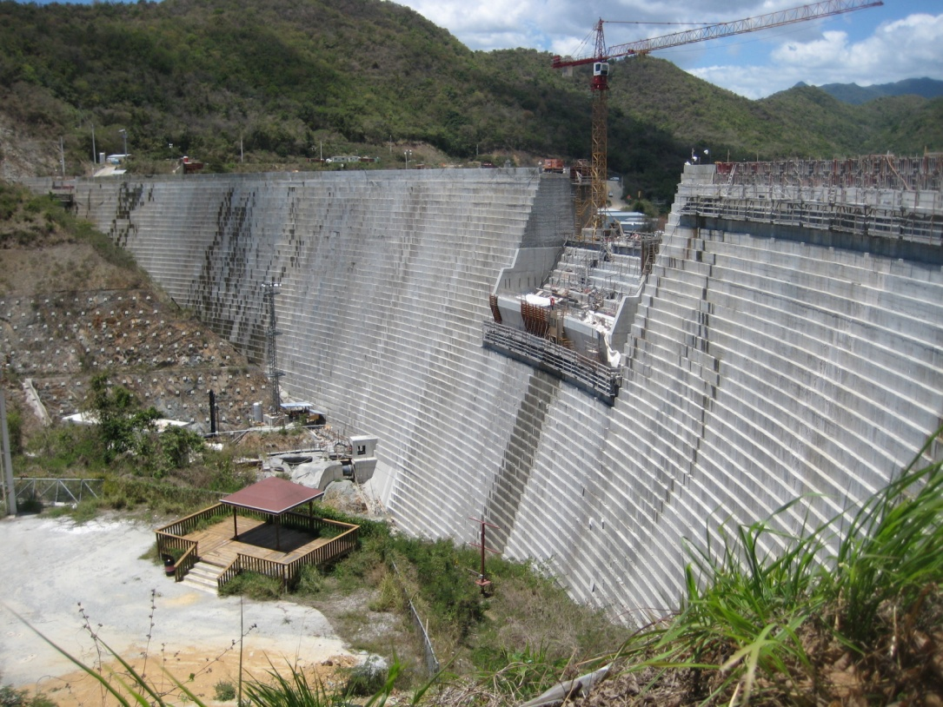
RCC Dam
(Roller-Compacted Concrete)
Portugués Dam
Portugués Dam

Slide 11
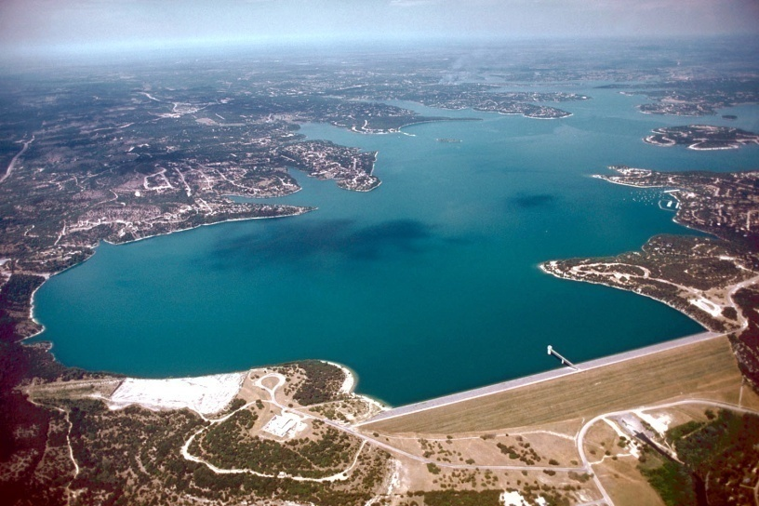
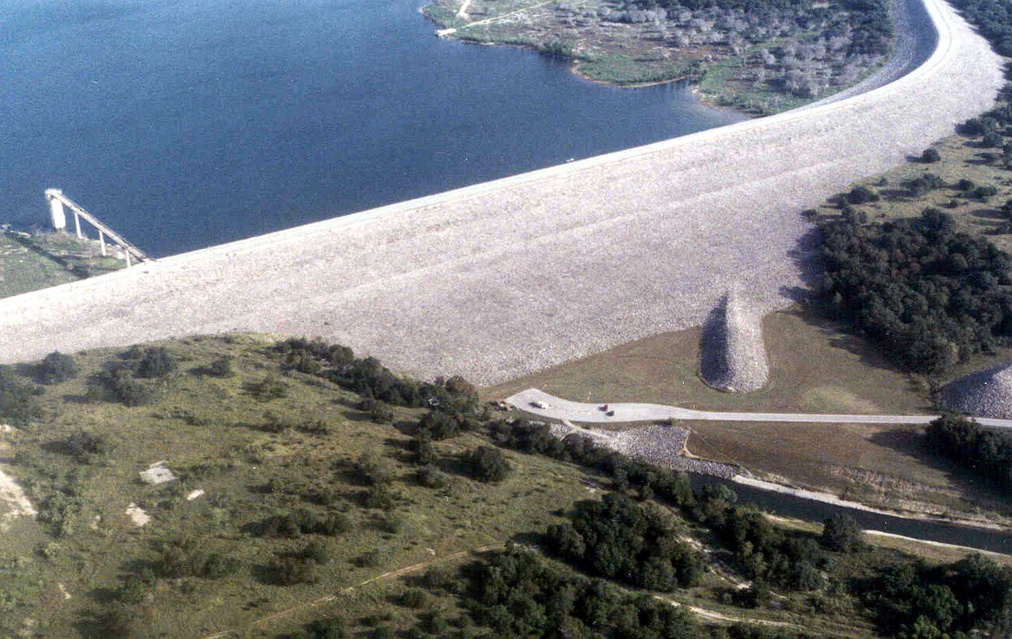
Embankment Dam
Can be built on a wider variety of foundations and topography than a concrete dam.
Typically built from materials excavated at or near the dam site.
Canyon Dam
Earth and Rockfill
Earthfill
North San Gabriel Dam

Slide 12

Embankment Dam
Typical Cross-Sections
Pool
Filter
Pool
Filter
Rock
Toe
Shell
Core
Homogeneous earthfill
Zoned Earth and Rockfill
Cutoff Trench
Grout Line
Impervious Lining
Pool
Filter
Pool
Inclined core
Rockfill
Notes:
Shown here are typical sections for earth and rock fill dams. The common theme in all these different types of sections is that there is an impermeable barrier to the flow of water, and there is also a collection system for whatever seepage that does occur. Furthermore, both the upstream and downstream slopes have to be stable for various upstream and downstream pool levels. In all cases there is a spillway provided to pass excess runoff if the storage capacity of the reservoir is exceeded by a severe storm event.

Slide 13
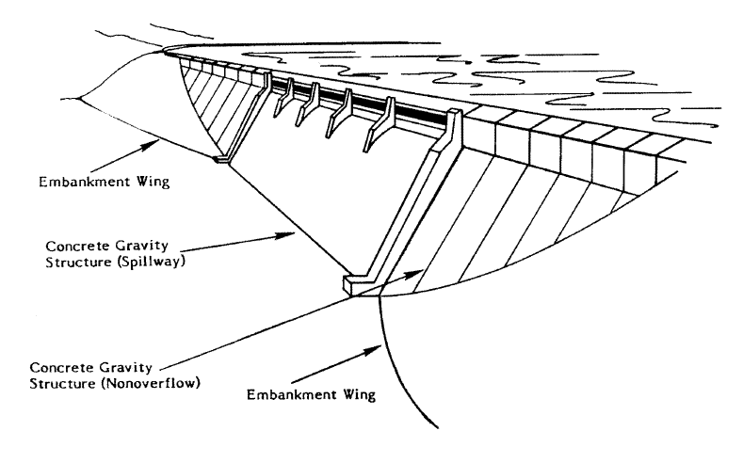
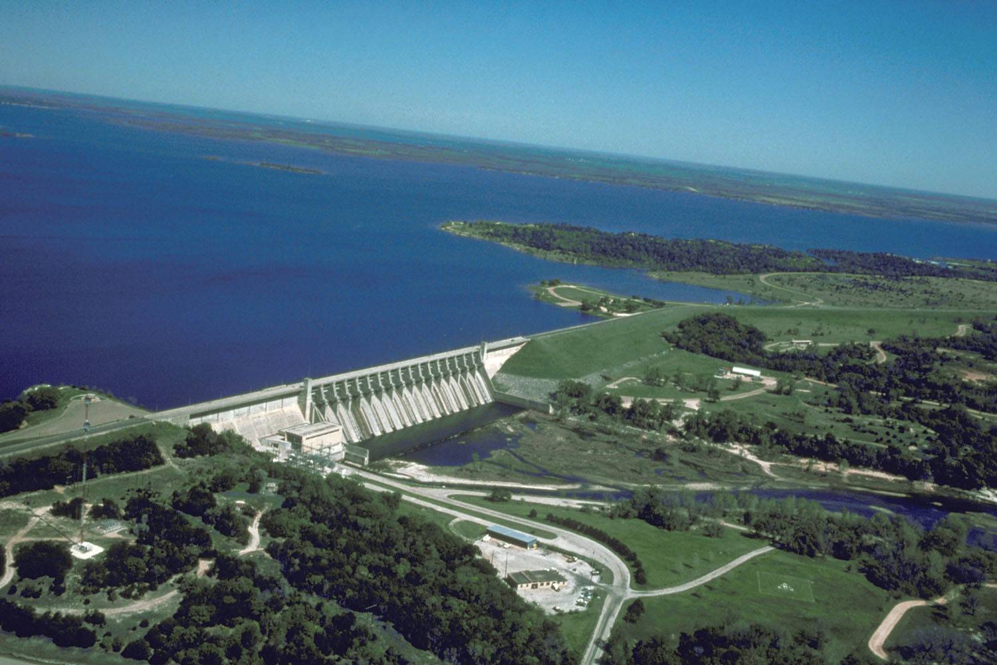
Composite Dam
Whitney Dam

Slide 14
Dam Classification
Hydraulic Design
Overflow
  Permit overflow of surplus water that cannot be retained in reservoir
  Generally not designed as overflow for entire length
Non-Overflow
  Water not allowed to overflow over its crest (embankment)
  Most dams have an overflow section (spillways) with the rest as non-overflow

Slide 15
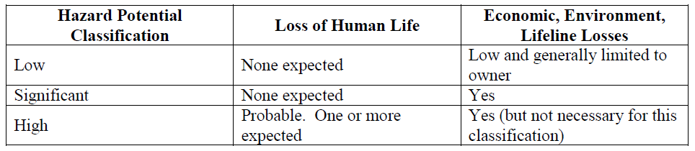
Dam Classification
Hazard Potential
Federal Emergency Management Agency (FEMA) Publication 333 – Federal Guidelines for Dam Safety: Hazard Potential Classification System for Dams

Slide 16
Dam Classification
Dam Safety Regulation
General Requirements
  Height
  Reservoir Volume
  Hazard Potential Rating

Slide 17
Dam Terminology
Classification
Parts of a Dam
Seepage Control Measures
Instrumentation
Features of a Dam
Issues Leading to Dam Failure
Risk Terminology

Slide 18
Abutments
Direction of Flow
Right
Left

Slide 19
Crest
Direction of Flow
Crest

Slide 20
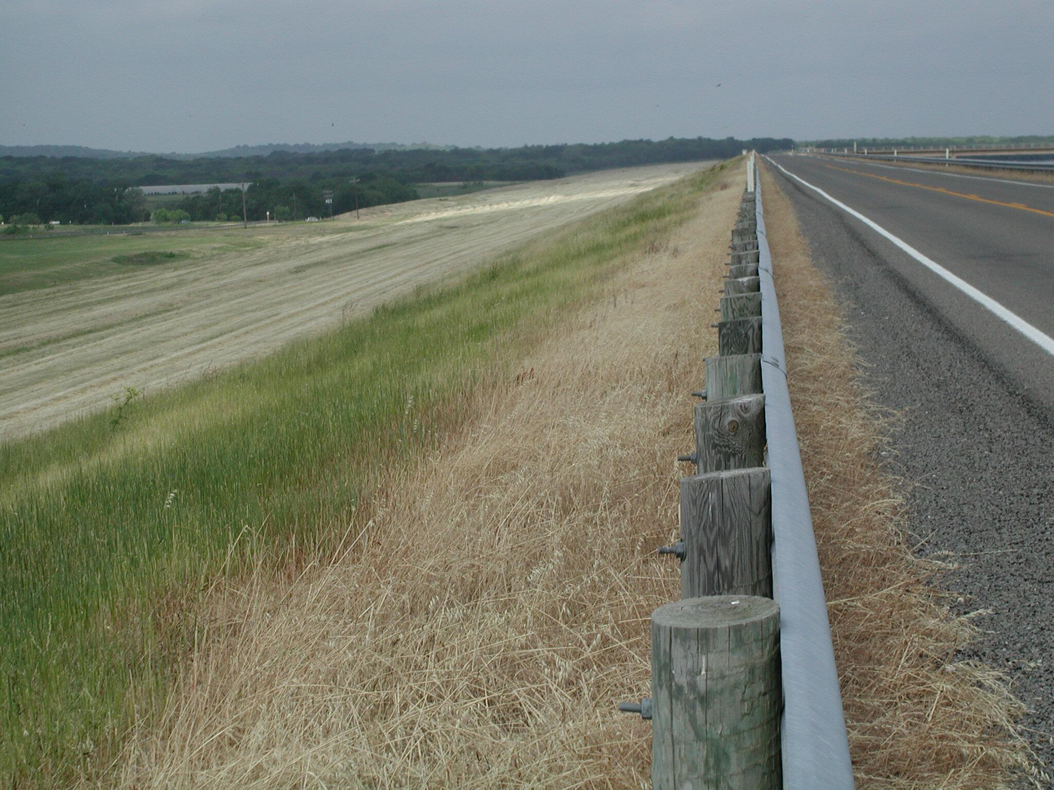
Aquilla Dam
Crest Looking Right

Slide 21
Embankment Slope
Direction of Flow
Upstream Slope
Downstream Slope

Slide 22
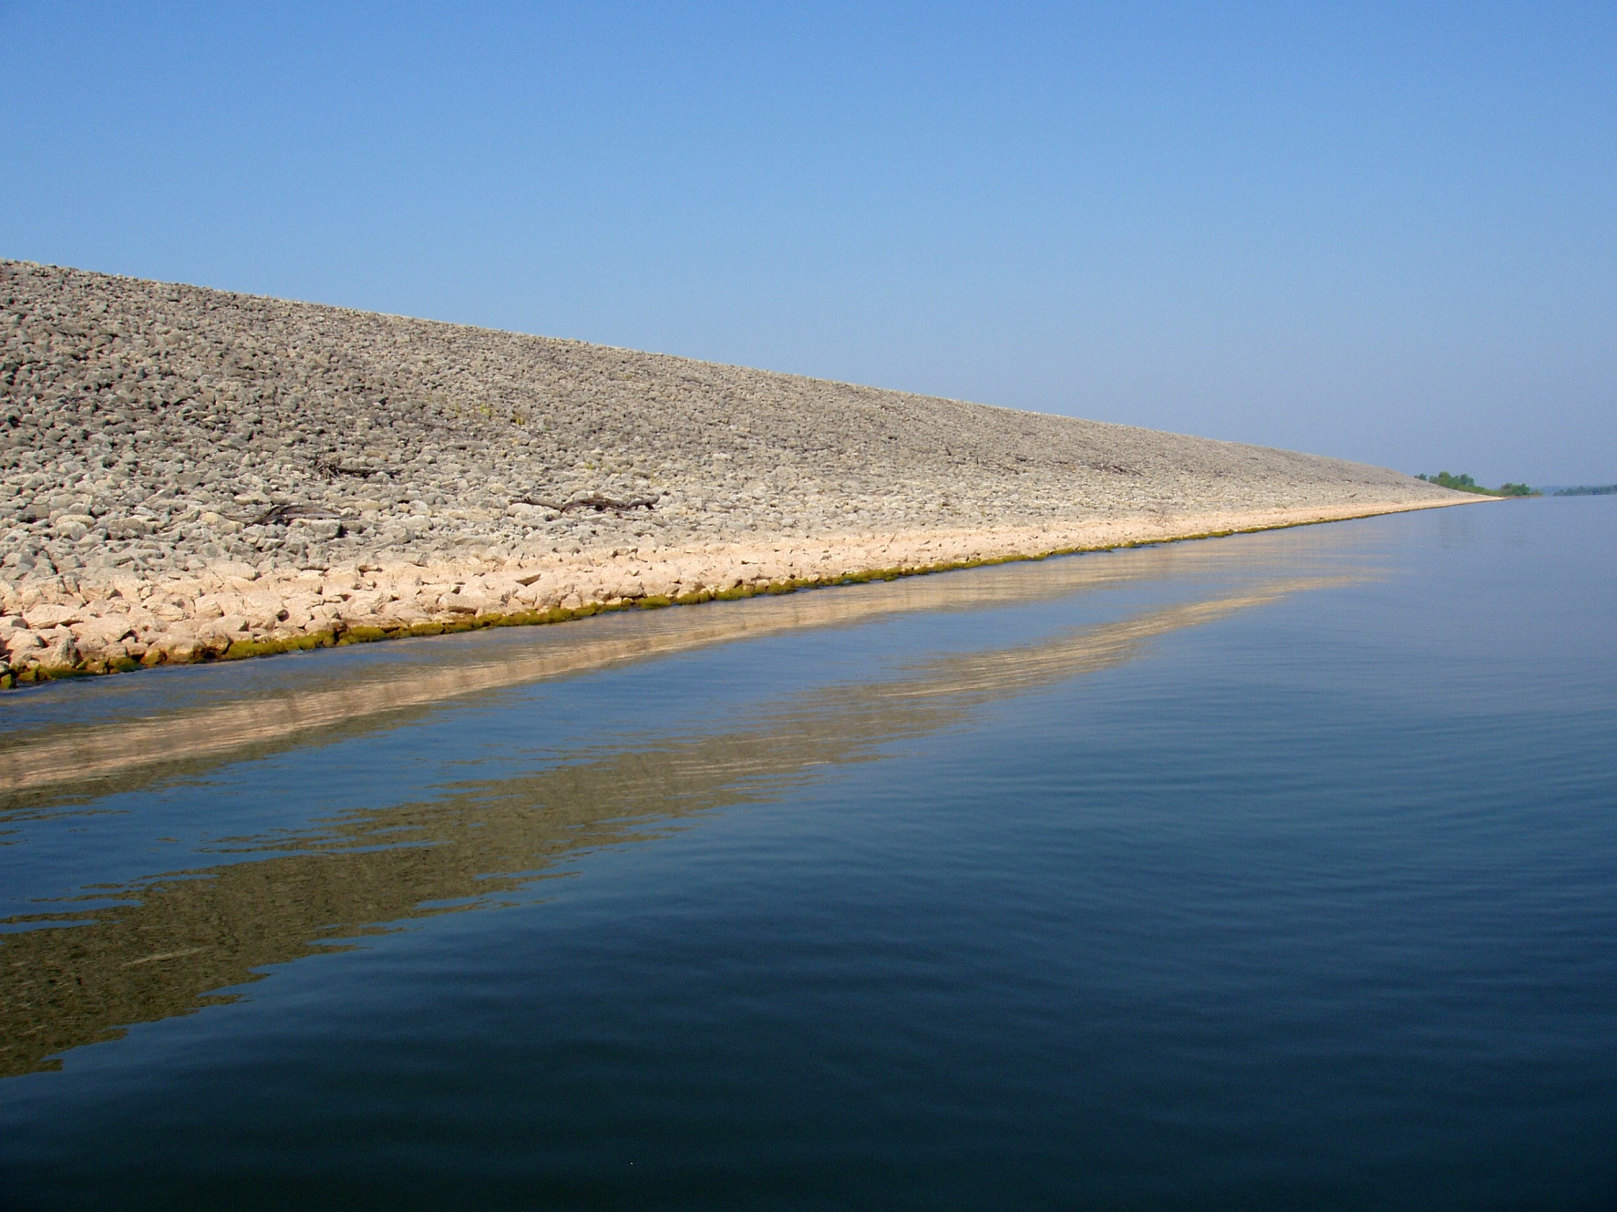
Proctor Dam
Upstream Slope Looking Right

Slide 23
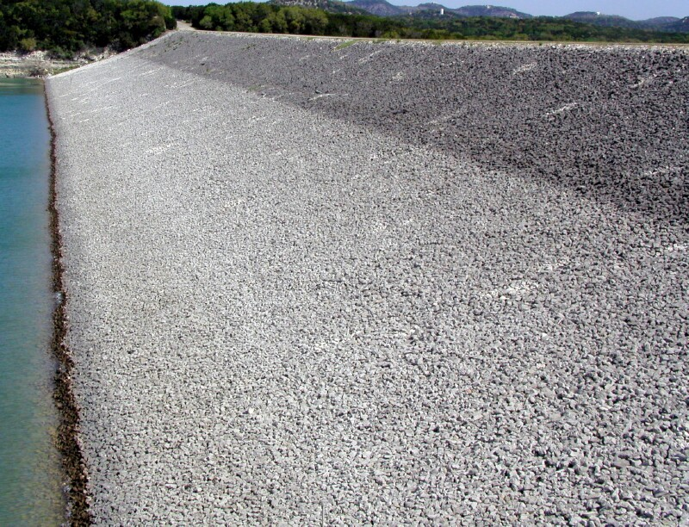
Canyon Dam
Upstream Slope Looking Left

Slide 24
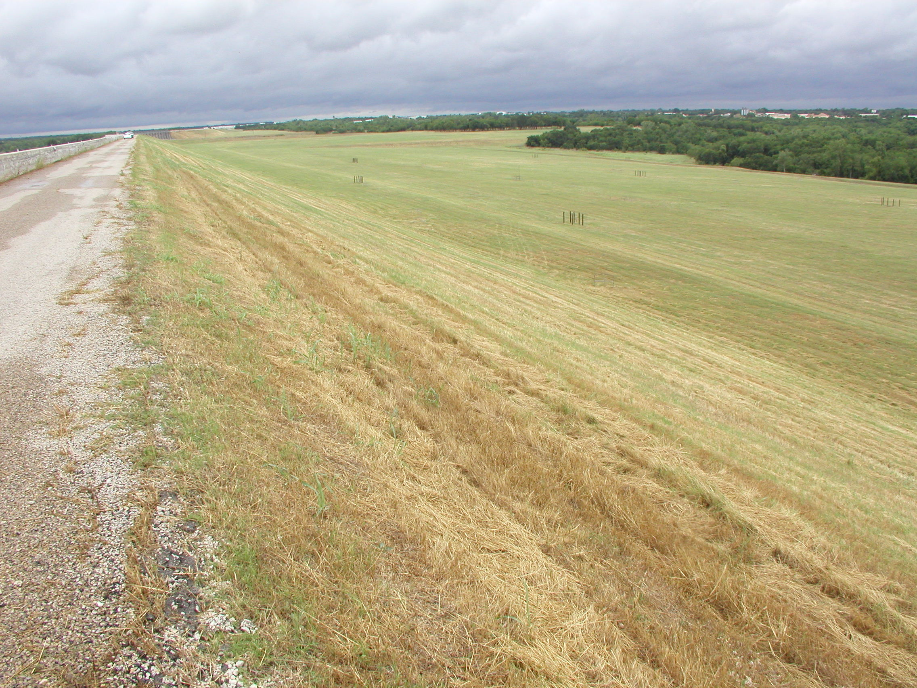
Waco Dam
Downstream Slope Looking Left

Slide 25
Toe and Heel
(Downstream and Upstream)
Direction of Flow
Heel
Toe

Slide 26
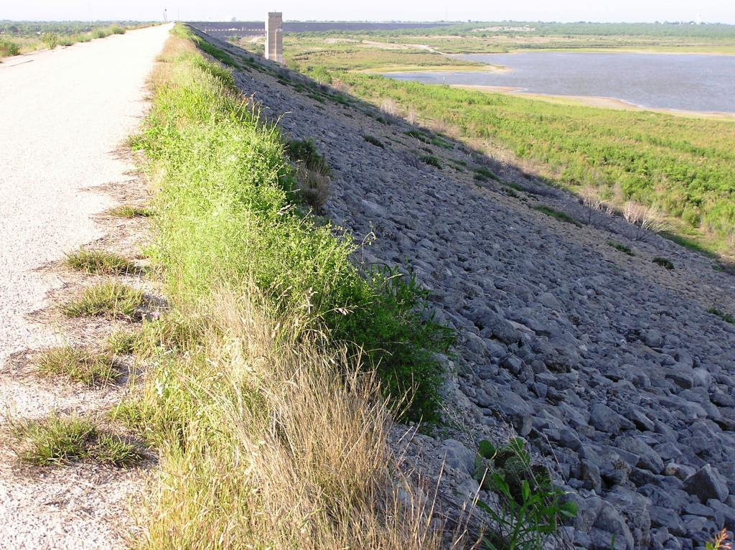
Waco Dam
Heel Looking Right

Slide 27
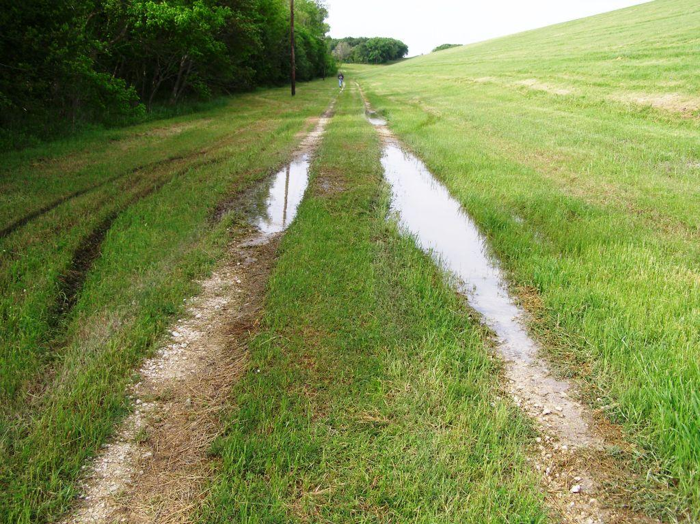
Navarro Mills Dam
Toe Looking Right

Slide 28
Abutment
Direction of Flow
Right
Abutment
Left
Abutment

Slide 29
Embankment/Abutment Contact
Direction of Flow
Groin
Groin
Groin
Groin

Slide 30
Embankment/Abutment Contact
Why is the groin of a dam a critical area?
  Dissimilar materials
  Joints and holes – not smooth
  Hard to compact soil with equipment
  High probability of seepage
  Natural area for water runoff

Slide 31
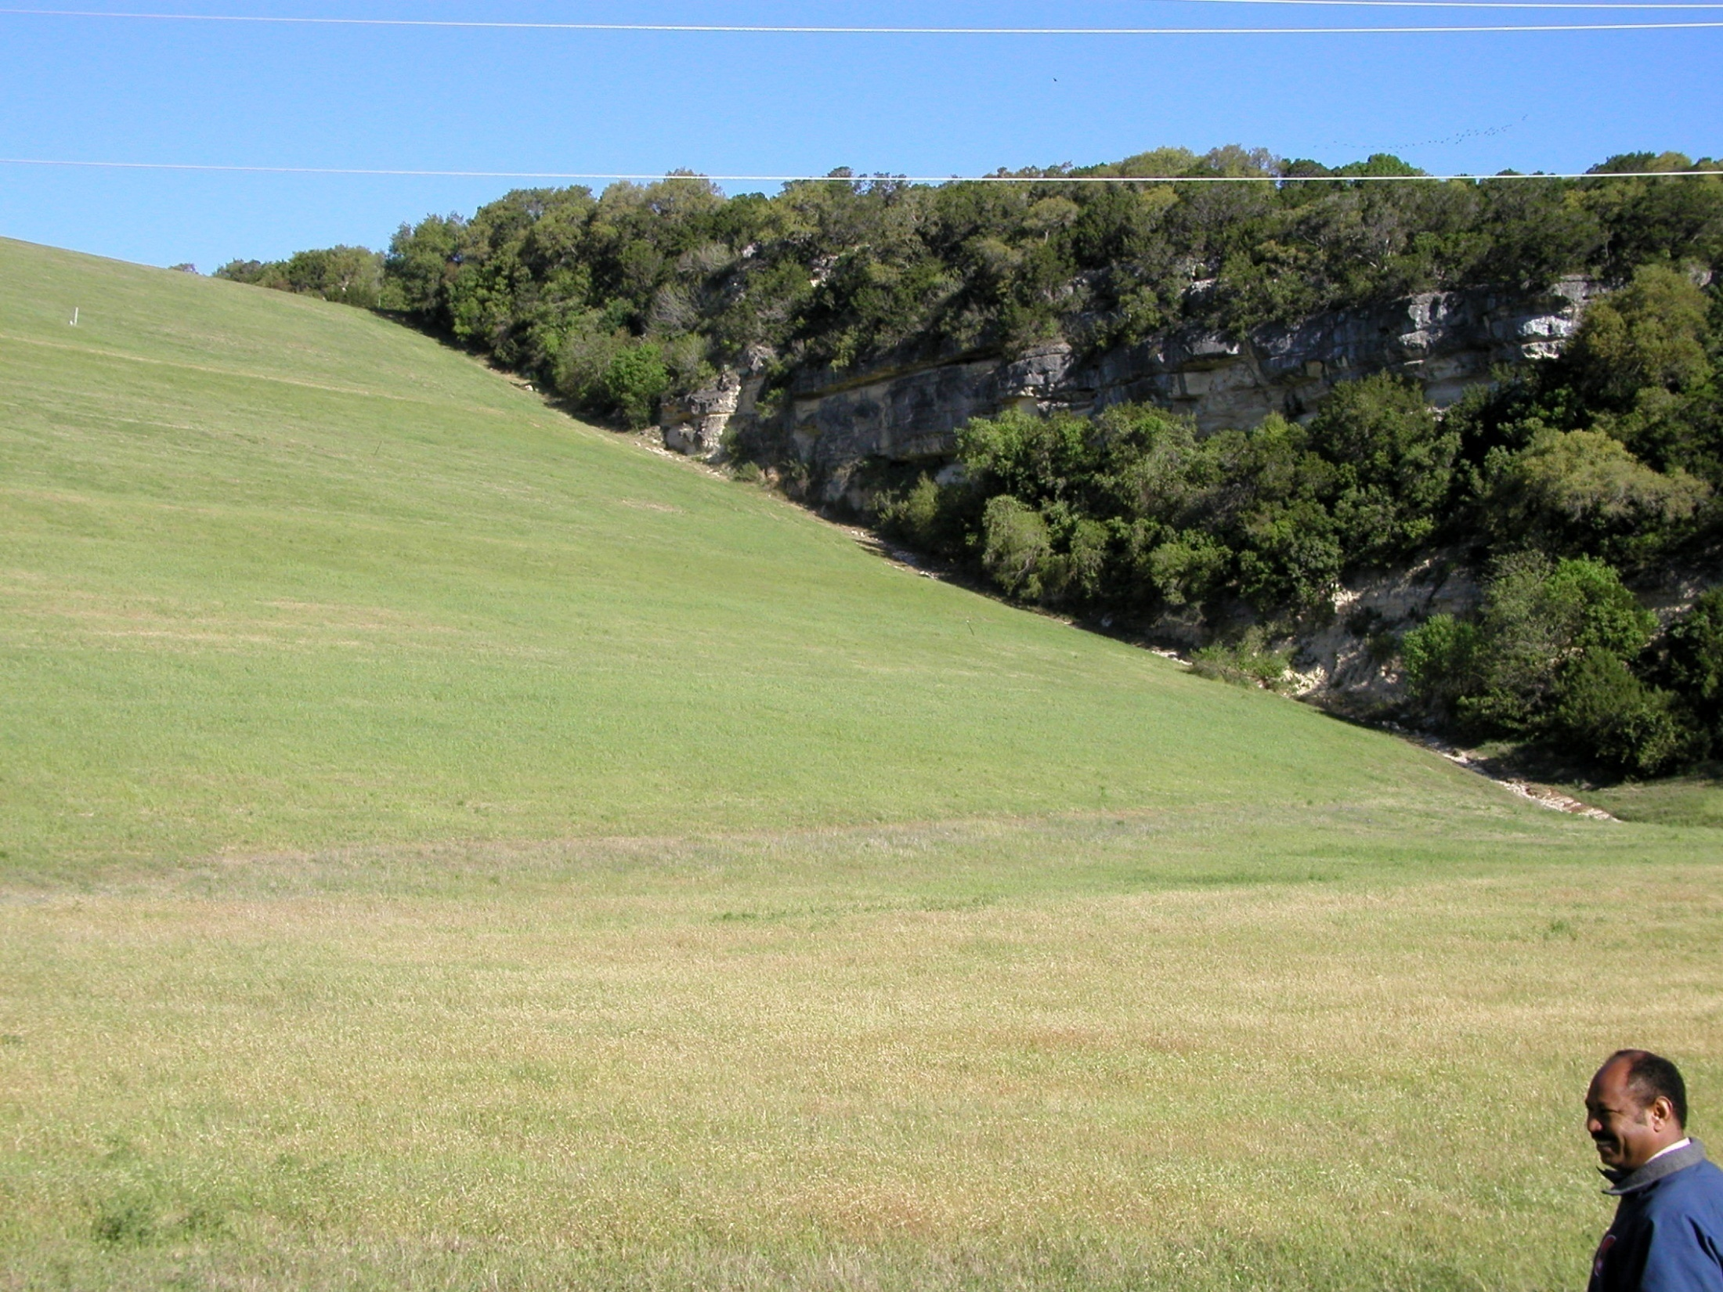
Canyon Dam
Downstream Slope Left Groin

Slide 32
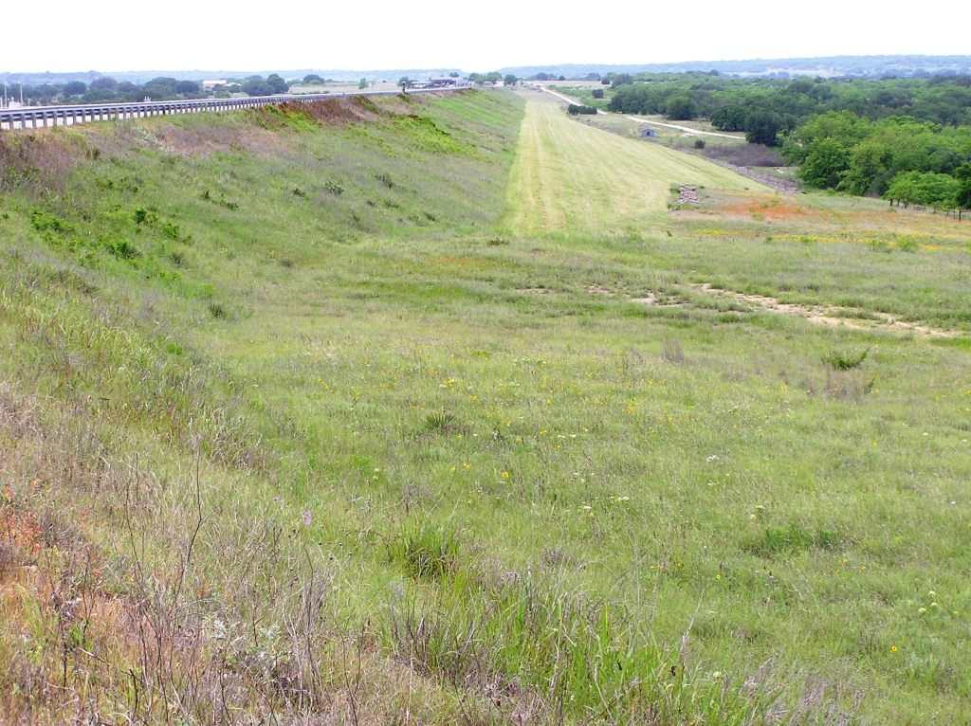
Hords Creek Dam
Downstream Slope Right Groin Looking Left

Slide 33
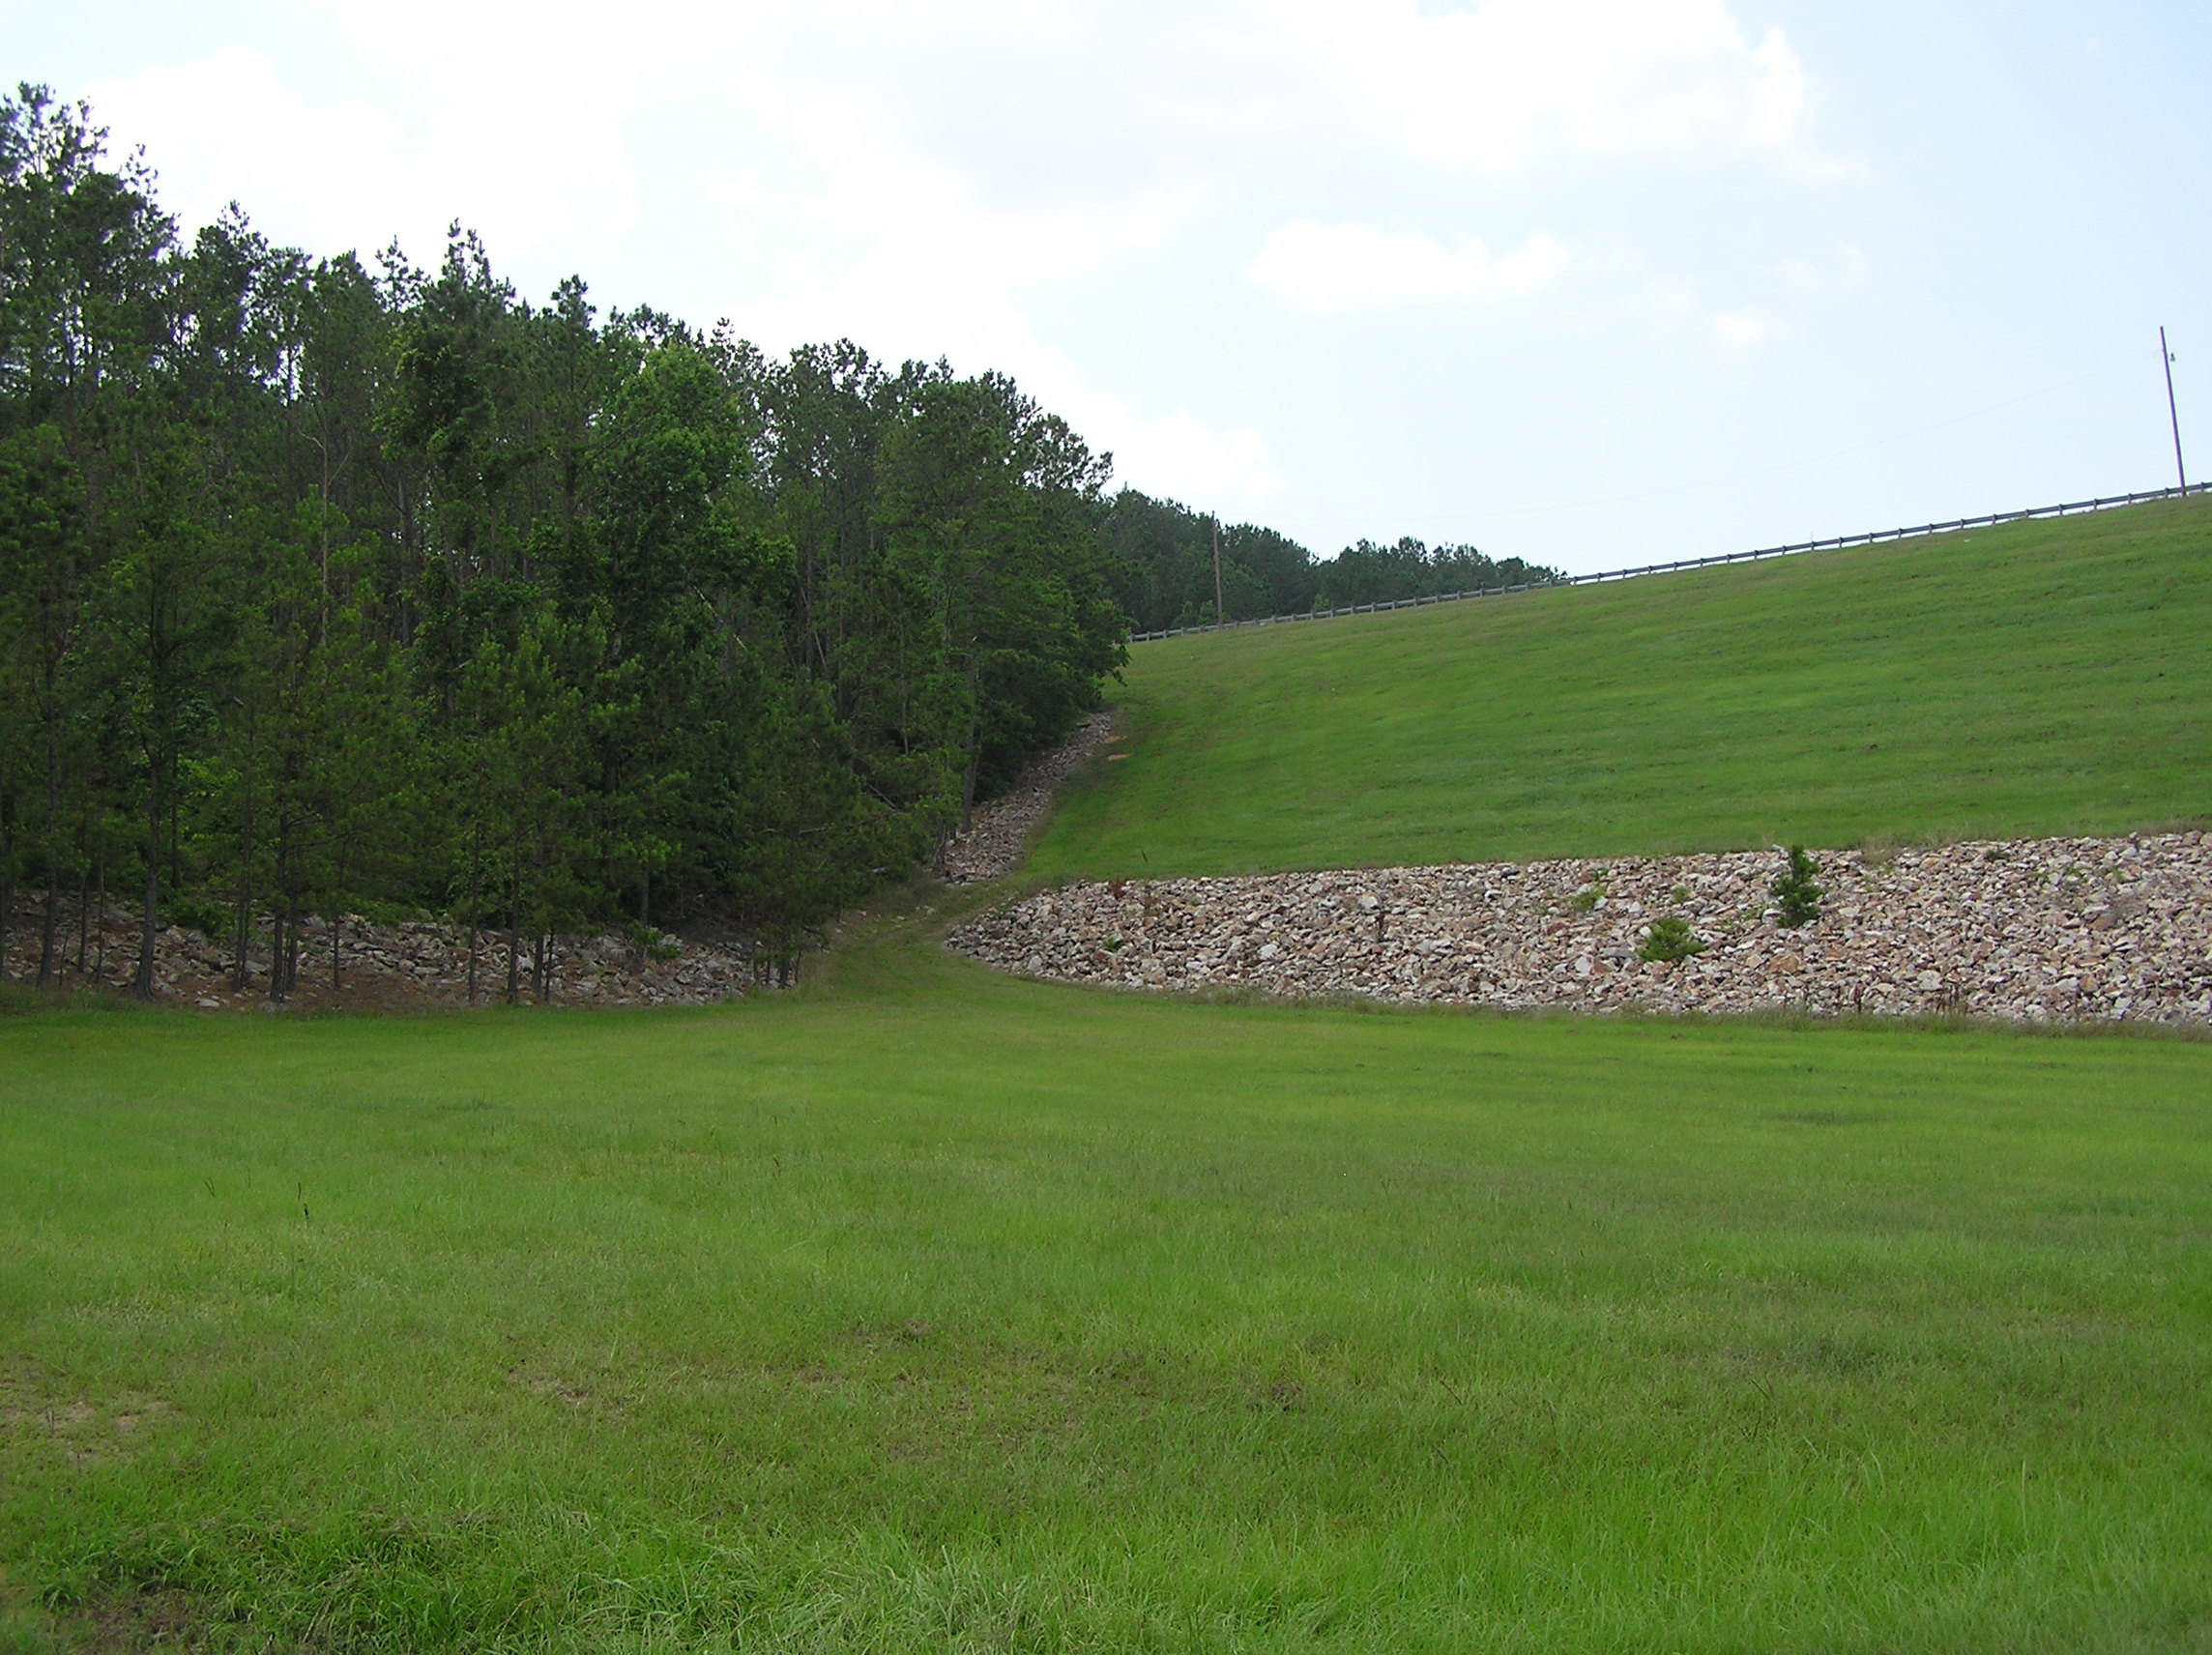
Sam Rayburn Dam, TX
Downstream Right Groin Looking Upstream

Slide 34
Dam Terminology
Classification
Parts of a Dam
Seepage Control Measures
Instrumentation
Flood Control Dams
Issues Leading to Dam Failure
Risk Terminology

Slide 35
Underseepage Control Measures
  Core or cutoff trench
  Cutoff wall
  Slurry wall (remedial action)
  Grout curtain
  Berm
  Impervious blanket
  Relief well

Slide 36
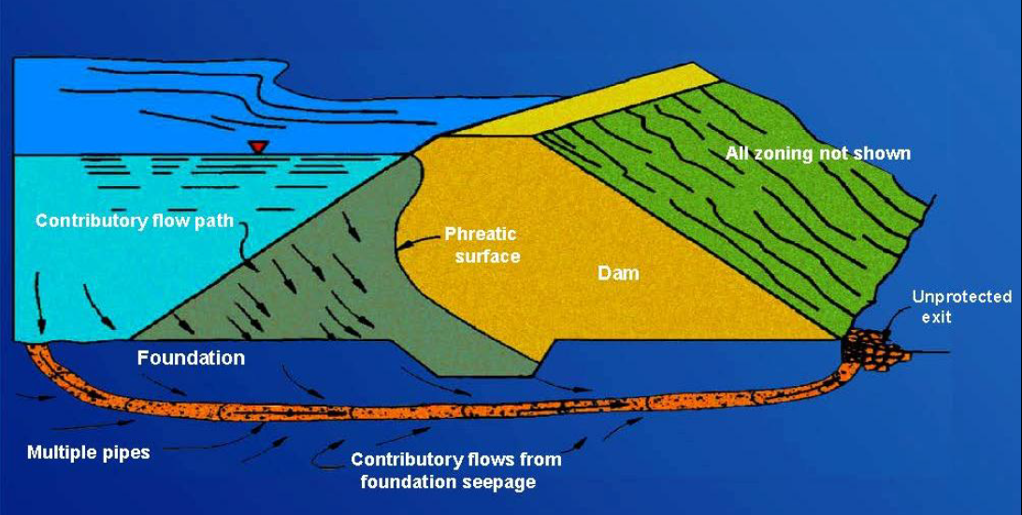
Internal Erosion Through Foundation

Slide 37
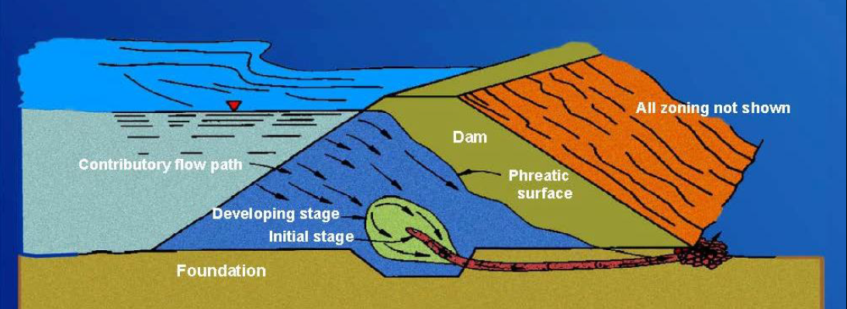
Internal Erosion of Embankment Through Foundation

Slide 38
Core Trench
Core Trench
Notes:
Impervious Core

Slide 39
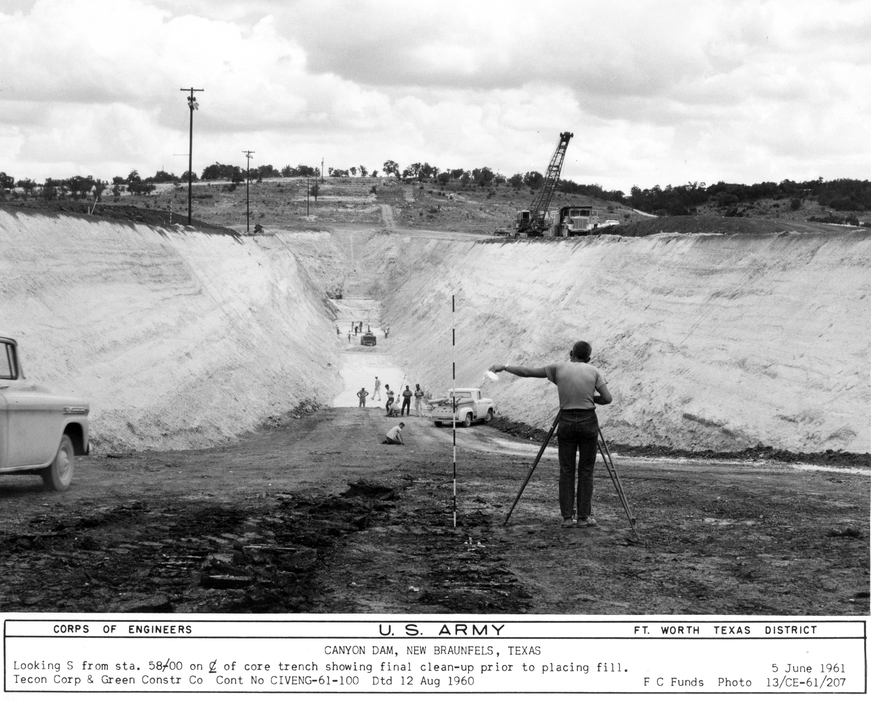
Canyon Dam
Core Trench

Slide 40
Cutoff Wall
Cutoff Wall

Slide 41
Slurry Trench
Slurry Trench

Slide 42
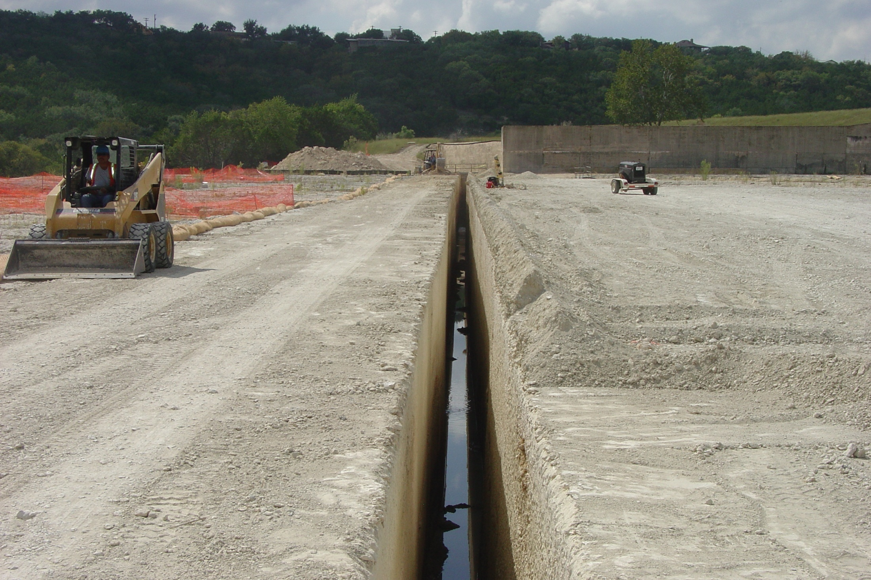
Canyon Dam
Spillway Cutoff Wall
Spillway Head-Cut Repairs – 20 September 2006

Slide 43
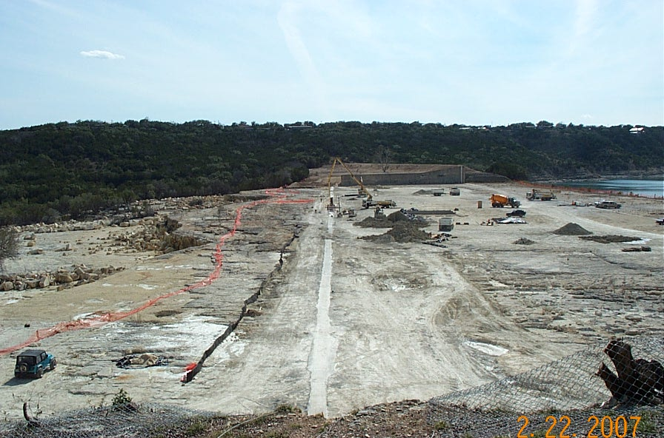
Canyon Spillway Head-Cut and Cutoff Wall Looking Left (after construction)
43

Slide 44
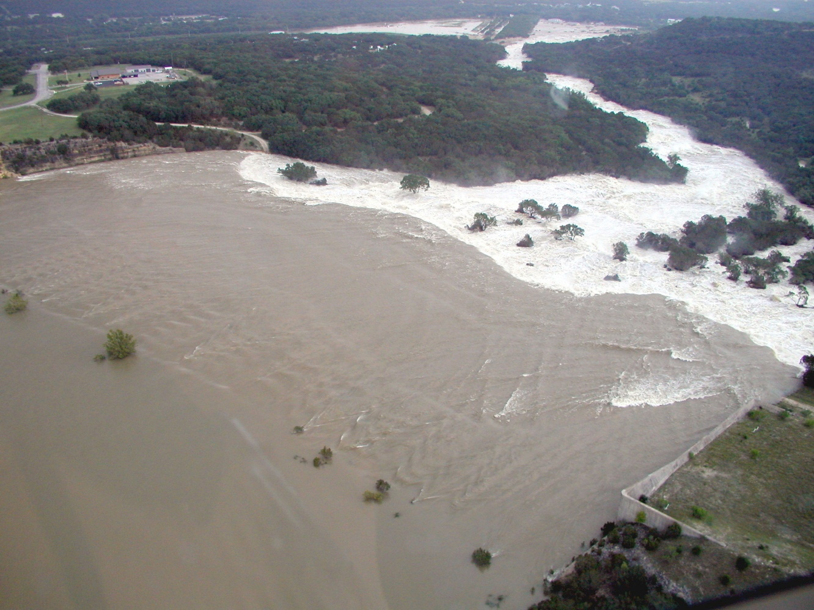
Bridge Washed Out
Project Building
Canyon Dam Spillway During 2002 Flood Event

Slide 45
Grout Curtain
Direction of Flow
Grout Curtain

Slide 46
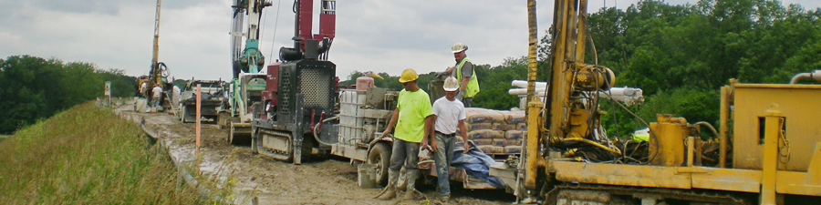
Grout Curtain
Grout Curtain

Slide 47
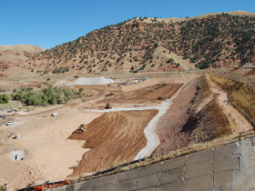
Berm
Berm
  Provides stability
  Increases length of seepage path

Slide 48
Uncontrolled Seepage
Uncontrolled Seepage
Clay Dam
Top Stratum
Pervious Sand Stratum
Bedrock

Slide 49
Seepage Control With/Berm
Seepage Control w/Berm
Clay Dam
Berm
Top Stratum
Pervious Sand Stratum
Bedrock

Slide 50
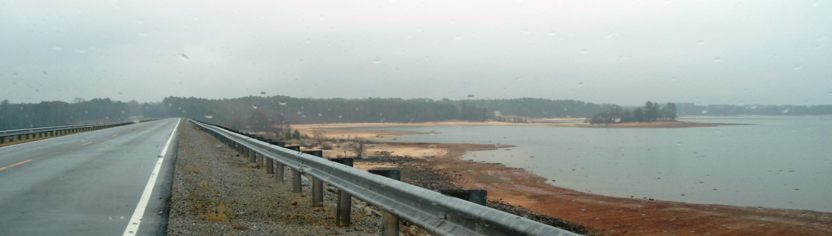
Impervious Blanket
Increases length of seepage path
Impervious blanket

Slide 51
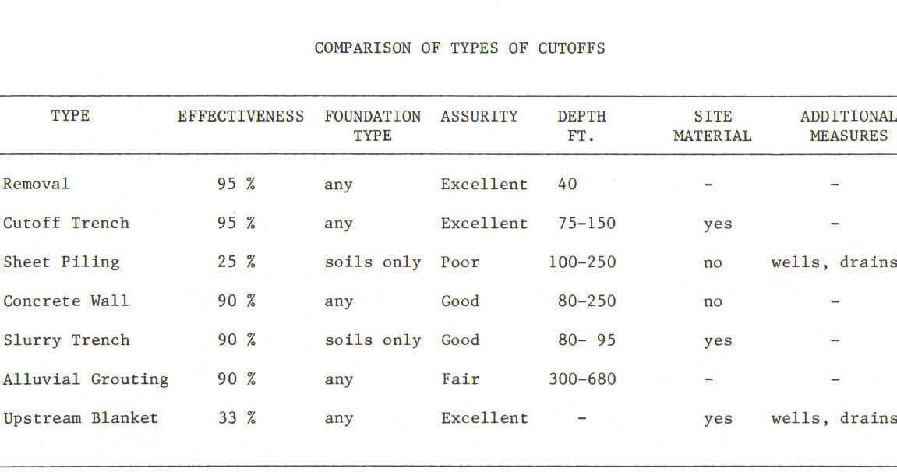
Cutoff Type Comparison

Slide 52
Relief Wells
Relief Well

Slide 53



Relief Well Typical Installation
Ground Surface
Concrete Seal
36-Inch Access
Manhole
Soil 1
Well Riser
Well Screen
Soil 2
Gravel Pack
24-Inch Diameter Boring
Bottom of Casing

Slide 54
Relief Wells
Uplift Pressure Without
Relief Well
Uplift Pressure With
Relief Well
Tailwater
Impervious Layer
Pervious Layer
Relief Well
Rock

Slide 55
Seepage Control With Berm & Relief Wells
Seepage Control w/Berm & Relief Wells
Relief Well
Clay Dam
Berm
Top Stratum
Pervious Sand Stratum
Bedrock

Slide 56
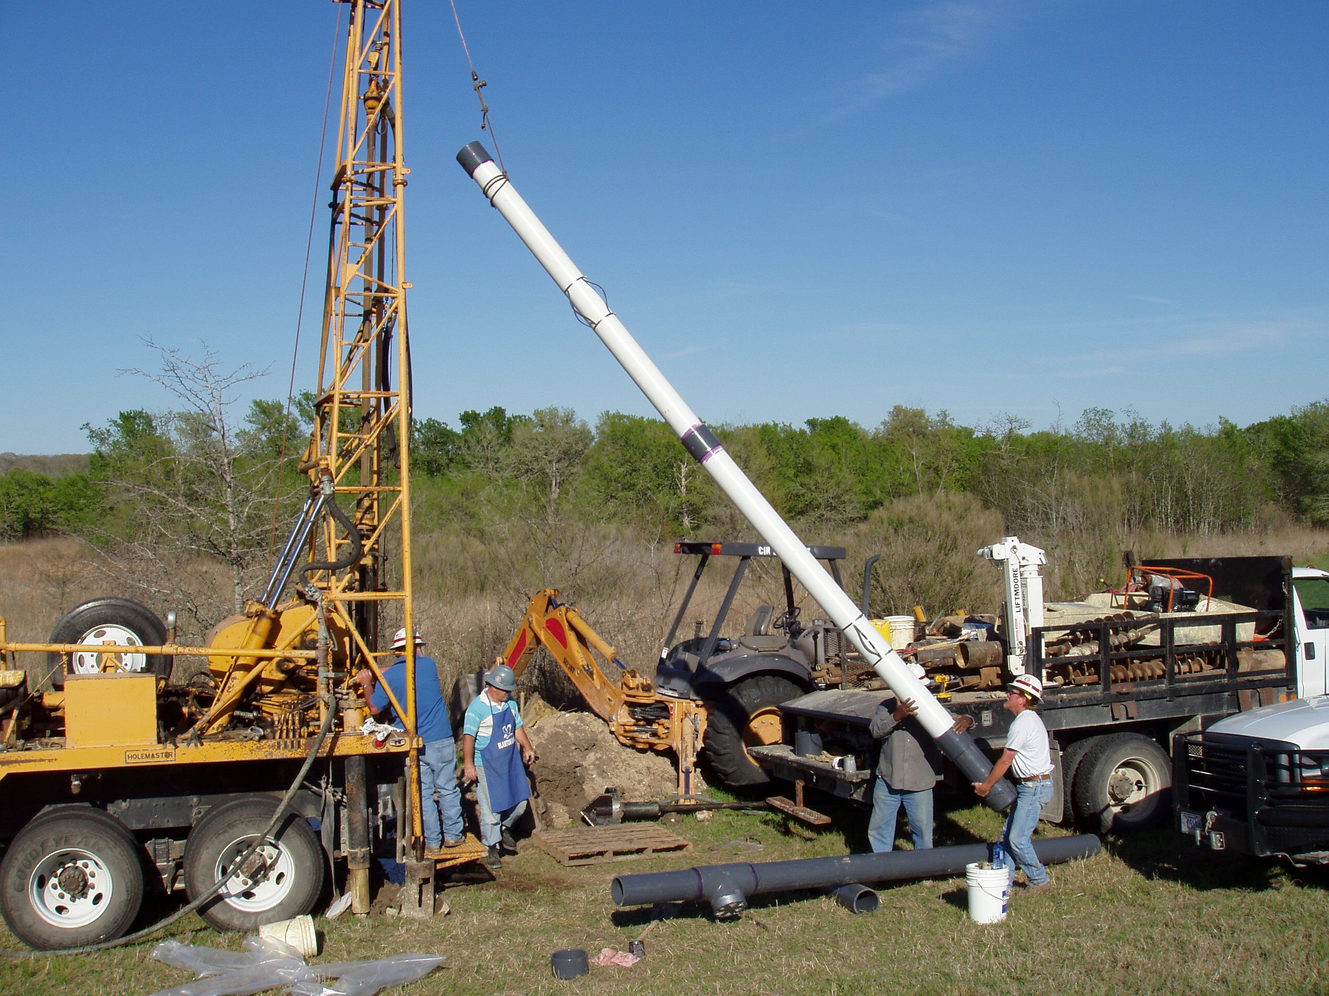
Somerville Dam
Relief Well Installation

Slide 57
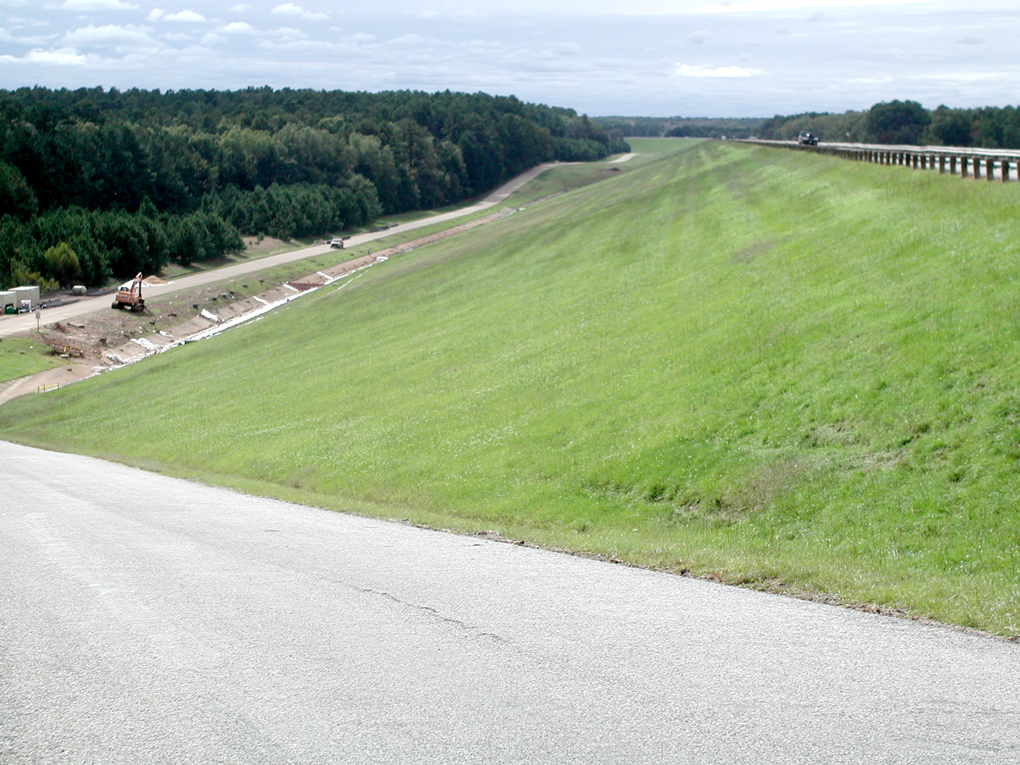
Ferrells Bridge Dam
Relief Wells Along Toe Looking Right

Slide 58
Through Seepage Control Measures
  Impervious zone including core of dam
  Blanket Drains
  Chimney Drains
  Filters
  Toe Drains
  Strip Drains and Abutment Drains

Slide 59
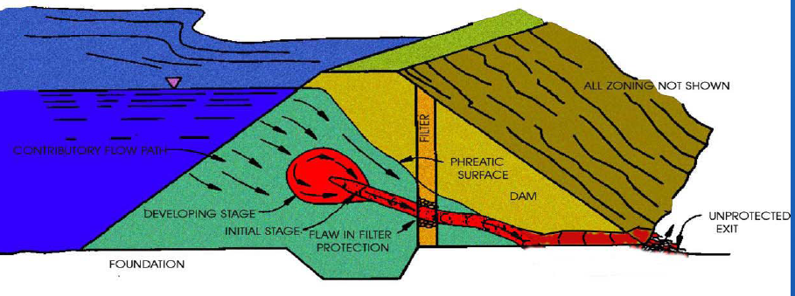
Through Seepage Control

Slide 60
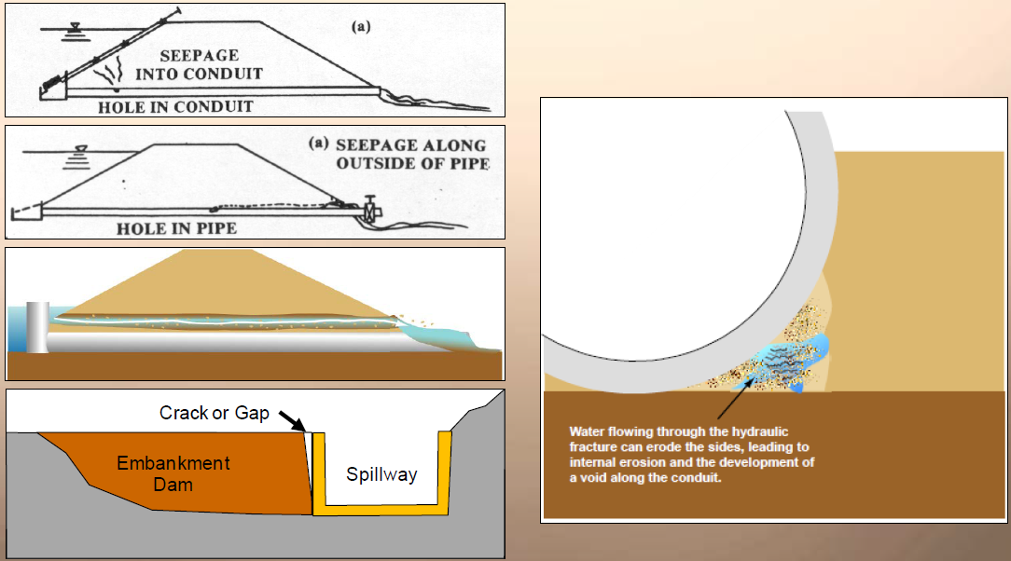
Internal Erosion Into/Along Structures

Slide 61
Seepage Line Through Embankment
Phreatic Surface

Slide 62
Drain
Purpose of a drain
  Collect water.
  Focus location for drainage.
  Take water away from critical area of dam in a safe manner.

Slide 63
Blanket Drain
Blanket Drain
Notes:
Phreatic Surface

Slide 64
Chimney Drain
Chimney Drain

Slide 65
Impervious Core
Impervious Core

Slide 66
Filter
Filter

Slide 67
Transition Zones (Filters)
Transition Zones
(Filters)

Slide 68
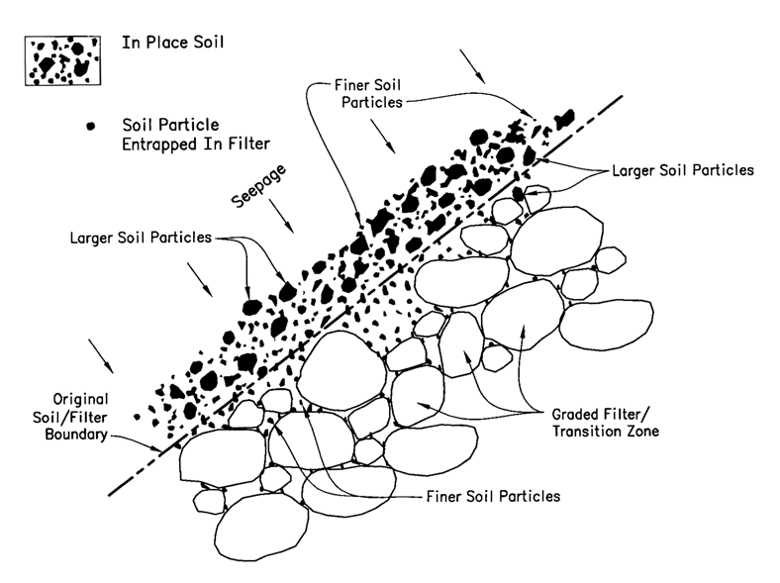
Prevention of Piping by Filters

Slide 69
Toe Drain
Toe Drain

Slide 70
Strip Drain
Continuous
Strip Drain

Slide 71
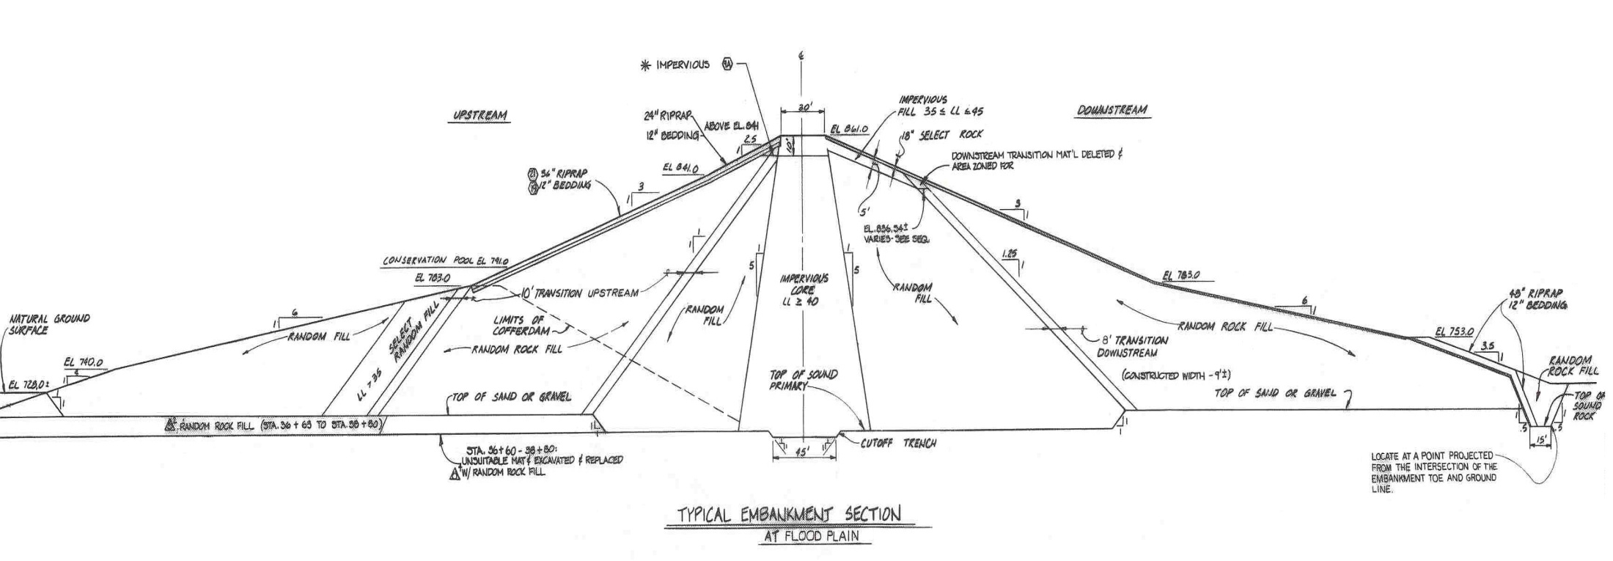
North San Gabriel Dam
Earth and Rockfill Zoned Embankment

Slide 72
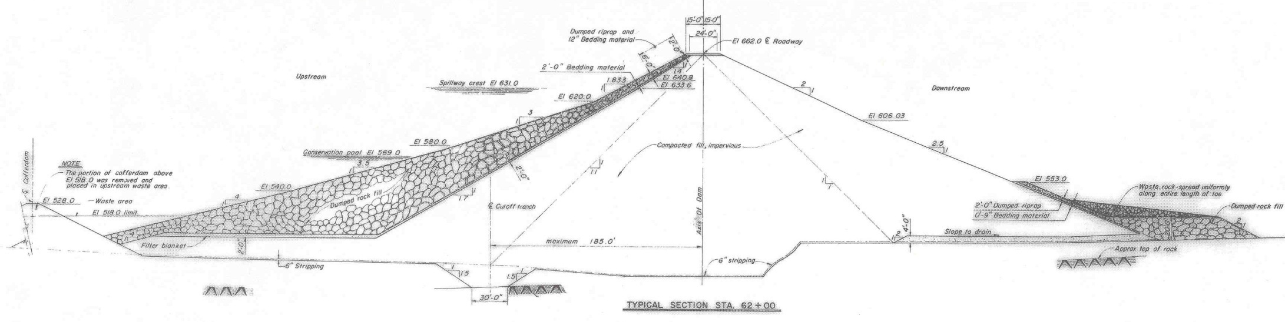
Belton Dam
Earthfill Embankment with Upstream Rockfill Zone
Cutoff Trench
Drainage Blanket

Slide 73
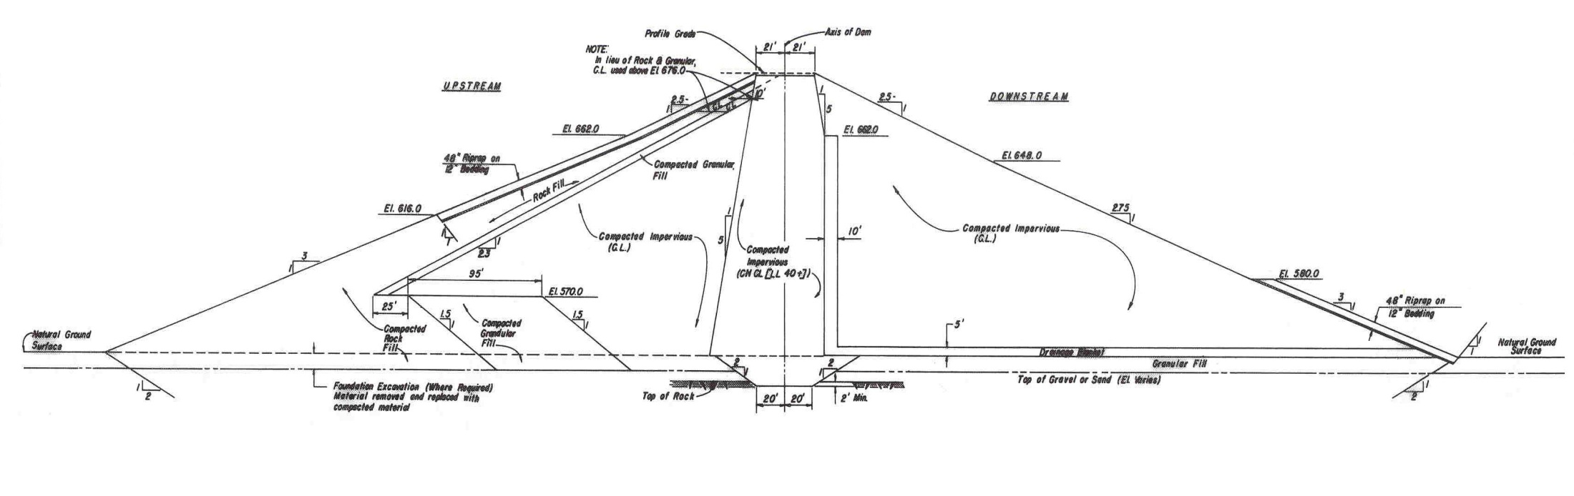
Stillhouse Hollow Dam
Earthfill Zoned Embankment

Slide 74
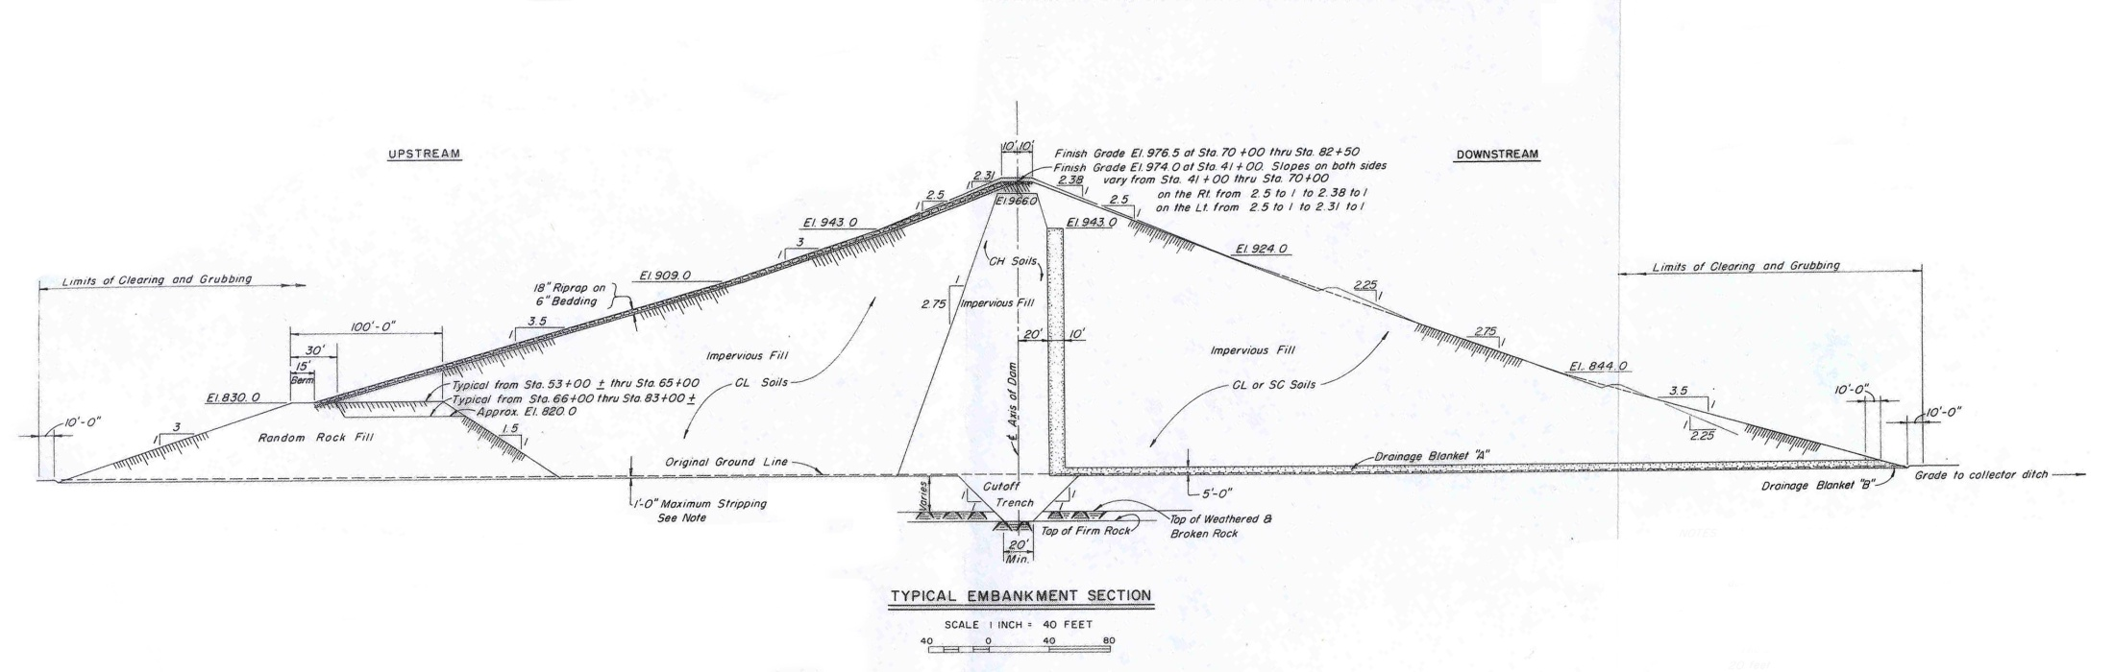
Canyon Dam
Earthfill Zoned Embankment

Slide 75
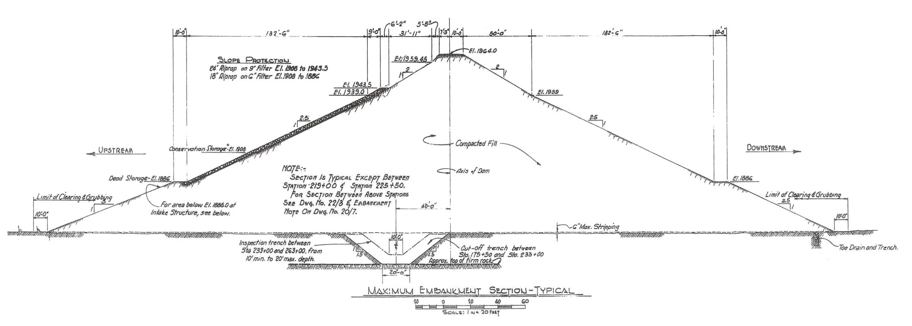
O.C. Fisher Dam
Homogeneous Embankment

Slide 76
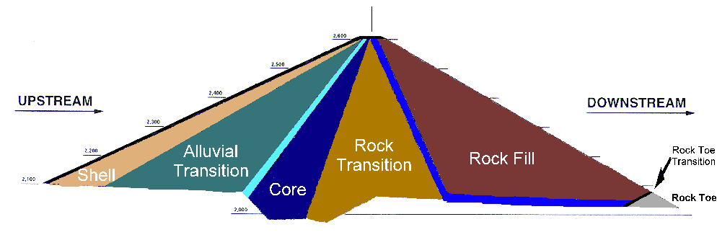
Embankment Components
Seven Oaks Dam
Notes:
Slide – Cross-section of Seven Oaks Dam
Shows that dams can have various zones with Many Different Materials. Having different material could be difficult because you have to ship/bring in material.
Dams can also be made of one material – designed of waterproof material – this is called a HOMOGENEOUS section
CORE – Area designed to stop the water. Call an impervious zone.
Should water get past the core area then Filter and Drains (next section) can be used to take the water away.
Shell – provide protection and support to the impervious core
Upstream pervious zone afford stability against rapid drawdown
Downstream zone act as a drain to control the line of seepage

Slide 77
Dam Terminology
Classification
Parts of a Dam
Seepage Control Measures
Instrumentation
Features of a Dam
Issues Leading to Dam Failure
Risk Terminology

Slide 78
Instrumentation
  Piezometers
  Weirs
  Survey points
  Settlement plates
  Inclinometers
  Crack and joint measuring devices

Slide 79
Purpose of Instrumentation
Provide data for evaluating the performance of a structure and detecting problems at an early and preventable stage.
Provide data to allow the comparison of actual and predicted behavior.
Effective instrumentation, proper monitoring, and timely evaluation are valuable for determining the performance of a dam.

Slide 80
Piezometers
  Determine water pressure at specific points.
  Locate the phreatic surface associated with seepage
  Open-System
  Closed-System. Pneumatic or vibrating-wire
  Can be automated.

Slide 81
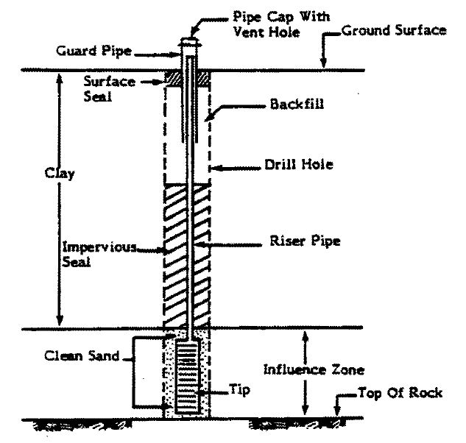
Typical Open-System Piezometer

Slide 82
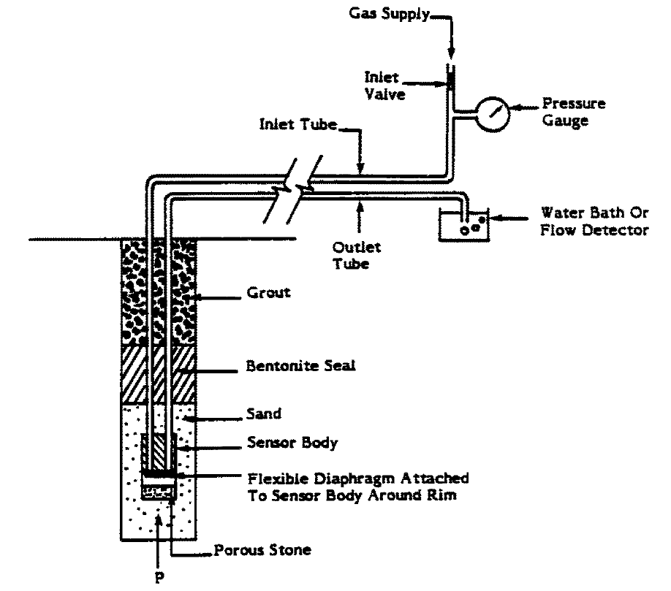
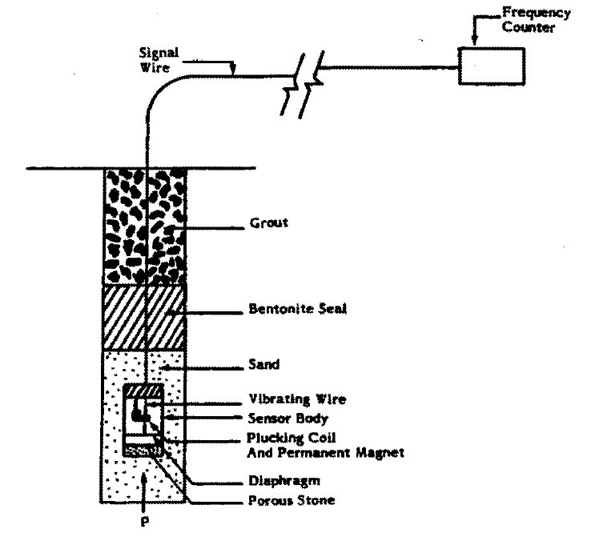
Typical Closed-System Piezometers
Pneumatic
Vibrating-Wire

Slide 83
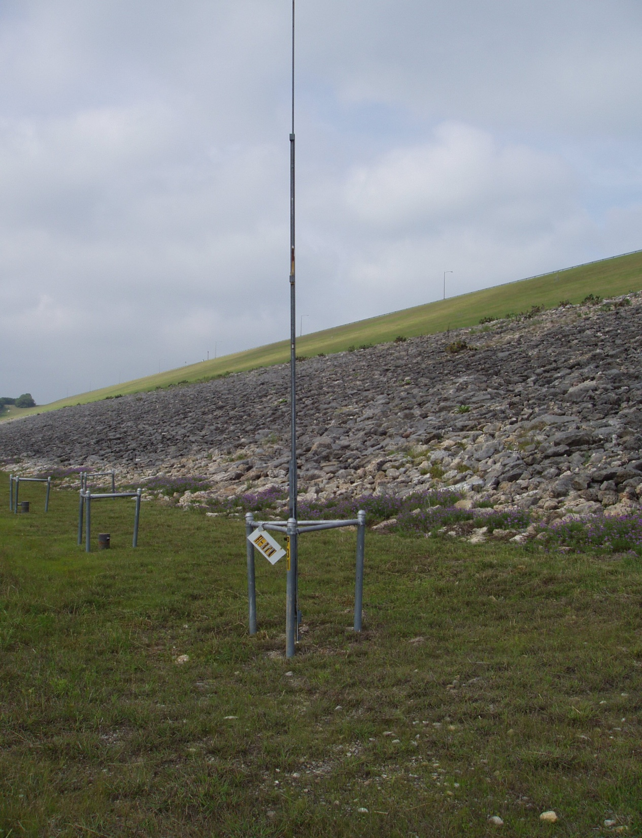
Stillhouse Hollow Dam
Piezometer with 22-foot Riser

Slide 84
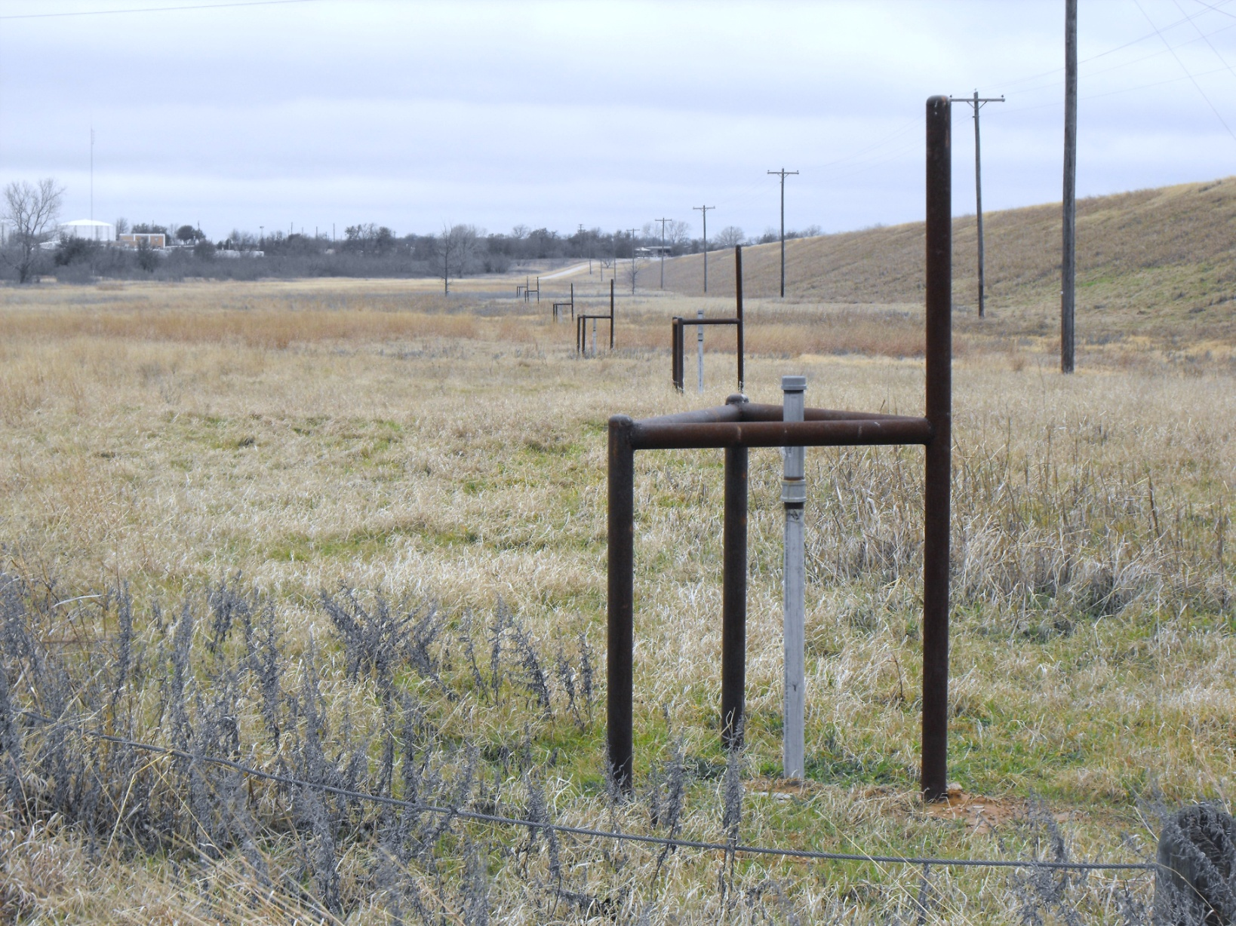
Proctor Dam
Piezometers Along/Beyond Toe Looking Right

Slide 85
Weirs
  Devices used for measuring seepage.
  Placed at the end point of a drain system where all the water is collected and measured.
  Usually built with sediment trap to quantify any soil migration as a result of piping.

Slide 86
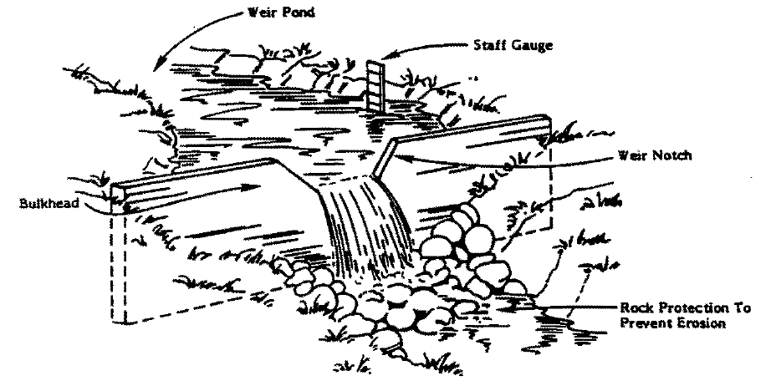
V-Notch Weir

Slide 87
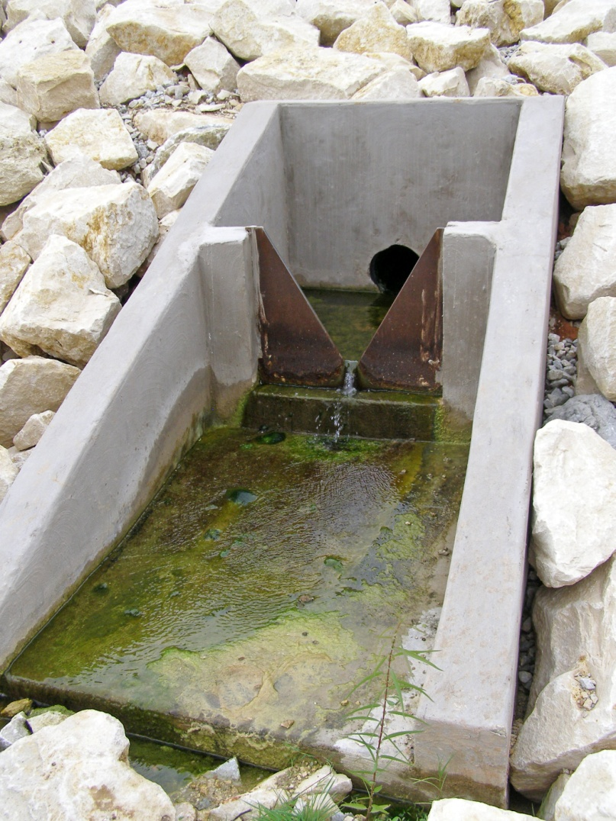
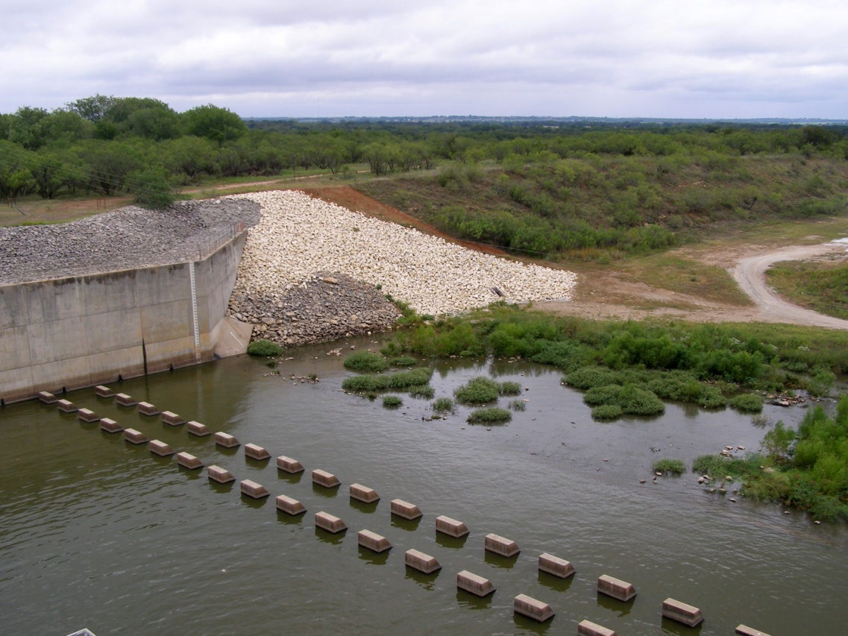
Proctor Dam, TX
Weir on Left Bank Downstream of Spillway

Slide 88
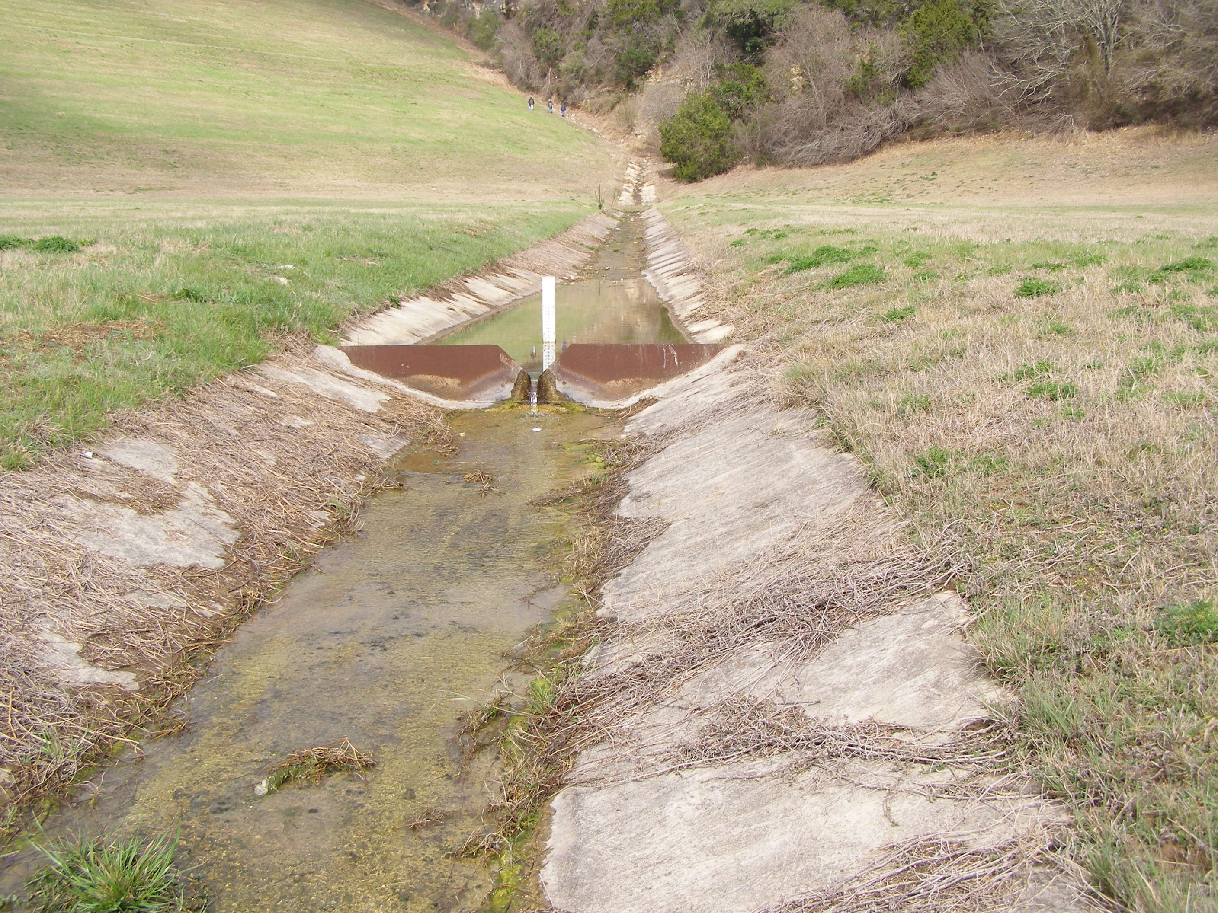
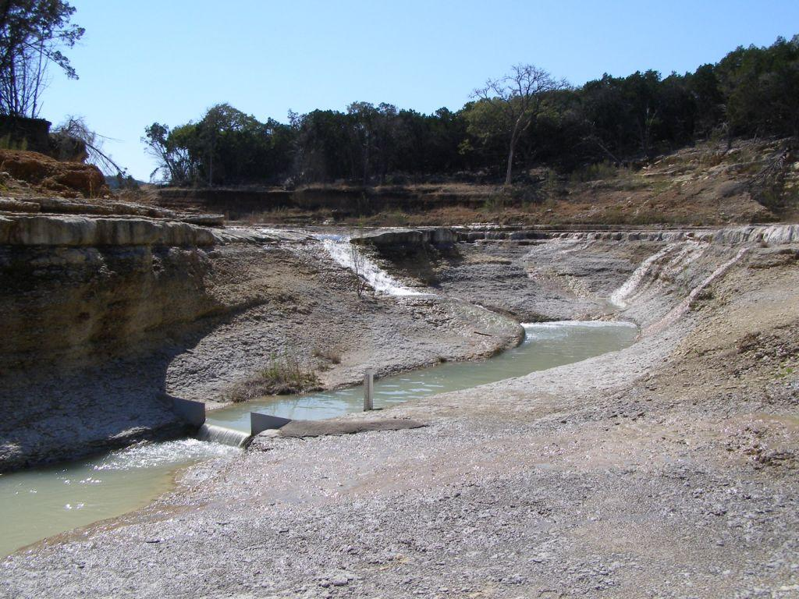
Canyon Dam
Rectangular- and V-Notch Weirs

Slide 89
Survey Points
  Monitor both vertical and horizontal movements on the dam, the abutments, or on appurtenant structures such as spillways and outlet works.
  Referenced to fixed points off the dam in order to detect absolute movements of the dam.

Slide 90


Survey Points
Survey Point on Embankment Dam
Survey Point on Concrete Dam

Slide 91

Canyon Dam
Survey Point Readings Along Dam Axis
Virtually no movement has been recorded in the last few surveys. However, there is a dip of 1.8’ between Stations 70+00 and 77+00.

Slide 92
Settlement Plates
  Measure the settlement in the foundation beneath a dam.
  Placed at top of foundation prior to placing fill.

Slide 93

Settlement Plate

Slide 94

Canyon Dam
Settlement Plate Readings
SP-E2 settled the most since 1963 (4.94’ but only 0.28” since last PI).

Slide 95
Inclinometers
  Monitor horizontal movements with depth on abutments, foundations or embankments.
  Measure internal movement along two horizontal axes perpendicular to each other at different levels within a vertical hole.

Slide 96


Inclinometer Parts

Slide 97


Inclinometer Parts

Slide 98


Inclinometer Plots
Shear Zone in an Embankment
Horizontal Movement vs. Depth

Slide 99
Crack/Joint Measuring Devices
  Measure relative movement between intact masses on either side of a crack or joint of a concrete structure or conduit.

Slide 100


Crack/Joint Measuring Devices
Tape Measure and Straight Edge
“L” Shaped Gage

Slide 101
Dam Terminology
Classification
Parts of a Dam
Seepage Control Measures
Instrumentation
Features of a Dam
Issues Leading to Dam Failure
Risk Terminology

Slide 102
Features of a Dam
Dam
Reservoir
Spillway
Outlet works
Control facility
Penstocks
Generators
Switch yard

Slide 103

Typical Concrete Dam

Slide 104
Whitney Dam
Project Features
Main Embankment
Spillway
Hydropower

Slide 105

Tainter Gate
Whitney Dam
Powerhouse Looking Upstream

Slide 106

Whitney Dam
Switchyard and Powerhouse Plaza Looking Right

Slide 107
Typical Embankment Dam Features

Slide 108

Reservoir Rim
Saddle Dike
Outlet Works
Spillway
Lake Office
Embankment
Canyon Dam Main Features

Slide 109
Intentional Water Releases
Outlet Works
Spillway

Slide 110
Distinguishing Outlet Works From Spillways
No definite dividing line can be drawn between outlet works and spillways because both release water.
In general, a pressurized, gate- or valve-controlled conduit that carries water through a dam is considered an outlet works rather than a spillway.
Spillways and outlet works may share many features, and can even be combined into one structure.
Small embankment dams often have only a conduit through the dam for passing water.
On large dams, a combined structure may have separate outlet works and spillway portions, with each portion having separate means of intake and control.

Slide 111
Outlet Works
  Discharge water from the intake structure.
  Dissipate energy of water discharged from the impoundment.
  Conduct releases to river channel or other water course.
  Connected to intake structure by conduit or tunnel.
  Allow continuous flow of water from reservoirs, and provide a way to draw down the water level of a reservoir.

Slide 112
Outlet Works Components
  Entrance Channel. Conveys water from the reservoir to the intake structure.
  Intake Structure. Serves as an entrance to an outlet works.
  Gate or Valve Housing. Supports or encases a gate or valve which regulates outlet works releases.
  Conduit. Conveys water through or around a dam.
  Energy Dissipation Section. Reduces the energy and velocity of the flowing water.
  Return Channel. Conveys discharges to the natural stream channel downstream from the dam.

Slide 113

Outlet Works Components

Slide 114

Intake Structure
What is the intake structure used for?
  Control pool level
  Controlled passage of water through the dam
North San Gabriel Dam
Outlet Works Intake Tower and Service Bridge

Slide 115

O.C. Fisher Dam
Intake Tower and Service Bridge

Slide 116

Aquilla Dam
Intake Tower and Service Bridge

Slide 117

O.C. Fisher Dam
Stilling Basin and Discharge Channel

Slide 118

Waco Dam
Stilling Basin and Discharge Channel

Slide 119

Waco Dam
Stilling Basin and Discharge Channel

Slide 120


Waco Dam
Conduit and Stilling Basin

Slide 121

Canyon Dam
Conduit Looking Upstream

Slide 122

Canyon Dam
Conduit Looking Upstream

Slide 123
Spillway
Passes normal and/or flood water in a manner that protects the structural integrity of a dam.
  Designed to release the maximum flood volume safely from the reservoir and prevent the dam from overtopping.
  Prevents head-cutting in outlet channel and loss of the impoundment.
  Can be on-site or off-site; controlled or uncontrolled.
  It is a vital dam safety feature.

Slide 124
Spillway Components
Entrance Channel. Conveys water from the reservoir to the control section.
Control Section. Regulates volume of releases.
Water Conveyance. Conveys flows from the control section over, through, or around the dam. May be a channel, conduit, or tunnel.
Energy Dissipation Section. Reduces the energy and velocity of the flowing water.
Return Channel. Conveys discharges to the natural stream channel downstream from the dam.

Slide 125

Spillway Components

Slide 126
Gated Flood Control Dam
Max pool
Pool of record
Conservation pool
Spillway crest
Dam height
tailwater
foundation

Slide 127

Proctor Dam
Tainter Gates and Stilling Basin Looking Left

Slide 128

Waco Dam
Tainter Gates and Stilling Basin Looking Upstream and Left

Slide 129
Ungated Flood Control Dam
Spillway crest
Untested zone
Flood control
storage
Pool of record
Dam height
B
Conservation pool
A
Tailwater
foundation

Slide 130

O.C. Fisher Dam
Concrete-Lined Spillway Weir and Stilling Basin

Slide 131

Aquilla Dam
Unlined Spillway and Sill
Flow

Slide 132
Dam Terminology
Classification
Parts of a Dam
Seepage Control Measures
Instrumentation
Features of a Dam
Issues Leading to Dam Failure
Risk Terminology

Slide 133
Unintentional Release of Water
Breach
  Overtopping
  Seepage/Piping
  Structural Failure
Misoperation

Slide 134

Issues Leading to Dam Failure
Courtesy of Association of State Dam Safety Officials
Notes:
Most common causes of dam failures:
Overtopping
Structural failure
Stability failure
Cracking
Poor maintenance
Piping

Slide 135

Overtopping
Notes:
Most common causes of dam failures:
Overtopping
Structural failure
Stability failure
Cracking
Poor maintenance
Piping

Slide 136

Overtopping
Notes:
Most common causes of dam failures:
Overtopping
Structural failure
Stability failure
Cracking
Poor maintenance
Piping

Slide 137

Structural Failure
Notes:
Structural failure of the materials used in dam construction is a common cause of dam failure. As shown here, failure of a spillway side wall will obstruct flow and cause washing out of a dam.
Walls of a spillway – Upheaval of the spillway floor.
________
SF of various parts of the spillway or various parts of the outlet structure can cause failure of a dam through a breach.

Slide 138


Stability Failure
View of Upstream Slide in Fujinuma Auxiliary Dam from Auxiliary Dam Right Abutment
View of Upstream Slide in Fujinuma Auxiliary Dam from Left Abutment

Slide 139


Cracks in Embankments
Before
After

Slide 140

Inadequate Maintenance
Notes:
Planting trees or allowing trees to grow on a dam is a dangerous practice, since trees may be blown over at the roots, forming a hole in the dam. Their root systems also encourage piping through the dam, as well as wildlife damage. Brush growth on a dam can conceal holes or other defects in the dam, and also invites wildlife, which may burrow into the embankment.
__________
Regardless of the cause of the dam failure the most common cause of whatever it is inadequate maintenance. Allowing trees to grow on the dam is not a good practice. They form holes and roots and when the trees die the stumps and roots die leaving holes in the dam. They can encourage PIPING and SEEPAGE through the dam they attract wildlife, dig hole in the dam and it makes the dam extremely hard to inspect, to know what is going on

Slide 141


Vegetation should not interfere with instrumentation!

Slide 142


Vegetation is too near these structures!

Slide 143



Root penetration in slopes and embankments may trigger failures!

Slide 144

Seepage/Piping
Notes:
Piping – The progressive development of internal erosion by seepage.
This picture illustrates one reason for keeping dams clear of trees. Roots within a dam often lead to uncontrolled seepage, which results in piping, the progressive development of internal erosion through an embankment.
Shows one of the most common mode of failure in dams, PIPING erosion which is progressing at such a rate that it is able to take part of the dam material with it
If it continues long enough piping will progress upstream resulting in an open tunnel completely through the embankment. PIPING can occur through the embankment or through the foundation of the dam.
Piping & seepage accounts for 20% of national dam failures. This includes internal erosion caused by seepage, seepage and erosion along hydraulic structures, leakage through animal burrows and cracks in the dam.

Slide 145
Dam Terminology
Classification
Parts of a Dam
Seepage Control Measures
Instrumentation
Features of a Dam
Issues Leading to Dam Failure
Risk Terminology

Slide 146
Potential Failure Mode
Potential Failure Mode – A way that failure can occur. Determined by which element or component failures must occur to cause loss of a system or subsystem that could result in a dam failure.
Potential Failure Mode Analysis (PFMA) – A determination of all of the ways that a dam might fail; conducted by a multi-disciplinary team of people. Team reviews all data and seek to quantify risk associated with the structure.

Slide 147
Risk Assessment
Many fancy methods used to evaluate how much risk a dam poses to various stakeholders, including the downstream population.
Usually done by groups of risk-experienced folks with all the relevant data they can get.
Provides the basis for informed decisions about courses of action for dams that are so evaluated.

Slide 148
Dam Safety Classification System (DSAC)
A relative classification of how safe or unsafe a dam is in accordance with consistent and systematic guidelines to address dam safety issues and deficiencies outlined on the DSAC Chart.
  DSAC I
  DSAC II
  DSAC III
  DSAC IV
  DSAC V

Slide 149


Slide 150
Issue Evaluation Study
Used to determine the nature and degree of urgency of dam safety concerns.
A more detailed risk assessment than used in SPRA that will enable informed decisions about further investigations.
Level of detail is that need to justify the decision to pursue or not pursue a DSMS.

Slide 151
Interim Risk Reduction Measures
(IRRMs)
Temporary measures to make your unsafe dam more safe or reduce the risk it imposes.
Examples:
  Pool Restriction
  Increased surveillance and instrumentation
  Monitoring
  Public awareness program

Slide 152
Periodic Assessment
A combination of periodic inspection, potential failure modes analysis, and risk assessment with minimum consequence data.
Used to confirm DSAC classification, justify IRRMs, provide input for risk education measures, and determine need and priority for an IES.
Confirm that the USACE dam safety guidelines are being met.

Slide 153
Acceptable Risks
Risks that people know about and are prepared to accept.
Insignificant and adequately controlled and no further action is required to reduce them.
Examples:
  Having electrical service in your home
  Riding in a modern elevator
  Using power tools or a modern lawn mower

Slide 154
Tolerable Risks
Risks that people will accept to obtain given benefits, provided the risk is known and adequately controlled.
NOT IGNORED but periodically reviewed and reduced as practicable.
Examples:
  Flying in a passenger airliner
  Driving an automobile
  Living by the seashore

Slide 155
Tolerable Risk Guidelines
Used in Risk Management to judge the significance of how risky your dam has turned out to be.
Tolerable Risk Guidelines input to the risk management decision process along with all other considerations.
Meeting Tolerable Risk Guidelines is what we want!!

Slide 156
First USACE Dam Safety Workshop
Thank You!
Muito Obrigado!

