Slide 1
Interim Risk Reduction Measures
José Hernández, P.E.
Regional Geotechnical Engineer
U.S. Army Corps of Engineers
South Atlantic Division
Jose.Hernandez@usace.army.mil
Dam Safety Workshop
Brasília, Brazil
20-24 May 2013

Slide 2
Objective
(1) IRRMs are a short-term approach to reduce Dam Safety risks while long-term solutions are being pursued.
(2) IRRMs should lower the probability of failure and associated consequences to the maximum extent reasonably.
IRRMs include and align with USACE’s Dam Safety Risk Policy
Risk Assessment
Analytically based
Risk Management
Policy and preference
based
Tolerable
Risk
Guidelines
Risk Communication
Interactive exchange of information, opinions,
and preferences concerning risks
Notes:
Interim Risk Reduction Measures are meant to be expedient actions to reduce dam safety risk.
They are not to be considered the final long term solution for a dam deficiency.
Although they are not the final solution the time frame for their application can extend to years while long term final solutions are pursued.
It might be that a final solution for a project is known but that there are other priorities for the existing funding.
The IRRM should lower the risk presented by a dam.

Slide 3
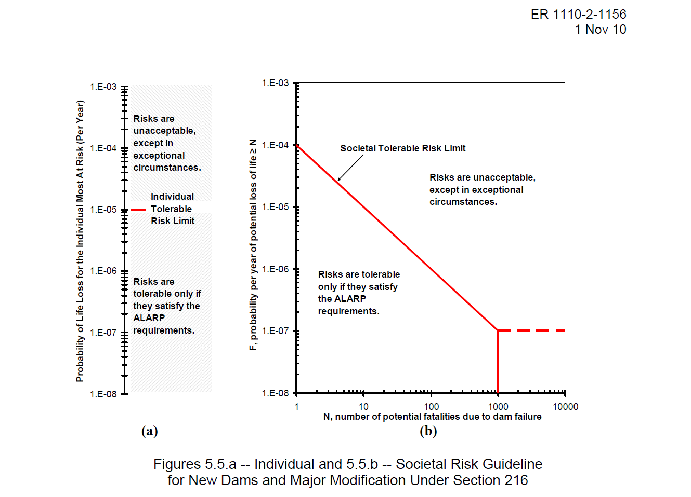
Risk Definition
Risk = Load Probability x Failure Probability Given a Specific Load x Consequences of Failure
Notes:
To reduce risk, you have to alter one of three things.
You can reduce the probability of a load occurring.
You can reduce the probability of the dam failing given a specified load.
You can reduce the consequences of the failure (in most cases life loss).
If you address structural failure modes only, it is possible to not change your risk from the project due to consequences downstream.
In many cases, it would be more effective from a cost and consequence standpoint to do non-structural alternatives for a lower cost, higher benefit result.

Slide 4
USACE Dam Safety Portfolio Risk Management Process
Develop
IRRMP
Modify IRRMP (if necessary)
Modify IRRMP (if necessary)

Slide 5
Generalized Risk Management Process
Screening Portfolio Risk Analysis (SPRA) FY05-09
Dams identified to have unacceptable risk, “Develop Interim Risk Reduction Measures Plan”
National queue for “Issue Evaluation Study (IES)”
Complete Dam Safety Modification Study (DSMS)
(if justified based on IES)

Slide 6
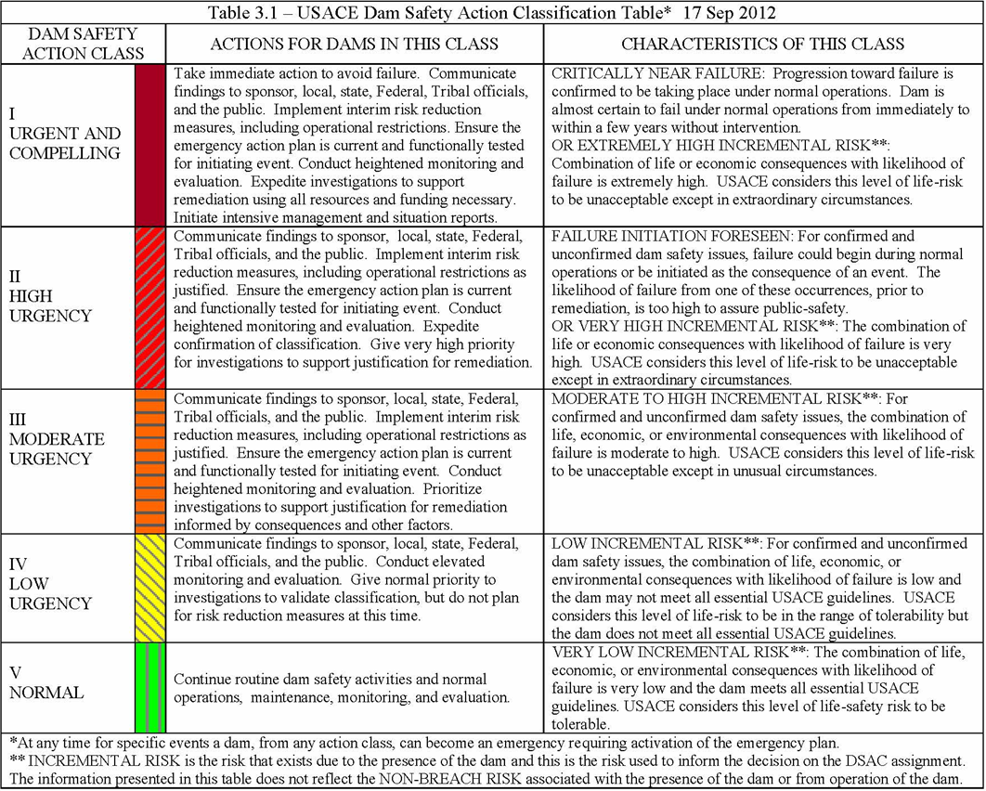
IRRMP
Required

Slide 7
Principles
It is not appropriate to refer to balancing or trading off public safety with other project benefits.
Instead, it is after public safety tolerable risk guidelines are met that other project purposes and objectives will be considered.
Notes:
In USACE Public Safety is paramount and the preeminent objective.
This means that consideration of the congressionally authorized purposes for the project are secondary to Life and Public Safety.
There is some balancing of priorities at these projects how much water to release, whether recreation is supportable etc.
But when Life and Public Safety are thrown into the mix they trump all other considerations.

Slide 8
Principles
The principle of “Do No Harm” should underpin all actions intended to reduce dam safety risk.
Applying this principle will ensure that proposed IRRM implementation would not result in the dam safety being compromised at any point in time or during IRRM implementation.
Notes:
You should apply an IRRM that will affect the existing condition of a dam and make the situation worse.
Or by increasing overall risk downstream – some items may increase overall risk downstream – early high releases, lowering spillway crests, etc.

Slide 9
Principles
Decisions are risk-informed and not risk-based.
Risk-informed decisions integrate traditional engineering analyses and judgment.
General public safety responsibility requires USACE to assure our projects are adequately safe from catastrophic failure that results in uncontrolled release of the water in the reservoir.
Notes:
USACE is an engineering organization with highly competent staff that are knowledgeable in all areas of dam safety. In this context, USACE uses risk assessments as one tool to inform decisions on dam safety.
Risk plus other information is used to assist USACE Decision makers prioritize and make decisions.
We no longer refer to risk-based decisions because of the inappropriate implication that life safety decisions can be reduced to simple, numerical solutions.

Slide 10
IRRMs
IRRMs should be tied to a documented area of concern or a potential failure mode.
IRRMs should not be a continued standard maintenance action, or following an established procedure.
IRRMs need to specifically state how a plan reduces the overall risk by decreasing loading, consequences or likelihood of failure.
A study by itself is not an IRRM, and does nothing to reduce risk. If a study is referenced in an IRRM, there needs to be information on how it is to be used to lower the risk.
Notes:
Give some examples:
If the only area of concern for a project is spillway erosion, or overtopping of the embankment, then installation of 20 piezometers along the toe of the embankment to measure seepage, or replacement of a outlet gate would not be justified as an IRRM.
Continued monitoring of the embankment in accordance of the operations manual, or mowing the grass when it gets over 12 inches would not be IRRM’s. These are supposed to be normal practice and fall under standard project O&M. There are exceptions to this though.

Slide 11
IRRMs
Non-Structural IRRMs are just as important as Structural IRRMs.
Local agencies and the public should be informed and have a chance to be involved or made aware of project decisions that could impact them.
Remember that the risk presented by a system can change because an IRRM is implemented, and it will not always go down.
Notes:
A non-structural IRRM such as public education in the floodway, changing system operations reduce downstream impacts, or increasing monitoring of the system during certain pool levels to allow earlier notification for intervention or evacuation can have larger impacts on the population at risk in the basin than even the most expensive structural fixes.
Another Non-Structural fix would be to keep the public and local governments/agencies aware of the projects existence, and inform them of area that would be impacted by project operations. For a new project, it could be cheaper to keep people from building in a spot, then it is to perform structural modifications to a project after it is in place and the risk goes up by people being present.
By keeping local regulatory agencies and the public informed about project operations or potential risk, local agencies or the public in general to know what actions are required if an emergency arises. When an emergency occurs, the local population would know who needs to evacuate, when they need to do it, and where they need to go.

Slide 12
IRRMs
Pool restrictions must be given serious consideration and explain why (very specific reasons) they are not being implemented.
Water Control Plans (WCPs) need to support IRRMs.
National Environmental Policy Act (NEPA) should be involved early and often in the process and should be discussed as part of the IRRM.
Notes:
Having the reasoning is important to allow what may trigger it to be considered in the future if conditions worsen – Also that a pool cannot be restricted below a specific elevation for all inflow events….
May want to consider making this an operational change and not just pool restrictions….
When a project is a DSAC I, a DSAC II or a DSAC III serious consideration must be given to restricting the pool; additionally, on these projects consideration of raising the pool levels for water reallocation should not be a consideration.
Water Management Plans need to complement the Interim Risk Reduction Measure Plans.
It is highly likely that restricting a project pool will have an impact on the environment either upstream or downstream.
Upstream because pools could be lower and affect the environment along the border of the pool.
Downstream we may require more water releases. The districts should be aware that they will need to prepare NEPA documentation…

Slide 13
IRRMs and WCPs
If the system operations change, pool restrictions are altered, or there are impacts up/downstream of the project outside of the project boundaries, the WCP may need to be revised or an Interim Operations Plan (IOP) should be developed.
IOPs can be used to supplement WCPs for guidance on system operations.
Having an IOP does not relieve the burden of updating the project’s WCP.
Notes:
The requirement to update the water control plan as part of the IRRMP documentation is provided in ER 1110-2-1156, Section 7.8.3.
As a rule of thumb, if an IOP is to be in place for longer than 3 years, it is a permanent change, and the Water Control Plan needs to be updated.
Changes to the Water Control Plan or temporary deviations through an IOP should be checked for NEPA compliance, and public notification.
If the system is operated in a manner that is not prescribed in the WCP, or the IOP the operator could personally liable for any damages due to the non authorized operations.

Slide 14
Overall IRRM Impacts
Consider changes to the overall project risk when developing an IRRM.
  Need to make sure that lowering the risk for a specific failure mode does not increase the overall risk of the project.
  Are you introducing new risk to the project by implementing a IRRM?
Notes:
When implementing an IRRM, are you doing anything to increase the risk in one area of the project while reducing risk in another.
Restricting a pool may reduce the risk of dam failure from seepage and piping, overtopping, etc. But if the restrictions result in large discharges downstream flooding residents and causing damage, this may not be acceptable. Or create more risk, then the risk presented by the seepage.
Conversely, restricting discharges downstream to prevent flooding for some events could increase the overall risk to the project due to higher pool elevations on a more frequent basis, and an increased hydraulic loading differential.
Both cases address potential risk, but increase risk in another form, or possibly increase the potential of failure from a different mode.

Slide 15
What is an IRRM?
IRRMs are not intended to be the process for permanently remediating dam safety concerns.
The following factors are used to determine if an IRRM is appropriate:
  Timely – Can it be implemented in a timely manner? If significant time and money is needed to investigate and design, it is not likely an IRRM.
  Cost effective – Is the cost within the threshold of a major maintenance (O&M funds) project? If it exceeds the threshold, it is not likely an IRRM.
  Risk – Does the measure reduce the overall risk to downstream public? IRRMs should not incur in new risk. Thus may need to do preliminary analysis as a check.

Slide 16
IRRM Plan (IRRMP) Guidance
Chapter 7, “Interim Risk Reduction Measures For Dam Safety,” and Appendices M and N in USACE ER 1110-2-1156, “Safety of Dams – Policy and Procedures”
To provide guidance and procedures for developing and implementing IRRMs required for all DSAC I, II and III
Funding for preparation and implementation of the IRRMP comes out from the O&M funds for the project
Notes:
USACE has an Engineering Circular 1110-2-6064 that describes the Interim Risk Reduction Measures Plans and provides a list of measures that can be considered for its dams.
Chapter 7 of the New dam safety guidance will address the Interim Risk Reduction Measures Plans. The guidance will be the same as that in the EC.
Interim Risk Reduction Measures plans are discussed in chapter 7 of the New Dam Safety Guidance.
The Chapter provides guidance on the implementation of the measures including guidance on when the interim risk reduction measure implementation should be accelerated.
The chapter also provides suggestions for evaluating the efficacy of the measures that are being proposed for a project.

Slide 17
IRRMP Basic Steps
Use existing project data (studies, analysis, performance data).
Use SPRA findings as a 1st cut on development of IRRM.
Follow-on with Potential Failure Mode Analysis (PFMA) to capture additional significant PFMs.
Refine IRRMP based on PFMA findings and new project data.
Ensure the Emergency Action Plan (EAP) is current.
Engage Public Affairs Officer (PAO) for Risk Communication Plan development.
Train and test internal staff and site personnel on IRRM strategy.
Functionally conduct an Emergency Exercise for an initiating event with state and local officials.

Slide 18
IRRMP Contents
Overall project description and purposes.
Overview of identified “risk-driver” potential failure modes; attach PFMA Report.
Summary of known consequences associated with each identified PFM to include: loss of life, economic and environmental damages .
List structural and non-structural IRRM alternatives considered to reduce the probability of failure and/or consequences associated with the failure modes.
Notes:
The full requirements are detailed in chapter 7, section 5. The requirements for the EAP coordination exercises are provided in chapter 16, and are based on the DSAC rating for the project. The Communications plan is discussed in Chapter 10.
When developing an IRRMP the district is supposed to use the most current information available. If a PFMA has been performed, that would supersede the SPRA analysis.

Slide 19
IRRMP Contents
For each considered IRRM, document general discussion of ability to reduce the likelihood of failure and associated consequences, potential impact on project purposes, environmental impacts, and economic impact to the region associated; both positive and negative.
Final IRRM recommendations to be implemented for each PFM.
Schedule to implement and cost to USACE (dam owner) and others (stakeholders) for each IRRM recommendation.

Slide 20
IRRMP Appendices
DQC/ATR comments and comment resolutions.
Updated EAP reflecting site-specific risks and emergency exercises for DSAC I, II, and III dams conducted in manners that are appropriate for the risk involved .
Risk Communication Plan (both internal and external).

Slide 21
IRRMPs
Are Living Documents. They should be revised…
  when conditions change
  new information is acquired
  studies are performed
  after completion of remediation phase
Should focus on “significant” risks when identified in a PFMA as part of a PA, IES, and DSMS.
Notes:
Do not need to consider every item mentioned in the SPRA document.
The Interim Risk Reduction Measures Plans is a living document.
Plans should be modified to address changes in the condition of the structure or even the knowledge of the structure that the districts have.
As the potential failure modes of a project are confirmed to be significant through the Periodic Assessment, Issue Evaluation Studies or the Dam Safety Modification Studies interim risk reduction measures should be developed to address them.

Slide 22
Potential Reasons for Rejection of IRRMPs
Inadequate consideration for pool restriction, or justification for no restriction
Automated early warning systems with automatic public notification
Pool releases based on rain forecasts
Inadequate description of consequences
Got Boils? Better have emergency stockpiles.
“Copy and Paste”
Waiting for studies . . .
Notes:
The use of an automatic system for monitoring that is connected to an alarm system is not recommended. Need some judgment and not a direct connection to the public here.
Pool restriction – if not recommended, state all that was considered and justify why action is not needed. IRRM Plans are meant to be living documents and should be updated as new information becomes available, especially if project conditions change and in a few years a District may need to implement pool restrictions. If the reasoning/justification is included in the IRRM plan, it makes updating the document easier.
“Copy and Paste – just copying the IRRM’s and not tailoring specifically for the dam - THIS IS THE TIME TO THINK INDIVIDUALLY ABOUT THE DAM AND WHAT IS KNOWN.
Why is a study needed to set up a monitoring surveillance plan specific for current knowledge of the dam. Base it on current knowledge – adjust as this knowledge changes
Needing a study to identify stockpile items for the potential failure modes for the dam could be grounds for non-concurrence.

Slide 23
Why use PFMA with IRRM?
All dams are unique and have specific vulnerabilities.
Identify “risk-driver” potential failure modes using a trained facilitator and multi-disciplinary team.
Match the IRRM with the identified potential failure modes, geology, dam design and loading, and determination whether the dam is on a failure continuum.

Slide 24
PFMA = Blueprint for IRRMP

Slide 25
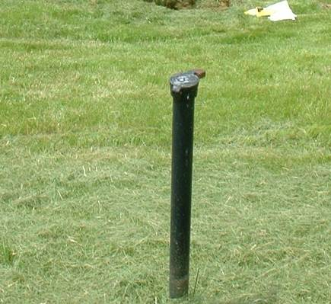
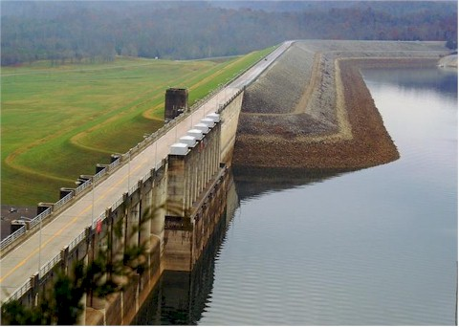
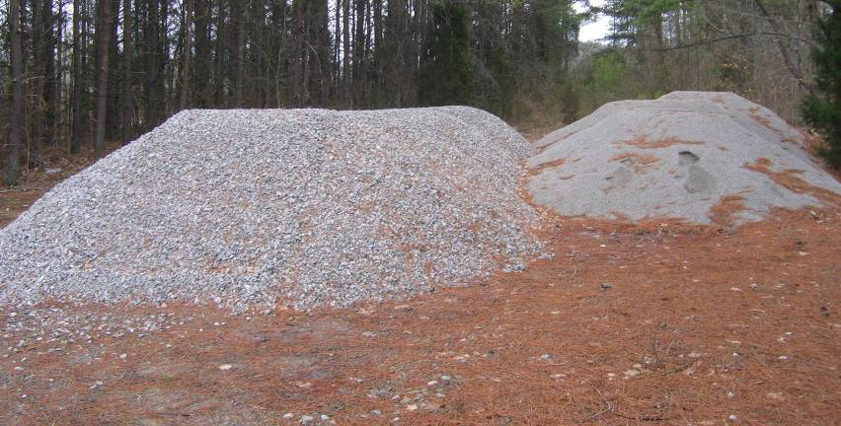
IRRM Alternatives
1. Operational changes
a. Reservoir restrictions
b. Changes in release patterns
2. Structural IRRMs
3. Non-structural IRRMs

Slide 26
1. Reservoir Restrictions
A lowered pool level typically provides a reduction in system loading, thus reducing the probability of failure.
Reservoir pool restrictions and modification of reservoir regulation plan must always be included as an option that is addressed in the IRRMP.
If a reservoir restriction has been ruled out, very specific reasons should be included as to why.
Life Safety is Paramount

Slide 27
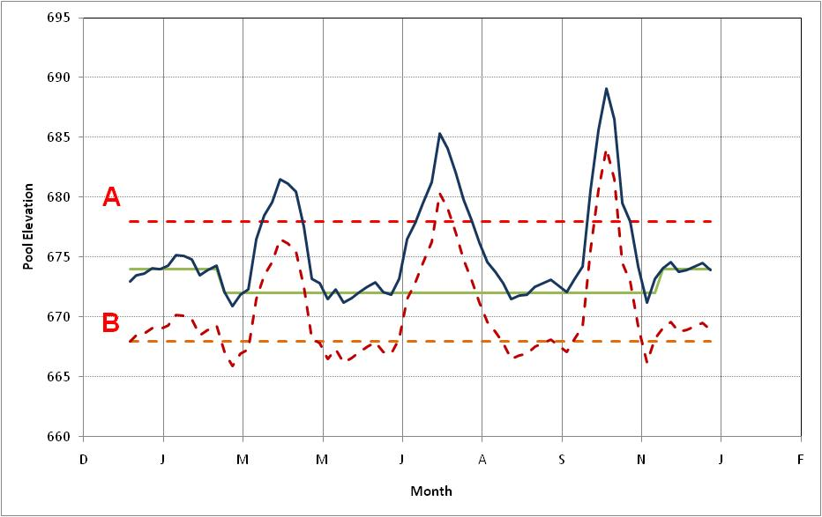
Reservoir “Restrictions”
Lower the reservoir water level and maintain at a lower level.
  A – pool elevation with concern for safety
  B - Intermediate pool to reduce “peaks” above seasonal pool
Notes:
A - shows pool elevation where historically there has been problems
The green curve is the guide curve showing historical target pool elevations by month of the year
B - shows the new guide pool with new target pool that will lessens the likelihood of reaching the pool of concern

Slide 28
2. Structural IRRM
Structural IRRM typically improve the system response by reducing the probability of failure.
Structural IRRM generally require a physical modification to the dam or appurtenant structures.
Some structural IRRMs can be incorporated into long-term remedial measures.

Slide 29
Structural IRRM Examples for Seepage/Stability
Target grouting program to slow seepage.
Improve seepage collection system.
Construct shallow cutoff trench to slow seepage.
Construct downstream dike to reduce head differential.
Isolate problem area.
Construct downstream seepage/stability berm.

Slide 30
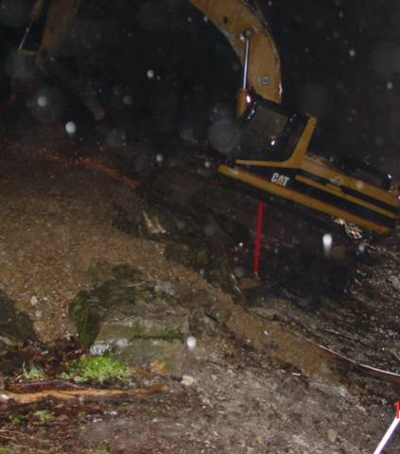
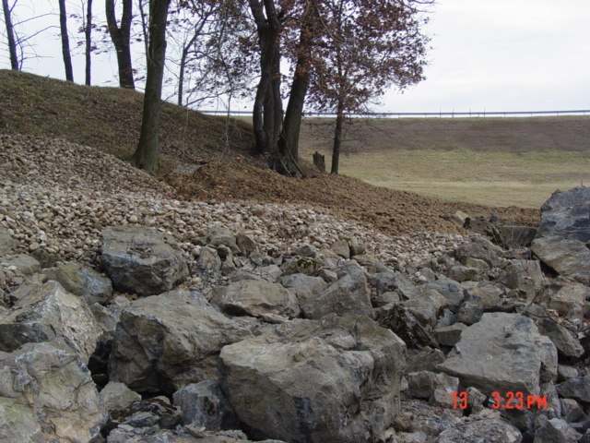
Construction of Emergency Seepage Blanket
Bolivar Dam

Slide 31
Toe Drainage System Installation

Slide 32
3. Non-Structural IRRMs
Non-structural IRRMs may include any short-term actions to reduce risk without physically modifying the dam or appurtenant structures.
Non-structural IRRMs, such as increased monitoring and surveillance and stockpiling materials, help to reduce the likelihood of failure by early detection and improve the ability to intervene should an incident occur.
Another example is testing EAP for better notification and evacuation, updated EAP inundation mapping, etc. All reduce the potential loss of life.

Slide 33
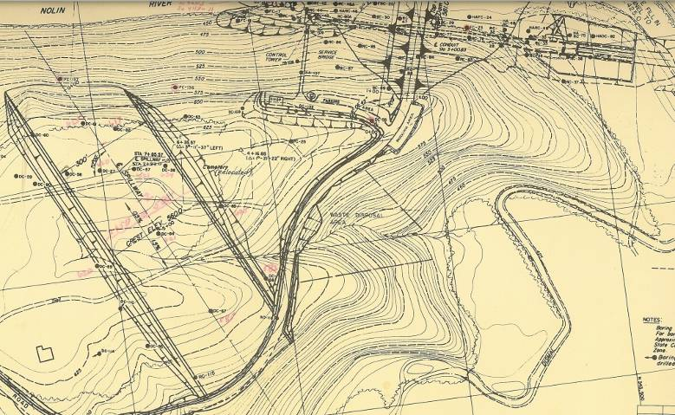
Expanded Surveillance Area
Dam
Reservoir
Grout Curtain
Spillway
Ridge
Ravine
Nolin Dam
Dismal Creek
Sinkholes

Slide 34
System Operational Changes and Cross-Training of Regional Project Staff
Reservoir A
Reservoir B
Reservoir C
Reservoir D

Slide 35
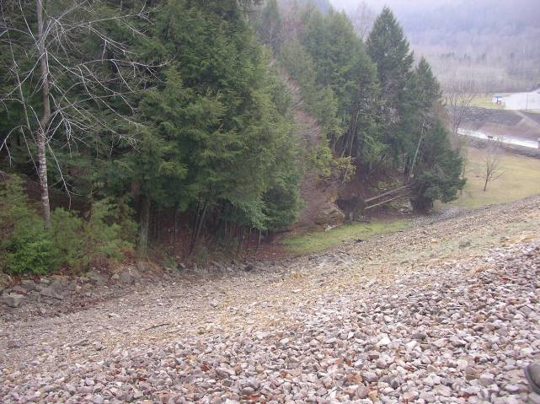
Review Clearing Limits – Ability to Detect
Nolin Dam

Slide 36
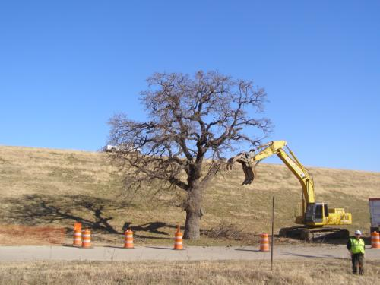
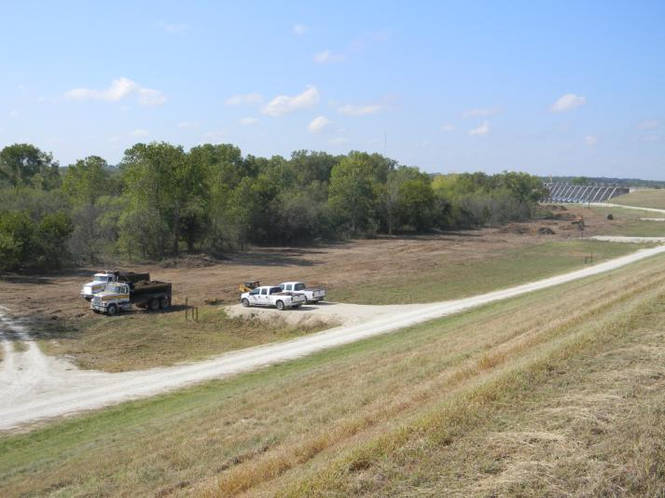
Vegetation Removal
Proctor Dam
Lewisville Dam

Slide 37

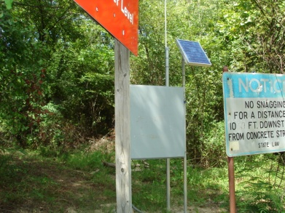
Surveillance and Monitoring
Provides potential for earlier detection of problem
Potentially allows more time to implement EAP and reduce consequences
Should be focused on failure modes
Do NOT just use existing monitoring schedule
Notes:
If surveillance and monitoring is to be used as an IRRM, there needs to be specific issues tied in with the failure modes they are to address.
If additional surveillance and monitoring is used, the Interim Operations Plan or EAP needs to note the changes and they need to be documented and published.

Slide 38
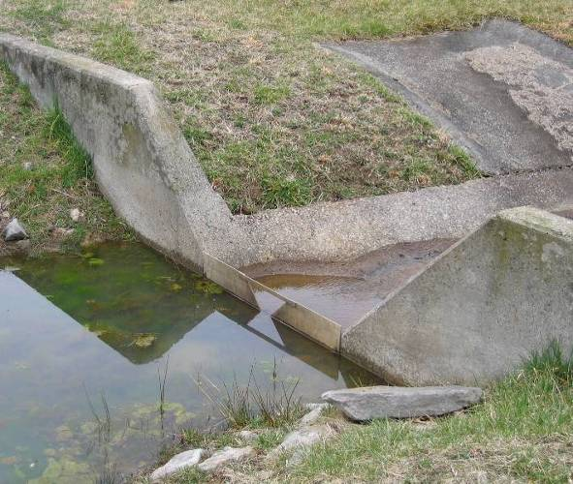
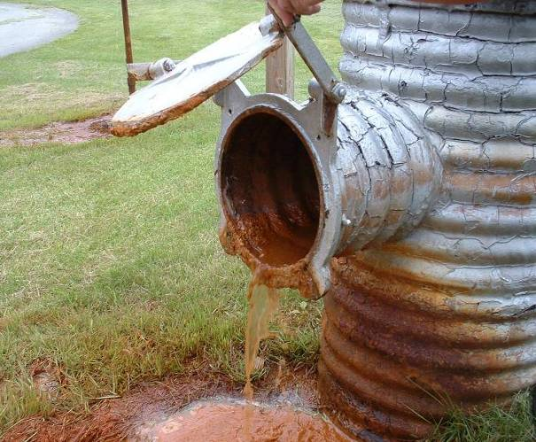
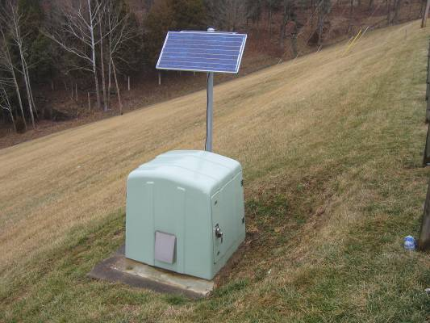
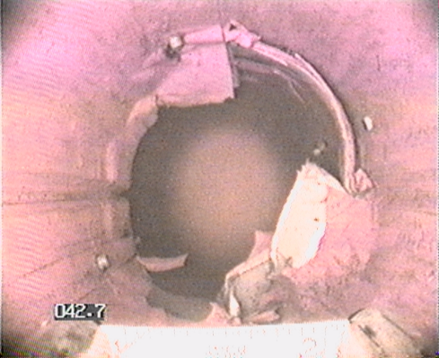
Instrumentation Review - Heightened Monitoring

Slide 39
Monitoring Principles
An adequate instrumentation and monitoring system is required by the Federal Guidelines for Dam Safety as well as by good engineering practice in order to:
  Provide data to validate design assumptions
  Provide information on the continuing behavior of the water control structure
  Observe the performance of critical features
  Advance the state-of-art of dam engineering

Slide 40
Monitoring Objectives
Focus the effort and cost of performance monitoring on those areas where failures are most likely to occur.
  Some existing instrumentation and observation systems may be determined to be unnecessary or redundant.
  Some additional instrumentation and observation systems may be required.
(after FERC Chapter 14, July 2005)

Slide 41
Monitoring Objectives
Define future methods and frequency of measuring and/or observing critical parameters that would give early indications of adverse dam performance.
Establish performance limits related to specific failure mode(s) and/or loading condition(s).
Increase the awareness of field personnel for the performance expectations.
(after USBR Comprehensive Facility Review)

Slide 42
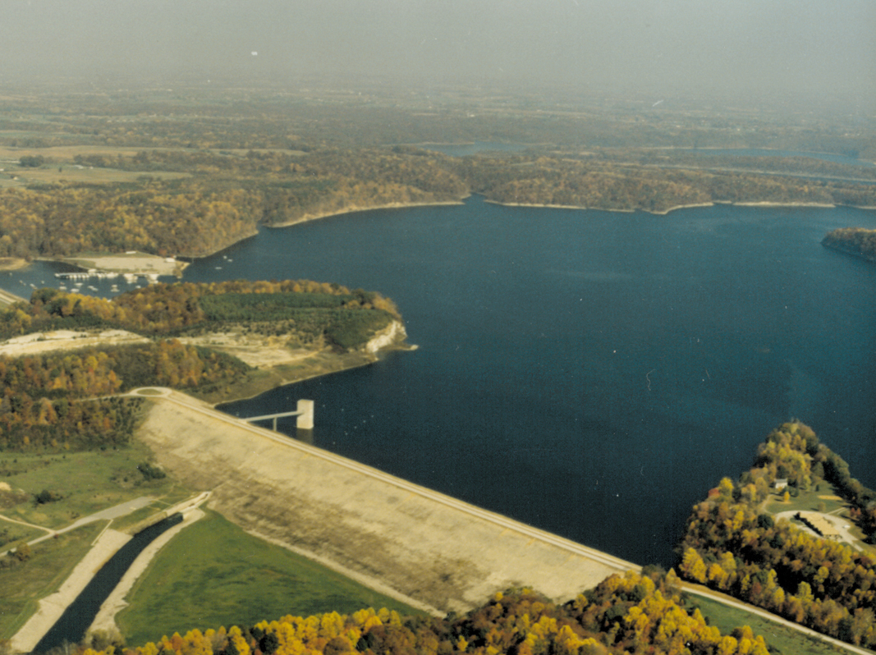
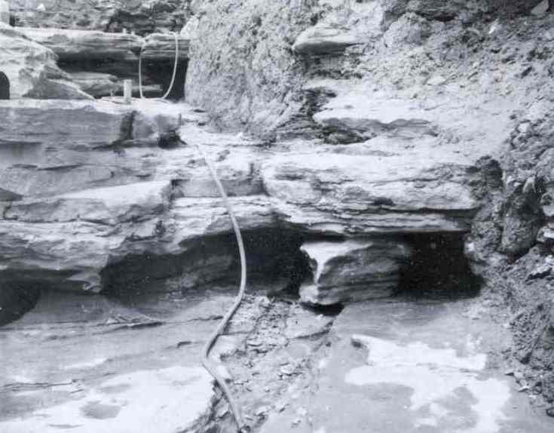
Case History: Green River Lake Dike IRRMP
Upper Portion of Solution Zone
Lower Portion of Solution Zone

Slide 43
Elevation Surveys
RM-4
Maximum Settlement = 3.5”
(from 1981 to 2008)

Slide 44
“Trigger” from Survey/Pool Data
RM-4 Settlement
Pool Triggering Elevation?
Pool

Slide 45
“Linking” Geology and High Grout Take Data
Triggering Elevation?

Slide 46
Resulting Surveillance Strategy

Slide 47
Update EAP

Slide 48
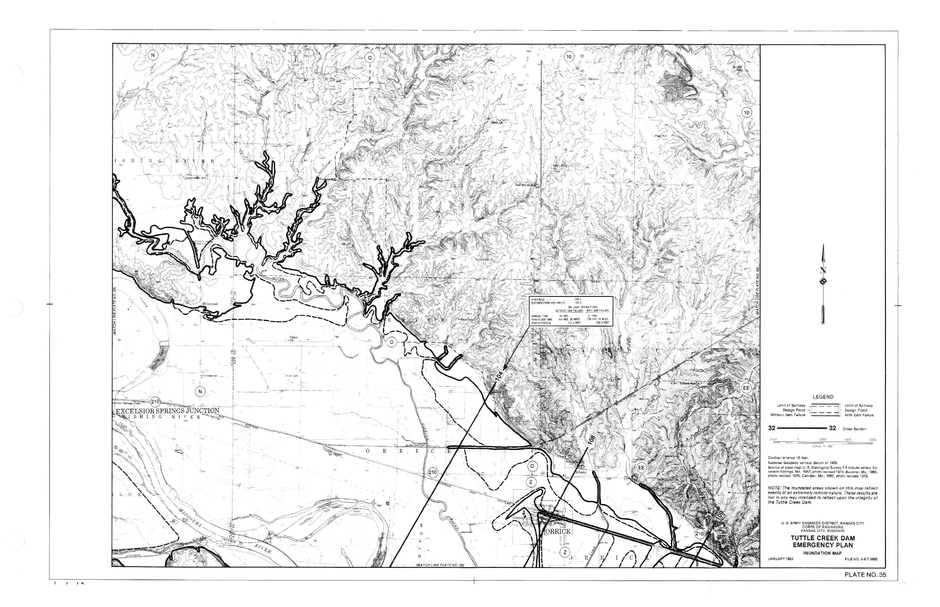
EAP Hardcopy Map Format
(1965-2009)
Notes:
Older inundation maps are typically contour maps with a particular elevation highlighted. These maps are useful, but have nowhere near the level of detail provided in the newer mapping. They generally are not in digital format and must be copied to be distributed. Ending this costly method can help to justify the expense of newer CADD drawings. As with other information, these maps must be protected. Release to the general public requires approval from HQ.
Older inundation mapping is more difficult to use and less accurate. Quad sheets were overlain with hand-calculated flood mapping using 10 or 20 foot contours. They were very useful in their day and continue to be useful for general purposes.

Slide 49
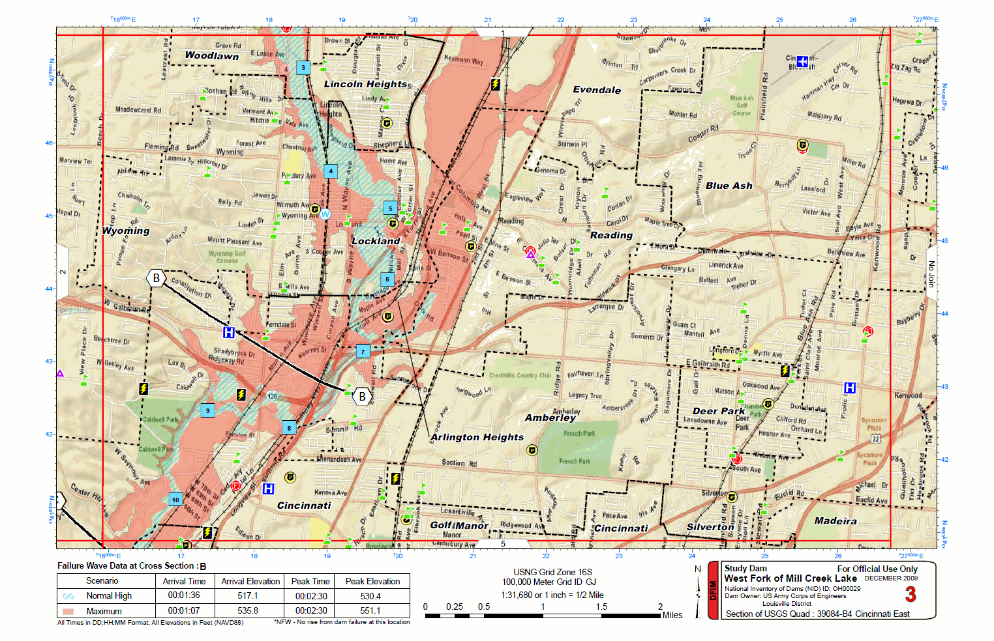
Map Sheet – Street Map Series
Notes:
This type of mapping is capable of providing street level detail. It is beneficial to utilities, hospitals, shelters, fire and police departments, etc to determine their requirements to remain functional during an event. Stockpiles of sandbags or storage of portable dams, etc could allow them to continue to function. Areas designated as shelters may have to be rethought. The shelters may be out of the flooded area, but what about access? If the only road leading to an area will be inundated, the location (or the access) will have to be changed.

Slide 50
Pre-Position Material Stockpiles
Fine Aggregate
Coarse Aggregate

Slide 51
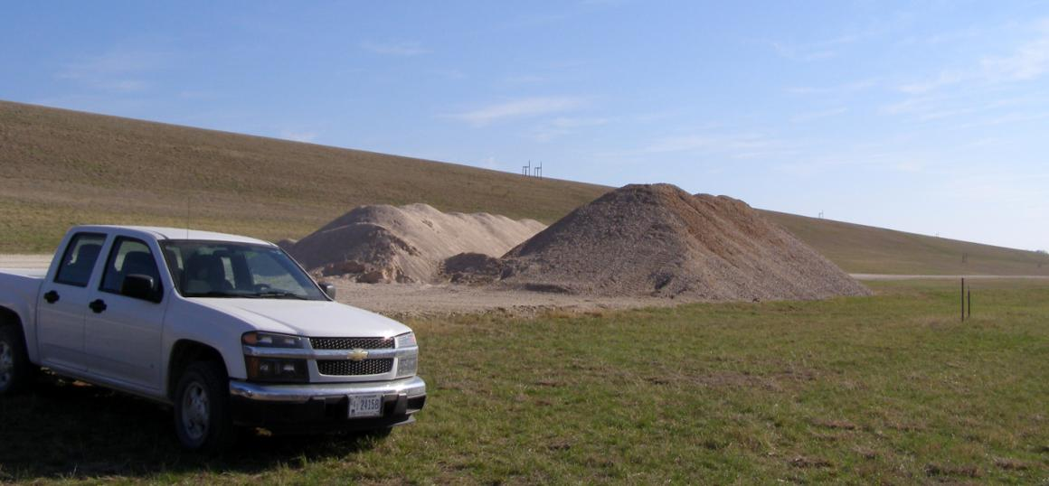
IRRM Example: Stockpiling
Proctor Dam
Notes:
Note that the piles are free of vegetation, they appear to have access to the piles where they can get equipment in.

Slide 52
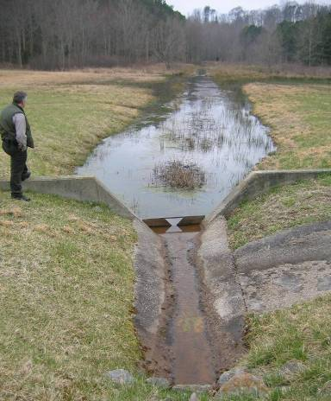
Perform Preventative Maintenance on Instrumentation

Slide 53
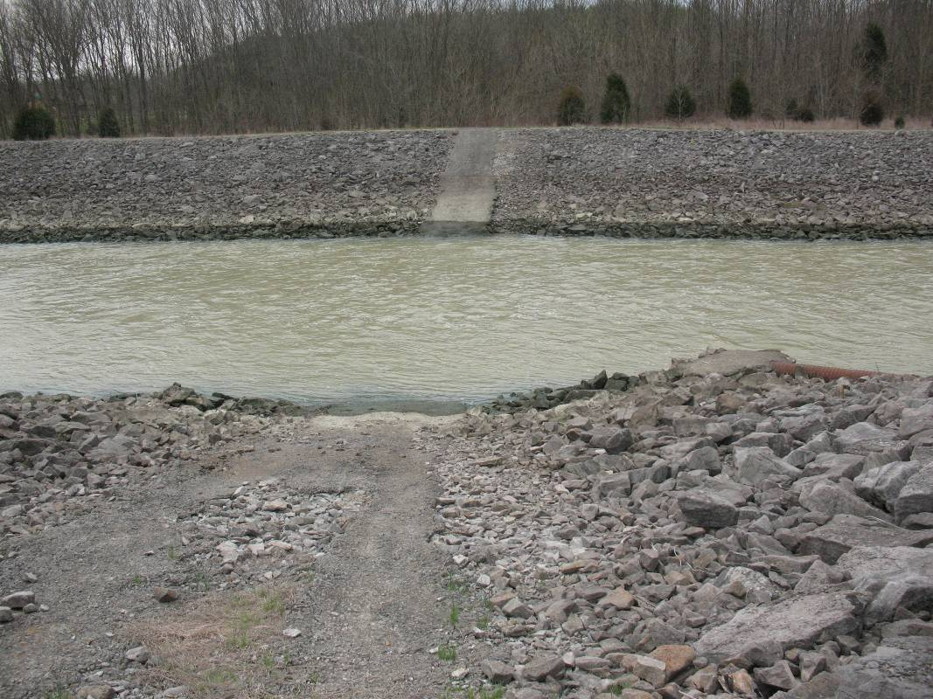
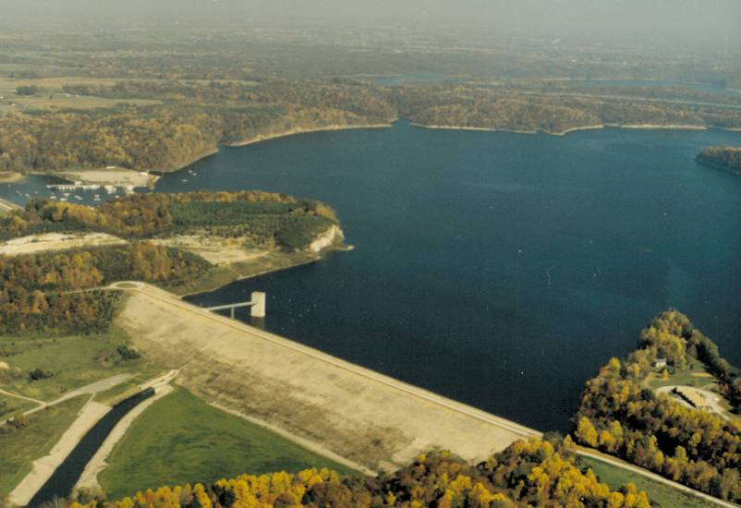
Review Downstream Access for Potential Heroic Measures

Slide 54

Provide Open/Transparent Communication

Slide 55
Train Field Personnel in:
Project-specific potential failure modes
Emergency indicators
Notification and reporting procedures
Temporary controls
Long-term studies, investigations, and possible remedial measures
Risk Communication Plan

Slide 56
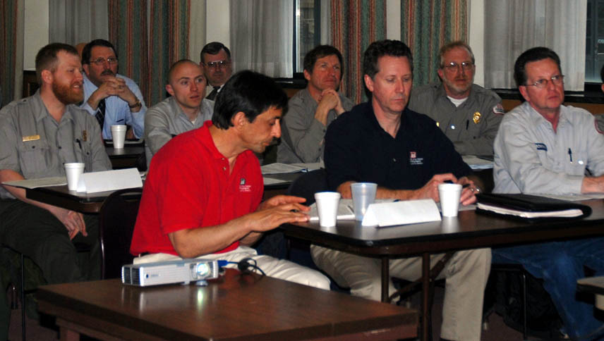
Conduct Emergency Exercises
Level of Exercise Should be Based on DSAC Rating
  Functional
  Table Top
  Contact Call Out

Slide 57
USACE Guidelines to Conduct Emergency Exercises
Notes:
One Interim Risk Reduction Measure that should not be ignored is the updating of the EAP.
Also, the EAP should be excercised on a regular basis. The slide indicates a reasonable schedule for such exercise based on the DSAC classification of the dam.

Slide 58
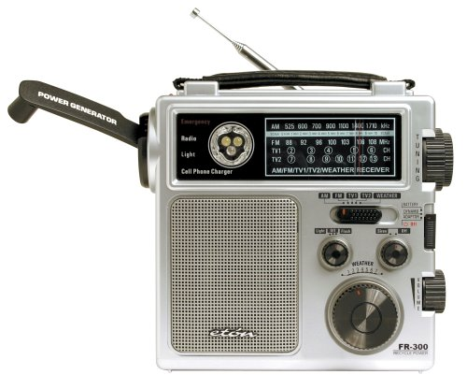
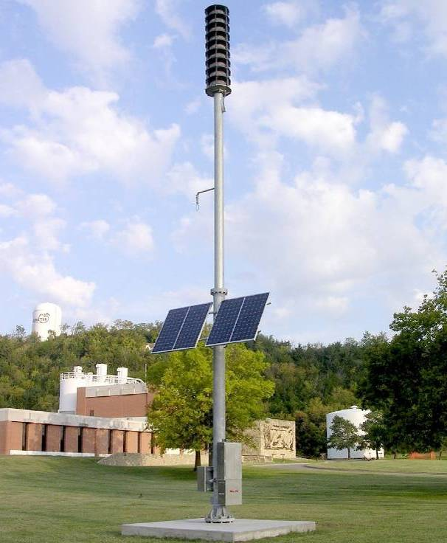
Consider Early Warning Systems

Slide 59
Contrasting IRRMs with Permanent Measures
IRRMs should not induce additional risks beyond existing conditions.
IRRMs should be timely (implemented within ≤ 6 months).
Some IRRMs may become permanent based on IES or DSMS recommendations.
IRRMs are funded from the O&M account and subject to dollar limitations described in Major Rehab guidance.

Slide 60
IRRM Tracking
Biweekly Status of IRRM Implementation for Approved Plans
Interim Risk Reduction Measures Plans
xxx District Dams
As of 24 November 2011
 |  | Completed: |  | Incomplete:
Click on Tabs at Bottom of Screen for Interim Risk Reduction Measures for Each Dam listed below:
 |  | Project Name | Funding for full IRRM Implementation
 |  | Project A | $250K
 |  | Project B | $600K
 |  | Project C | $275K
 |  | Project D | $1.3M
 |  | Project E | $530K
 |  | Project F | $965K
 |  | Project G | $313K
 |  | Project H | $320K
 |  | Project I | $690K
 |  | Project J | $990K
 |  | Project K | $600K
 |  | Project L | $110K
 |  | Project M | $1.2M
Red text indicates new information.
Excel Spreadsheet developed by Fort Worth District is considered a Best Practice example.
Notes:
The first sheet lists the projects and the funding requirements.

Slide 61
 |  |  | Completed: |  | Incomplete:
Project A
DSAC: III | PM: |  |  | Secondary POC:
SPRA: 11 Jul 05 | Office Phone: |  |  | Office Phone:
IRRMP Approval Date: 10 Jun 11 | Cell: |  |  | Cell Phone:
Communication Plan Approval Date: 10 Jun 11
PFMA: Not scheduled at this time.
IES: Not scheduled at this time.
Interim Risk Reduction Measure | Status | Recommendation |  | Scheduled/Completed | Action Taken | Cost | Remarks | Reason Not Fully Implemented
Stockpiling Emergency Materials |  | Emergency flood fighting materials such as gravel, sand, geotextile, and riprap should be stockpiled in areas that are fully accessible in a high water event. Potential failure modes related to seepage can progressively erode soil from embankment or is foundation resulting in rapid failure of the dam. |  | FY13 | Waiting on quotes from DLA for materials. | $150K |  | Funding and Resources
Update Surveillance and Monitoring Schedule |  | There are long-established inspection thresholds for different pool elevations. Based on the results of the IES, there may be changes to these thresholds if required. |  | FY11 | Some interim changes are being incorporated at this time. | $25K
Communication Plan Implementation
Date | Visit/Meeting |  |  |  | Notes/Highlights/Issues
4-Nov-11 | Congressional Visit |  |  |  | PPMD and Operations personnel met with represenatives from Congressman's office to discuss the project, DSAC III Dams, and the USACE Dam Safety Program.
Notes:
Each project sheet lists the IRRMs, whether they’ve been fully implemented, schedule and cost, etc.
Keeping track of your IRRMs in this way helps provide input to the DS Scorecard.

Slide 62
IRRMP in Scorecard
Is an interim reduction measures plan (IRRMP) required? (25 points)
Has an IRRMP been prepared AND approved? (9 points)
Has an approved IRRMP been fully implemented and regularly updated (according to the approved IRRMP schedule)? (10 points)
Have all required items in IRRMP been completed? (6 points)
Notes:
IRRMs are a big part of the scorecard. 25% of the scorecard has to do with IRRMs. Here are the questions it asks.
If no IRRMP is required, i.e., it’s a DSAC IV, then you get the full 25 pts.
9 points for having an approved IRRMP.
10 points for implementing according to schedule.
Another 6 points when all IRRMs have been completed.
This last question was added because districts were putting in IRRMs but not scheduling them for several years out.

Slide 63
Summary
IRRMs are short-term measures taken to reduce the risk of catastrophic failure to the maximum extent reasonably practical until permanent repairs can be made, or investigations determine that a potential failure mode is not probable.
Focus the effort and cost of IRRMs on “risk-driver” potential failure modes.

Slide 64
Summary
Pool restrictions and modification of the WCP must be considered for DSAC I, II, or III dams.
Structural IRRMs can be incorporated into long-term repairs.
With any IRRMP, the level of detail should be proportionate with the dam’s overall risk.

Slide 65
Summary
Non-structural IRRMs can help to reduce the likelihood of failure by early detection and improve the ability to intervene should an incident occur, and they are cost-effective.
Communication with internal and external stakeholders and the public is essential to establish trust and coordinate proper assessment and support.

Slide 66
First USACE Dam Safety Workshop
Thank You!
Muito Obrigado!

