Slide 1
Dam Safety Program Management Tools
José Hernández, P.E.
Regional Geotechnical Engineer
U.S. Army Corps of Engineers
South Atlantic Division
Jose.Hernandez@usace.army.mil
Dam Safety Workshop
Brasília, Brazil
20-24 May 2013

Slide 2
Why is DSPMT needed?
Provide simple, unbiased data to evaluate our dam safety programs
Document the condition of USACE dams
Tracking status and progress of District dam safety programs
Prioritize funding ‘needs’
National reporting requirements – NID and Biennial Report to Congress

Slide 3
What is DSPMT?
Since 2011, web application with Common Access Card access
Previously, combination desktop software and internet
Three main components:
Dam Safety Program Performance Measures
USACE Inventory of Dams
Dam Safety Scorecard for Routine Dam Safety Program Activities

Slide 4
DSPMT Components
Dam Safety Program Performance Measures
USACE Inventory of Dams
Dam Safety Scorecard for Routine Dam Safety Program Activities

Slide 5
DSPMT helps answer the “big” questions
How well are our dam safety programs being implemented?
Are we doing too much in some areas and not enough in others?
Are we spending our scarce resources in the right places?
Are we improving?

Slide 6
Goals of DSPMT
Allow quantitative, consistent, un-biased evaluation of dam safety programs individually at the District level, or collectively at the MSC and Agency level
Consistent interface with automated error checking and identification of conflicting data
Allow exchange of data with other databases
Export of local inventory or performance data
Simplify data collection process to allow frequent updating and reporting
Notes:
Consistent interface outputs consistent data.
Simply data collection – also means one-time data entry.
Web version allows all USACE to view information but the District Dam Safety Program Manager (and persons they select) can edit the data. Information contained in the DSPMT is For Official Use Only.

Slide 7
DSPMT Implementation
District Dam Safety Program Manager responsible for maintaining up-to-date information in the DSPMT
Update Schedule:
Quarterly prior to HQ quarter review
As inspections are completed, update necessary information
Notes:
Need to make sure updating inventory-type information as well as performance measures.
Potential information to update based on inspection – inspection date, identified deficiencies, estimated cost of remediation, priority ratings, etc.

Slide 8
DSPMT Implementation
Division Dam Safety Program Manager responsible for providing quality assurance and review
Any errors or problems should be corrected at the District level not Division or HQ
District Dam Safety Program Manager can allow other users to edit DSPMT, must be requested so users can be added to access list

Slide 9
Dam Safety Program Performance Measures (DSPPM)
Dam Safety Program Management Authorities and Practices (Unused/Obsolete/Not included)
Dam Safety Staff Size and Relevant Experience
Inspections and Evaluations
Identification and Remediation of Deficient Dams
Project Response Preparedness
Agency and Public Response Preparedness
Unscheduled Dam Safety Program Actions

Slide 10
DSPPM 2- Dam Safety Staff Size and Relevant Experience
Staffing spreadsheet
Notes:
DSPPM2 documents staff size, expertise and experience

Slide 11
Staffing – Output Example
1094 Total Dam Safety Staff
Color bands show Staff Specialty

Slide 12
DSPPM 3- Inspections and Evaluations
Periodic & Annual Inspections, Periodic Assessments, Evaluations including Hydrologic, Seismic, FC/Non-FC HSS, and SPRA/RA
Notes:
Tabs on the bottom represent different sections of this performance measure.

Slide 13
DSPPM 4- Identification and Remediation of Deficient Dams
Identification, Prioritization, Remediation of Deficiencies
Notes:
Questions differ based on if the dam is need of remediation.

Slide 14
DSPPM 4- Identification and Remediation of Deficient Dams
Deficiencies and Budgeting Prioritization Spreadsheet
Notes:
District can prioritize, Division can add priorities, HQ can rank.
Deficiency spreadsheet beneficial to budget process, worked very well in SWD.

Slide 15
DSPPM 5 – Project Response Preparedness
Training and Documentation (including Inspection Report Executive Summaries)

Slide 16
DSPPM 5 – Project Response Preparedness
Documentation Spreadsheet

Slide 17
DSPPM 6 – Agency and Public Response Preparedness
Emergency Action Planning, Preparedness, and Response
Notes:
EAPs now required at all USACE dams.
Level of detail of the EAP should be commensurate with the hazard potential classification.

Slide 18
DSPPM 7 – Unscheduled Dam Safety Program Actions
Notification of distress
Capability was included in desktop software but has not been added to the web DSPMT
Incident Module under development
Enter specific failure and non-failure incidents
Query type of incidents across USACE

Slide 19
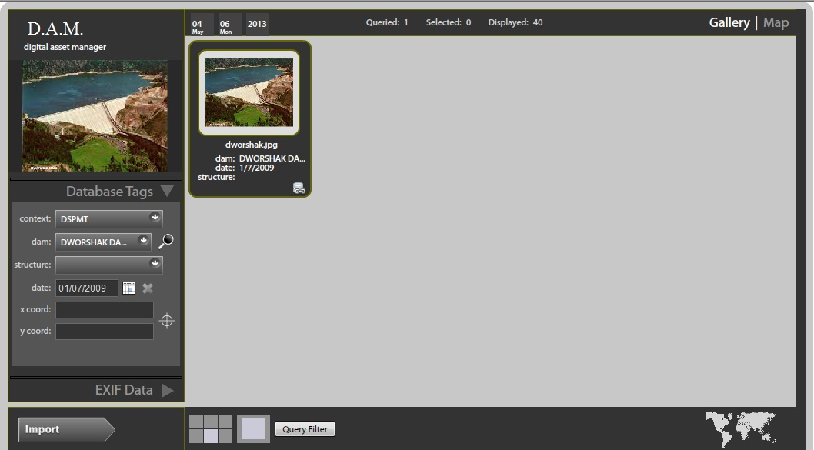
DSPMT Photo Manager
Upload pictures of project

Slide 20
DSPMT Components
Dam Safety Program Performance Measures
USACE Inventory of Dams
Dam Safety Scorecard for Routine Dam Safety Program Activities

Slide 21
USACE Inventory, Jan 2013
Notes:
From DSPMT, Jan 2013

Slide 22
Number of USACE Dams
704 structures at 556 projects
Numbers have been changing as adding/removing appurtenant structures
Potential changes to inventory:
Remove 35 appurtenant structures and add 4 for a total loss of 31
Possible addition of 4 dams
Two dams currently under construction
As periodic inspections and assessments occur, appurtenant structures may be added or removed

Slide 23
USACE Inventory
Engineering Information: Height, Reservoir Volume, Location, Purpose, Dam Type, Condition
Regulatory Information: Regulatory Authorities, Regulating Agency, Federal Involvement
Ownership Information: Owner Name, Type
Inspection Information: Last Inspection Date, Inspection Frequency, Dam Condition
Emergency Action Planning: EAP, Revision Date EAP
Exports into NID format during NID update cycle

Slide 24
National Inventory of Dams
Congressionally authorized database documenting dams in the United States and its territories
Maintained and published by the U.S. Army Corps of Engineers
Contains information about dam’s location, size, purpose, type, last inspection and regulatory facts

Slide 25
NID History
1972: PL 92-367, National Dam Inspection Act – Corps to carry out a national dam inspection program, which included an inventory of dams
1986: WRDA; expanded definition of dam, re-authorization of Corps to continue development of a national inventory
1989: USACE-FEMA MOA; FEMA assumed responsibility to maintain and update inventory with authorized funds; CD updates produced in 1992, 1994, and 1996.
1996: WRDA; Corps re-authorized to maintain inventory; Corps resumed lead responsibility to exploit map-based publication tools and updated data collection software.
1998: CD and Web updates
2000: WRDA; Corps re-authorized
2002-2004: National Dam Safety and Security Act of 2002 reauthorized USACE; collected NID data and published updated NID data on Internet in Feb 2005

Slide 26
NID History (cont.)
2005-2007: USACE collects and compiles NID data
2006-2007: Dam Safety Act of 2006 reauthorized the maintenance and update of NID; published the 2007 NID
2008: USACE collects NID data; launches new NID web site with new security restrictions
2009: Published the 2009 NID including new fields of condition assessment
2010: Collected partial update of NID with focus on the new condition assessment fields
2011: Published the 2010 NID
2012: Collected data from states and federal agencies; NID data team used new web-based tool to upload and validate data
2013: Published the 2013 NID with one new data field, Date of Last Revision of Emergency Action Plan (not all state and federal agencies maintain this information)

Slide 27
NID Inclusion Criteria
All high hazard potential classification dams
All significant hazard potential classification dams
Low hazard or undetermined potential classification dams which
Equal or exceed 25 feet in height and which exceed 15 acre-feet in storage, or
Equal or exceed 50 acre-feet storage and exceed 6 feet in height.
Notes:
1. LOW HAZARD POTENTIAL
Dams assigned the low hazard potential classification are those where failure or mis-­operation results in no probable loss of human life and low economic and/or environ­mental losses. Losses are principally limited to the owner’s property.
2. SIGNIFICANT HAZARD POTENTIAL
Dams assigned the significant hazard potential classification are those dams where failure or mis-operation results in no probable loss of human life but can cause economic loss, environment damage, disruption of lifeline facilities, or impact other con­cerns. Significant hazard potential classification dams are often located in predom­i­nantly rural or agricultural areas but could be located in areas with population and significant infrastructure.
3. HIGH HAZARD POTENTIAL
Dams assigned the high hazard potential classification are those where failure or mis-operation will probably cause loss of human life.

Slide 28
NID Data Fields
* Restricted access to data – Government users only, not publicly available from NID

Slide 29
2013 NID Data Contributors
USACE collected inventory data from 47 states*, Puerto Rico and 15 federal offices**
The federal agencies own or regulate 6% of the dams in the U.S.
The state dam safety offices regulate 80% of the dams included in the NID
* Alabama does not have dam safety legislation to regulate dams. Using the 2010 NID information for Connecticut and Kentucky.
** Using the 2010 NID information for the National Park Service and Department of Energy.

Slide 30
NID Upload Tool
Data needs to be in Excel format
Maps local database fields and data values into the NID
Template created one time and can be used for multiple submittals
If start over with new Excel file, remembers previous mapping
Cannot submit data with critical errors (missing data in required fields)

Slide 31
NID Upload Tool
DSPMT exports USACE inventory into Excel with appropriate NID values and easily imported into NID Upload Tool
NID is only updated every two years
Because the NID is not a “living” document, there is no direct connection between DSPMT changes and NID updates.
Notes:
If NID was a “living” or “real-time” database, easily could have live connection between NID and DSPMT. All DSPMT changes could be automatically updating NID. However, that is not the current state of practice with the NID. The NID is a snapshot in time that does not change until the next full database is published.

Slide 32
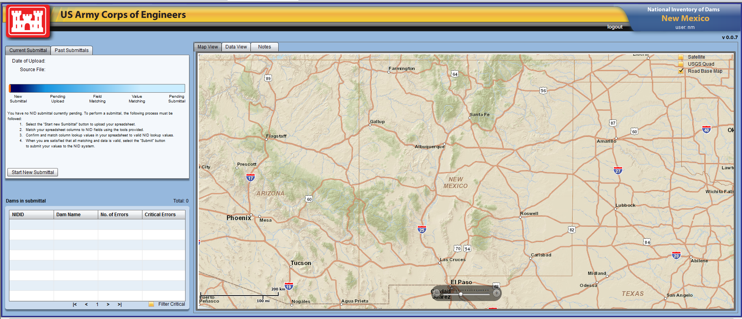
NID Upload Tool
First screen shows map of state based on login
Steps in submittal process
Notes:
For federal agencies, map is the entire U.S.

Slide 33
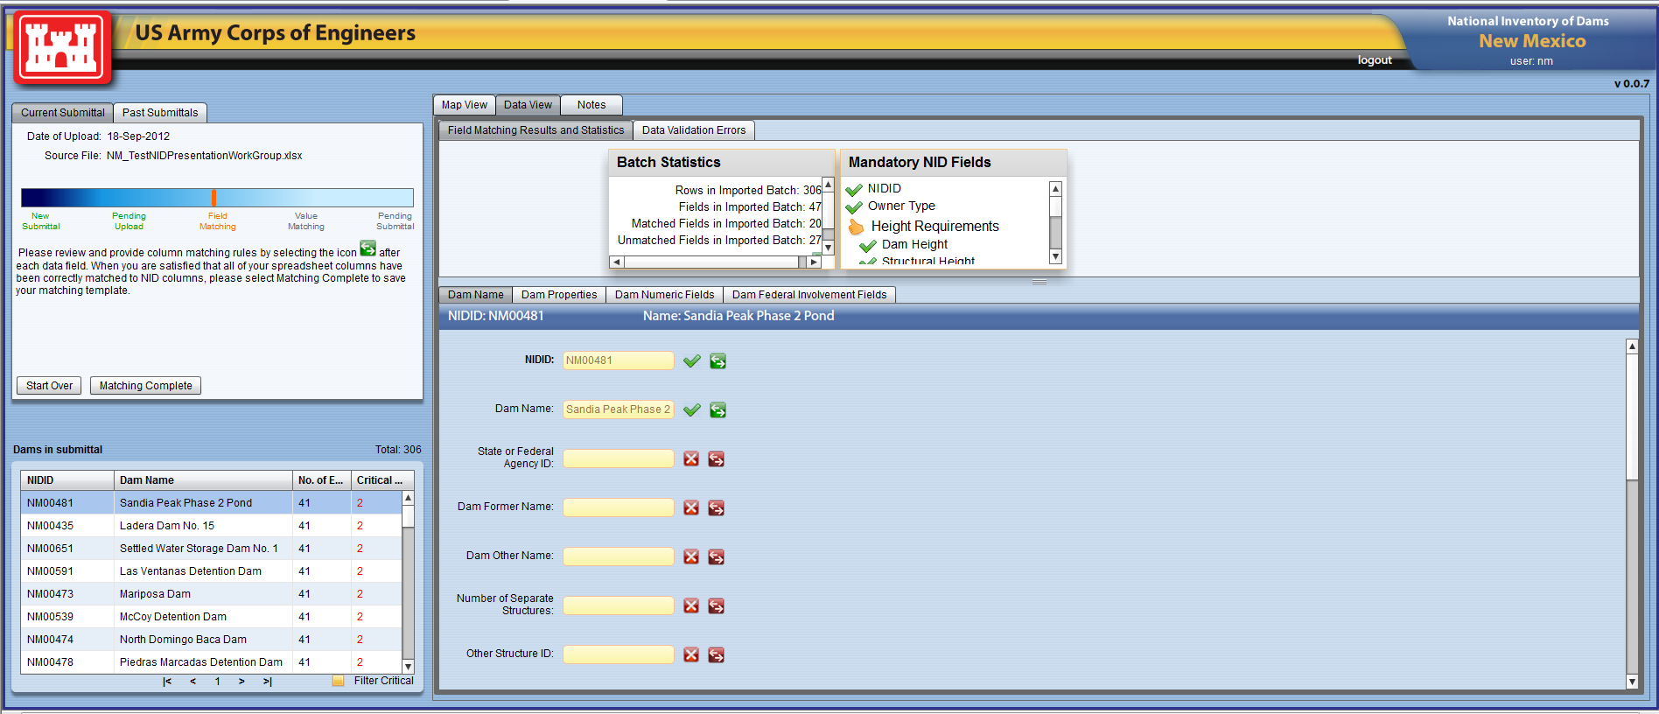
NID Upload Tool
After select the input file, must map local database fields to NID fields
Notes:
The states and federal agencies may use different field names than the NID in their local inventories. Do not need to change their local databases because they map their field to the NID. For example, the NID calls the unique numerical identifier the NID ID, where as many states called this field National ID. At this point, they would map their National ID field to the NID ID. Another example is the Maximum Storage (total storage space in a reservoir below the maximum attainable water surface elevation), one state may call this data field Dam Crest Storage. This state would link their Dam Crest Storage field to the NID Maximum Storage field.

Slide 34
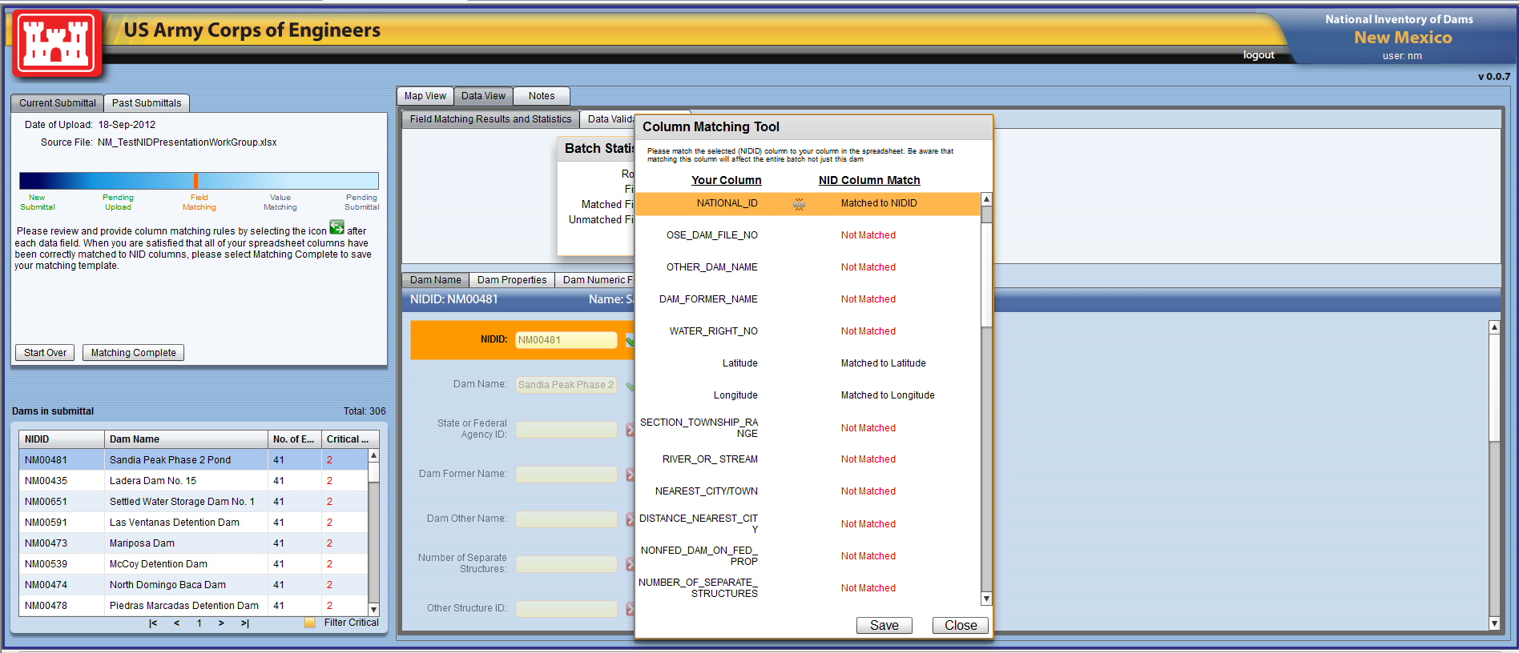
NID Upload Tool
If local field name is same, automatically matches
If names are different, must select each field and manually match local to NID
Mapping template saved for future submittals
Notes:
An agency only has to perform this linking of data one time because the NID upload saves the template for future submittals. The template will be applied with the next upload of dam data.

Slide 35
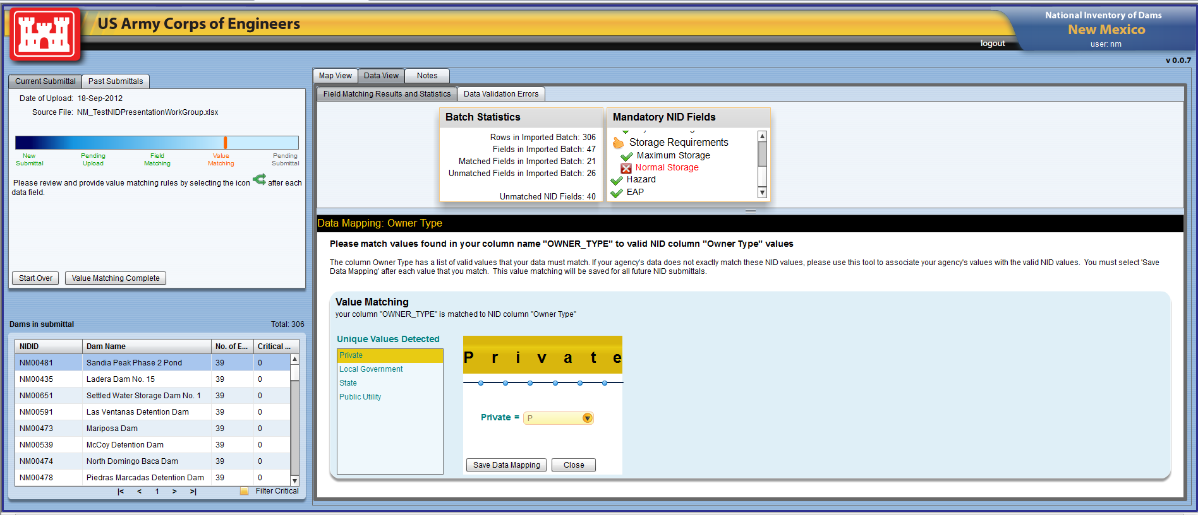
NID Upload Tool
Must match all NID-coded values, ex. Owner Type
Value Matching saved for future submittals
Notes:
All local data values must be linked to the NID values. For example, with Owner Type a state may use “private water supply” and that value would be mapped to “private” in the NID. For downstream hazard potential classification, an agency may use 1,2,3 whereas the NID uses high, significant and low. In this case, “1,2” are equal to the NID high and “3” is low; this state does not use the significant category. This step in the upload process allows the agency to use their own data values and at the same time, keep the national data set consistent.

Slide 36
NID Update Process
From August 2012 to February 2013, information was collected from the states and federal agencies that regulate dams in the United States.
USACE utilized the NID Upload Tool to import the individual agency’s data and quality check the data for potential errors
From February to May 2013, USACE compiled and published the NID
Notes:
The 2013 NID was published on the NID web site – 2 May 2013.

Slide 37
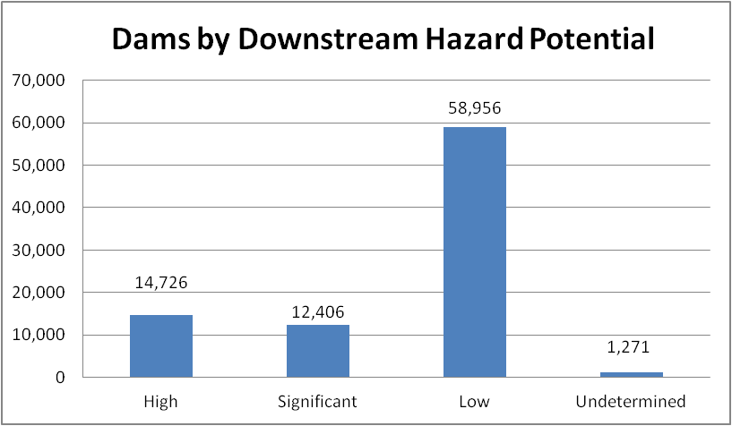
2013 NID Statistics
Hazard Potential Classification | Loss of Human Life | Economic, Environmental, Lifeline Losses
High | Probable. One or more expected | Yes (but not necessary for this classification)
Significant | None expected | Yes
Low | None expected | Low and generally limited to owner

Slide 38
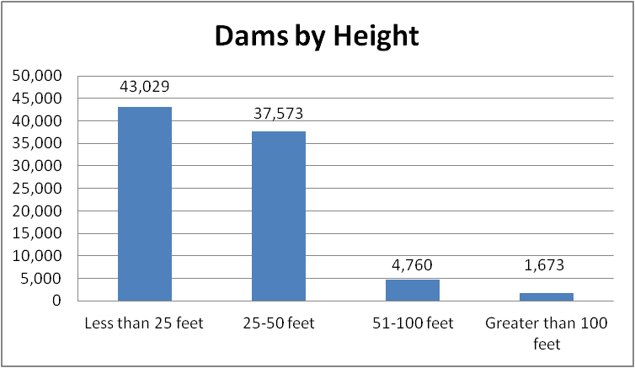
2013 NID Statistics

Slide 39
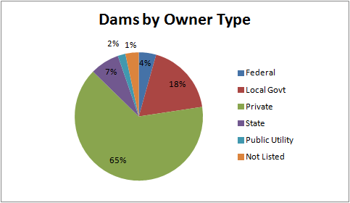
2013 NID Statistics

Slide 40
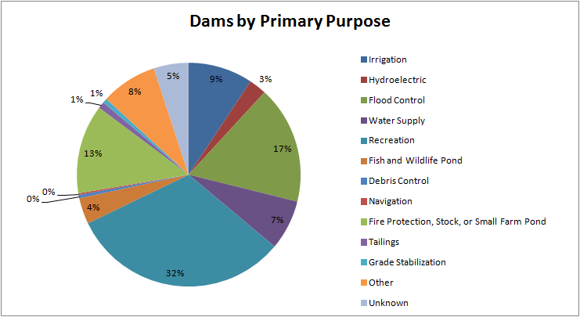
2013 NID Statistics

Slide 41
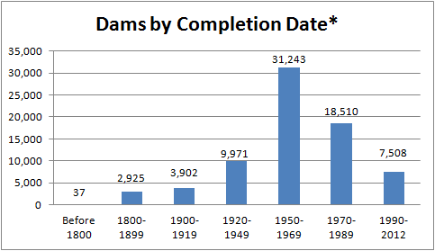
2013 NID Statistics
* Approximately 13,260 dams do not have a Year Completed Date in the 2013 NID and those dams are not included in this chart.
Notes:
Average Age of Dam in NID = 55 years old

Slide 42
NID Data Summary
USACE collects and publishes national dam information approximately every 2 years
NID used by National Dam Safety Review Board and Association of State Dam Safety Officials to recommend dam safety policies
FEMA uses NID in the state-assistance grants process
NID informs the public of general dam information, such as where the dams are located and their purpose
NID Web Site – http://nid.usace.army.mil

Slide 43
2013 National Inventory of Dams
http://nid.usace.army.mil

Slide 44
NID Web Site – Public View, No Account Required
State by State and National Statistics
State or National Map

Slide 45
NID Web Site Restrictions
National Dam Safety Review Board recommended USACE restrict access to the NID
Three data fields no longer available to the public: downstream hazard potential, nearest city and distance to nearest city
New Condition Assessment information restricted
Public (non-government) users cannot download any data or be given any aggregate data
Must have username/password to query the database
Two levels of users – government and non-government
Government users must accept the non-disclosure agreement
Cannot provide the actual NID data (in electronic format) to anyone outside of their agency
Cannot provide the government-restricted information to anyone outside of their agency

Slide 46
Web Site – Account Required
Allows user to query the database and use the interactive map
Two levels of Access: government and non-government
Government users must have valid government email address and purpose for using the NID

Slide 47
NID Web Site Users
Since 2008, NID web site requires account
Current registered users (6 May 2013):
2,407 Government (local, state and federal)
4,165 Non-Government

Slide 48
Web Site – Interactive Map
Search by Zip Code – example 22554 (Stafford VA)
Available to all registered users (government and non-government)

Slide 49
Web Site – Interactive Map
Other Map Layers available
Example – live weather radar

Slide 50
DSPMT Components
Dam Safety Program Performance Measures
USACE Inventory of Dams
Dam Safety Scorecard for Routine Dam Safety Program Activities

Slide 51
Dam Safety Scorecard
Uniform and consistent evaluation
Provide a numerical and graphical report of the implementation of routine dam safety activities on a per dam basis
Total score
Verbal ratings: Excellent, Fair to Good, Poor
Colors: Green, Yellow, and Red
Not to be used as indicator of the dam’s condition or DSAC

Slide 52
Dam Safety Scorecard
Staffing and Funding Adequacy (2)
Inspections and Evaluations (30)
Project Instrumentation (18)
Project Response Preparedness (10)
Agency and Public Response Preparedness (15)
Interim Risk Reduction Measures (25)
Notes:
Six sections of the Scorecard.
Values for each area were devised using expert elicitation of opinion based on perception of relative importance of each subject compared to others.

Slide 53
Dam Safety Scorecard
Generated from District input to DSPMT
Evaluate the program on a per-dam basis
Perform trend analysis
Highlight program accomplishments or document areas that need improvement
Reviewed quarterly at Civil Works DMRs and HQ Dam Safety Committee meetings

Slide 54
DSPMT Score Card Questions and Values
Staffing and Funding - Maximum Score: 2
Is sufficient annual baseline funding being received for routine Engineering DS activities? | 1
Are adequate in-house dam safety resources available to perform routine Engineering DS activities? | 1
Are routine dam safety activities being supplemented by contracting with the private sector? | 0
Are routine dam safety activities being supplemented by contracting with other Districts within the Corps? | 0
Inspections and Evaluations - Maximum Score: 30
Is a 10 year Periodic Inspection and Periodic Assessment schedule established in DSPMT? | 4
Has a Periodic Inspection or Periodic Assessment been completed within the past five years? | 11
Was the most recent PI or PA report completed within 90 days of the inspection/ assessment? | 5
Was the most recent PI or PA report completed, but completed in more than 90 days of the inspection/ assessment? | 1
Was the most recent annual inspection completed and documented in a report within the past 15 months? | 3
Are dam safety deficiencies identified and prioritized in DSPMT, and identified in the budget request? | 7
Notes:
If a District indicates one staffing or funding constraint, they will lose the 1 point available. Scores and colors for funding and staffing questions will self populate based on whether budget constraint or funding constraint is blamed for one or more items not being completed or implemented.

Slide 55
Instrumentation - Maximum Score: 18
Are all instrumentation readings current as scheduled AND has all instrumentation data been reviewed and interpreted by a qualified individual/ Engineer? | 5
All scheduled instrumentation readings and interpretations have been documented in an annual instrumentation report and furnished to the MSC? | 2
Instrumentation readings and interpretations since the last PI or PA are given a thorough assessment in the PI or PA report that is submitted to the MSC? | 2
Have procedures been established for evaluating data accuracy and addressing unusual readings? | 1
Are all essential instrumentation functional, and none needs replacement? | 1
Adequacy of instrumentation has been evaluated as part of the PI or PA AND is considered adequate for monitoring critical failure modes? | 3
Instrumentation threshold values or ranges for irregular readings are established? | 1
Procedures, for more frequent readings and inspections, have been established based on higher pools? | 1
Do you have adequate gages to support water management operational decisions including precipitation, stage and discharge information for developing basin responses? | 1
Do you have adequate gages in place to monitor consequences within the watershed and support emergency evaluation planning? | 1

Slide 56
Project Response Preparedness - Maximum Score: 10
Does the water control plan reflect current operating procedure for the project? | 2
Are as-built drawings and all engineering data as required in ER 1110-2-1156 available? | 1
Has site specific dam safety training been performed within the last five years? | 7
Agency and Public Response Preparedness - Maximum Score: 15
Has an EAP been prepared and emergency contact lists, local contractor's names and phone numbers lists, and emergency supplies lists all been updated or verified in the last 15 months? | 7
Have inundation maps been prepared for uncontrolled release of water for 'sunny day' and flood flow conditions? | 1
Have dam safety exercises appropriate for the DSAC class been conducted specifically involving this dam in the past five years? | 5
Has the EAP been coordinated with all upstream and downstream State, Federal, and Local authorities who are responsible for developing evacuation plans? | 1
Has the security office been invited to participate in the most recent annual or periodic inspection to facilitate their requirements to perform a physical security inspection? | 1
According to the security office, is a physical security inspection and report (DA Form 2806-1-R) current as required by AR 190-13, the Army Physical Security Program? | 0

Slide 57
Interim Risk Reduction Measures Maximum Score: 25
Is an Interim Risk Reduction Measures Plan (IRRMP) required? | 25
Has an IRRMP been prepared AND approved? | 9
Has an approved IRRMP been fully implemented and regularly updated (according to the approved IRRMP schedule)? | 10
Have all required items in IRRMP been completed? | 6

Slide 58
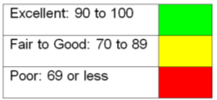
USACE Dam Safety Program Scorecard Points for Routine Activities, Per dam
As of 30 Apr 2013
Total Points %Average
Staffing and Funding Adequacy 2 39
Inspections and Evaluations 30 87
Project Instrumentation 18 89
Project Response Preparedness 10 91
Agency & Public Response Preparedness 15 74
Interim Risk Reduction Measures 25 82
100 84

Slide 59
First USACE Dam Safety Workshop
Thank You!
Muito Obrigado!

