Slide 1
TABLE TOP EMERGENCY EXERCISE PRACTICUM
William Empson, PE, PMP
Senior Levee Safety Program Risk Manager
U.S. Army Corps of Engineers
Risk Management Center
William.B.Empson@usace.army.mil
Dam Safety Workshop
Brasília, Brazil
20-24 May 2013

Slide 2
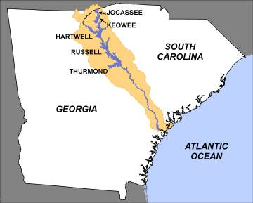
Emergency Exercise Practicum
Savannah river basin
2 non-federal projects
(Duke Energy)
keowee dam
jocassee dam
4 USACE FRM Projects
hartwell dam
Upper clemson Diversion Dam
Lower Clemson Diversion dam
russell dam
thurmond Dam
1 Usace navigation project
New savannah bluff lock & dam
(Savannah District)
Clemson Diversion Dams
New Savannah Bluff

Slide 3
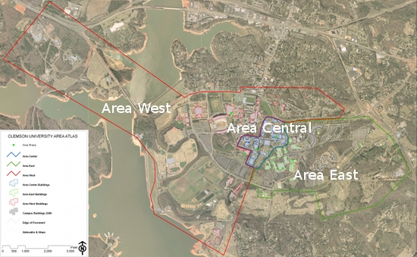
Local Setting
Emergency Exercise Practicum
clemson diversion dams
Located in upper hartwell
reservoir
Protects a portion of Clemson
University Campus
Hartwell Dam controls stage on
the diversion dams
two rehabs performed on dams
seepage cutoff
Seismic rehabilitation
currently dsac iv
Breach would inundate a portion of the university, including the athletic complex and football stadium.
Clemson Upper Diversion Dam
Clemson University
Clemson Lower Diversion Dam

Slide 4
Background
Emergency Exercise Practicum
basin information
The Savannah River is a major river in the southeastern United States, forming most of the border between the states of South Carolina and Georgia. Two tributaries of the Savannah, the Tugaloo River and the Chattooga River, form the northernmost part of the border. The Savannah River drainage basin extends into the southeastern side of the Appalachian Mountains just inside North Carolina, bounded by the Eastern Continental Divide. The river is around 301 miles (484 km) long. It is formed by the confluence of the Tugaloo River and the Seneca River.
The Savannah River basin has an area of 10,577 square miles in which 175 square miles are in southwestern North Carolina, 4,581 square miles are in western South Carolina, and 5,821 square miles are in eastern Georgia.

Slide 5
Climate, Geology and Seismology
Emergency Exercise Practicum
basin information
Climate
The Savannah River basin is characterized by mild winters and hot summers in the
lower portions, and cold winters and mild summers in the mountain area. Mean annual precipitation ranges from 40 to 80 inches per year. Precipitation occurs chiefly as rainfall, and to a lesser extent, as snowfall. Rainfall is fairly evenly distributed throughout the year, but a distinct dry season occurs from mid-summer to late fall. Rainfall is usually greatest in March and least in October. The mean annual temperature is about 65 degrees Fahrenheit. Hurricanes do impact the Savannah River Basin.
Geology/Seismology
The rock underlying the dams is limestone subject to moderate jointing and disolution that can form caverns. Earthquakes are rare.

Slide 6
Process
Class Breaks into 4-5 groups
Take 30 minutes to discuss and document each of the following:
Review and Discuss the characteristics of the basin
Develop 3 Emergency Exercise Scenarios for the Clemson Diversion
Dams based on the location, basin characteristics, climate, and
infrastructure.
Discuss and recommend the logistics of the exercise – who, what, when,
and where for a table top exercise.
Discuss who should be the coordinator and facilitator for the exercise
Develop a generic internal notification chart.
Discuss and document who you would invite to the exercise based on
the scenarios.

Slide 7
Reporting
Emergency Exercise Practicum
Table top exercise
Each group presents the results of their discussions.
Class discussion concerning most probable / best scenarios to use.
Discuss Lessons Learned from the exercise development
Discuss improvement to the practicum for the next class.

