Slide 1
Stockton Dam Turbine Dam Safety Management Case History
William Empson, PE, PMP
Senior Levee Safety Program Risk Manager
U.S. Army Corps of Engineers
Risk Management Center
William.B.Empson@usace.army.mil
Dam Safety Workshop
Brasília, Brazil
20-24 May 2013

Slide 2
General Plant Information
45 MW capacity
Single vertical axis Kaplan unit
Peaking plant
Average annual energy production of 55,000,000 KWH
Plant placed in service in 1973
Remote operated from Truman Power Plant
Located on the Sac River near Stockton, MO

Slide 3
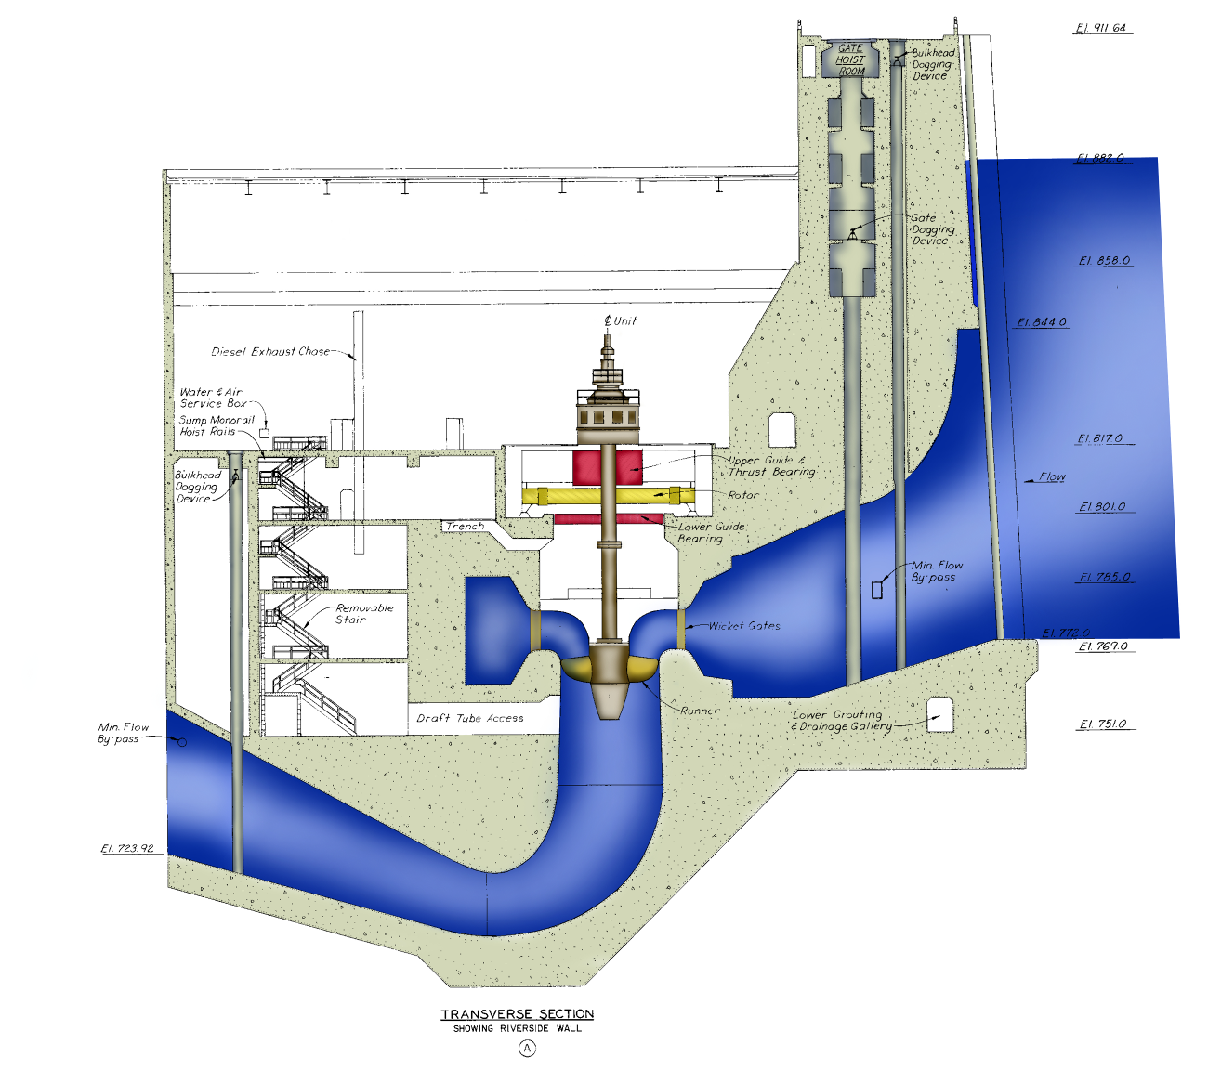
Power Plant Cross Section
Intake Bulkheads
Intake Gates
Draft Tube Bulkheads
Notes:
Note locations of HSS.

Slide 4
Hydraulic Steel Structures
(HSS)
Engineering Manual 1110-2-6054.
Inspection, Evaluation, and Repair of Hydraulic Steel Structures.
USACE Operation and Maintenance policy.
Staff are not allowed to work behind Hydraulic Steel Structures holding water unless they meet all of the inspection and maintenance requirements.

Slide 5
HSS Policy Impacts
Inspection of turbines and intake gates required as part of routine inspections.
Routine O&M budget did not prioritize HSS inspections high enough for bulkheads to be inspection.
Turbine and intake gates had not been inspected for years.

Slide 6
Power Plant Cross Section
Intake Bulkheads
Intake Gates
Draft Tube Bulkheads
Notes:
Note locations of HSS.

Slide 7
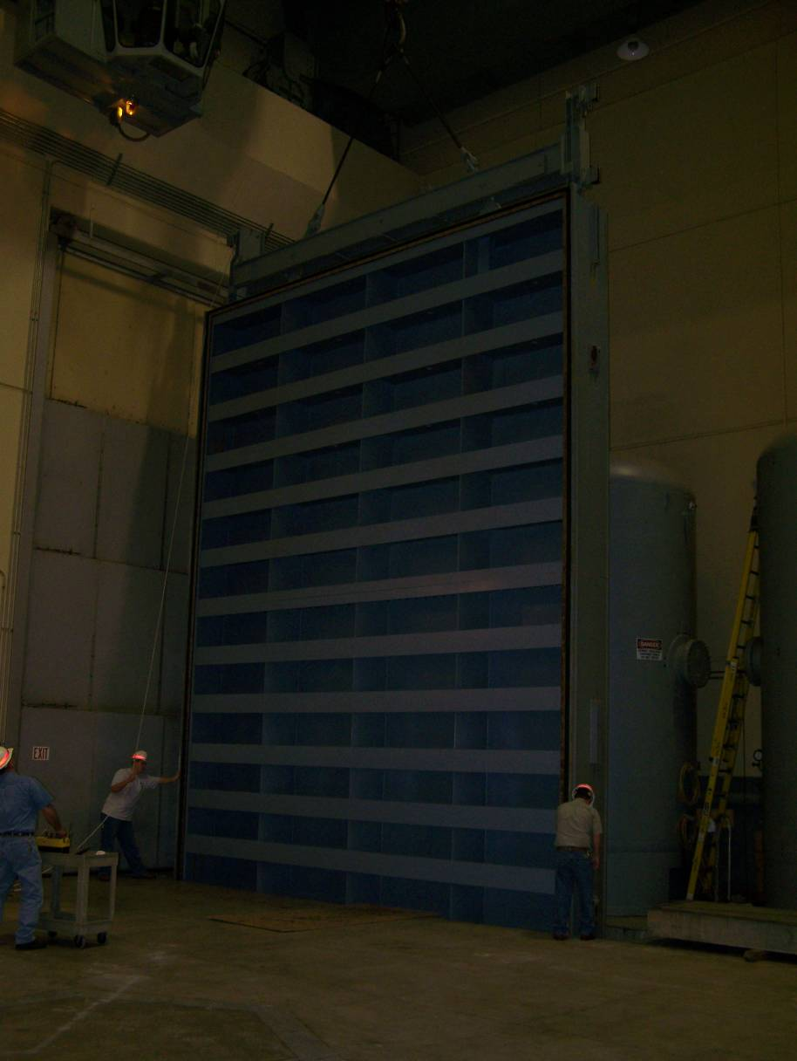
Draft Tube Bulkheads
Total of 3 draft tube bulkheads
Each draft tube bulkhead consists of two bolted sections that will require disassembly
Two draft tube bulkheads (middle and riverside) require weld repair and all three will require additional NDT of fracture critical welds
98 linear feet of weld repair on middle DTB and 14 linear feet of weld repair on riverside DTB
Work also includes sandblasting and painting of weld inspection and repair areas and J-bulb seal replacement

Slide 8
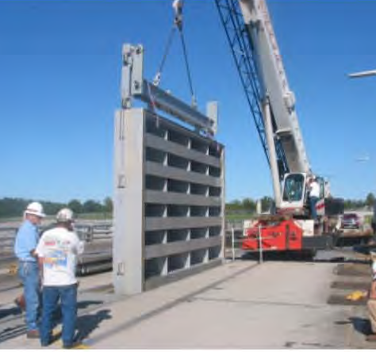
Intake Bulkheads
Total of 3 intake bulkheads
Mobile crane required to remove/install bulkheads
All three intake bulkheads require weld repair
50 linear feet of weld repair for all three bulkheads
Work also includes sandblasting and painting of weld repair areas and J-bulb seal replacement

Slide 9
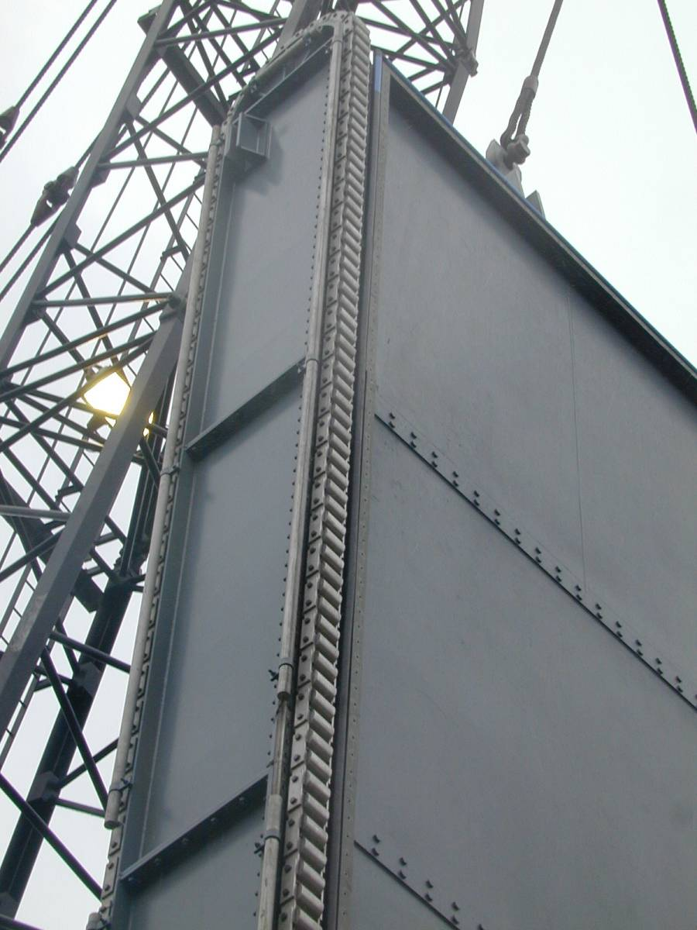
Intake Gates
Total of 3 intake gates
All three intake gates require weld inspection
Inspection work will be performed onsite within the intake gate chamber
Intake bulkheads must be repaired before intake gates can be inspected
All three intake bulkheads must be installed to dewater the area upstream of one intake gate
Work will also include replacement of anodes and weld repair if defective welds are found
Notes:
This is not a picture of Stockton’s intake gates.
It may be necessary to remove the gates from service if a significant amount of weld repairs are required. The gates would have to be hauled offsite.

Slide 10
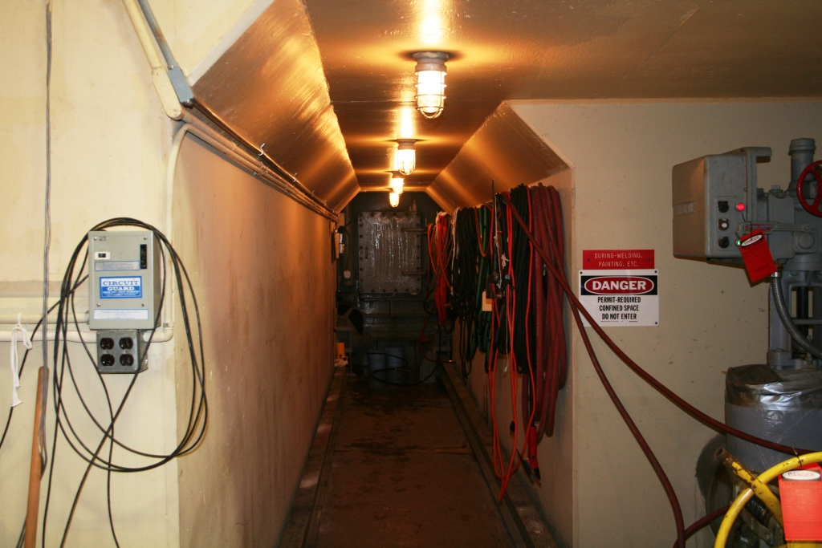
Draft Tube Hatch Door
Elev. 751.0
BUILDING STRONG
Notes:
Location of draft tube liner crack and draft tube entrance. Work platform is installed through this doorway.

Slide 11
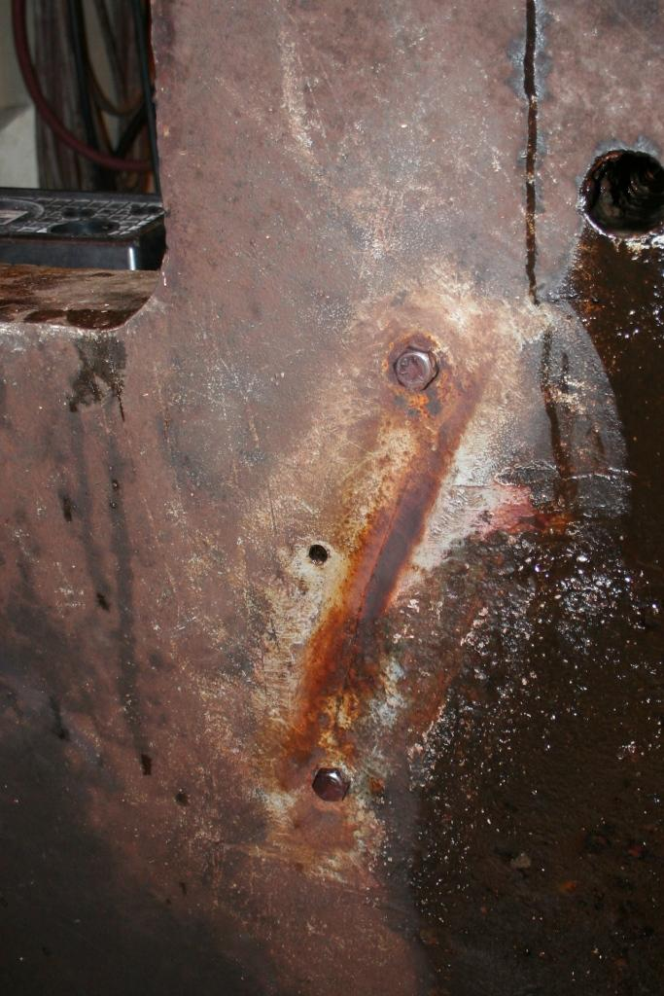
Draft Tube Liner Crack
Crack discovered and mitigated in April 2008
Two holes were drilled at the ends of the crack and two bolts installed
Still need to perform permanent weld repair
Crack

Slide 12
04 Feb 2009
Two plant workers heard a loud bang followed by severe vibration.
The unit experienced a severe vibration activating vibration alarms at the remote operations center 100 km away.
Unit historically ran rough and vibration alarms were silenced.
Cyclic pulsations and water leakage at the draft tube hatch door were observed.
Call was made to remote operator to shut unit down immediately.
VERY real life safety risk.

Slide 13
Draft Tube Hatch Door
Elev. 751.0
Notes:
Location of draft tube liner crack and draft tube entrance. Work platform is installed through this doorway.

Slide 14
Crack

Slide 15
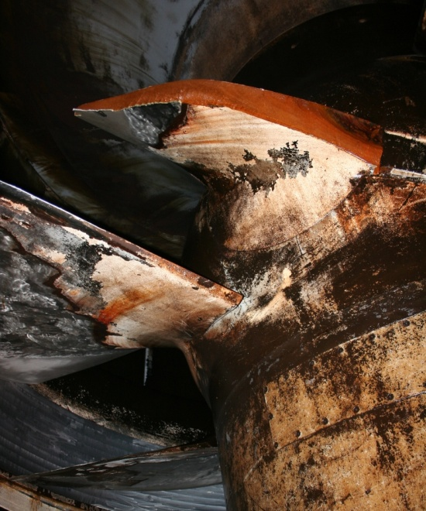
Blade Failure
Partial dewatering was performed to inspect turbine runner
Turbine blade #4 experienced a catastrophic failure
Potential cracks have been observed on four of the other five blades (blades #1, #3, #5, and #6)
Failed blade section was recovered by divers in August 2009

Slide 16
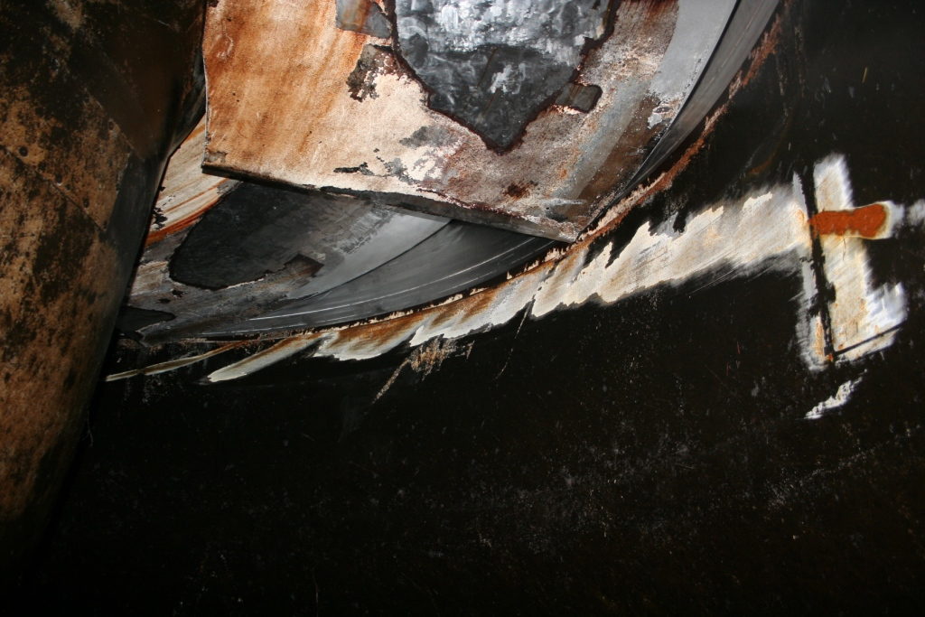
Draft Tube Liner Scoring from
Failed Blade Section
Notes:
No deep gouges were observed.

Slide 17
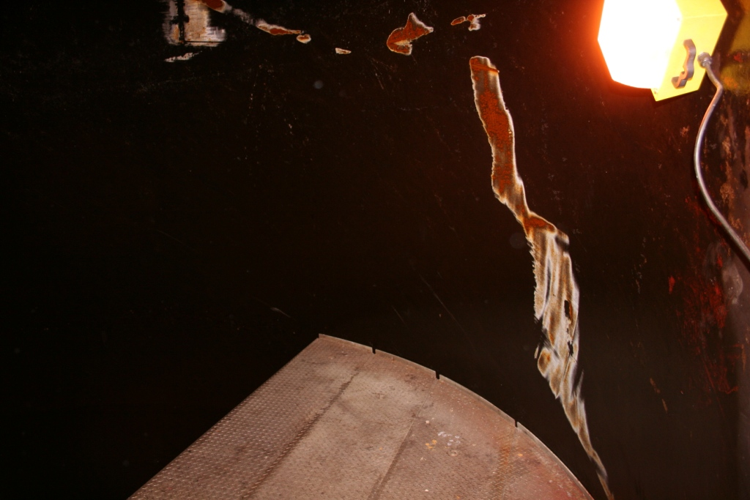
Draft Tube Liner Scoring from Failed Blade Section
Work Platform

Slide 18
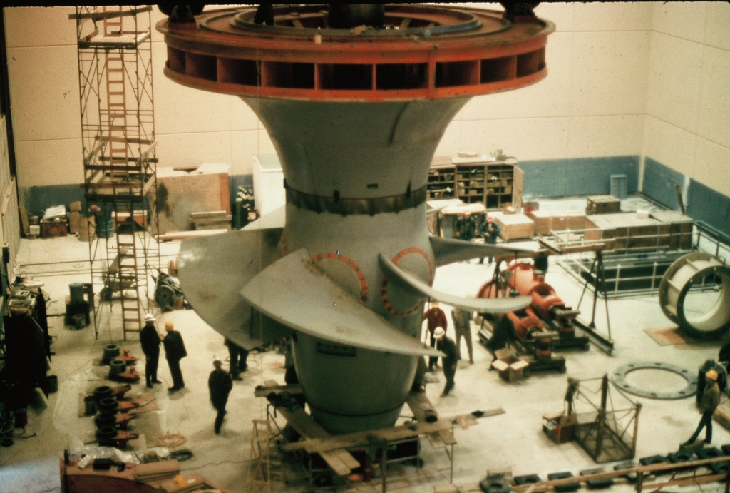
Blade Failure Location
Approximate Location
of Blade Failure

Slide 19
Potential Impacts
Had plant not been staffed, unlikely that remote operator would have shut down unit due to historic rough zone in turbine operation.
Breached draft tube hatch and liner, flooded powerhouse and likely resulted in runaway turbine and catastrophic damage to the turbine and powerhouse.
Pool would likely have drained since gates could not be closed and bulkheads cannot be placed in flow.
Unknown impacts on structural monoliths/dam.
Public perception of Dam Safety.

Slide 20
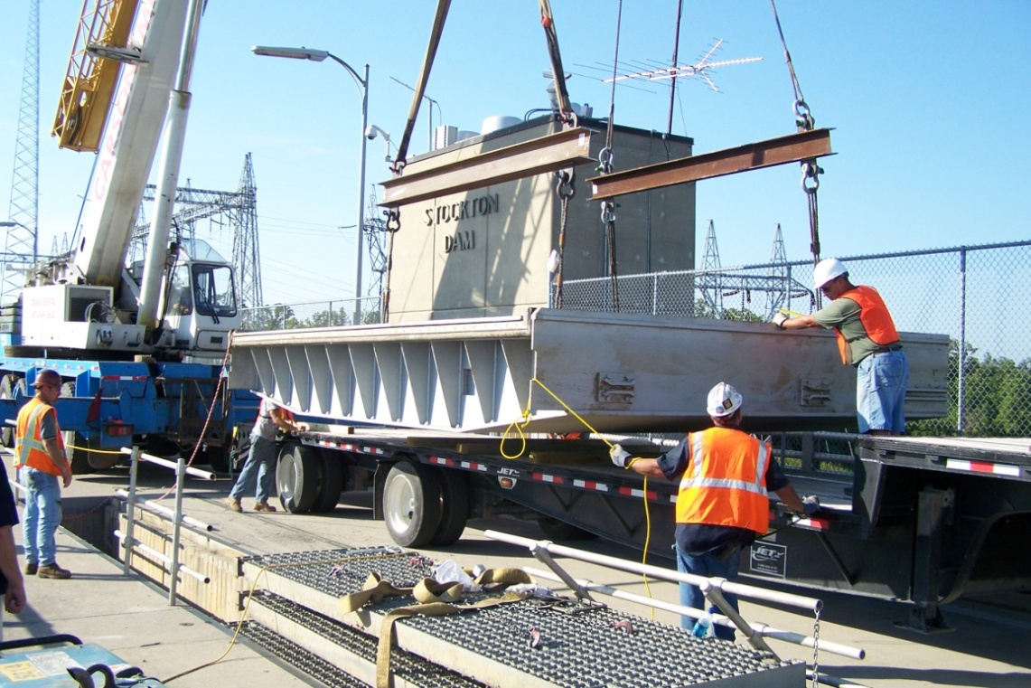
Hydraulic Steel Structure Repairs
Contract Awarded: July 09
Contractor: OCCI, Inc.
Contract Completion: April 10
Summary Weld Repair
  Draft Tube Bulkheads - 1000 cc on all 3 bulkheads
  Intake Bulkheads – 740cc on all 3 bulkheads
  Intake Gates - 385 cubic inches on all 3 gates
Other Work
  Replacement of anodes on intake gates
  Replacement of seals on intake and draft tube bulkheads
Total Contract Costs: $1,156,834

Slide 21
Repair Summary
Work Item | Cost
Failed Blade Section Recovery (Completed) | $69,487
Hydraulic Steel Structures (HSS) Inspection/Repair (Completed) | $1,156,834
Main Power Transformer Replacement | $1,134,650
In-place Turbine Blade Repair (Completed) | $1,352,250
Blade Placement in Draft Tube (Completed) | $16,100
Generator Rewind, Turbine Runner, Governor, and Exciter Replacement | $30,818,940
13.8 kV GM and Station Service Breakers and Station Service Transformer Replacement | $334,500
AC/DC Preferred Systems Replacement | $469,964
Transformer Pad and Secondary Containment Construction | $525,076
EDC, S&A, and Contingency | Approx. $6,705,199
Total | $42,583,000

Slide 22
Systems Engineering
(Pat Reagan, FERC)
A high level, top-down, view of the system similar to NAT that considers the relationships between technical, organizational and social aspects.
Safety and reliability are different properties of a system that are often in conflict.
This distinction is becoming increasingly important in dam safety with the increased use of SCADA systems.

Slide 23
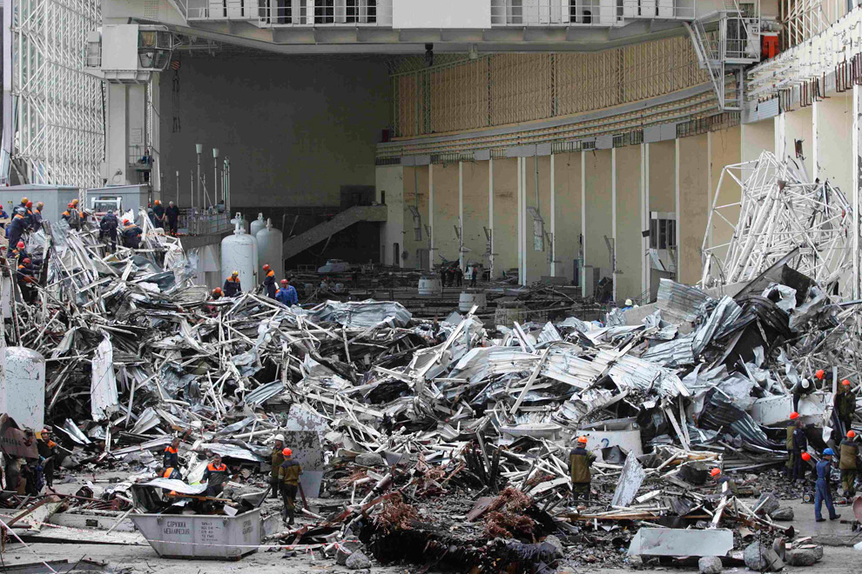
Sayano-Shushenskaya
23

Slide 24
Potential Hydropower Impacts
(Pat Reagan, FERC)
In the dam safety community we do the first part, examining a single failure, fairly well.
In few instances do we adequately address the combination of failures – the system failures.
  An example is the thought that we don’t need to simultaneously consider earthquake and flood loading. What we often overlook is the fact that if an earthquake severely damages a critical component such as a spillway, we only have until the onset of the next rainy season to repair the damage without endangering the dam and the population at risk.

Slide 25
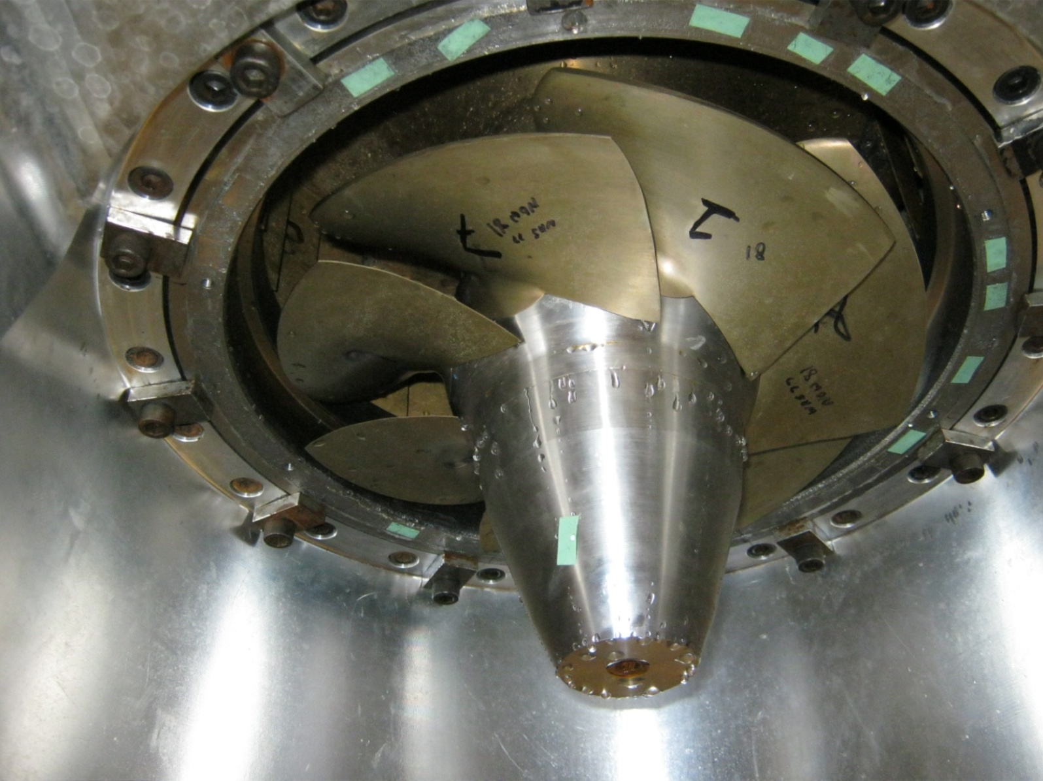
Discussion

