Slide 1
Dam Safety Monitoring and Instrumentation
William Empson, PE, PMP
Senior Levee Safety Program Risk Manager
U.S. Army Corps of Engineers
Risk Management Center
William.B.Empson@usace.army.mil
Dam Safety Workshop
Brasília, Brazil
20-24 May 2013

Slide 2
LEARNING OBJECTIVES
Explain the importance & benefits of a dam safety monitoring, instrumentation, and evaluation program.
Describe the types of instrumentation and the features to monitor
Present case histories, as actual examples of a dam safety monitoring & continuing evaluation program.

Slide 3
Common Types of Instrumentation
Crack Monitors
Movement Indicators
Slope Indicators
Settlement Plates
Piezometers
Flow Rate Measurement Devices

Slide 4
Common Types of Monitoring
Inspection
Collecting Measurements
Surveys
Scour Surveys
Foundation Drain Flow

Slide 5
Typical Schedule of Required Observations for Physical Measuring Devices
Regular
3 Months
3 Months
3 Months
1 year
1 Year
1 Year
1 Year
N/A
1 Month
Flood Control
Weekly *
Weekly *
Weekly +
Weekly *
1 Month
**
**
***
Weekly *
Embankment Piezometers + ++
Foundation Piezometers ++
Abutment Piezometers ++
Slope Indicators +
Embankment Settlement Gage ++
Surface Settlement & Horizontal
Movement Points +
Reference Monument-Bridge
Abutments & Piers +
Outlet Works Conduit Reference Plugs +
Parshall Flumes ++
Weekly observation during storage exceeding prior maximum pools of record, and
additional reading for each five feet of change in pool elevation above or below normal pool.
** Periodic Observations during flood control storage and drawdown.
*** Observation as warranted during storage exceeding prior maximum pools of record.

Slide 6
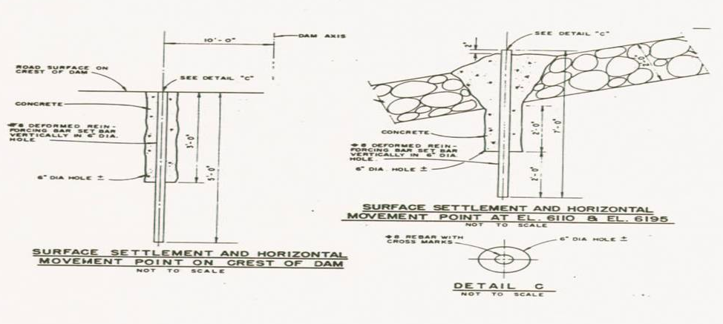
Surface Settlement & Horizontal Movement Points

Slide 7
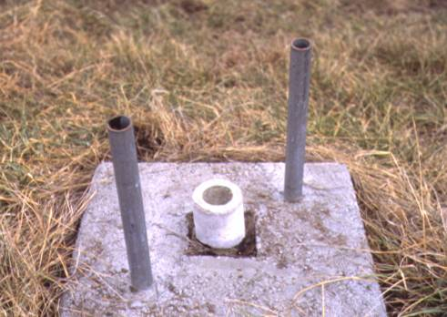
Survey Control Monument

Slide 8
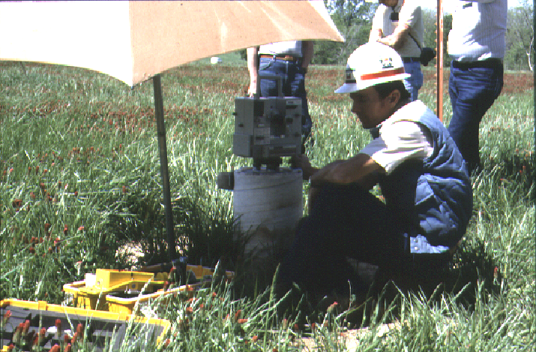
Survey Control

Slide 9
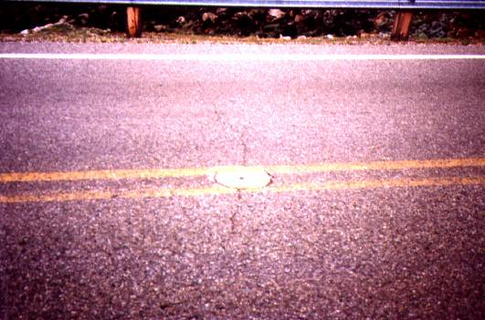
Surface Settlement Point

Slide 10
Settlement

Slide 11
Horizontal Movement

Slide 12
Settlement & Horizontal Movement
Movement Downstream
Movement Upstream

Slide 13
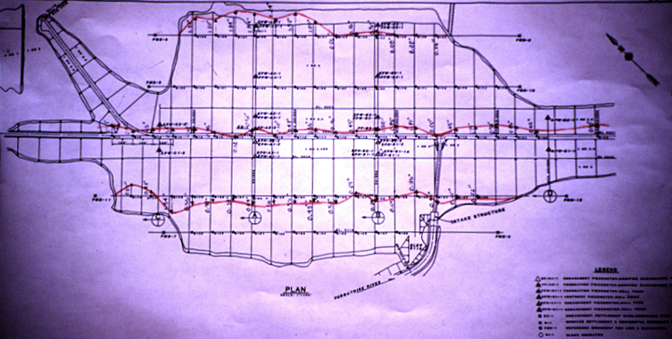
Horizontal Movement

Slide 14
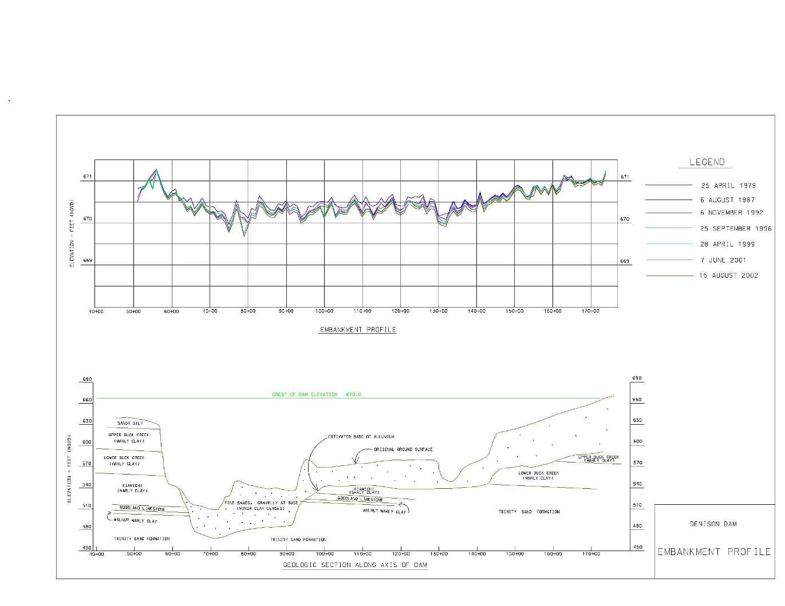
Settlement

Slide 15
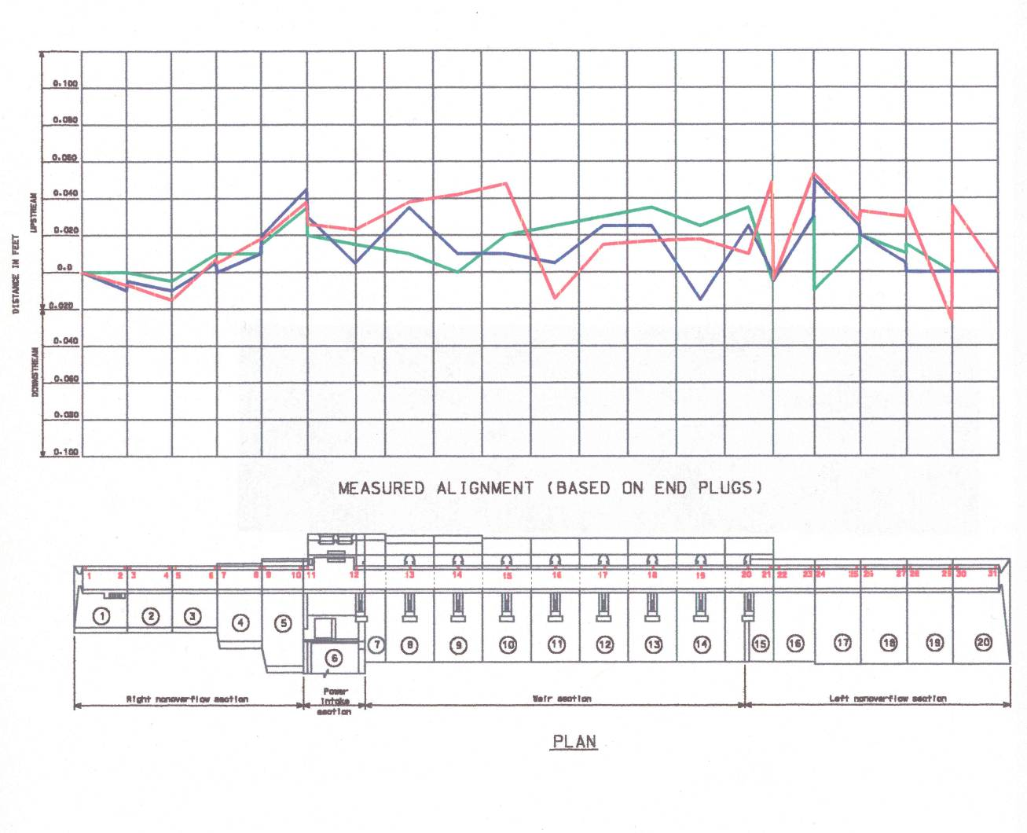
Horizontal Movement

Slide 16
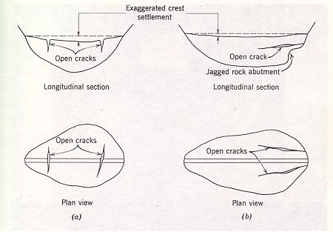
Transverse & Longitudinal Cracks

Slide 17
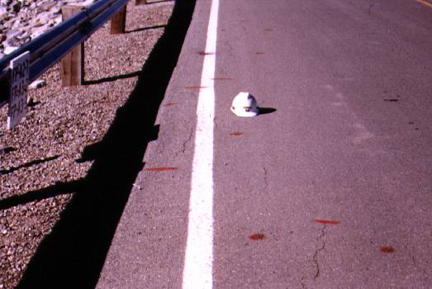
Longitudinal Cracks

Slide 18
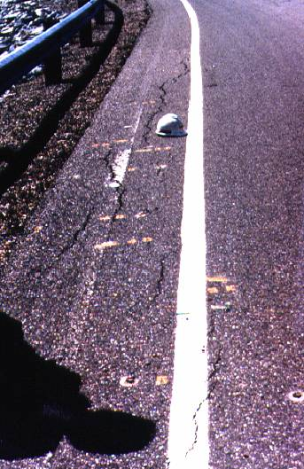
Longitudinal Cracks

Slide 19
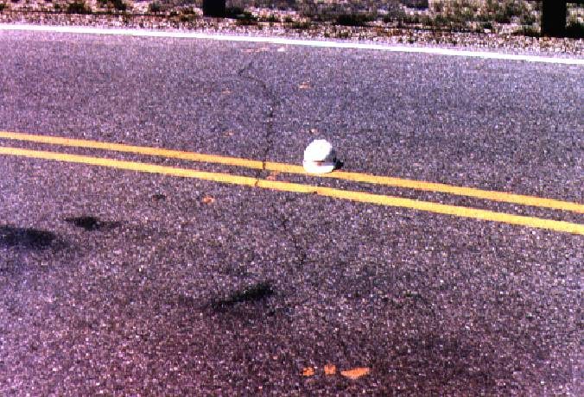
Transverse Crack

Slide 20
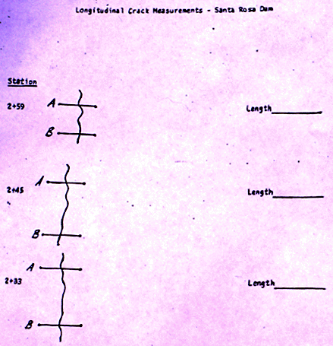
Crack Measurements

Slide 21
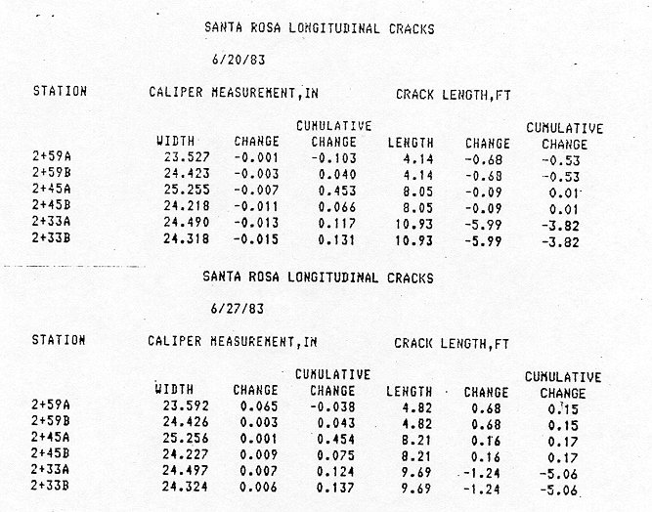
Crack Measurements

Slide 22
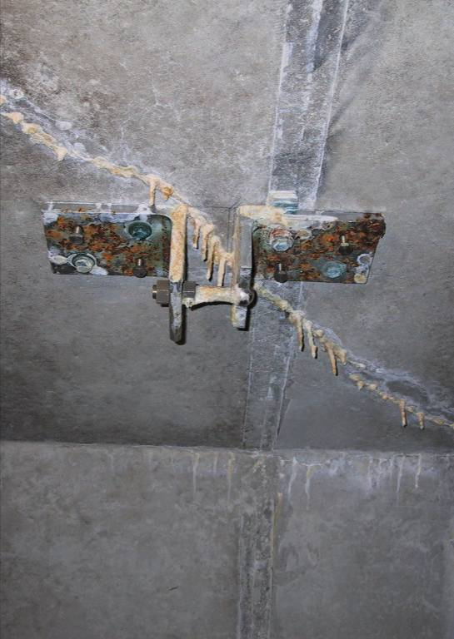
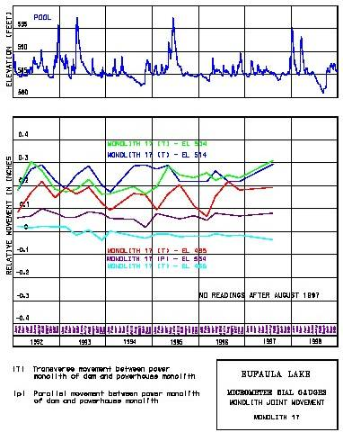
Crack Measurements

Slide 23
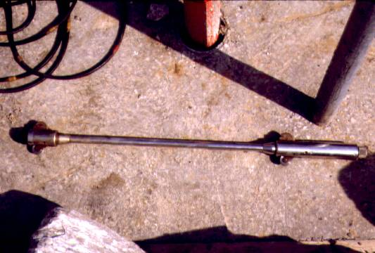
Slope Inclinometer

Slide 24
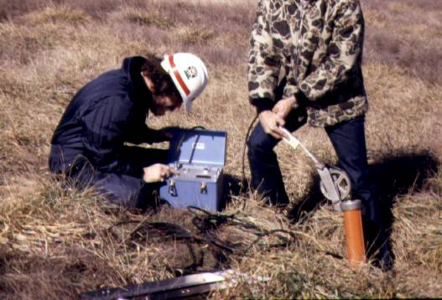
Slope Inclinometer Measurements

Slide 25
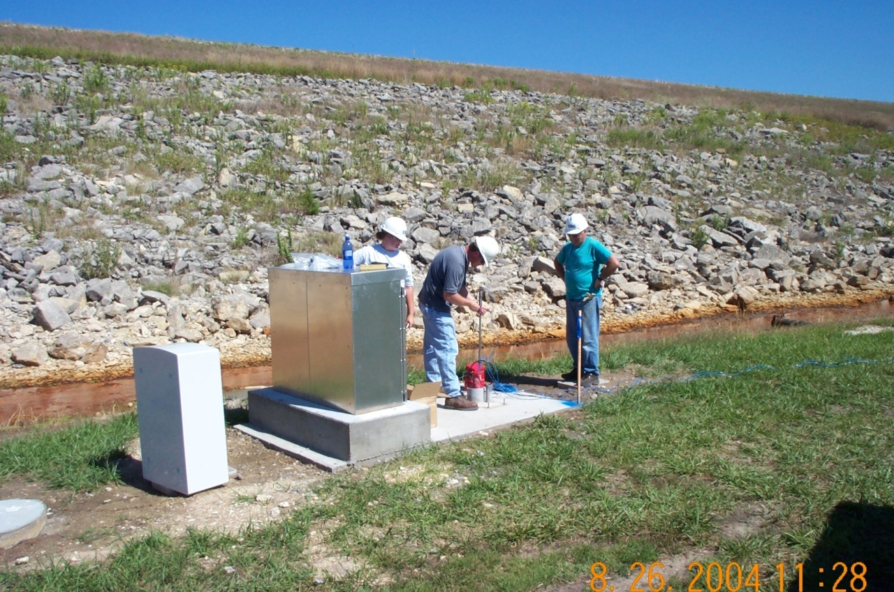
In-Place Inclinometers

Slide 26
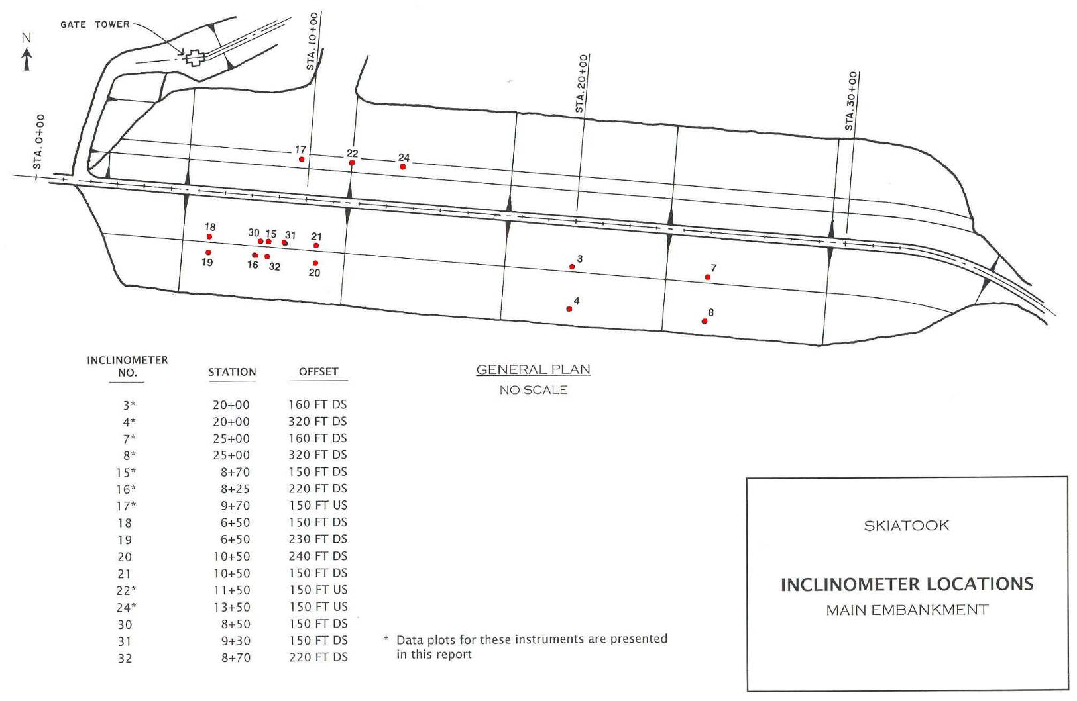
Slope Inclinometer

Slide 27
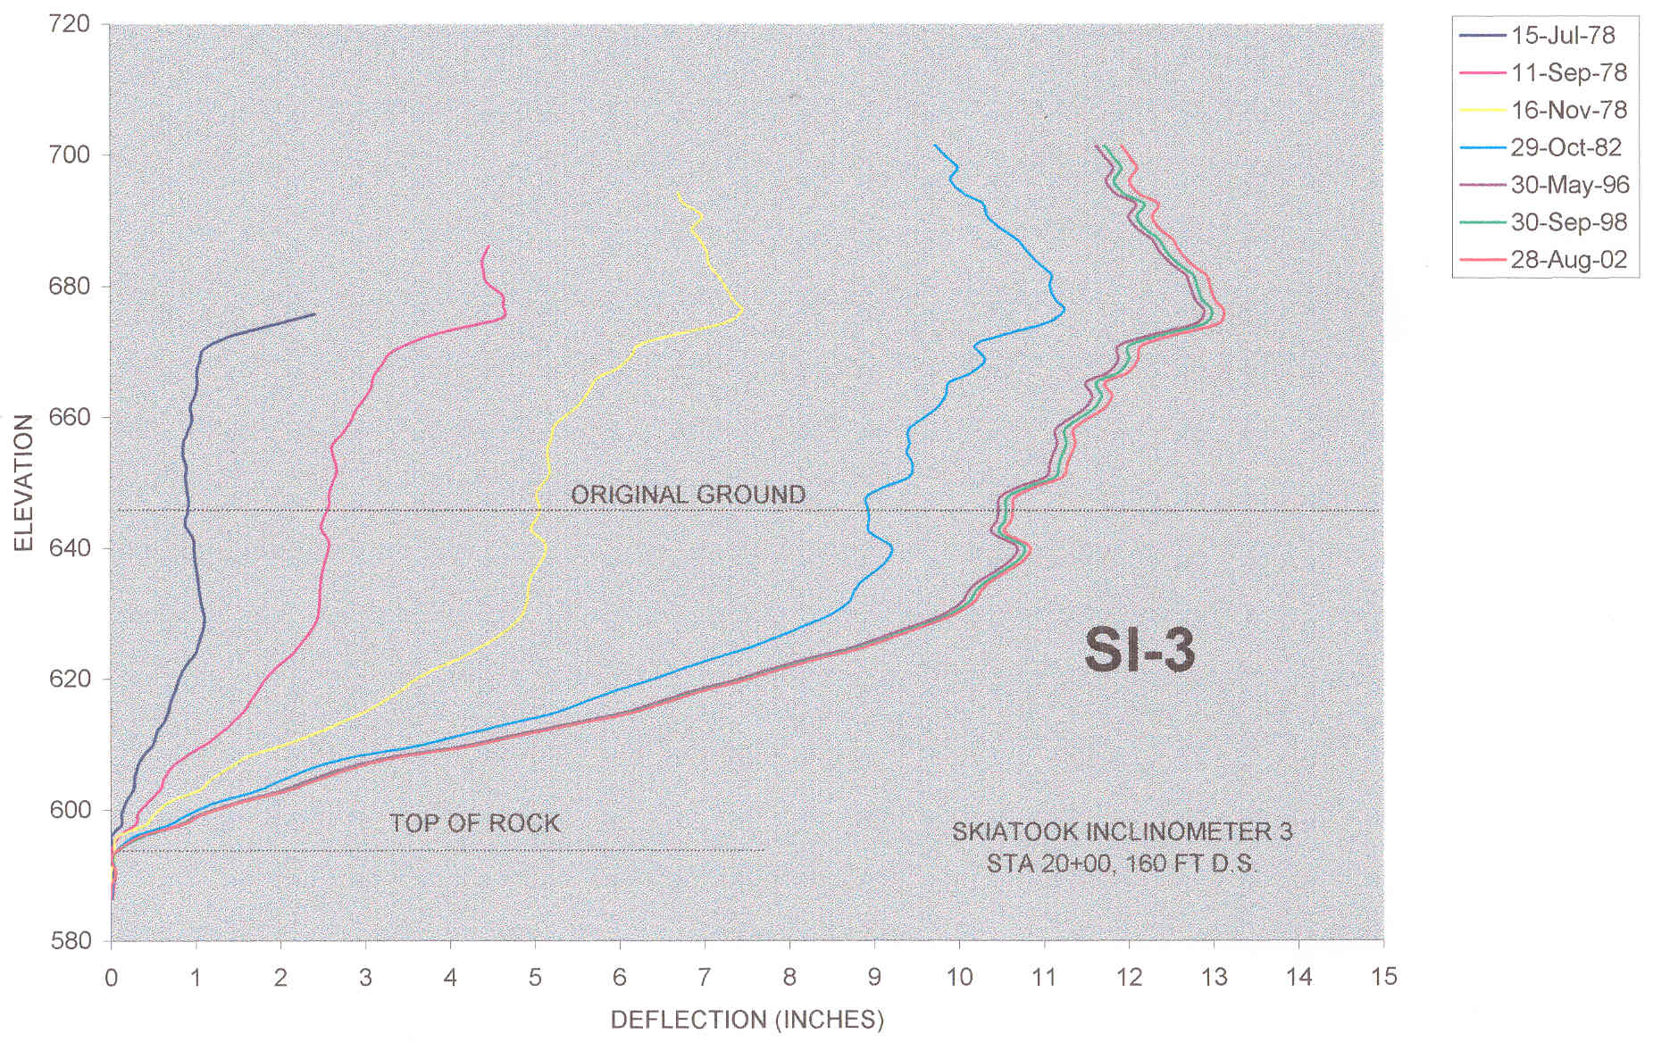
Slope Inclinometer

Slide 28
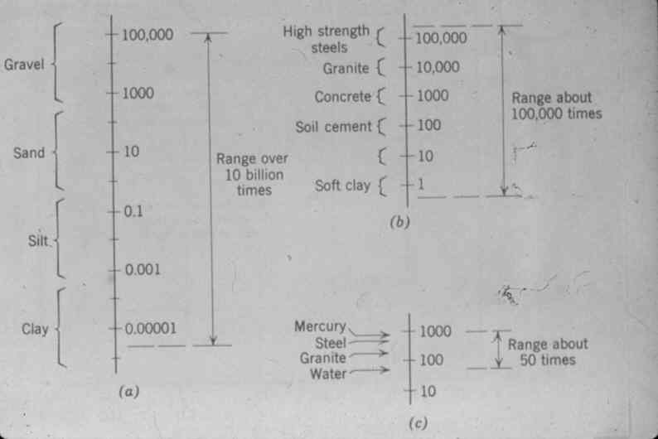
Range in Permeability

Slide 29
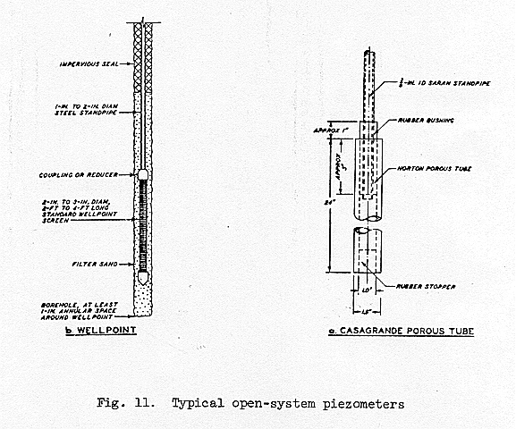
Open System Piezometers

Slide 30
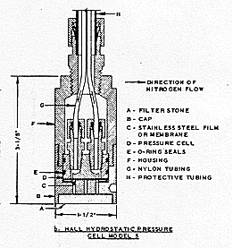
Closed System Piezometer

Slide 31
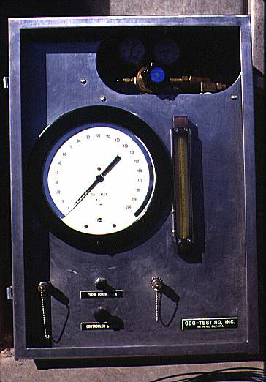
Closed System Piezometer Readout

Slide 32
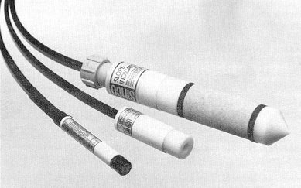
Pneumatic Piezometer

Slide 33
Pneumatic Piezometer
Pneumatic Piezometers
    Twin pneumatic tubes run from the piezometer to a terminal at the surface.
    The piezometer contains a flexible diaphragm. Water pressure acts on one side of the diaphragm and gas pressure acts on the other.
    Compressed nitrogen gas from the indicator flows down the input tube to increase gas pressure on the diaphragm. When gas pressure exceeds water pressure, the diaphragm is forced away from the vent tube, allowing excess gas to escape.

Slide 34
Pneumatic Piezometer
Pneumatic Piezometers (cont.)
    When the return flow of gas is detected at the surface, the gas supply is shut off. Gas pressure in the piezometer decreases until water pressure forces the diaphragm to its original position, preventing further escape of gas through the vent tube.
    At this point, gas pressure equals water pressure.

Slide 35
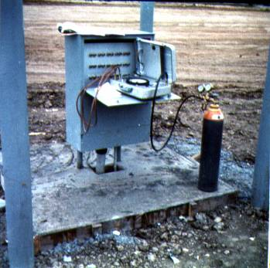
Instrumentation Terminal

Slide 36
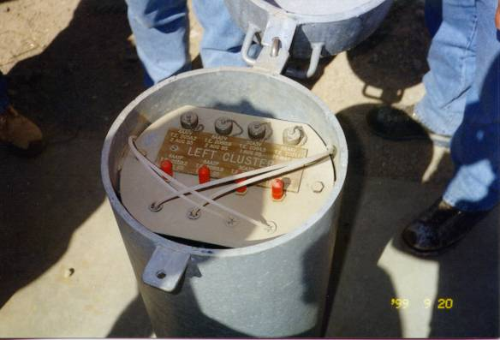
Seven Oaks Dam

Slide 37
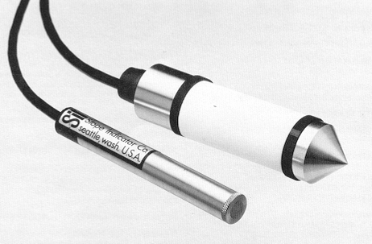
Vibrating Wire Piezometer

Slide 38
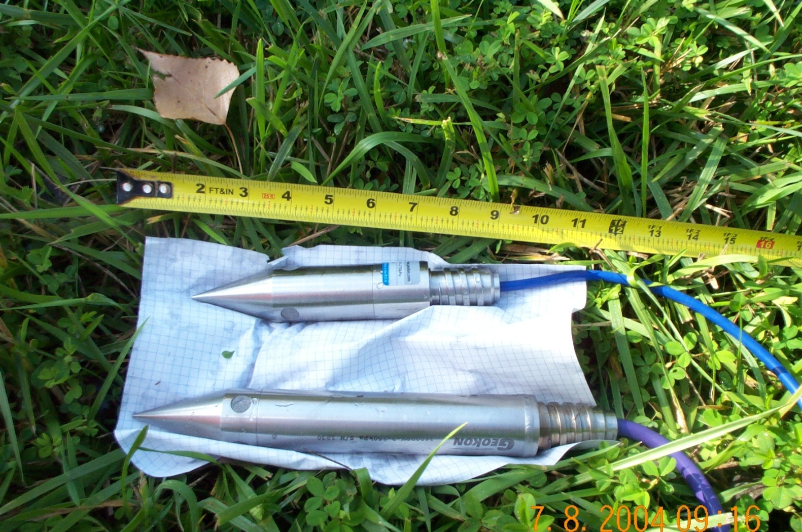
Vibrating Wire/Strain Gage Piezometers (no trigger)
VWP Geokon 4500DP
SGP Geokon 3400DP

Slide 39
Vibrating Wire Piezometer
VWP Piezometers
    The VWP piezometer converts water pressure to a frequency signal via a diaphragm and a tensioned steel wire.
    The vibration of the wire in the proximity of a magnetic coil generates a frequency signal that is transmitted to the readout device. The readout device processes the signal and displays a reading.

Slide 40
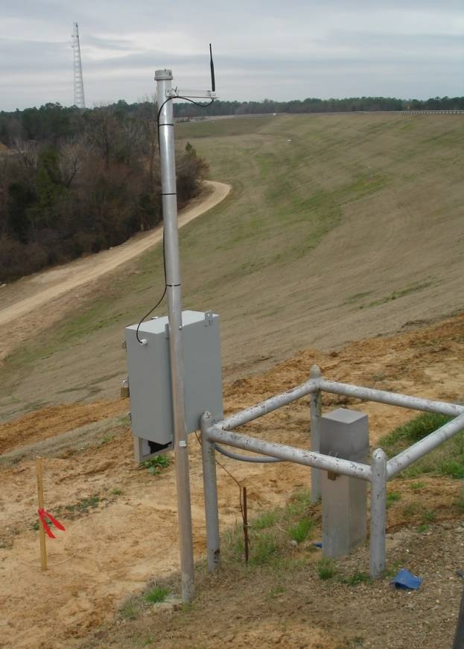
Pine Creek Instrument

Slide 41
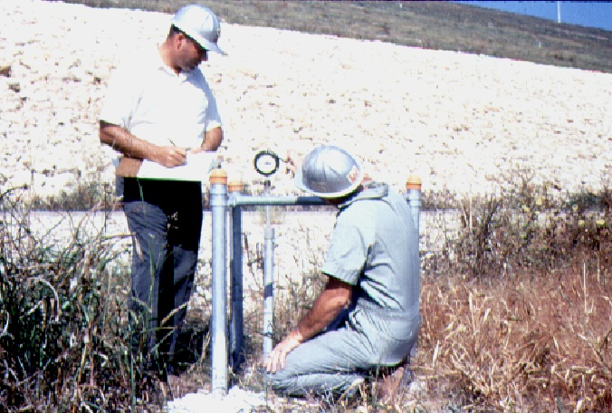
Project Personnel Training

Slide 42
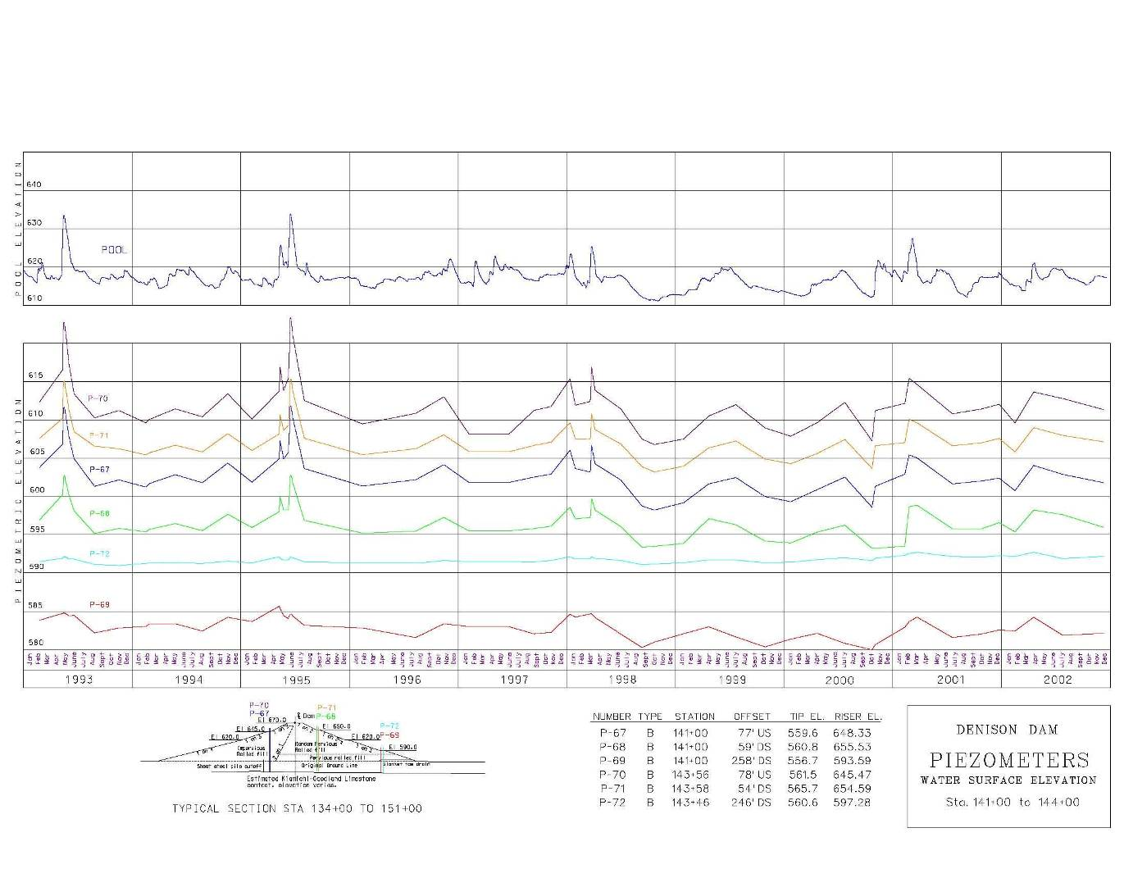
Typical Piezometer Plot

Slide 43
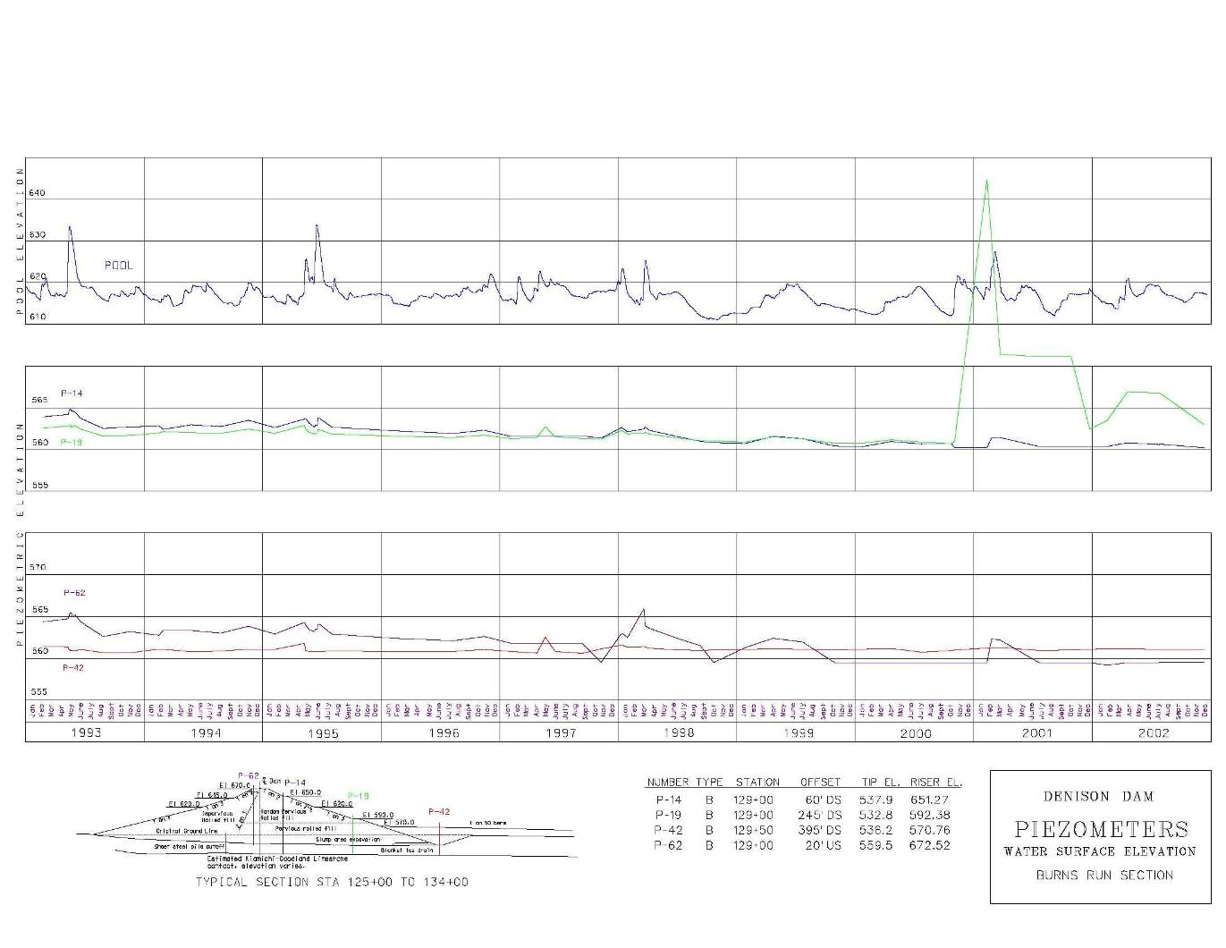
Typical Piezometer Plot

Slide 44
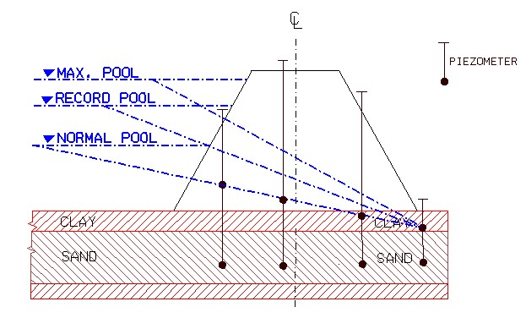
Extrapolation of Piezometer Data

Slide 45
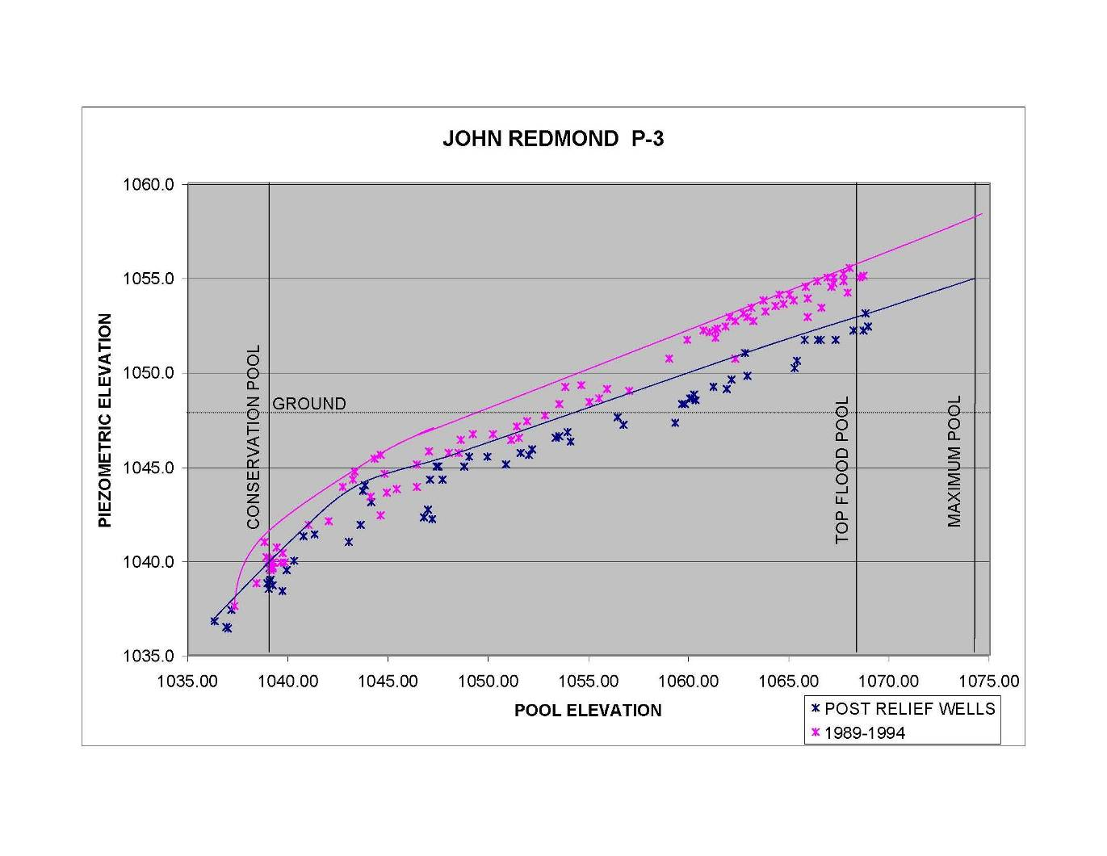
Pool vs. Piezometer Elevation

Slide 46
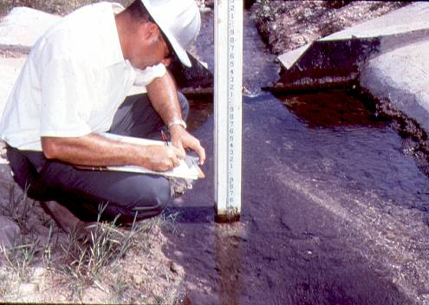
V-Notch Weir Seepage

Slide 47
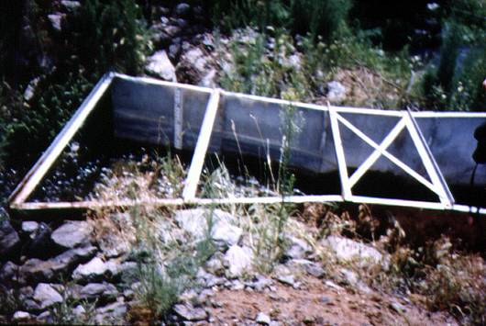
Parshall Flume Measurement

Slide 48
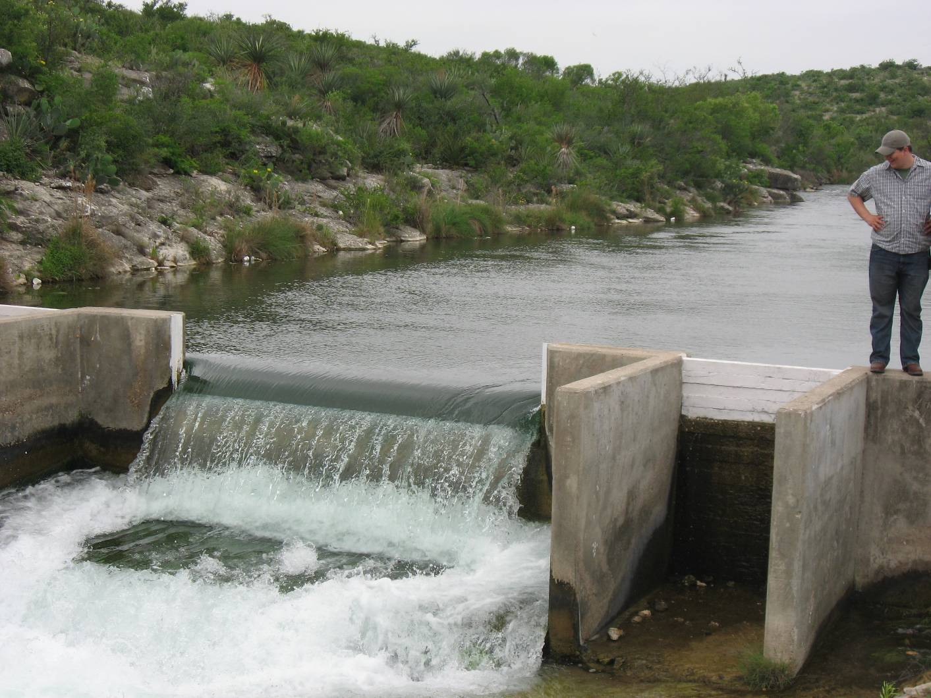
Broadcrested Weir

Slide 49
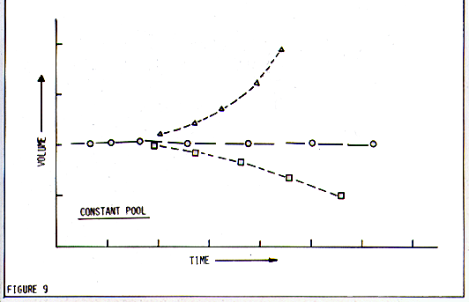
Seepage Rate vs. Time

Slide 50
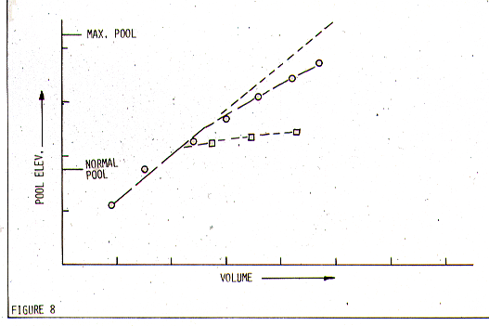
Pool Elev. vs. Seepage Rate

Slide 51
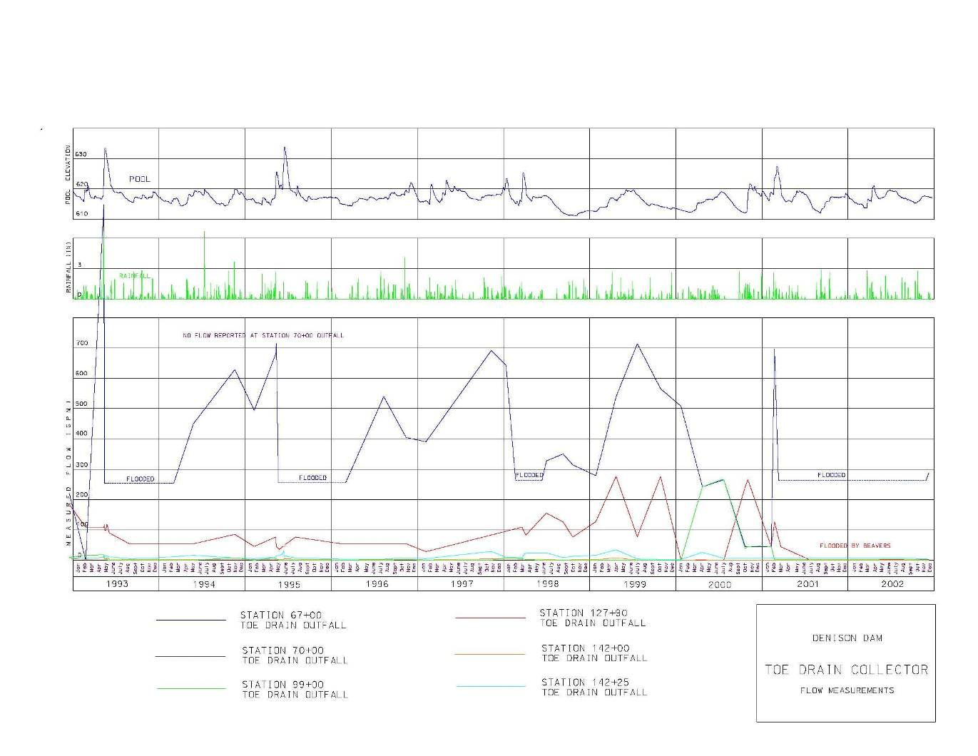
Precipitation - Seepage
Rate Relationship

Slide 52
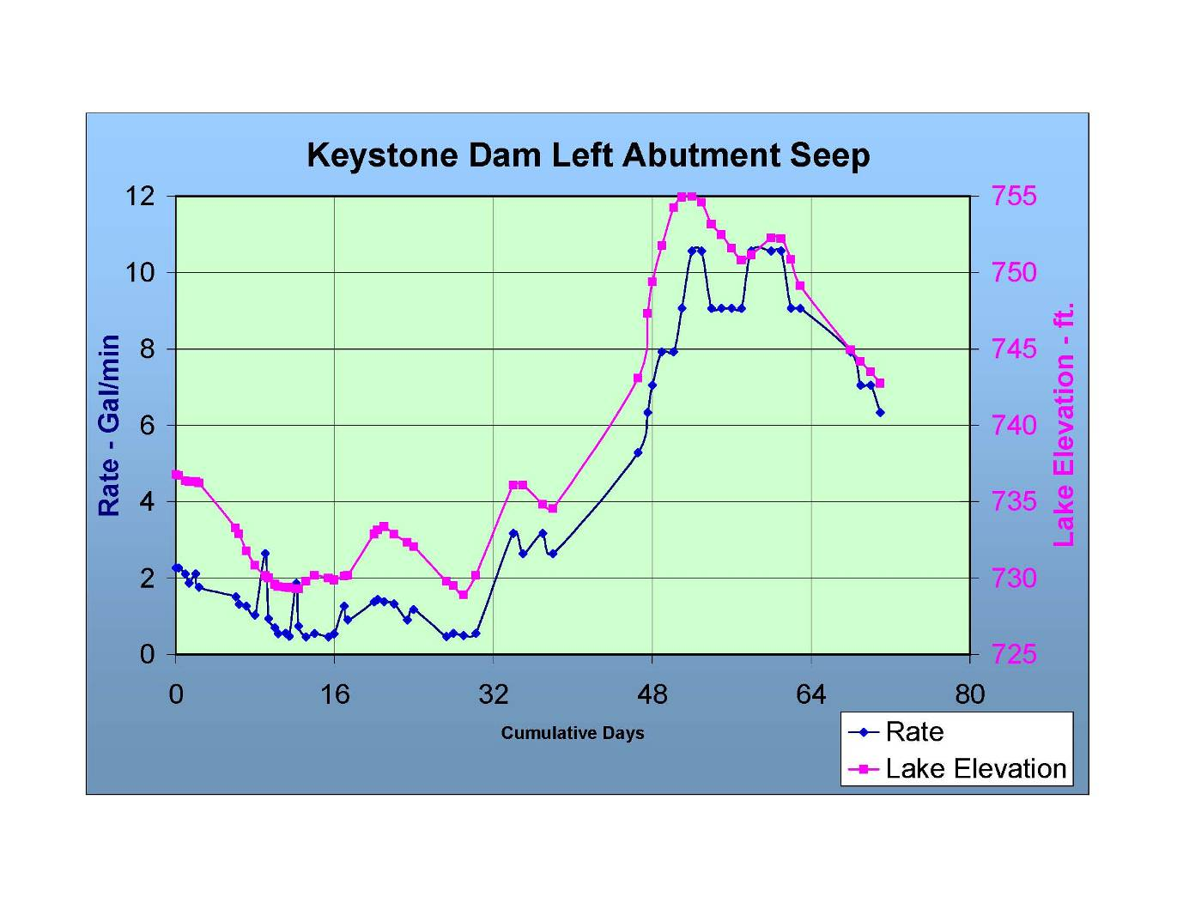
Pool - Seepage Rate Relationship

Slide 53
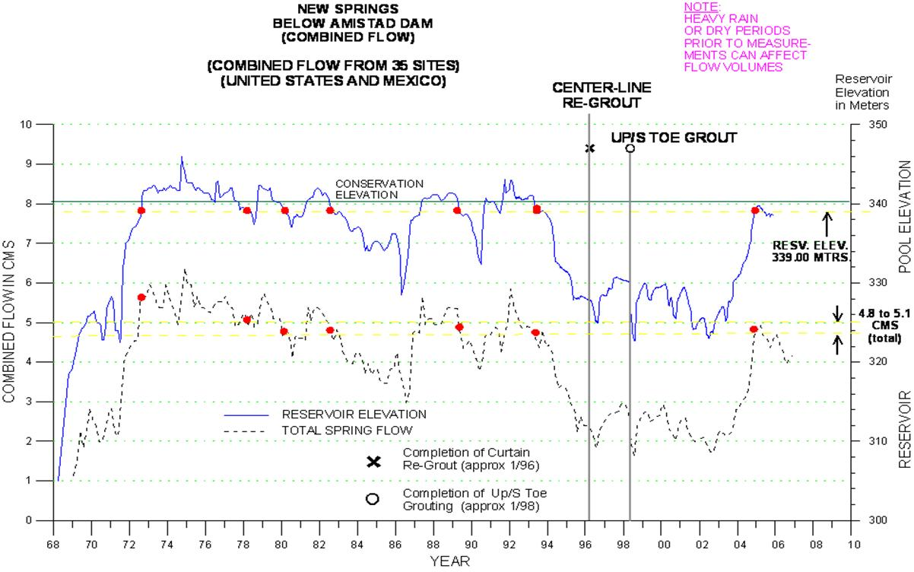
Pool - Seepage Rate Relationship

Slide 54
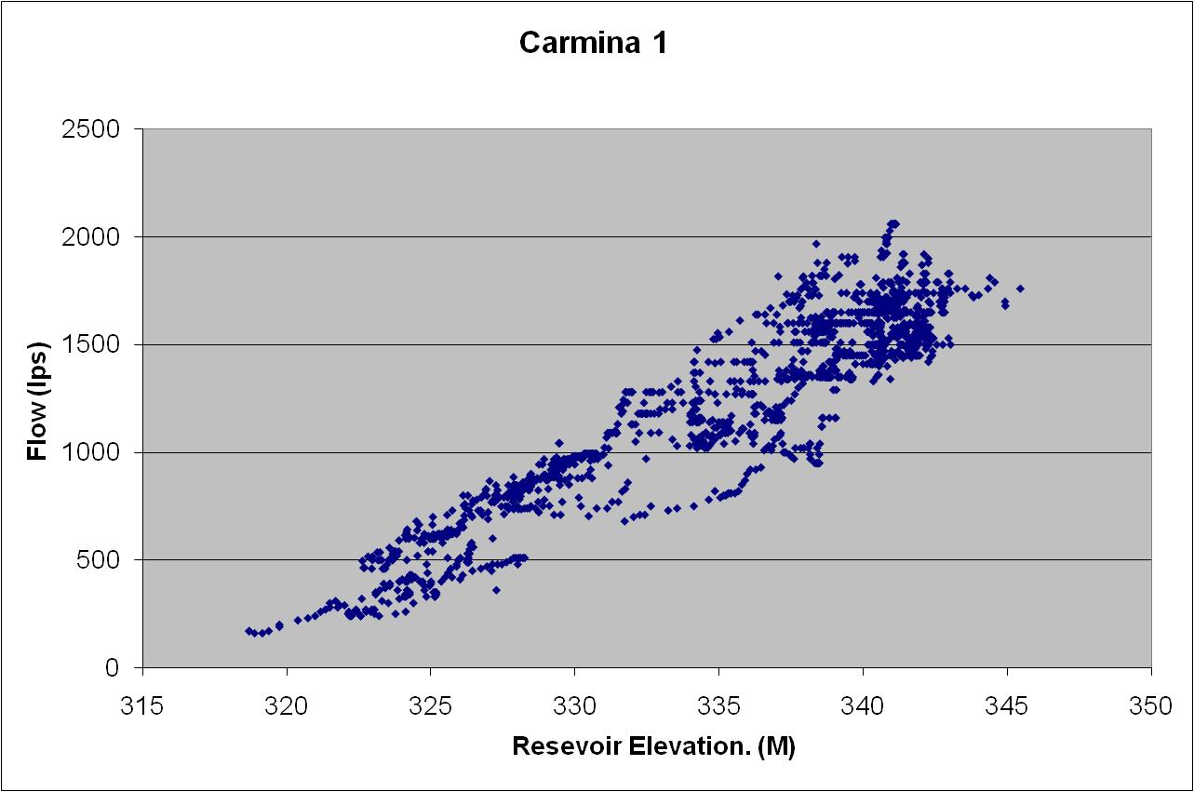
Pool - Seepage Rate Relationship

Slide 55
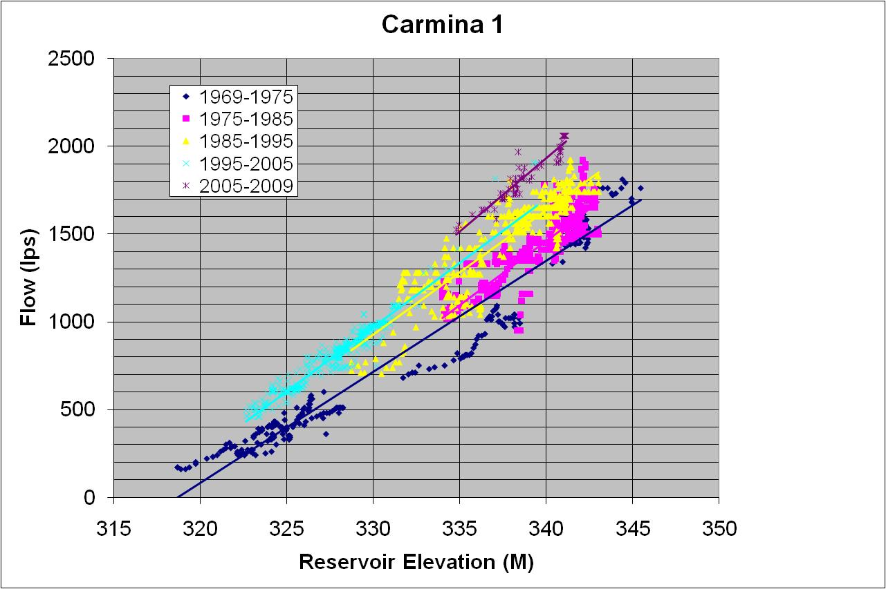
Pool - Seepage Rate Relationship

Slide 56
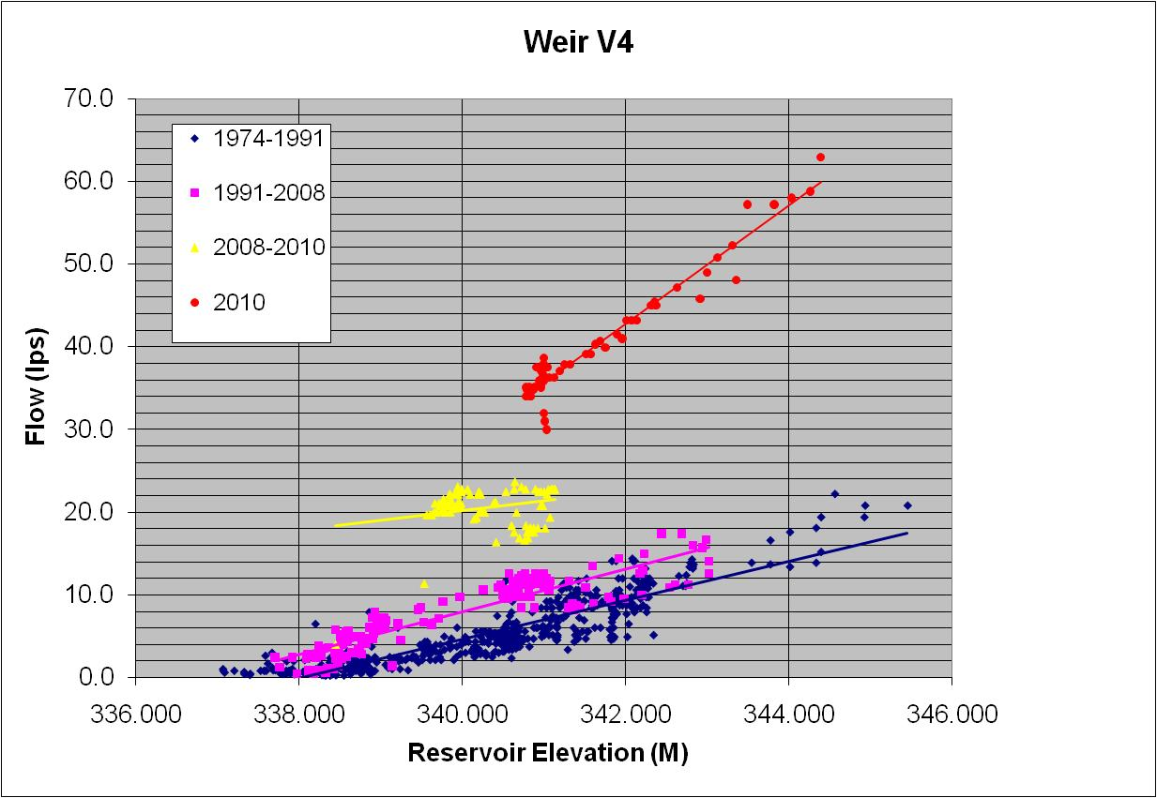
Pool - Seepage Rate Relationship

Slide 57
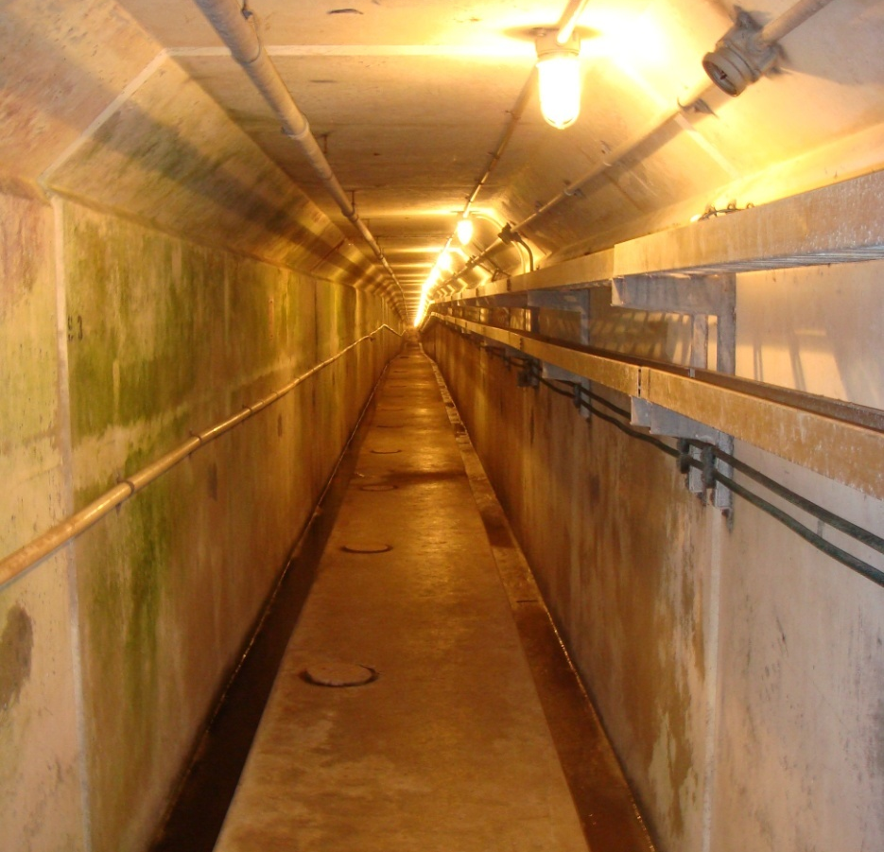
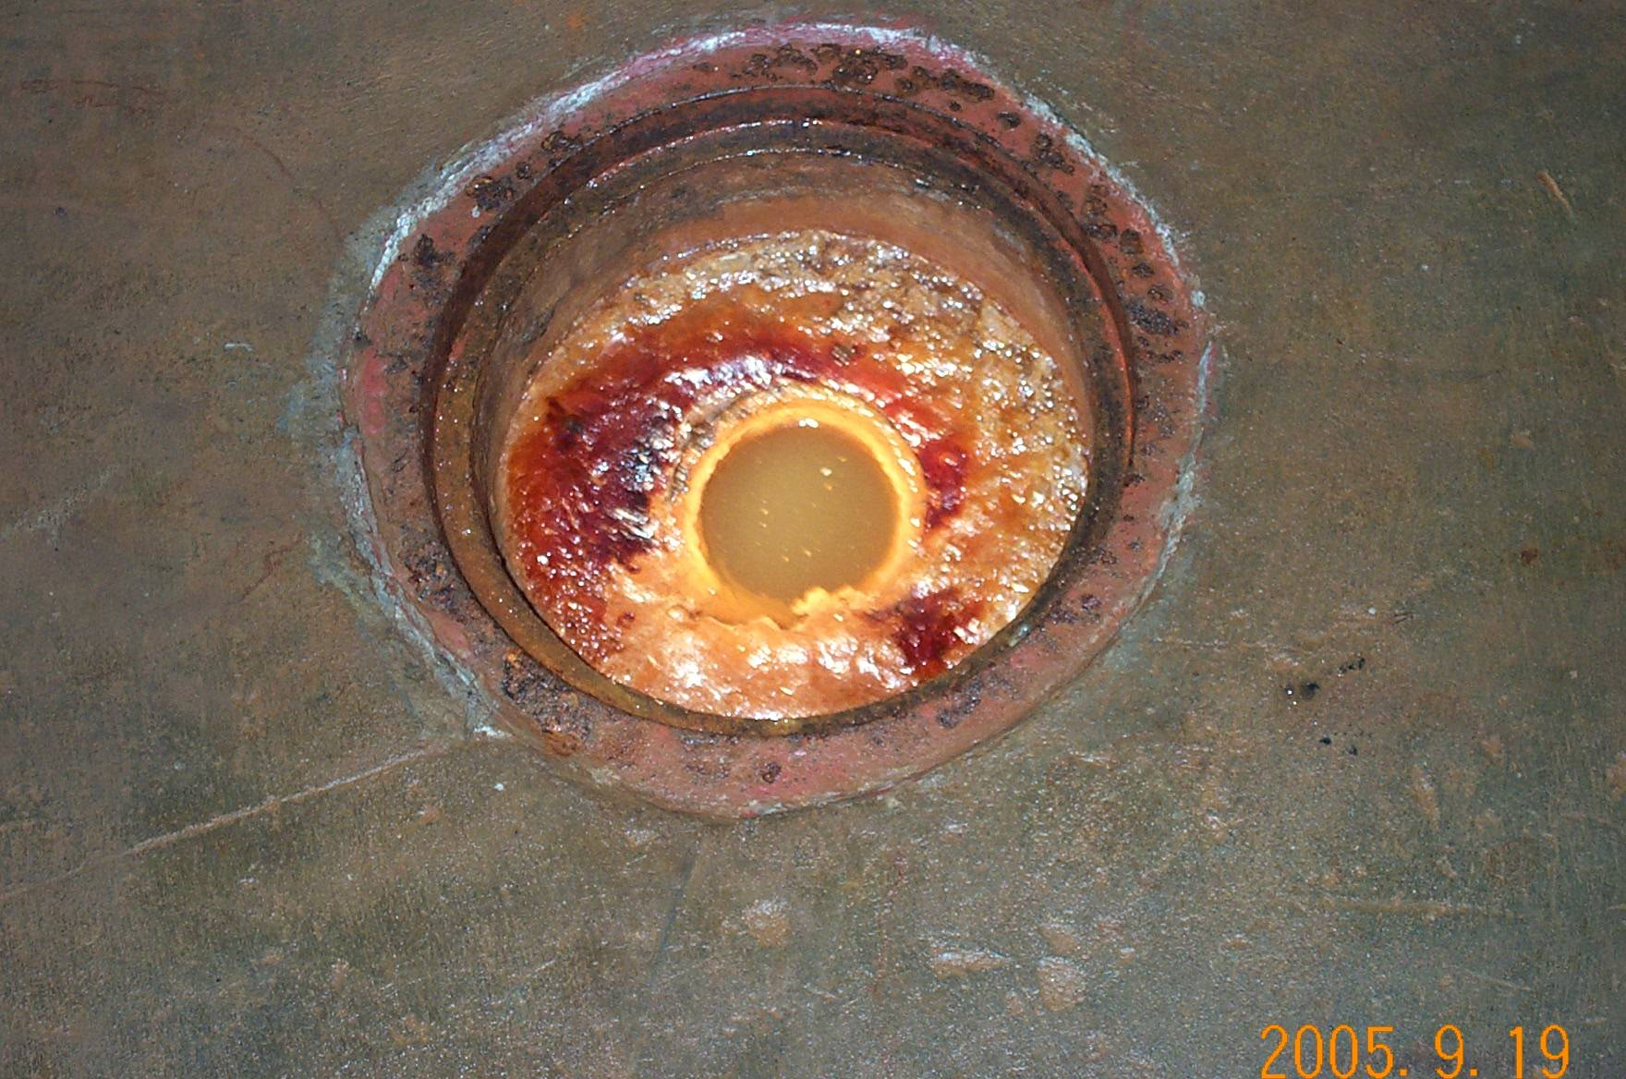
Foundation Drains

Slide 58
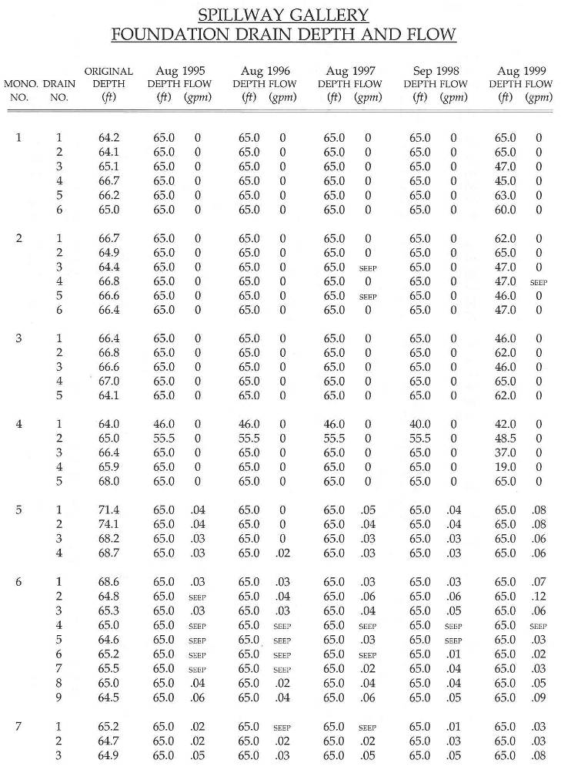
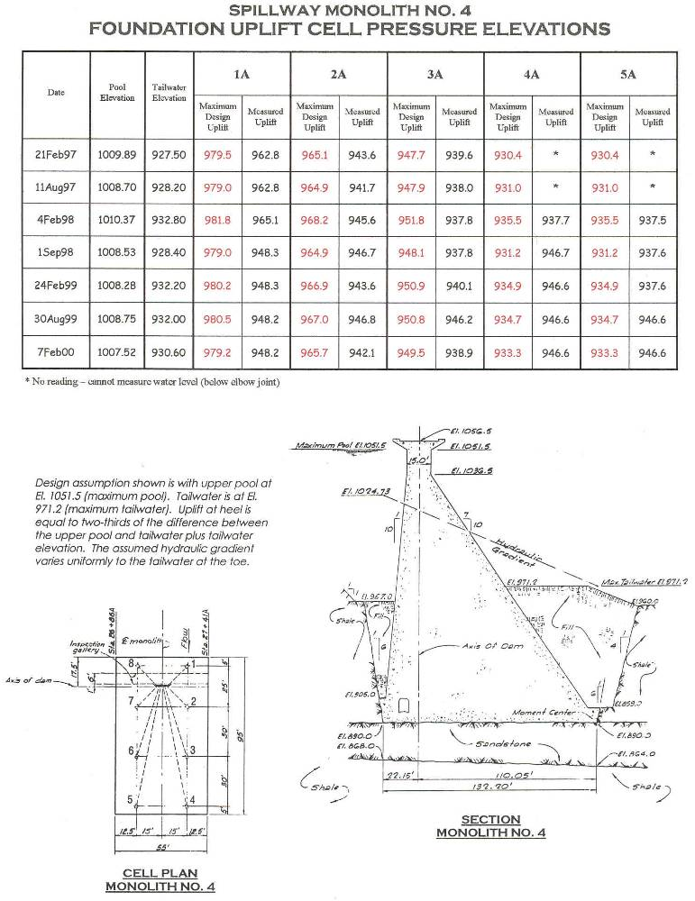
Gallery Instrumentation
Foundation drains Clogging!
Increased Uplift pressures!

Slide 59

Sump Inflow

Slide 60

Digital Accelerographs (Etna SMA) Dual Trigger

Slide 61

Time Domain Reflectometry Cables (TDR)

Slide 62

TDR Trench / RMU 6

Slide 63


Installing TDR Cables

Slide 64
Dam Crest Integrity Monitor
Trigger
Three Loop System (RMU 1)
Linked to Siren Activation System (Radio)
Linked to ADAS (Radio)

Slide 65




Dam Safety
Instrumentation Automation

Slide 66

Typical Network

Slide 67
Advantages
Increased Accuracy, Frequency & Consistency.
Can be placed in areas of poor accessibility.
Remote Acquisition, Programming, Diagnostics.
Timeliness of Information.
Check Data Validity.
Program for Increased Frequency at Trigger levels.
Monitor Unpredictable Events.
Alarms – 24 hours a day, 365 days a year.
Compatibility with a Variety of Functional Needs.
Caution!!! Replace Personnel.

Slide 68
Automation Challenges
Vandalism.
Lightning (Can Mitigate).
Instrument Type.
Maintenance.
Specialized Expertise.
Physical Environment Constraints.
Cost: Installation and Maintenance.
Data Management.
No Eyes on Project.

Slide 69
“An instrument too often overlooked in our technical world is a human eye connected to the brain of an intelligent human being.”
– Ralph Peck

Slide 70


Hydrographic Surveys

Slide 71
DISCUSSION

