Slide 1
Emergency Action Plans
William Empson, PE, PMP
Senior Levee Safety Program Risk Manager
U.S. Army Corps of Engineers
Risk Management Center
William.B.Empson@usace.army.mil
Dam Safety Workshop
Brasília, Brazil
20-24 May 2013

Slide 2
Emergency Planning
and Response
Reasons for Emergency Planning and Response
Criteria for Effective Plans
Emergency Response Exercises
Notes:
Today we will discuss 1) 2) 3) and 4)

Slide 3
Emergency Planning and Response
A dam safety emergency situation is a condition that:
Develops unexpectedly; sinkhole, earthquake, seepage increase.
    -Decisions must be made now.
Develops relatively gradually; flood, depression, slope movement.
-Decision timing is more difficult.
Endangers the integrity of the dam or a component and/or endangers property or lives.
Requires action.
Notes:
What constitutes a dam safety emergency?

Slide 4
What conditions might create a potential emergency?
Dam breach
Developing conditions
Component failure
Unusual loading
Gate malfunction
SDF or high discharge
Human error
Sabotage

Slide 5
What is ....
....an Emergency Action Plan?
A formal plan that identifies potential emergency conditions at a dam and describes procedures to minimize property damage and loss of life.
EAPs are interim or permanent risk reduction measures

Slide 6

Why do we need
emergency plans?
To provide for TIMELY notification,
warning, and evacuation
Reduce loss of life risk
Evacuation is a local responsibility
USACE cannot order an evacuation
Notes:
Emergency plans help to eliminate guess work. Evacuation routes can be selected and marked well in advance of an impending disaster. Shelters can be designated and stocked. Sandbags and portable dams can be stockpiled. Closure structures can be closed or water management plans can be implemented to lessen effects to property and reduce the risk of loss of life.

Slide 7
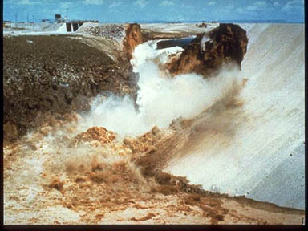
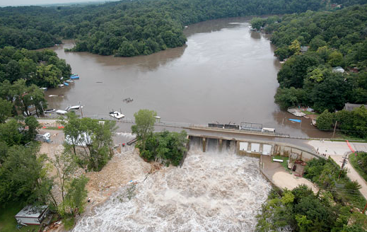
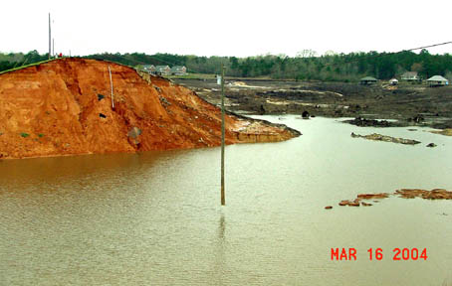
Despite our best efforts . .
Lake Delhi, Iowa 2010
Teton Dam, Idaho
Big Bay, MS - 2004
Notes:
These scenes are the result of levee failures in New Orleans following Hurricane Katrina. The sudden catastrophic failure of structures impounding water cause immediate devastation immediately downstream and can destroy lives and property hundreds of miles beyond, depending on the amount of water stored. Despite our best efforts, we can’t control water.

Slide 8
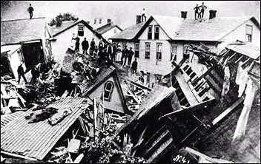
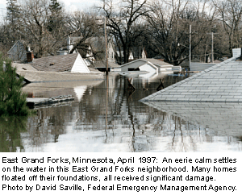
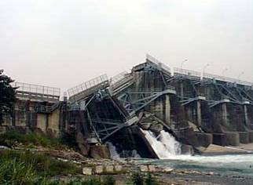
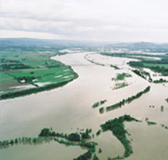
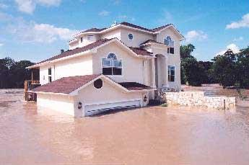
Reasons for Emergency Planning and Response
Pre-plan measures to prevent or
minimize the consequences……
Notes:
Pre-planning allows emergency personnel and the public to react to an emergency in a rational, methodical way. Evacuation route markers can help emergency workers move people in the right direction. Shelters can be designated and supplied to provide life support for evacuees. Reciprocity agreements can be worked out in advance with adjacent counties, etc. to provide additional emergency response and life support. Emergency personnel can concentrate on the specifics of the crisis rather than the things that can be planned in advance.

Slide 9
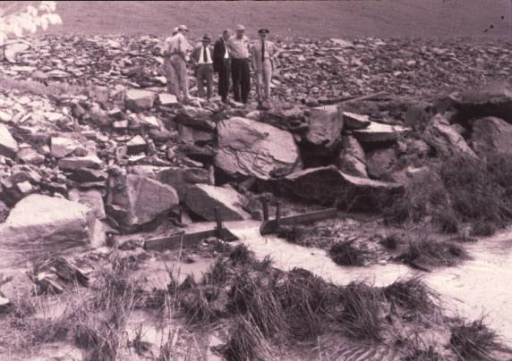
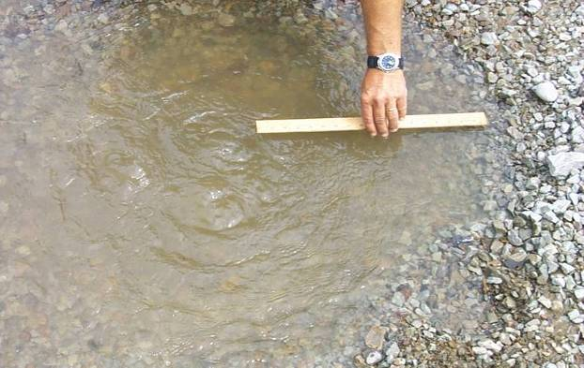
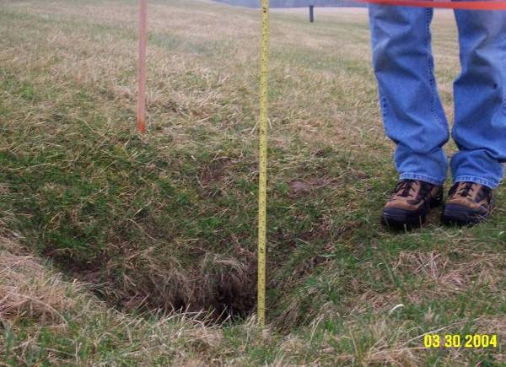
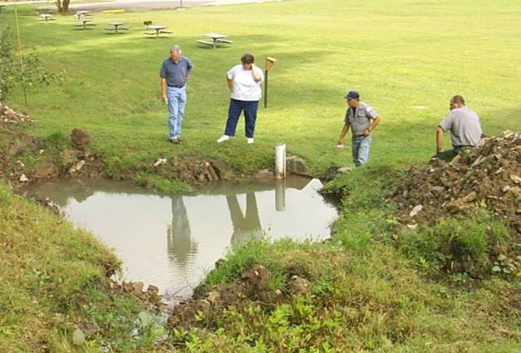
Reasons for Emergency Planning and Response
Recognize and Assess Issues
Notes:
This week you have studied and discussed problems contributing to possible or probable failures of structures impounding water. The sooner these distress signs are identified the more time is available to either prevent a failure or evacuate downstream. More “eyes on the project” means more opportunities to catch these problems early.

Slide 10




Reasons for Emergency Planning and Response
Mitigate Consequences
Notes:
Inundation maps provide local emergency managers the data needed to plan evacuation routes, designate shelters, and pre-stage roadway barriers, etc to enhance emergency response. Designating, testing, and marking evacuation routes prevents people from driving INTO flood waters instead of away from them. Designating shelters provides an opportunity to stockpile food, water, cots, linens, diapers, formula, etc. in advance. It also allows the general public time to familiarize themselves with routes and shelter locations. Tourists and visitors can also evacuate quickly by following pre-placed route markers.

Slide 11
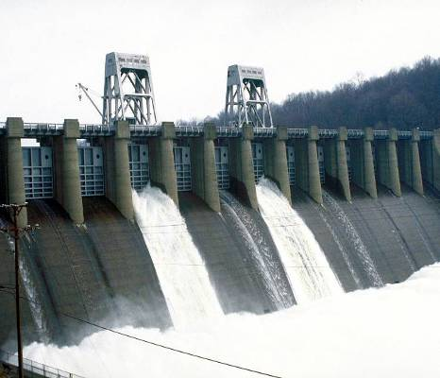
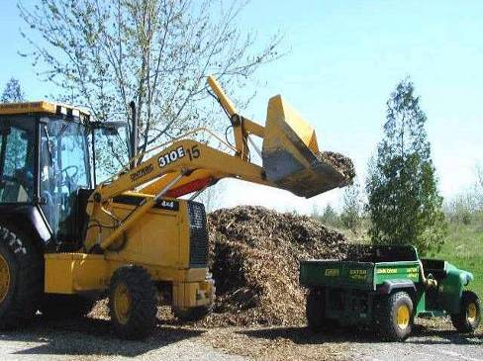
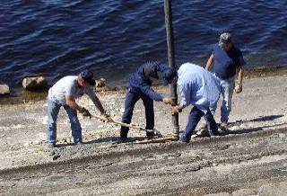
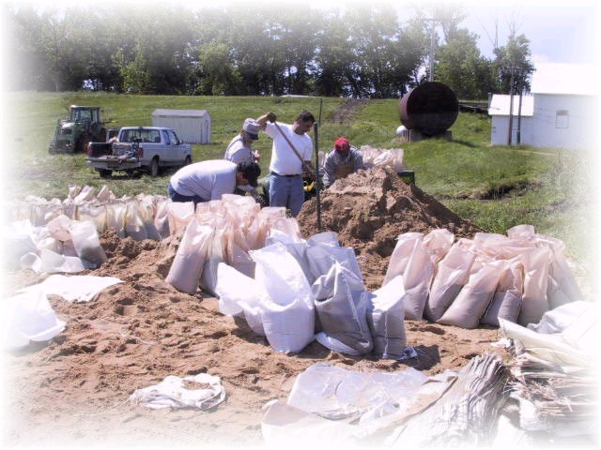
Reasons for Emergency Planning and Response
Guide Emergency Operation and Repair
Notes:
Emergency Action Plans include a section describing appropriate repair methods. Problems can occur at any time, but they sometimes occur during the night, or on weekends, or holidays. These guides can be used in the absence of specific instructions provided by engineering/ construction division and can help mitigate the problem until engineers can assess the situation.

Slide 12
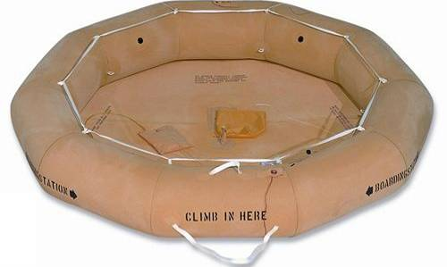
Emergency Planning
and Response
E
A
P
Notes:
Your emergency action plan is similar to a life raft. If you take it down and test it periodically to ensure it will float, it has the ability to save you. If you don’t test it periodically, it may dry rot. It will give you a false sense of security. Your EAP is the same way. If you don’t test it periodically, it may become outdated. The information you need won’t be available in an emergency. You won’t have time to research all the information required in an emergency. People, equipment locations, available contractors, and telephone numbers should be constantly updated to ensure quick response.

Slide 13
EAP dam safety emergency levels
Failure imminent or has occurred
Could lead to failure
Non-Failure Emergency
Non-Emergency Condition
Notes:
These are the basics of an EAP

Slide 14
Features of an EAP
Notification Flowchart
Emergency Detection, Evaluation, and Classification
Responsibilities
Preparedness
Inundation Maps
Appendices
Notes:
These are the basics of an EAP

Slide 15
Features of an EAP
Notification Flowchart
COMMUNICATION!!!
Levels of Emergency
    Based on urgency of condition
    Terminology varies
FAILURE IN PROGRESS – Heroic Efforts
Most Urgent
Rapidly developing condition
Dam failure in progress or imminent
Minutes count
First priority is to notify those first affected
Notes:
There are two notification flowcharts in EAPs. Who you call and in what order is determined by the urgency of the condition. Failure in progress is the most urgent. Your first priority is to notify downstream officials to begin evacuation.

Slide 16
Features of an EAP
Notification Flowchart
Contacts and Sequence
Project Notification Chart
FAILURE IN PROGRESS
District Office Notification Chart
Manager at Dam
Dam Safety Officer
First Downstream Official
Water Mgmt
Agencies
Second Downstream Official
EOC
Branches
Chief, Ops
Sections
Third Downstream Official
Assist Chief, EC
PAO
Dam Safety Officer
or Alternate
DE or DD
MSC Cmdr
MSC DSO
HQUSACE
Notes:
The manager at the dam is generally responsible for notifying all the downstream officials before he notifies the Dam Safety Officer. Since these positions downstream are either appointed, elected, or voluntary; the names and phone numbers change regularly. It is imperative to update these contacts often.

Slide 17
Features of an EAP
Notification Flowchart
Contacts and Sequence
National Weather Service = Widespread Public Warning
Dam Safety Officer reports through chain of command to the USACE Dam Safety Officer
USACE DSO will notify the following:
Director of Civil Works
Deputy Commander for Civil Works and Contingency Operations
USACE Commander if necessary
Notes:
The manager at the dam is generally responsible for notifying all the downstream officials before he notifies the Dam Safety Officer. Since these positions downstream are either appointed, elected, or voluntary; the names and phone numbers change regularly. It is imperative to update these contacts often.

Slide 18
Features of an EAP
Notification Flowchart
Levels of Emergency (Continued)
POSSIBLE DAM FAILURE PROBLEM
COULD LEAD TO FAILURE
Less urgent
Change from normal conditions
Unusual loading on dam or component
Rate of change is slow or not apparent
Internal notifications to Dam Safety Officer
Notes:
The notification procedure for possible dam failure is completely different from failure in progress. Internal notifications to the Dam Safety Officer and Dam Safety Committee can provide timely instructions to prevent catastrophic failure.

Slide 19
Features of an EAP
Notification Flowchart
Contacts and Sequence
POSSIBLE DAM FAILURE PROBLEM
Notification Chart
Manager at Dam
Area Manager
Readiness
Agencies
Dam Safety Officer
Assist Chief, EC
Branches
Sections
Chief, Ops
PAO
DE or DD
MSC DSO
Notes:
The manager at the dam will notify the area manager and the Dam Safety Officer. The Dam Safety Officer will notify the Dam Safety Committee. The Area Manager may additionally contact the Readiness Chief, who is a Dam Safety Committee member. Contacting the Readiness Branch will assist the Committee by activating the EOC (by order of the Commander, or his acting official) and will additionally begin upward notification .

Slide 20
Features of an EAP
Notification Flowchart
Redundancy
List work and home or 24-hr numbers.
Email.
List alternates for key contacts.
Provide additional contacts in an appendix.
Communication matrix.
Notes:
Redundancy is the key to successful notification. Most people have cell phones or blackberry devices. List as many phone numbers and alternate phone numbers as they are willing to provide. List alternates for key contacts and multiple phone numbers for them. Ensure that all personal information is safeguarded under the privacy act. Unless you have permission in writing to publish these numbers, DON’T!

Slide 21
Emergency Detection, Evaluation, and Classification
Conditions indicating trouble
What and how to measure and report
Aids to interpret conditions and assess severity
NOT A COOKBOOK – still need to apply experience, judgment, common sense
Notes:
This section of the EAP is to aid personnel at the dam in assessing emergency situations. Early information provided to the Dam Safety Committee must be correct and useful. The interpretation given to decision makers prior to engineers arriving on site will lead their course of action. This portion of the EAP is not a cookbook. Common sense, experience, and judgment must be used when describing a situation or providing critical data.

Slide 22
Responsibilities
Clearly define by position
  (Battle Captains, etc.)
Apply to each feature or subplan of EAP
Apply to key decisions, including:
  Emergency declaration
  Security
  Termination
  Follow-up evaluation
  After-action report
Notes:
An EAP should clearly define who has responsibility for what actions.
Responsible parties need to be aware prior to the event. This will aid in data gathering and record keeping.
Who OFFICIALLY declares an emergency? (Commander or alternate)
Who is responsible for security?
Who declares an emergency OFFICIALLY over? (Commander or alt)
Who is responsible for a follow-up evaluation?
Who writes the after-action report (AAR)?
Designating these responsibilities prior to an emergency provides a better opportunity for record keeping by the responsible party.

Slide 23
Preparedness
Actions taken BEFORE an emergency
Moderate or alleviate effects
Facilitate response to emergency
    Engineering data
    Check lists
    Supplies & equipment
    Back-up power
    Back-up communications
Notes:
Many things can be done prior to an event to speed response and recovery. Engineering data should be available to determine trends or historical events. Check-lists enable personnel to provide complete information. A list of available supplies and equipment in the area will save valuable time. Back-up power may prevent additional problems. Back-up communications are crucial to maintain contact. Preparation of these lists could provide an opportunity to recognize gaps and shortfalls that could be alleviated immediately.

Slide 24
Inundation Maps
Mapping Modeling and Consequences Center
Working to update USACE Portfolio for Mapping
Standardized Mapping Procedures
Inundation Elements
Normal High Pool Inundation Area
Maximum Pool Inundation Area
Failure Wave Arrival Time (hours)
Reference Mile
Cross Section
Base Map Elements (roads, police, fire)
Notes:
Inundation maps provide crucial information for owners of downstream structures and emergency managers. It would be GREAT to have maps for the three conditions listed however, most dams only have mapping for SDF. Travel times for wave front and flood peaks give downstream emergency workers information needed to safely and efficiently evacuate the area. This not only tells them who needs to be evacuated first, but prevents people from being moved into an area that may become flooded. Failure maps for sunny day dam failure conditions would allow emergency workers to evacuate fewer people, but funding is not available for new mapping.

Slide 25
ISSUES TO CONSIDER WHEN REVIEWING INUNDATION MAPS
Be sure to determine what “zero” travel times start at since they can be hours different:
Start of “breach” or Full breach development.
Rate of water rise is very important
Velocity is important and is usually not shown
Evacuation difficult after 2 feet deep with much velocity; peak may not be critical
Notes:
Inundation maps provide crucial information for owners of downstream structures and emergency managers. It would be GREAT to have maps for the three conditions listed however, most dams only have mapping for SDF. Travel times for wave front and flood peaks give downstream emergency workers information needed to safely and efficiently evacuate the area. This not only tells them who needs to be evacuated first, but prevents people from being moved into an area that may become flooded. Failure maps for sunny day dam failure conditions would allow emergency workers to evacuate fewer people, but funding is not available for new mapping.

Slide 26
ISSUES TO CONSIDER WHEN REVIEWING INUNDATION MAPS
Inundated areas are approximate and may be off significantly due to
Breach development characteristics
Debris
New development in the flood plain.
(How much flow does the new Wal-Mart block)
Other event impacts, bridges, levees, etc.
Notes:
Inundation maps provide crucial information for owners of downstream structures and emergency managers. It would be GREAT to have maps for the three conditions listed however, most dams only have mapping for SDF. Travel times for wave front and flood peaks give downstream emergency workers information needed to safely and efficiently evacuate the area. This not only tells them who needs to be evacuated first, but prevents people from being moved into an area that may become flooded. Failure maps for sunny day dam failure conditions would allow emergency workers to evacuate fewer people, but funding is not available for new mapping.

Slide 27
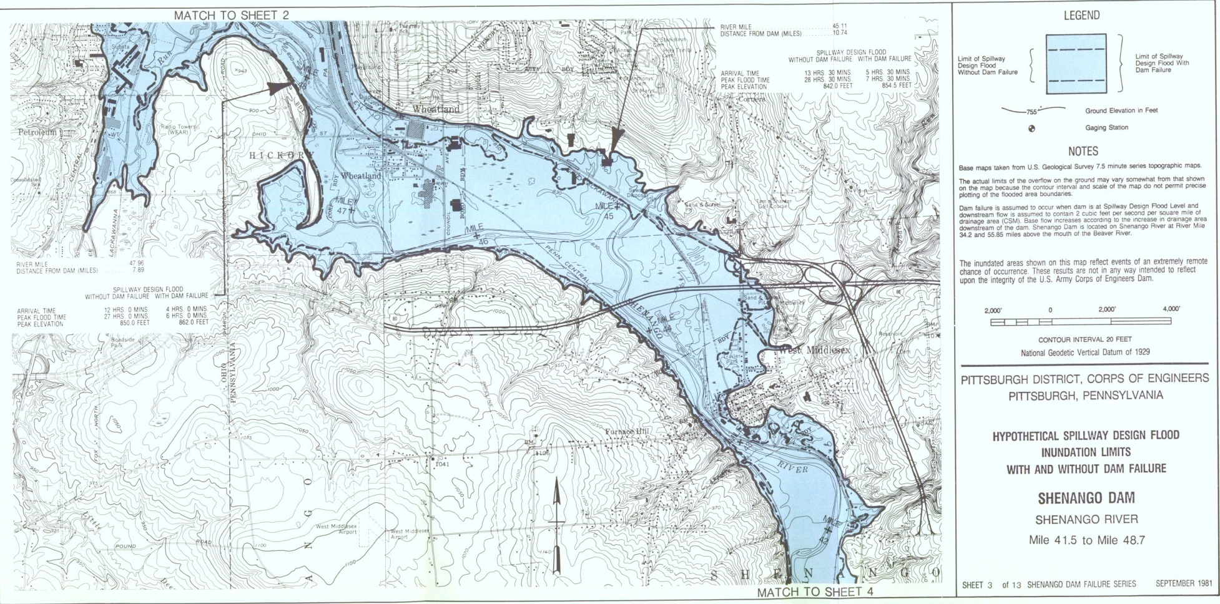
Inundation Maps
Older version with Landmarks
Notes:
Older inundation maps are typically contour maps with a particular elevation highlighted. These maps are useful, but have nowhere near the level of detail provided in the newer mapping. They generally are not in digital format and must be copied to be distributed. Ending this costly method can help to justify the expense of newer CADD drawings. As with other information, these maps must be protected. Release to the general public requires approval from HQ.

Slide 28

Detail
Older version with Landmarks
Notes:
Older inundation mapping is more difficult to use and less accurate. Quad sheets were overlain with hand-calculated flood mapping using 10 or 20 foot contours. They were very useful in their day and continue to be useful for general purposes.

Slide 29

Inundation Maps- Arrival Table
Notes:
Older inundation maps included charts with specific travel times and elevations. CADD technology provides graphical representations of this information, which is easier for novices and the general public to interpret.

Slide 30

Detail inundation Maps
Arrival Table

Slide 31
Inundation Maps
Notes:
This is newer digital mapping in CADD format. Having this information digitally allows other information to be added in layers. Local emergency managers can collect and add any type of information which will aid them with evacuations.

Slide 32
Inundation Maps
Notes:
This type of mapping is capable of providing street level detail. It is beneficial to utilities, hospitals, shelters, fire and police departments, etc to determine their requirements to remain functional during an event. Stockpiles of sandbags or storage of portable dams, etc could allow them to continue to function. Areas designated as shelters may have to be rethought. The shelters may be out of the flooded area, but what about access? If the only road leading to an area will be inundated, the location (or the access) will have to be changed.

Slide 33

Features of an EAP
Appendices
Support and supplement EAP
Valuable as reference but not part of basic plan
    Additional contact information
    Email, Communication Matrix (who has what comms)
    General data on dam
    Instrumentation details
    Data on upstream dams
    Record of EAP updates and maintenance
    References used for EAP development
    ANYTHING YOU WANT!!

Slide 34
Features of an EAP
Emergency Operations and Repair Subplan
Evacuation Subplan (NON-FEDERAL)
Ref. HEC Research Document 13, “Flood Emergency Plans, Guidelines for Corps Dams”

Slide 35
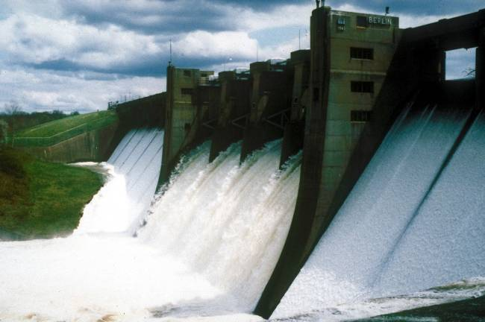
Features of an EAP
Emergency Operations and Repair
Guide immediate operational decisions
  Reservoir de-watering plan - RARE
  Identify equipment, material, labor sources
  Procurement procedures
  Repair actions for specific problems

Slide 36
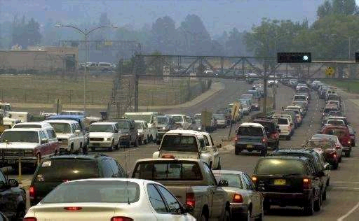
Features of an EAP
Evacuation Subplan
NON-FEDERAL, responsibility of state and local officials to develop and execute
FEDERAL, responsibility to encourage evacuation planning:
Coordinate with local officials on EAP updates, exercises, training
Share inundation mapping
Build public awareness
Tuttle Creek and Wolf Creek warning systems

Slide 37
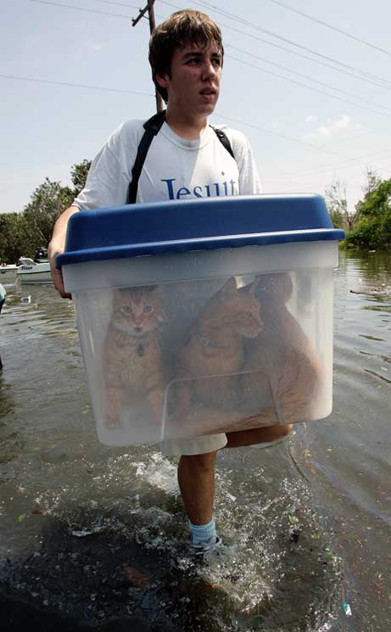
Evacuation Planning
Details Matter

Slide 38
Risk Communication Posters
There usually isn’t a wall of water; but there can be.

Slide 39

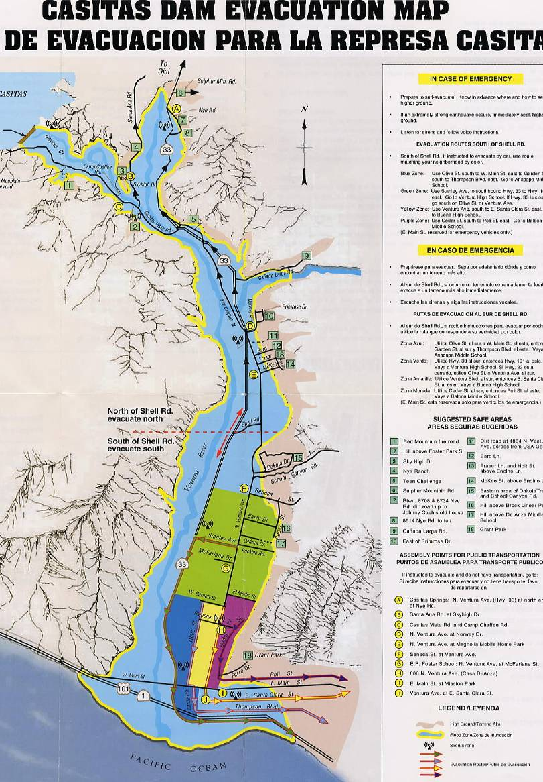

Slide 40
Coordination
Coordinate internally – Operations, Readiness, Engineering, Security, Dam Safety Committee.
Coordinate with local emergency agencies
at least annually.
Include Hydropower in coordination and planning.

Slide 41
Maintenance
Review and update “perishables” at least annually:
    Notification names and numbers
    Suppliers
    Contractors
Exercise to test and verify the EAP.

Slide 42
Emergency Planning
and Response
Questions
?

