Slide 1
Dam Safety Data Management
William Empson, PE, PMP
Senior Levee Safety Program Risk Manager
U.S. Army Corps of Engineers
Risk Management Center
William.B.Empson@usace.army.mil
Dam Safety Workshop
Brasília, Brazil
20-24 May 2013

Slide 2
Data
Management
You have the data – what next?
Amanda Sutter, P.E.
CEMVS

Slide 3
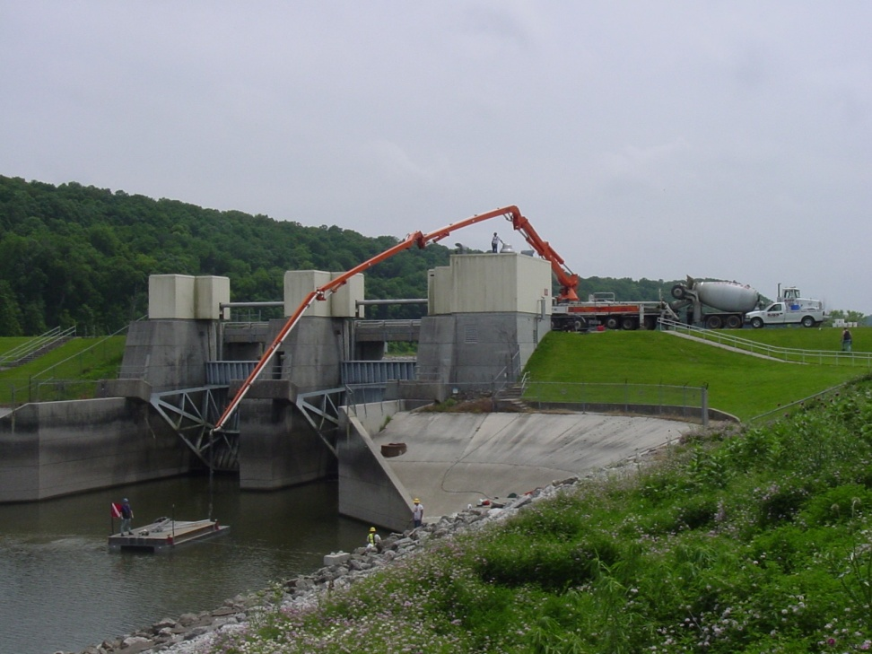
Purpose
Perform timely evaluation of data to assure that unsafe performance of a structure is detected as early as possible.

Slide 4
Objectives
Learn various methods of data collection, processing, presentation, evaluation and reporting requirements
Identify various factors that influence dam safety instrumentation data.

Slide 5
Components of Data
Management
Collection
Reduction and processing
Presentation
Evaluation

Slide 6
Data Collection Schedule
Factors affecting schedule
Purpose of the instrument
Project conditions
Age of project
Loading event
Observed anomaly
Availability of personnel
Project location
Funding
Corporate policy
Funds
New
Leak
Flood

Slide 7
Data Collection
Data set should contain
Project
Instrument ID
Instrument reading
Readout unit
Reader’s name
Date
Pool and Tail
Weather conditions
Unusual conditions
Instrument damage

Slide 8
Data Collection
Consistency
Personnel
Manner readings are taken
Equipment
Label instruments
Train data collection personnel
Multiple readings
Coordination of instrument readings

Slide 9
Data Collection
Data Entry
Data books
Field sheet
Laptop computer
Handheld or pocket computer

Slide 10
Data Collection
Equipment used to monitor instruments should be calibrated and in good operating condition.
Good communication is critical between person(s) reading instruments and office personnel
Threshold values should be established and furnished to person(s) collecting and transmitting data.

Slide 11
Reduction and Processing
Data Reduction Software
Corps Instrumentation Database
Package, WinIDP
Software developed in district
Commercial software
Microsoft Excel or Access
SINCO
GeoKon
Geomation

Slide 12
WinIDP
Development
      HQUSACE proponent
      Based on survey of Districts (1990)
        Dam safety instrumentation needs
        Compatibility with existing databases
      Converted to windows 1996
      Web portal and GIS modules 2003
      Continually updated; current version 5.5d
        Latest version added Grapher 7 and modified scheduled tasks for data import and plotting.

Slide 13
WinIDP: Features
  User defined formats for input, plots, reports
  Time dependent constants (repair riser => new elevation)
  Manual data entry with shared field conditions
  Data import (can be automated / scheduled)
  Compatible with Geomation and CSI dataloggers
  Recalculate by data set or instrument
  Data edit by data set or instrument
  Mask data that is questionable
  Batch plotting
  Network or stand alone
  Multiple users (concurrent use)
  Internet accessible, WebIDP.

Slide 14
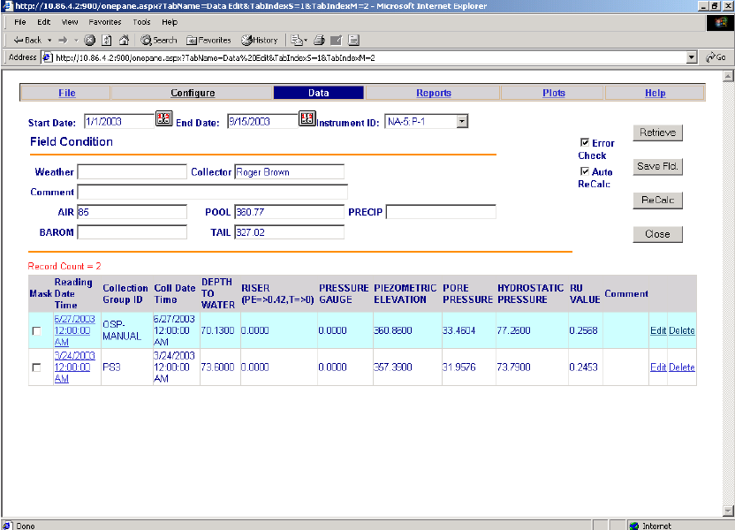
WebIDP
Requires internet explorer and internet access - No local installation.
Data entry
Plots
Reports

Slide 15
WinIDP: Benefits
A Good Choice
  Supported by COE dam safety people
  Tailored for dam instrumentation
  Upgrades and costs shared with others
  Compatible with other engineering processes and other information systems used in dam safety
  Program is free. Pay as you go for support
  Don’t reinvent the wheel – improve the wheel if needed.

Slide 16
Data Presentation
Time History Plots
Positional Plots
Multiple Plots
Correlation Plots

Slide 17
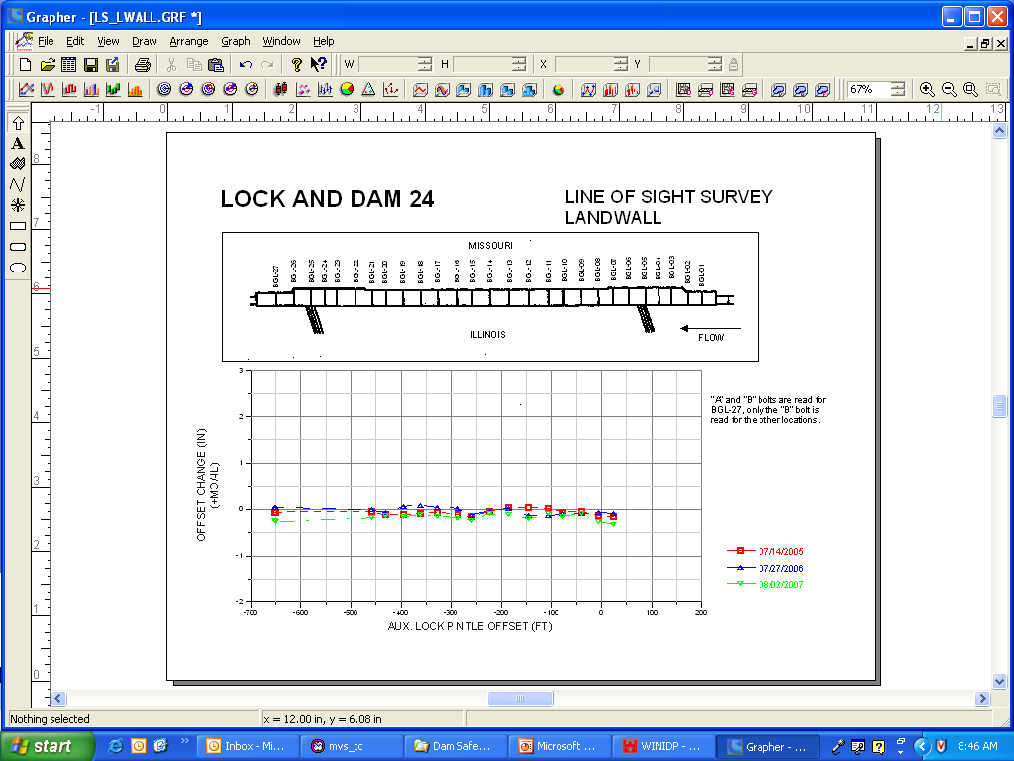
How does this data look?

Slide 18
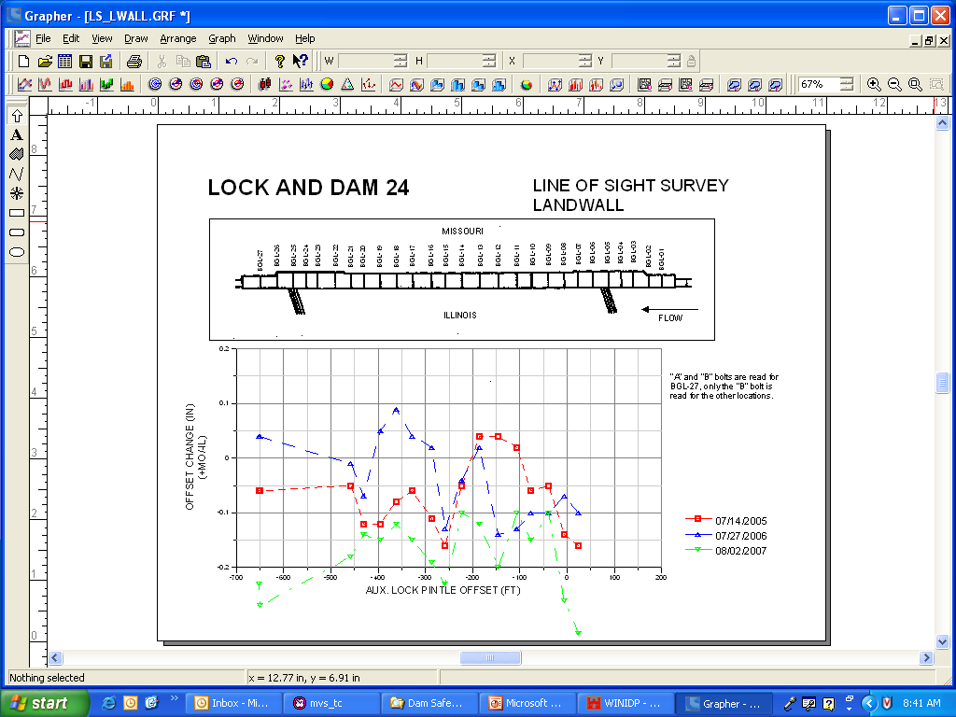
How about this data?

Slide 19
What if I told you it’s the same data?

Slide 20
Guidelines for Presentation
  Appropriate scale
  Standardize format
  Display relevant field conditions
  Location and cross section on graphs
  Note events and observations that may
  explain unusual data
  Avoid over crowded plots

Slide 21
Time Series

Slide 22
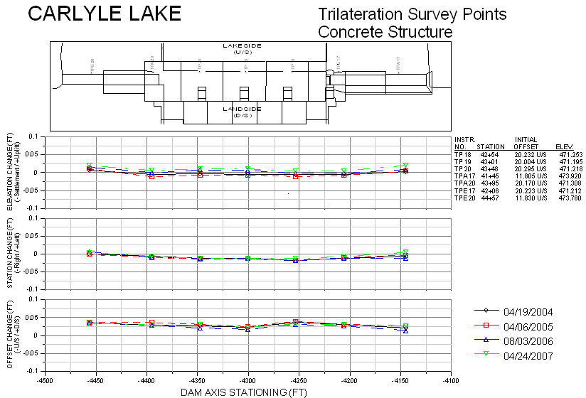
Positional (Fixed) & Multiple Graphs

Slide 23
Positional (Variable)
Notes:
Offset for shots vary each survey

Slide 24
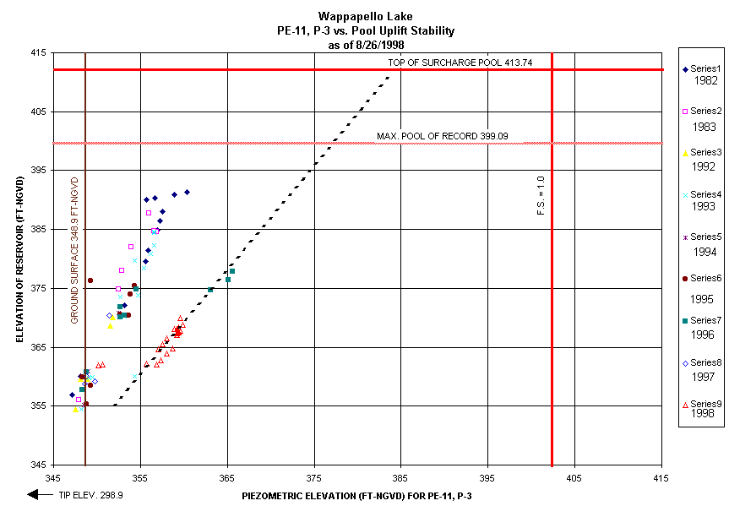
Correlation

Slide 25
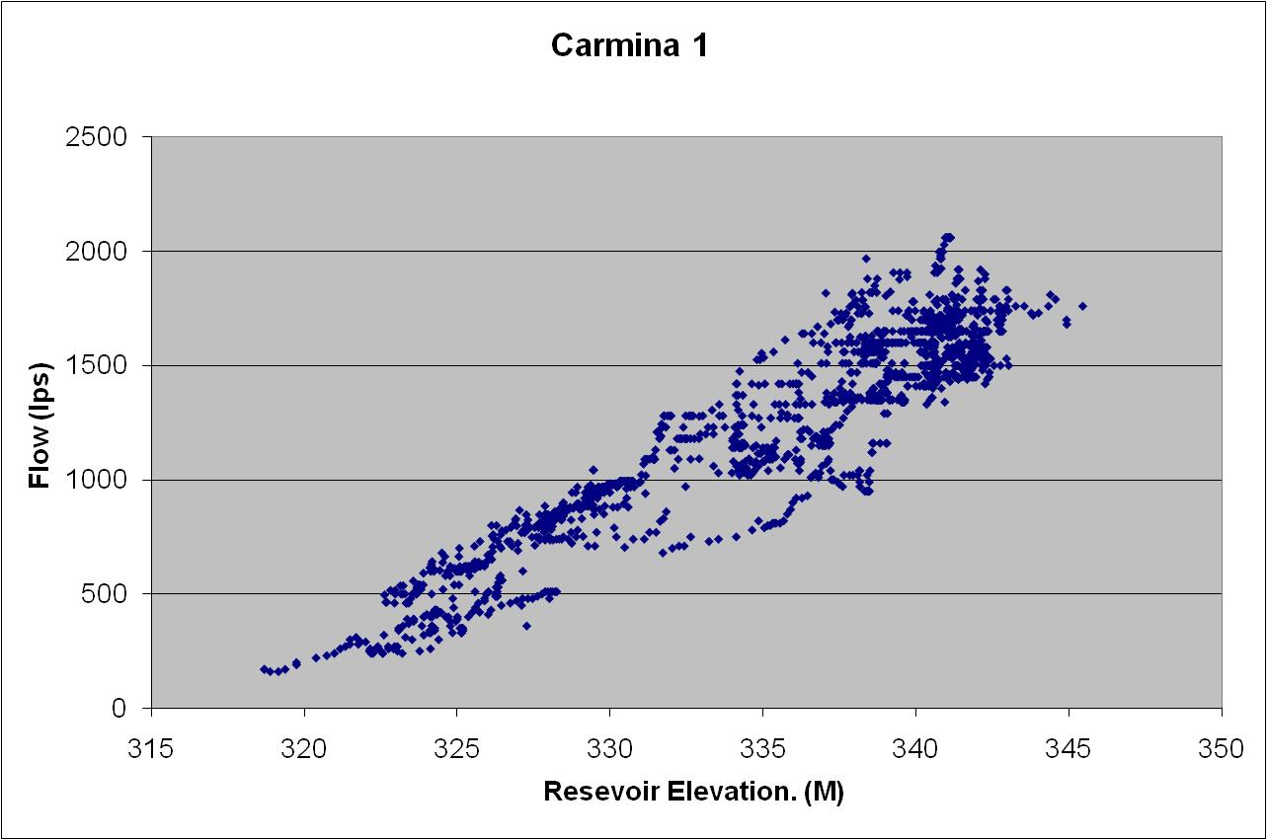
Loading Path Presentation
Best Fit

Slide 26
Loading Path Presentation
Upstream Limited

Slide 27
Loading Path Presentation
Storage

Slide 28
Analysis and Evaluation
Trends, Patterns and Thresholds
Performance Prediction
Recent data
Historical data
Field conditions
“Reasonable” limits
Notes:
Guidance given in ER 1110-2-1156

Slide 29
Benefits to performance prediction
  Quick assessment of dam behavior
  Indication that data was collected properly
  Field conditions
  Alert that readings are outside expected values
Notes:
Guidance given in ER 1110-2-1156

Slide 30
Warning for threshold use
  Will not reveal plugged instrument
  Only as good as data derived from
  Should not substitute for thorough data analysis
Thresholds may be applied during
  Data collection
  Data entry
  Data evaluation
Notes:
Guidance given in ER 1110-2-1156

Slide 31
Analysis and Evaluation
Compare Current Data to
Recent data
Historical data (established trend)
Initial
Field conditions
Design Prediction / Thresholds
Other instrument types
Notes:
Guidance given in ER 1110-2-1156

Slide 32
Analysis and Evaluation
Other considerations
  Construction activities.
  Maintenance of instrument.
  Change of procedures.
    (i.e. temperature correction; esp. concrete)
  Change of equipment or personnel.
  Lag time.
Notes:
Guidance given in ER 1110-2-1156

Slide 33
Actions after the analyses
  Document the evaluation.
  Verify suspect readings and readout calibration.
  Verify procedures (I.e. different sensitivity setting).
  Duplicate reading.
  Notify pertinent personnel
  Verify with other instrument type
  Ask for visual observation of area
  Modify collection schedule
  Request additional investigation
Notes:
Guidance given in ER 1110-2-1156

Slide 34
Actions after the analyses
Reporting Requirements
    Annual instrumentation summary and evaluation to Division
    Evaluation to be included in Periodic Inspections
Notes:
Guidance given in ER 1110-2-1156

Slide 35
Instrumentation Planning
Predict controlling mechanism (I.e. Pool)
Define question to be answered (I.e Cutoff is 90% effective)
Select parameter to monitor (I.e. piezometric elevation)
Predict magnitude of change (I.e. 50 feet)
Select instrument location (I.e. toe of dam)
Select instrument
Select reading frequency
Data collection and management
“Geotechnical Instrumentation for Monitoring Field Performance” Dunnicliff, 1993
“Instrumentation of Embankment Dams and Levees” EM1110-2-1908, 30 Jun 1995
Notes:
Begin with a design concern or performance problem.
Planning is required to get reliable and effective systems. Do not just try something, you will not be that lucky.

Slide 36
Objectives
Learn various methods of data collection, processing, presentation, evaluation and reporting requirements
Identify various factors that influence dam safety instrumentation data.

Slide 37
Conclusion
Perform timely evaluation of data
to assure that unsafe performance of a structure is detected as early as possible.
Instrumentation data is a valuable asset for the life of the structure.
Backup the data.

Slide 38
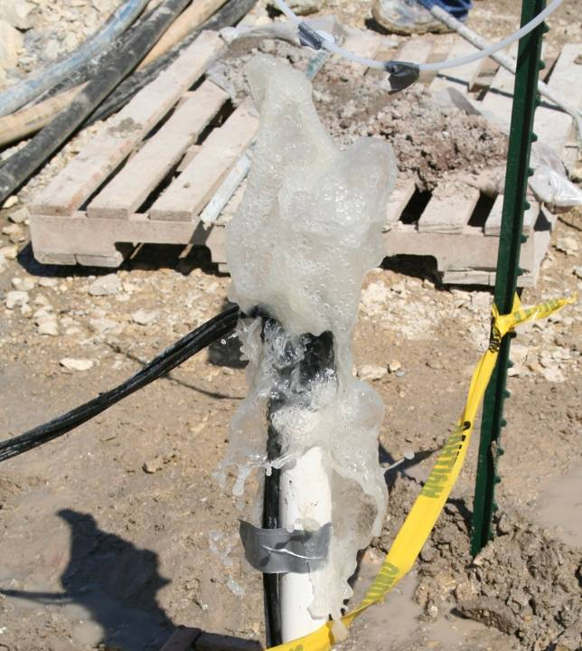
Discussion

Slide 39
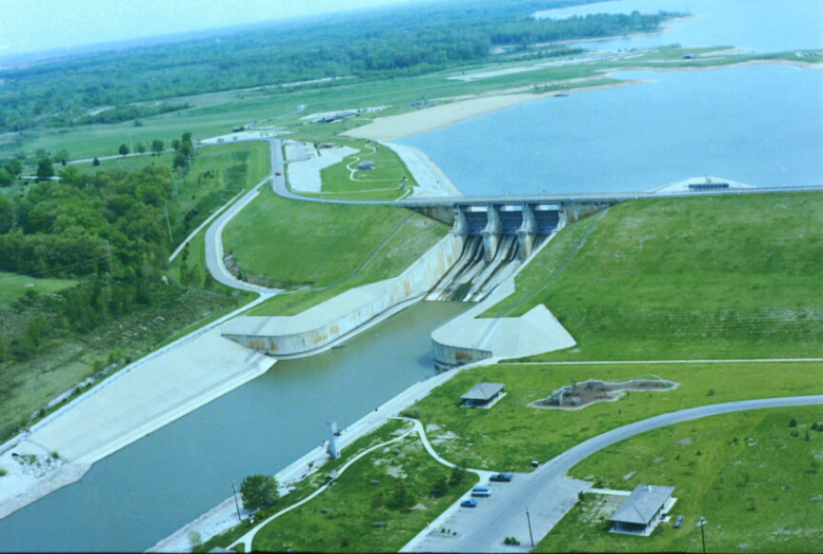
Shelbyville Dam
Piezometer monitoring example

Slide 40
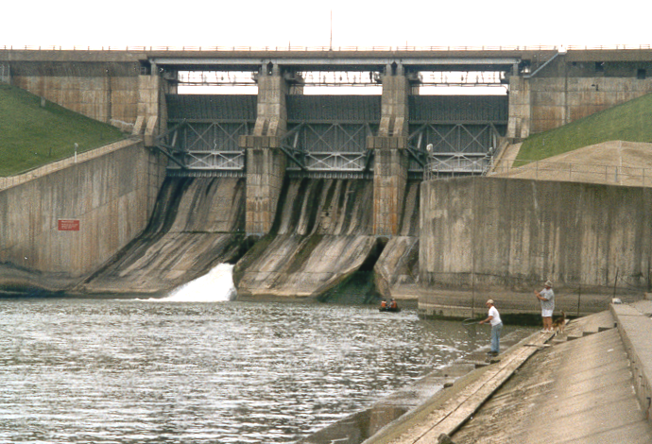
Spillway retaining wall

Slide 41
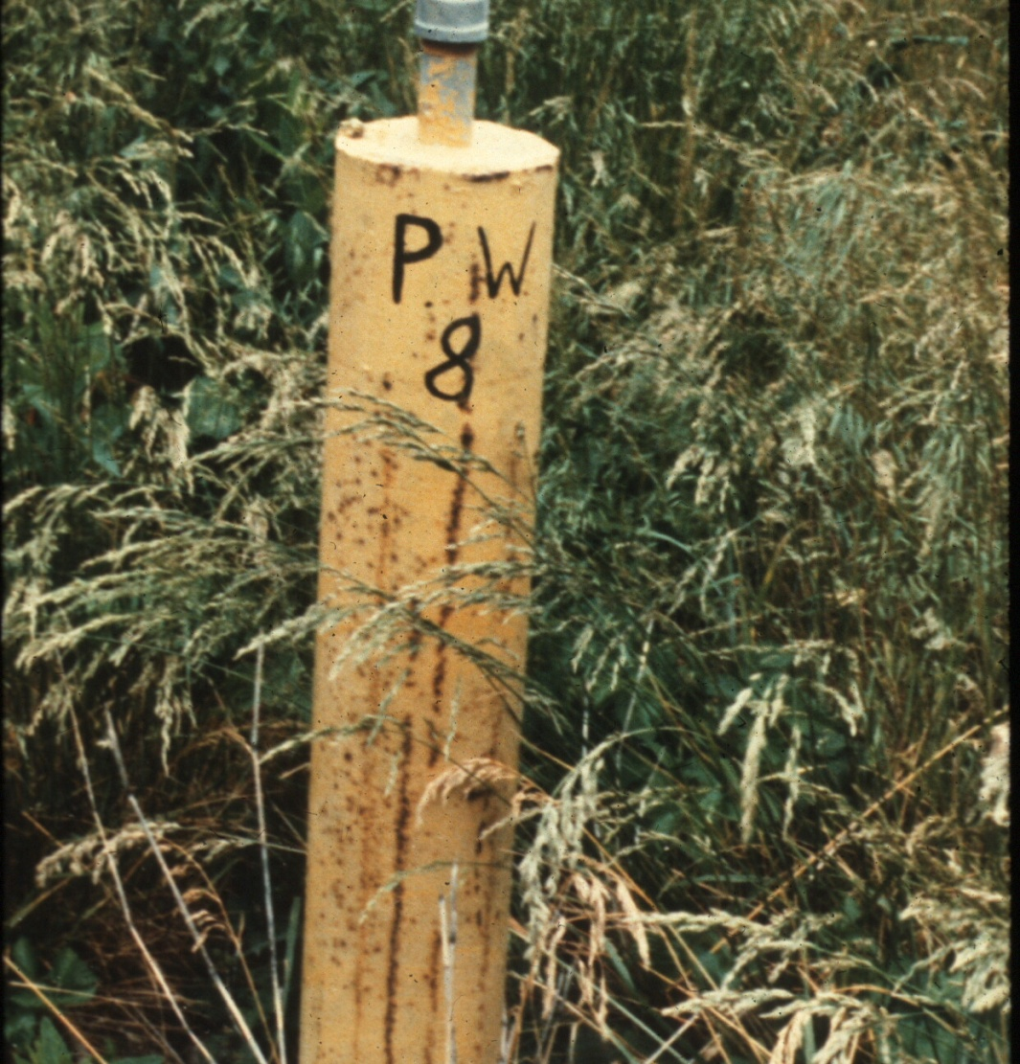
Open-System Piezometer

Slide 42
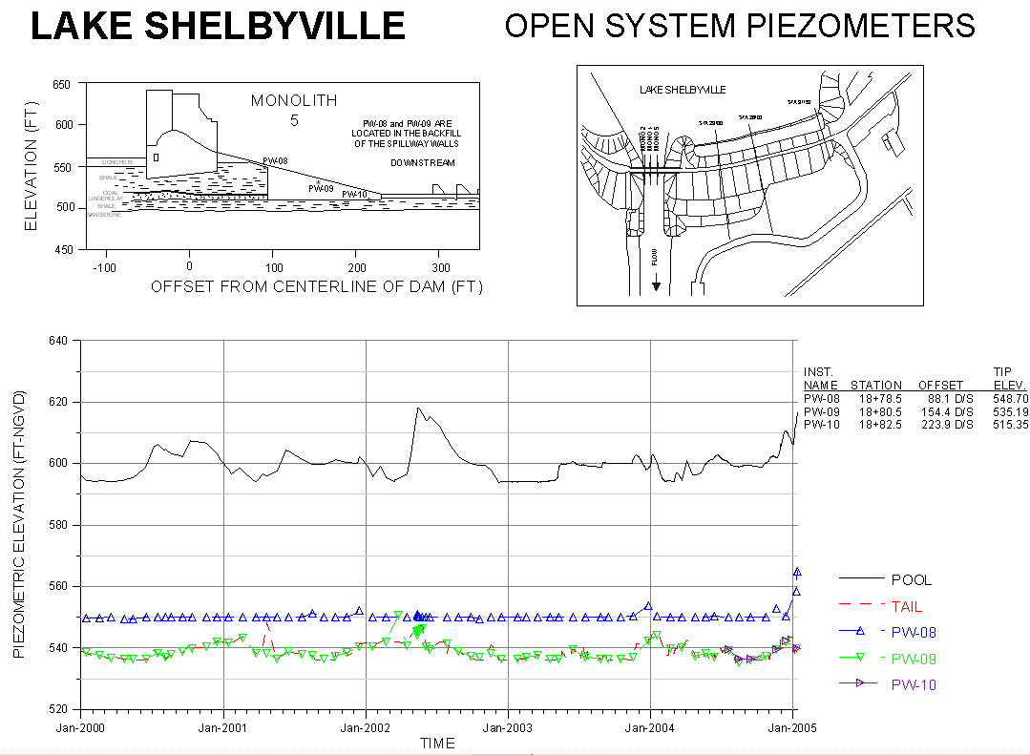

Slide 43
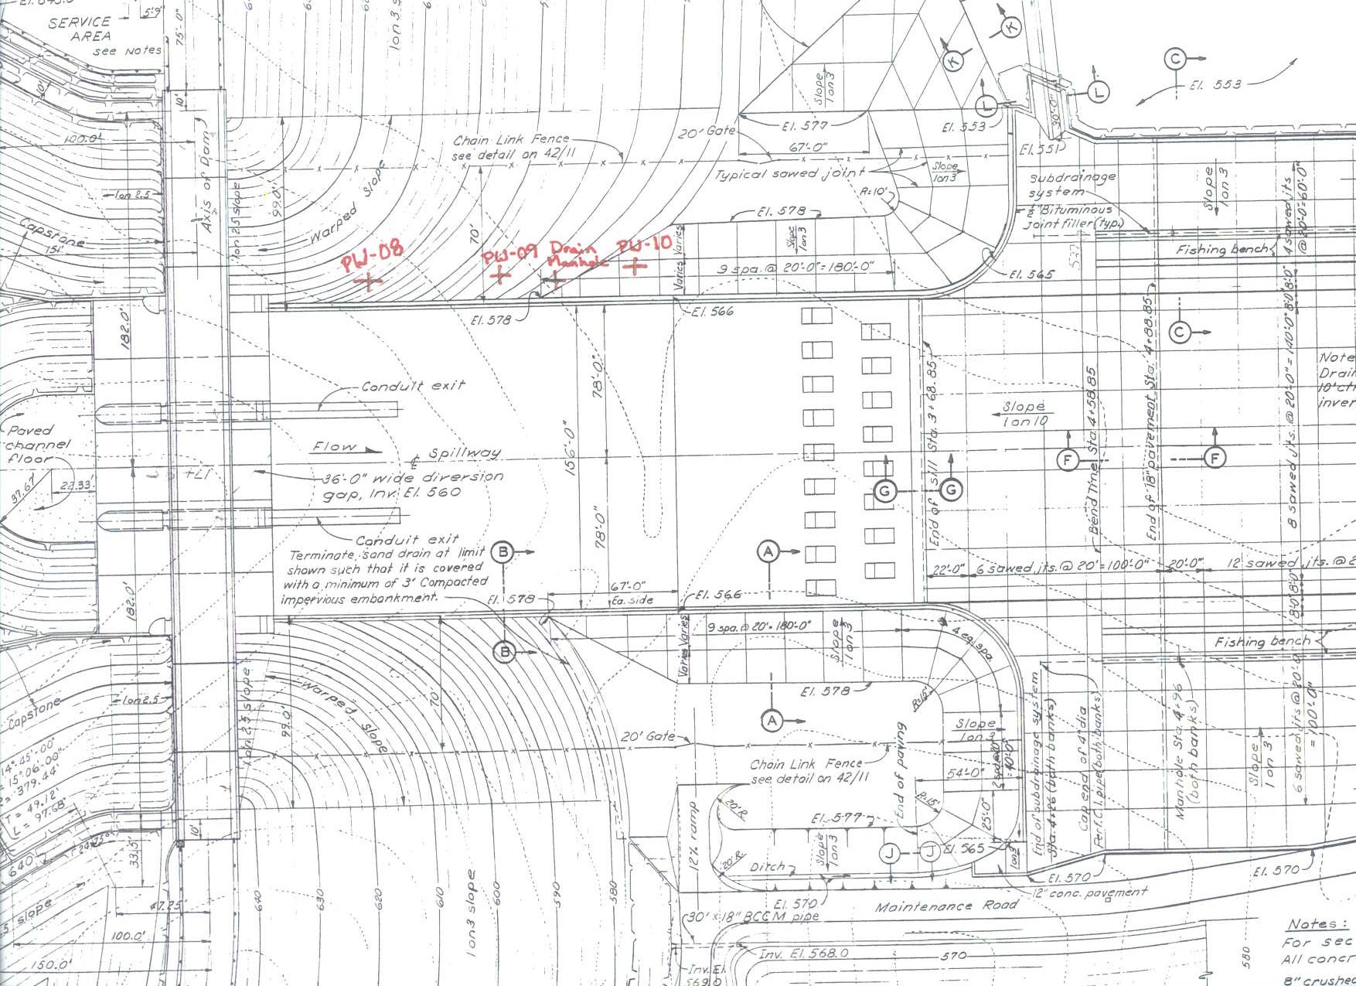
PW-08
PW-09
PW-10
Stilling Basin
Flow
Dam Centerline

Slide 44
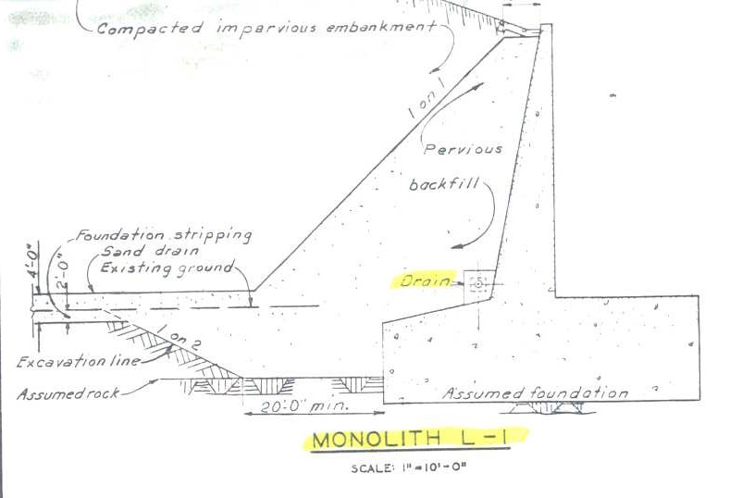
Open-System Piezometer (wellpoint tip)
Set in pervious backfill
Pervious backfill has a drainage collector perforated pipe
PW-08
Collector pipe

Slide 45
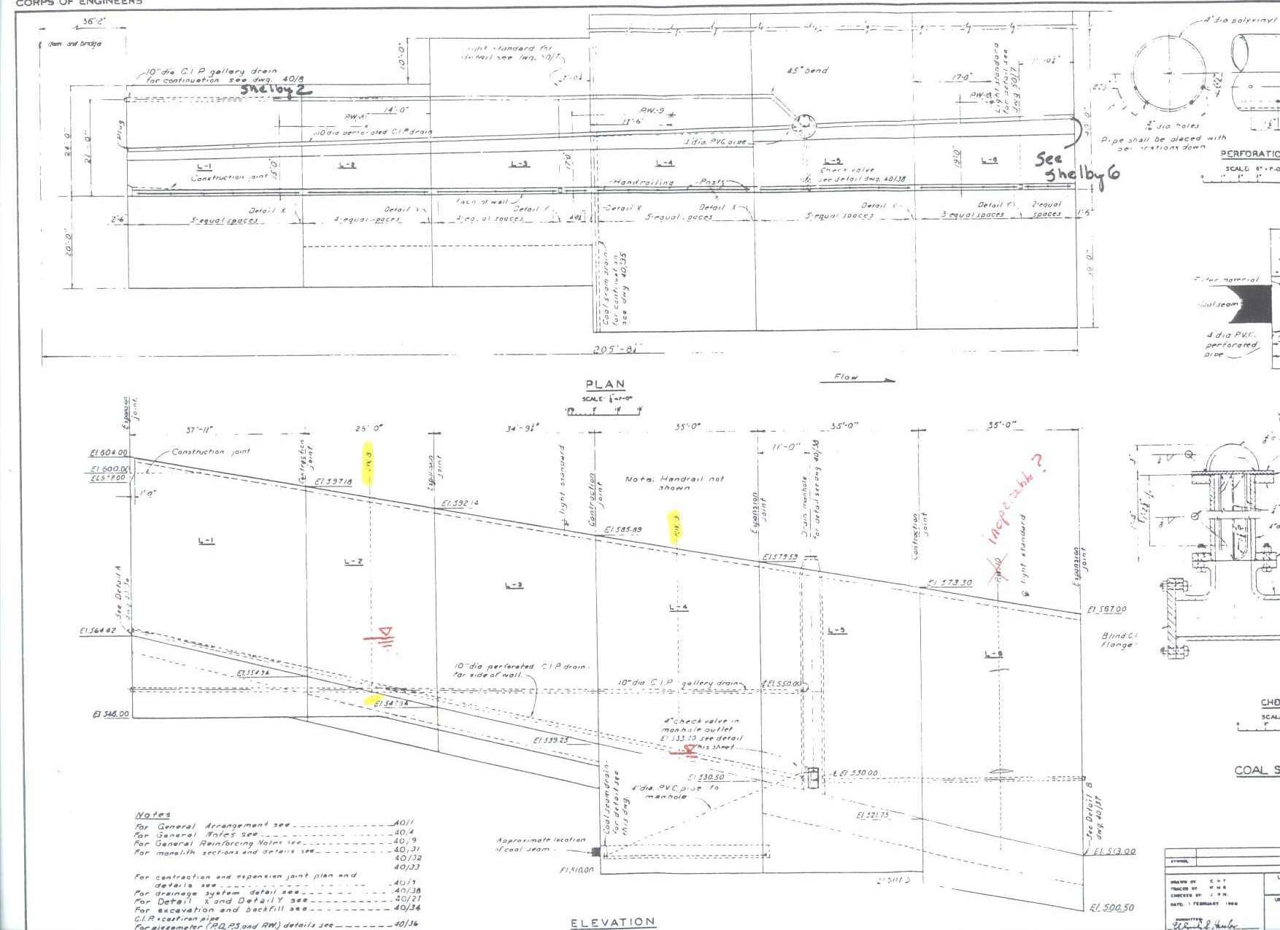
PW-08
PW-09
PW-10

Slide 46
Piezometer Data Evaluation
What is observed on the plot
  Progressive increase in piezometric pressure
  Behavior not consistent with previous high pools
  Downstream piezometers reflect tailwater (expected)
  PW-08 was typically dry (expected)
What factors could be relevant
  Time
  High pool
  Backfill material clogged or collector pipe blockage
  Temperature
  Coal mine treatment
  Piezometer tip clogged or riser cracked
  Previous falling head tests (5’ fall in 5 minutes in 2003)

Slide 47
Piezometer Data Evaluation
What actions could be taken
  Do not assume impending failure of the dam
  Observe the area for distress
  Check visually for instrument damage
  Notify project staff, management, and other pertinent staff
  Perform rising and falling head tests
  Sound bottom of hole
  Use inflatable bladder to test for breaks in the piezometer
  Install additional instrumentation
  Analyze wall stability
  Increase reading frequency
  Automate with alarm callout
  Pump down drainage manhole and camera inspect the pipe
  Further literature research on foundation treatment

Slide 48
EXERCISE 1: Piezometer Data Evaluation
What would be your recommended threshold for PW-08
  Dry
  Tailwater plus 5 feet
What would be your recommended threshold for PW-09
  Tailwater plus 5 feet
Which phases of data collection and evaluation could the thresholds be implemented
  Data collection (Automated or Manual)
  Data entry
  Data plots
  Data evaluation

