Slide 1
DAM SAFETY DURING CONSTRUCTION
Dave Paul, P.E.
Lead Civil Engineer
U.S. Army Corps of Engineers
Risk Management Center
David.B.Paul@usace.army.mil
Dam Safety Workshop
Brasília, Brazil
20-24 May 2013

Slide 2
Beginning of Dam Safety in the U.S. June 5, 1976

Slide 3
Lessons Learned
Design and Construction Teams need to be fully integrated from start of design through completion – Total Design/Construction Process
Independent peer review
No place for hubris
It is a serious business that we endeavor to practice

Slide 4
Risk Management Center
Implement risk informed decision framework to Dam Safety projects
Represents HQ for Dam Safety projects where life safety decisions are made during design and construction
Technical resource to Districts and Divisions for Dam Safety projects
Review design/construction to ensure risk reduction and design intent is being implemented

Slide 5
Risk Reduction Philosophies
Passive solutions are preferred to active solutions
Construction activities that are observable are preferred to those that aren’t
Risk analysis does not replace quality engineering and construction

Slide 6
Ancient City of Petra in Jordan

Slide 7
Outline
Chapter 22 Philosophy
Policies
Total Design/Construction Process
Project Phases
Roles and Responsibilities
QA/QC
Foundation Approval
Documentation of Construction

Slide 8
Dam Safety Regulation ER 1110-2-1156 Chapter 22
General processes to manage construction are already covered in detail in existing Corps regulations
The intent of this chapter is simply to supplement those regulations and provide a perspective of their application from a dam safety perspective

Slide 9
Objective
“ Construction (design implementation) is a crucial phase in achieving an adequately safe dam. The objective for construction management is always to deliver a quality project in a timely manner at a reasonable cost”

Slide 10
Dam Safety Regulation ER 1110-2-1156 Chapter 22
Risk Based/Failure Modes
Emphasis on Lead Engineer
Emphasis on Total/Design Construction Process
Emphasis on Government Oversight
Do No Harm

Slide 11
Hippocratic Oath
I will prescribe regimens for the good of my patients according to my ability and my judgment and never do harm to anyone.
Damocratic Oath
I will not do harm to a dam or abutment while prescribing treatments to reduce unacceptable risks.

Slide 12
Policies
ER 1110-2-1150 (Engineering and Design for Civil Works Projects)
“A Project Delivery Team (PDT) is established for all projects (products) in accordance with ER 5-1-11. The PDT consists of a Project Manager and the technical personnel necessary to develop the project. When more than one individual from the Engineering organization is on the PDT, the technical chief shall designate a "lead engineer"

Slide 13
Policies
ER 5-1-11 (USACE Business Process)
“One project, One Team, One Project Manager (PM). Each project is assigned to one PDT, with a single PM for management and leadership during the lifecycle of the project. Senior leaders select the PM based on the individual’s abilities to best lead the specific project without regard to assigned organizational element.”

Slide 14
Policies
ER 1110-2-1156 (Dam Safety)
Districts/Divisions shall designate a Lead Engineer to be the leader of the dam safety project once it is determined that modification to the structure is required to reduce risk to acceptable levels.
The Lead Engineer shall be a senior person who is experienced in leading multi-disciplinary teams.

Slide 15
Policies
ER 1110-2-1156 (Dam Safety)
All technical matters related to the proposed risk reduction measure shall be under the direct control of the Lead Engineer.
The Lead Engineer will be responsible for all aspects of the preliminary engineering design (PED).
The Lead Engineer will be part of the District management structure/functionality.

Slide 16
Policies
ER 1110-2-1156 (Dam Safety)
The Lead Engineer shall also be directly involved during the construction phase of the project to inspect/review the conditions uncovered make informed judgments regarding the applicability of the design to existing conditions

Slide 17
Total Design/Construction Process
“Planning, Operations, Design, Geology, Construction, Environmental, Contracts – all elements within the District shall function as an integrated TEAM from start of design through construction and resumption of full operation”

Slide 18
Total Design/Construction Process
This includes not only the technical elements within a district (planners, designers, constructors, PMs, etc…) but also the involvement of vertical elements such as the Division, HQ staff and the Risk Management Center (RMC).
Involving all elements from the inception of a project will ensure the correct alternatives and failure modes are identified and that the best project solution is chosen.

Slide 19
Project Phases
Design/Pre-Construction
Construction
Post Construction

Slide 20
Design/Pre-Construction Phase
In order to provide the best opportunity for project success, districts should always strive to build a cohesive team built upon the principles in ER 5-1-11.
This entire design/construction team shall be involved in the project from planning, design, and through completion of construction.

Slide 21
Wolf Creek Dam Nashville District

Slide 22
Ridges Basin Dam Animas LaPlata Project Durango Colorado

Slide 23
Observation
Modifying existing structures are generally more complicated than building a new ones
Existing structures create many constraints
Operation is continued which generally increases risk

Slide 24
Procurement Stategy
Prescriptive versus Performance
Contract type
Scope of work
Risk allocation between Contractor and Government
Impacts to Public

Slide 25
Construction Risk Assessment
If construction risks are judged to be significant during construction, then a risk assessment should be performed by PDT.
Guiding Principal: DO NO HARM
Visual observations and frequent instrumentation readings
PDT shall generate Action Levels

Slide 26
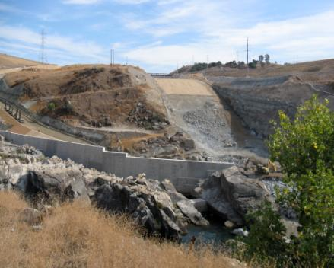
Folsom Dam Joint Federal Project Sacramento District

Slide 27
Engineering Considerations for Construction Personnel
ER 1110-2-1150
Failure modes
Design intent
Communication during construction
Acceptance criteria
Quality Assurance/Quality Control

Slide 28
Howard Hanson Dam Seattle District

Slide 29
Use of Schedules
During Planning and Design
During Construction
To Analyze Changes, Modifications, Claims

Slide 30
Design/Pre-Construction Phase
Developed by PDT Team
Used during constructability reviews
Used to determine a reasonable project duration and phasing
Used by Cost Estimating Group

Slide 31
Elements of Schedule
Appropriate logic
Detailed work breakdown structure
Potential constraints
Production rates
Long lead items
Factory inspections

Slide 32
BCOE
ER 415-1-11
Act as a Contractor bidding the job
Indentify constructability issues

Slide 33
Constructability Issues
Borrow area utilization
Unwatering and Dewatering
Protection of work from flooding
Weather
Access
Right of way
Utility relocations

Slide 34
Ridges Basin Dam Animas LaPlata Project Foundation

Slide 35
Ridges Basin Dam
Zone Descriptions
Zone 2 – Filter Sand Zone 2A – Upstream Filter Zone 3 – Gravel Drain Zone 4 – Shell Material Zone 4B – Transition Material Zone 6 – Downstream Slope Protection

Slide 36
Cost Estimating
Assist Design Team with development of alternatives
Alternatives are to be at Feasibility level for DSMS Reports
Percentages for contingencies

Slide 37
Cost Estimating

Slide 38
Roles and Specific Information for Cost Estimates
Team Leader | Contracting Officer | Cost Estimator | Construction Manager or Personnel
Knowledge of Design Requirements and Technical understanding of the Project | CO May have specific knowledge about approved Overhead Rates and Labor Rates for your Contractor | Provide CO with Cost Estimate with all supporting assumptions and rationale | Site specific information, access problems to the site, impacts, restrictions, and schedule information
Understanding and Interpretation of Drawings and Specifications for the Project | Will have information regarding Contract type and Bid Process | Assist in Contractor Negotiations with other USACE team members | Can help the Estimator develop crews, tasks durations, crew makeup including equipment requirements
Can assist in preparation of a list of items and/or “Quantity Takeoffs” | Knowledge of Contractual terms of Project (Boiler Plate) | Determination of Fair Market Value | Specifically, Production Rate Information for the Estimator’s work tasks

Slide 39
Specifications
Prescriptive design is preferred
The construction staff that are going to implement need to be involved in preparation
Review by ATR/Dr. Checks/e-mail is less than desirable.
Constructability review is invaluable

Slide 40
Center Hill Dam Nashville District

Slide 41
Instrumentation Monitoring During Construction
Action levels
Instrumentation lead
Reporting
Evaluation
Incorporated into EAP
Coordinate with local authorities

Slide 42
Herbert Hoover Dikes Jacksonville District

Slide 43
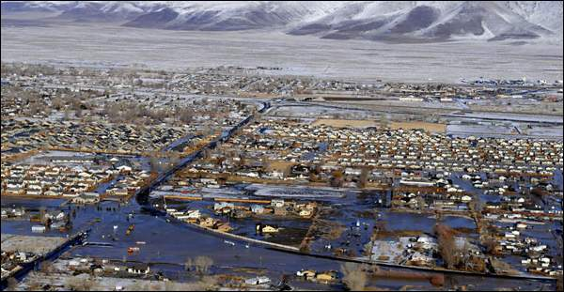
Truckee Canal Failure Fernley Nevada

Slide 44
Emergency Action Plan
Instrumentation Action Levels
Coordinate with Operations
Coordinate with State and Local Officials
Communicated with Public
Tested
Chapter 7 and 16

Slide 45
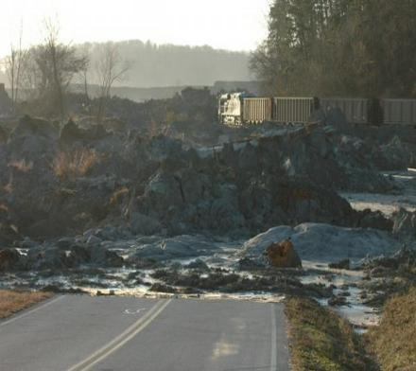
Kingston TVA Coal Ash Failure EPA Region 4

Slide 46
Project Phases
Design/Pre-Construction
Construction
Post Construction

Slide 47
Use of Schedules
During Planning and Design
During Construction
To Analyze Changes, Modifications, Claims

Slide 48
Construction Phase
Baseline schedule from contractor to show plan at the time of bid
Baseline schedule reviewed to ensure contractor understands the project
Tool to predict upcoming work activities
Schedule Factory Inspections
Schedule Field Inspections
Resource planning
Used to determine if Contractor will exceed funding limitations

Slide 49
Construction Phase
Construction Schedule – Activities
Submittals
Submittal Review by Owner
Fabrication and Delivery of Equipment, Metalwork
Civil Work: Earthwork, Dewatering, Concrete, Steel, Pipeline, Site work
Mechanical: Equipment installation, plumbing, duct work (HVAC)
Electrical: Equipment installation, wiring, testing
Milestones: Completion dates for phased work, final completion date
Interim milestones: In-river work times, water delivery dates, use of site dates, irrigation seasons
Include Clean up of site, demobilization

Slide 50
Construction Phase
Updated Schedules submitted each month to track progress and document history
Identify critical submittals
Prioritize issuance of modifications
Prioritize responding to Requests for Information from contractor

Slide 51
Submittals
Process is outlined in specifications
Managed by RE
Lead Engineer/PM coordinate at District
Tracking of response times
Responsible disciplines
Be Proactive
Minimize iterations

Slide 52
Quality Assurance Plan
Construction staff shall prepare project specific QAP that is consistent with scope and complexity of the work in accordance with ER 1180-1-6
Quality of construction meets the specifications requirements and design intent

Slide 53
Engineering Considerations for Construction Personnel
ER 1110-2-1150
Failure modes
Design intent
Communication during construction
Acceptance criteria
Quality Assurance/Quality Control
Special features requirements

Slide 54
Construction Office
RMS
Contract administration
Quality Control ?
Quality Assurance
Communication protocol

Slide 55
QA/QC
Contractor typically provides QC
Government performs QA
Contract laboratory support for QC
USACE should consider performing both QA/QC for critical modifications

Slide 56
Government Acceptance
Inspection and quality assurance are required to prevent deficiencies in materials and construction practices
Construction inspectors are the “front line” to ensure design intent is implemented
Must be informed of the critical aspects
Must be empowered to be proactive

Slide 57
Operations and Maintenance Manual
Revised/updated as a result of a modification
Summary of critical features
Includes summary of failure modes
Prepared during construction phase

Slide 58
Inspection by Lead Engineer/PDT
In accordance with ER 1110-2-112
Frequent visits/inspections to confirm site conditions and evaluate any impact to design
Temporary duty assignments are desirable

Slide 59
Inspection of Construction
Cofferdams
Dewatering
Blasting
Permanent slopes/support
Grouting
Mechanical/Electrical
Earthwork
Concrete
Foundation cleanup/treatment
Instrumentation

Slide 60
Cofferdams
Generally designed/installed by Contractor
Serves as temporary dam
Critical structure
Can result in significant negative impacts to project schedule and cost

Slide 61
Portugues Dam Overtopping of Cofferdam

Slide 62
Deer Flat Dam Caldwell Outlet Works-Cofferdam

Slide 63
Dewatering
All contractor designs shall be reviewed and approved by USACE or designed by USACE
Ensure installation/operation meets the specifications requirements and design intent to minimize risk to structure
Specifications should be structured to add additional wells/features
Monitoring to verify

Slide 64
Bradbury Dam Cachuma Project - California

Slide 65
Blasting
Blasting Plans to be reviewed and approved by USACE
Monitoring drilling and loading of holes to be inspected
Can result in excavation and backfill quantity over runs
Can result in additional cleanup

Slide 66
Folsom Dam New Spillway Excavation

Slide 67
Supported Permanent Slopes
USACE shall provide direction/oversight on design and installation of permanent support
Can result in long term slope stability issues
Create new failure modes/safety issues
Important to document for future PA’s

Slide 68
Folsom Dam Slope Stabilization/Support

Slide 69
Folsom Dam Gate Modifications

Slide 70
Folsom Dam Gate Rehabilitation

Slide 71
Wickiup Dam Toe Drain Installation

Slide 72
Grouting
USACE generally does not direct drilling/ grouting operations
Performance criteria is specified
Grouting Consultants/Contractors implement practices to meet criteria
RMC will be active in project specifications involving drilling/grouting in embankments/DO NO HARM

Slide 73
Ridges Basin Dam Animas LaPlata Project Durango Colorado

Slide 74
Foundation Cleanup and Treatment
New requirement in 1110-2-1156
All foundation surfaces that are to be covered by fill and/or concrete shall be formally inspected, approved, and documented by the Lead Engineer, Project Geologist, AND Resident Engineer
No foundation surface shall be covered until this formal review is completed

Slide 75
Foundation Cleanup and Treatment

Slide 76
Foundation Approval
Specifications should be written to accommodate this requirement.
In order to effectively accomplish this critical task, the Lead Engineer and Resident Engineer should work together to establish the foundation inspection procedures.

Slide 77
Bradbury Dam Cachuma Project-California

Slide 79
Bradbury Dam Cachuma Project - California

Slide 80
Instrumentation Monitoring During Construction
Action levels
Instrumentation lead
Reporting
Evaluation
Incorporated into EAP
Coordinate with local authorities

Slide 81
Monthly Status Reports
Construction staff shall prepare monthly reports
Distribute to Divisions, RMC
Conference calls with Division/HQ/RMC as required to address issues

Slide 82
Monthly Reporting
Instrumentation readings/plots need to be summarized monthly and submitted to Engineering on a monthly basis
Earthwork statistics prepared/summarized
Concrete statistics prepared/summarized
Grouting data prepared/summarized
Geology data prepared/summarized

Slide 83
Project Phases
Design/Pre-Construction
Construction
Post Construction

Slide 84
Use of Schedules
During Planning and Design
During Construction
To Analyze Changes, Modifications, Claims

Slide 85
Modifications and Claims
Contractor and Government uses as a tool to determine time impacts from changes or contract modifications
Used to determine if contract completion date should be extended

Slide 86
Construction Debriefing
Lessons learned
Things that worked
Things that didn’t work
Enter into DrChecks/Dam Safety CoP (TEN)

Slide 87
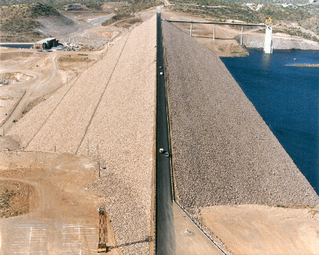
New Waddell Dam Central Arizona Project Phoenix Arizona

Slide 88
Final Construction Report
In accordance with ER 1110-1-1901 – Project Geotechnical and Concrete Materials Completion Report for Major USACE Projects
Report to be all encompassing
Invaluable for future PA’s

Slide 89
Post Implementation Risk Assessment
Performed to determine if risk management objectives were achieved

Slide 90
Current Observations
Construction personnel need to be more integrated in development of alternatives
Construction personnel need to review DRAFT specifications and be involved during design phase
Communication/cooperation between Engineering/Construction very good once construction starts

Slide 91
RMC Future Goals Engineering/Construction
Support Lead Engineer
Continue to Improve Communication with Divisions/Districts
Mentor Design Teams/Self Perform
Emphasize Total Design/Construction Process
Emphasize Prescriptive Designs
Emphasize QA and QC
Cost Estimating Processes
Preparation of Specifications/Geology
Review of Specifications
Instrumentation/Geology

Slide 92
“Do No Harm” Quality Integrated Design and Construction

Slide 93
Questions

