Slide 1
Water Management & Cascading Dams
Jerry W. Webb, P.E., D.WRE
Principal Hydrologic & Hydraulic Engineer
Hydrology, Hydraulics & Coastal Community of Practice Leader
US Army Corps of Engineers, Headquarters
Jerry.w.webb@usace.army.mil
Dam Safety Workshop
Brasília, Brazil
20-24 May 2013

Slide 2
Agenda
Water Management Policies and Responsibilities
  Water Control Manuals
  Reservoir Filling Plans
  Project Operations
Corps Water Management System (CWMS)
  Water Control Data Systems
  Real Time Water Management
  Risk Management/Risk Informed
Cascading Dams

Slide 3
Water Management Policies / Responsibilities
Stewards of our Nation’s Water Resources
Water Management makes decisions every day that affect people, the economy, and the environment.
Water Management is Mission Critical in supporting decision making related to reservoir regulation, flood control, hydro power, navigation, water quality, water supply, environmental, recreation, irrigation, fish and wildlife and other project related water resources objectives of the Corps water resources infrastructure.
Primarily we accomplish the mission by following the authorized/approved water control operations plans that are documented in water control manuals
Notes:
First, I would like to discuss what Water Management means in the Corps.

Slide 4
Water Management
Project Operation
  Failure of a project can be due to mis-operation
Minimize mis-operation with documented procedures and plans
  Periodic Inspections/Tests
  Water Control Manuals
Notes:
Things to check every year.
Contacts
Phone numbers
Operational requirements (flow augmentation, flood regulation,new physical limitations, etc)
Stage-discharge relationships
Things to update in the Manual
Operations description
Project configuration (new outlets or new limitations?)
Statistical information
Lake storage-elevation (have you lost storage?)

Slide 5
Water Control Manuals
The main purpose of a manual is for day-to-day use in water control for essentially all foreseeable conditions affecting a project or a system.
Division and district commanders will develop water control plans as required by Section 7 of the 1944 Flood Control Act, the Federal Power Act and Section 9 of Public Law 436-83 for all projects located within their areas, in conformance with ER 1110-2-240.
They must be prepared in compliance with the existing guidelines:
  Engineering Regulation ER 1110-2-240, Water Control Management
  Engineering Manual EM 1110-2-3600, Management of Water Control System
  Engineering Regulation ER 1110-2-8156, Preparation of Water Control Manuals
  Environmental Operating Principals ER 200-1-5
Notes:
ER 1110-2-240: “Water control plans will be developed for reservoirs, locks and dams, deregulation and major control structures and interrelated systems to conform with objectives and specific provisions of authorizing legislation and applicable Corps of Engineers reports. They will include any applicable authorities established after project construction. The water control plans will be prepared giving appropriate consideration to all applicable Congressional Acts relating to operation of Federal facilities.”

Slide 6
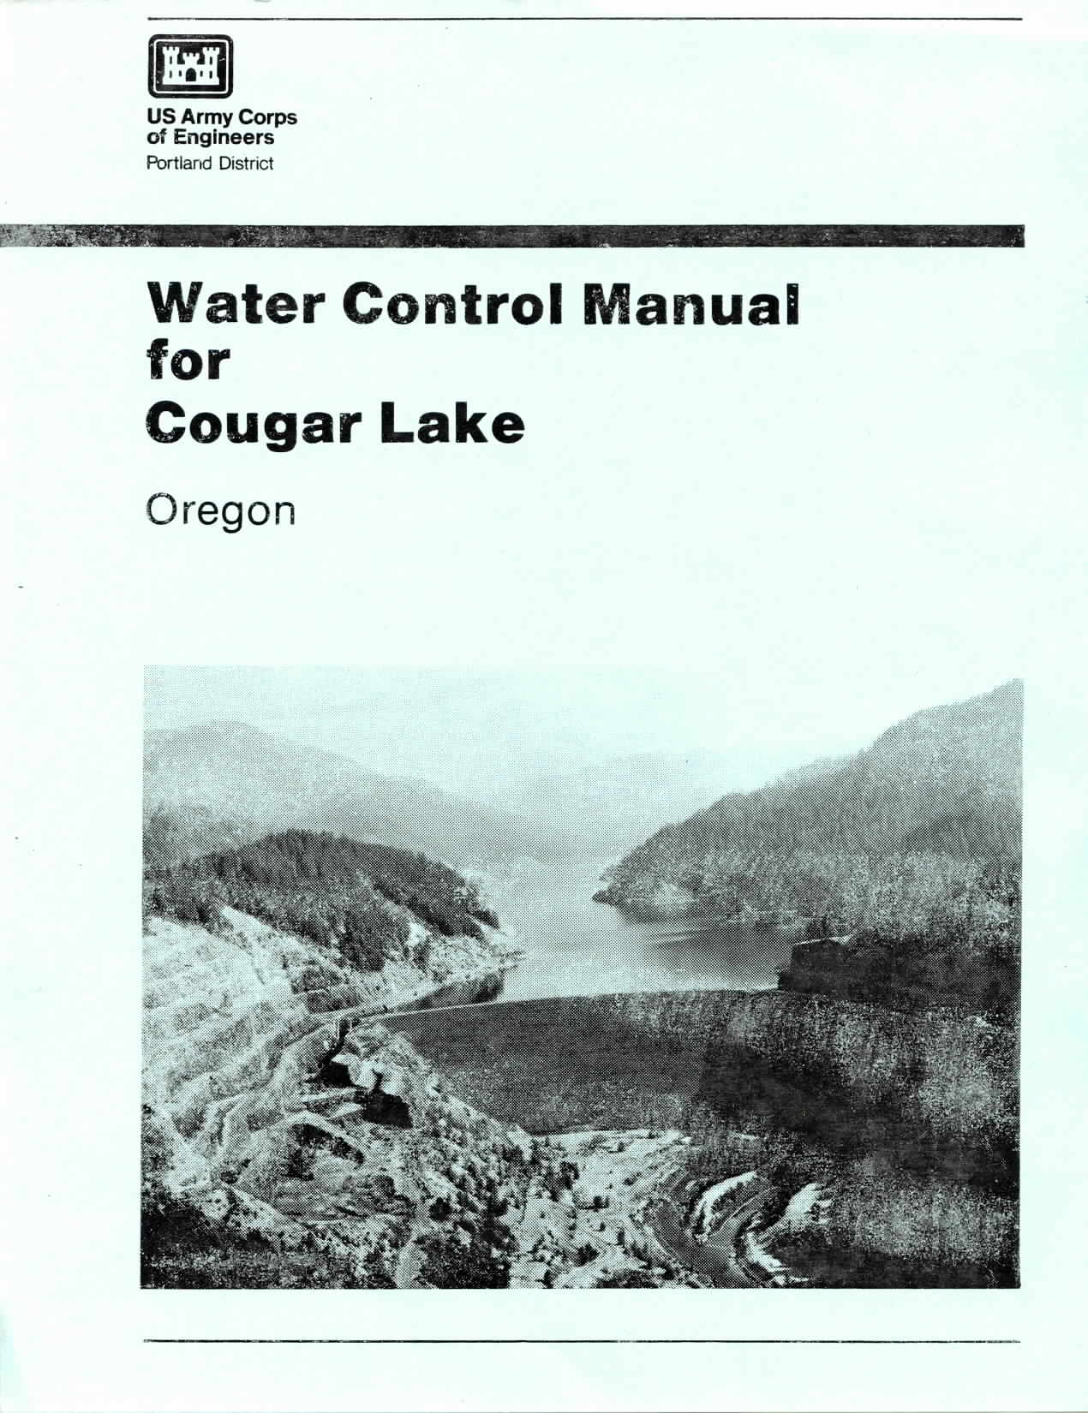
Water Management
ER 1110-2-8156
Contents
I Introduction
II Basin Description
III Project Description
IV Climatology
V Hydrology
VI Seasonal Regulation
VII Flood Control Regulation
VIII Storing for Conservation
IX Utilization of Stored Water
X Hydrometeorological Facilities
XI Responsibilities and Emergency Instructions
Notes:
A couple of chapters are critical to day-to-day
XI - includes standing orders to dam tenders. What are these? Could also be termed "Emergency Action Procedures" or something similar. They describe the actions to be taken should communications be cut or reduced.

Slide 7
Water Control Plan
Standing instructions to dam tender
Channel capacity and control points
Rate of release change
Flood control plan
  Normal and emergency
Notes:
Standing instructions to damtender – Normal conditions, communication outage, unforeseen emergency.
Flood control plan – Release schedule, downstream controls, gate operation curves, example floods.
Rate of release plan – Safety to downstream populations
Planned deviation – Notification requirements
Unplanned – Minor deviations
Emergency – Drowning, chemical spills, equipment failure

Slide 8
Emergency Action Plan
Notification flowchart
Emergency detection, evaluation, classification
Responsibilities
Preparedness
Inundation maps
Notes:
Notification – Prioritized list of notifications
Emergency detection, evaluation, and classification – Procedures for identifying problems and taking quick and appropriate action
Responsibilities – EAP related tasks. Dam owners develop and maintain EAP, state and local emergency management provide warning and evacuation.
Preparedness - Actions to mitigate or alleviate effects of a failure.
Inundation maps – Delineate areas affected by failure

Slide 9
Reservoir Filling Plan
Required for
  First filling of a new reservoir
  Significant modification to an existing reservoir
  Reservoirs that have not been filled to their design elevation

Slide 10
Reservoir Filling Plan
Risk informed
  Potential failure modes and consequences
Water control plan
Inspection and monitoring plan
Instrumentation plan
Observer instructions
Public safety and contingency plan

Slide 11
Reservoir Filling Plan
Approved by District Dam Safety Officer and furnished to MSC Dam Safety Officer for information
Water control plan in support of reservoir filling plan developed and approved in accordance with ER 1110-2-240

Slide 12
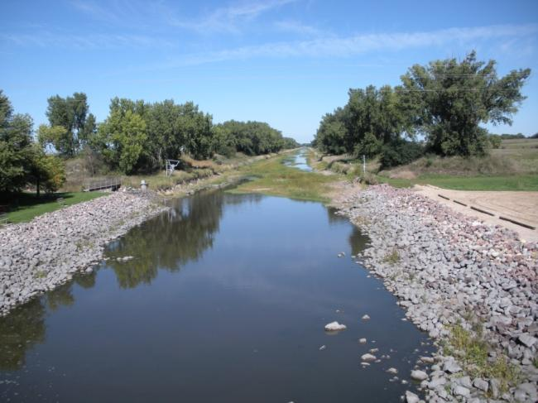
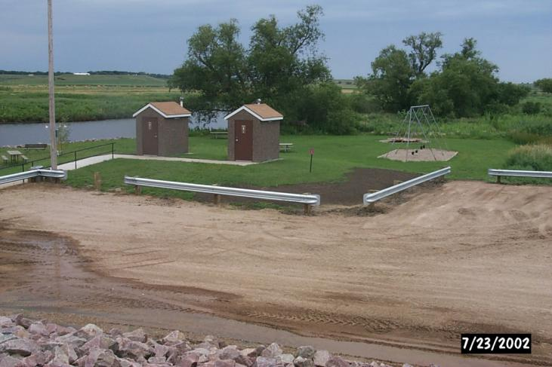
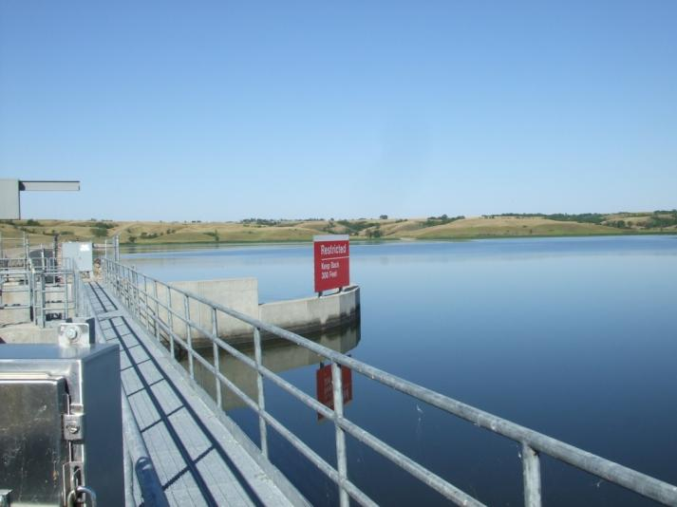
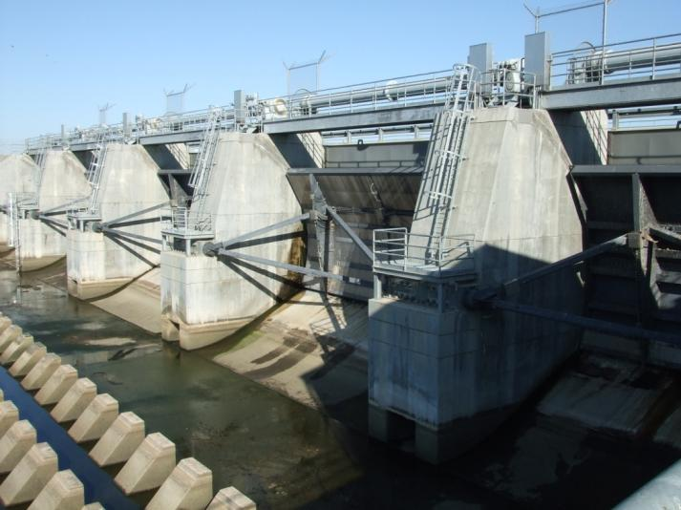
Normal Operations
Notes:
Chapter 7 describes operations.
Projects usually have a conservation elevation that has to be maintained in order to balance the purposes.
While maintaining that conservation elevation (usually have a +/- band) things such as low flow, rate of change etc must be considered.

Slide 13
Flood Control
10 ft
RESERVOIR
9 ft
Winter Control Stage
Summer Control Stage
8 ft
7 ft
DOWNSTREAM
RIVER GAGE
Maintain Pool Level
Storage
Notes:
This is an interactive slide viewed in “slide show” format. It shows a general flood control operation during a storm event. Click to advance the animation
A storm moves in and the stream begins to rise.
Stream elevation approaches control stage.
Outflow is reduced in order to reduce the amount of water downstream in an attempt to keep the stream elevation below the control stage. The lake begins to store water.
As the storm moves out of the area and stream elevation starts to fall, the lake begins to release water.
In order to get rid of excess water as quickly as possible, the lake increases the release as stream elevation falls even farther.
Notes: 1. A Control Stage is an elevation above which damage occurs. It is not necessarily flood stage. It can be higher or lower
Notes: 2. Normal operation is based on rainfall on the ground. It is not based on forecasted rainfall.

Slide 14
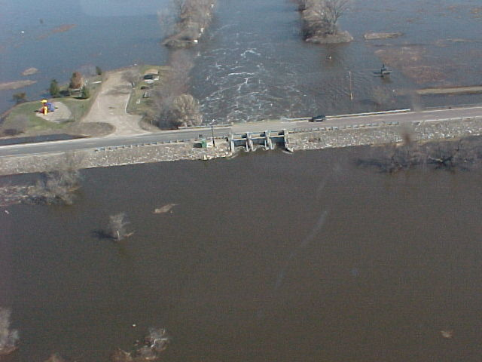
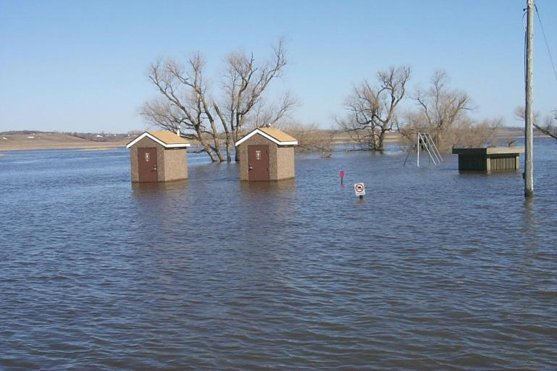
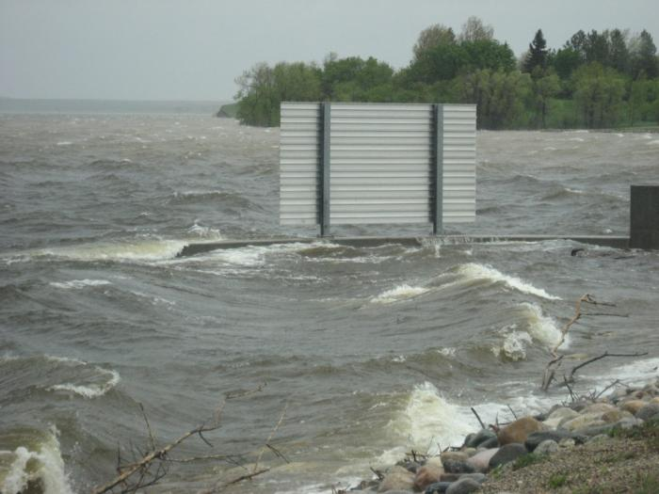
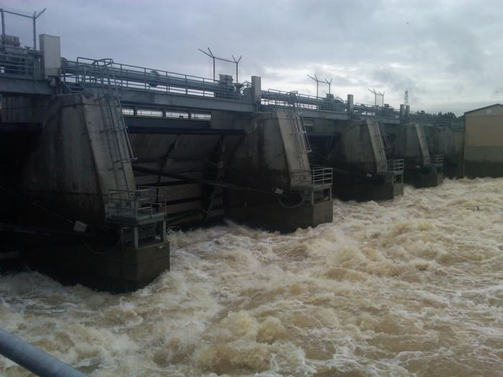
Flood Operations
Notes:
Note previous slide photos to these.
Once the pool is in flood control, you are balancing inflow, storage and outflow to the best of your ability to reduce downstream damages.

Slide 15
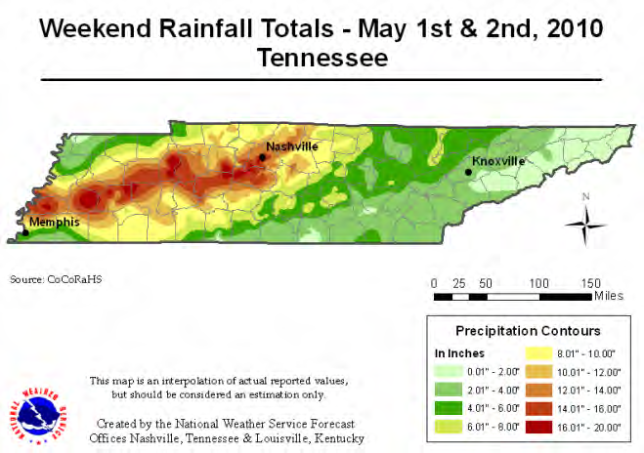
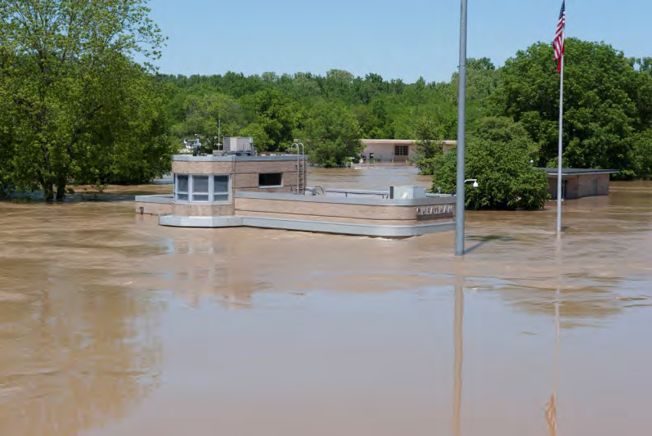
Cheatham

Slide 16
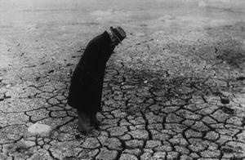
Drought Operations
Drought... abnormally dry and/or unusually warm weather sufficiently prolonged for the corresponding deficiency of water to cause a "serious hydrologic imbalance“
Reservoirs: Every reservoir has a Drought Contingency Plan which provides for releases for downstream communities.
Mississippi River Locks: Typically there are no drought operations; inflow = outflow.
Notes:
This photo is of Lake Traverse during the drought of the 1930’s.

Slide 17
Water Supply
The Corps can enter into Water Supply agreements for municipal or industrial use.
The Corps can also enter minor water supply agreements during State declared droughts.
Water Supply accounts for a minimal amount of storage in Corps Lakes.

Slide 18
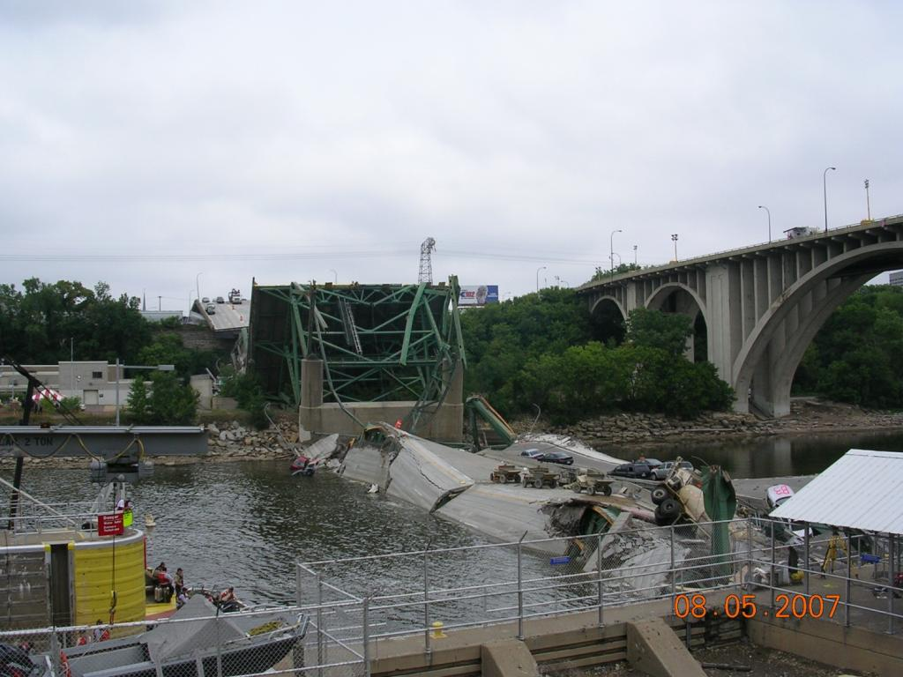
Emergencies and
Special Operations
Notes:
All reservoirs have emergency action plans that lay out what to do for different situations that could occur at the dam. Events are normally classified into a system that will help determine the severity of the problem. Example: Lake Darling Dam has three levels: Level 1 is an unusual event that is a slowly developing situation that may endanger the structural integrity of the dam. Level 2 is an emergency event that is rapidly developing and could quickly lead to dam failure and flash flooding downstream of the dam. Level 3 is an emergency event where dam failure or flash flooding downstream of the dam is imminent.
Emergencies or special operations can also occur from outside sources and not be a concern of dam failure. Examples where operations may have to change drastically and differ from the manual include drownings/missing people, bridge failure, etc. The photo is of the collapse of I-35W in the tailwater of Lower SAF Lock and Dam.

Slide 19
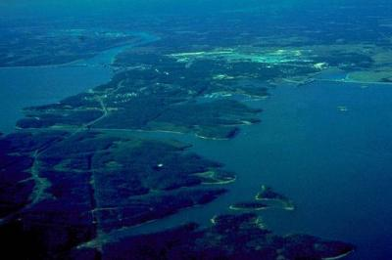
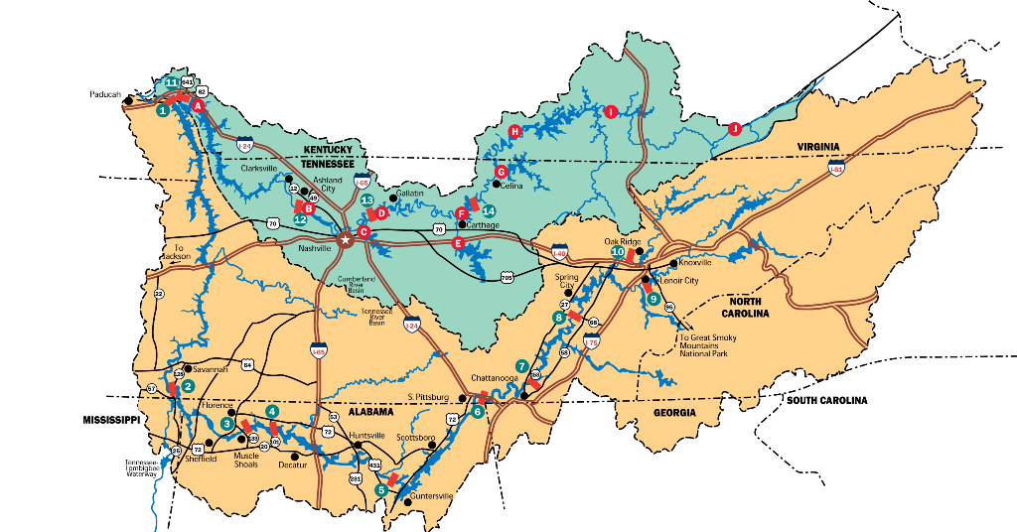
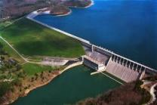
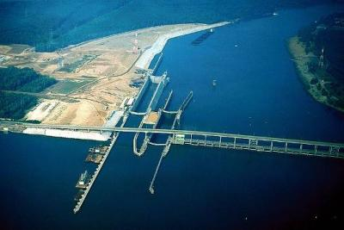
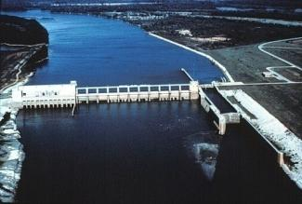
Multi-Agency Cooperation
Tennessee – Cumberland River System
Cumberland River with 4 major storage and 4 high head navigation and 10 total projects
Tennessee River with 13 major storage and 9 high head navigation and 54 total projects
Notes:
CWMS must allow for multi-agency exchange of data and sharing of results.
shown here is as an example is where TVA, Nashville District and LRD work together to manage 64 dams within two river systems to produce primarily peaking hydropower, flood control and navigation.
Together they produce 125 Billion KW hrs of hydropower annually (about 65 cents per KW hr)

Slide 20
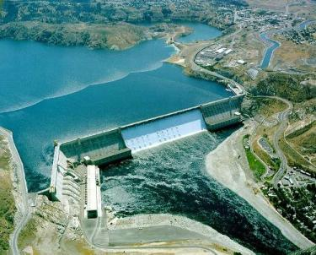
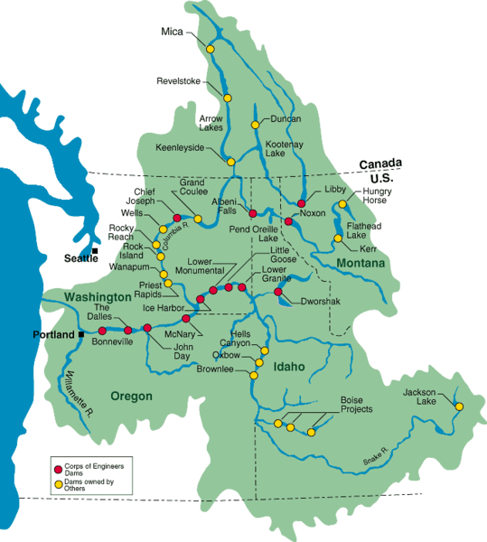
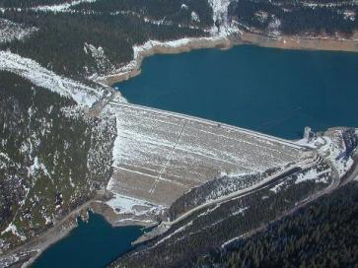
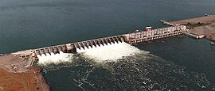
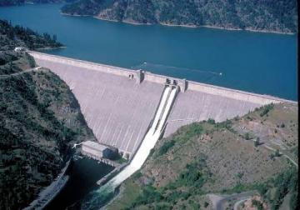
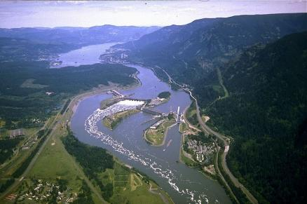
International Cooperation
Columbia River System
Hydropower, Fish Passage, Navigation, Flood Control (snow melt), Canadian Treaty, Indian Treaty, Private, multi-Agency, International
Notes:
The results of CWMS computation and analyses must be accepted internationally and must handle the complex issues related to the quality and volumes of water crossing back and forth between Canada and the US.
The Columbia River System shown has an inter mingled group of various federal agencies which include Corps & Bureau dams, Private Energy dams and BC Hydro dams
Which all must be operated in accordance complex Canadian and Indian treaties.

Slide 21
Agenda
Water Management Policies and Responsibilities
  Water Control Manuals
  Reservoir Filling Plans
  Project Operations
Corps Water Management System (CWMS)
  Water Control Data Systems
  Real Time Water Management
  Risk Management/Risk Informed
Cascading Dams

Slide 22

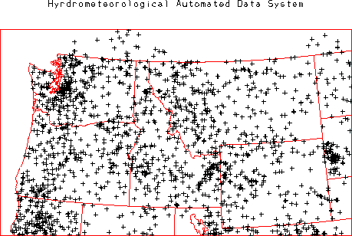




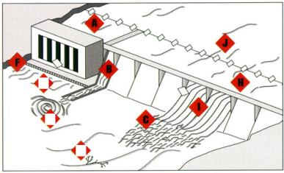



A Water Control Data System (WCDS)
NWS/RFC
State/Local Agency
NWS/RFC
State/Local Agency
Leased Line
Data Exchange
GOES &
NOAAPort
Data
Internet
Data Exchange
VHF
LoS
Data
Instructions to &
from Dam Operator
WMS
National GOES Network Source
A District’s WCDS
Notes:
The WCDS is comprised of data, computers, networks, and models.
Maintaining the WCDS is critical to Water Control’s mission.
Data needs to be received 24/7.
The data that is received is
quality controlled
archived

Slide 23
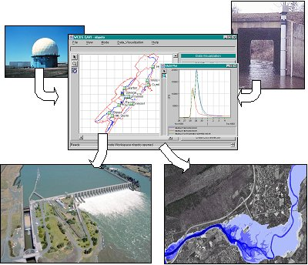
CWMS
Comprehensive, integrated system for real-time water control decision support
Complete data retrieval / verification / database system
Full range of hydrologic / hydraulic modeling software to evaluate operational decisions and compare the impact of various “what if?” scenarios
Client / Server architecture, with full set of visualization tools to evaluate data and model results
Complete set of User Manuals, Installation Manuals, Training and Technical Support
Notes:
In summary CWMS it is a:
- Comprehensive and integrated system
- Capable of data management
- A full range of hydrologic modeling
- Including "what if" analysis
With a complete set of visualization tools for making water control decisions.
And as an added bonus they provide Comprehensive Training, Manuals and Full Technical Support

Slide 24
Watershed Modeling
Modeling
Data Collection
Data Base
(Hydrology)
(Storage)
HMS
ResSim
FIA
RAS
Modeling
(Damages)
(Hydraulics)
Data
Visualization
Information dissemination
Notes:
The watershed modeling piece contains 4 independent modeling components

Slide 25
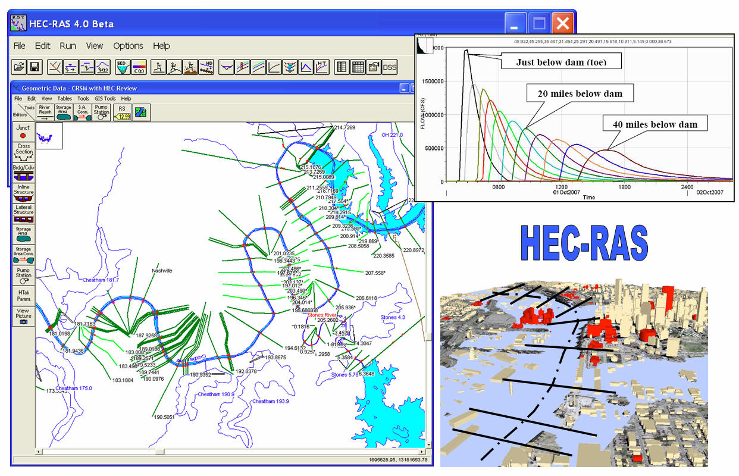
River Modeling and Inundation Mapping
Notes:
It is the most used hydraulic model in the entire world. It is considered the staple for determining flood elevations on streams and rivers.
These flood profiles are then used to develop flood inundation maps.
These maps are used by decision makers and emergency managers to safe lives and property during flooding situations.

Slide 26
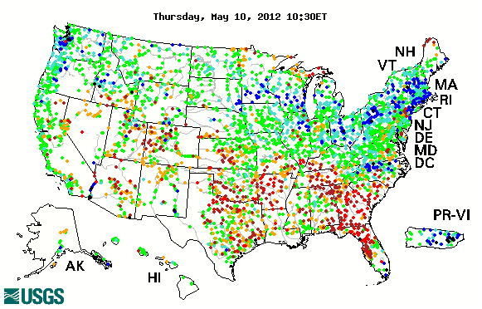

Water Control Data Systems
National Gaging Programs
Notes:
Often Districts enter into a cooperative stream gaging agreement with the USGS to maintain our gages and provide ratings.
Districts may also have their own gage crew. The gage crew takes care of ordering equipment for USGS sites and Corps sites, fixing Corps gages, etc.

Slide 27
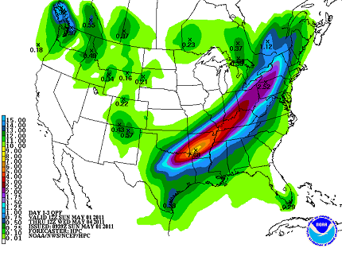
Integration / Use of NWS Products
QPFs

Slide 28
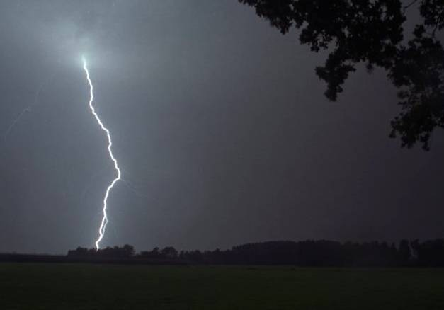
Precipitation Analysis
Precipitation processed on a grid basis.
Observed data from NEXRAD or interpolated from gages.
Future Precipitation Scenarios:
  NWS Quantitative Precipitation Forecasts (QPF)
  Multiples of the QPF
  Manual-entry or standard scenarios (What if?)
    Timing
    Location (watershed “zones”)
Notes:
HMS is a data hog and requires as much data as can be found including both continuous or intermittent data.
This include data inputs from thousands of gages nationwide as well as NWS radar data , and any other data we can get loaded into our CWMS database.

Slide 29
Challenges, Issues and Concerns
Incorporate climate variability and change scenarios to anticipate water management planning and operations
Increase flexibility of systems operations through revision and updating of water control manuals
Implement CWMS nationally. Estimated $125 million program.

Slide 30
Low Water Regulation
Release of water from lake storage (augmentation) in order to meet downstream water temperature and/or flow targets.
Original low water regulation targets were developed using the “solution to pollution is dilution” principle of assuring downstream water quality.
Notes:
Original national policy until the Clean Water Act of 1972 was the “solution to pollution was dilution”. The Clean Water Act re-focused addressing the problem of AMD to the source (point and non-point)

Slide 31
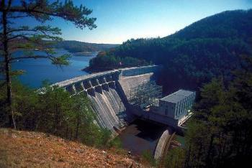
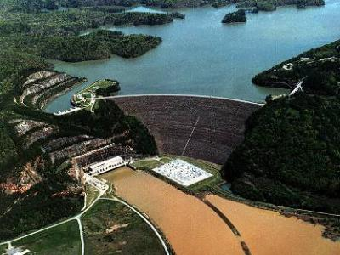
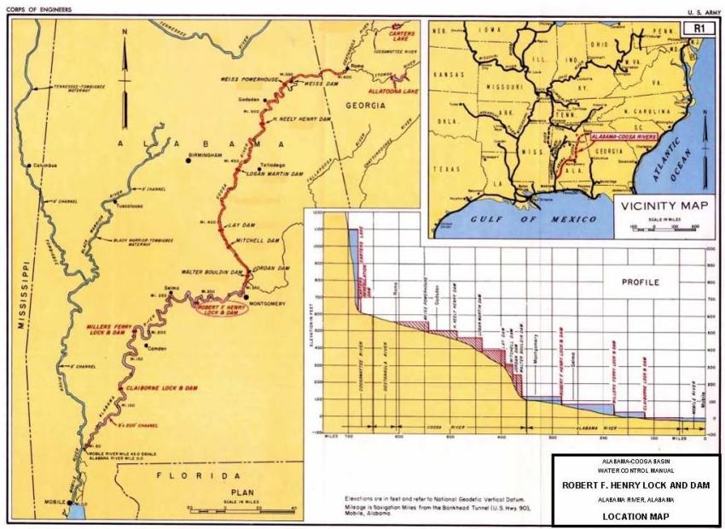

Master Water Control Manuals
Requirements for Reservoirs to be operated as “SYSTEMS”
Two Flood Control, Hydropower, Water Supply, Recreation and “Environmental” Headwater Reservoirs Feeding Downstream Hydropower & Navigation Dams
Notes:
CWMS must allow the user to Evaluate and Operate our dams as a system -- and to meet “all” authorized project purposes.
Shown is an Example of a typical Corps system where you have headwater and tributary dams storing water for water supply and flood control --- and navigation dam passing water down the system to generate hydropower while also maintaining navigation pool

Slide 32
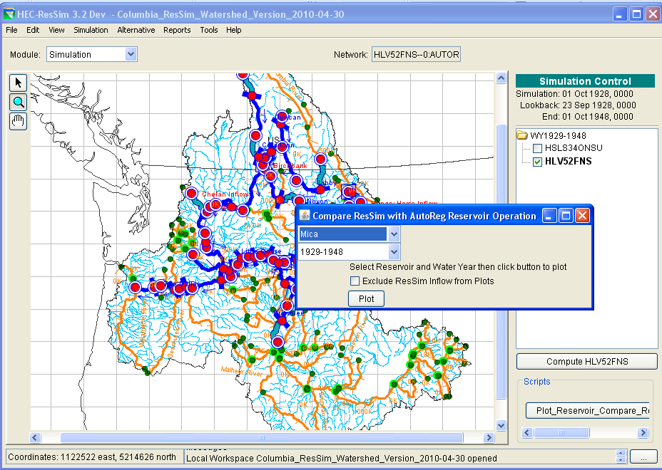
System Model Operations
Added Visualization script similar to AUTOREG
Projects = 22*
Junctions = 69
Reaches = 38

Slide 33
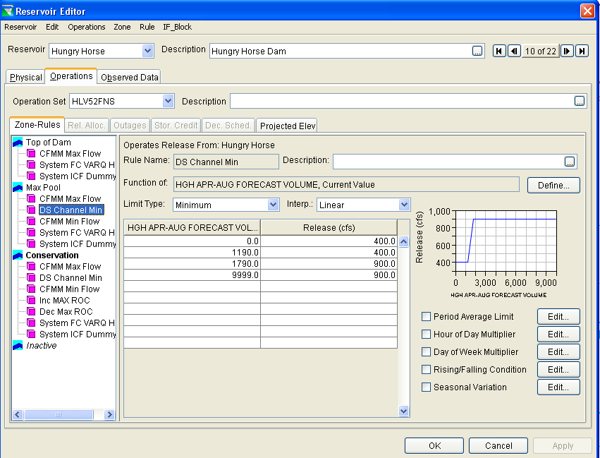
HEC-ResSim
Reservoir Network Module
Rule Stack
Notes:
Function of internal or external variables

Slide 34
Agenda
Water Management Policies and Responsibilities
  Water Control Manuals
  Reservoir Filling Plans
  Project Operations
Corps Water Management System (CWMS)
  Water Control Data Systems
  Real Time Water Management
  Risk Management/Risk Informed
Cascading Dams

Slide 35
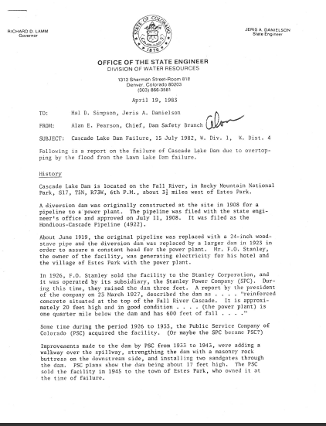
Memo from Colorado State Engineer Office
^{April 19, 1983}
“Cascade Dam failed by overtopping due to the flood from the Lawn Lake Dam Failure. The combination of hydrostatic forces and erosion of the abutments and foundations were the most probable reasons for the dam to fail.”

Slide 36
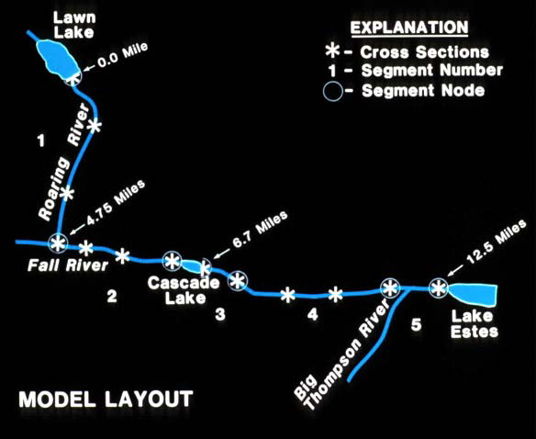
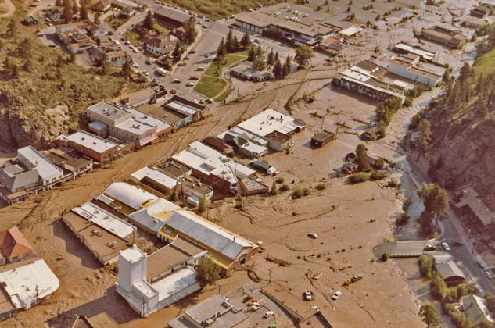
Cascading Dam Failure

Slide 37
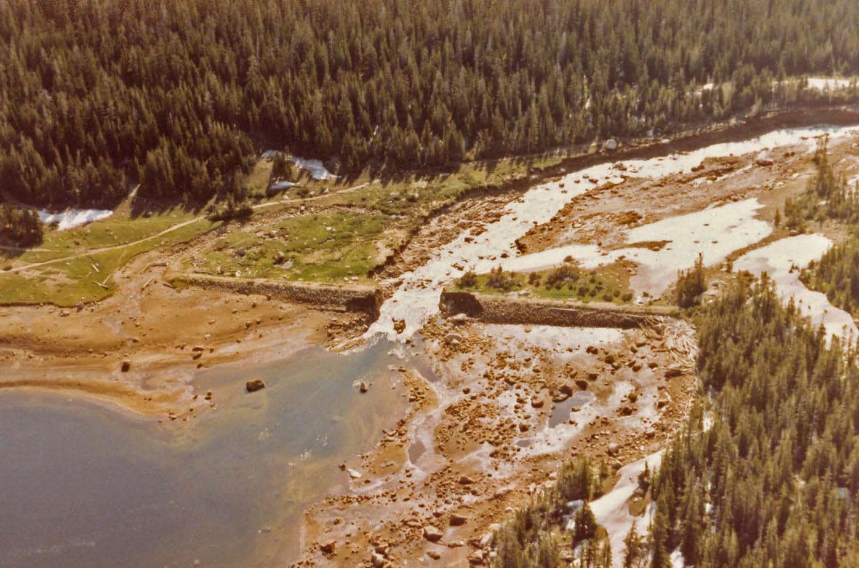
Lawn Lake Dam Failure Thursday, July 15, 1982
Dam type: Earthfill
Dam height: 26 feet
Dam crest length: 560 feet
Reservoir volume: 674 acre-feet

Slide 38
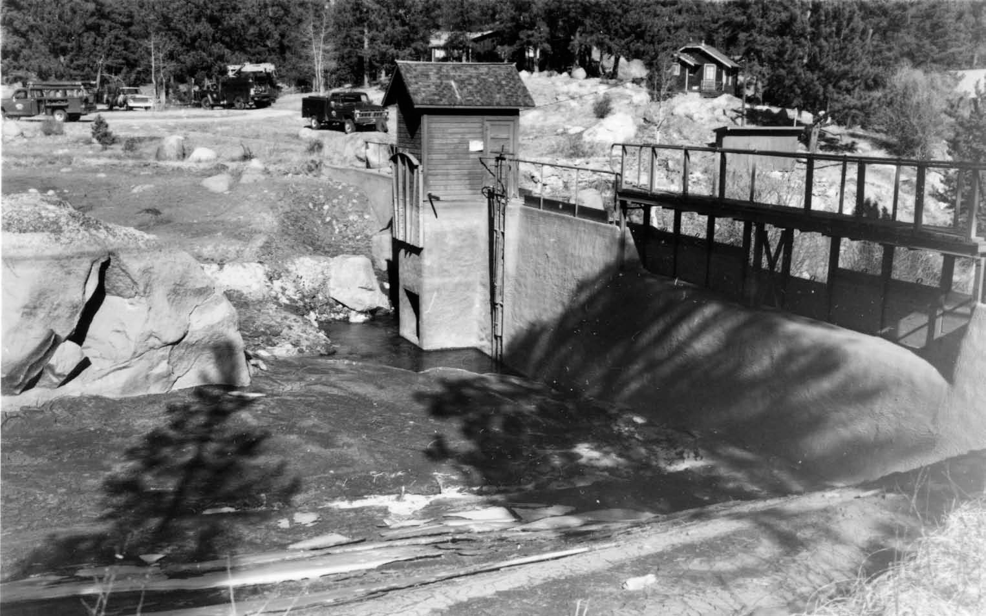
Cascade Lake
Concrete Gravity Dam
Height:17 Ft.
Length:143 Ft.
Constructed: 1908
Storage:12.1 Ac-Ft
Authorized for Hydropower

Slide 39
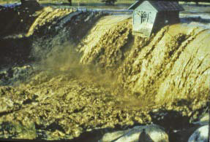
Flows from Lawn Lake Reach Cascade Lake

Slide 40
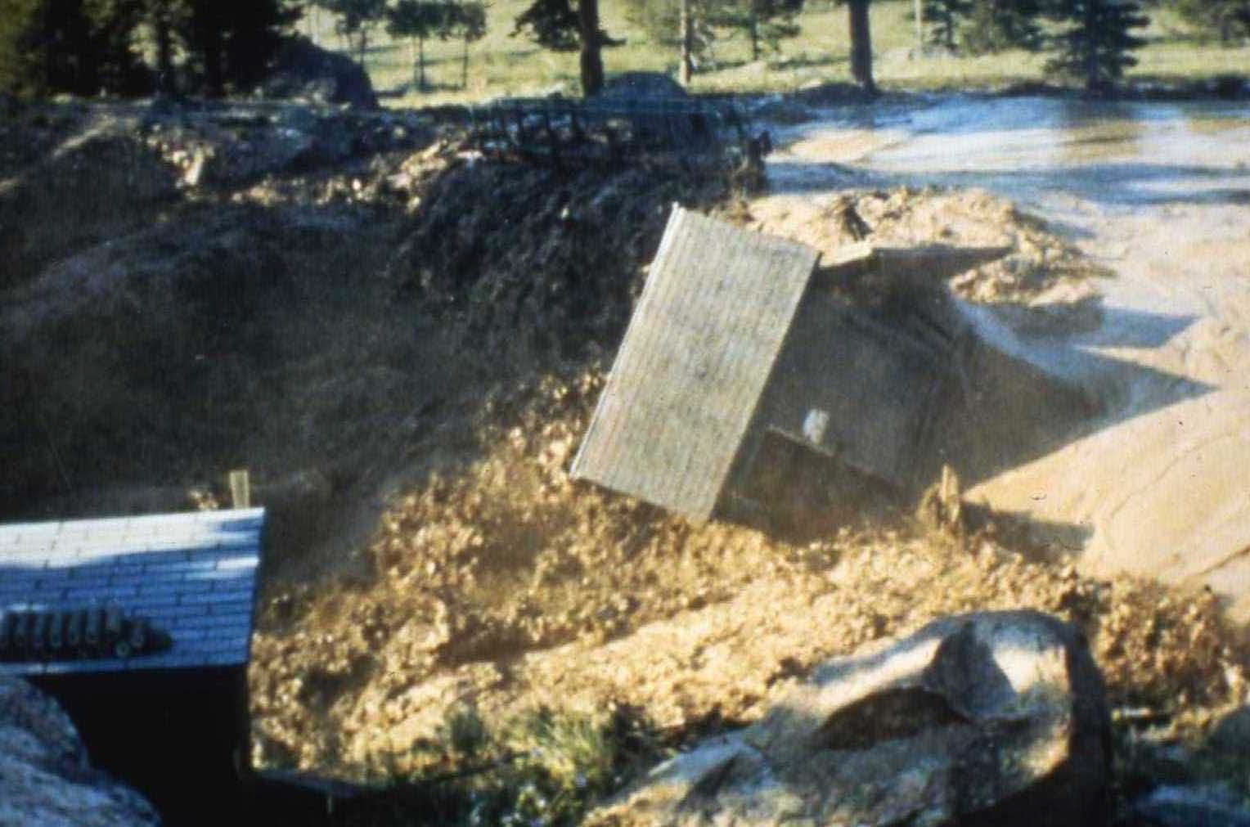
Cascade Dam Fails / Overtopping
Dam failed: 7:42 a.m. (about 2 hr, 12 minutes after Lawn Lake Dam failed.

Slide 41
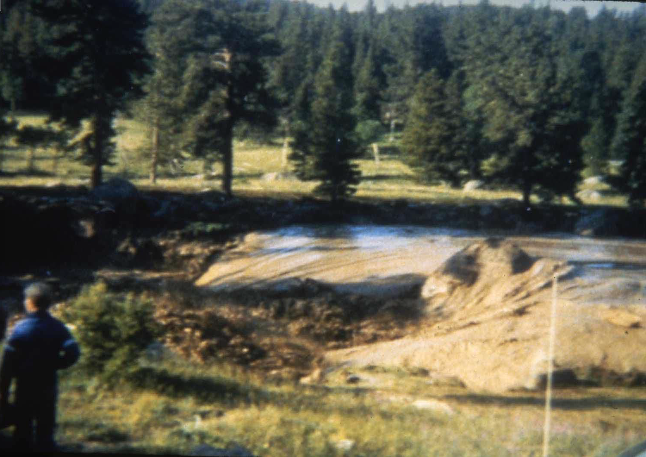
Dam Breach Moves Toward Estes Park

Slide 42
Downstream Consequences
3 Lives Lost Damages=$31 Million

Slide 43
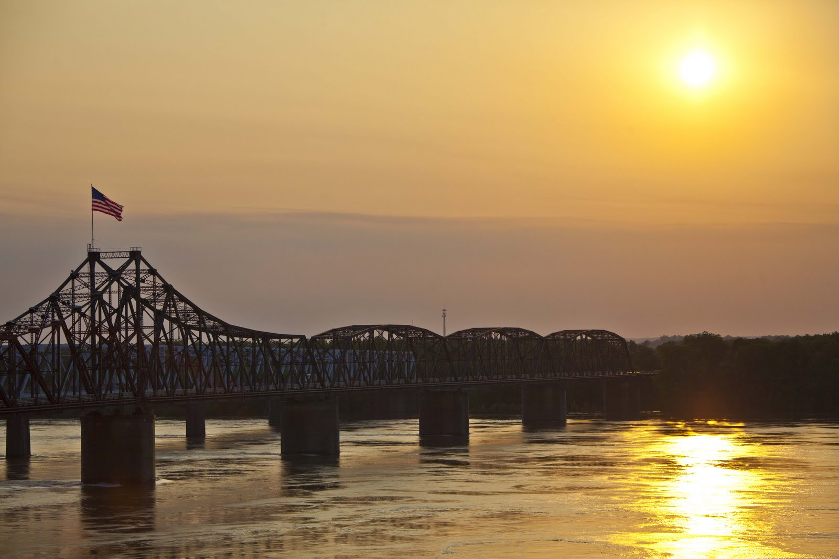
LEARNING OBJECTIVES
Using the course manual, references and lecture notes, the student will be able to understand hydrologic and hydraulic aspects of dam safety program. After this presentation, the student will be familiar with concepts, terminology and inter-relationships between hydrologic, hydraulic and water management considerations essential in the engineering analysis associated with the administration of the USACE Dam Safety program.
QUESTIONS

