Slide 1
Dam Safety Risk Communication
William Empson, PE, PMP
Senior Levee Safety Program Risk Manager
U.S. Army Corps of Engineers
Risk Management Center
William.B.Empson@usace.army.mil
Dam Safety Workshop
Brasília, Brazil
20-24 May 2013

Slide 2
Dams are Special in Risk Communication
Dams are iconic structures.
They change people’s lives.
Families remember good and bad times associated with dams for generations.

Slide 3
Dam Safety Risk Communication
ER 1110-2-1156, Chapter 10
Provides guidance on integrating risk communication:
routine and non-routine dam safety program activities
to both internal and external audiences

Slide 4
What is Risk Communication?
An open, two-way exchange of information and opinion about risk with internal and external stakeholders/public, leading to better understanding and better risk management decisions by all parties.
When working with stakeholders, listening is as important as talking.

Slide 5
Risk Communication is a Science

Slide 6
Why Communicate Risk?
ER 1156 requires IRRMP for DSAC I, II, and III projects
Communication plan is an IRRMP requirement

Slide 7
But Really, Why?
It’s the right thing to do
Influence the message, get in front of issue
Engender agency credibility, trust, respect
Local, state, federal emergency response
Improve coordination
Define roles/responsibilities
Reduce risk (it is an IRRM)
Informed, engaged public/stakeholders
Empower to take responsibility/risk-informed action
Inform risk COE management decisions
Build relationships

Slide 8
Risk Communication Goals
Prevent/decrease injury, deaths, economic loss.
Build understanding/support for response plan.
Assist in executing response plan.
Prevent misallocation & wasting of resources.
Keep decision-makers well informed.
Listen and learn.
Counter or correct rumors.
Prevent negative behavior and encourage constructive responses to risk or crises.
Empower stakeholders/public to make informed decisions and share responsibility (Howard Hanson Boeing).

Slide 9
A Variety of Risk Communication Situations
Outrage Management | Crisis / Emergency Communication
Public Relations | Precaution Advocacy
High
Outrage
(fear, anger)
Low
High
Hazard (danger)
Source: Charles Yoe, PhD
Professor of Economics Notre Dame of Maryland
Risk Communicator Training
Notes:
No simple solutions
No cookbook, one size fits all
Tailor to meet the situation

Slide 10
Risk Communication Team
Requires multi-discipline team throughout the vertical dam safety team
Public Affairs Officer –lead, synchronize and execute.
Identify spokesperson, roles and responsibilities
Develop the message/talking points
Orchestrate, monitor and managecontacts
EM personnel
Contractors
Stakeholders
Office of Counsel
Others
Engineers/SME’s
Construction staff
Operations personnel
PM

Slide 11
Credibility
Respected, neutral informed local citizens.
Health and safety professionals/First responders.
Professors and educators.
Media.
Environmental groups.
Industry.
Federal government
Consultants.

Slide 12
Understand and Communicate Change
No longer “safe” project vs. “needs remediation”
Flood risk mitigation, not flood control – zero risk unachievable
Degrees of risk, DSAC I-V
Tolerable ≠ acceptable,
Use the DSAC descriptions to guide however; no reinterpreting or redefining project classification (see Appendix F of ER)
Risk= P_{f} x Consequences

Slide 13
DSAC I Language!

Slide 14
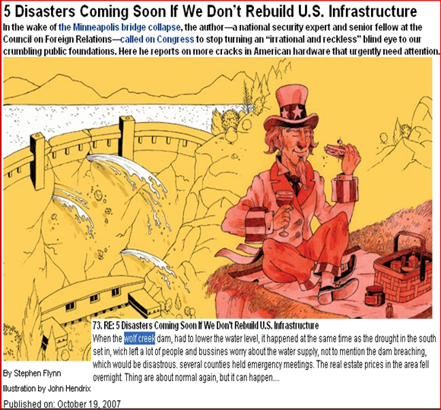
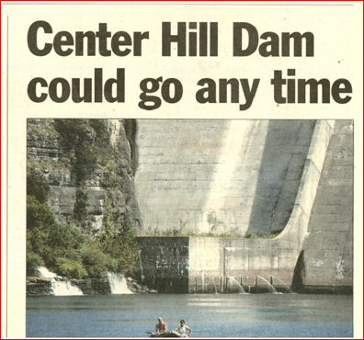
Public/Stakeholder Meetings, Media Contacts
Preparation and Planning – Some how to’s, rules, tips, & lessons learned from Wolf Creek and Center Hill

Slide 15
+Rules, tips, & lessons learned from Tuttle Creek and Weldon Spring
Relationships were critical.

Slide 16
Risk Lessons on Communication
Address Uncertainty
Keep it Simple
Benefits and Risks
Context: Move Away from Binary Words
Focus on Options
Source & Nature of Risks is Important

Slide 17
Target Audiences
First Responders need to know first.
All political levels.
Public works and utilities.
Elder care, schools, day cares, special needs facilities.
General Public.
Homeowner, Business & Retiree groups.

Slide 18
Preparation and Planning
Get risk communication/crisis/media training.
(there are differences; media, meetings, stakeholders)
Determine communication channel.
Develop event specific communication plan.
Key messages – the Good, Bad, and Ugly.
ID spokesperson(s).
Stay on message – consistent, informed, cohesive message from each spokesperson.
Know target audience – tailor message.

Slide 19
Media/Public/Stakeholder Meetings
Response Structure
Express empathy and caring.
Provide conclusion.
Provide supporting facts.
Repeat conclusion.
Describe future action.

Slide 20
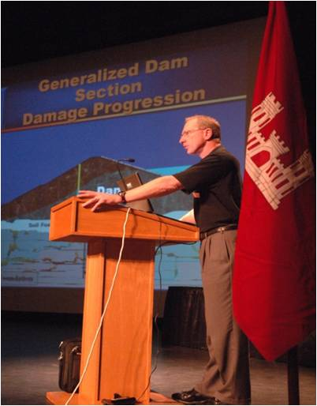
Media/Public/Stakeholder Meetings
Practice, practice, practice, critique, refine, practice
Write down all potential questions and answers.
Role play.
Tough questions.
You are killing my Grandma!
Focus group.
Verbal and non-verbal.

Slide 21
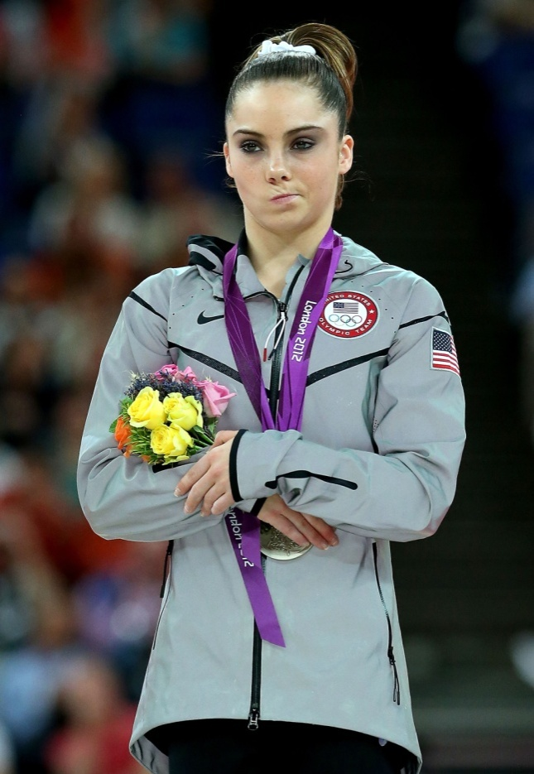
Non-Verbal Communication
50-75% of content.
Intensely noticed.
Overrides verbal.

Slide 22
Splenetic’s Curve
# of people
Detractors
Undecided
Target audience
Supporters
Not there to make friends.
Be open, honest, sincere, genuine.
Not optimistic, not pessimistic, be realistic.
Don’t take attacks personally.
Expect and allow some venting.
Don’t answer questions not asked.
Support

Slide 23
Simplification
Simplify language.
Simplify graphics.
Simplify content.
Notes:
Simplification
Why is it hard to simplify? It is hard for technical people who learn complexity. Many think simple and interesting means inaccurate. We learn this in school to be more complex because that gets better grades
We often do not want it simple. We know what we are doing, this is my field, why do I need to explain this to people, they are not experts. We get irritated when we explain our field to people not in it—so it gets to be passive aggressive. We make them feel stupid for wanting to know this to begin with.

Slide 24
Simplify Language
If the word is there to impress—cut it
6th-8th grade level, no jargon, no acronyms
Short, simple sentences
Avoid words that have technical meanings that differ from their common meanings
Avoid:
Negatives; No, can’t, don’t, not, never, “I am not a lying”
Pushback; “Why don’t you believe me?”
Speculation
Guarantees
Humor
Personal opinion
Notes:
Simplify language
If the word is there to impress—cut it out—Hard to do. Find the examples and phrases you are most proud of and get rid of them. You are not to impress people.
If the word needs defining, define it, then cut it out, e.g. potable water, call it drinking water
If you have to teach the jargon introduce the concept before the word—sometimes you must have the jargon, explain the concept then say engineers have a word for this they call it…..
When tension is high use less jargon-anger or fear high means high feelings people will be less tolerant of jargon and the amt you use goes up when you’re upset. Technical people use jargon for efficiency and insulation!
Ask your audience to stop you if you use jargon they do not understand—stop me quickly, when I say it. Legitimate stopping you immediately, make it your problem not theirs. My training is technical if I go off into jargon, stop me and I’ll back up and say it right
Keep your sentence structure simple—high correlations (.6-.7) sentence structure and understanding, persuasiveness and interest. Keep it simple, short sentences. Avoid nominalization—using nouns where normal people use verbs—cracks in effluent settlement tanks grow faster when there is more stuff in the tank—tank crack growth rate is nominalization. Four one syllable common words that are hard to understand
Ask nontechnical to read what you’ve written or to listen to you and ask them to stop you when there is something they do not understand or something uninteresting (boredom is a factor, people stop listening when they get lost but they call it boredom.
Run a readability check—Rightwriter is a software machine will help you
Warn your audience about difficult material—if there are terms or concepts that are difficult tell people you’re sorry but now we are getting to the hard part—better than just launching into it
Be especially careful about words that have technical meanings that differ from their common meanings—“Significance” it has a statistical meaning that is very different from the normal use—“conservative” is another word, bias and such

Slide 25
Simplify Graphics
Do not underestimate the power of a good PowerPoint slide – take the time.
Don’t use recycled technical drawings.
Simplify to the point of a “cartoon” to illustrate a point.
Use color to convey meaning.
Consider color blindness.
Use animation to simplify complex information.
Notes:
Avoid too much data—do not make it too small, do not offer too much information
Make it readable and make it understandable too,
Ask the question you want people to focus on and answer it with data if possible—ask and answer one question in ways people can understand
Scare people first then reassure them
Simplifying graphics:
Limit yourself to one point per graphic
Put the conclusion right on the slide—if it won’t fit the slide or the conclusion are too complex
Use step through graphics to simplify complex information-animate the reasoning
Focus on bar graphs and pie charts when you can—this is RC simplicity, they are more intuitively understandable—don’t use plots you have to explain. There is no point giving people data you know in advance they’re not going to be able to understand. They’ll just resent it!
Stand in front of the graphic rather than behind it so you can look at it with your audience. A big advantage of graphic material is you get to join people and look at the data with them
Use color to convey meaning but remember some people are color blind

Slide 26
Grout-Line 12 Section
Too busy, detailed, complicated – take too much time to explain
Sinkhole #1
u/s 30 ft
T0345r
u/s 6 ft
1705 cu ft
100 cu ft
EL 500
Bottom of
Grout Curtain
EL 513
Leipers /
Catheys
Contact
Looking Upstream
NRI
Notes:
Engineering produced interpretative geological drawings along the grout lines
This shows the connection of the crest grout line with the concrete monolith
Shown is limestone solutioning along the line

Slide 27
Typical Dam Section
El. 773
El. 680 restricted
Embankment
Lake
Cutoff Trench
Top of Rock El. 570 ±
Soil Foundation
Limestone Foundation

Slide 28
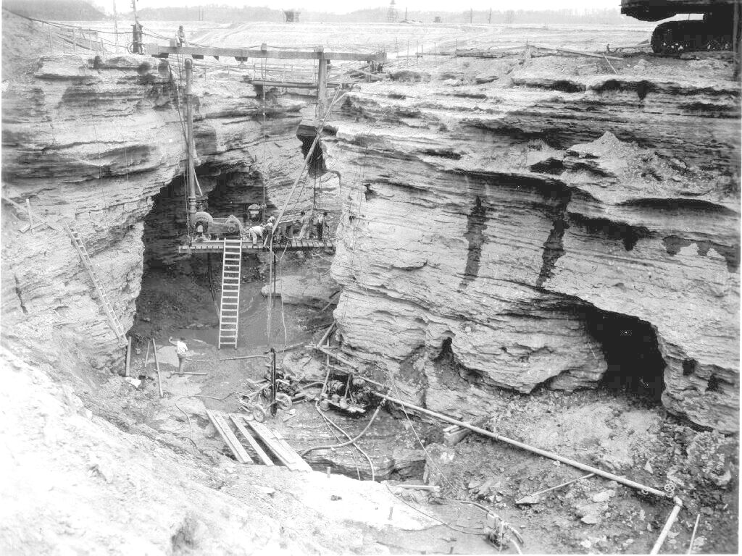
Foundation Treatment
Cave
Cutoff Trench
Caves
Notes:
Same view as previous slide only further away. Note size of twin caves in relation to workers.
Note other caves and small solution features
Seepage along bedding planes.
Footbridge at top
Tie in to monolith will be near top of picture

Slide 29
Conceptual Failure Mode
El. 773
Work Platform Elev. 750
El. 680 restricted
Lake
Embankment
Top of Rock El. 570 ±
Soil Foundation
Limestone Foundation

Slide 30
Rise of Cumberland River at Celina – River Mile 381
River Elev.
571
750 Lake Level
562
552
717 Lake Level
Hwy 52 Bridge
’75 Flood Level
680 Lake Level
Time to Rise ~ 9 hrs
Time (days)
Rate of Rise: 1.5 – 2 ft/hr

Slide 31
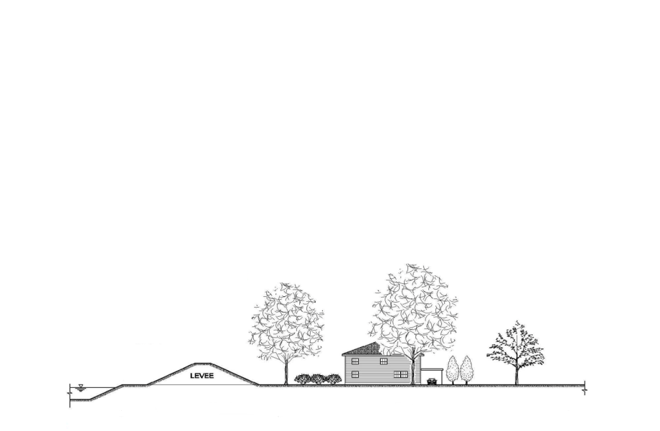
Levee System :
Loss of life is of paramount concern.
Economic and environmental losses are also important.
How Likely is it that the Hazard (flood, earthquake) will Occur?
How Will the Infrastructure Perform during this Hazard?
What are the Consequences for Non-Performance?
The USACE Risk Framework

Slide 32
Risk Slider #1
Performance Risk
Consequence Risk
LSAC Assignment
Low Risk

Slide 33
General Concepts
30 seconds to establish trust and credibility.
Main points, stay on message.
What you want them to know
What they want to know
What is likely to be misunderstood if not addressed
Stay out of the technical weeds.
Stop talking when finished.
Notes:
Stick to your main points-you either want people to know or they really want to know it (the best reason) or there will be a misunderstanding down the road are the 3 reasons for explaining something. If it does not meet one of these 3 delete it. Something true or interesting or something we worked really hard to find out is not a good enough reason to include something.
Provide three different levels of complexity, organized like an onion—in technical writing we use executive summary, the report and the appendices. Do same thing with public-in writing. If you leave info out people feel a trust problem but if you give them too much info they resent that
Include only details that are needed to explain your main points or to avoid losing credibility later—this is test for including a detail. 1 Can they understand the main point without this detail? 2. If they heard the detail later from someone else would it seem to contradict what you told them? If so include it. Imagine a bad effect that may not be statistically significant, if you leave it out now and someone says it later you may have to discuss it. If you do not mistrustful people will find it in the appendix and say right here in your own report it says…. And so even the detail may not be serious but leaving it out is serious
Don’t skimp on history, politics or context, do not leave out information the audience already knows—don’t skimp on non-technical details. People may remember the screw-up or the lawsuit in the past so do not slide over that. If you do the technical report looses credibility. Tell people what they already know in language they understand. Let them know you share the history.
Tell stories or at least use concrete language. Stories are better than raw data. Show pictures of you on the job doing the work—here I am in Prince Williams sound diving into the water to see how many fish died. Stories that demo a specific point are best, a story that doesn’t is better than no story.
Personalize-if you dare, be a person. We are trained to be impersonal and we need to overcome that with an audience. Give a little background, would you drink the water—I would drink the water but my wife would be drinking water quality. It empowers audience to have any position they want to have. Allow your emotions to show, but do not show anger with the public. A useful feeling to express is hurt. Show you are a human and people can be more respectful and understanding. If you act impersonally you cannot blame people for treating you as if you are not.
Check for understanding—watch for glazed or wandering eyes, watch for writing everything down (maybe I’ll figure it out later). If you ask if people understand they are not likely to say no, so look for the nonverbal cues.

Slide 34
Communication
Don’t fear “I don’t know but I’ll find out and here is how I will get back to you with an answer”.
Personalize-be a person.
Explain uncertainty…..like flood mapping.
Use risk comparisons carefully.
Don’t tell them how they should feel.
Don’t tell them that you know how they feel.
Notes:
Stick to your main points-you either want people to know or they really want to know it (the best reason) or there will be a misunderstanding down the road are the 3 reasons for explaining something. If it does not meet one of these 3 delete it. Something true or interesting or something we worked really hard to find out is not a good enough reason to include something.
Provide three different levels of complexity, organized like an onion—in technical writing we use executive summary, the report and the appendices. Do same thing with public-in writing. If you leave info out people feel a trust problem but if you give them too much info they resent that
Include only details that are needed to explain your main points or to avoid losing credibility later—this is test for including a detail. 1 Can they understand the main point without this detail? 2. If they heard the detail later from someone else would it seem to contradict what you told them? If so include it. Imagine a bad effect that may not be statistically significant, if you leave it out now and someone says it later you may have to discuss it. If you do not mistrustful people will find it in the appendix and say right here in your own report it says…. And so even the detail may not be serious but leaving it out is serious
Don’t skimp on history, politics or context, do not leave out information the audience already knows—don’t skimp on non-technical details. People may remember the screw-up or the lawsuit in the past so do not slide over that. If you do the technical report looses credibility. Tell people what they already know in language they understand. Let them know you share the history.
Tell stories or at least use concrete language. Stories are better than raw data. Show pictures of you on the job doing the work—here I am in Prince Williams sound diving into the water to see how many fish died. Stories that demo a specific point are best, a story that doesn’t is better than no story.
Personalize-if you dare, be a person. We are trained to be impersonal and we need to overcome that with an audience. Give a little background, would you drink the water—I would drink the water but my wife would be drinking water quality. It empowers audience to have any position they want to have. Allow your emotions to show, but do not show anger with the public. A useful feeling to express is hurt. Show you are a human and people can be more respectful and understanding. If you act impersonally you cannot blame people for treating you as if you are not.
Check for understanding—watch for glazed or wandering eyes, watch for writing everything down (maybe I’ll figure it out later). If you ask if people understand they are not likely to say no, so look for the nonverbal cues.

Slide 35
Understanding and Feelings
Repeat all important messages 3 times
40% forgotten within 30 minutes, 60% by end of day
Actively Listen.
Mirroring feelings helps gauge your audience understanding and makes them feel valued.
What I hear you saying is…
It sounds as if you feel….
In the end, what people remember is…how you made them feel.
Notes:
Stick to your main points-you either want people to know or they really want to know it (the best reason) or there will be a misunderstanding down the road are the 3 reasons for explaining something. If it does not meet one of these 3 delete it. Something true or interesting or something we worked really hard to find out is not a good enough reason to include something.
Provide three different levels of complexity, organized like an onion—in technical writing we use executive summary, the report and the appendices. Do same thing with public-in writing. If you leave info out people feel a trust problem but if you give them too much info they resent that
Include only details that are needed to explain your main points or to avoid losing credibility later—this is test for including a detail. 1 Can they understand the main point without this detail? 2. If they heard the detail later from someone else would it seem to contradict what you told them? If so include it. Imagine a bad effect that may not be statistically significant, if you leave it out now and someone says it later you may have to discuss it. If you do not mistrustful people will find it in the appendix and say right here in your own report it says…. And so even the detail may not be serious but leaving it out is serious
Don’t skimp on history, politics or context, do not leave out information the audience already knows—don’t skimp on non-technical details. People may remember the screw-up or the lawsuit in the past so do not slide over that. If you do the technical report looses credibility. Tell people what they already know in language they understand. Let them know you share the history.
Tell stories or at least use concrete language. Stories are better than raw data. Show pictures of you on the job doing the work—here I am in Prince Williams sound diving into the water to see how many fish died. Stories that demo a specific point are best, a story that doesn’t is better than no story.
Personalize-if you dare, be a person. We are trained to be impersonal and we need to overcome that with an audience. Give a little background, would you drink the water—I would drink the water but my wife would be drinking water quality. It empowers audience to have any position they want to have. Allow your emotions to show, but do not show anger with the public. A useful feeling to express is hurt. Show you are a human and people can be more respectful and understanding. If you act impersonally you cannot blame people for treating you as if you are not.
Check for understanding—watch for glazed or wandering eyes, watch for writing everything down (maybe I’ll figure it out later). If you ask if people understand they are not likely to say no, so look for the nonverbal cues.

Slide 36
Recommendations
Wall of water vs. rate of rise (cm/hr).
Academics testing your technical knowledge.
Avoid a stage or elevated platform if you can.
Dress one step above most attendees.
Bring in an impartial moderator for meetings.

Slide 37
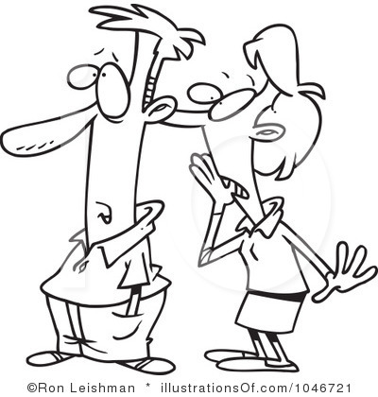
Rumors
By the time you hear a rumor, everyone in town has heard it.
Don’t ignore it.
Coffee talk at breakfast is a good gauge.
Use it to time and tailor outreach.

Slide 38
Community Outreach Program
Web Site - #1 Expectation
Press releases.
Newsletter.
Information kiosk.
Public meetings – Every Community.
Radio announcements & Call In Shows
Regional television

Slide 39
News Letters

Slide 40
Fact Sheets

Slide 41
Posters

Slide 42
Information Kiosk

Slide 43
13,000 Annual Mailings

Slide 44
Subzone Maps

Slide 45
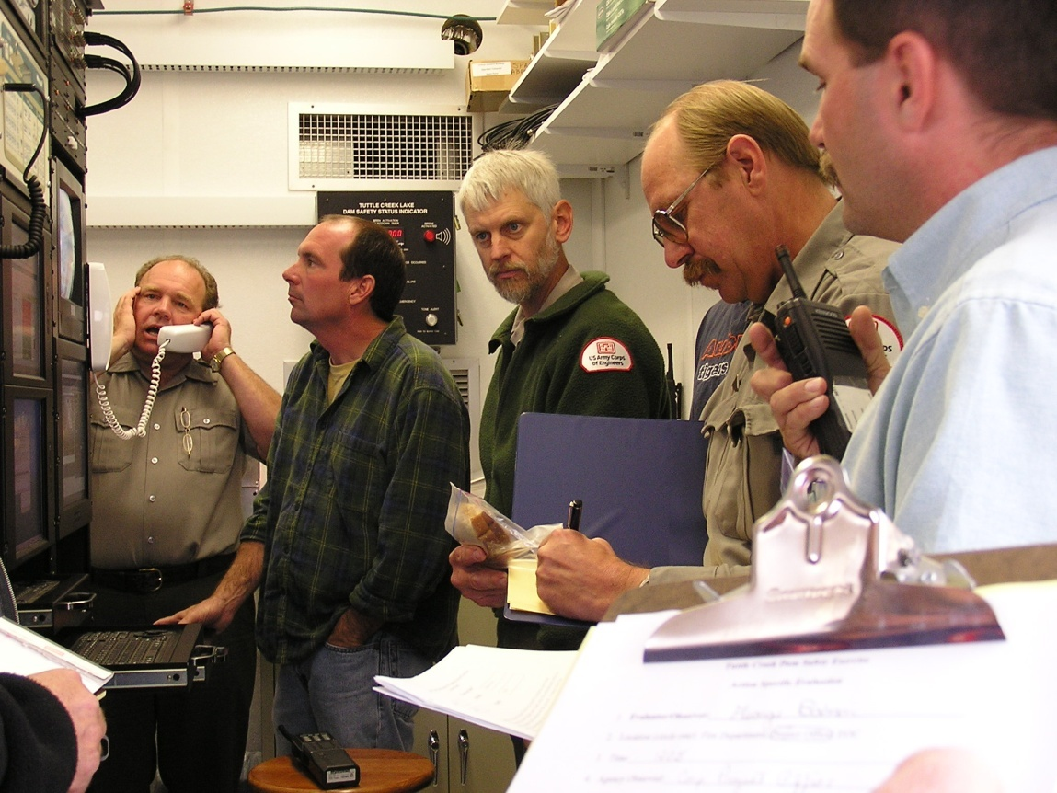
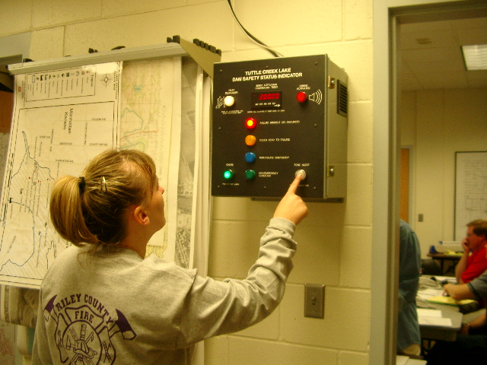
Functional Exercise for Local Responders

Slide 46
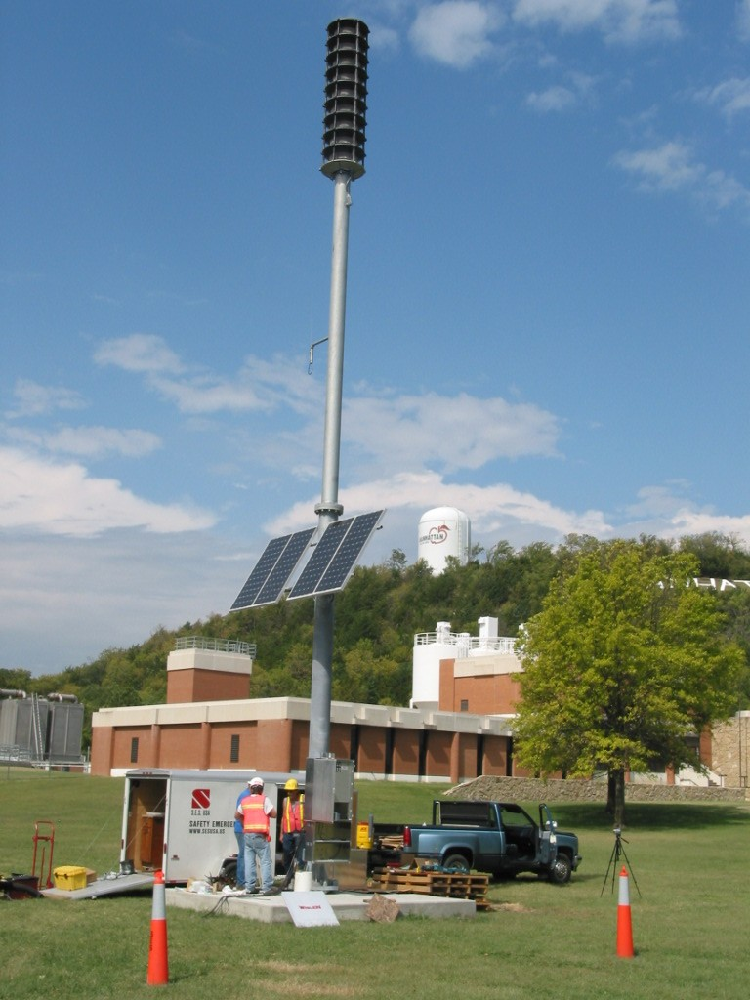
Siren Testing
Voice
Tornado Warning
Flooding
Evacuation

Slide 47
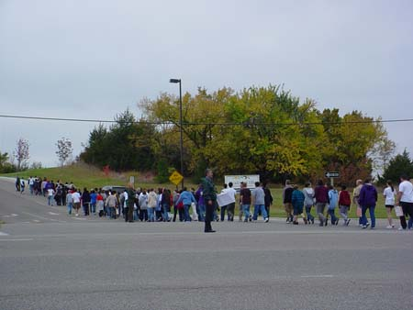
Family Risk Communication Exercise Evacuated Middle School

Slide 48
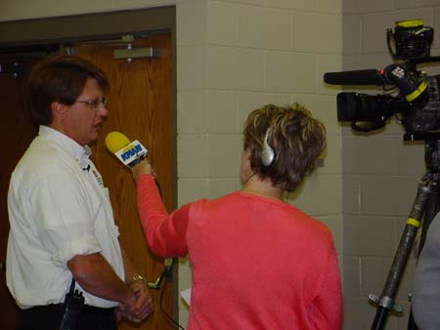
Lesson Learned Set up Joint Information Center (JIC)
Media Distracts from exercise and real response at multiple locations.

Slide 49
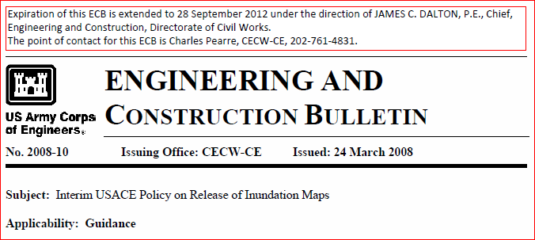
Release of Inundation Mapping
PAO was for release
Security was against
Office of Counsel felt strongly both ways
In the end, no public release
Reference:
Vs.
Public
Right
to Know
Security Threat
New Policy Being Developed Now.

Slide 50
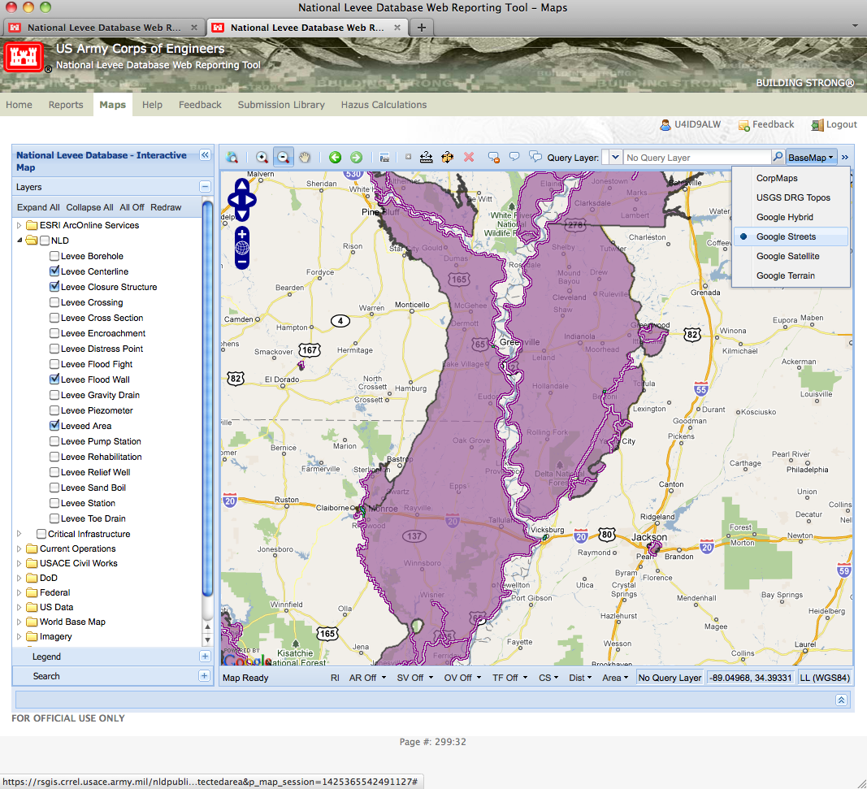
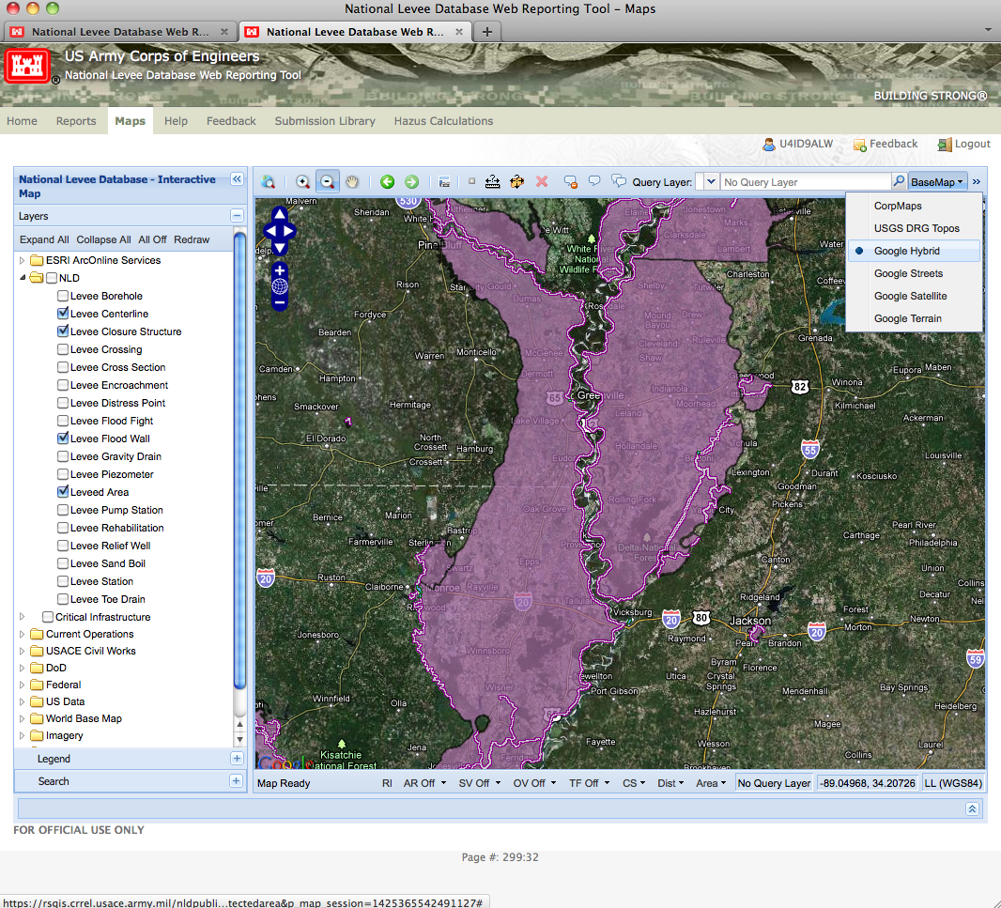
Release of Inundation Mapping
Notes:
Google Hybrid

Slide 51
Does Risk Communication Work?
Look at how perceptions changed at Wolf Creek?
Then (40 yrs ago):
Tight lipped bureaucracy
No public meetings
Hid the bad news
Now:
Availability at moment’s notice
Numerous public meetings
Forthrightly answered questions
Refreshing change
Public has been totally informed
“Corps officials in the 1960’s and 70s wouldn’t talk. They misled the press so badly that a public relations person, after he retired, apologized to the Commonwealth Journal for disseminating misleading information.”
“… it sure has created a more favorable image of the Corps and revealed their total dedication to the public’s safety and commitment to permanently repair the dam.”
Notes:
DOES IT WORK?
(Talk to slide)

Slide 52
Discussion

Slide 53
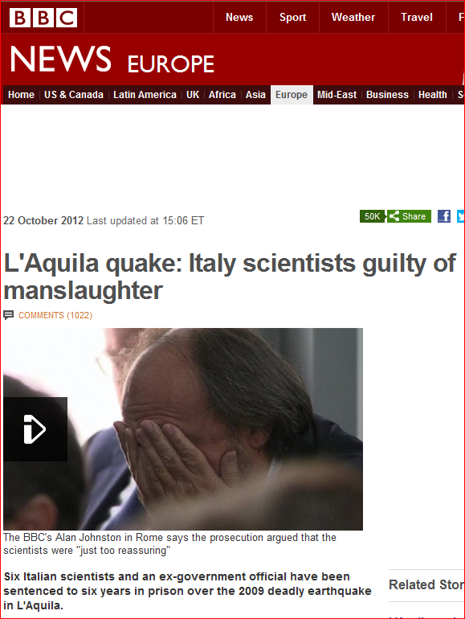
If That’s Not Enough Reason Then,

