Slide 1
Interim Operating Pools
Jerry W. Webb, P.E., D.WRE
Principal Hydrologic & Hydraulic Engineer
Hydrology, Hydraulics & Coastal Community of Practice Leader
US Army Corps of Engineers, Headquarters
Jerry.w.webb@usace.army.mil
Dam Safety Workshop
Brasília, Brazil
20-24 May 2013

Slide 2
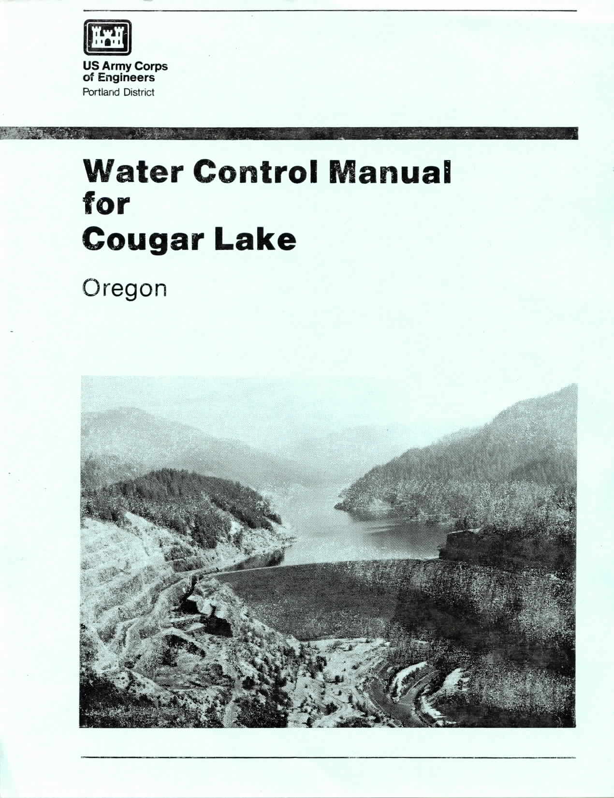
Water Management ER 1110-2-8156
Contents
I Introduction
II Basin Description
III Project Description
IV Climatology
V Hydrology
VI Seasonal Regulation
VII Flood Control Regulation
VIII Storing for Conservation
IX Utilization of Stored Water
X Hydrometeorological Facilities
XI Responsibilities and Emergency Instructions
Notes:
A couple of chapters are critical to day-to-day
XI - includes standing orders to dam tenders. What are these? Could also be termed "Emergency Action Procedures" or something similar. They describe the actions to be taken should communications be cut or reduced.

Slide 3
Water Management
Water Control Manual (WCM)
All projects have a WCM (Average age= 20+ years)
These are the bible of reservoir operations
WCM’s must support IRRM/IOP’s
REMEMBER- DO NO HARM !!!!!!!!!
As a Minimum-Use deviation process
Long-term- Must update WCP
Program funds now for review and updates
Notes:
Things to check every year.
Contacts
Phone numbers
Operational requirements (flow augmentation, flood regulation,new physical limitations, etc)
Stage-discharge relationships
Things to update in the Manual
Operations description
Project configuration (new outlets or new limitations?)
Statistical information
Lake storage-elevation (have you lost storage?)

Slide 4
Deviations Defined
Change from approved operation regardless of magnitude or duration
Within the scope of the water control plan
Minor – Short duration, negligible impact to authorized purposes, typically do not require NEPA
Major – Short duration, impacts to authorized purposes, typically require NEPA
Emergency – Threat to public safety
Outside the scope of the water control plan
Prolonged duration – Water control plan update
Significant magnitude - Reallocation

Slide 5
Deviation Approval
Minor – Approved by District Commander or designee in Water Management
Major – Approved by Division Commander or designee in Water Management
Emergency – Notify Division Commander and prepare written documentation as soon as practicable

Slide 6
Water Control Plan Update
Prolonged deviations for any reason, including IRRM, require an update to the water control plan
Rule of thumb > 3 years
Public involvement and meetings
Minimum 30 days advance notice
NEPA compliance

Slide 7
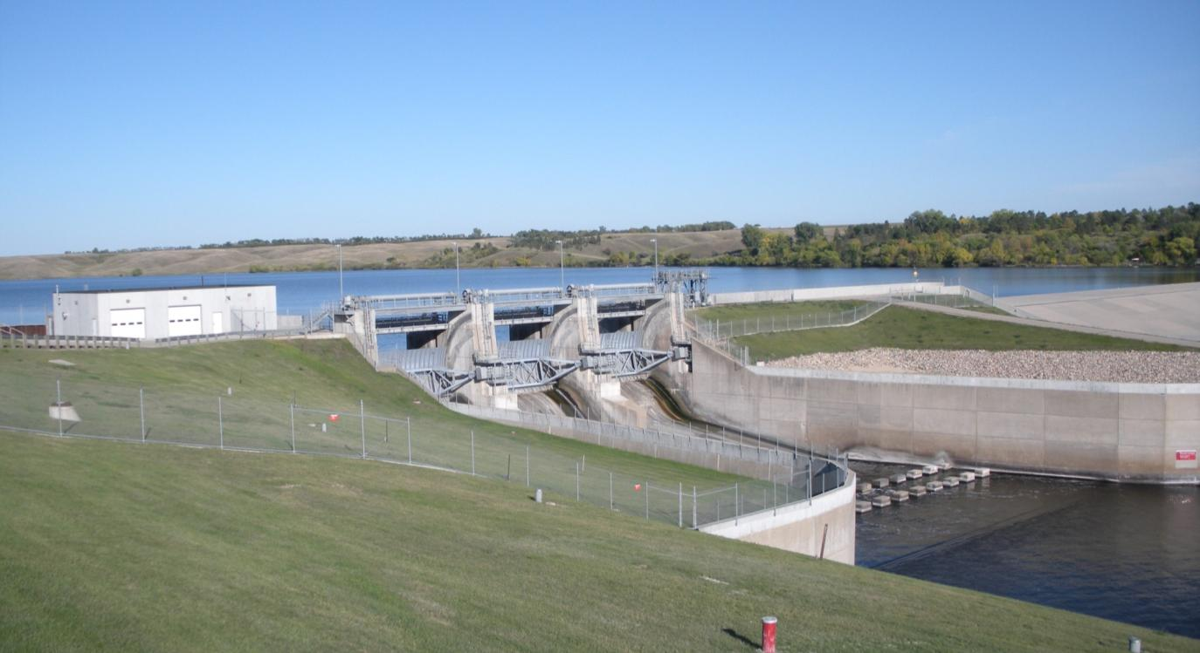
Reallocation
Deviations of significant magnitude require a reallocation study (IRRM are exceptions)
Rule of thumb > 5% change in authorized purposes and/or benefits

Slide 8
Deviation for Periodic Inspections
Coordinate gate operations that are needed to support the inspection with water management
Document and get approval as a deviation based on the type (minor in most cases)

Slide 9
Deviation as an IRRM
Assess type based on magnitude and duration
Obtain approval based on type
Considerations
Threshold events, decision points, and actions
Maximum safe operating reservoir level that is maintained through non damaging releases
Returning the reservoir to the restricted level as soon as practicable
Emergency measures such as evacuation of reservoir storage
Not an absolute requirement for all situations

Slide 10
Water Management /IRRM
Project Operation
Water Management must work with Dam Safety to develop Interim Operating Plans/IRRM
To the extent possible these IOP’s must continue project operations to maximize capability to meet authorized purposes while recognizing/reducing Dam Safety risks.
Extraordinary measures, such as making releases above control levels based on forecasts should only be included once emergency conditions have been observed/declared.
Notes:
Things to check every year.
Contacts
Phone numbers
Operational requirements (flow augmentation, flood regulation,new physical limitations, etc)
Stage-discharge relationships
Things to update in the Manual
Operations description
Project configuration (new outlets or new limitations?)
Statistical information
Lake storage-elevation (have you lost storage?)
Notification – Prioritized list of notifications
Emergency detection, evaluation, and classification – Procedures for identifying problems and taking quick and appropriate action
Responsibilities – EAP related tasks. Dam owners develop and maintain EAP, state and local emergency management provide warning and evacuation.
Preparedness - Actions to mitigate or alleviate effects of a failure.
Inundation maps – Delineate areas affected by failure
When was the last inspection of your high risk projects?
It’s a Team Effort!
Get a Hydraulic Engineer on the inspection if at all possible
Review the last inspection report before you conduct your inspection
Share information!
Review all the dam safety data (piezometers, drainage weirs, crack meters, Etc.) before you go to the project

Slide 11
ER 1110-2-1156 Language
7.2.8 Interim Risk Reduction Measure Plan. The Interim Risk Reduction Measure Plan (IRRMP), including changes to the supporting Water Control Plan, is the key document that frames operational decision making for DSAC I, II, and III dams. This plan establishes the specific threshold events, decision points, and actions required. The IRRMP should recognize the need for two primary water control management objectives.

Slide 12
Water Management Objectives
7.2.8.1 A recommended safe operating reservoir level that is maintained for the vast majority of time through non damaging releases to restore the reservoir to restricted level as quickly as reasonable
7.2.8.2 A plan for which emergency measures such as rapid reservoir drawdown and recommendations on evacuation of the reservoir storage must occur.
7.2.8.3 This approach to water control management recognizes that pool restrictions established for safety purposes cannot and should not be viewed as “must meet” requirements in all flood events, but that there does come a point when emergency measures are necessary.

Slide 13
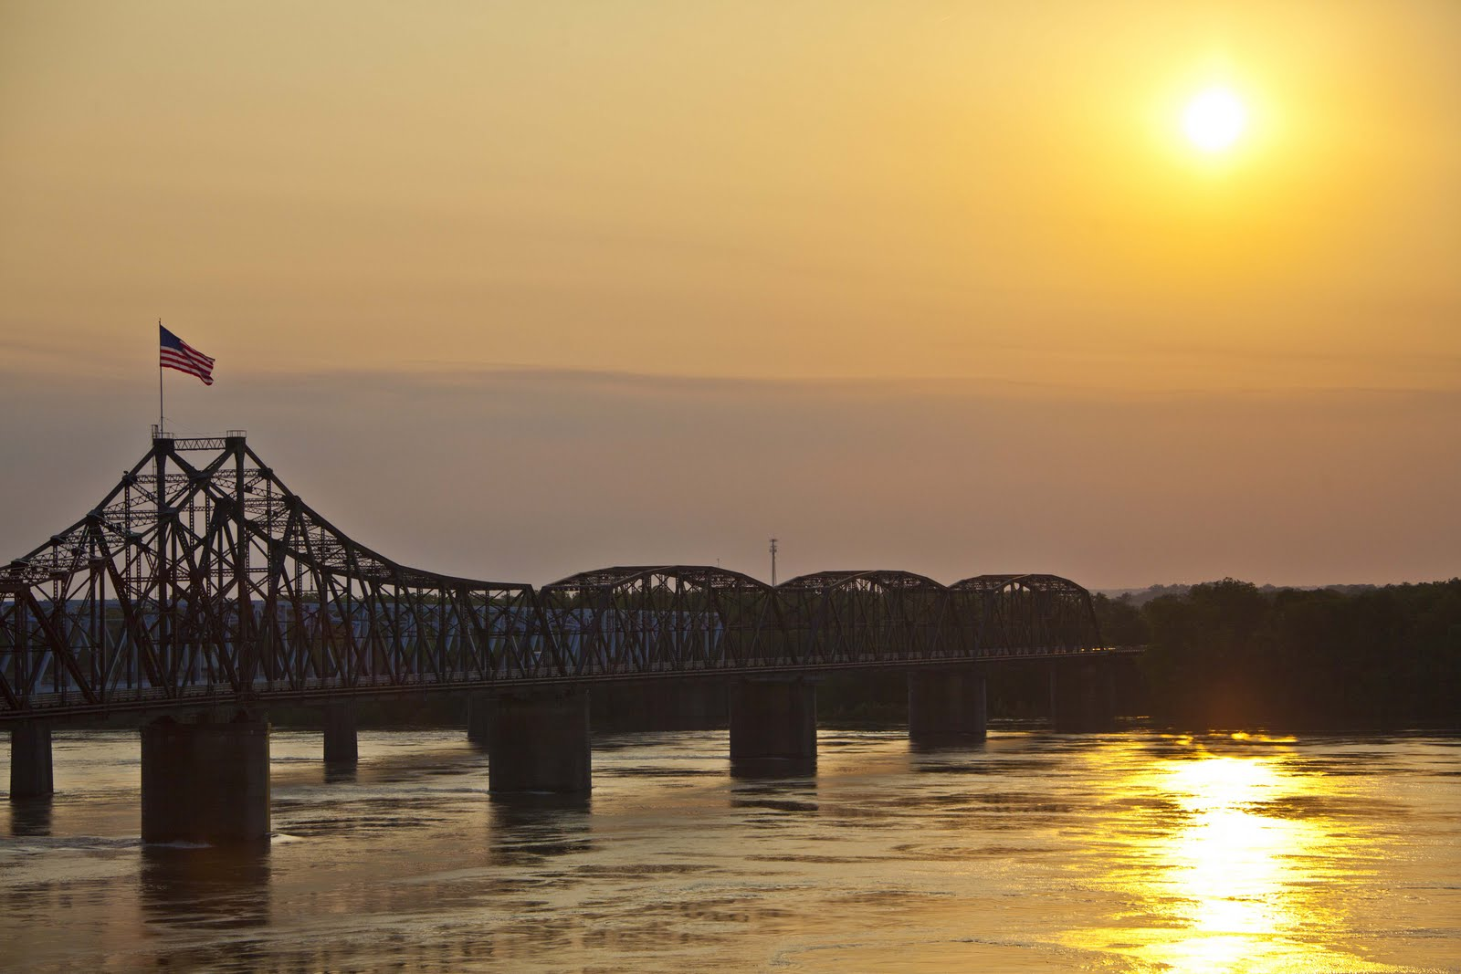
LEARNING OBJECTIVES
Using the course manual, references and lecture notes, the student will be able to understand hydrologic and hydraulic aspects of dam safety program. After this presentation, the student will be familiar with concepts, terminology and inter-relationships between hydrologic, hydraulic and water management considerations essential in the engineering analysis associated with the administration of the USACE Dam Safety program.
QUESTIONS

