Slide 1
Hydraulic and Hydrologic
Aspects of Dam Safety
Jerry W. Webb, P.E., D.WRE
Principal Hydrologic & Hydraulic Engineer
Hydrology, Hydraulics & Coastal Community of Practice Leader
US Army Corps of Engineers, Headquarters
Jerry.w.webb@usace.army.mil
Dam Safety Workshop
Brasília, Brazil
20-24 May 2013

Slide 2
Presentation Topics
Hydrologic considerations
Hydraulic considerations
Typical alternatives used to correct deficiencies
Modeling Mapping & Consequences (MMC) Production Center
Notes:
Course Objectives. Most of the class come from operations background, so we want to present some of the background aspects of hydrology and hydraulics; from a design standpoint (why are certain features as they appear) and from an O&M standpoint (things to know).
This will cover a wide range of topics, the tie among them being their importance to the ultimate safety of our civil works projects.
Emphasize the critical nature of H&H personnel – both hydraulic and hydrologic – to dam safety.
In aspects of: design, operation, maintenance, and monitoring.

Slide 3
Dam Safety Problem Identification
64% of Corps’ Dams are over 30 years old
28% have reached or exceeded their 50-yr economic design life
11% (65) of the Corps’ Dams have been identified as being hydrologically or seismically deficient, based on current methodologies & criteria
Many are untested for a full pool condition
The cost to fix these deficiencies is estimated in billions of dollars
Source: USACE Risk Analysis for Dam Safety Research Unit (2001)

Slide 4
Guidance Documents
USACE Publications Website
  http://www.usace.army.mil/publications/
  EM’s, ER’s
    ER 1110-8-2(FR) (Inflow Design Floods for Dams and Reservoirs)
      Dam Standards (Classification based on failure impacts)
      Unit Hydrograph adjustments
      Antecedent Flood
      Lists Many References
    EM 1110-2-1415 (Hydrologic Frequency Analysis)
      Guidance Based on Bulletin 17B
    EM 1110-2-1417 (Flood Runoff Analysis)
    EM 1110-2-1420 (Hydrologic Engineering Requirements for Reservoirs)
      Flood Runoff Analysis
      Dam Break Analysis
    EM 1110-2-1413 (Hydrologic Analysis of Interior Areas)
Notes:
USACE HQ website provides links to all guidance documents. These are some that provide guidance for analysis relating to Dam Safety

Slide 5
Topics
Hydrologic Considerations
Hydraulic Considerations
Typical alternatives used to correct deficiencies
Modeling Mapping & Consequences (MMC) Production Center
Notes:
Course Objectives. Most of the class come from operations background, so we want to present some of the background aspects of hydrology and hydraulics; from a design standpoint (why are certain features as they appear) and from an O&M standpoint (things to know).
This will cover a wide range of topics, the tie among them being their importance to the ultimate safety of our civil works projects.
Emphasize the critical nature of H&H personnel – both hydraulic and hydrologic – to dam safety.
In aspects of: design, operation, maintenance, and monitoring.

Slide 6
Hydrologic Deficiencies
Overtopping - 34% of all failures (nationally)
  Inadequate Spillway Design
  Debris Blockage of Spillway
  Settlement of Dam Crest
Notes:
Overtopping
-Inadequate spillway design-Debris blockage of spillway
-Settlement of dam crest-Foundation defects-Differential settlement

Slide 7
Hydrologic Considerations
Hydrologic Capacity!
  Inflow Design Flood (IDF)
  Conditions during the IDF
  Project outlet capacity
  Project design
  Threshold Flood
  ER 1110-8-2(FR) - Inflow Design Floods for Dams and Reservoirs
Notes:
These are the things we'll run through.
IDF - Inflow Design Flood. The flood hydrograph used in the design of a dam and its appurtenant works particularly for sizing the spillway and outlet works, and for determining maximum temporary storage and height of dam requirements.
BSC - Base Safety Condition. The BSC is met when a dam failure related to hydrologic capacity will result in no increase in downstream hazard over the hazard that would have existed if the dam had not failed.
TH - Threshold Flood. The flood that just exceeds the design maximum water surface elevation at the dam (top of dam minus freeboard). As part of new project design work, this would theoretically be the IDF.

Slide 8
Hydrologic Considerations
The Inflow Design Flood (IDF) ***
  Inflow Design Flood is the flood hydrograph used in the design of a dam and its appurtenant works (particularly outlet works)
  Probable Maximum Flood (PMF)
    For most Corps storage projects this used as the Inflow Design Flood
    Four Dam Safety Standards
Notes:
PMF - Probable Maximum Flood. This is the most severe flood that is considered reasonably possible at a particular location as a result of hydrologic and meteorological conditions.
There are four standards. The standard employed is governed by circumstances associated with the specific project.
Capable of placing human life at risk OR causing a catastrophe should they fail. = PMF
Typically run-of-river, hydroelectric
Analysis shows that failure could be tolerated at some flood magnitude
Small recreational lakes, farm ponds, etc. [less than ~20 AF]

Slide 9
Hydrologic Standard for Corps Dams
Standard | Description | Inflow Design Flood
1 | Risk to life and property | Probable Maximum Flood (PMF)
2 | Run of river projects | No Unique inflow/safely pass major floods
3 | Negligible incremental impacts due to failure | ½ PMF
4 | Small dams (24K cm) | Floods of frequent occurrence
Notes:
Standard 1 – Most Corps flood control dams
Standard 2 – Navigation dams and some run of river hydropower facilities
Standard 3 – Impacts must be well documented
Standard 4 – Small ponds with less than 20 acre-feet of storage
Probable maximum flood – Largest flood possible for a particular region
Standard project flood – Significant flood typical for a particular region (500-1000 year)
Base safety condition – Evaluated based on downstream impacts of failure

Slide 10
Hydrologic Criteria
Probable Maximum Precipitation
  Greatest precipitation physically possible for a particular area
Probable Maximum Flood
  Flood resulting from the probable maximum precipitation
Threshold Flood
  Maximum flood a dam can safely pass

Slide 11
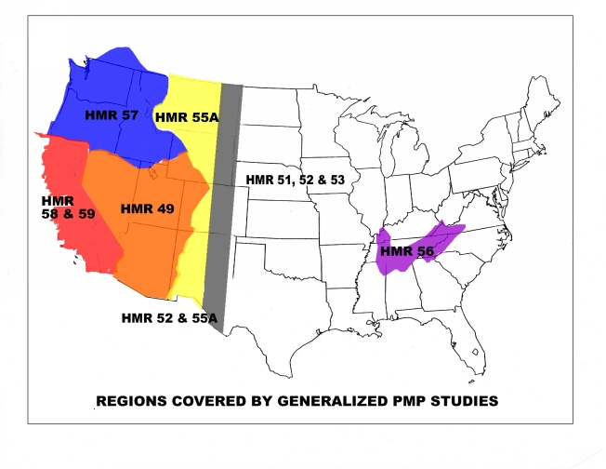
Probable Maximum Precipitation
http://www.nws.noaa.gov/oh/hdsc/currentpmp.htm
HMR= Hydrometeorological Reports
Notes:
Definition of PMP - "Theoretically, the greatest depth of precipitation for a given duration that is physically possible over a given size storm area at a particular geographical location at a certain time of the year."
PMP - Probable Maximum Precipitation. The theoretically greatest depth of precipitation for a given duration that is physically possible over a given size storm area at a particular geographical location at a certain time of year.
Hydrometeorological Reports Nr. 57, etc. A multi-agency document spear headed by NOAA-NWS to describe the PMP for various geographical areas of the country.

Slide 12
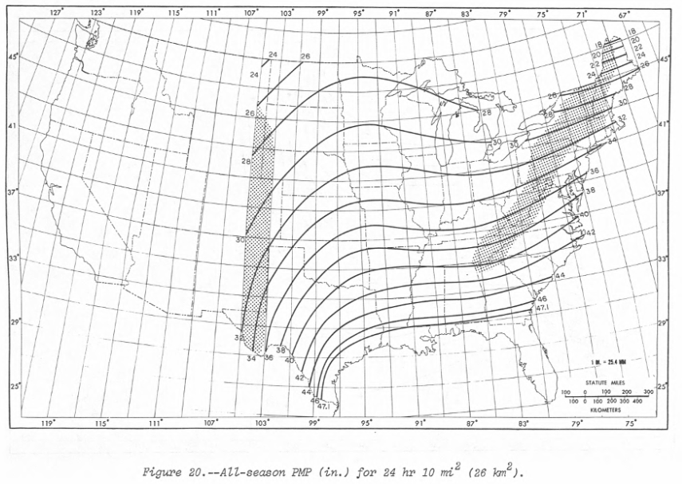
Probable Maximum Precipitation
All-Season PMP (Inches) for 24 Hour / 10 Sq Mi
Notes:
Definition of PMP - "Theoretically, the greatest depth of precipitation for a given duration that is physically possible over a given size storm area at a particular geographical location at a certain time of the year."
PMP - Probable Maximum Precipitation. The theoretically greatest depth of precipitation for a given duration that is physically possible over a given size storm area at a particular geographical location at a certain time of year.
Hydrometeorological Reports Nr. 57, etc. A multi-agency document spear headed by NOAA-NWS to describe the PMP for various geographical areas of the country.

Slide 13
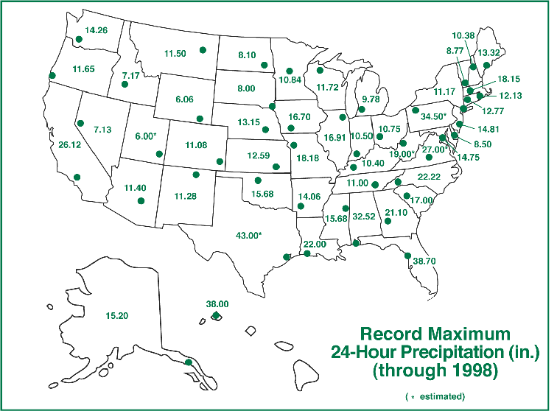
Extreme Rainfall Events Do Occur

Slide 14
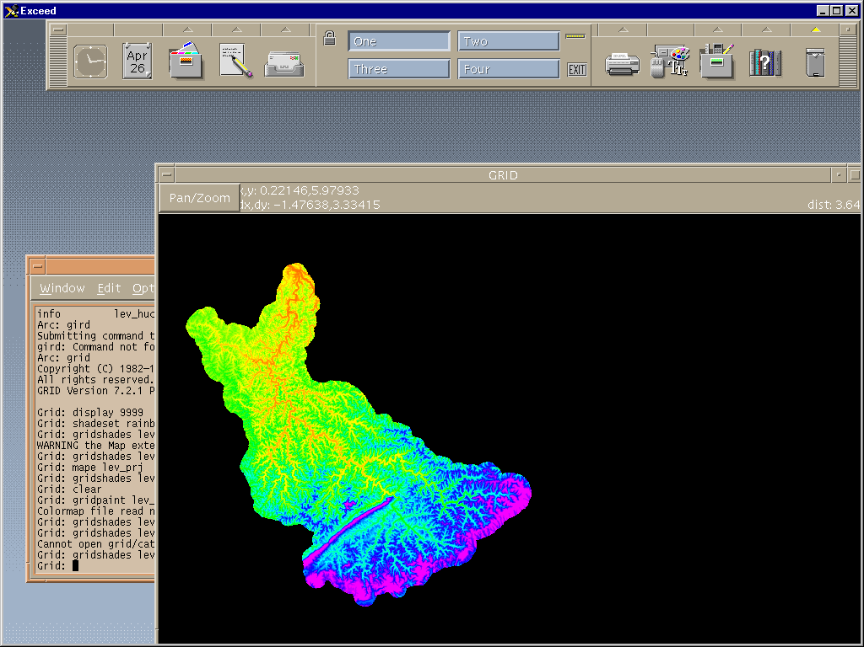
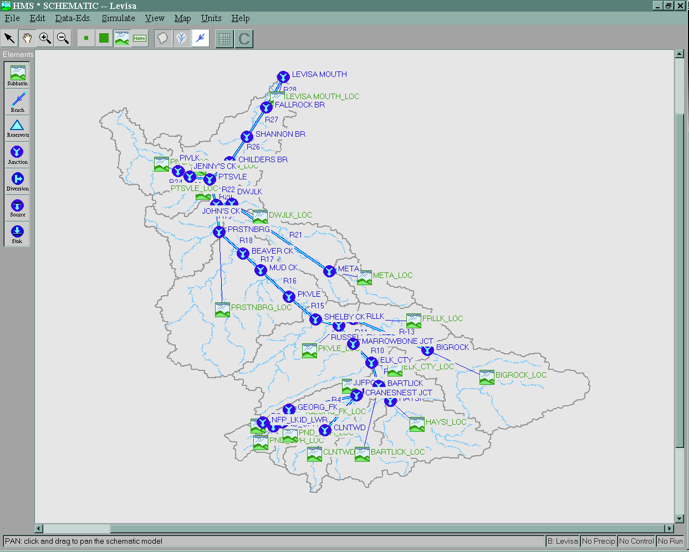
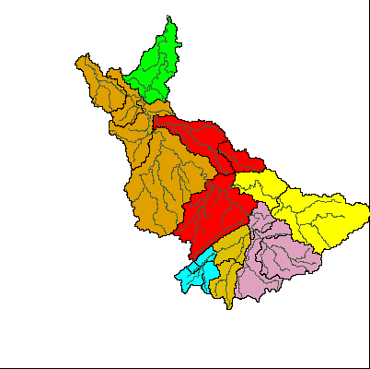
Hydrologic Models
Notes:
Screen captures from GIS software and HEC-HMS

Slide 15
Hydrologic Routing
Water control manual procedures
Reservoir storage volume
Outlet works and spillway capacity
Antecedent conditions
Pool elevation and outflow hydrographs
Inflow Hydrograph
Reservoir Storage
Outflow Hydrograph
Notes:
Antecedent conditions
ER 1110-8-2(FR) – ½ IDF with 5 day dry period or flood control pool
NWS (Ohio River Basin) – 0.30 IDF with 3 day dry period or 0.39 IDF with 5 day dry period

Slide 16
Hydrographs
Top of Dam
Spillway Crest

Slide 17
Purpose of Dam Safety Assurance
ER 1110-2-1156 Safety of Dams – Policy and Procedures - “The Dam Safety Assurance Program provides for modification of completed Corps of Engineers dams and related facilities, when deemed necessary for safety purposes due to new hydrologic or seismic data or changes in state of the art design or construction criteria.”

Slide 18
Hydrologic Considerations
Has the IDF (PMF) changed?
Has your elevation storage curve changed due to sedimentation ?
D/S flow control limits might have changed; encroachment in the floodplain
Operational constraints, can’t go above a pool elevation due to Geotechnical concerns
Other…

Slide 19
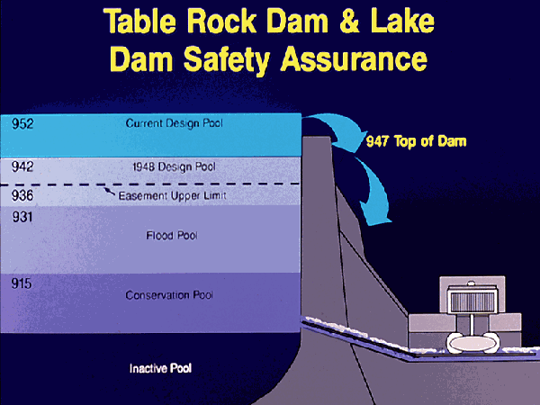
Courtesy USACE Little Rock

Slide 20
Cherry Creek Dam

Slide 21
Topics
Hydrologic Considerations
Hydraulic Considerations
Typical alternatives used to correct deficiencies
Modeling Mapping & Consequences (MMC) Production Center
Notes:
Course Objectives. Most of the class come from operations background, so we want to present some of the background aspects of hydrology and hydraulics; from a design standpoint (why are certain features as they appear) and from an O&M standpoint (things to know).
This will cover a wide range of topics, the tie among them being their importance to the ultimate safety of our civil works projects.
Emphasize the critical nature of H&H personnel – both hydraulic and hydrologic – to dam safety.
In aspects of: design, operation, maintenance, and monitoring.

Slide 22
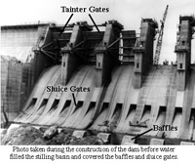
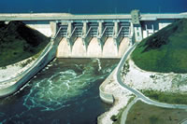
Hydraulic Considerations
Hydraulic Features
Hydraulic Integrity!
Notes:
At issue are hydraulic "features;" spillways, outlets, sluices, gates, pumps, navigation locks, etc.
Hydraulic Integrity. Many definitions of "integrity" but from an hydraulic standpoint we are interested in "dependability" and "reliability."

Slide 23
Hydraulic Considerations
Spillway gates
  During periodic inspections are they inspected?
  Gate settings, how do you know the gate is really open 2 feet
  Night time operations
  Do you have vortex or cavitation problems?
  Do you have any flow pattern requirements (this can often cause localized stilling basin erosion)
Notes:
Are the gates inspected? Ours are rotated via the periodic inspection program every 5 years or so.
The Dalles trunion pin. – Seized pin found during a periodic inspection. This is on a spillway gate (1 of 23) which are routinely used. This is a run-of-river project.
Are the gates tested (operated)? Gage indications for openings.
All mechanics are operated every fall. Usually this means without a load. But prior to winter flood control season anyway.
Is there Full-time staff at the Project?
Vortex – Uneven spillway gate openings for example. Or at Red Rock Dam all gates open the same, but tremendous vibrations, breaking gate cables (replaced with stainless steel cables and replace about every 5 years).
Cavitation – more later
Flow Patterns – for example for fish attraction…

Slide 24
Hydraulic Considerations
Spillway Channel
  Lined (concrete) or unlined
  Wave action in the chute
  Crossover Waves
  Erosion problems in the chute (increased roughness)
  Joint Concerns
  Vegetation may impede flows
    flushing flows, sprays, vegetation removal

Slide 25
Hydraulic Considerations
Stilling Basin
  Erosion problems can result in the loss of your tailwater, which reduces energy dissipation
  Erosion problems with Baffle Blocks
  Undercutting problems at the downstream end of the stilling basin
  Debris (boulders) in the basin can cause erosion problems
Notes:
Baffle Blocks
· Bonneville Dam (Col River) has had almost all replaced in the mid-1950s
Stilling Basins
·The Dalles (Col River) had a large portion eroded right after construction. So we maintain close watch. Now, because we are looking at some modifications to the spillway for fishery operation, we are looking into the issue in more depth.
· We always try to get post flood surveys (large floods), especially on the Columbia. And divers if necessary to inspect or ROVs w/film.
· Hills Creek. The impact zone for the flip Regulating Outlets completely took out the concrete slab. It was founded on rock, but, of course, we watch it closely anyway.

Slide 26
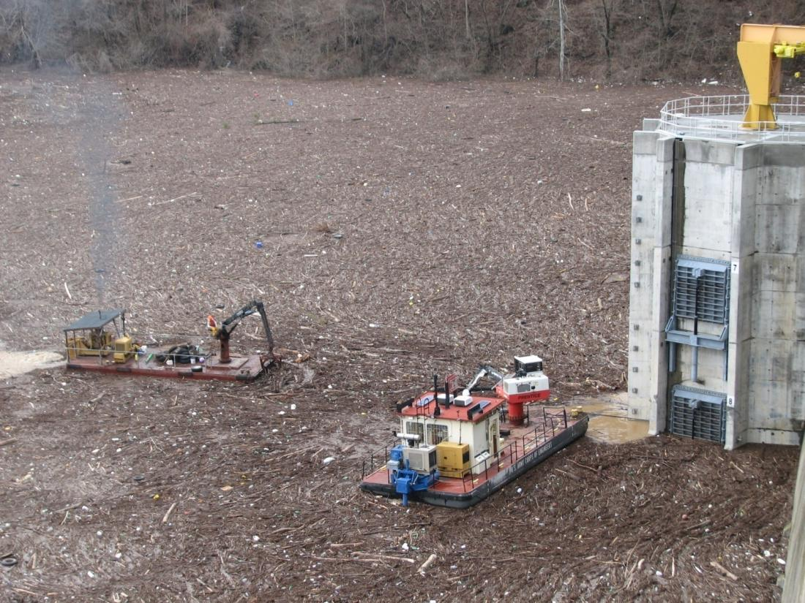
Operational Risk Assessments
March 2010 Flood Event at BLN
Notes:
26

Slide 27
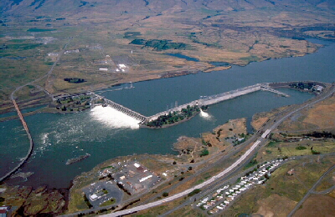
Hydraulic Considerations
The Dalles Dam
Notes:
The Dalles Dam spillway and stilling basin showing even releases. By closing selected gates, the pattern may change dramatically – erosion of the stilling may increase…
Constructed: 1960 (units 1-14); 1973 additional units 15-22 completed
Full Pool: 160.0 feet
Nameplate capacity: 14 @ 78 MW, 8 @ 86 MW, 1780 MW total
Stations service units: 2 @ 3 MW, 6 MW total
Hydraulic capacity: 375 kcfs
Spillway: 1380 feet, 23 gates

Slide 28
Hydraulic Considerations
Regulating outlets
  Cavitation can cause big problems
  Minimum and maximum flow requirements
  Transition zones (rough zones)
  Brittle steel problems for older projects, problems for penstocks
  Inlet problems, sediment & trash rack
  Operations for temperature control
Notes:
Cavitation – Pumps, engines, air foils, and for our purposes low pressure areas in channels and tunnels, etc.
cav.i.ta.tion \ kav' i ta' shun \ n [1. the rapid formation and collapse of vapor pockets in a flowing liquid in regions of very low pressure. 2. such a pocket formed.] (Webster)
Transition Zones - Both open channel flow to pressure flow during changes in operation and within the outlets at bifurcations, etc.
Trash Racks – At Savage Rapids Dam on the Rogue, a small irrigation diversion dam, there were continuous problems with accumulations of aquatic growth. Used summer hires on a full time basis to keep the structure and outlets clean. Changed the operation at Lost Creek dam (upstream) to modify the water temperatures in the lower reach at Savage Rapids. Stopped growth, virtually eliminated the problem.
Temperature Control - transition among ports, submergence, etc.

Slide 29
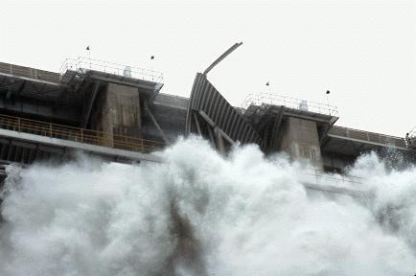
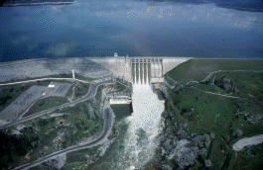
Hydraulic Considerations
Folsom Dam
July 1995
Notes:
Pin broke at Folsum Dam and 40K cfs cam rushing through, nearly 40% of the lake was drained before the gate was repaired.

Slide 30
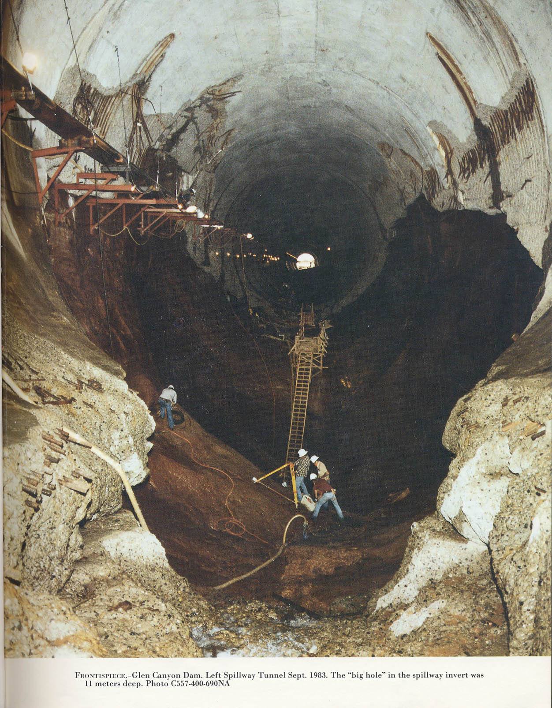
Glen Canyon Dam Erosion
Glen Canyon Dam, left spillway tunnel. Sept. 1983.
The “big hole” in the spillway invert was 11 meters deep.
Notes:
Glen Canyon Dam
The dam has two huge spillways, one on each side. These are 41 feet in diameter, and have a capacity of 104, 000 cubic feet per second each. There are 4 outlet valves connected to 8-foot outlet tubes designed to discharge water around the power plant. Water can also be released through a tunnel once used to divert water during construction of the dam.
This system was put to the test in 1983 when a late regional winter storm system increased the snow level by 200% of normal, then began to melt quickly. Lake Powell was already at a high level, so water needed to be released to make room for the heavy snow-melt. Even with the dam wide open, the lake continued to rise for weeks but was eventually controlled. Because of the high run-off that year, all the Colorado River dams released excess water causing some flooding downstream on the lower portions of the river.

Slide 31
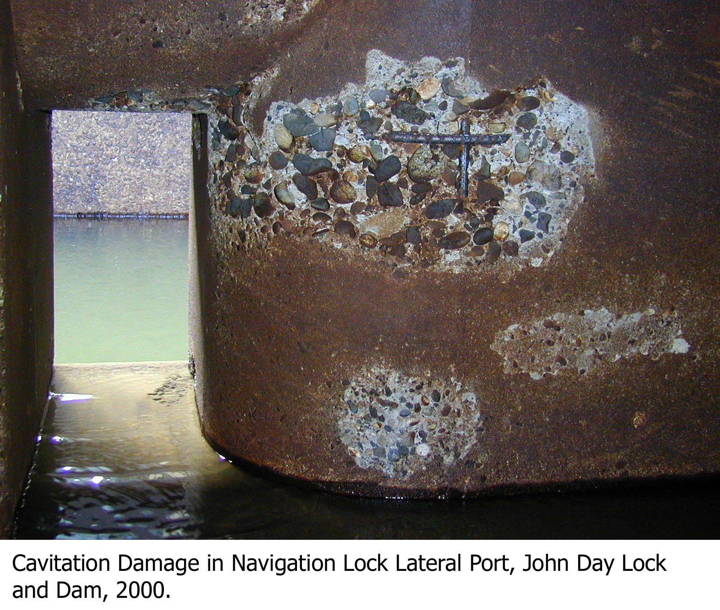
John Day Nav Lock Cavitation

Slide 32
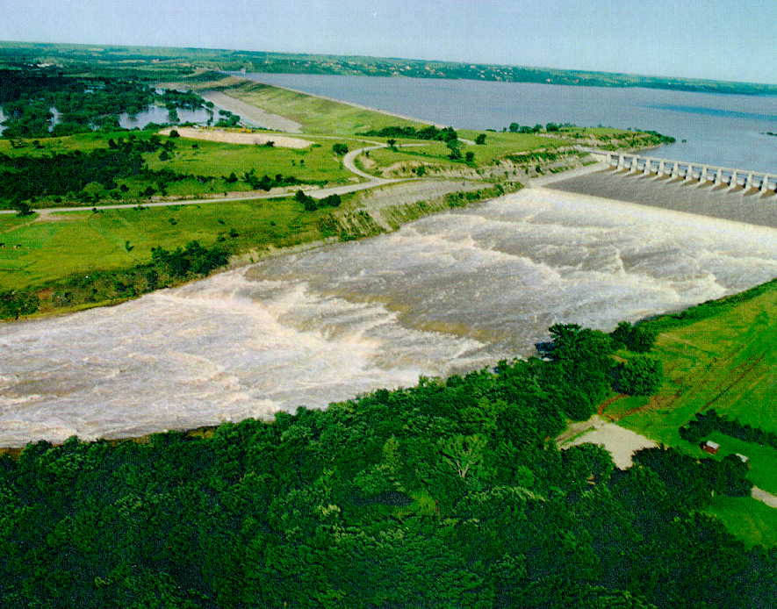
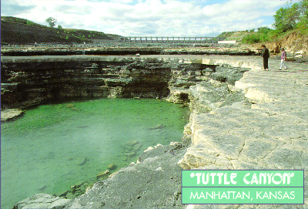
Spillway Erosion: Tuttle Canyon
Tuttle Canyon
Manhattan KS
Notes:
23
23
The value of the dam was proven during the Great Flood of 1993, when floodwaters reaching up to 63 feet (19 m) above normal were held back. However, when the dam reached capacity in July 1993, it necessitated the first release of the spillway. All 18 gates on the spillway were raised 4 feet (1.2 m) during the peak of the flood, producing a flow rate of 60,000 cubic feet per second (1,700 m³/s). The roar of the water was audible half a mile (800 m) away and some people in nearby Manhattan reported hearing the noise. After three weeks the gates were closed, revealing a 20-foot (6.1 m) deep canyon that had been carved in the earth of the spillway channel. The exposed rock is 290 million years old. Locally, this area is known as "The Canyon" and is a popular fossil-hunting area.

Slide 33
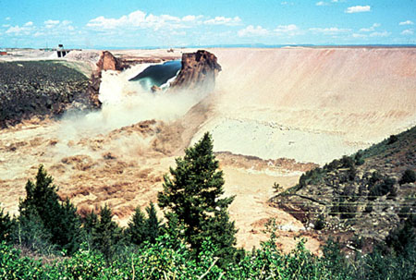
Hydraulic Evaluation
Breach parameters
Inundation
Flood wave travel time
Warning time
Population at risk
Loss of life

Slide 34
Evaluating Downstream Effects
Discharge
Channel geometry
Roughness (Manning’s n)
Structures (bridges, dams, levees)
Water surface profiles and inundation maps
  Comparison with natural condition

Slide 35
Topics
Hydrologic Considerations
Hydraulic Considerations
Typical alternatives used to correct deficiencies
Modeling Mapping & Consequences (MMC) Production Center
Notes:
Course Objectives. Most of the class come from operations background, so we want to present some of the background aspects of hydrology and hydraulics; from a design standpoint (why are certain features as they appear) and from an O&M standpoint (things to know).
This will cover a wide range of topics, the tie among them being their importance to the ultimate safety of our civil works projects.
Emphasize the critical nature of H&H personnel – both hydraulic and hydrologic – to dam safety.
In aspects of: design, operation, maintenance, and monitoring.

Slide 36
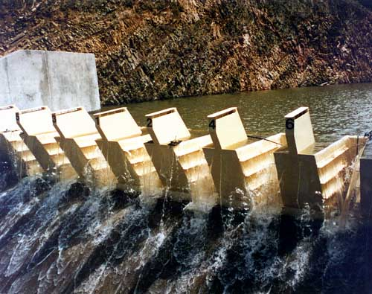
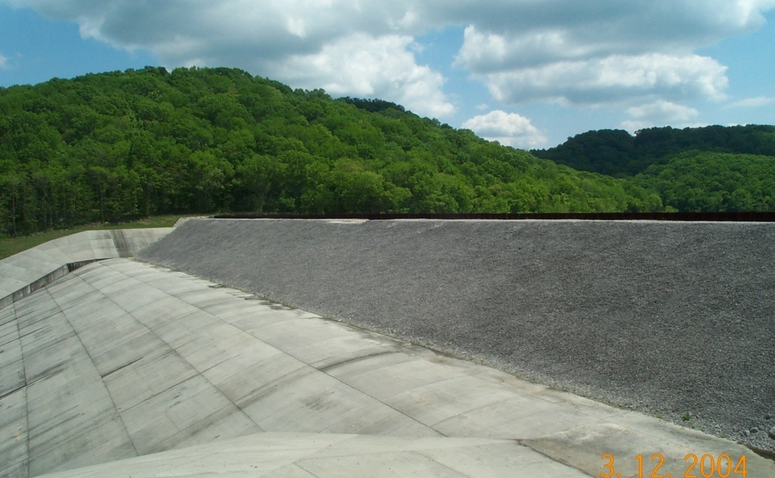
Remediation
Fuseplug
Fusegate
Notes:
Fusegate – Increase storage capacity for nominal floods. Designed to tip over when overtopped by significant floods to increase discharge capacity.
Fuseplug – Erodible embankment material to increase storage capacity for nominal floods. Designed for controlled erosion during significant floods to increase discharge capacity.

Slide 37
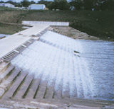
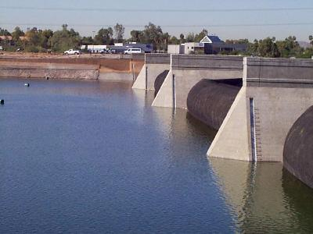
Remediation
Inflatable Dam
Overtopping
Notes:
Overtopping – RCC or other armoring to allow safe overtopping of dam.
Inflatable dam – Polyethylene bladder that can be filled with water to act as a retention structure. Increases storage capacity.

Slide 38
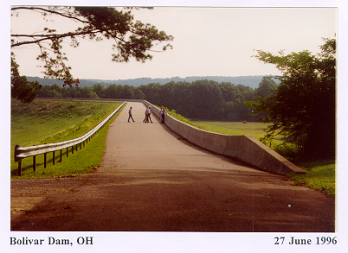
DSA PROGRAM
TYPICAL ALTERNATIVES
PARAPET WALL

Slide 39
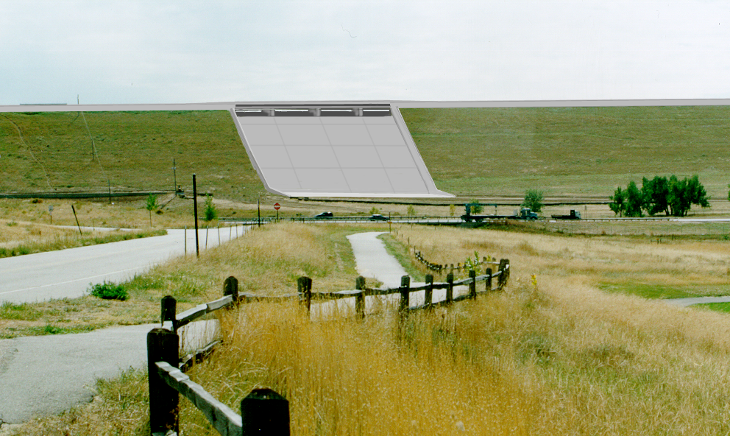
DSA PROGRAM
TYPICAL ALTERNATIVES
Combined Parapet & Spillway Modification

Slide 40
Topics
Hydrologic Considerations
Hydraulic Considerations
Typical alternatives used to correct deficiencies
Modeling, Mapping & Consequence (MMC) Production Center
Notes:
Course Objectives. Most of the class come from operations background, so we want to present some of the background aspects of hydrology and hydraulics; from a design standpoint (why are certain features as they appear) and from an O&M standpoint (things to know).
This will cover a wide range of topics, the tie among them being their importance to the ultimate safety of our civil works projects.
Emphasize the critical nature of H&H personnel – both hydraulic and hydrologic – to dam safety.
In aspects of: design, operation, maintenance, and monitoring.

Slide 41

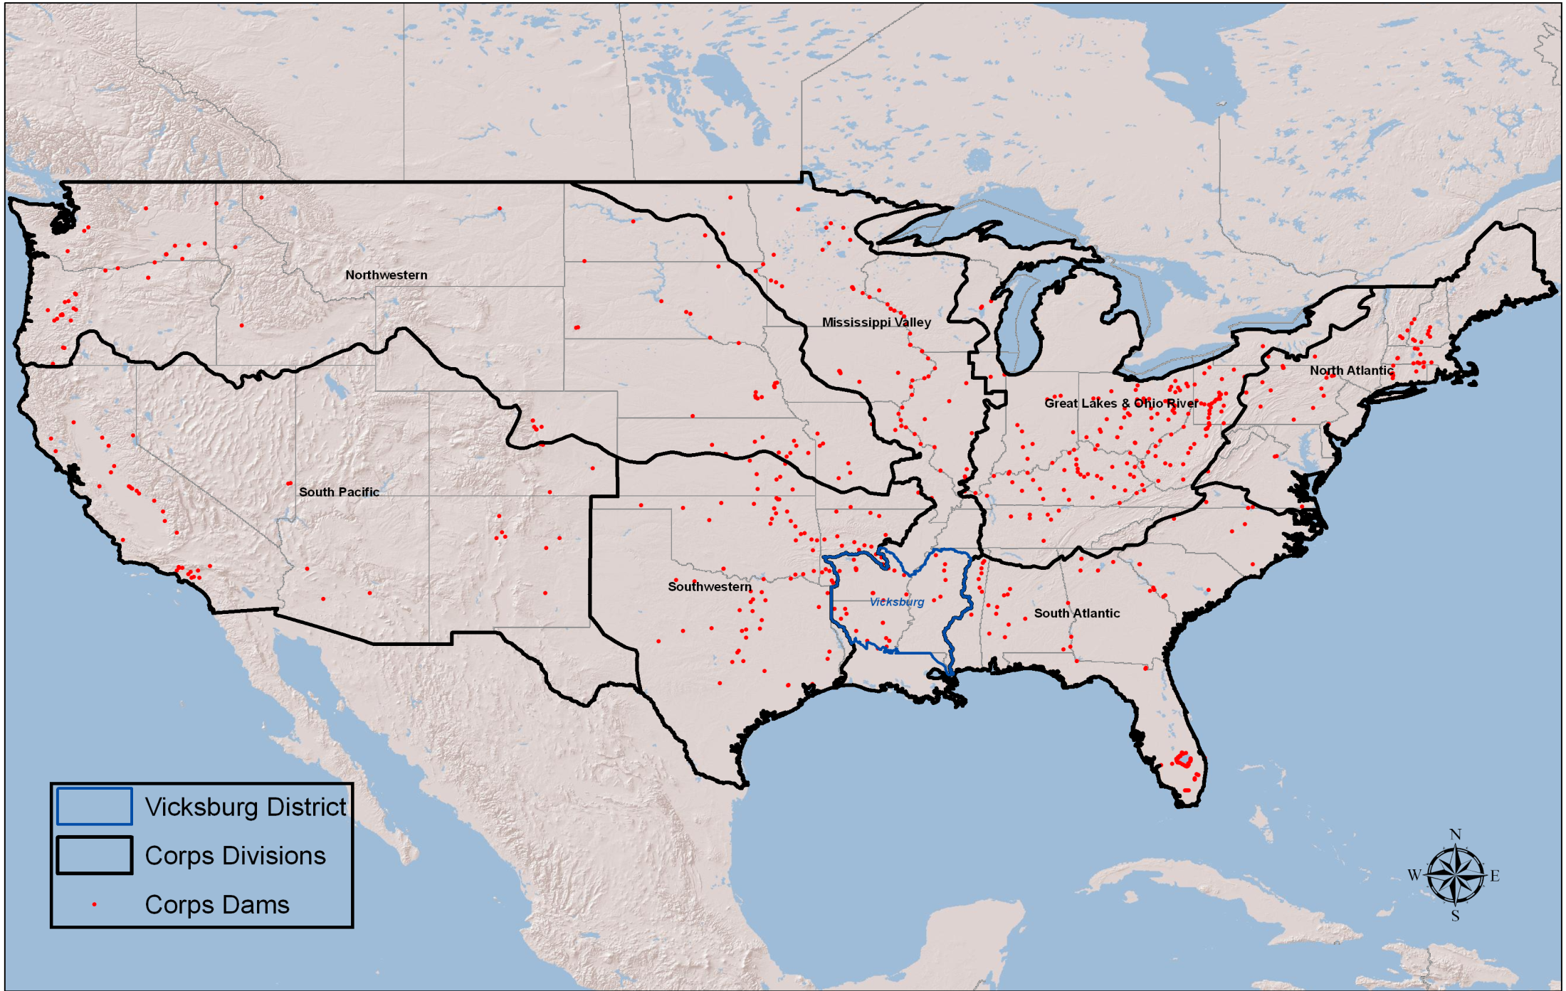
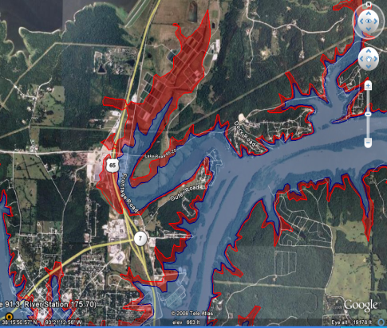
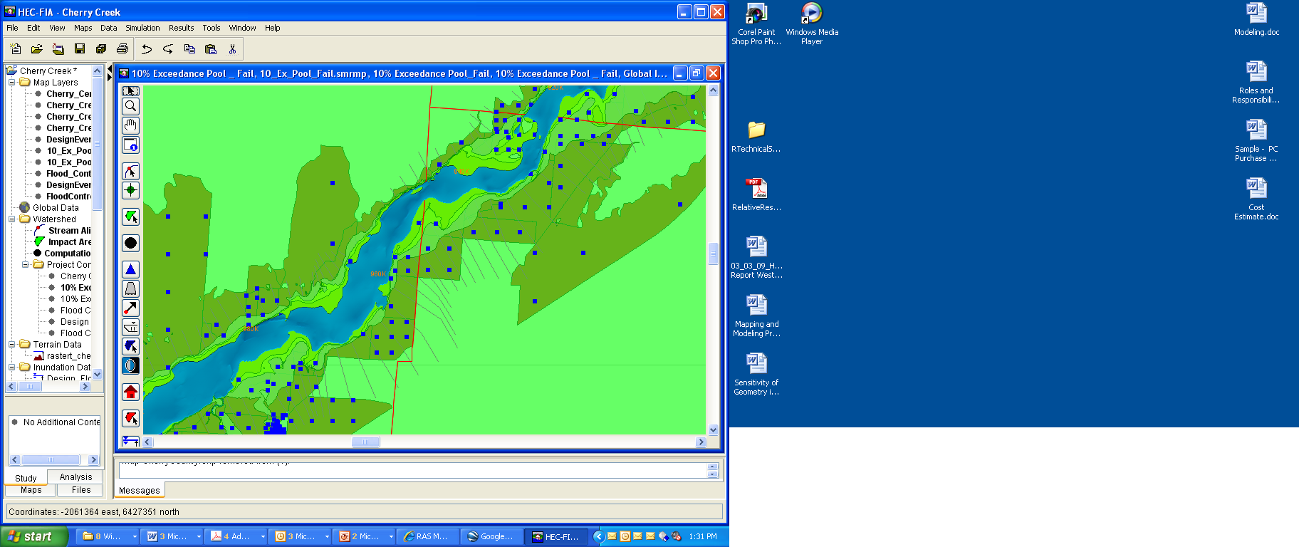
Modeling, Mapping and
Consequences Production Center
MMC Virtual Staff of H&H, GIS, Economist

Slide 42
Why Form the MMC Production Center?
Consistent standards, specifications & products
Cost effective production
Maintain technical competence in HH&C, GIS, and Economists’ COPs
Originating programs
  Critical Infrastructure Protection & Resilience (CIPR)
  Dam Safety and Levee Safety
Priorities set by HQ based on DSAC/IES & CIPR
MMC works under direction of the MMC Steering Committee

Slide 43
MMC Products
Modeling
  Geo-referenced Unsteady Hydraulic Models
    1D – HEC-RAS
    2D – Flo 2D – (HEC-RAS with 2D Capability)
  Models easily accessible via RADSII such that they can be modified to simulate real time event
  Models will be available for District use
    Can be supplemented with New Data and returned to RADSII after review
    Can be modified to be used for various study types for District Mission
Mapping
  Digital Files for 10 scenarios
  Map books for 2 scenarios to support EAP’s
  Corpmap files
  KMZ animation (Google Earth Files)
Consequence Estimates
  Detailed Consequence estimate to include PAR, LOL, Total Damages.
  Results Support Critical Infrastructure Protection and Resilience Program
    CTS Worksheets
    Project Reports(Consequences Assessment Report)
  Allows Dam Safety to categorize Corps inventory by Risk and prioritize funding

Slide 44
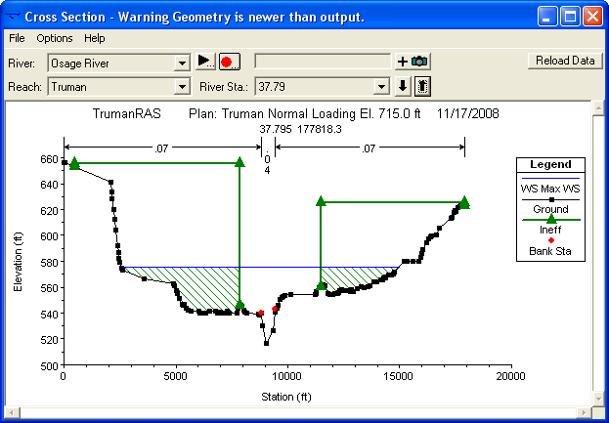
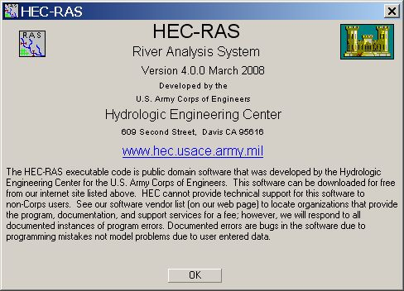
Ten Standard Model Scenarios
Five each, failure and non-failure conditions
  Normal low pool – 90% exceedance duration
  Normal high pool – 10% exceedance duration
  1% exceedance pool – 1% exceedance duration
  Top of active storage - Scaled design storm or PMF
  Maximum high pool - Scaled design storm or PMF
Notes:
Scenarios that the MMC is producing for Each Dam. Underline scenarios are the ones that are mapped in EAP books

Slide 45
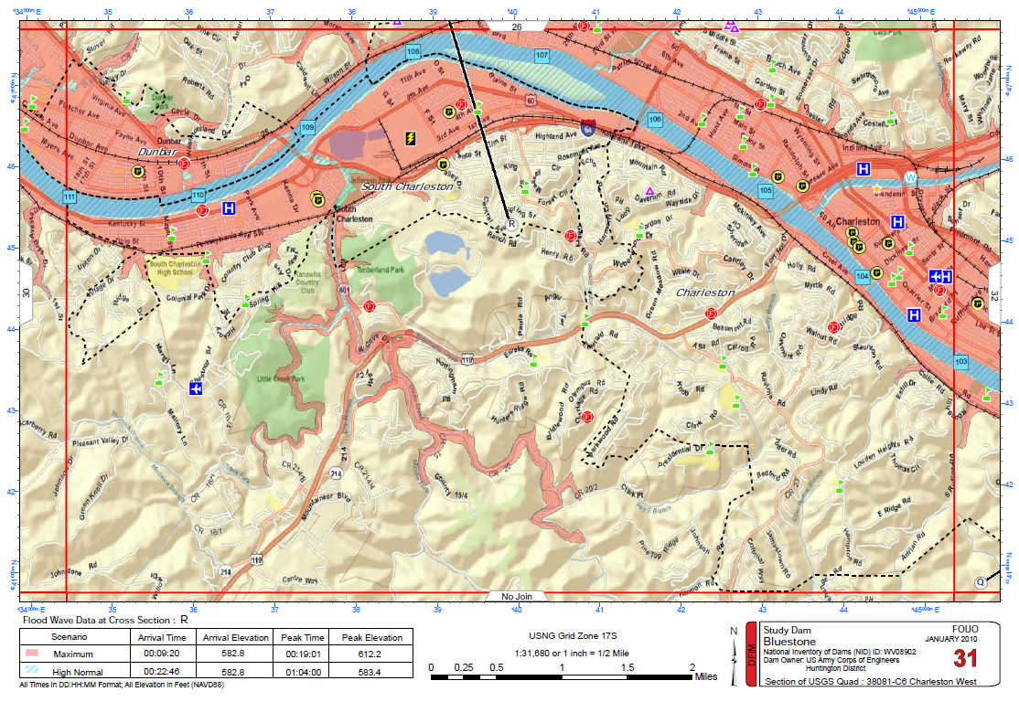
EAP Street Map View

Slide 46
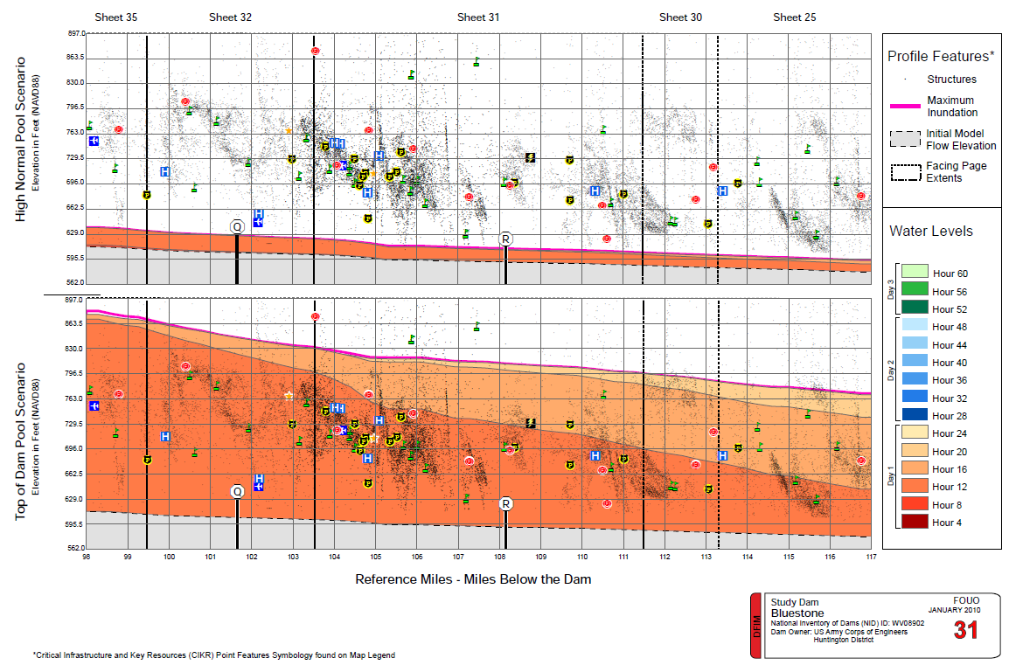
Flood Profile – Facing PagesF
Flood Profile View

Slide 47
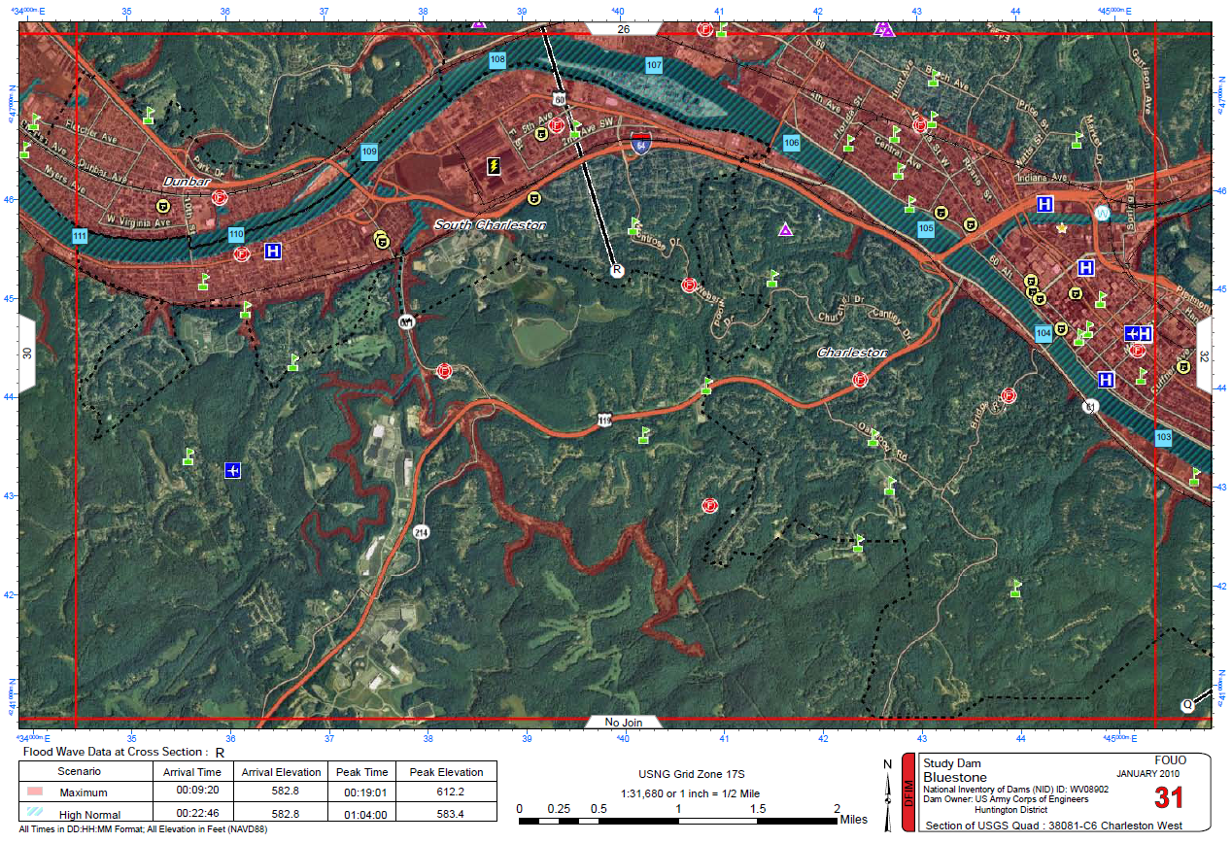
Aerial Map View

Slide 48
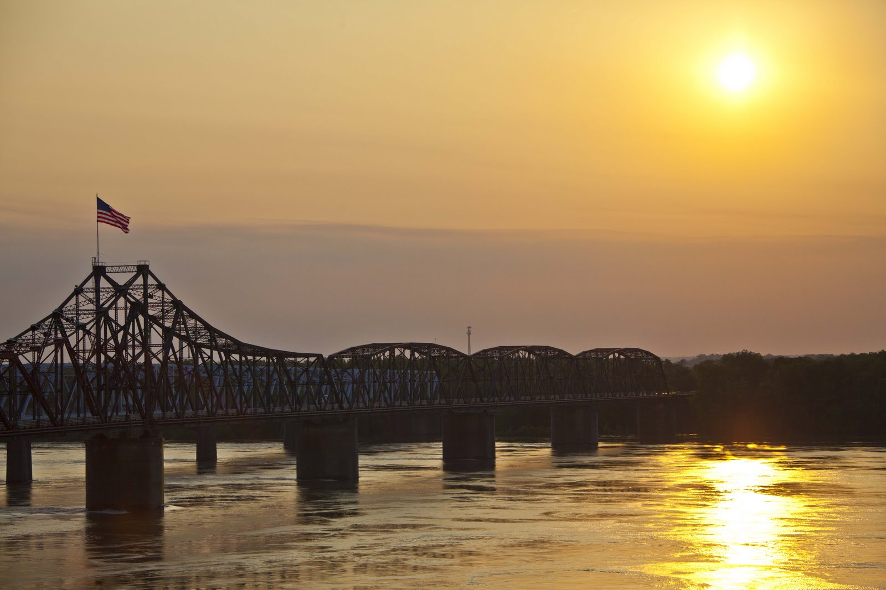
LEARNING OBJECTIVES
Using the course manual, references and lecture notes, the student will be able to understand hydrologic and hydraulic aspects of dam safety program. After this presentation, the student will be familiar with concepts, terminology and inter-relationships between hydrologic, hydraulic and water management considerations essential in the engineering analysis associated with the administration of the USACE Dam Safety program.
QUESTIONS

