Slide 1
2011 Flood Fight
Missouri River Main Stem Reservoir System
Jerry W. Webb, P.E., D.WRE
Principal Hydrologic & Hydraulic Engineer
Hydrology, Hydraulics & Coastal Community of Practice Leader
US Army Corps of Engineers, Headquarters
Jerry.w.webb@usace.army.mil
Dam Safety Workshop
Brasília, Brazil
20-24 May 2013

Slide 2

Operation Mighty MO
Flood of 2011 Video

Slide 3
Missouri River Mainstem Reservoir System
2341 Miles in Length
17% Continental U.S.
North Dakota
Notes:
Missouri River 2341 mi long, 1/6 of continental U.S.
Upper 1/3 – Source of 2011 flood.
Middle 1/3 – 6 mainstem reservoirs Ft Peck to Gavins Point.
Lower 1/3 – levees along both sides of river (focus of this presentation)
Floodplain >5 mi wide, heavy agricultural use with some urban areas including Sioux City, Omaha, Council Bluffs, Kansas City, St. Louis.

Slide 4
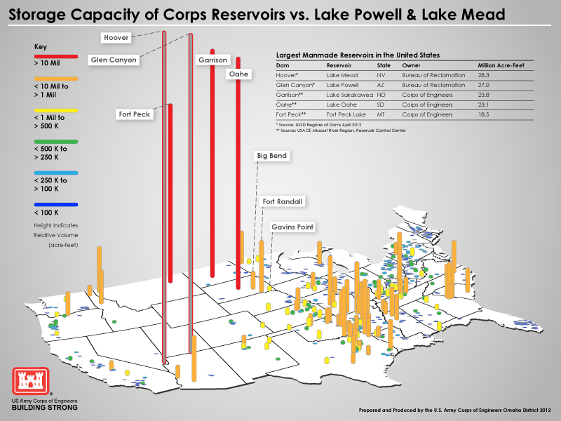
Notes:
Note reservoir size of Ft Peck, Garrison, and Oahe.

Slide 5
2011 Flood
Operational Significance
High Pools of Record Experienced at Fort Peck, Garrison, Oahe, and Fort Randall.
  Fort Peck and Garrison pools entered surcharge zones.
Maximum Project Releases (65kcfs – 160kcfs) Exceeded Prior Operational Records by Approximately 250%.
  First time Garrison and Big Bend Spillways were ever used.
  First time Fort Randall flood tunnels were ever used.
Sustained Flood Releases from May – December.
  Peak releases sustained for nearly two months at each project.

Slide 6
2011 Flood -Dam Safety Surveillance
Surveillance Planning
  OD & ED Technical Personnel on Each Team
  Multiple Teams on Continuous Shifts (2 week rotations)
  Surveillance Lead (Dam Safety Engineer)
  Temporary Field Office (Equipment, Files, Misc Support)
  Light Plants & Remote Video Surveillance
  Public Access Restrictions, Security & Crowd Control
Surveillance Activities
  Inspections
  Instrumentation Readings & Data Analysis
  Communication - Daily Reports, Briefings (OPM, EOC)
  Temporary Mitigation Measures

Slide 7
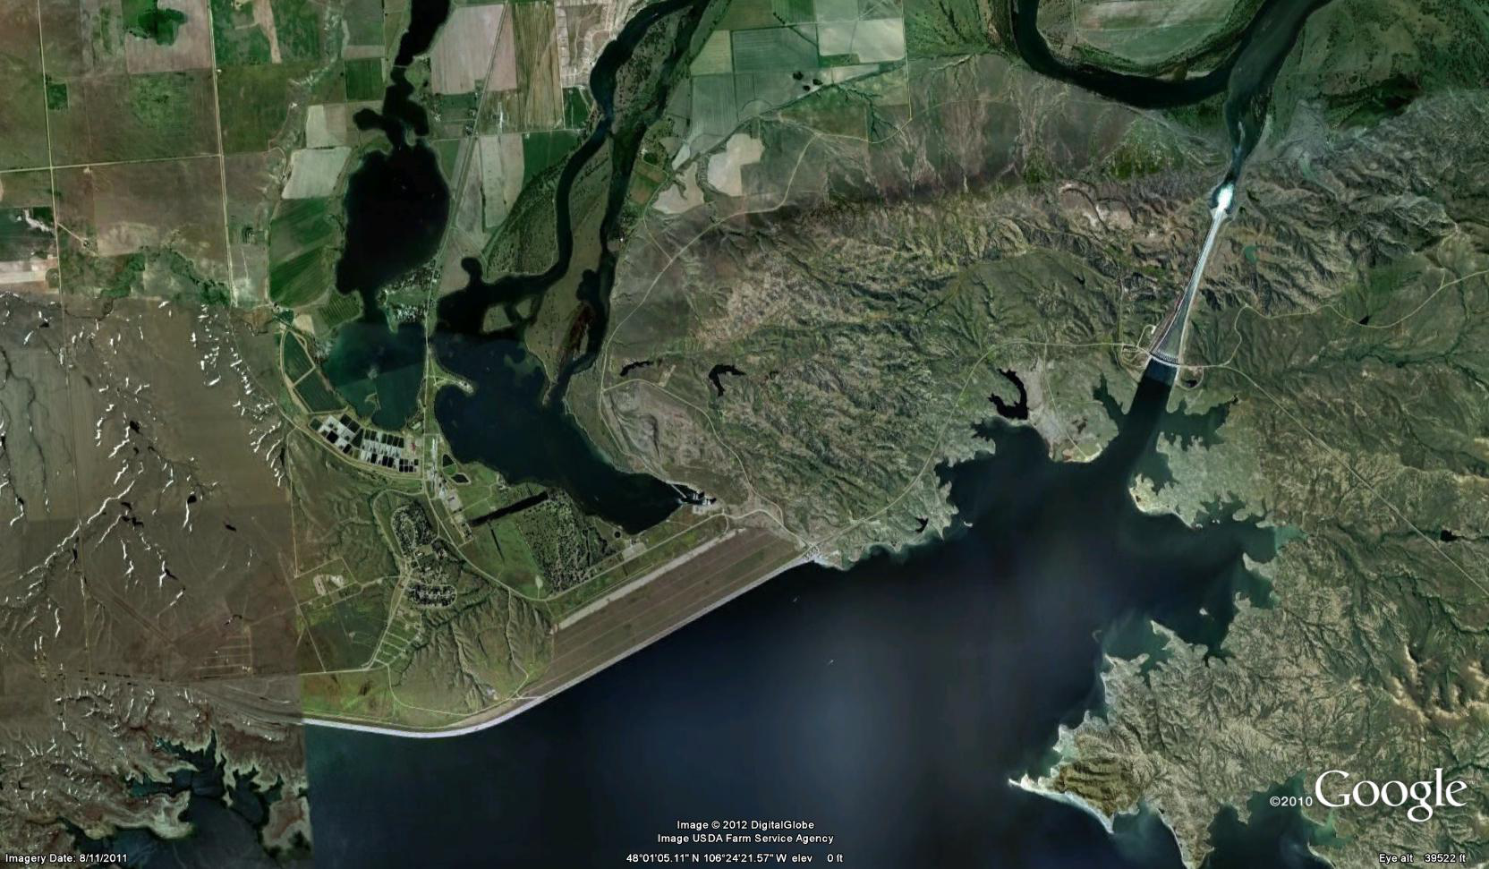
Fort Peck Dam
Plunge Pool
Main Embankment
Spillway

Slide 8
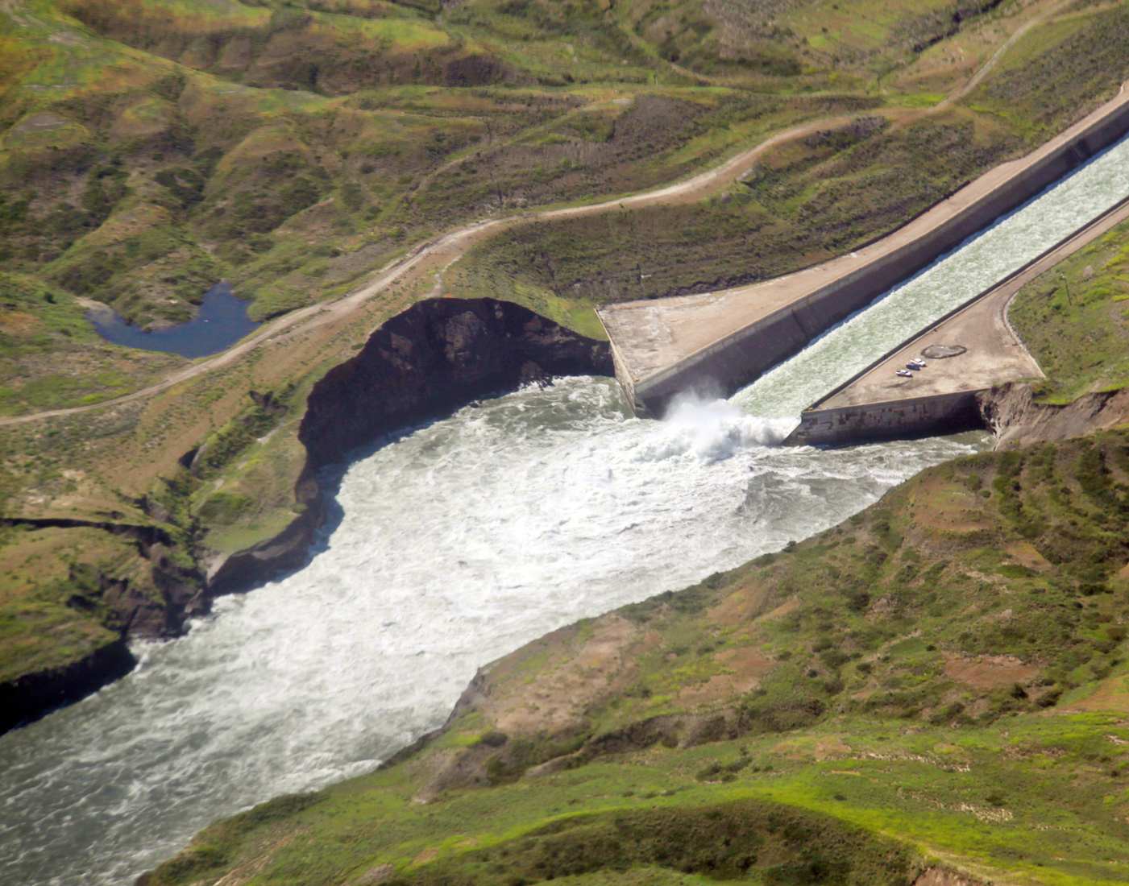
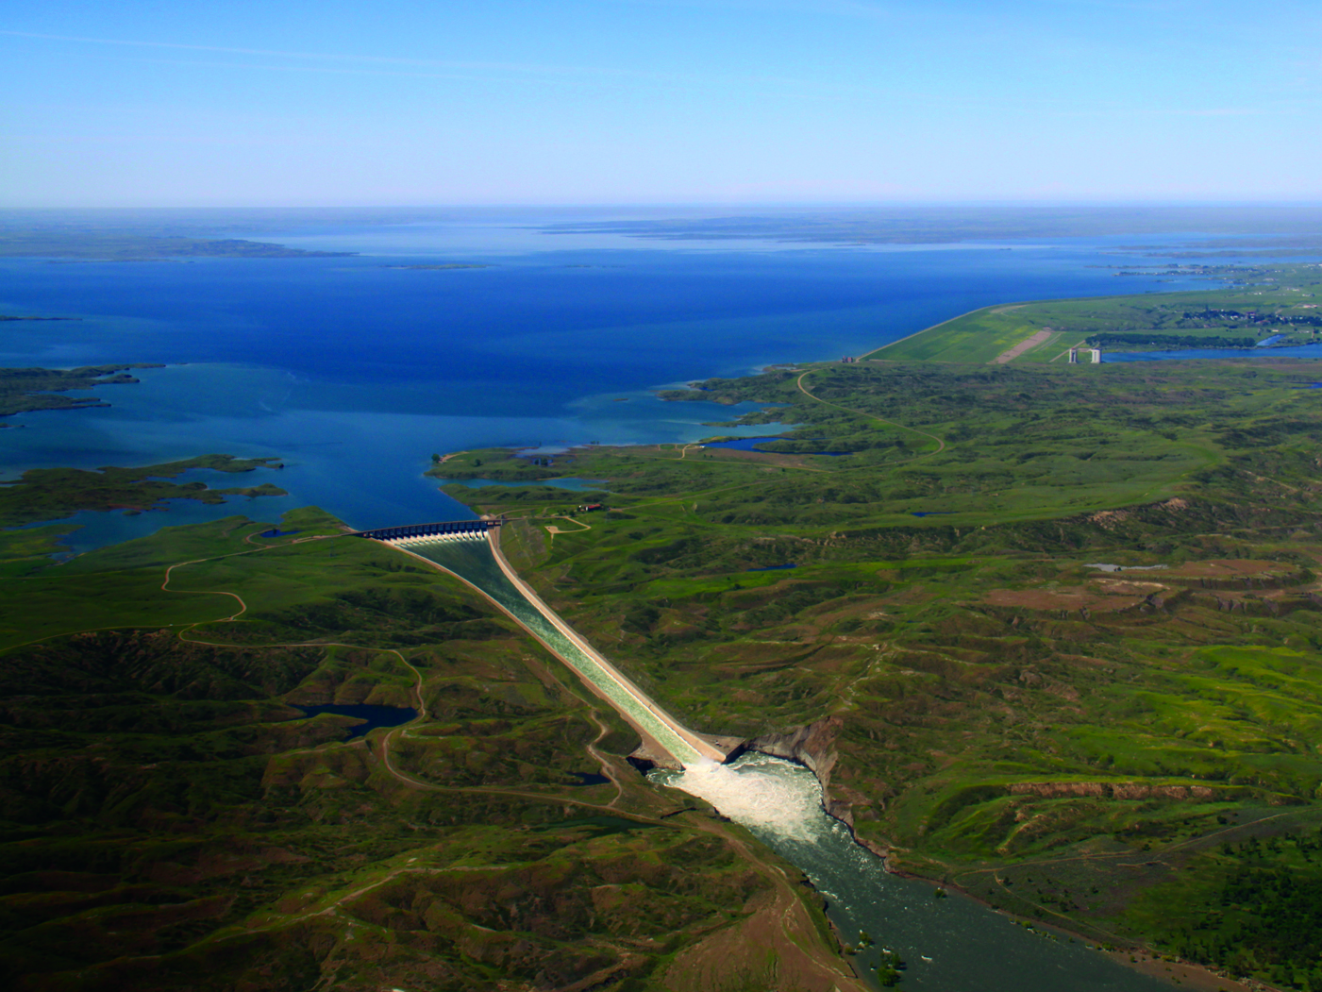
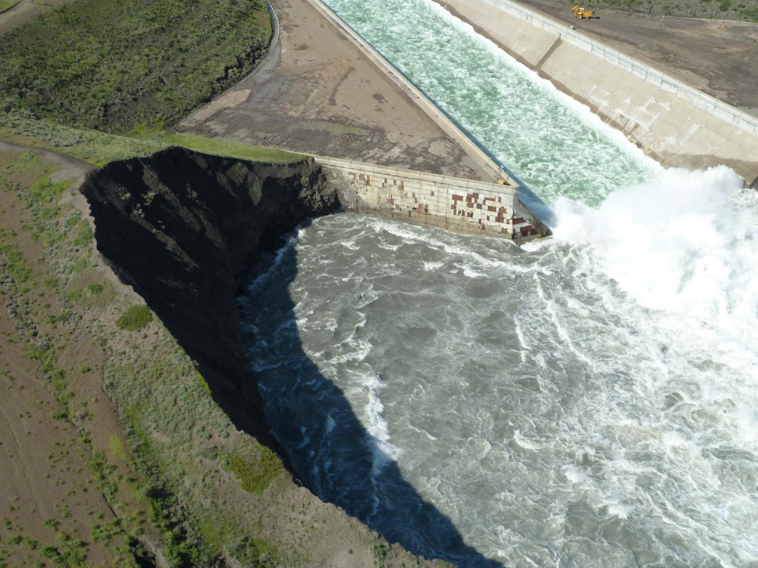
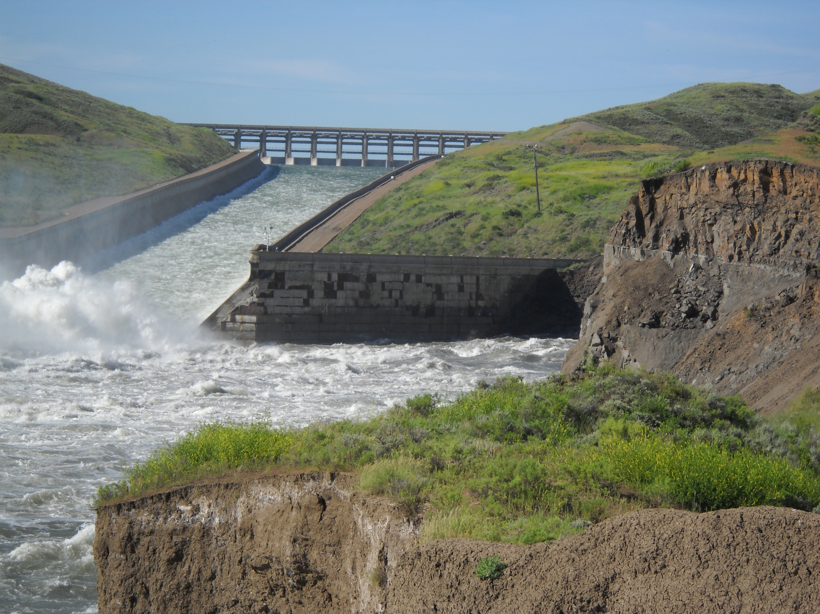
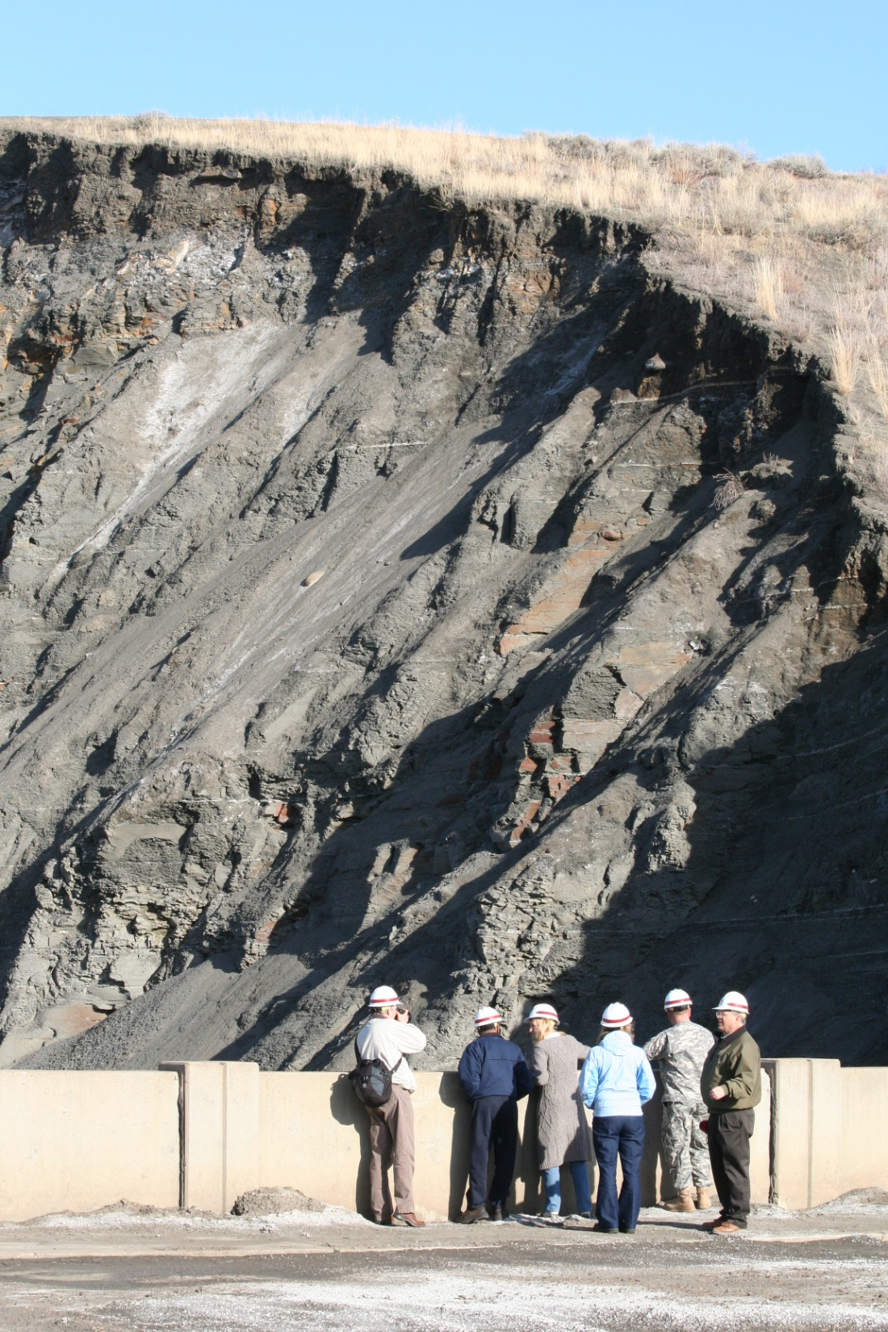
Fort Peck Spillway
Plunge Pool Erosion 2011
Notes:
Enormous Hydrauilic Fill Dam. First Dam to ever use Relief wells to control underseepage.
75 yr old Spillway in Bearpaw Shale, very erosive and unstable
No Stilling basin, only vertical cutoff wall that extended 70 feet down
Considerable historical movement experienced down chute and damage to underdrain system;
Several documented concerns regarding stability of cutoff structure and chute slabs
Spillway flows were double previously experienced

Slide 9
Fort Peck Spillway

Slide 10
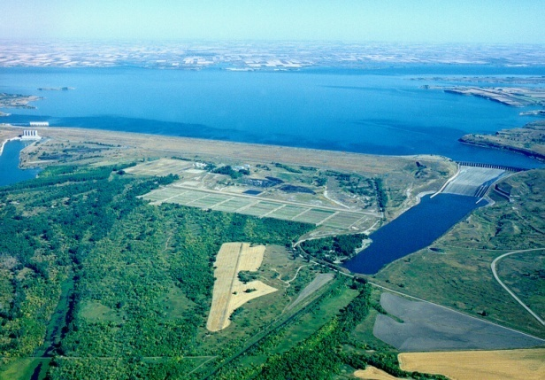
Garrison Dam
Powerhouse
Spillway
Max Operating Pool | 1854.0 feet
Base of Exclusive Flood Control | 1850.0 feet
Base of Flood Control | 1837.5 feet
 | 1955-2010 | 2011
Maximum Pool Elevation (Date) | 1854.8 feet (1975) | 1854.6 feet (July 1, 2011)
Maximum Daily Average Release (Date) | 65,000 cfs (1975) | 150,600 cfs (June 25, 2011)

Slide 11
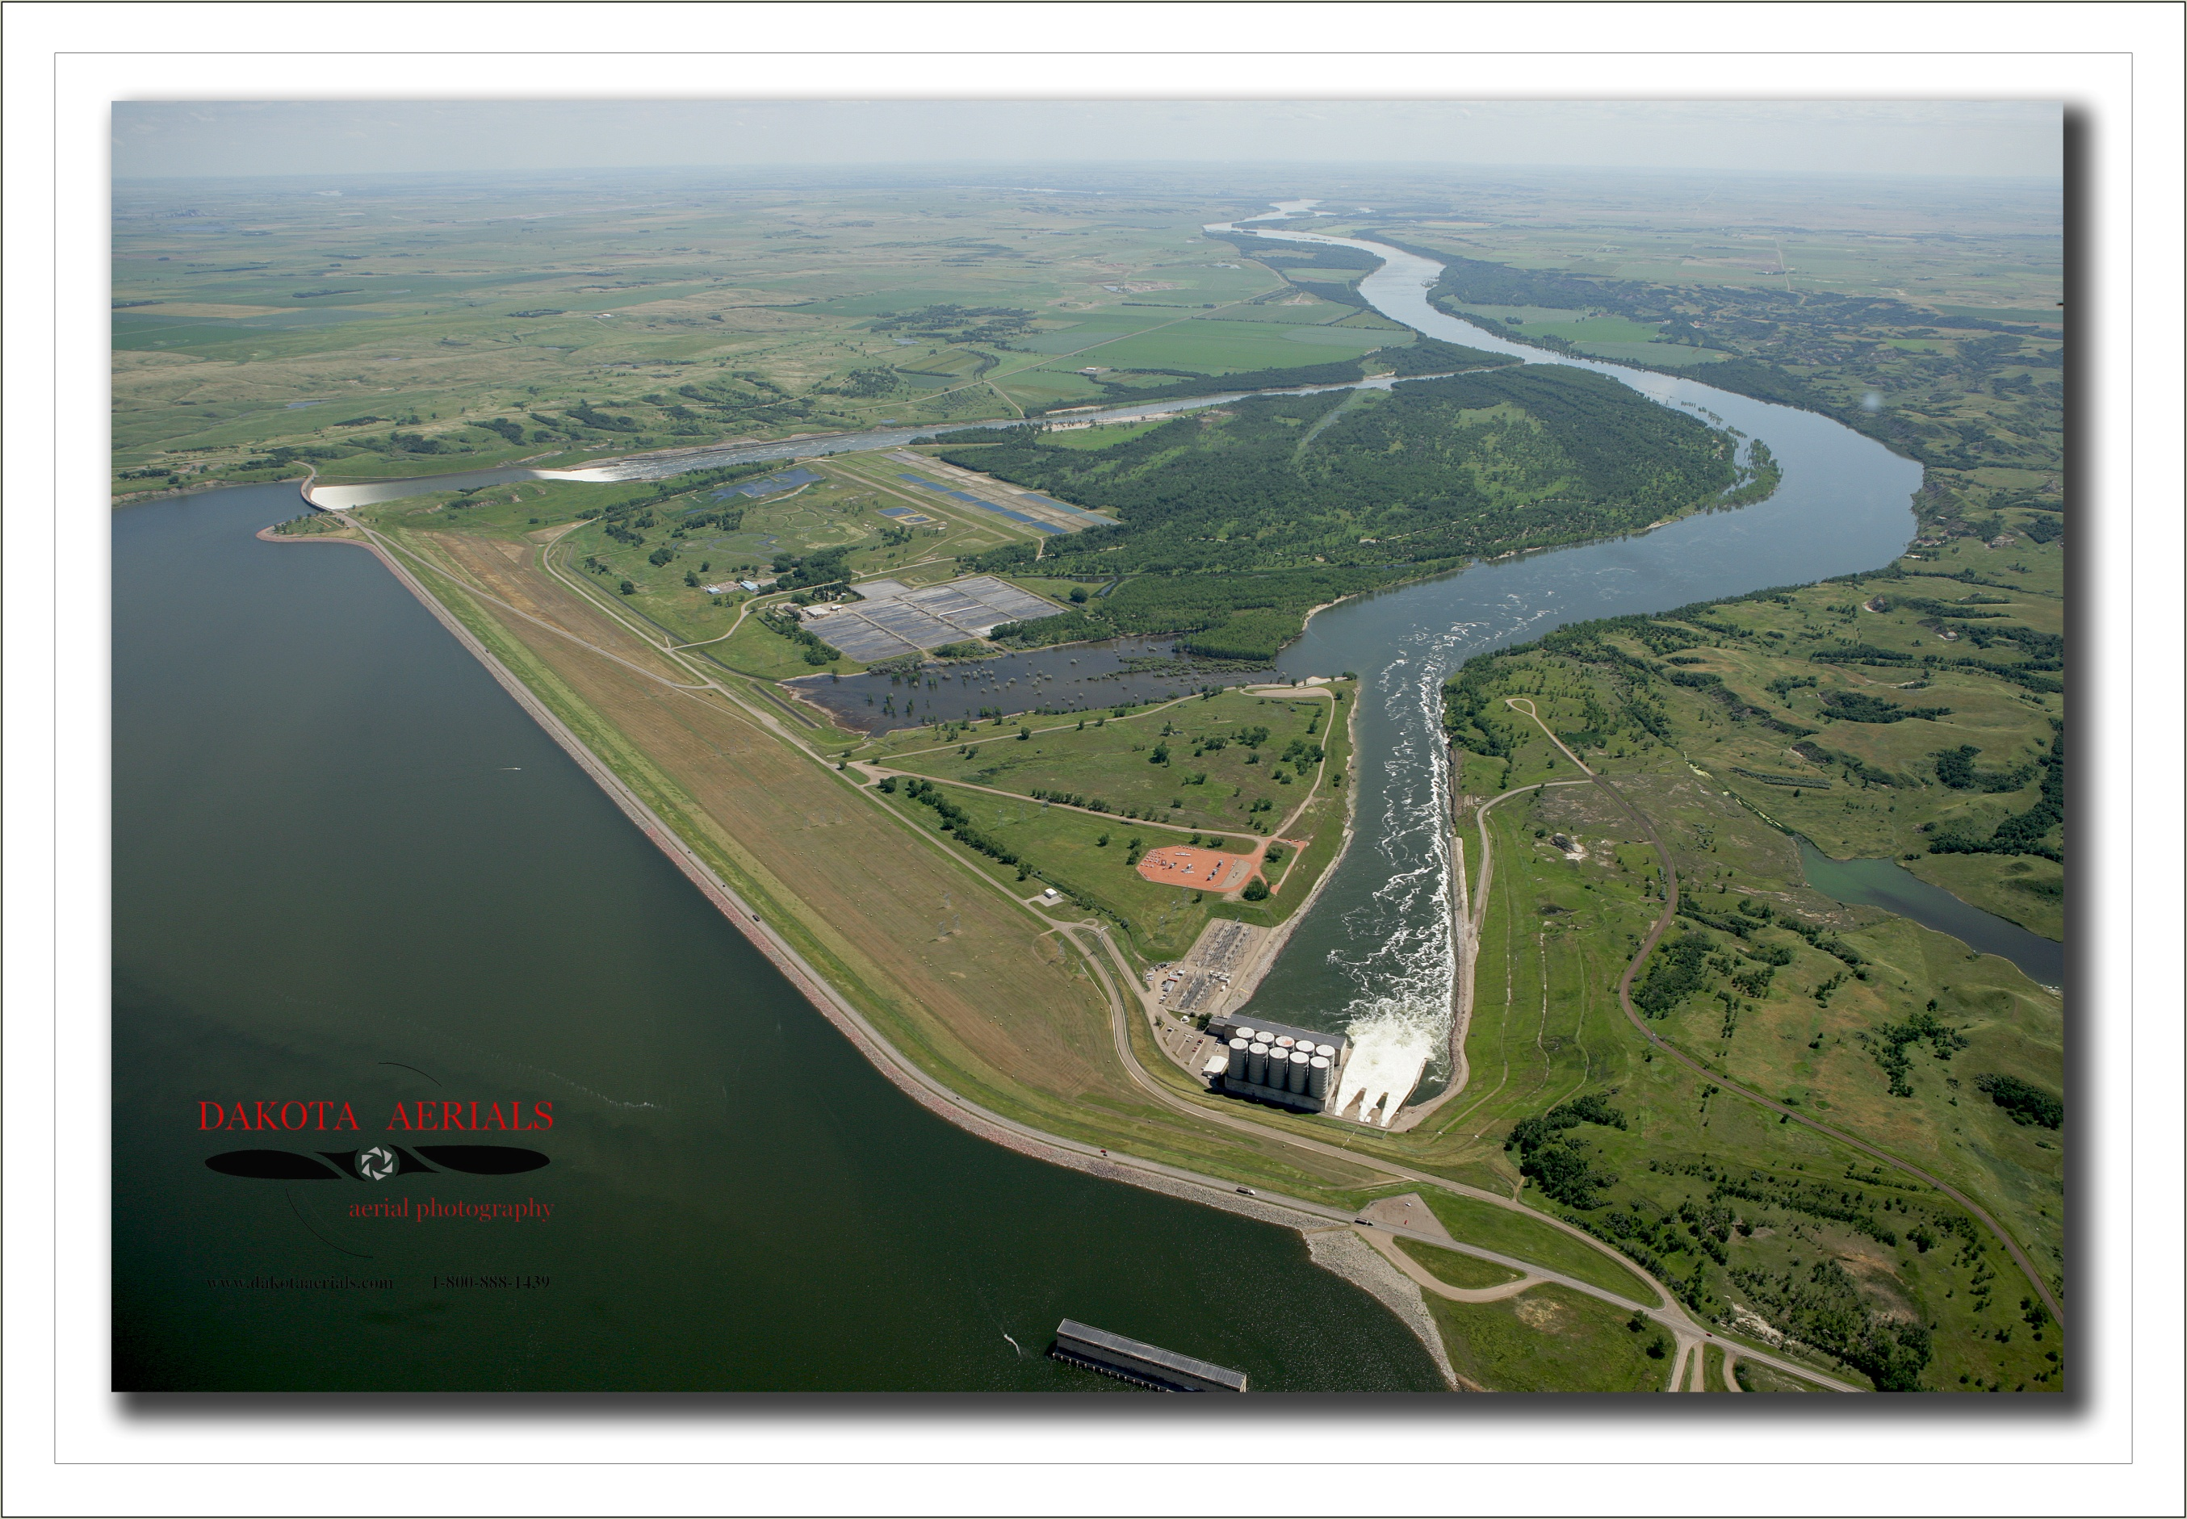
Garrison Dam
Spillway erosion and potential uplift
Left abutment seepage
Tailrace bank sloughing
Minor sinkhole activity
West abutment seepage
Notes:
Garrison Dam – Historic Movement along upstream face and underseepage in right terrace due to flaw in underseepage cutoff.
Main Concern was 1st time use of Spillway

Slide 12
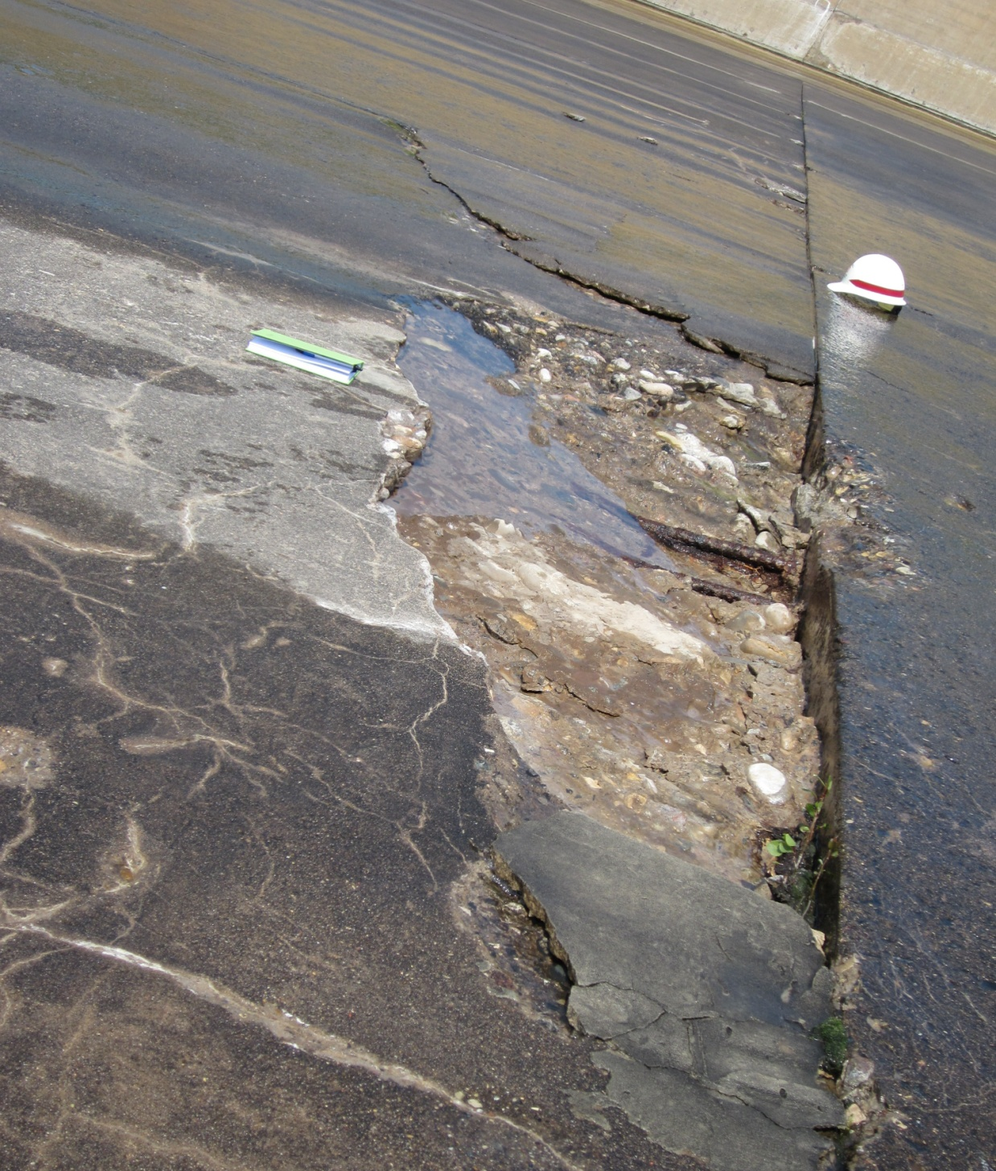
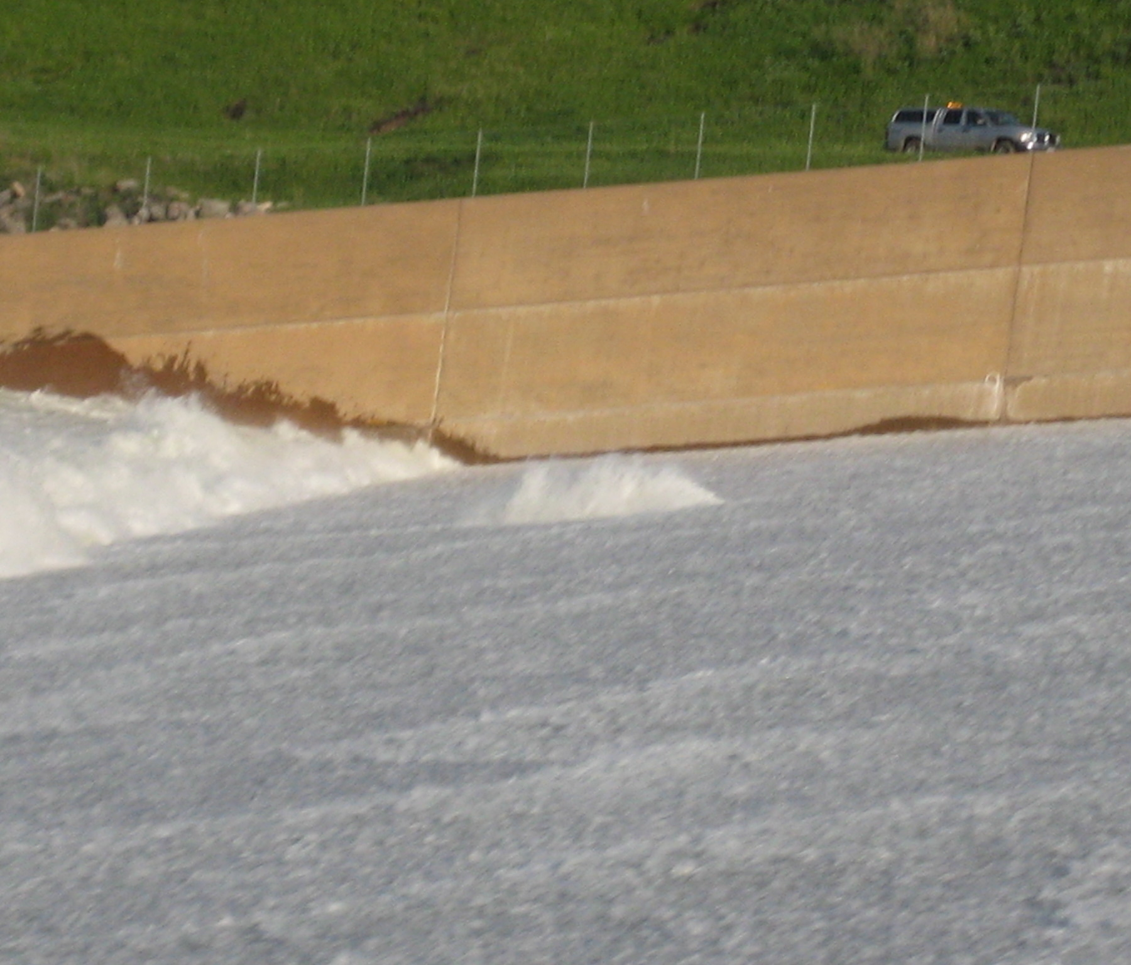
Garrison Dam
Spall on the concrete
spillway slab
Rooster tail caused by spall

Slide 13
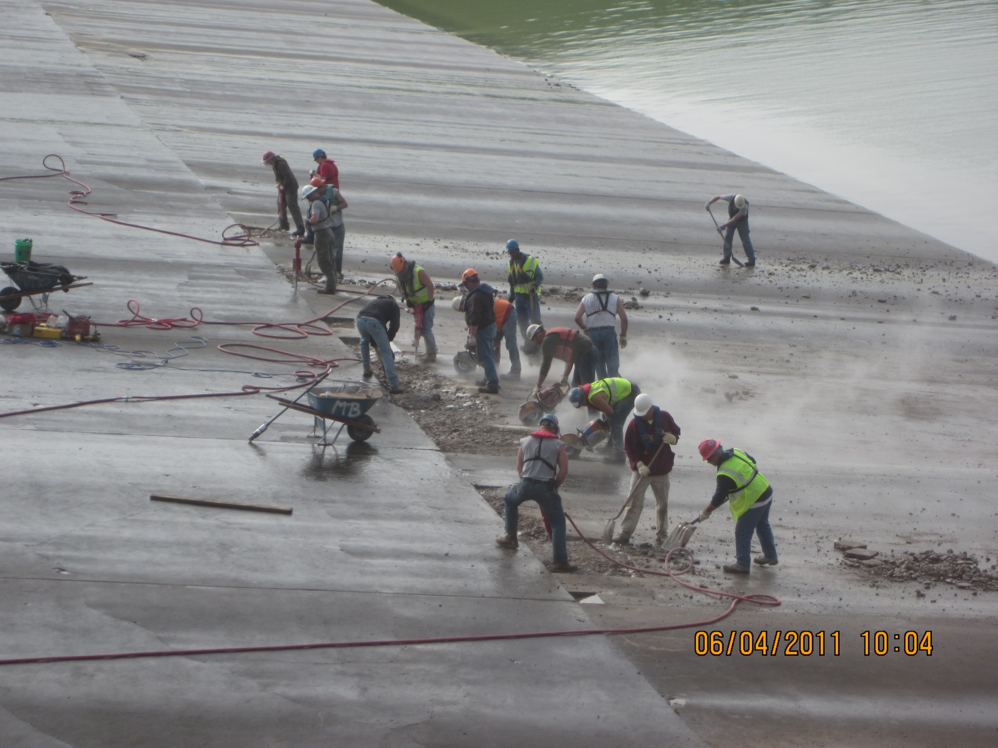
Contractors repair spalls to the concrete slab on Garrison Dam Spillway

Slide 14
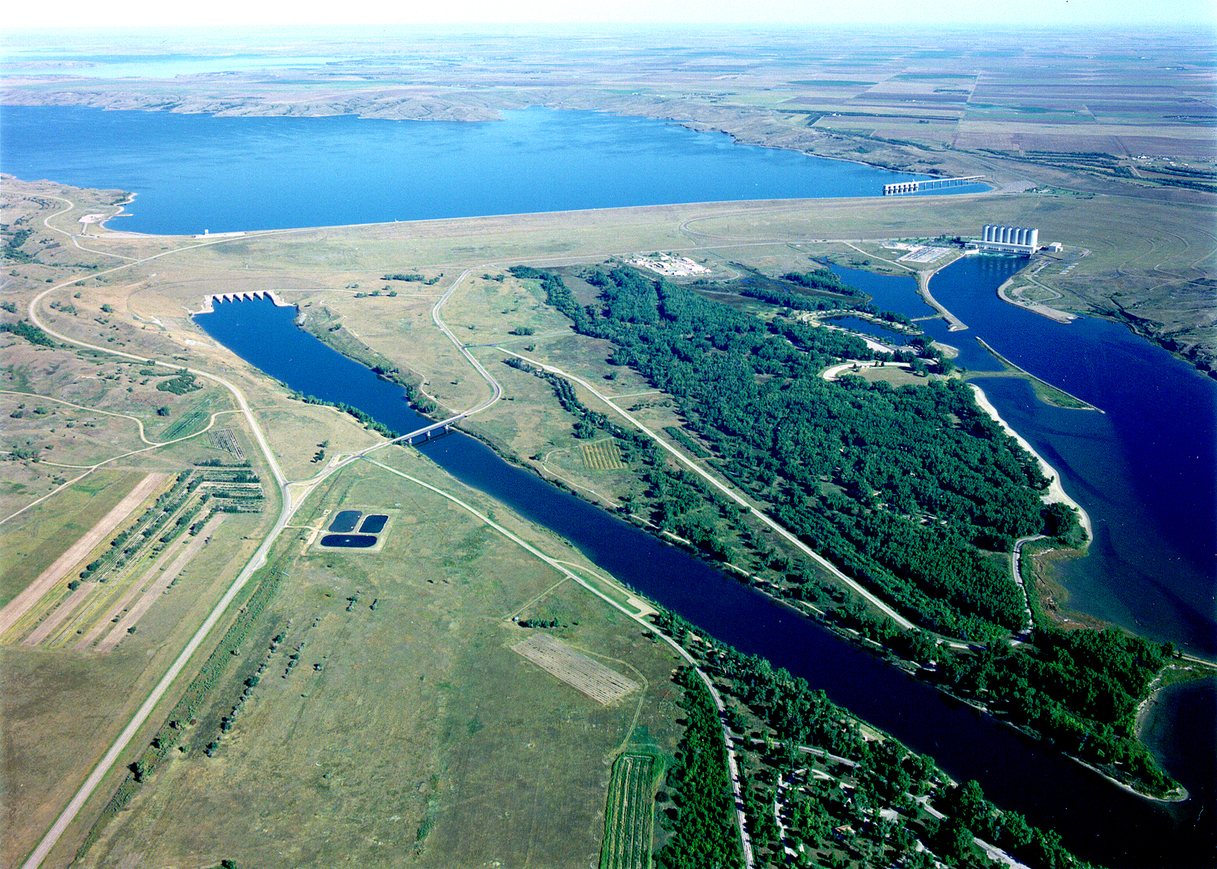
Oahe Dam
Powerhouse
Outlet Works Stilling Basin
Max Operating Pool | 1620.0 feet
Base of Exclusive Flood Control | 1617.0 feet
Base of Flood Control | 1607.5 feet
 | 1962-2010 | 2011
Maximum Pool Elevation (Date) | 1618.7 feet (1995 & 1996) | 1619.7 feet (June 26, 2011)
Maximum Daily Average Release (Date) | 59,000 cfs (1997) | 160,300 cfs (June 20, 2011)

Slide 15
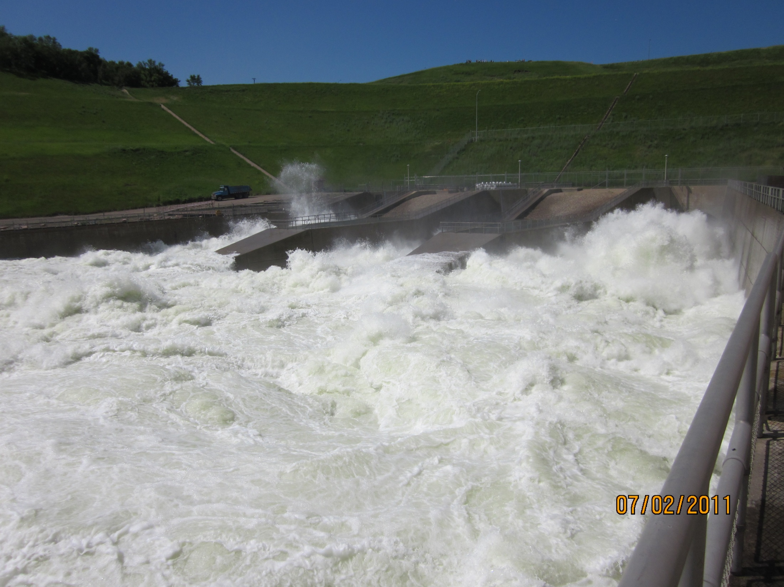
Notes:
Flood Tunnel Releases, rarely used, releases were in excess of 200% of previous max
History of severe cavitation that was repaired in the 90s, but never tested
After confidence was gained in Spillway, release flexibilities enabled ROV inspection.

Slide 16
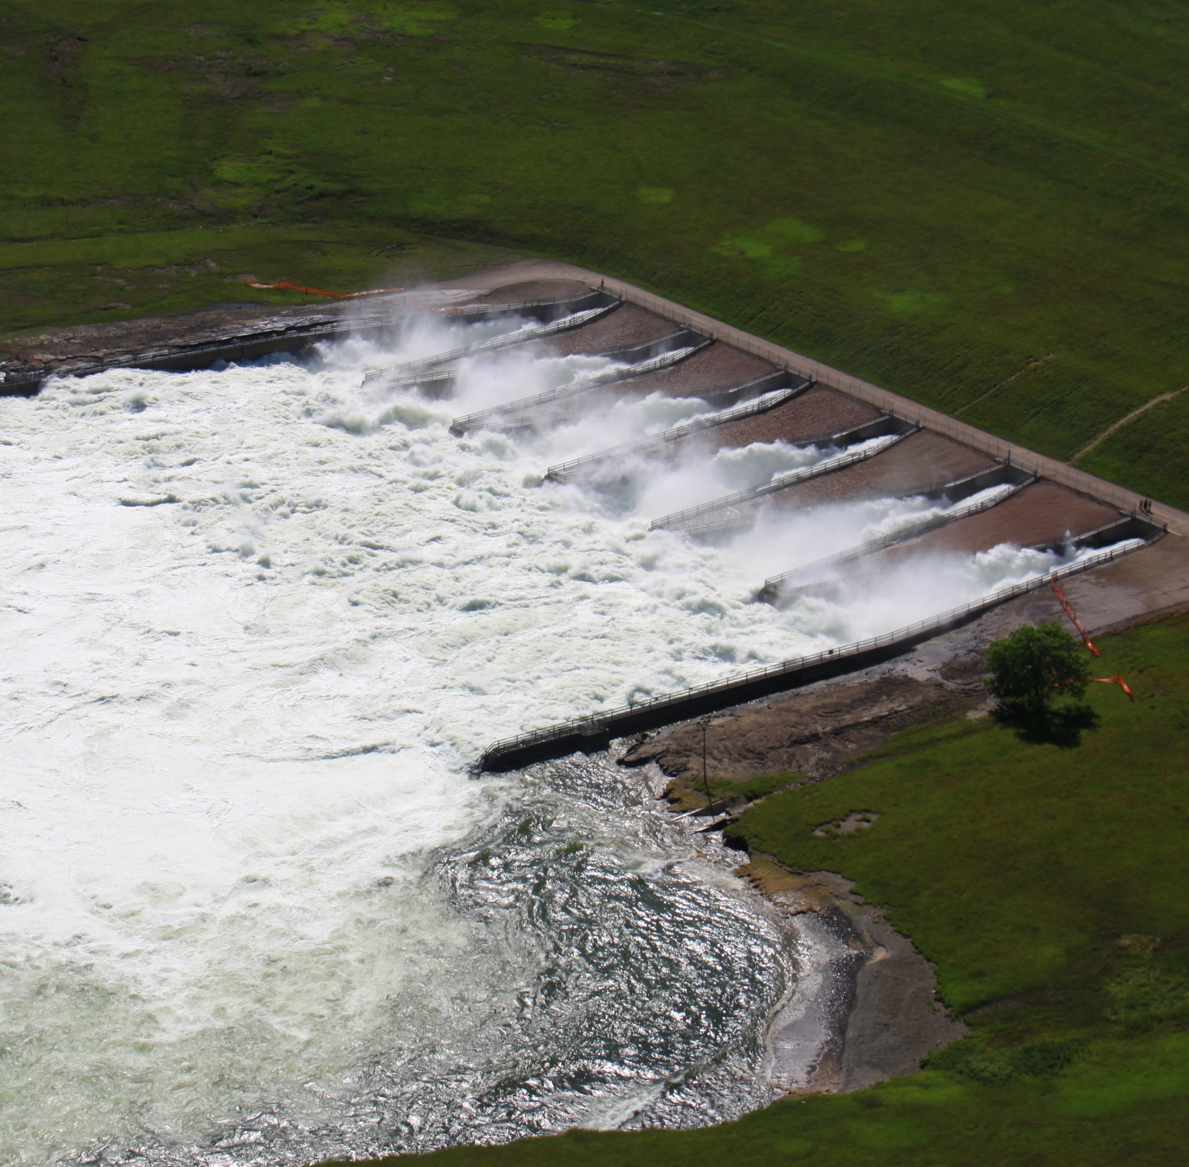
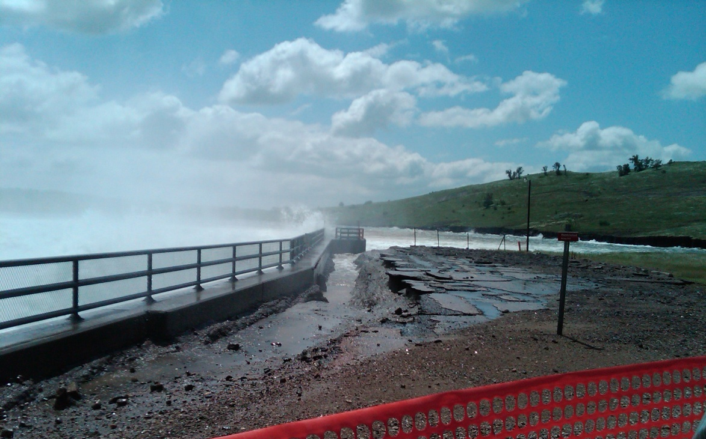
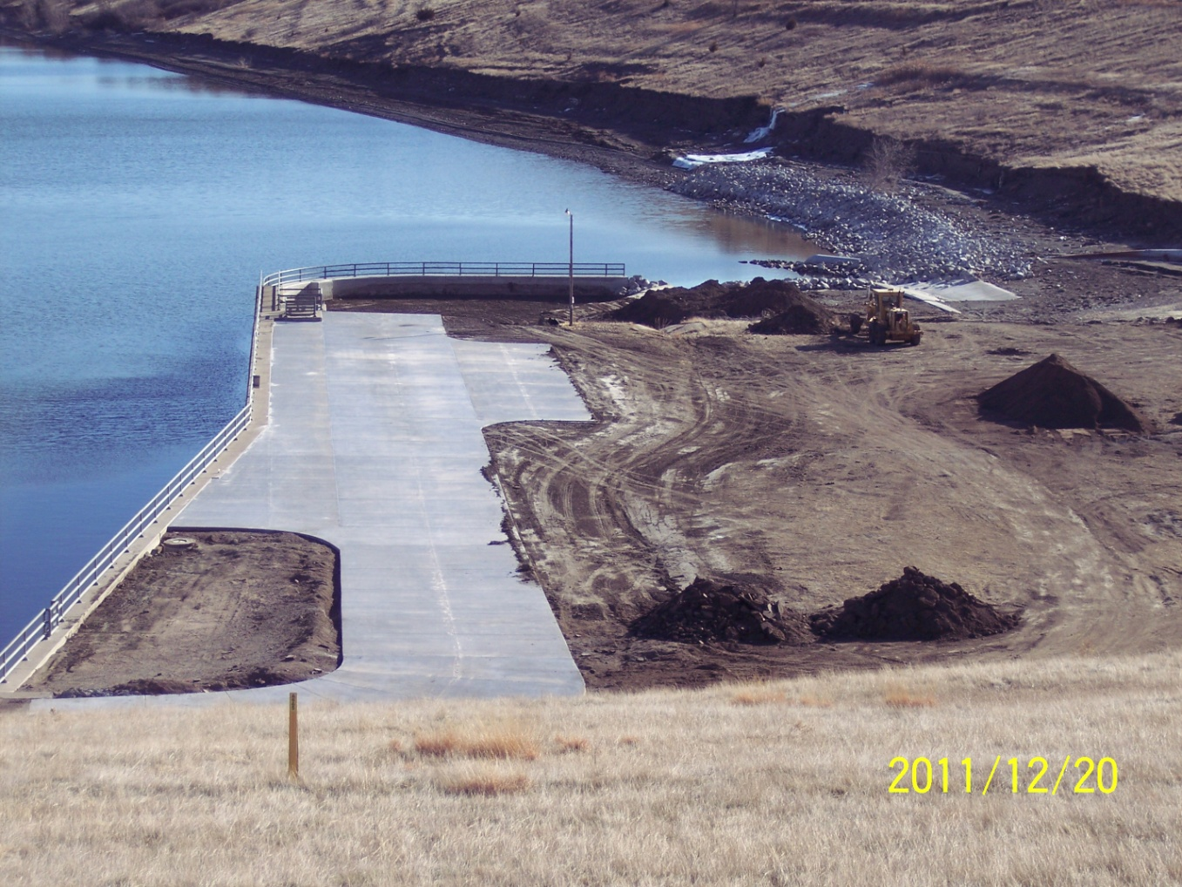
Erosion seen on both left and right wingwalls
High releases from Oahe Dam
at stilling basin
Completed Emergency Repairs

Slide 17
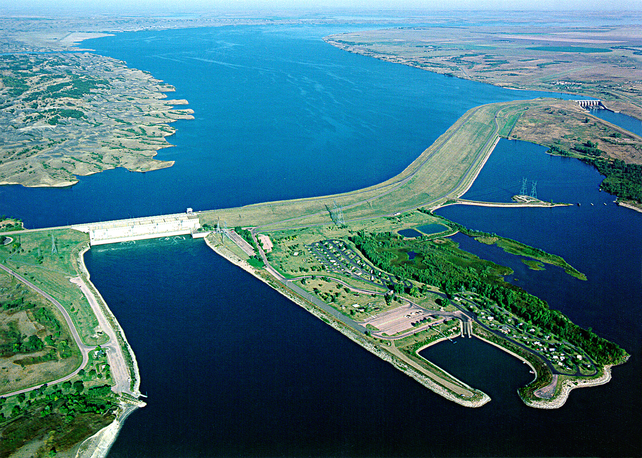
Big Bend Dam
Primary Dam Safety Issues: 1. Spillway Erosion
2. Left Abutment Seepage
Spillway
Powerhouse
 | 1964-2010 | 2011
Maximum Pool Elevation (Date) | 1422.1 feet (1991) | 1421.5 feet (June 22, 2011)
Maximum Daily Average Release (Date) | 74,000 cfs (1997) | 165,000 cfs (June 23, 2011)
Max Operating Pool | 1423.0 feet
Base of Exclusive Flood Control | 1422.0 feet
Base of Flood Control | 1420.0 feet

Slide 18
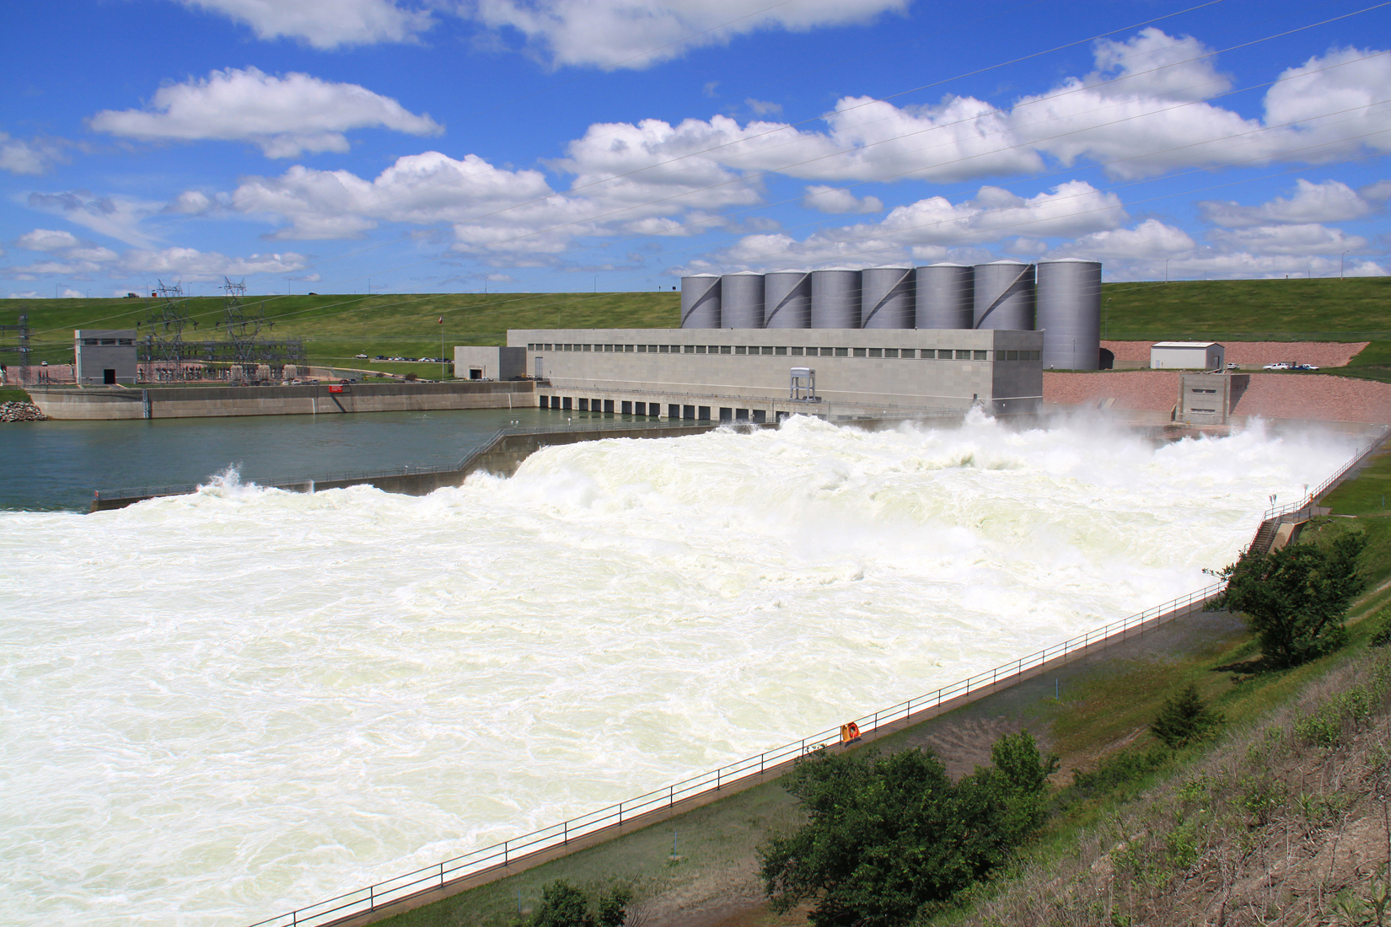
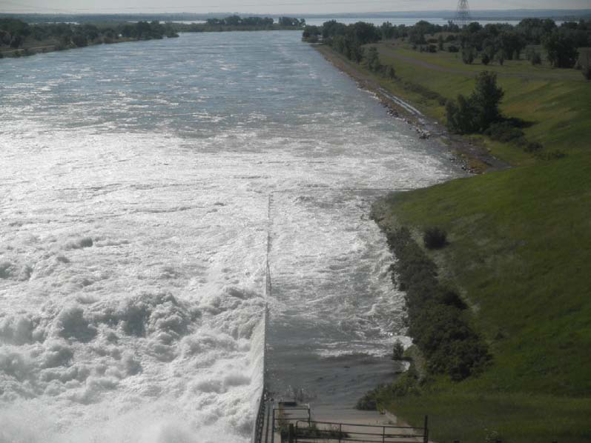
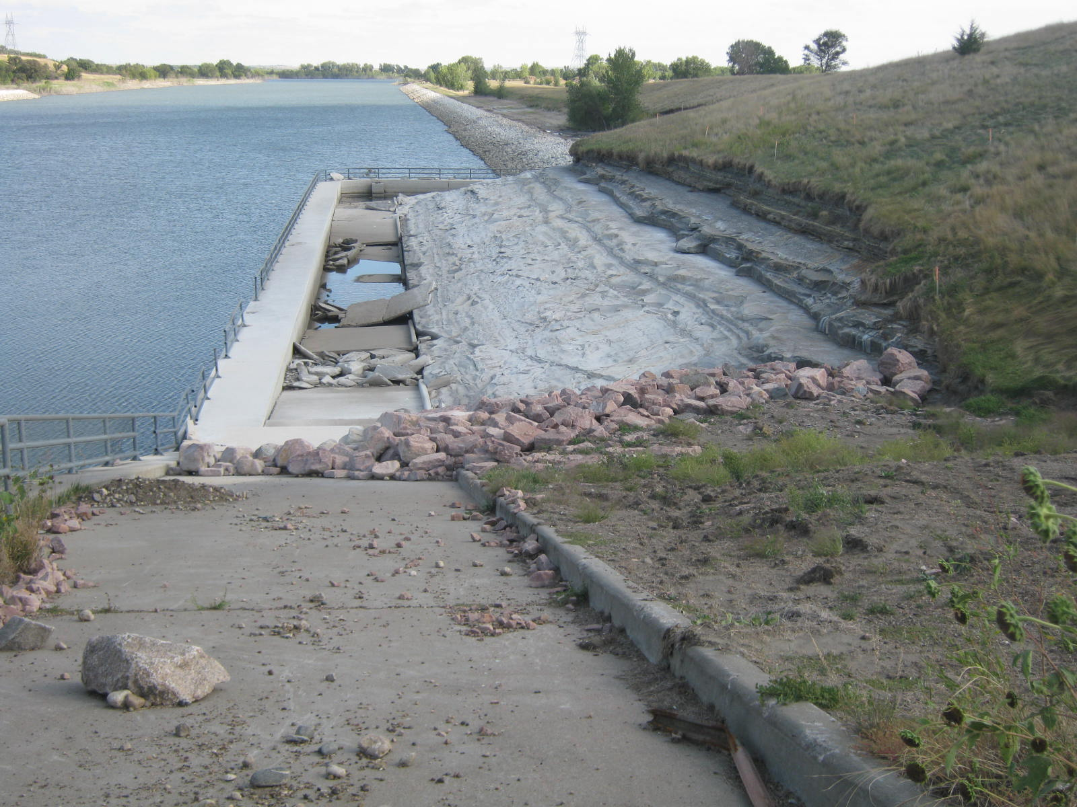
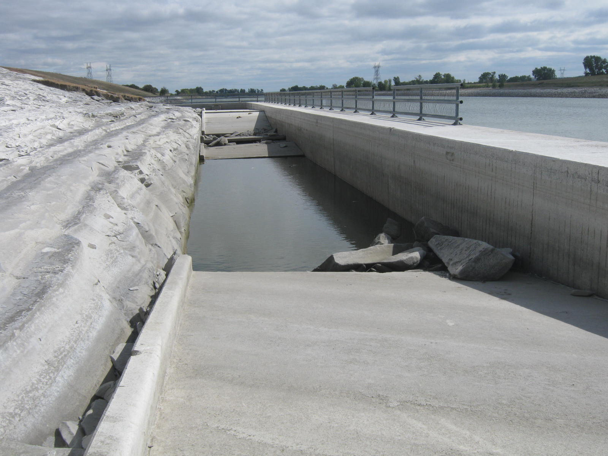
Erosion behind wingwalls due to high spillway releases

Slide 19
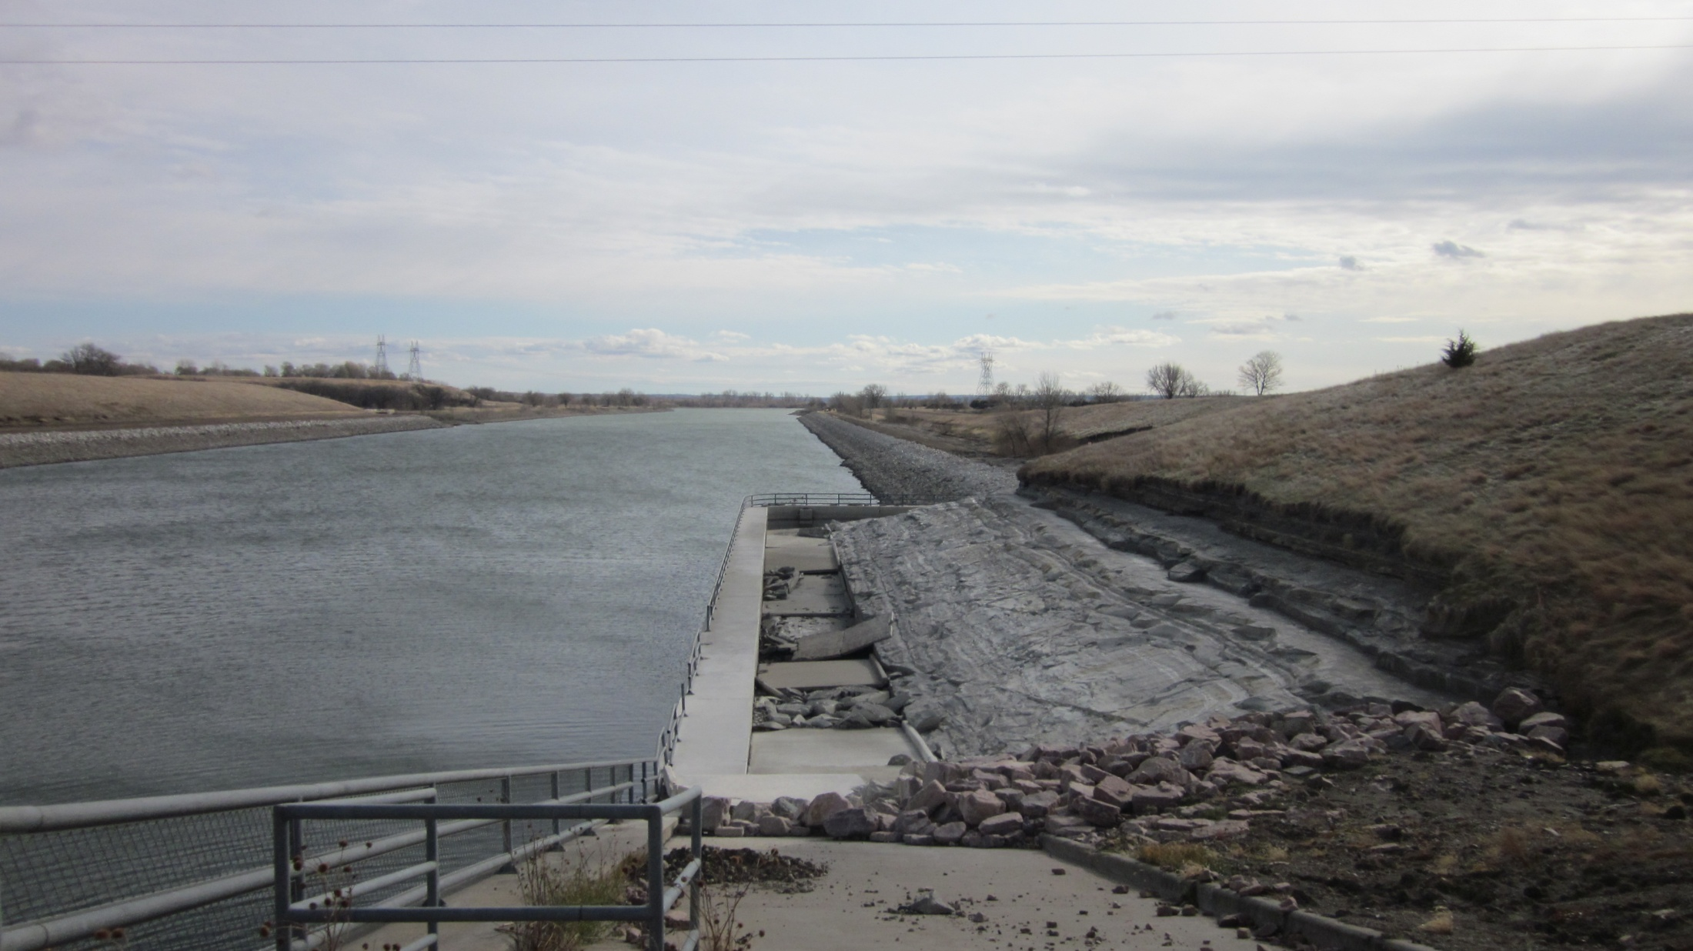
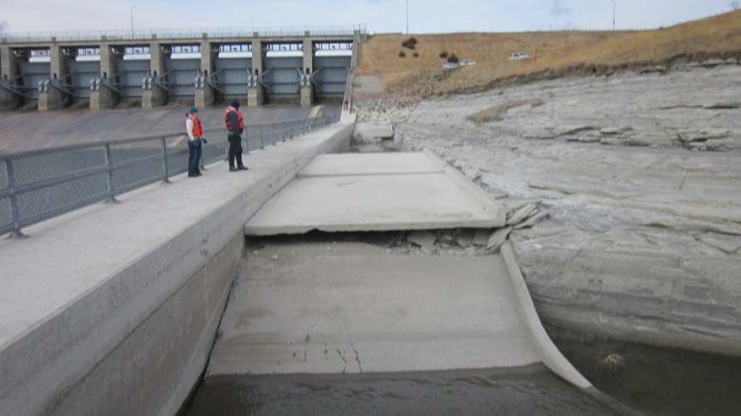
Big Bend Dam, SD – Spillway overtopping damage
Photo here

Slide 20
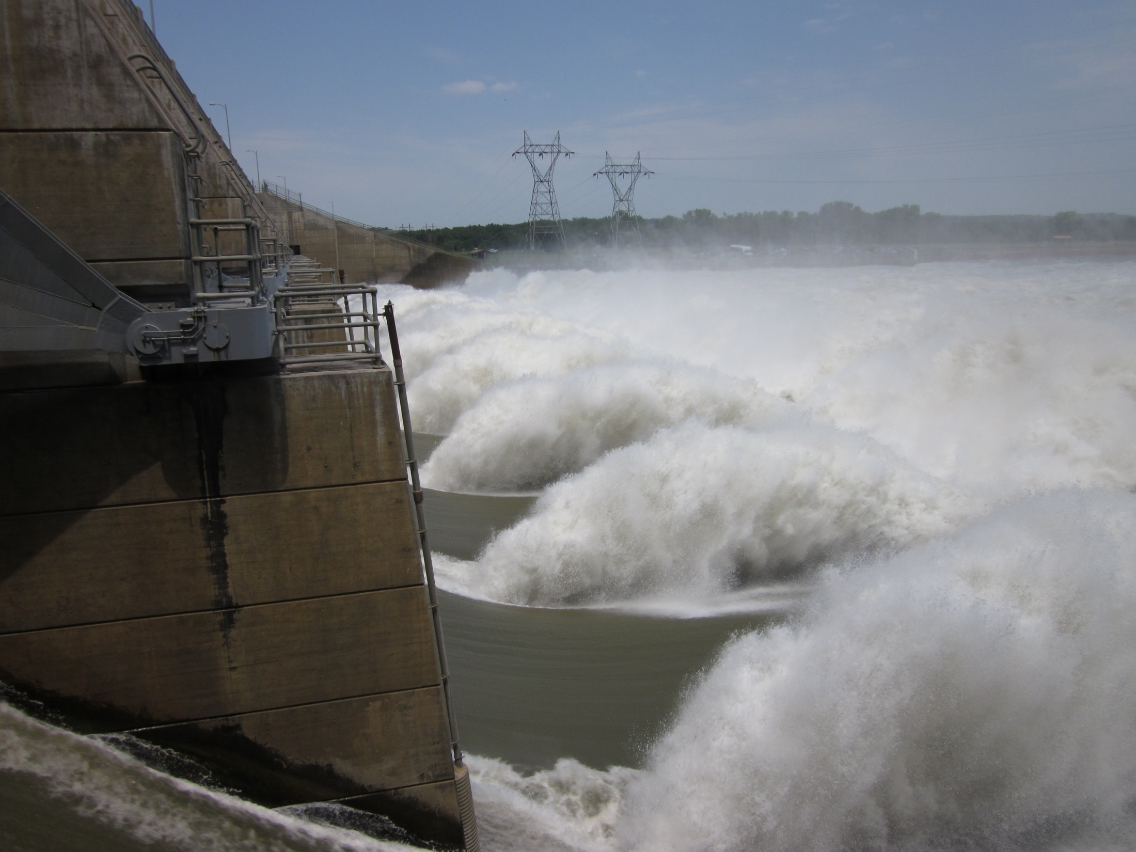

Slide 21
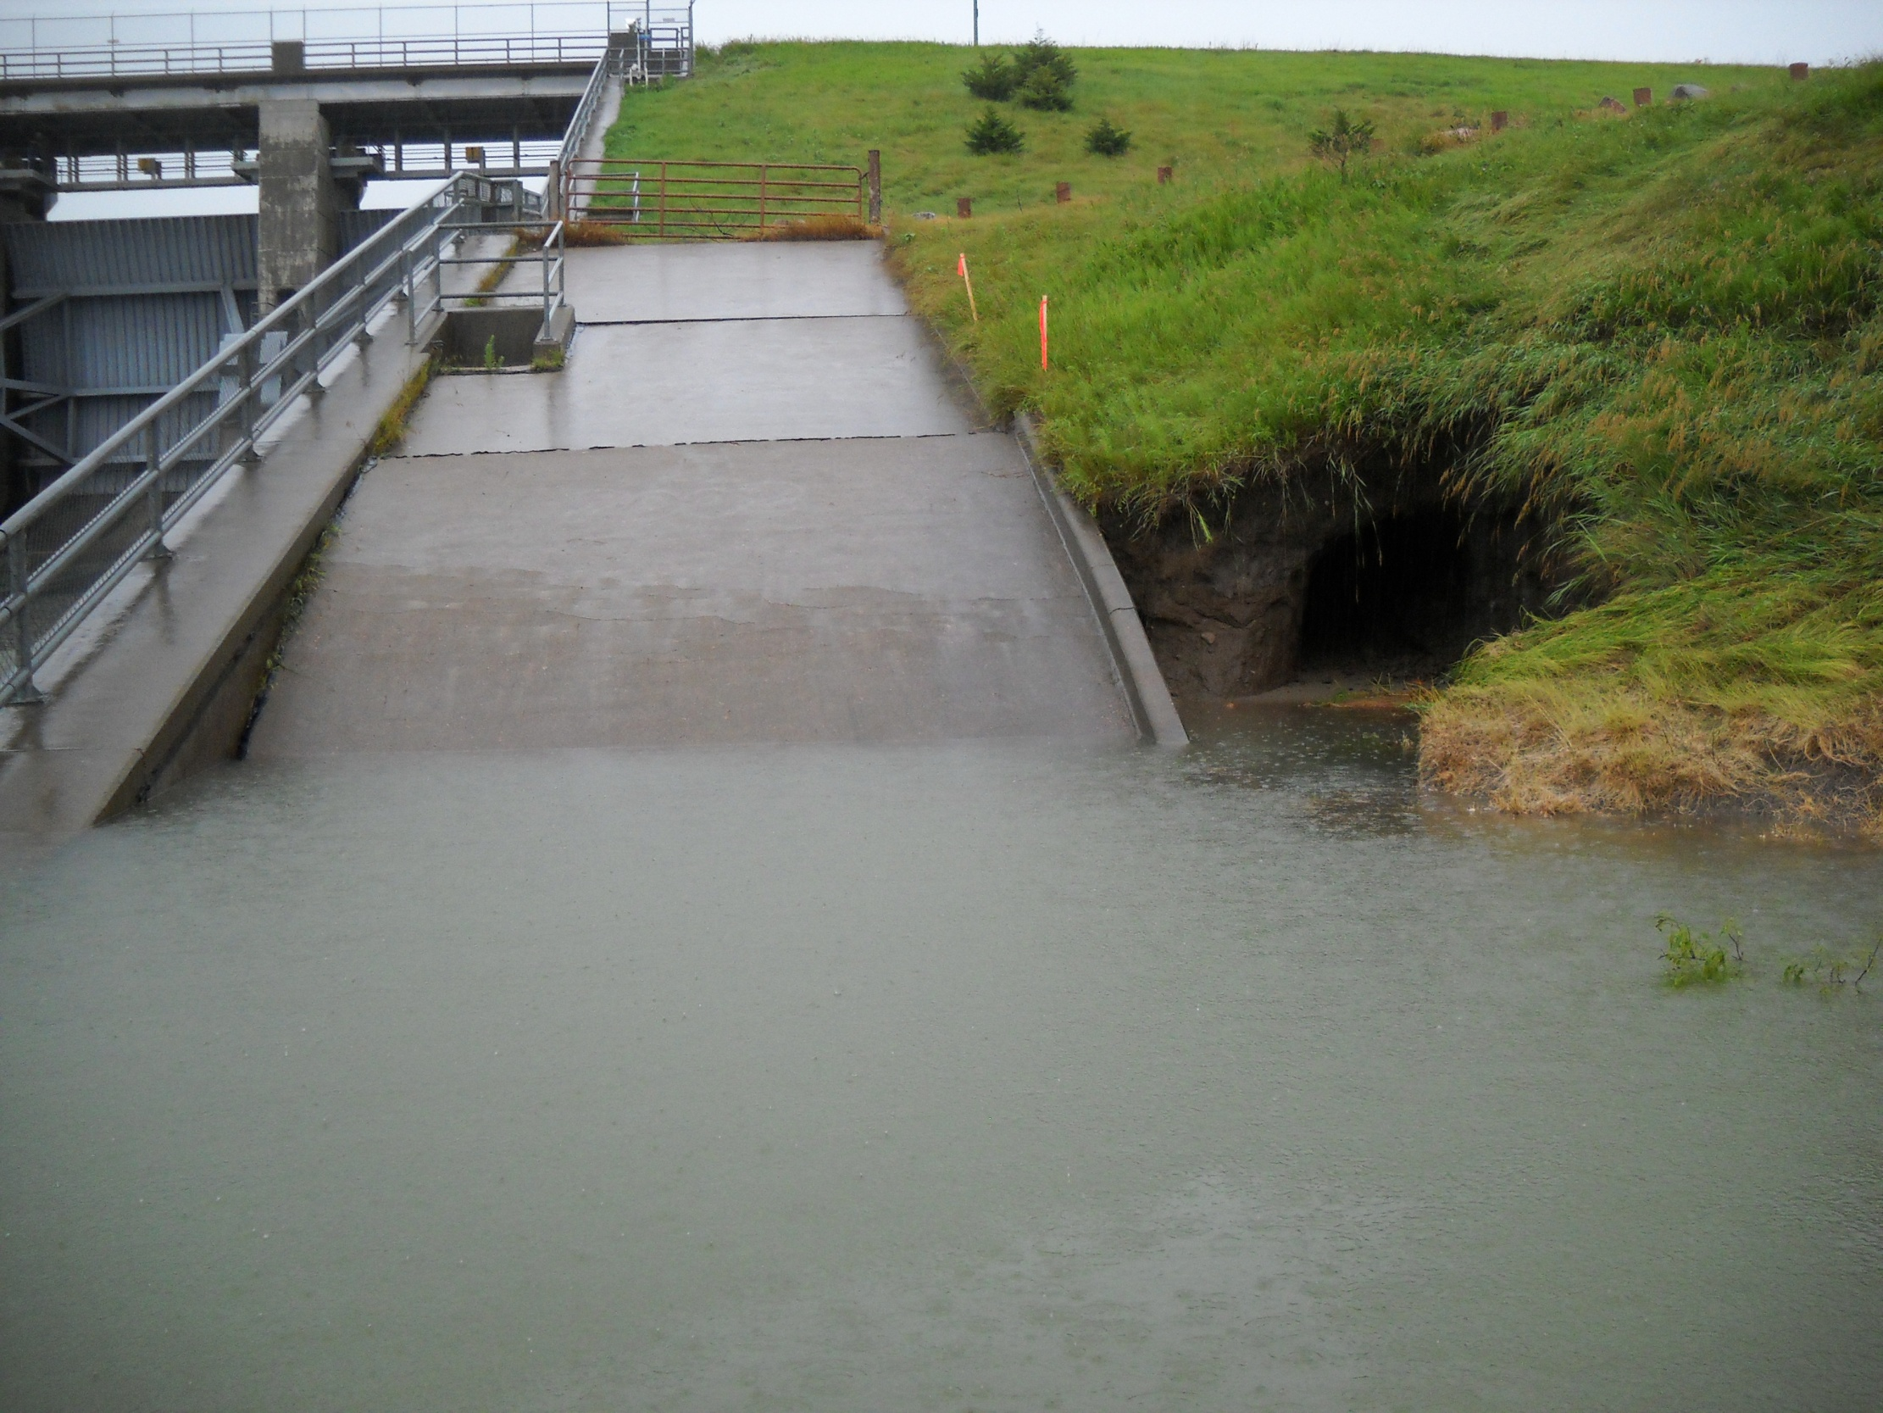
New Piezometers
Note subsidence.
Underwater slabs failed and
scoured upper 5 to 8 feet of material
below top of basin walls
Scour & sloughing
of granular backfill
July 1 – Fort Randall Pool approx El 1373 ft
Notes:
Surveillance personnel observed what was thought to be panels of slabs being uplifted
Spillway temporarily shut downs to permit inspection with SONAR device to verify condition, assure materials were not ball milling, assess erosion and install monitoring devices.
Granular backfill behind walls tied into a embankmnent toe train and was being eroded
Tailwater still projected to climb, decision was made to place riprap to slow down erosion and lessen potential for undermining toe of embankment.

Slide 22
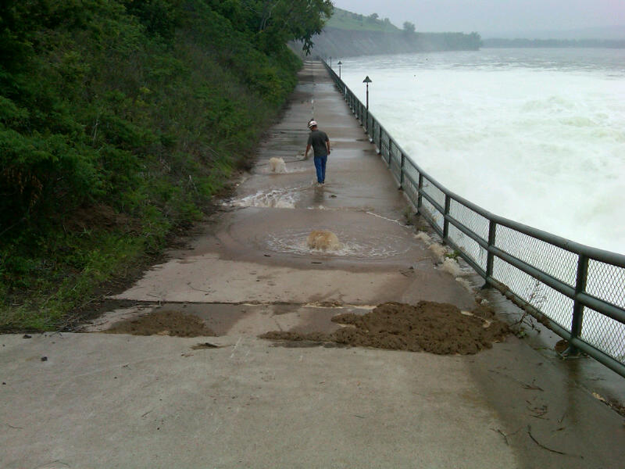
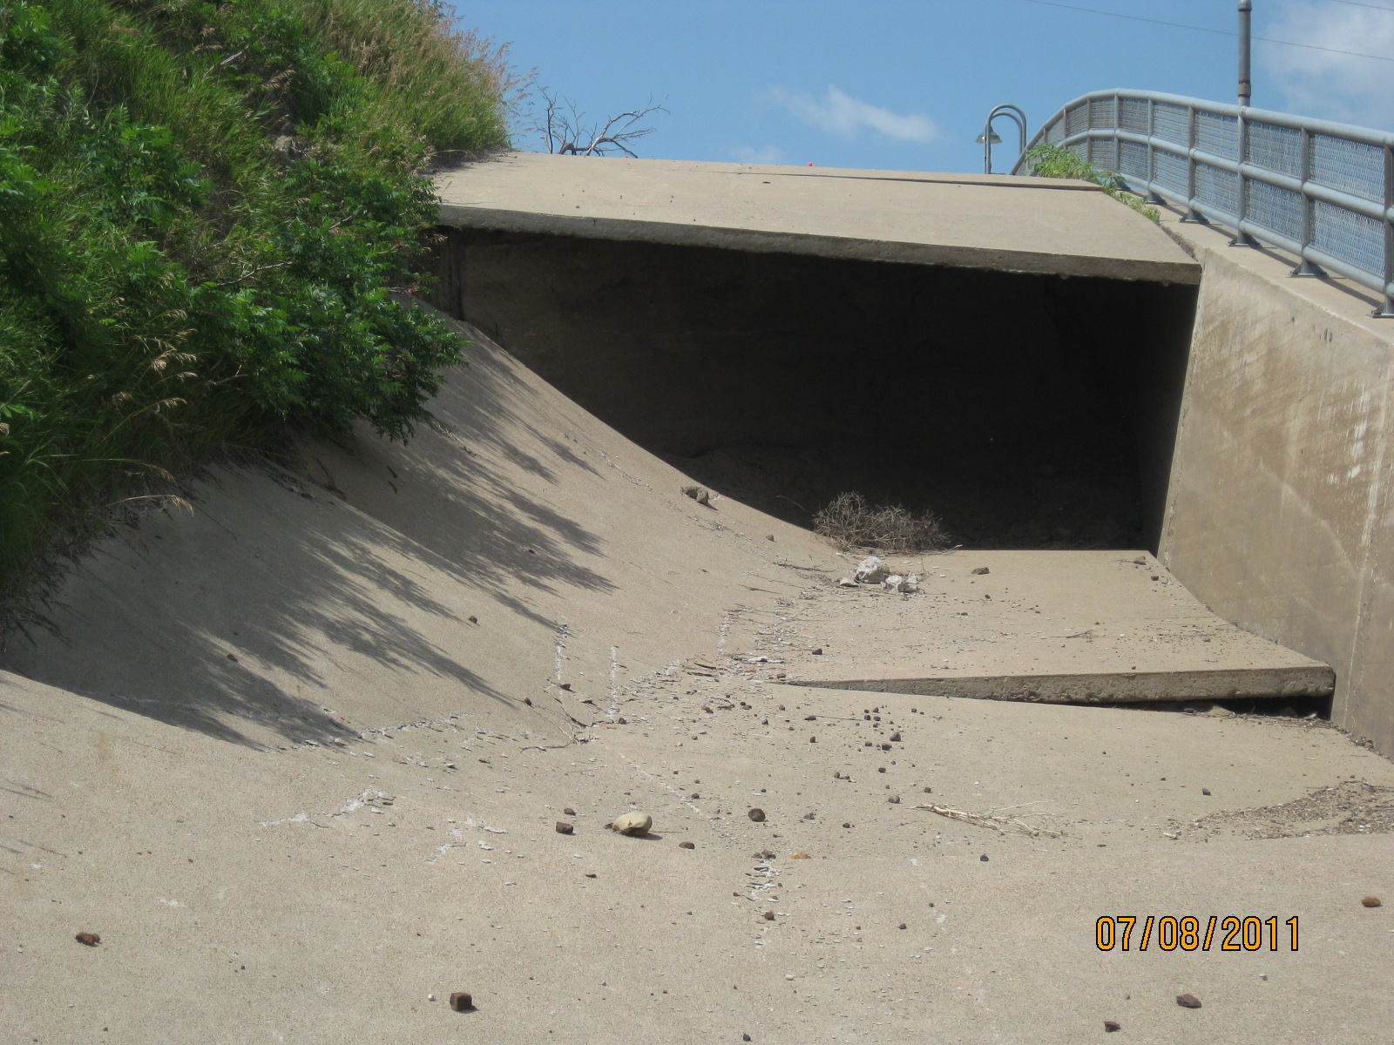
Notes:
Slabs blew out and backfill washed away

Slide 23
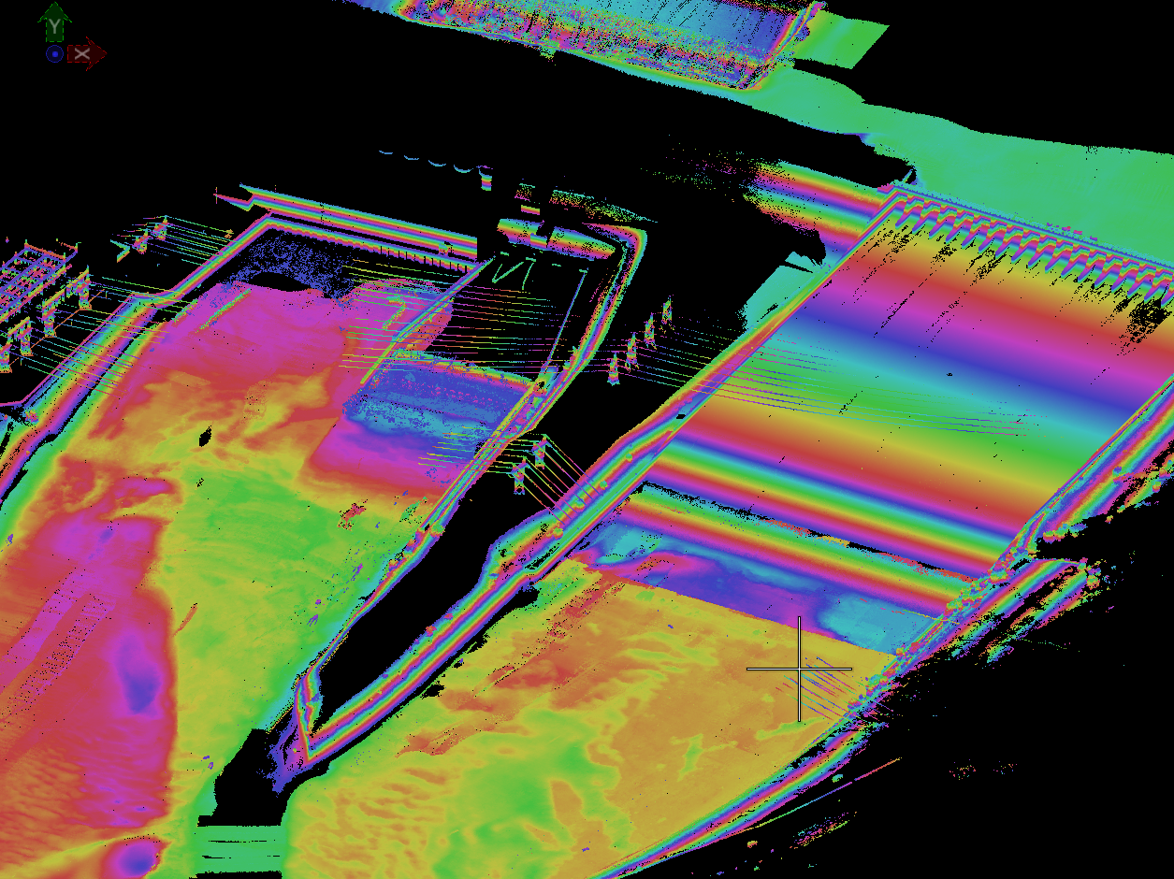
LIDAR and SONAR Surveys

Slide 24
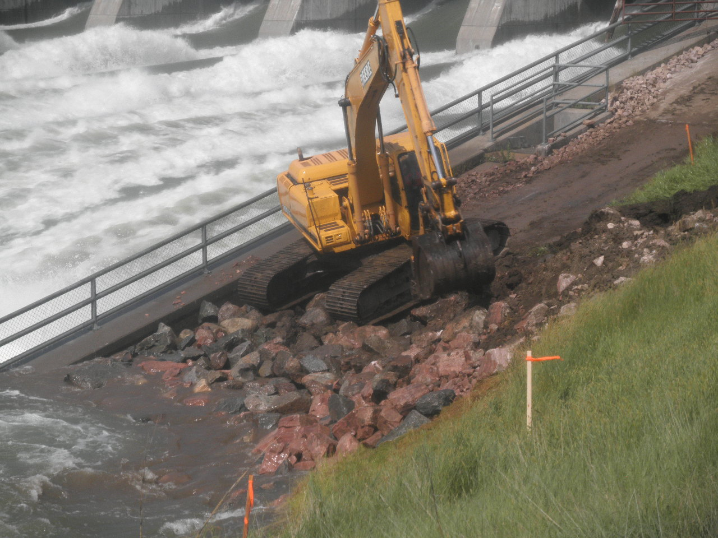
Notes:
Project Forces performed work with emergency stockpile materials

Slide 25
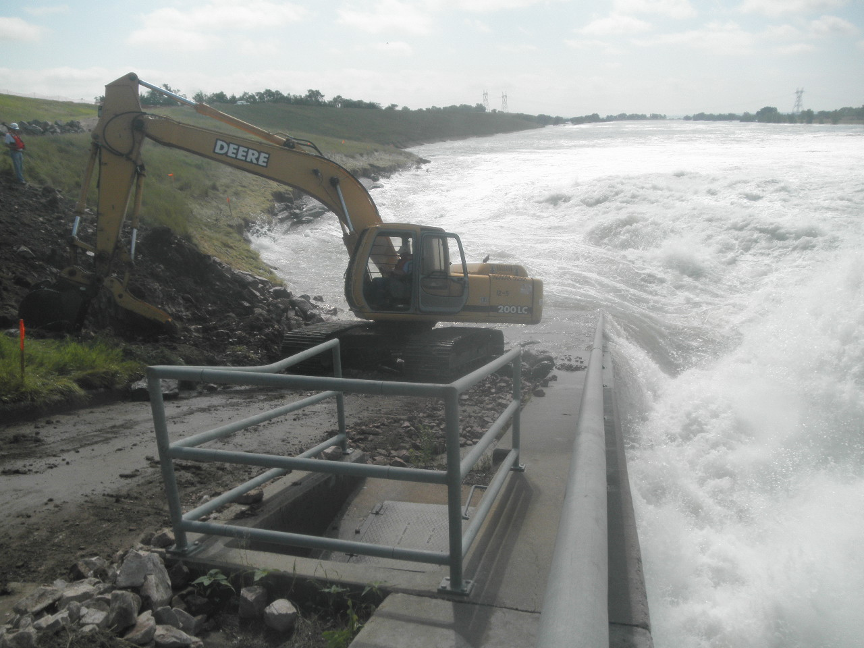

Slide 26
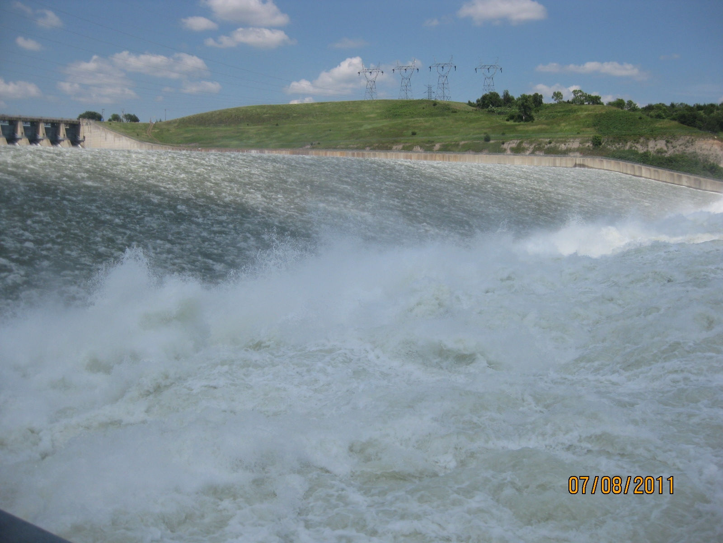
Notes:
Discharges through Spillway more common, but no where near this magnitude or duration.
Some of the gates were under minor repair and could not be in operation during initial stages
Unbalanced loading and long duration of discharges had unexpectedly charged and pressurized the granular wall backfill to the higher elevations.

Slide 27
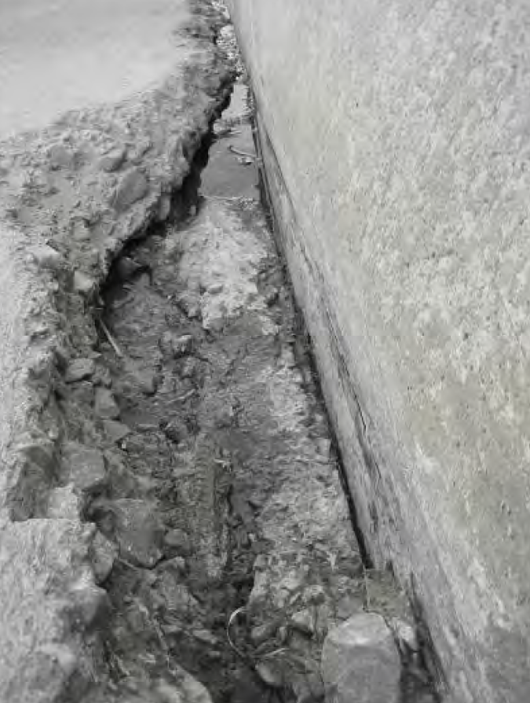
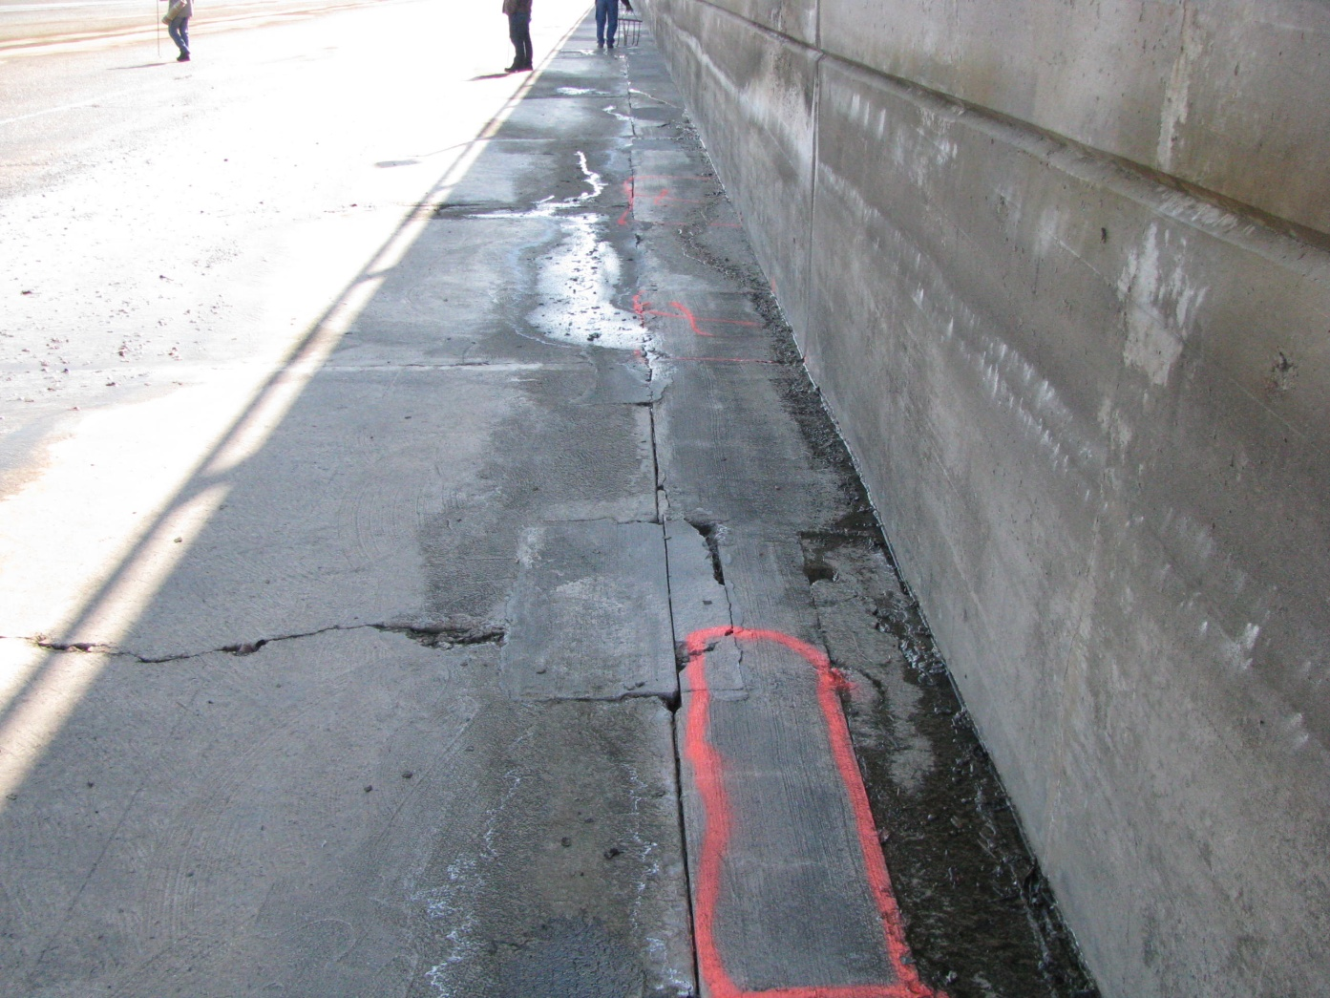
Fort Randall Dam - Spillway Slab Deterioration
Notes:
Temporarily shut down spillway to perfrom patching repairs and closed off (grouted) drain openings

Slide 28
Missouri River at Sioux City, IA
Actual and Unregulated Flows
Flood Stage = 30 ft (~ 122,000 cfs)
Notes:
Run off from the snow melt and rain filled flood storage of all six maintem reserviors.
Red line shows unregulated – flows without dams in place.
Gray area shows the 2011 flood flows, a few miles downstream of Gavins Pt dam.
Long duration: June – September
Reservoir system effective at removing peak of hydrograph.
Some public perception in lower basin: “Man made flood.”

Slide 29
Flood Fight Summary
Value of good Surveillance Plans
Anticipate erosion with large flood releases
Need resources readily available for emergency actions (intervention).

Slide 30
THANK YOU

