Slide 1
Electrical and Mechanical Aspects of Dam Safety
William Empson, PE, PMP
Senior Levee Safety Program Risk Manager
U.S. Army Corps of Engineers
Risk Management Center
William.B.Empson@usace.army.mil
Dam Safety Workshop
Brasília, Brazil
20-24 May 2013

Slide 2
Objectives
Identify common electrical and mechanical features associated with navigation and flood control dams
Recognize problem areas and deficiencies commonly found and discuss “what to look for” during periodic inspections
Describe a suggested procedure for performing and documenting an inspection for electrical and mechanical features

Slide 3
Overview
Importance of Inspections
Inspection preparation and documentation
Types of gates
Electrical distribution equipment
Emergency power systems
Gate and valve operating machinery
Cranes and hoists
Sump pumps

Slide 4
Importance of Inspections
The consequences of failure
  Proper operation of a dam in an emergency situation depends on proper operation of its outlet works and gated spillways
  Improper operation of the electrical and mechanical equipment may lead to dam failure
The need for periodic inspections
  Because some equipment is used infrequently, regular inspections ensure that equipment will function when needed. Example: Emergency bulkhead cranes

Slide 5
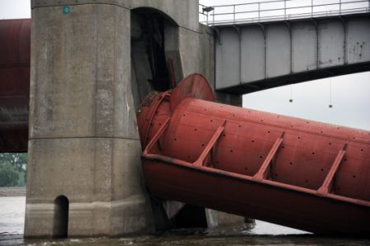
Problem
Aging Mechanical Electrical Systems and structures
“Why”
Lock & Dam 25 Limit Switch Failure

Slide 6
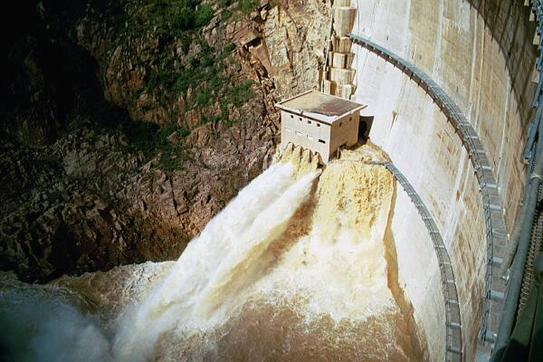
What Can Happen?
South Africa, 2001

Slide 7
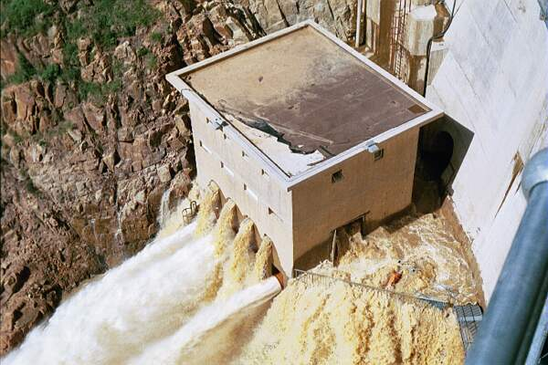
We’ve got a little problem here

Slide 8
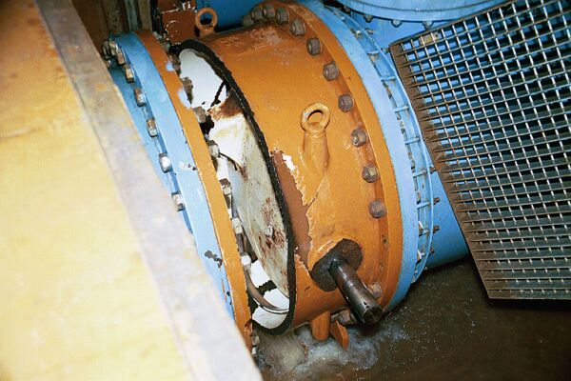
Valve failure

Slide 9
Inspection Essentials
Planning: get familiar with the type of equipment involved prior to the inspection. Review drawing plans and previous inspection reports
Inspection procedure: discuss the inspection procedure you will be performing
Coordinate with other inspection team disciplines
Operate all equipment to the extent possible
Deficiency identification: do not hesitate to bring up an issue or concern you may have with a component
Talk with project personnel
Documentation: document your findings
Notes:
Note that inspection results that yield issues often get funding to correct. Get work in the pipeline to get issues corrected.

Slide 10
Documentation
Describe noted conditions as well as possible
Take photographs for report and historical records
Capture anything that could present a safety, maintenance or operations problem in the future
Make sure to record the location where the deficiency took place
Provide some type of recommendation or “action”. Offer a known solution to the issue if possible.
    Further investigation required by…..
    Continue to monitor condition

Slide 11
Types of Gates
Service Gates
Spillway Gates
Emergency Gates
Maintenance Gates or Bulkheads
Low Flow Gates or Bypass Valves

Slide 12
Electrical Inspection
Distribution Equipment
Some common issues include:
  Age of equipment. Obsolescence; Parts difficult to obtain
  Moisture; Corrosion. Integrity of the enclosures compromised
  Adequate working space; Electrical rooms used as storage rooms

Slide 13
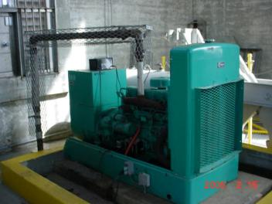
Key Item in Dam Safety
Emergency Power Source
Standby Generator (Inspect and test it)
  Automatic transfer switch (ATS)
  Manual transfer switch
Notes:
Availability and reliability of Emergency Power are the most critical electrical issues relative to Dam Safety effectiveness. The downstream conditions of dams have changed over time, and the lack of control over land use has resulted in undesirable consequences for dam failures, therefore, emergency power requirements may need revision. The importance and location of the dam aid in determining the level of backup and emergency power source required for a specific project.

Slide 14
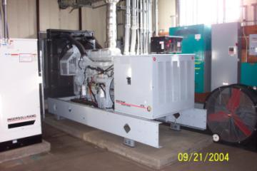
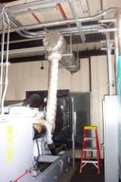
Generator Features
Line side breaker
Control panel
Batteries
Battery charger
Radiator
Exhaust piping
Silencer (muffler)
Fuel piping
Exhaust louvers
Heat resistant shield for muffler
Notes:
Note that exhaust is covered with a heat resistance shield

Slide 15

Generator Inspection
Test the generator under load
Check engine for oil, fuel, and antifreeze leakage
Check engine for proper operating temp, oil pressure, fuel pressure, RPM
Notes:
Simulate a commercial power outage by opening the main disconnect switch. Generator should start in a few seconds. Test the generator under load

Slide 16
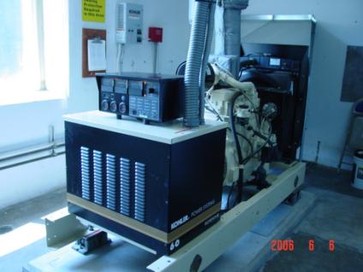
Generator Inspection
Inspect exhaust system (any signs of corrosion or leakage)
Check fuel tank for spill containment and proper venting
Inspect fuel piping for signs of corrosion and leakage
Check operation of cooling air intake and exhaust louvers

Slide 17
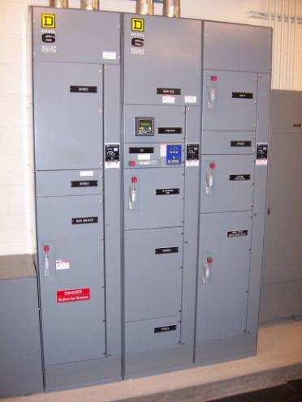
Electrical Distribution Features
Power distribution equipment
  Motor control centers
  Switchgear
  Transfer switches
  Power panels
  Transformers
  Motor starters or controllers
  Wire and cable; feeders

Slide 18
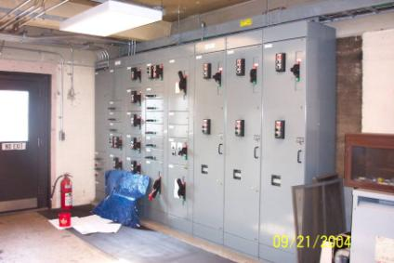
Motor Control Centers (MCC)
Large enclosure to house standard motor control equipment
  Starters
  Drives
  Main and feeder breakers
  Transformers
  Metering
  Transfer switches
  Control devices

Slide 19
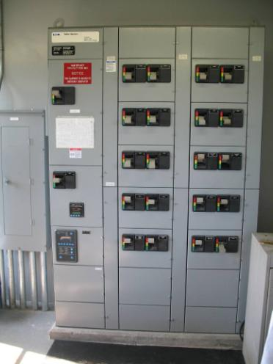
Distribution Equipment
Visual inspection
Note overall condition, age, electrical characteristics
Enclosure integrity
Any evidence of moisture
Missing hardware
Grounding
Are parts still available if needed
Disconnect and circuit identification
Suitable working space
Notes:
Question to ask yourself these questions. Is the enclosure suitable for the environment. (nema rating)

Slide 20
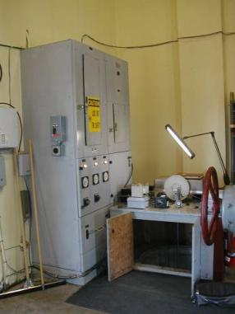
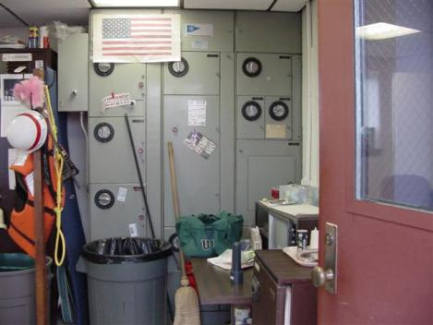
Working Space
Suitable working space?

Slide 21
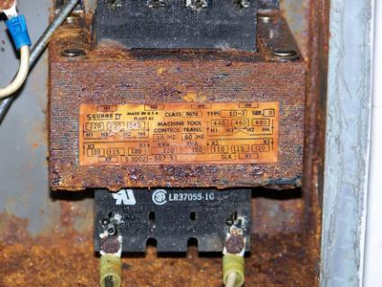
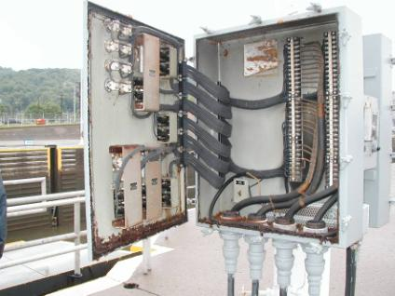
Corrosion
Worst thing that can happen to electrical equipment
Notes:
Insure that electrical enclosures are appropriately NEMA rated for the environment

Slide 22
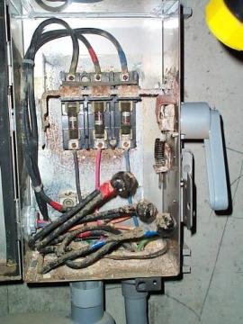
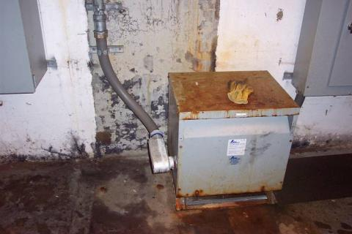
Corrosion
Take note of any electrical equipment that has any evidence of moisture entering the cabinet

Slide 23
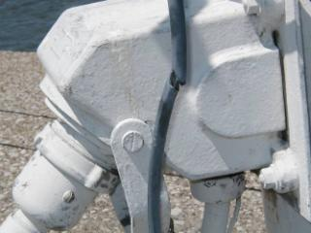
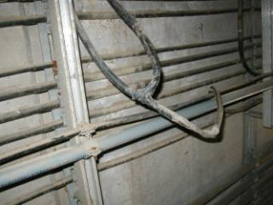
Wire and cable
If cables are to be touched or moved, they should be de-energized
Inspect visually for physical damage
Jacket damage, swelling
Sharp bends
Splices
Weakened or corroded cable supports
Insulation resistance testing (meggering)

Slide 24
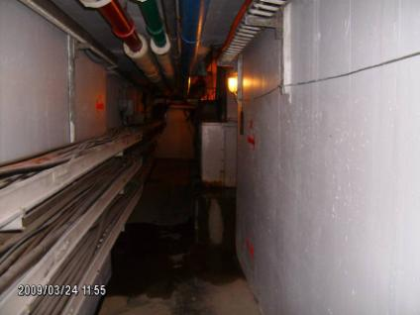
Cable Trays
Insure that cable trays are not overloaded
Trays should be kept free from debris
Check supports
Corrosion
Notes:
Overfilling and improperly securing cable trays is one of the most common issues. Overloded cable trays can result in excess heat when conductors are active and can lead to insulation breakdown.

Slide 25
Mechanical Equipment Inspection
Thinks to check
Electric hoist machinery
Hydraulic operated equipment
Manual operated equipment

Slide 26
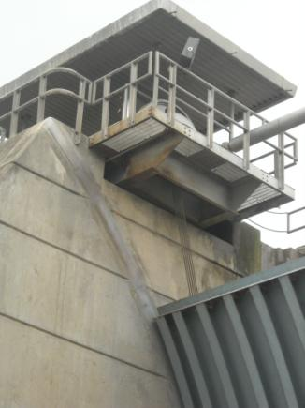
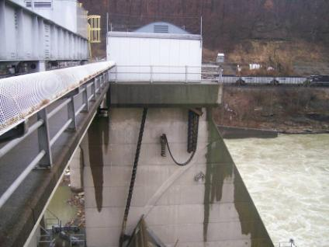
Traditional Spillway Gates
Tainter/Radial Type Some Vertical Lift Type
Electric Hoist Operated
Wire Rope Drive
Roller Chain Drive

Slide 27
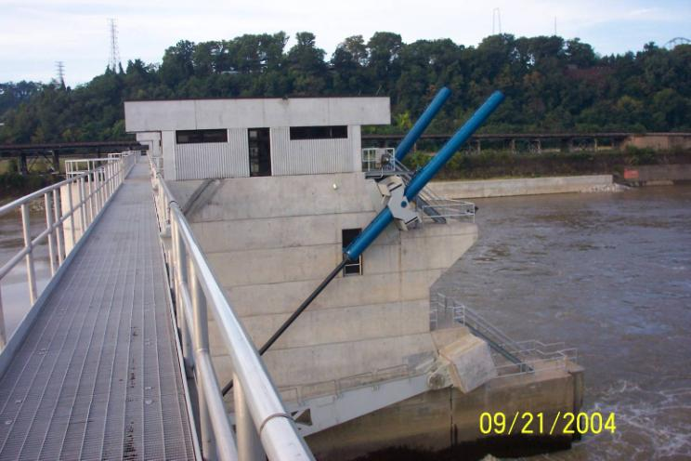
New Technology
Hydraulic Operated Tainter Gates

Slide 28
Service Gates
Located Inside Control Tower or Dam
Three types of lifting systems
Wire rope or chain hoist drive
Hydraulic power unit and cylinder drive
Manual of electric screw actuator drive

Slide 29
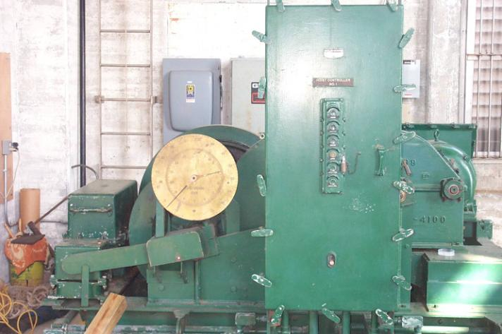
Hoist Type Drive Machinery
Brake Housing
Control Panel
Gate Position Indicator
Limit Switch Assembly
Grenada Lake Intake Tower, MS
Notes:
identify various features. This particular machine operates vertical lift gates.

Slide 30
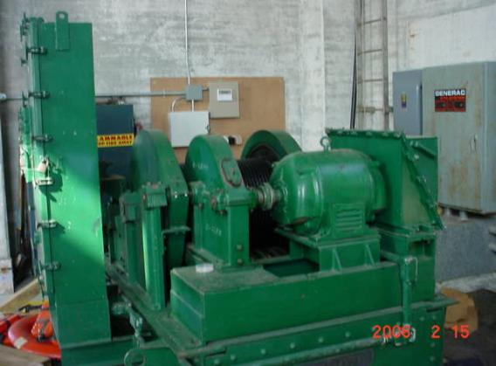
Wire Rope Hoist Machinery
Gearbox
Gate Controls
Drive Motor
Grenada Lake Intake Tower, MS

Slide 31
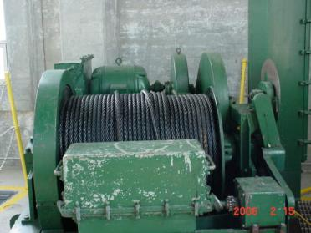
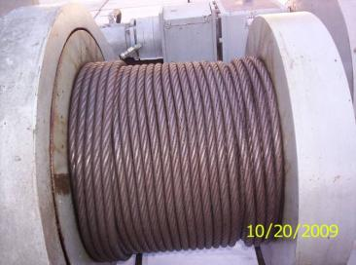
Wire rope
Inspect wire rope for external wear, kinks, corrosion, broken wires within the wire rope
Proper lubrication
Observe operation of hoist for proper spooling or wire rope onto hoist drum
Notes:
What can you tell me about the wire rope shown here??

Slide 32
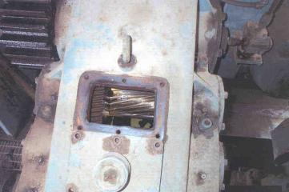
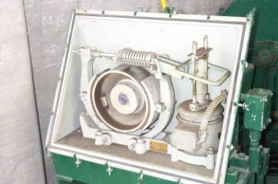
Gear and Brake Assembly
Inspection
Remove inspection cover and look for worn or broken teeth in gear reducer
Remove brake cover and inspect shoes

Slide 33
Hoist Operated Machinery
Recap
Things to look for:
  Check for unusual wear patterns on gear teeth
  Check machinery for loose bolts and keys, worn bearings
  Check gear boxes for excessive temperature or unusual noises during operation
  Check gear boxes for proper level of lubrication oil
  Check gear boxes for oil leakage around gaskets and shaft tubes
  Check shafting for vibration and integrity of shaft couplings

Slide 34
Hoist Operated Machinery
Things to look for:
  Insure all safety shields are installed
  Verify no unusual noises from motor
  Verify proper operation of brake, inspect shoes
  Proper operation of limit switch
  Inspect controller panel wiring, contacts, enclosure, functional heater, age of components
  Insure controls function from local and remote locations

Slide 35
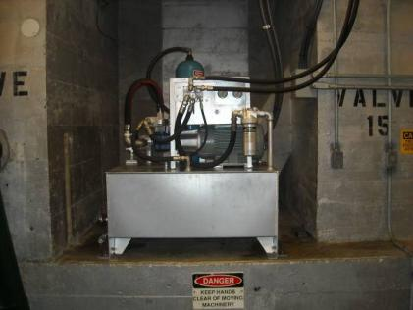
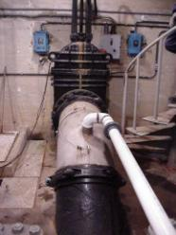
Hydraulic Operated Machinery
Used for:
  Vertical lift gates (Service Gates, Emergency Gates and Low Flow Valves)
  Low Flow Bypass Valve Hydraulic Power Unit

Slide 36
Hydraulic Operated Machinery
  Key components
  Hydraulic Cylinders or Motors
  Hydraulic Lines
  Hydraulic Pump
  Control Valves
  Hydraulic Fluid

Slide 37
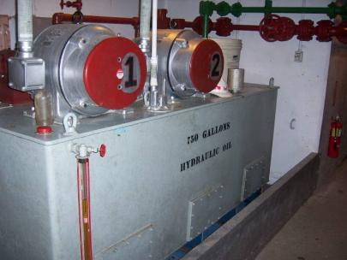
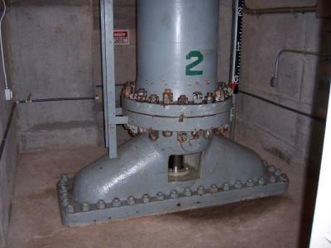
Service Gate Bonnet, Cylinder and Piston Rod
  Hydraulic Power Unit
  Typically two pumps for redundency

Slide 38
Hydraulic Operated Machinery
  Things to Check:
  Hydraulic leaks
  Valves that stick
  Pumps that vibrate or run hot
  Electric motors
  Hydraulic piston rod scoring
  Reservoir fluid level
  Water mixed with hydraulic fluid

Slide 39
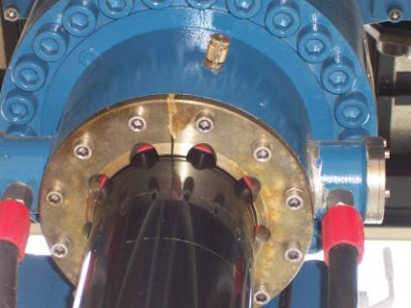
Hydraulic Cylinders
Check anchorage of hydraulic cylinders
Check condition of cylinder rods
Inspect piston rod seals for leakage of hydraulic oil

Slide 40
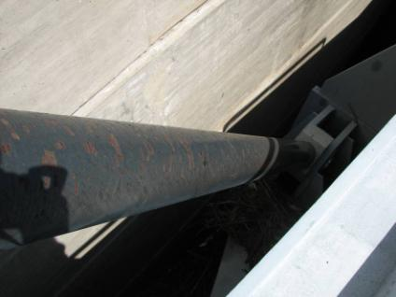
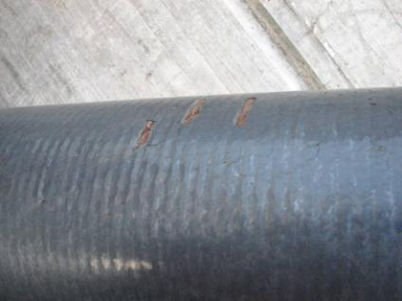
Cylinder Rod Corrosion

Slide 41
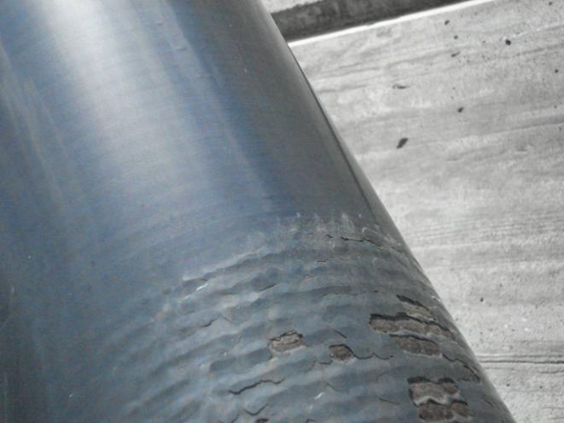
Cylinder Rod Corrosion

Slide 42

Low Flow or Bypass Valve System
  Comprises of small diameter pipe typically 36” diameter and smaller and a valve or gate to control flow.
  Often used with multilevel intake sluice gates for water quality regulation

Slide 43
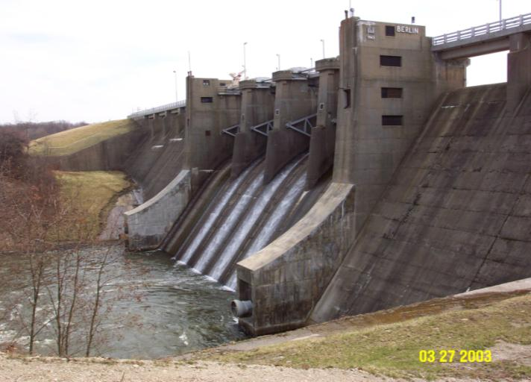
Alternate type of low flow valve
Ring–Jet or Howell-Bunger Valve
Ring-jet valve
Ring-jet valve
Also called Howell-Bunger Valve
Notes:
The outlet works consists of five sluices through the dam. The end sluices are each controlled by a 36-inch ring jet valve. There is an emergency 36-inch ball valve upstream of each ringjet valve. Three center sluices are each controlled by a service 36-inch ball valve and an emergency 36-inch ball valve upstream.
The ringjet valves discharge into the atmosphere, while the ball valves discharge underwater in the stilling basin.
The end sluices with ringjet valves are used for low flow releases, while the center sluices with ball valves are used for larger releases. The ball valves are designed to operate fully opened or fully closed, and the ringjet valves are designed for throttling low flows.
The stilling basin is 564 feet wide including paved areas below the uncontrolled spillway portions. It is 167 feet wide at the bottom. The length of the stilling basin is 83 feet with an end sill that is submerged by the tailwater created by the downstream stilling weir.

Slide 44
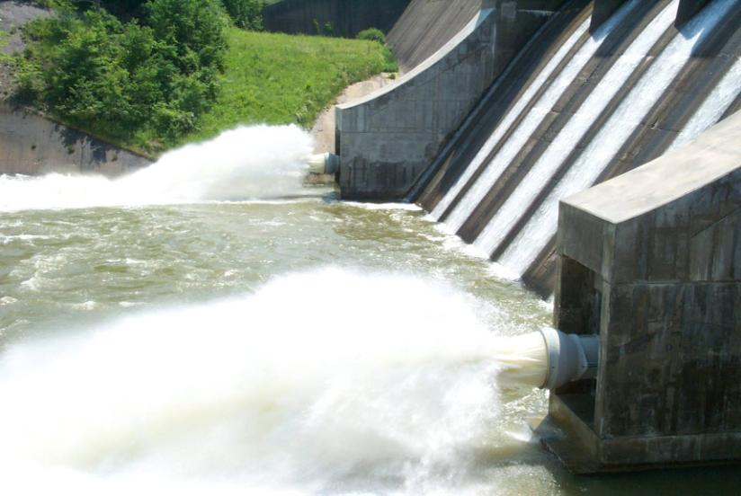
Berlin Dam - general view of ring jet valves.

Slide 45
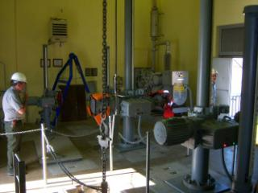
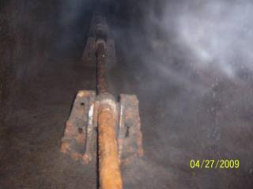
Screw Actuated Slide Gates
Motor operated actuators
Stem, stem guides, and couplings
Torque switches tripping may be related to mechanical issues with the stem guides or gate

Slide 46
Cranes and Hoists
Gantry: intake towers and service bridge
Bulkhead hoists: navigation dams and flood control reservoirs
Jib cranes
Auxiliary cranes: usually provided on the service bridge of a gated navigation dam
  Used for maintenance and for getting equipment up to the service bridge
Notes:
Cranes and hoists are used to lift gates and other heavy equipment at the project. Gantry cranes are mounted on a moving platform to permit use for lifting more than one gate, and are part of the project. Portable, truck-mounted, or barge-mounted, cranes are used for smaller projects, or to permit the use of one crane for multiple projects.
Stoplogs may be used for operation under water flow, or may be sized for use only as safety backups for maintenance or repair of gates, after the water flow has been restricted,… as are bulkheads.

Slide 47
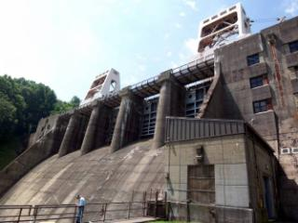
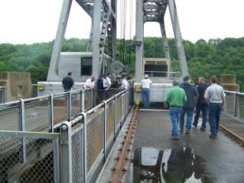
Gantry Cranes
Cranes shown here used to lift crest gates when needed

Slide 48
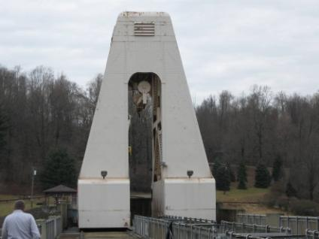
Gantry Cranes
Check dogging mechanism for lubrication, wear, functionality
Motors, brakes and controls
Drums and sheaves for excessive vibration or unusual noises
Make sure wire rope is spooling properly on drum
Check wire rope for wear, broken strands, lubrication
Examine trolley wheels and rails for wear and misalignment
Notes:
Loyalhanna flood control reservoir. Motor bearing noises….

Slide 49
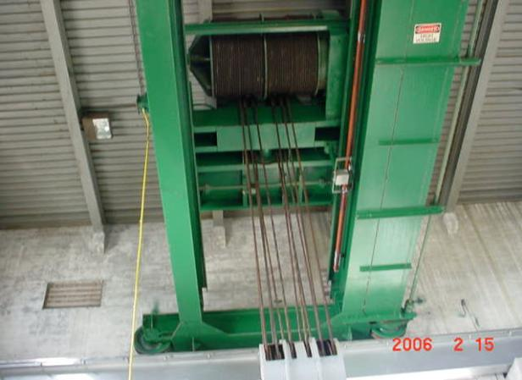
Grenada Lake Intake Tower
Over head Hoist
Gantry Crane

Slide 50
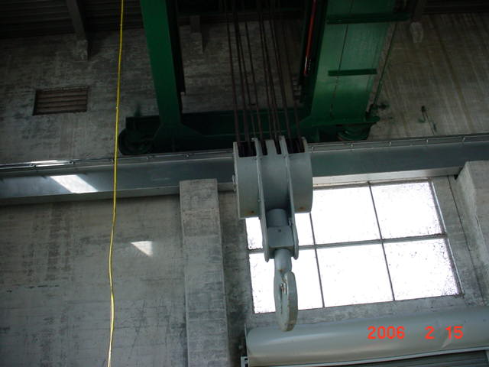
Grenada Lake Intake Tower
Gantry Crane
Hook

Slide 51
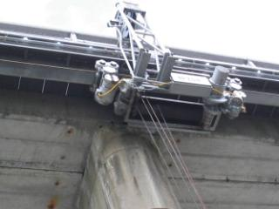
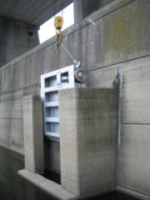
Monorail Hoist
Used to place bulkheads
Bulkheads placed for maintenance or emergencies due to inoperable valves or gates
Notes:
Shenango 10 Ton monorail hoist

Slide 52
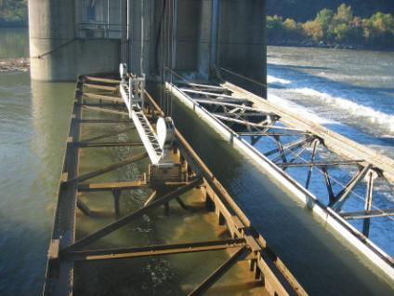
Bulkhead Hoist
Observe the hoist operation and placement of bulkheads
Once bulkhead is placed, raise gate to see how the bulkhead seals.

Slide 53
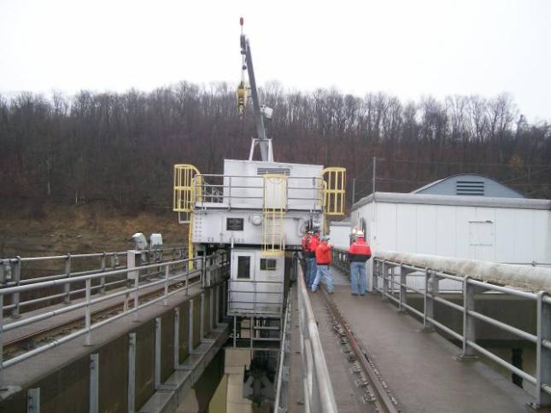
Bulkhead Hoist with
Auxiliary Crane

Slide 54


Jib Crane
Jib crane lifting a maintenance bulkhead
Notes:
Control tower showing three intakes with horizontal screen bars. Note the wall mounted jib crane.

Slide 55


Auxiliary Crane
Things to check:
Operate crane through all functions (hoist, travel, boom, rotate)
Verify operation of travel alarms
Inspect hook blocks for wear and free rotation of hook
Insure hook safety latch is operable
Verify proper operation of all limit switches including anti two-blocking device for the hook block
Check hydraulic system

Slide 56

Sump pumps
Used to remove internal seepage that is collected in drains within the dam
Check operation of sump pumps
Manually trip the float switches
Usually provided with high water alarm
Corrosive area

Slide 57
Thank You…..
Any Questions ?
Notes:
3
Thanks for your attention and interest in this presentation. I welcome questions at this time, but, additionally, if you have any questions later - or even after you return home - please don’t hesitate to call me at 412-395-7268, or send me an email to john.nites@usace.army.mil.

