Slide 1
Dam Break Analysis and Mapping
Jerry W. Webb, P.E., D.WRE
Principal Hydrologic & Hydraulic Engineer
Hydrology, Hydraulics & Coastal Community of Practice Leader
US Army Corps of Engineers, Headquarters
Jerry.w.webb@usace.army.mil
Dam Safety Workshop
Brasília, Brazil
20-24 May 2013

Slide 2
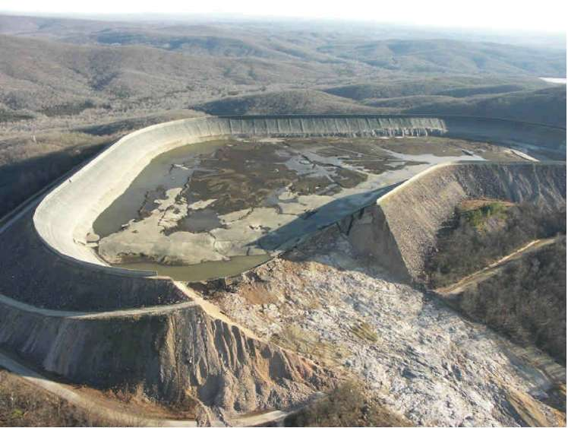
Contents
General
Modeling
Mapping
Notes:
General – Failure can be caused by a variety of problems. Geotech, structural, Manmade, Hydrologic,

Slide 3
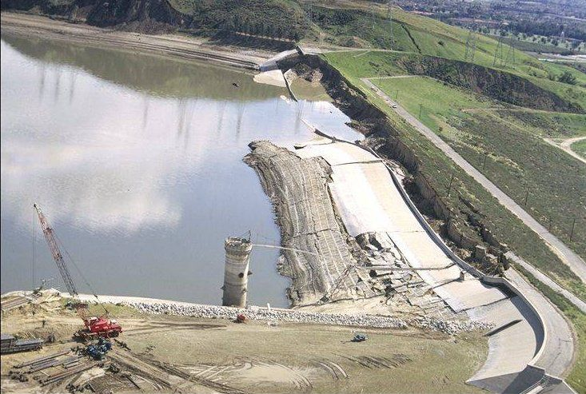
Geotechnical Problems
Notes:
Type of potential hazard

Slide 4
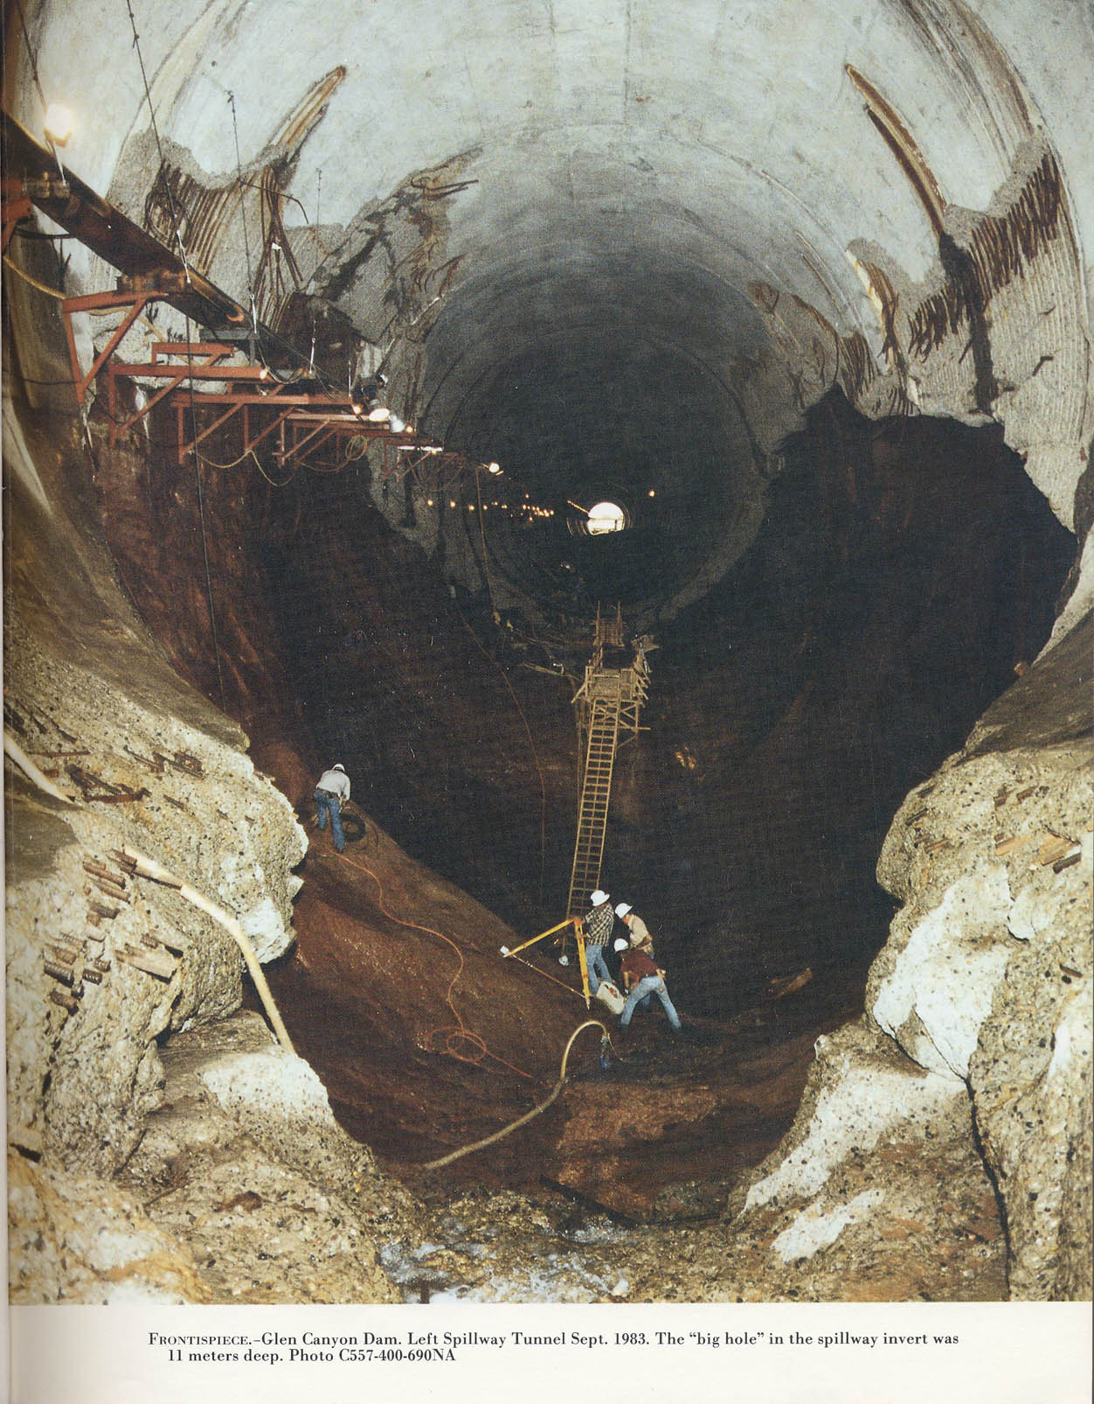
Spillway
Notes:
Glen Canyon Dam
The dam has two huge spillways, one on each side. These are 41 feet in diameter, and have a capacity of 104, 000 cubic feet per second each. There are 4 outlet valves connected to 8-foot outlet tubes designed to discharge water around the power plant. Water can also be released through a tunnel once used to divert water during construction of the dam.
This system was put to the test in 1983 when a late regional winter storm system increased the snow level by 200% of normal, then began to melt quickly. Lake Powell was already at a high level, so water needed to be released to make room for the heavy snow-melt. Even with the dam wide open, the lake continued to rise for weeks but was eventually controlled. Because of the high run-off that year, all the Colorado River dams released excess water causing some flooding downstream on the lower portions of the river.

Slide 5
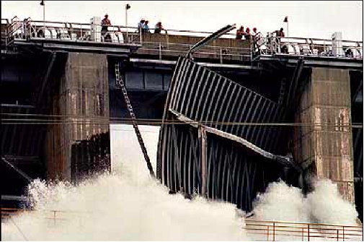
Accidental Failure
Notes:
Folsom Dam on the American River about 20 miles upstream of Sacramento. On July 17, 1995 a gate failed during testing. About 35,000 cfs was released through the broken gate into the American River. This was over 10 time the normal summer flow in the river. No deaths were reported.

Slide 6
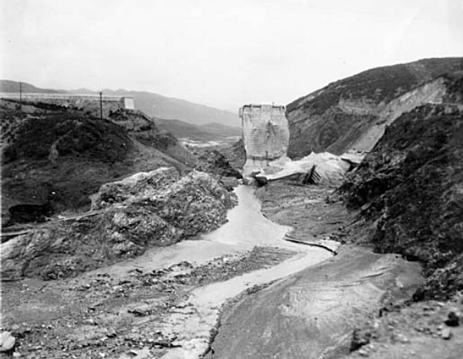
Complete Failure
St Francis Dam, Ca
Johnstown, Pa
Kaloko Dam, Kauai, Hi
Teton Dam
Notes:
Type of potential hazard
St Francis Dam failed in 1928 Dam. Designed by Mulholland. Over 100 died
Teton Dam failed June 5 1976. 11 Deaths
Johnstown, Pa failed May 1989. 2200 deaths
Kaloko Reservoir on Kauai, March 2006. 7 Dead

Slide 7
Dam Failure Modeling
HEC-HMS
Modeled within Context of Watershed
HEC-RAS
Dynamic Routing
Capture the Hydraulic Implications of the Failure
Model Floodplain
Notes:
Dam failure can be modeled in RAS or HMS

Slide 8
Downstream Considerations
HMS
Hydrologic Flow Routing
Better for Medium to very Steep Slopes
RAS
Hydrodynamic Routing (Very flat to steep slopes)
Possible stability issues on very steep streams
Generate Floodplain
Damages
Emergency Planning
FERC
Notes:
Each of the programs have different routing capabilities. With HMS, routing within the model is accomplished with hydrologic modeling as opposed to dynamic modeling in RAS. HMS may be better if slopes are steep but if downstream tailwater impacts are important, RAS can automatically handle this situation.

Slide 9
HMS Overall Concept
Calculate hydrograph at a location downstream from the reservoir, given that a breach develops in the dam.
Dam breaches happens within the larger context of the watershed:
Prevailing conditions in the soil, stream channels, and reservoir pool at the beginning of the simulation.
Meteorologic conditions before, during and immediately after the breach initiation.
Notes:
The lecture is intended to review the Hydrologic Modeling System (HEC-HMS) users who have previous experience with the program. It briefly covers the basics of the program including how a project is organized, the program layout, main components, and modeling elements. More detail is provided on the subbasin and reach elements since these are key to computing inflow to a reservoir. Even more detail is provided for the reservoir element that is the focus of dam safety studies.

Slide 10
Initial Model Development
Basin model with subbasins, reaches, and junctions.
Diversions and reservoirs with normally operating outlet structures.
Assemble simulation run and compute it to make sure everything is working correctly.
Calibrate the model using historical storms with greater emphasis on matching large events.
Notes:
The initial model development proceedes in much the same was as the development of a hydrology model for general use. The watershed must be delineated and then the subbasins as well. Within HEC-HMS, subbasins, reaches, and junctions should be configured to represent the channel network. Engineered structures such as diversions and reservoirs must also be added. The normally operating features of diversions should be specified, such as physical dimensions of a lateral weir. Features of a reservoir must also be specified such as outlets, spillways, etc.
Create a simulation run and compute it to make sure all data is entered correctly. Next, the basic model must be calibrated. Calibration can proceed as for any other hydrology model. Collect precipitation data (and possibly snowmelt data) for several storms from the historical record. Where ever possible, collect observed flow data as well. Use several storm events to calibrate the loss rate, unit hydrograph, and baseflow parameters in the subbasins. Select appropriate routing methods in the reaches and calibrate the parameters. Try to verify that the configuration of any diversions or reservoirs reproduces the observed operations.

Slide 11
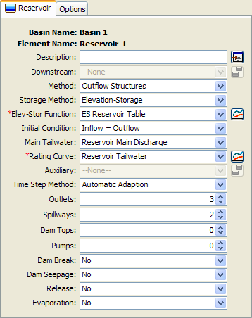
General Reservoir Data
Outflow structures routing method with elevation-area or elevation-storage curve.
Include any spillways, outlets, overflows, or other structures that operate normally.
Multiple basin models with all elements and data the same including the base condition reservoir.
Separate basin model for each alternative.
Alternatives for no break, different break scenarios.
Notes:
Because we are focusing on a dam break analysis, the focus of much of our efforts after calibration will be the reservoir element. We must use the “Outflow Structures” routing method in order to use the dam break simulation tool. This method requires that the storage capacity of the reservoir be described using an elevation-area or elevation-storage curve. Be sure that the curve extends from the bottom (including any dead storage) past the top of the dam. It is not enough to bring the curve up to the emergency spillway elevation. The curve will need to extend up to the highest surcharge elevation that will be reached during a simulation.
Add structures to the reservoir as appropriate. Likely you will need outlets and spillways (with or without gates) and possibly dam tops or pumps. The physical properties for each structure must be entered. The best place to find this information is the reservoir regulation manual.
Begin with the calibrated basin model, including the reservoir with all normally operating structures. Usually we will make several copies of the basin model. Each one will have a dam break added to it, with slightly different breach parameters in each model. The results obtained with each different basin model will represent different break scenarios.

Slide 12
Dam Break Assumptions
Water surface in the pool behind the dam is level before, during, and after the break.
Horizontal velocity in the pool is close to zero.
Total head is equal to gravity head.
Discharge from the breach enters the downstream channel.
Implications:
Water supply to the break may be overestimated, especially if the reservoir is long and narrow, or the break forms quickly.
Velocity of water though the break may be under estimated, causing underestimate of breach flow rate.
Best use:
Reservoirs with large capacity compared to inflow volume.
Reservoirs that are not long and narrow.
Notes:
A number of assumptions are made in the dam break module included in the HEC-HMS reservoir element. The most significant is that the water surface behind the dam is assumed to be level before, during, and after the breach forms. This is generally only true for small reservoirs. In large reservoirs, water cannot reach the breach fast enough to maintain a level surface and instead a sloped surface forms.
Along with the level pool elevation is the assumption of nearly zero horizontal velocity. This implies the next assumption which is that the total head of the water in the pool is equal to the gravity (or elevation) head. In reality, if the pool surface is sloped then horizontal velocity will be greater than zero and the total head will include both a gravity and velocity component.
All discharge from the breach is assumed to enter the downstream channel. Some reservoirs may be such that when a dam or dike fails, the discharge spreads out over the land surface until it eventually enters a stream channel. Situations such as these require a different software tool.
Overall these assumptions mean that HEC-HMS is bested suited to simulating reservoirs where a sloping water surface does not develop. Also, that the breach opens at a rate slow enough to match the draw down capacity of the reservoir.

Slide 13
Breach Parameters
Overtop or piping mode.
Extra parameters only required for piping.
Piping elevation: elevation where the piping hole opens.
Piping coefficient: coefficient for orifice flow through the piping hole.
Define ultimate size of the break.
Top elevation: elevation at the top of the break.
Bottom elevation: elevation at the bottom of the break.
Bottom width: width at the bottom of the break.
Left/right side slopes: side slopes of the break opening in the dam face.
Define the development time.
length of time required for break to grow from initiation to ultimate size.
Use the "critical" time, which begins with significant outflow and ends when the breach stops growing significantly.
Reservoir may still contain a large volume of water when breach stops growing.
Notes:
The main parameter for a dam break is whether the breach forms as an open-top trapezoid due to overtopping, or like a conduit due to piping. HEC-HMS does not physically model either development mode. Instead parameters from external sources are entered to describe the shape of the breach as it opens and the rate at which it opens.
The ultimate size of the breach must be described. This is the size that is expected when for all practical purposed the breach has stopped growing. Remember that the breach may stop growing because the entire dam is eroded or because the reservoir is drained and there is no more water to erode the dam. Both failure methods require the top elevation, usually taken as the top of the dam. The bottom elevation is the point where the dam will stop eroding, usually either bedrock or the bottom of the reservoir pool. The width at the bottom elevation must also be specified. Finally the left and right side slopes must be entered; they are not required to be equal to each other.
After defining the maximum size of the dam break, it is necessary to define when the break initiates and how long it takes for the breach to open to the ultimate size. The development time defines the length of time from first meaningful flow through the breach, to reaching the ultimate size. Often dams begin to fail and evidence of the impending failure is visible. This time should not be included in the development time; only include the time after flow actually begins through the breach.
If the bottom elevation of the breach is above the bottom of the reservoir, then there may be dead storage that does not leave the reservoir.

Slide 14
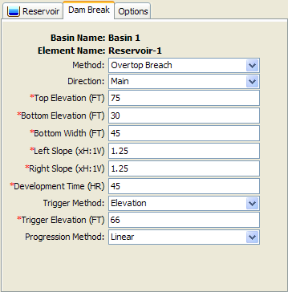
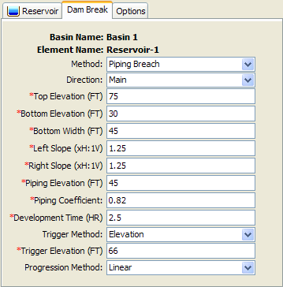
Breach Parameters
Notes:
Picture of the dam break editor in HEC-HMS. Navigate to the editor by clicking on the reservoir element in the Watershed Explorer or in the Basin Map. Next expand the reservoir node in the Watershed Explorer and click on the Dam Break sub-node. Depending on the method (overtop or piping) the appropriate data entry fields will be shown.

Slide 15
Breach Initiation
(Option 1) Duration at elevation: the break initiates when the reservoir pool elevation exceeds a specified elevation for a required amount of time.
Trigger elevation.
Duration requirement.
(Option 2) Elevation: the break initiates as soon as the reservoir pool elevation reaches a specified elevation.
Trigger elevation.
(Option 3) Specific time: the break initiates at a specified date and time regardless of the pool elevation.
Trigger date.
Trigger time.
Notes:
At this point, you have defined the ultimate size of the breach and the length of time necessary for the breach to develop. It is necessary to define when the breach will initiate during the simulation. One option is to specify the length of time the reservoir pool elevation must remain above some threshold. This information may be the result of a detailed geotechnical investigation into the dam itself. A second option is to specify a pool elevation; the breach begins to open as soon as the elevation is reached. The final option is a specific time during the simulation regardless of the pool elevation.
The second option is used frequently during a PMF study. A simulation will be performed without dam break. Use this simulation to determine the maximum pool elevation reached. This elevation can then be used as the trigger elevation in order to maximize the volume of water that contributes to the dam break. The third option can be used to try and match historic data of an actual dam failure, or to consider what-if scenarios during forecasting operations.

Slide 16
Breach Progression
Progression defines the rate at which the break grows from the initial size to the ultimate size.
(Option 1) Linear.
The break grows at a single uniform rate for the development time duration.
(Option 2) Sine wave.
The break grows at a variable rate defined by the first quarter of a sine wave.
(Option 3) User curve.
Specify a curve that gives the percentage of the break growth versus percentage of the development time duration.
Development time increases linearly.
Notes:
The development time of the breach describes how long it takes for the full breach to form. The breach initiation controls when the breach starts to form. Progression describes how the rate at which the breach grows during the development time.
The simplest progression is linear and means that the breach grows at a uniform rate. Consider a development time of 2 hours and a control specifications time interval of 15 minutes. The breach will develop over 8 time steps. For each time step, the breach will grow by 1/8 of the ultimate breach opening.
The sine wave progression results in a breach that initially grows very quickly then slows down towards the end of the development time. You can define your own growth pattern using a percentage curve in the paired data manager. That curve defines the percentage of breach growth as a percentage of the development time.

Slide 17
Tailwater Condition
In general, submergence affects must be included when computing flow though a breach.
(Option 1) None.
Only valid if the bottom of the breach is always above the water surface in the tailwater.
There is almost always at least some affect due to tailwater, especially when the breach is at its ultimate size.
(Option 2) Reservoir outflow plus rating curve.
Generally valid when the reservoir is the only source of flow to the tailwater.
(Option 3) Downstream flow plus rating curve.
Required when other elements contribute flow to the tailwater.
(Option 4) Specified stage.
Only when the reservoir release is small compared to the total downstream flow, and the downstream flow is known.
Usually not applicable in dam break scenarios.
Notes:
Tailwater condition is used to describe the depth of water immediately downstream of the dam and affecting how much water flows through the breach. The affect of tailwater is to reduce the flow through the breach, since physically the flow is partially blocked by the presence of dowstream water. For a high dam, it may be possible that the bottom of the breach always remains above the tailwater. However, this situation is very rare. There are virtually no cases where the modeling of tailwater can be ignored.
The most common way to model tailwater is to compute the depth using the reservoir outflow and a rating curve. The curve could be developed using stream measurements. However, the outflow during a dam failure will be significantly larger than previously observed flow. You should consider using a hydraulics model to extend the rating curve. HEC-HMS will not extend the curve for you; you must specify it to the maximum flow that will be discharging from the reservoir.
In some cases there are contributions to the tailwater from other locations besides the reservoir. In these cases the reservoir flow must be added to the additional inflow before applying the rating curve. This might be the case if the reservoir discharges into a river as a lateral inflow.
In some rare cases, you may be able to use a specified tailwater stage using a time-series gage. However, this can only be done if the reservoir discharge will have a minimal affect on the tailwater stage. This is rarely the case in dam failure studies.

Slide 18
Limitations
Long and narrow reservoirs that will develop a non-level water surface after the breach initiates.
Failures where the breach discharge is diffuse instead of into a well-defined channel.
Downstream reaches with small slope and/or channel geometry that leads to complicated routing.
Levee overtopping and failure.
Backwater storage in tributaries.
Stage estimates are generally not reliable enough to support floodplain mapping.
Notes:
There are several limitations to the dam break modeling in HEC-HMS that must be considered. If any of these are a factor in a project, then it may be necessary to consider a hydraulic model.
Reservoirs with a long, narrow pool usually develop a sloping water surface during a dam breach. The assumptions in HEC-HMS are for a level pool. Breaks that develop faster than the reservoir can draw down may also be a problem; these situations also lead to sloping water surface in the pool. In both of these cases, the HEC-RAS program can be used since it considers a non-level pool in the reservoir.
Dam breaks are usually envisioned to happen on dams across a river. However, some reservoirs are situated in relatively flat topography and have one or more dikes to contain the storage pool. This dikes are not immune from failure and should be evaluated. Often, failure of a dike leads to discharge that is diffuse across the land surface. This situation may require a two-dimensional hydraulics model.
You may not be able to use HEC-HMS if the downstream reaches lead to complicated routing. For example, high stages resulting from the dam break may overtop levees; the program does not explicitly represent levees. Also, the program cannot model backwater and significant volume may be temporarily stored in tributaries.
The stage estimates from downstream routing within HEC-HMS are generally not good enough for floodplain mapping. If you require floodplain maps then you will need to do the downstream routing using HEC-RAS.

Slide 19
Dam Break Analysis in HEC-RAS
Failure Modes
Overtopping and Piping
Failure Initiation based on:
stage
simulation time
stage + duration, and immediate initiation stage.
Breach progression
linear or nonlinear (user specified)
New Simplified Physical Breaching Option
User Input Data:
Max breach bottom width, final bottom elevation, development time, failure initiation mode and value, growth progression method, right and left side slopes.
Notes:
HEC-RAS can be used to model both overtopping as well as piping failure breaches for earthen dams. Additionally, the more instantaneous type of failures of concrete dams (generally occurring from earthquakes) can also be modeled. The resulting flood wave is routed downstream using the unsteady flow equations. Inundation mapping of the resulting flood can be done with the HEC-GeoRAS program (companion product to HEC-RAS) when GIS data (terrain data) are available.

Slide 20
HEC-RAS Breach Locations
Reservoir
(Storage Area)
Elev
vs.
Vol
Dam
(Inline Structure)
Levee
(Lateral Structure)
Notes:
The formation of a breach can be simulated in two types of structures: inline and lateral. The parameters and hydraulic computations for the breaches are the same. A reservoir is usually modeled as “inline”; that is, its geometry is described with cross sections. This allows dynamic routing of the flood wave through the reservoir.
Alternatively, the reservoir can be described as a “storage area” for which the geometry is described by an elevation-volume relationship. Level-pool hydrologic routing within the reservoir is done for this situation. (See Goodell¹)
There must be at least two cross sections between the storage area and the dam. The first cross section is associated with the storage area and the second is associated with the inline structure that represents the dam. These two cross sections should be large, “reservoir-sized” cross sections.
A lateral structure may be a levee that overtops and does not fail, or possibly fails (depending on user input data). The levee is connected to a neighboring reach or storage area.
¹Goodell, Christopher R. “Dam Break Modeling for Tandem Reservoirs – a Case Study using HEC-RAS and HEC-HMS,” Presented at the ASCE World Water & Environmental Resources Congress 2005, EWRI, Anchorage, AK, 15-19 May 2005.

Slide 21
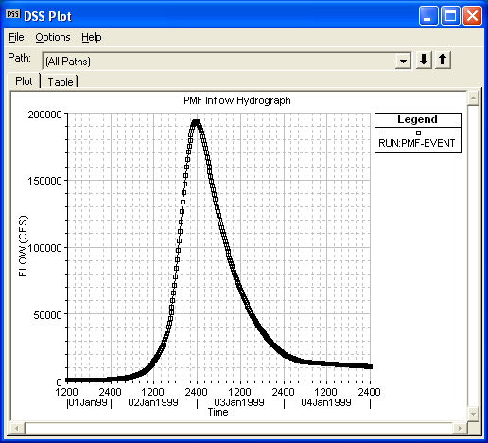
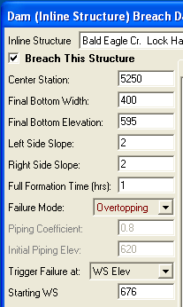
Extreme Conditions Events
Modeled with the “Overtopping” or “Piping” Failure Modes in HEC-RAS
Extreme Rain-Induced Flood Events
PMF
100 yr, 200 yr, 500 yr, etc…
Upstream Dam Failure
Land Slide Mega-Tsunami
Vajont Dam, Italy
Notes:
Most dam failures occur during some type of event that has caused a significant rise in the water surface elevation behind the dam. When performing an analysis of a dam for evaluation of the risks and uncertainties associated with the dams failure, generally extreme events, such as the PMF are analyzed. If the Dam is considered to be a “High Hazard” dam, meaning there is a population at risk downstream if the dam were to fail, then the PMF is considered to be the design event for the dam. If the dam is not considered to be a “High Hazard” dam, then often a smaller event is considered to be the design event, such as ½ the PMF, or even lower depending on the type and location of the dam.
Other types of events can also cause dam failures, such as the failure of an upstream dam, or a landslide that occurs above the dam. It is also good to look at other lesser events, such as the 100 year event, which may still be a very significant event for many dams.

Slide 22
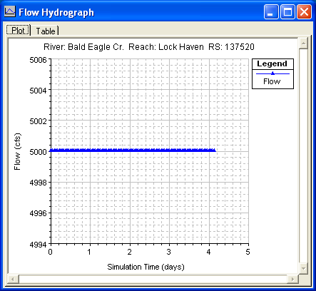
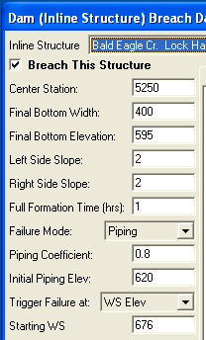
Sunny Day Events
Modeled with the “Piping” or “Overtopping” Failure Mode in HEC-RAS
Abutment or embankment failure
Teton Dam
Outlet Works Malfunction
Gate stuck in Closed Position
Debris
Slides
Embankment
Reservoir
Earthquakes
Planned Removal
Acts of War/Terrorism
Notes:
Many Dams have also failed while there was no significant hydrologic event occurring. These are called “Sunny Day” failures. Generally, when we think of Sunny Day Breach events, we think of piping failures such as occurred at Teton Dam. These typically begin with small leaks through the embankment, usually because of poor design/placement of soils. The leaks quickly erode material on the downstream face of the dam. The rate of breach development can be alarming as more and more soil is eroded from within the dam. Finally the crest of the dam slumps into the void, creating a wedge –shaped opening n the embankment. Sunny Day events are usually not associated with a particular flood event, although the increase in pool elevation resulting from an incoming flood wave could produce enough head on a weak point in the dam to induce piping. Other sunny day events include embankment slides, earthquakes (liquefaction, crest slumping, uplift), planned removal and demolition, and acts of war.

Slide 23
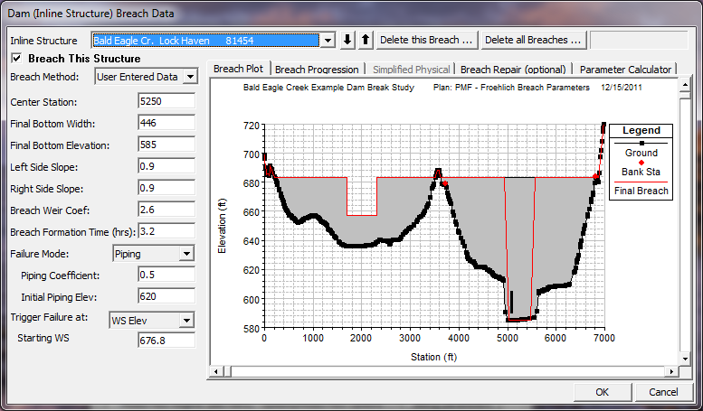
Dam Breach Data
Notes:
Center Station - This field is used to enter the cross section stationing of the centerline of the breach.
Final Bottom Width - Bottom width of the breach when it has reached its maximum size.
Final Bottom Elevation - Bottom elevation of the breach when it has reached its maximum size.
Left Side Slope - Left side slope for the trapezoid that will represent the final breach shape. Side slopes are entered in values representing the horizontal to vertical ratio.
Right Side Slope - Right side slope for the trapezoid that will represent the final breach shape. Side slopes are entered in values representing the horizontal to vertical ratio.
Breach Weir Coefficient –Weir coefficient used for overtopping (weir) flow in the breach area.
Failure Mode - This option allows the user to choose between two different failure modes, an Overtopping failure and a Piping failure.
Piping Coefficient - If a piping failure mode is selected, the user must enter a piping coefficient.
Initial Piping Elev. - If a piping failure mode is selected, the user must enter an initial piping elevation.
Trigger Failure At - This field is used to select one of two trigger methods for initiating the breach. The two trigger methods are a water surface elevation or a specific time and date.
Starting WS - If the user selects water surface elevation for the failure trigger mode, then this field must be entered. This field represents the water surface elevation at which the breach should begin to occur.
Start Date - If the user selects a starting date and time as the failure trigger mode, then this field must be entered. This field is used to enter the date at which the breach will begin to occur.
Start Time - If the user selects a starting date and time as the failure trigger mode, then this field must be entered. This field is used to enter the time at which the breach will begin to occur.

Slide 24
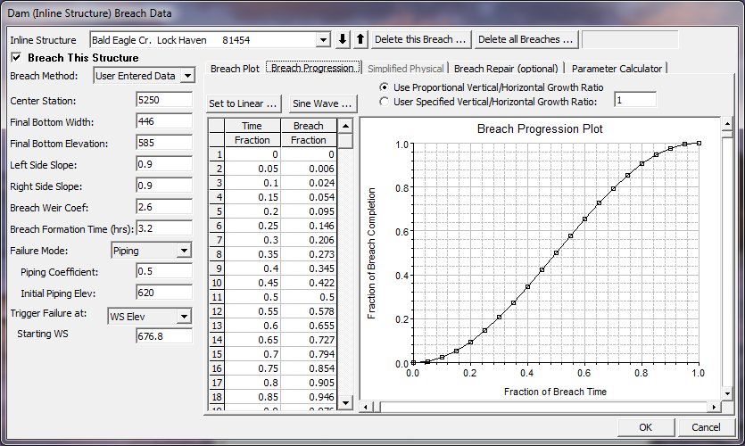
Non-Linear Breach Growth
Notes:
By clicking on the Breach Progression button, the above editor will be shown. By default, the breach growth is assumed to be linear from start to maximum size (Full Formation Time). However, a non-linear breach growth curve can be entered. This is done by entering a Time Fraction (from zero to 1.0) and a Breach Fraction (from zero to 1.0). The user-entered data is plotted in the graphic next to the table. The breach progression curve is then used during the breach formation time to adjust the growth rate of the breach.
In addition to adjusting the curve in order to have a more realistic breach growth, the curve can sometimes be used in order to improve stability. If the program is having stability problems during part of the breach growth, the rate of growth during that time can be reduced by adjusting the curve.

Slide 25
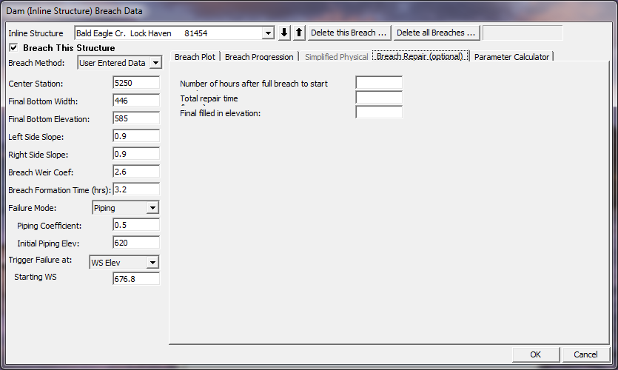
Breach Repair Option
Notes:
This option allows the user to have the breach fill back in during a simulation. This would most often be used for levee breaches, but could also be used for a dam breach if the user were running a long term simulation or if it was assumed that some effort would be put in place to fill a breach back in during a failure.
The Breach Repair Option requires the user to enter three pieces of information:
Number of hours after full breach to start repair: This field is used to enter the amount of time (in hours) it takes to start the repair process after the breach has occurred.
Total repair time (hours): This field is used to enter the total amount of time that it will take to perform the breach repair, in hours.
Final filled in elevation: This field is used to enter the top elevation of the final repaired breach.

Slide 26
Model Output
Cross Section, Profile, and XYZ Plots
Stage and Flow Hydrographs
Tabular Output
General Profile Plots (i.e. velocity)
GIS Export of Results
Notes:
Several plots and tables are available for evaluating the results of a dam break analysis within HEC-RAS. Graphics include cross section, profile, and 3 dimensional plots, all of which can be animated on a time step by time step basis in order to visualize the propagation of the flood wave. Hydrographs can be viewed at any location for which the user requested hydrograph output. Additionally the user can view Tabular output, general profile output, and export the results to the GIS for Inundation Mapping.

Slide 27
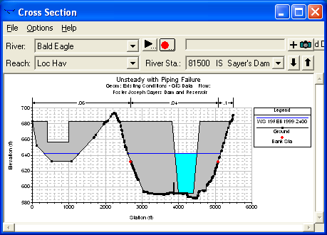
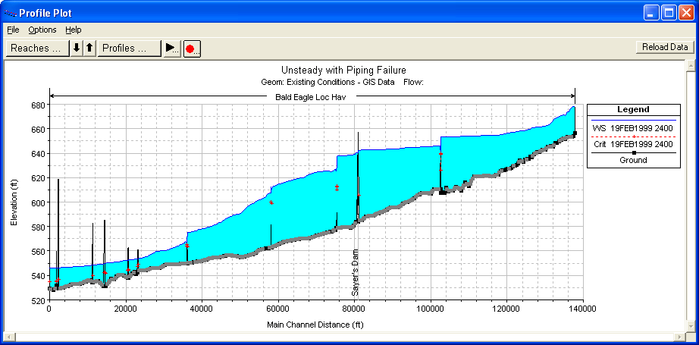
Cross Section and Profile Plots
Notes:
An example cross-section plot of a dam while it is breaching is shown in the Figure above. Additionally, the corresponding water surface profile for the same instance in time is shown in the profile plot above.

Slide 28
Example Dam Break Animation
Notes:
Under the animation option in HEC-RAS, an animation of the profile plot or the cross section plot can be written out as an AVI.

Slide 29
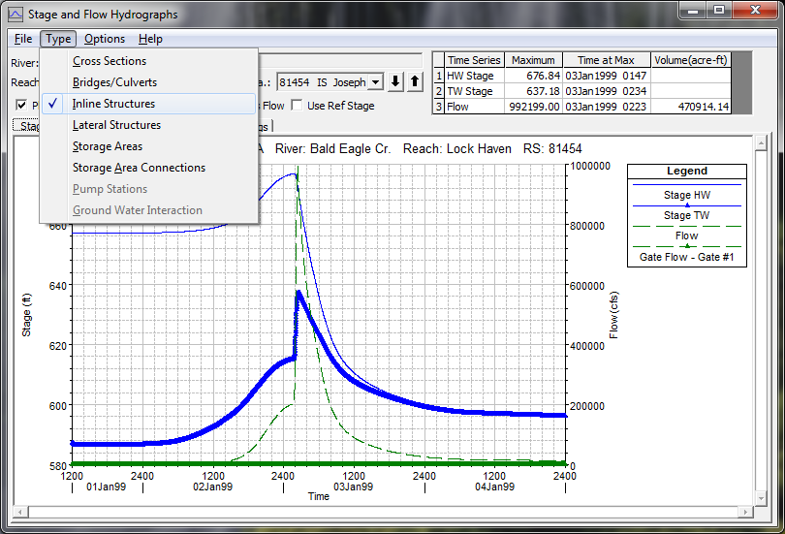
Stage and Flow Hydrographs
Notes:
Stage and flow hydrograph plots can also be viewed for normal cross section locations, as well as bridges/Culverts and the Inline Structure itself. Shown above is an example plot of the Stage and Flow Hydrographs for a dam )Inline Structure). Note that Peak flow, stage, and volume statistics at the top of the plot.

Slide 30
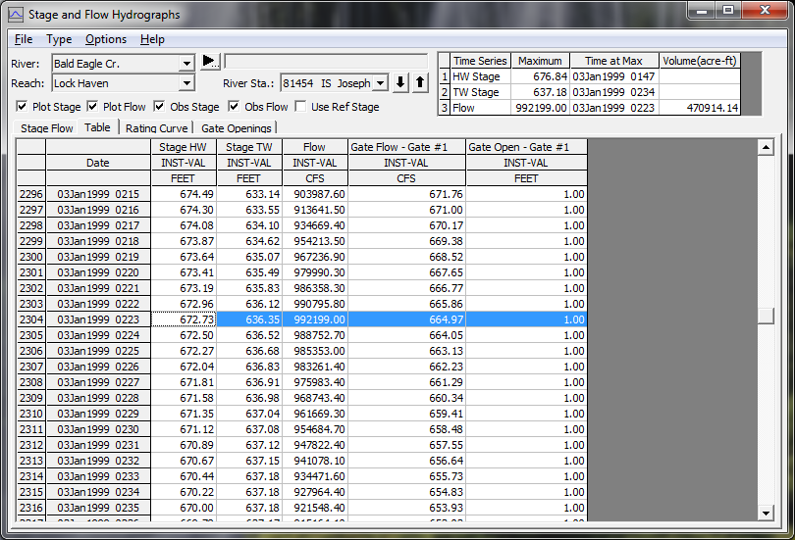
Tabular Time-Series Output
Notes:
A tabular view of the hydrographs on a Stage and Flow plot can also be viewed by simply pressing the Table tab on the window.

Slide 31
Dam Break Modeling Issues
Breach Parameters and Floodwave Propagation
Computational Time Step
Cross Section Spacing and Hydraulic Table limits (HTAB parameters)
Roughness Coefficients
Storage Issues
Bridges and Culverts
Levees
Notes:
Modeling a Dam Break flood wave is one of the toughest unsteady flow models to put together and get stable model simulations. The user must pay close attention to the following issues:
Dam Breach Parameters
Cross section spacing and Hydraulic Tables Properties
Computation time step
Roughness Coefficients
Downstream Storage
Bridges and Culvert crossings
And Levees

Slide 32
Dam Break Floodwave Progression
Notes:
How important the breach parameters are depend largely on how far downstream from the dam the study area is located. At the toe of the dam, the computed peak flow often varies wildly within the assumed limits of the breach parameters. However, as the study area is moved downstream, the breach parameters have less and less effect on the flow hydrograph. There are two main reasons for this. First, the total volume of water in each of the different hydrographs is basically the same (being the stored water behind the dam). Second, as the hydrographs move downstream, a sharp hydrograph will attenuate much more quickly than a flat hydrograph. Hydrographs from different assumed breach parameters can converge to produce the same peak flow (and for that matter, the same rise and fall) in a surprisingly quick distance. In the above example (Fread), the hydrographs have substantially converged within five miles and are indistinguishable by mile 13. It is still recommended that the user perform a sensitivity analysis on the breach parameters for all dam break studies.
Levee breaches in general and dam breaks in particular have rapidly varying water surfaces and flows. Because of this, a small time step is required to maintain stability and accuracy. Often on the order of a few seconds for a dam break problem. (See next slide).

Slide 33
Cross Section Spacing
Cross sections should be placed at representative locations to describe the changes in geometry
Samuels (1989) and Fread (2003) have equations for maximum spacing
Other references (USGS, USACE)
Additional cross sections should be added at locations where significant changes occur in discharge, slope, velocity, and roughness
Cross sections must also be added at levees, bridges, culverts, and other structures
Notes:
Samuels, P.G. (1989). “Backwater lengths in rivers”, Proceedings -- Institution of Civil Engineers, Part 2, Research and Theory, 87, 571-582.
Other references that discuss cross-section spacing:
Davidian, J. (1984). “Computation of water-surface profiles in open channels.” USGS Techniques of Water-Resources Investigations, Book 3, Chapter A15. http://water.usgs.gov/pubs/twri/twri3-a15/
Thompson, D.B., and Rogers, T.D. (1993). “Water surface profile computations – how many sections do I need?” Proc., ASCE Conference on Hydraulic Engineering, San Francisco, CA, July 25-30, 791-796.
USACE. (1986). “Accuracy of computed water surface profiles.” Hydrologic Engineering Center, RD 26, Davis, CA.

Slide 34
Bridges and Culverts
When should they be included in the model?
When road embankment and bridge will cause significant backwater during event.
In order to evaluate if structure will be overtopped.
When not to include in the model?
When you are sure the structure will be washed out
Structure and road embankment will not impact stage significantly
Make sure bridge tables go high enough to capture entire flood range (HTAB parameters)
Notes:
Bridges and culvert crossings can often be a source of model instability problems in a dam break model. Many downstream bridges will be overtopped, and may even be washed away. If it is almost certain that a downstream bridge/Culvert will be washed away, then it probably does not need to be included in the model. However, if the road embankment, and the bridge/culvert will cause a backwater (i.e. a significant rise in the water surface), then it should be included in order to obtain the correct stages upstream of the structure, and the increased storage behind the structure.
Just as with cross sections, HEC-RAS pre-processes bridges/culverts into a family of rating curves. User’s must ensure that these curves go high enough to capture all possible water surface elevations and flows.

Slide 35
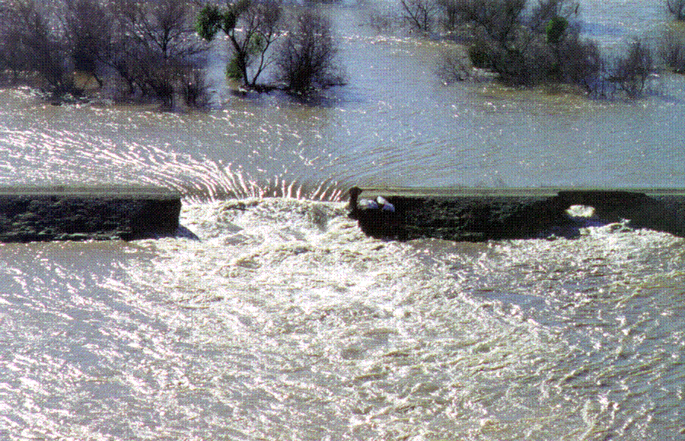
Levee Overtopping and Breaching
Feather River, 1997 Flood
Notes:
Levee overtopping and breaching can be analyzed within HEC-RAS by modeling the levee as a lateral structure. When modeling a levee with a lateral structure, the area behind the levee should not be included in the cross section data of the main river. The cross sections should stop at the bottom of the levee. The lateral structure (levee) can be connected to a storage area or another river reach. The strategy for modeling the area behind the levee will depend upon what will happen to the water if the levee overtops or breaches. If the water going over or through the levee will pond, then a storage area would be more appropriate for modeling the area behind the levee. If the water will continue to flow in the downstream direction, and possibly join back into the main river, then it would be more appropriate to model that area as a separate river reach.

Slide 36
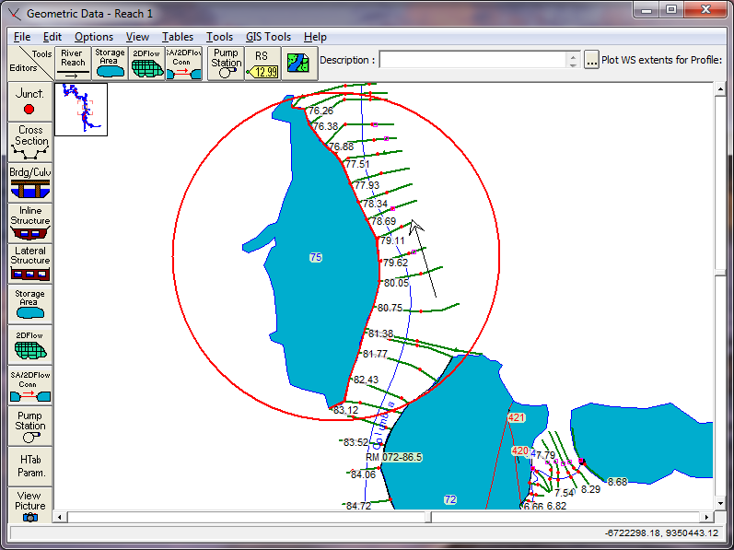
Levee – Defined as a Lateral Structure
Notes:
The user defines the levee by entering a series of station and elevation points that represent the top of levee profile. This station and elevation data is then used as a weir profile for calculating the amount of water going over top of the levee. An example levee entered as a lateral structure is shown in the Figure above.

Slide 37
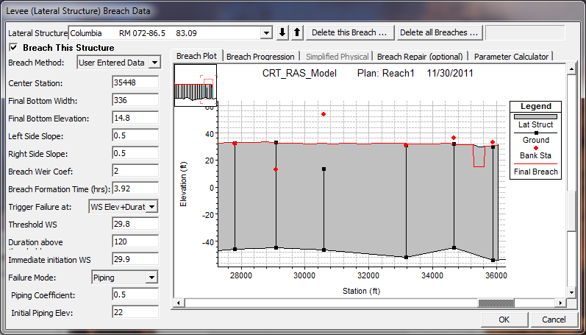
Levee Breach Data
Notes:
This option is very similar to the Dam Break option described previously. The only difference is that the breaching is performed on a levee. The options and data entered to describe the breach is the same as a Dam Break.
In order to use this option, the user must first define the levee as a lateral weir within HEC-RAS. The lateral weir profile is used to describe the top of the levee along the stream both at and between the cross sections. Second, a weir coefficient is entered for calculating the flow that may go overtop of the levee if the water surface gets high enough. Entering breach data for the levee can be accomplished from the lateral weir editor or from the Levee (lateral weir) Breach option from the unsteady flow simulation window. The levee breaching data is stored as part of the unsteady flow plan file, just as it is for a dam break. When the levee breach option is selected, a breach editor will appear as shown above.
The information entered in the fields is the same as for a Dam Break.

Slide 38
Profile Plot of Levee Breach
Notes:
The plot above is an example profile animation of a levee breach.

Slide 39
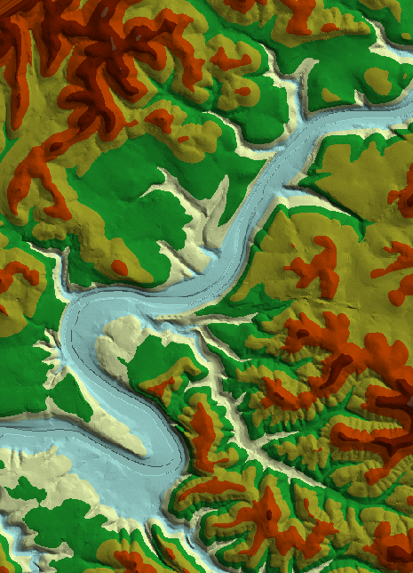
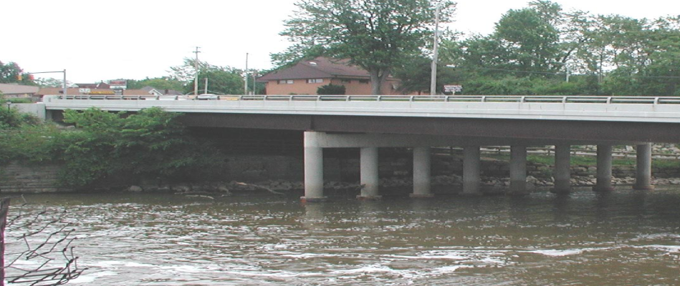
Data Acquisition and Processing
Terrain data
Aerial photographs
Hydraulic structures

Slide 40
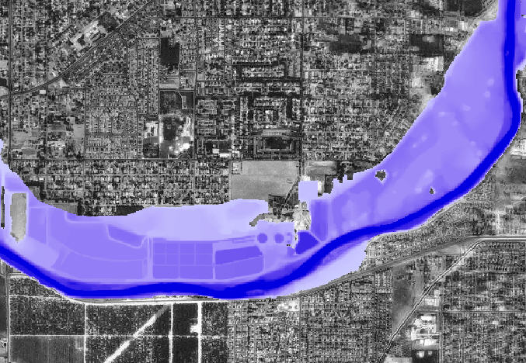
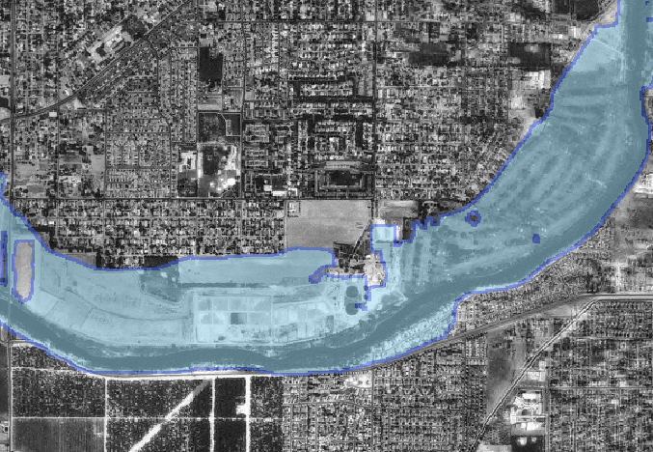
HEC-GeoRAS/Floodplain Mapping
Depths
Floodplain Boundary
Notes:
The results of the floodplain mapping step may be used with other layers to assist the hydraulic engineer in improving the hydraulic model. After examination of the floodplain boundary and inundation depths, hydraulic properties can be modified and refined.
With the publishing of the final product it may be used for multiple purposes. Flood damage reduction studies, flood warning and response preparedness, idenfication and impact to environmental areas. There are endless uses.

Slide 41
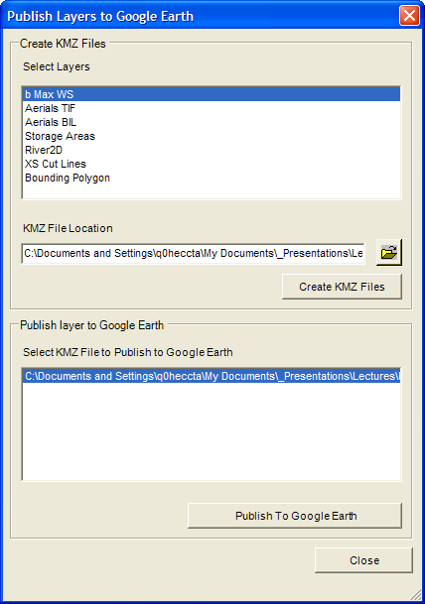
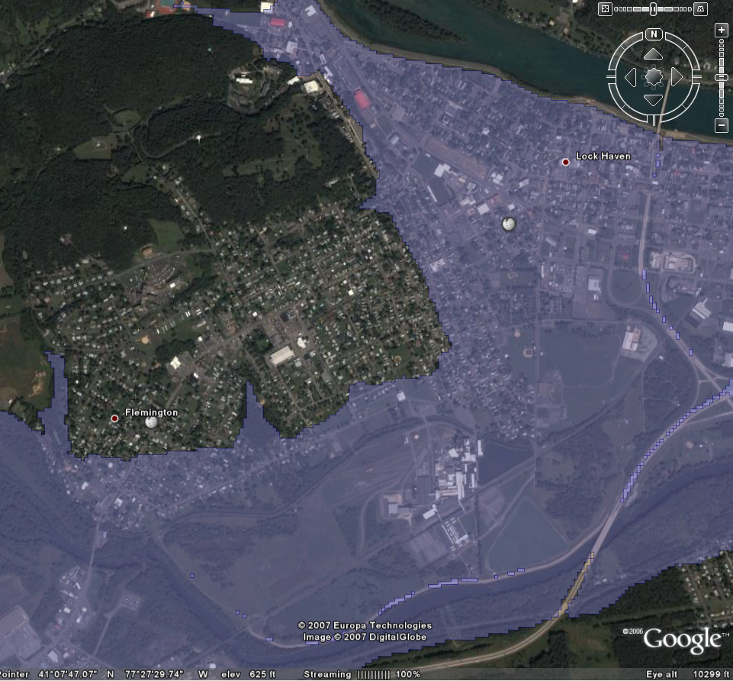
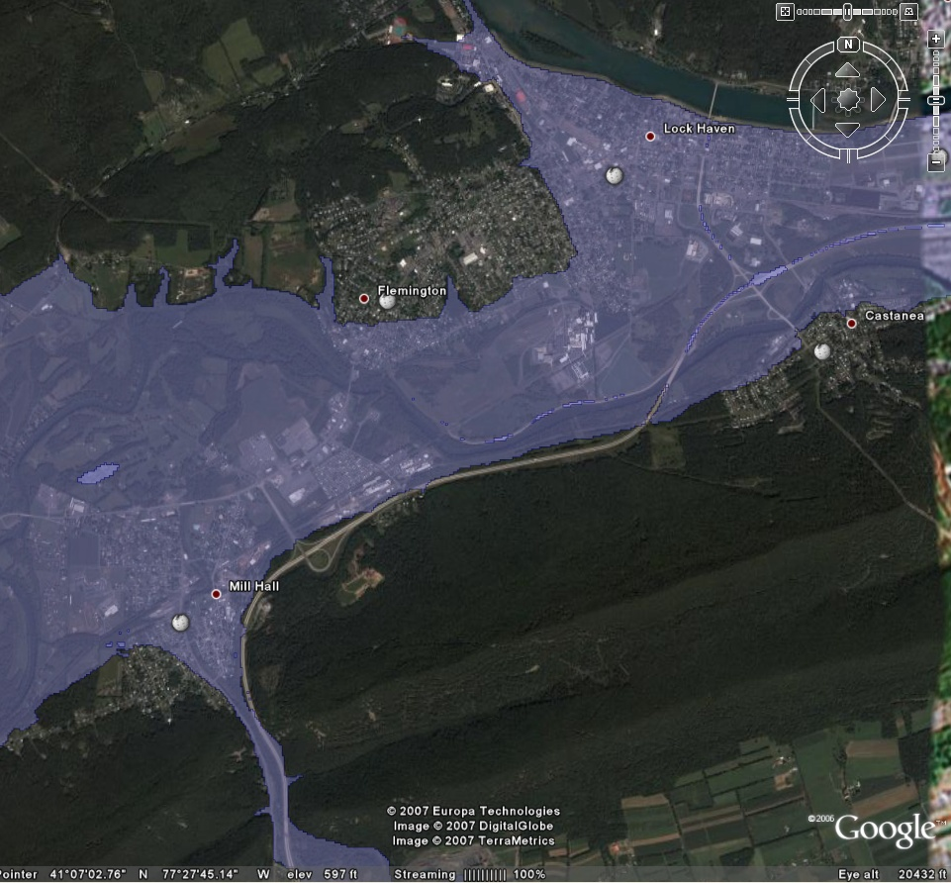
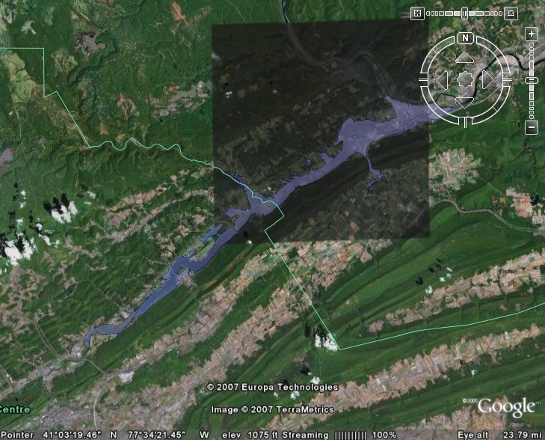
Google Earth Mapping
Notes:
The Publishing to Google Earth tool allows you to choose the floodplain boundary (or other features) to export. A KMZ file is created, which is Google Earth’s native format.
Once the KMZ file is created, you can lauch Google Earth from GeoRAS and the feature will be displayed… Pretty Cool.
Not all color schemes in ArcGIS will be supported in the export process. You will probably need to adjust them using the palette options available in Google Earth.
This process projects the dataset in the Lattitude/Longitude coordinate system that Google Earth uses and will not work on Raster datasets.

Slide 42
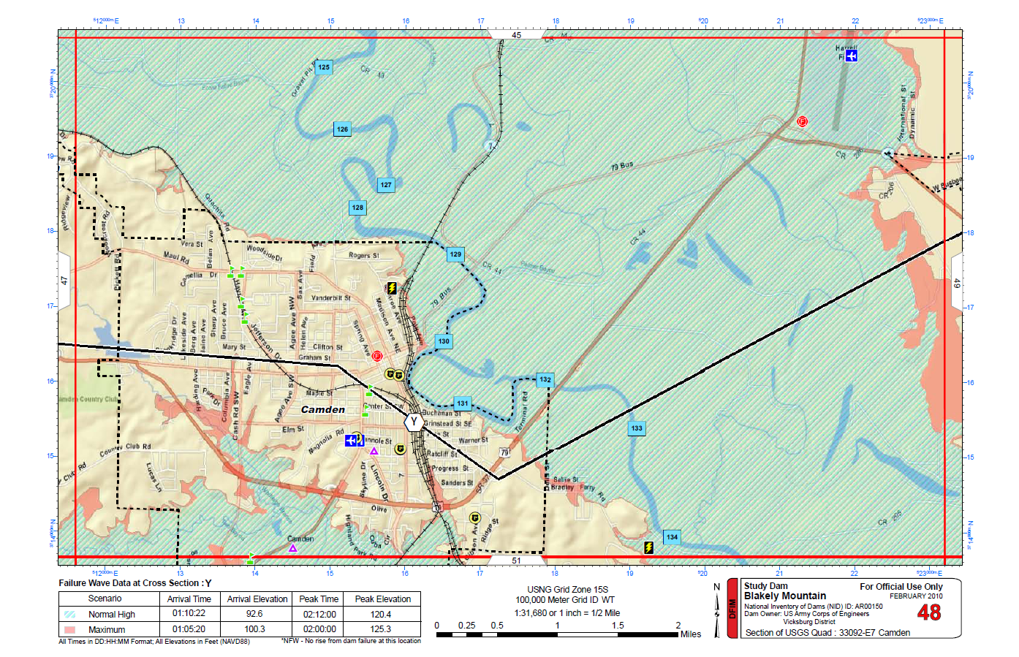
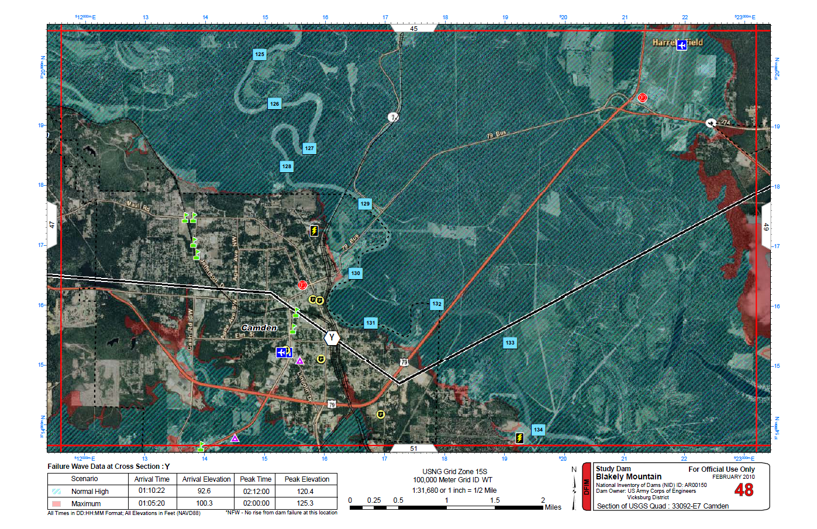
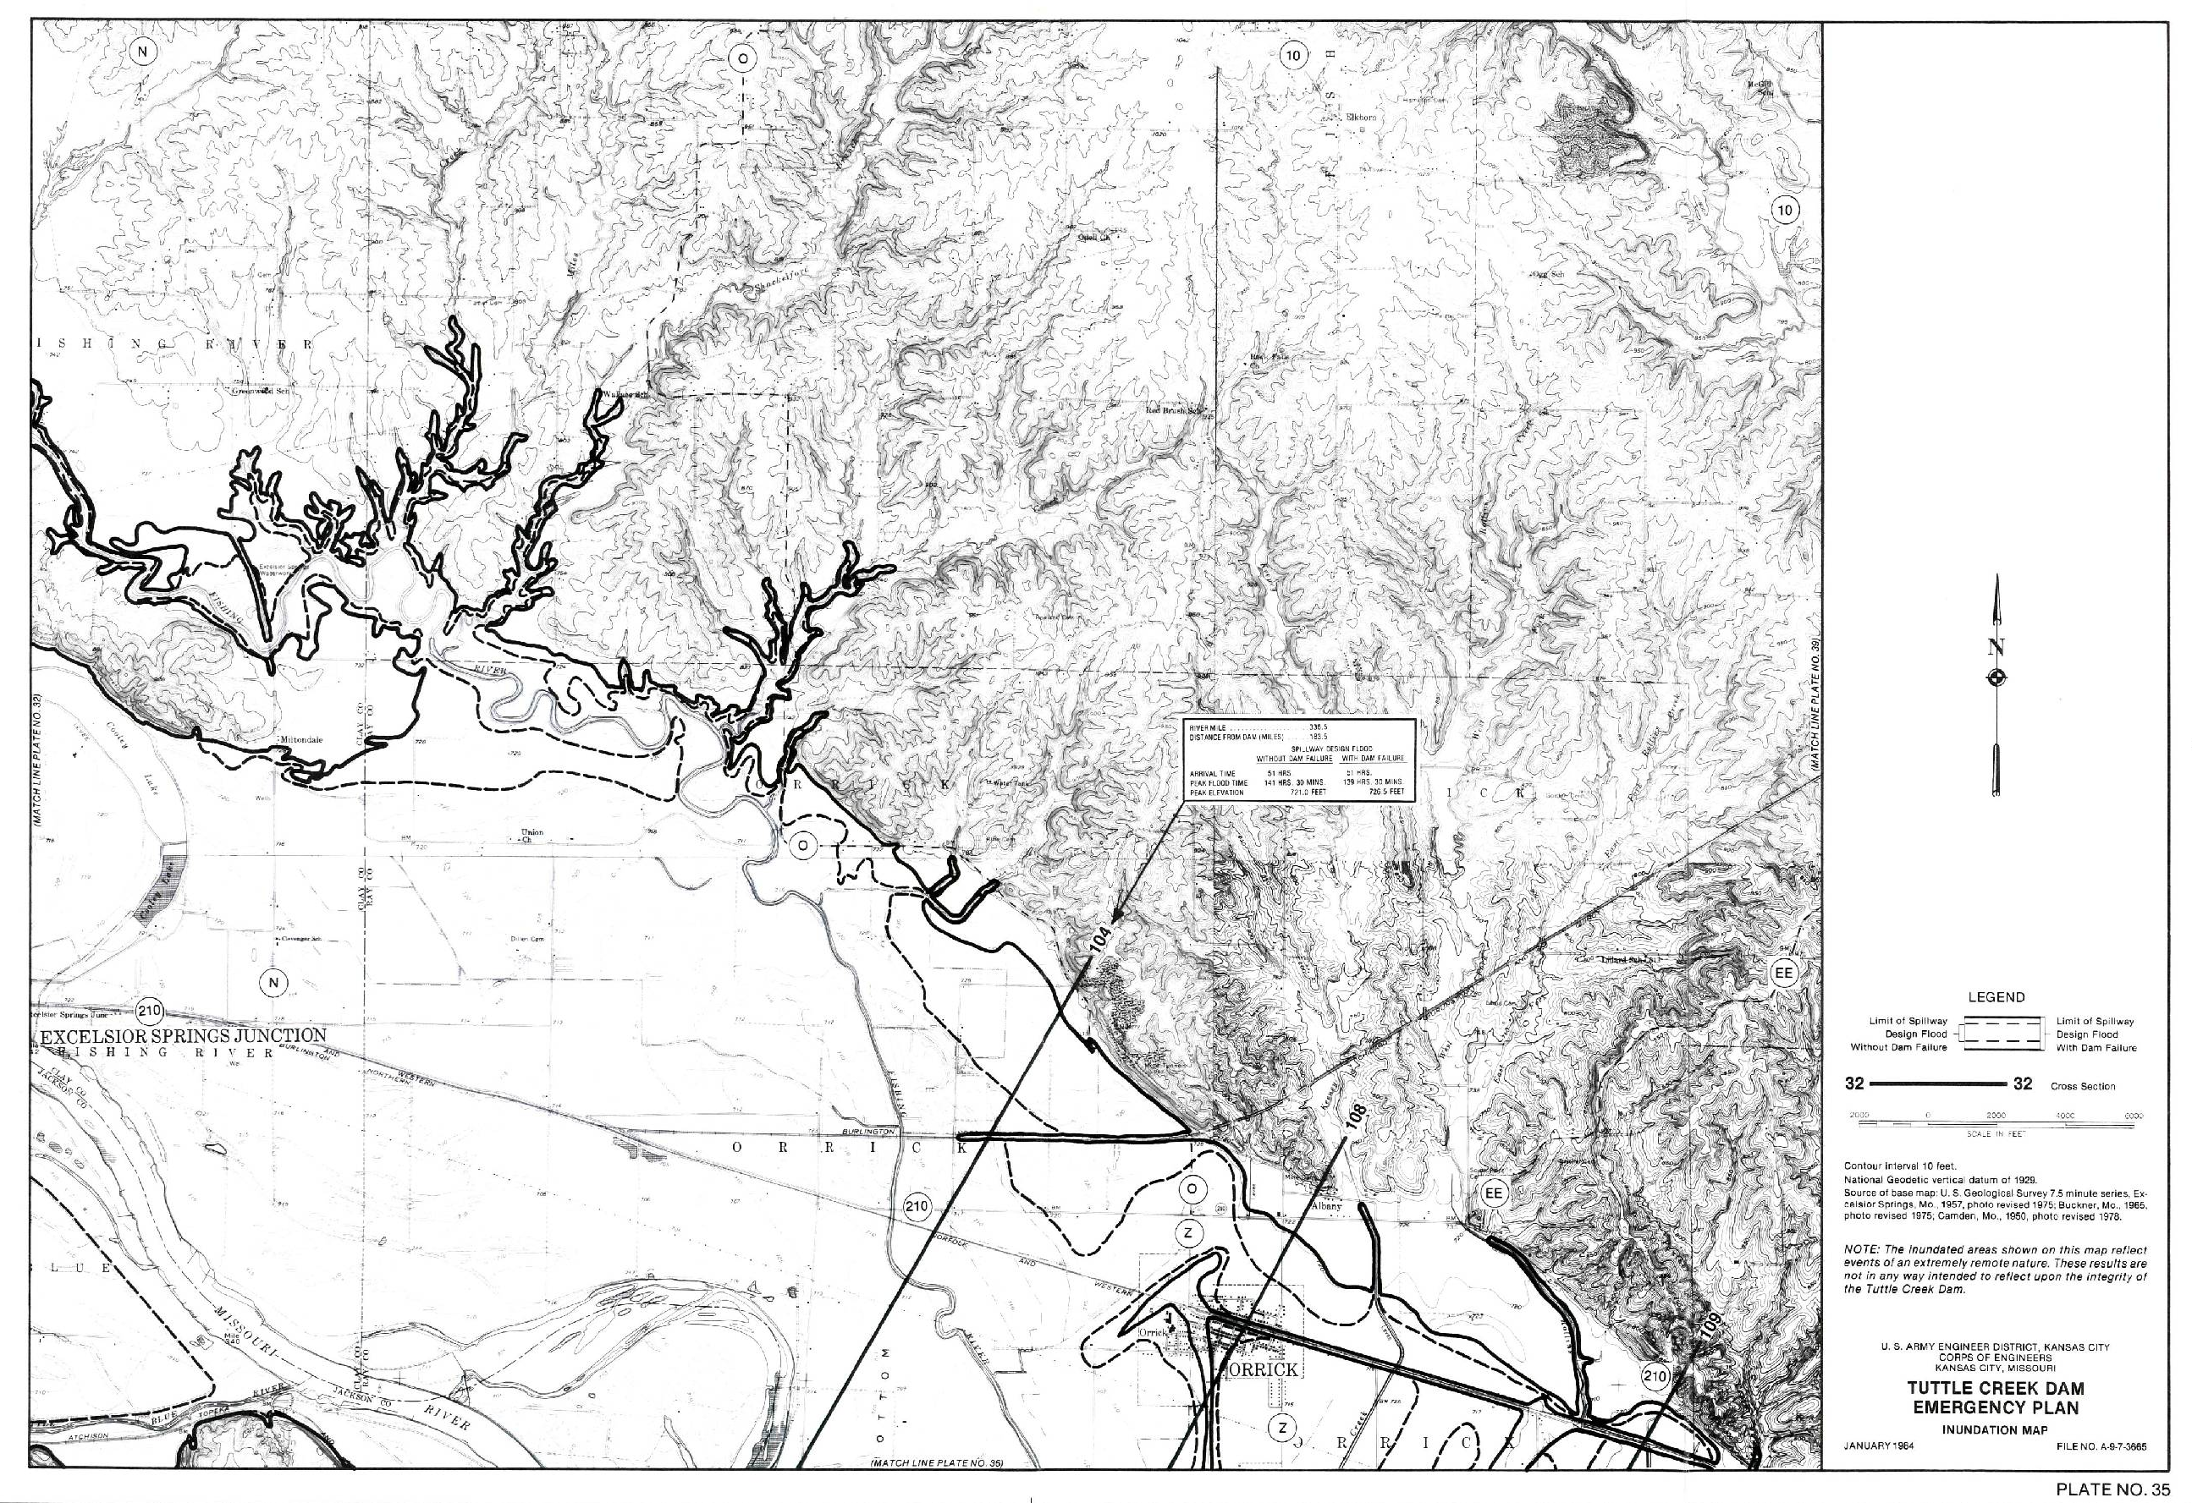
Map Sheets
Notes:
Shows the old way of doing things and the new way.

Slide 43
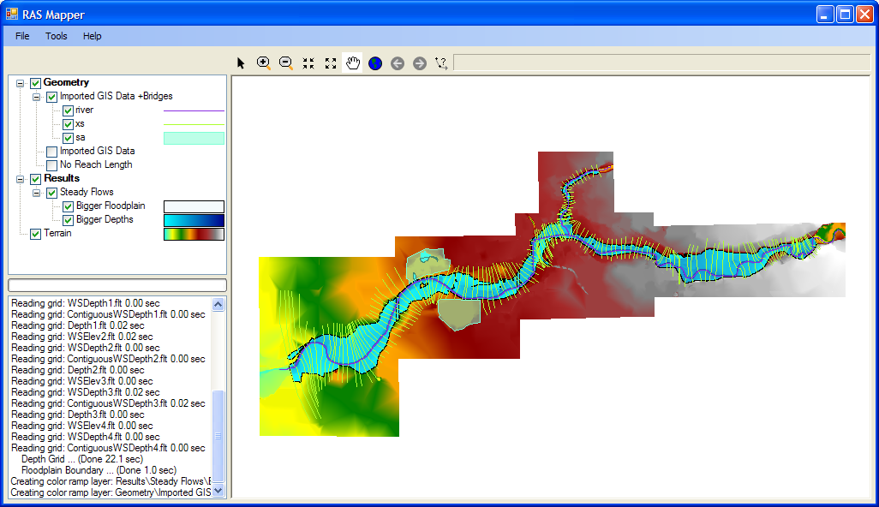
RAS Mapper
Notes:
Here’s the RAS Mapper. It is comprised of a Layers panel, Status panel, and Display window. Note that data is organized for you by Geometry and Results based on how you have your data setup in your RAS model.

Slide 44
Example Animation
Notes:
HEC-RAS 2-d floodplain modeling sample. Muncie Indiana

Slide 45
Example Animation
Notes:
HEC-RAS 2-d floodplain modeling sample. St. Paul, Minnesota

Slide 46
Example Animation
Notes:
Flyover is generated from RAS data and loacl inventory data. It visualizes the areas that could be flooded under varying flood events. The Blue represents a 1% and the red is a larger flood (don’t know what). The largest population is at the downstrewam end and it ends up showing a school being flooded. This helps someone visualize what would happen at a location under this flood condition. If you say there are 1,000 cms in the river people can’t visualize what that really means. By showing that the school would be under 3m of water (or some value) that flow rate can be equated to an elevation that would be recognizable to basically anyone.

Slide 47
Flow
Collapse of Embankment
Full Breach
Pipe between lake and exit formed
Intervention Attempted
Warning Issuance
Decision dam will fail
Failure Mode Initiates
Muddy Flow Observed
Warning Issuance Offset - Important time for consequence estimate – SENSITIVITY ANALYSIS
Time
Notes:
Simulates the steps of an impending dam failure.

Slide 48
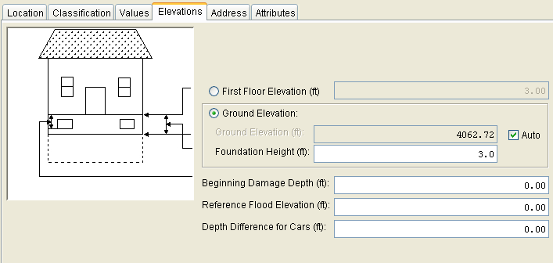
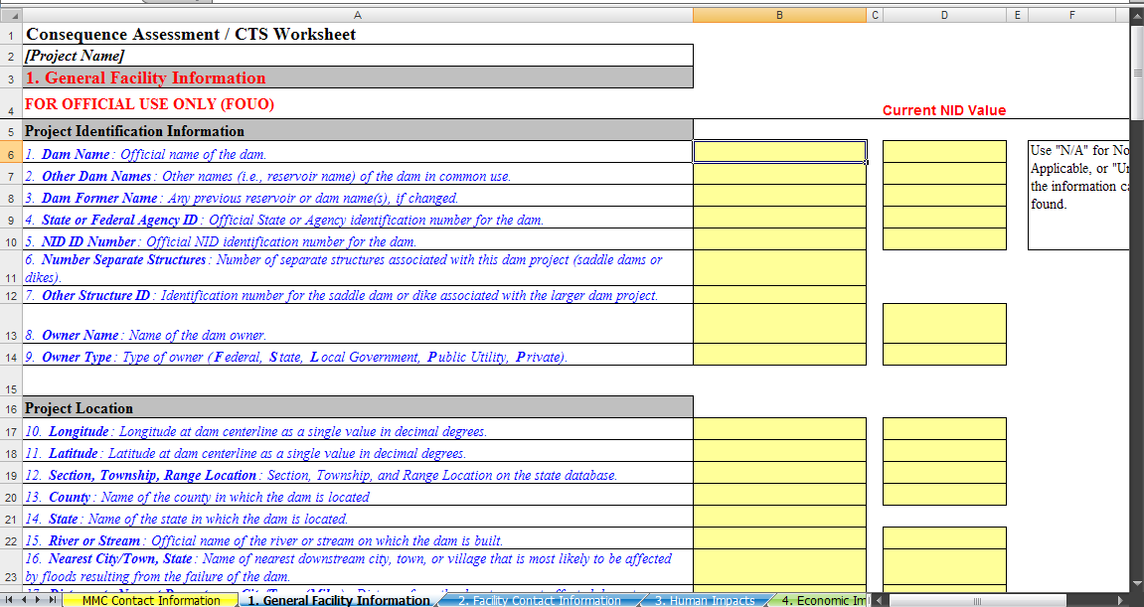
Consequence Numbers
Consequence Database
Impact Area Name | Failure Event | Total Urban Damages ($1000) | Total Damages ($1000) | Total Number of Structures Flooded | Total Population Impacted | Total Population Over 65 Impacted
Nevada County | 10% | 2,452 | 2,452 | 18 | 24 | 0
 | FCE | 7,164 | 7,164 | 40 | 83 | 3
 | DFE | 9,411 | 9,411 | 59 | 116 | 5
Storey County | 10% | 1,547 | 1,547 | 100 | 45 | 84
 | FCE | 11,790 | 11,790 | 206 | 332 | 111
 | DFE | 17,207 | 17,207 | 245 | 409 | 127
Washoe County | 10% | 89,587 | 89,587 | 1,545 | 955 | 360
 | FCE | 922,063 | 922,063 | 6,681 | 8,961 | 1,863
 | DFE | 2,348,758 | 2,348,758 | 13,387 | 28,230 | 4,353

Slide 49
LEARNING OBJECTIVES
Using the course manual, references and lecture notes, the student will be able to understand hydrologic and hydraulic aspects of dam safety program. After this presentation, the student will be familiar with concepts, terminology and inter-relationships between hydrologic, hydraulic and water management considerations essential in the engineering analysis associated with the administration of the USACE Dam Safety program.
QUESTIONS

