Slide 1
Climate Change / Adaptation
Jerry W. Webb, P.E., D.WRE
Principal Hydrologic & Hydraulic Engineer
Hydrology, Hydraulics & Coastal Community of Practice Leader
US Army Corps of Engineers, Headquarters
Jerry.w.webb@usace.army.mil
Dam Safety Workshop
Brasília, Brazil
20-24 May 2013

Slide 2
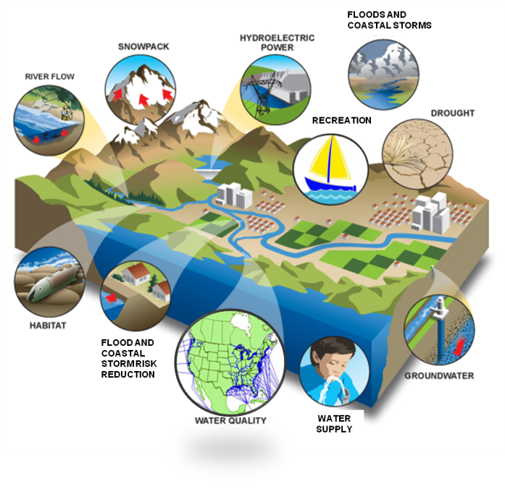
US Army Corps of Engineers Civil Works Missions: Water Resources Management
Hydropower
Emergency Management
Ecosystem Restoration
Recreation
Flood and Coastal Storm Risk Reduction
Regulatory
Water Supply
Navigation
NAVIGATION
Notes:
This presentation is based my experience working with the US Army Corps of Engineers (USACE) in dealing with how to incorporate new and changing information into our missions and operations.
The USACE has about 34,000 people supporting military and civilian missions. I will be talking about the Civil Works program, which has about 24,000 employees and an operating budget of about $5B, which can be supplemented to support emergency response and recovery operations, such as those that were associated with the great Midwest floods of 2011 and currently, hurricane Sandy.
Our Civil Works missions support navigation, flood and coastal storm risk reduction, ecosystem restoration, hydropower, recreation, regulatory, water supply and emergency management.

Slide 3
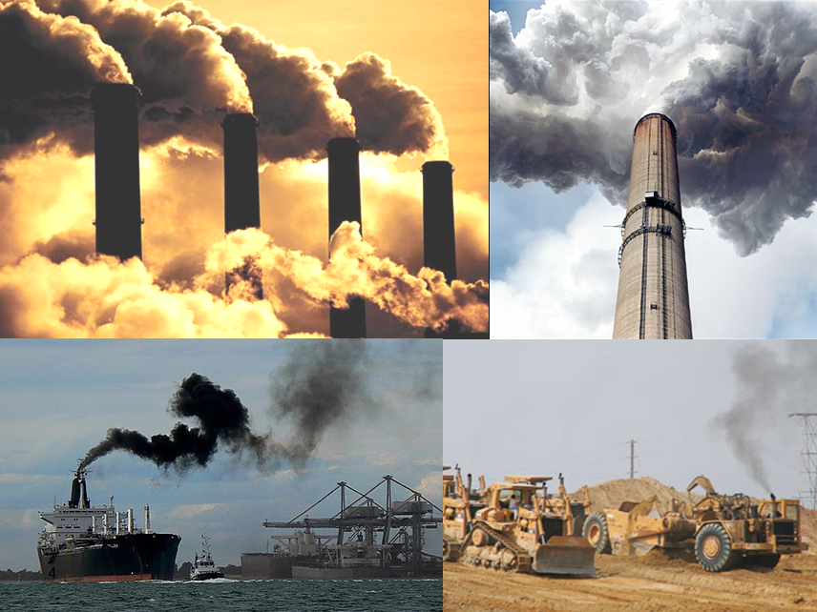
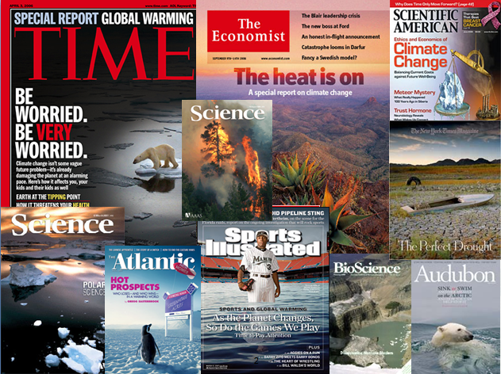
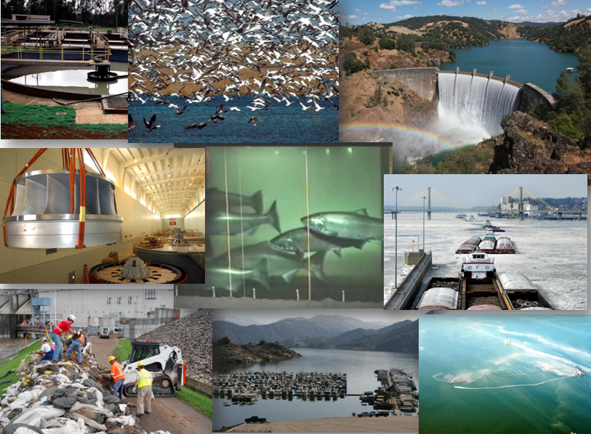
Carbon
Climate change mitigation is about
Climate change adaptation is about
Water
Notes:
We know climate is changing and that climate change principally affects temperature, precipitation and storm intensity and frequency.
In simple terms, climate change mitigation is about CARBON. USACE has an active sustainability and energy program to conserve energy and water and reduce greenhouse gas emissions (mitigation activities) in accordance with EO 13514. [Source: adapted from NOAA NCDC & USGCRP, 2009]
On the other hand, climate change adaptation is about WATER, to put it simply. This is because climate change can directly affect the hydrologic cycle and, through it, the quantity and quality of water resources. Climate change can lower minimum flows in rivers, affecting water availability and quality for drinking water, aquatic resources, energy production (hydropower), industrial manufacturing, thermal-electric plant cooling, and navigation. Climate change can also directly affect demand for water, when demand for crops increases in certain seasons, for instance.
And because we are a water resources management agency, we are already seeing changes, especially in snow-dominated watersheds, glaciers, Arctic ice covers, and permafrost areas. We may suspect some other changes are occurring, but don’t yet have enough definitive information to attribute these changes to climate change.
What we don’t know is how fast climate is changing, how these changes will manifest themselves, and whether some changes are irreversible. But we do know that the steps we take to adapt to climate change also help us adapt to other challenges to our missions and operations, because they share a common goal: to improve resilience and decrease vulnerability.

Slide 4
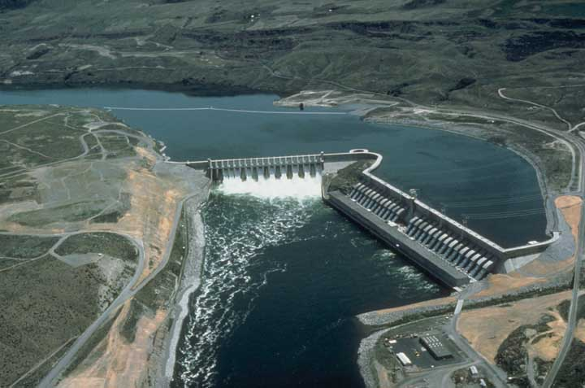
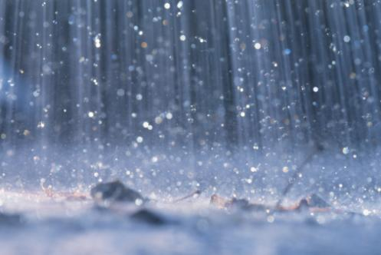
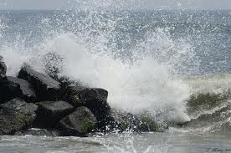
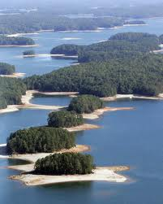
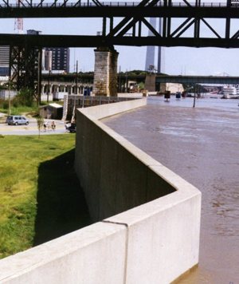

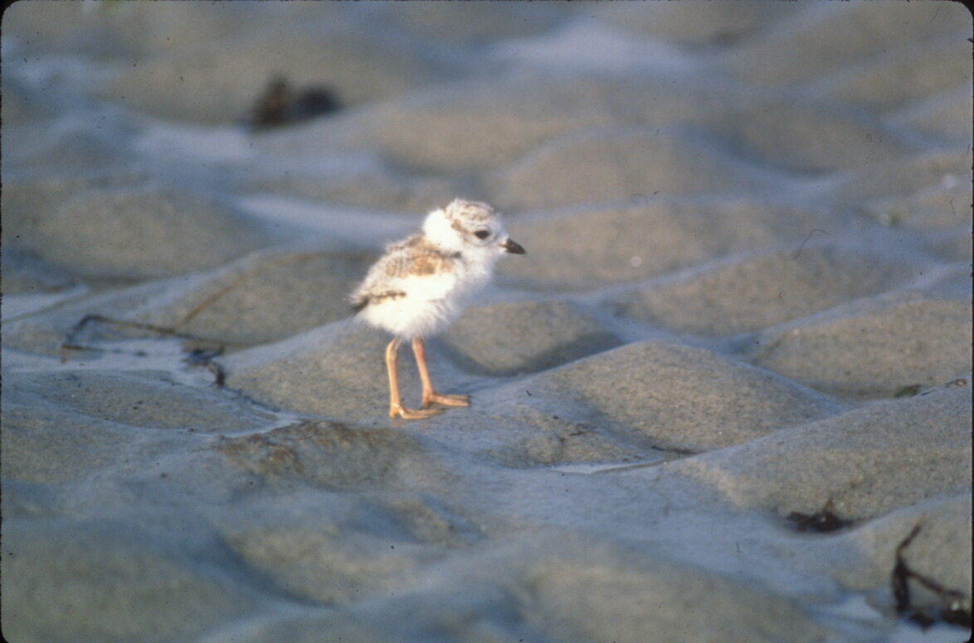
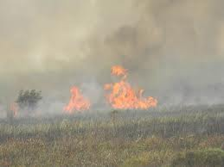
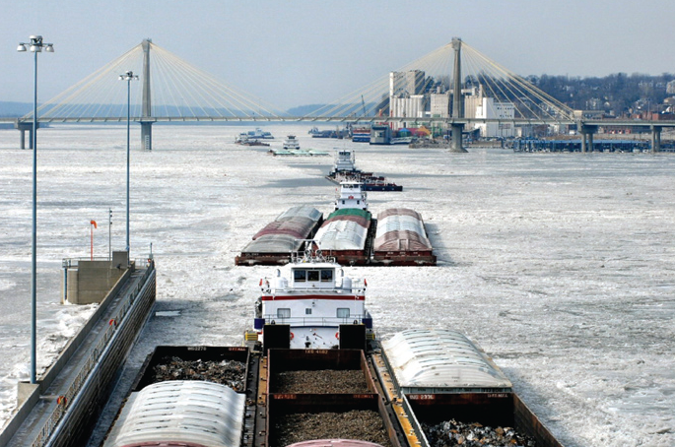
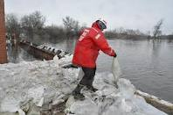
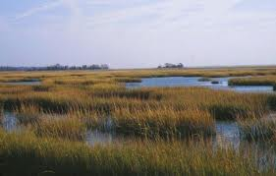
USACE Climate Adaptation Mission:
To improve resilience and decrease vulnerability to the effects of climate change
and variability
Bill Byrne, MA F&W
Notes:
The Responses to Climate Change Program supports the USACE Climate Adaptation mission to improve resilience and decrease vulnerability to the effects of climate change and variability.
We believe that the scope, collaboration, and resources applied to climate change adaptation planning, demonstrate the importance USACE has placed on this critical challenge to the long-term sustainability of our mission, operations, programs and projects that oversee and administer public water resources and associated infrastructure in every state, as well as several international river basins, and support military operations worldwide that promote peace and stability.
There are many definitions of resilience – but essentially for USACE, improving resilience means that we can successfully perform our missions, operations, programs, and projects despite the challenges of global and climate change, and that we have the capacity for positive adaptation with no significant change to structure or function.
****************************************************************************
Resilience – Amount of change a system can undergo without changing state. (IPCC, TAR, 2001)
Resilience – Resilience is a tendency to maintain integrity when subject to disturbance. (UNDP, 2005)
Resilience – The ability of a system to recover from the effect of an extreme load that may have caused harm. (UKCIP, 2003)
Resilience – The capacity of a system, community or society potentially exposed to hazards to adapt, by resisting or changing in order to reach and maintain an acceptable level of functioning and structure. This is determined by the degree to which the social system is capable of organizing itself to increase its capacity for learning from past disasters for better future protection and to improve risk reduction measures. (UN/ISDR, 2004)

Slide 5
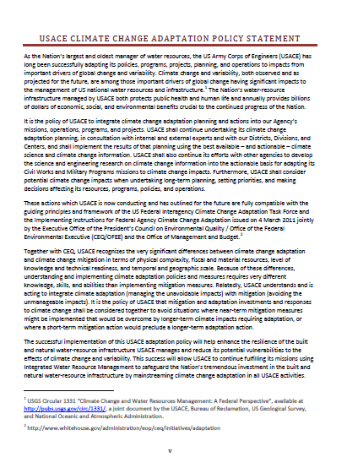
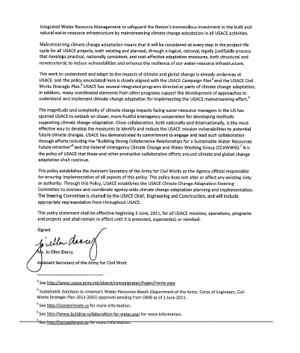
USACE Climate Adaptation Policy
June 2011
Integrate climate change adaptation planning and actions into USACE missions, operations, programs, and projects
Use the best available and actionable climate science and climate change information at appropriate level of analysis
Consider climate change impacts when undertaking long-term planning, setting priorities, and making decisions
http://www.corpsclimate.us/adaptationpolicy.cfm
Notes:
In June 2011, the Assistant Secretary of the Army for Civil Works, Ms. Jo-Ellen Darcy, signed the USACE Climate Change Adaptation Policy Statement.
The policy statement signed by Ms. Darcy calls for integrating climate change adaptation into all that we do. The statement notes that climate change and variability, both observed and as projected for the future, are among those important drivers of global change having significant impacts to the management of US national water resources and infrastructure.
It also points out that we should do this now based on the best available and actionable science – and plenty of information is available – and that we should consider climate change impacts as we plan for the future. We are developing methods that will support an appropriate level of analysis for the decision being made.
This policy establishes the Assistant Secretary of the Army for Civil Works as the Agency official responsible for ensuring implementation of all aspects of this policy.
Through this Policy, USACE establishes the USACE Climate Change Adaptation Steering Committee to oversee and coordinate agency-wide climate change adaptation planning and implementation. The Steering Committee is chaired by the USACE Chief, Engineering and Construction, and the first meeting is tomorrow.

Slide 6
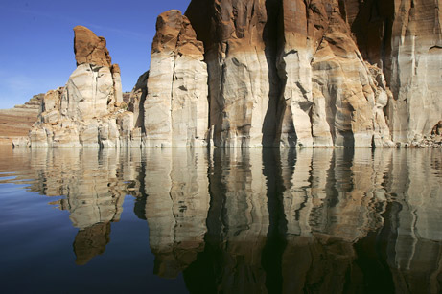
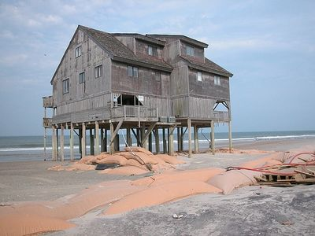
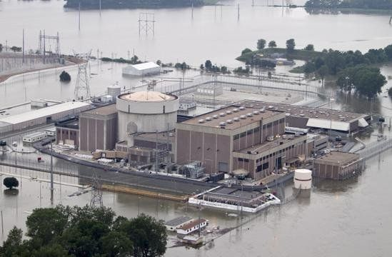
Climate Change, Extreme Events and Water Infrastructure
Extreme events and increasing variability increase water resources vulnerability
  Public health and safety
  Economic development
  Environmental sustainability
National Geographic
Notes:
Two factors of water resources management are especially important to note:
First – climate change, extreme events, and increasing variability increase the vulnerability of water resources infrastructure, and
Second, the long lifetime of water resources infrastructure has additional implications we need to consider in the context of extreme events.
Our own experience shows us that climate change and variability – especially extreme events – are increasingly important considerations for water infrastructure.
This is because climate change and variability directly affects the hydrologic cycle and, through it, the quantity and quality of water resources. Climate change can lower minimum flows in rivers, affecting water availability and quality for drinking water, aquatic resources, energy production (hydropower and thermoelectric generation), industrial manufacturing, navigation, and recreation. These impact all of us in three major ways: public health and safety, economic development, and environmental sustainability
And because we are a water resources management agency, we are already seeing changes, especially in snow-dominated watersheds, glaciers, Arctic ice covers, and permafrost areas. For example, we know that sea-levels are changing and that geological processes can exacerbate the changes. We know that changes in the onset and volume of snowmelt are impacting water management for floods and drought in the Sierra Nevada Mountains and the Pacific Northwest. We may suspect some other changes are occurring, but don’t yet have enough definitive information to attribute these changes to climate change.
There are a few characteristics of both climate change and water resources that we need to bear in mind as we approach adaptation.
Shown here: impacts to North Carolina coastline, drought on the Colorado River, and 2011 flooding along the Missouri River impacting electrical generation at a nuclear facility

Slide 7
Extremes and Surprises Add Complexity
“… the biggest issue is not a failure to envision events that may be surprising.”
“It is a failure to decide which ones to act upon, and to what degree.”
“That failure results, at least partially, from the fact that there is no systematic mechanism in place…. to help decide which events to act upon aggressively, which to treat to a lesser degree, and which to ignore, for the time being.”
US DoD Defense Science Board: Capability Surprises
Notes:
Not only are we dealing with a wicked problem, but climate change impacts to water resources infrastructure is about surprises, some known (e.g., global sea levels are rising) and some unknown (how will atmospheric carbon levels outside the observed range manifest themselves at the local level?).
It’s these surprises and their potentially very disruptive consequences that water resources managers are concerned with.
I think as engineers, we are certainly familiar envisioning plausible futures, and we may already have engineering solutions that can deal with these. So in part, we have the “how.”
The bigger problem facing us, and society as a whole, is: which changes do we act on, and when?
For the most part, we do not have a systematic method, an overarching policy, and a socioeconomic or political mechanism in place to help us know which are the urgent needs and which can wait. So in effect, we’re forced to take the wicked problems approach.
The relationship between water infrastructure and large scale social stability helps to maintain the health of stable cultures that support economic development and ecologic sustainability.
But we can’t afford to be reactive to every surprise climate brings us, nor can we afford to be proactive about every potential future condition.
On the other hand, we need to be able to discern when an investment in being proactive pays off. It is in answer to this question that science moves into policy and then action.
*****
Known and unknown surprises and how to manage them was a topic of the 2008 DSB Summer Study: Capability Surprise (Volume I: http://www.acq.osd.mil/dsb/reports/ADA506396.pdf and Volume II: http://www.acq.osd.mil/dsb/reports/ADA506396.pdf) . DSB pointed out in Vol. 1 that “In both cases, the biggest issue is not a failure to envision events that may be surprising. It is a failure to decide which ones to act upon, and to what degree. That failure results, at least partially, from the fact that there is no systematic mechanism in place within DoD or the interagency to help decide which events to act upon aggressively, which to treat to a lesser degree, and which to ignore, for the time being.”
In the Appendix to the Main volume, DSB said: “Wicked problems will characterize more and more of DoD’s future challenges… The interdependencies, complexities and non-linear behavior of the modern world require something beyond the traditional approaches that were effective in a simpler time.”
“Policymakers benefit when they can take into account what the analysts see as the full range of possible outcomes on a tough issue . . . analysts should not usurp the decision role of policymakers by prematurely limiting the options on the table.” Davis, J. “The Challenge of Managing Uncertainty: Paul Wolfowitz on Intelligence Policy-Relations,” Studies in Intelligence, 1996 Unclassified Edition

Slide 8
Water Resources Infrastructure Long Service Life and Long Lead Time
Increasing Severity of Climate Impacts
Engineering and Design
Infrastructure Service Life
Planning
Construction
In Service
Infrastructure planned and built with past climate and weather in mind may not be adequate for future resilience and operation.
0 10 20 30 40 50 60 70 80 90 100
Years
After United States Ports: Addressing the Adaptation Challenge, Mr. Mike Savonis
Notes:
The second factor is that water resources infrastructure is often publicly funded and provides benefits to a population that can be spatially far removed from an actual project or system. Funding these projects involves intergovernmental collaboration, social and political partnering, and complicated financial leveraging.
These processes can impact the length of the planning process, in turn affecting engineering design and construction.
Thus for water resources infrastructure, we are looking at a long planning, engineering, and construction process. This, combined with the long lifetime of water resources infrastructure, means that we need to build flexibility to adapt to changing conditions, particularly extreme events. As a result, building lead time for adaptation to changing extremes is important.
One way to increase lead time is to consider a wide range of potential future conditions, especially extremes, and to identify triggers or thresholds at which adaptation decisions need to be made. This concept is incorporated in the adaptation guidance USACE is developing.

Slide 9
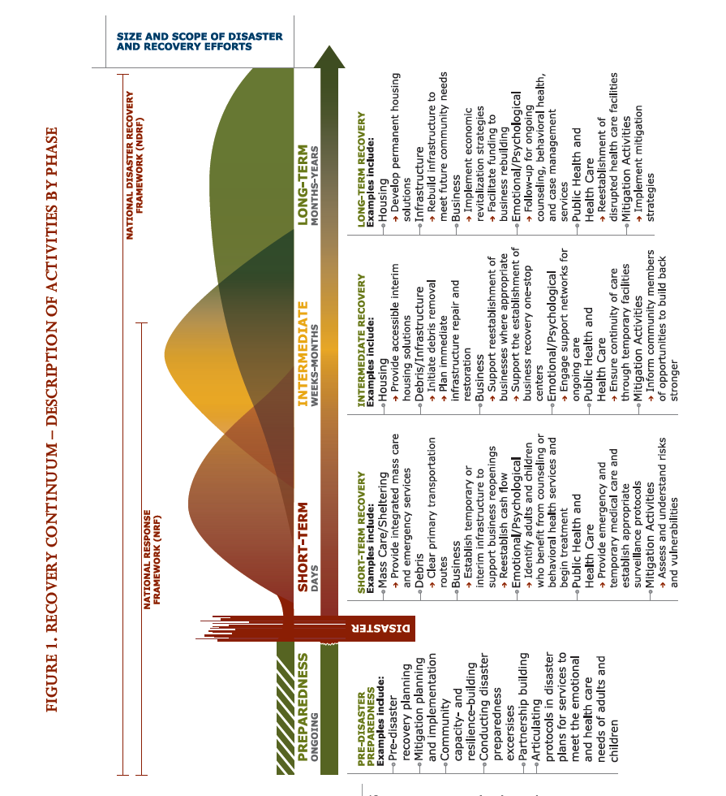
Adaptation to Climate Change and Extreme Events is a Continuum
Analyses, Operational Measures, Anticipatory Engineering
Policy, Structural Measures, Post-Event Adaptation
Preparedness, Response, Recovery
DISASTER
Notes:
So we can consider adaptation to extreme events as a continuum from preparedness, response and recovery through to implementation of adaptation measures, whether operational or structural.

Slide 10
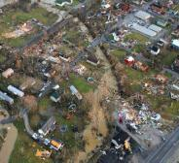
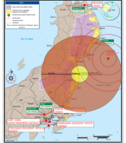
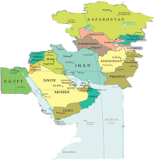
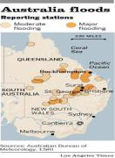
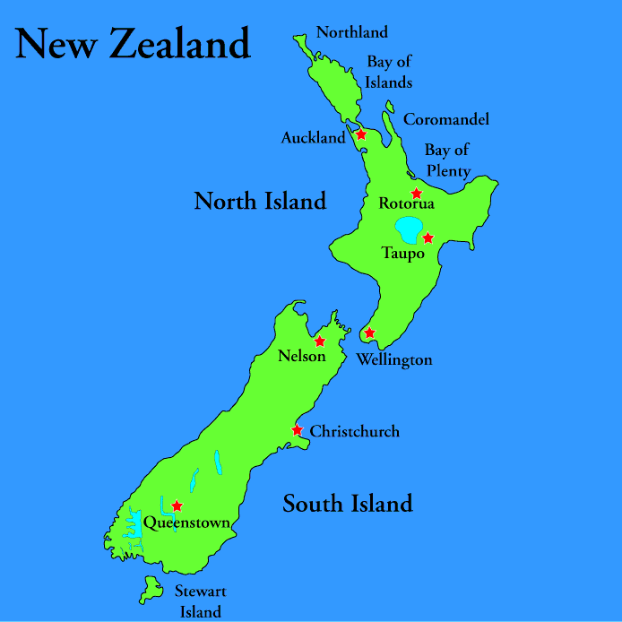

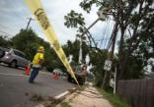
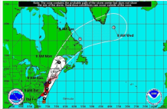
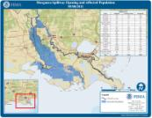
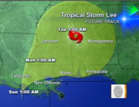
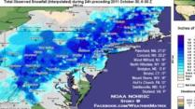
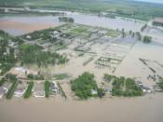
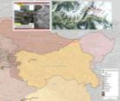
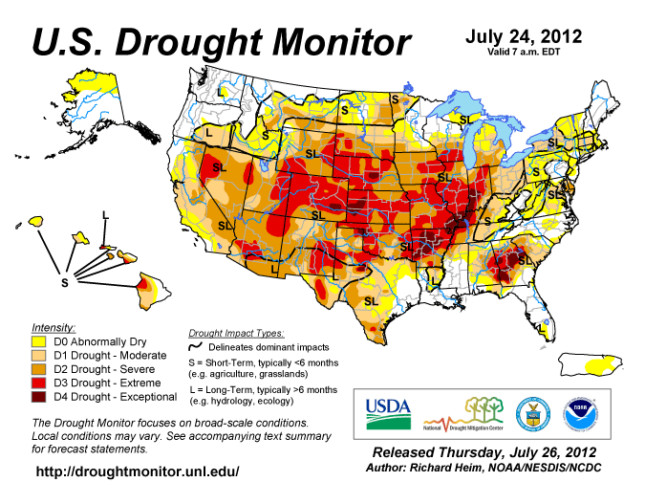
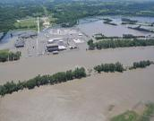
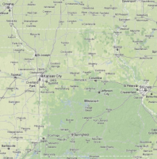
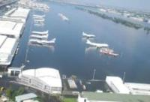
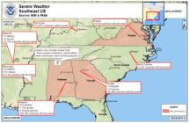
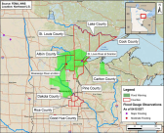

Key 2011/2012 Responses
Severe Weather – Midwest
Mar 2012
Japan EQ & Tsunami - Mar 2011
FEST Deployments Jan – Mar 2011 & OEF/OND
Queensland, Australia Flood - Jan 2011
Christchurch, New Zealand Earthquake - Feb 2011
Kootenai River Basin
2012
Northeast Snow Storm
Oct 2011
Derecho Storms
JUN-JUL 12
Hurricane Irene
Aug 2011
Tropical Storm Lee
Sep 2011
MS Floods
May 2011
Pakistan Siachen Glacier SME Support
April 2012
Souris River Flood
Jun/Jul 2011
Joplin, MO
Tornado - June 2011
2012 Drought
MO River Flood
Jun/Jul 2011
AL & MS Tornados
Apr 2011
RRCC VII
Duluth, MN Flood
Joplin, MO (RFO)
Thailand Flood - Nov 2011
Fort Crowder
Logistics Point
Notes:
But we also need to understand that where we have not yet adapted to extreme conditions through anticipatory engineering or adaptive measures, it is emergency preparedness, response, and recover that are the key factors in how successful we are in managing extreme events.
Here are just some of the key emergency responses we’ve supported in 2011 and 2012.
So we can consider adaptation to extreme events as a continuum from preparedness, response and recovery through to implementation of adaptation measures, whether operational or structural.

Slide 11
Quick Review of Using Scenarios in Support of Climate Change Analyses With Emphasis on Sea-Level Change

Slide 12
Changing Paradigms:
From Equilibrium to Dynamic
Hurricane Katrina
  Internal and external reviews following Hurricane Katrina (IPET, HPDC, ASCE, National Academies, and others) demonstrated that we need to incorporate new and changing conditions, both foreseen and surprise, into USACE projects and programs
Stationarity
  Climate change undermines a basic assumption that historically has facilitated management of water supplies, demands, and risks.’ Milly et al 2008
Notes:
The USACE has undergone a paradigm shift from viewing the world primarily as one in which processes tended toward an equilibrium case, which would allow us to be prepared for the future if we could just describe it adequately, to one in which we now recognize that the world is dynamic and changing.
Our impetus to recognize this paradigm came from internal and external reviews following Hurricane Katrina, and from the climate change literature. One important paper by Milly et al is shown here: “ Stationarity is Dead: Whither Water Management?” This paper asks, was stationary ever alive?
These the internal and external reviews of Hurricane Katrina were a clear indication to us that we need to incorporate foreseen and surprise changes into our projects and programs. The IPET-HPDC Lessons Learned Implementation Team began working in 2006 to develop guidelines and recommend policy and program changes along with supporting technologies, to address dynamic processes, temporal and spatial changes, and their impacts to USACE projects on watershed, regional or system scale (e.g., subsidence, climate change and variability, sea level change).
Reviews were provided by the Interagency Performance Evaluation Team (IPET, see https://ipet.wes.army.mil/), the Hurricane Protection Decision Chronology (HPDC, see http://www.iwr.usace.army.mil/docs/hpdc/hpdc.cfm), the American Society of Civil Engineers (ASCE, see http://www.asce.org/uploadedFiles/Publications/ASCE_News/2009/04_April/ERPreport.pdf) and the National Academies (see http://www.nae.edu/Publications/Bridge/EngineeringfortheThreatofNaturalDisasters/LessonsfromHurricaneKatrina.aspx), among others.

Slide 13
Fundamental Change in Approach to Future Conditions
Historically, we identified a single most likely future condition and based our without-project (baseline) analyses on this condition
Now, we understand that there can be multiple plausible futures, each representing a different combination of physical processes, social and political values, and economic conditions, among other factors
In particular, for hydrology, we can no longer rely on the assumption of stationarity, where statistical properties of hydrologic variables in future time periods are assumed to be similar to past time (i.e., future variation in the same range as in the past)
Notes:
This changing paradigm brings with it the need to assess the future in different ways, particularly in the area of water resources management.
There are numerous ways to develop and describe future conditions.

Slide 14
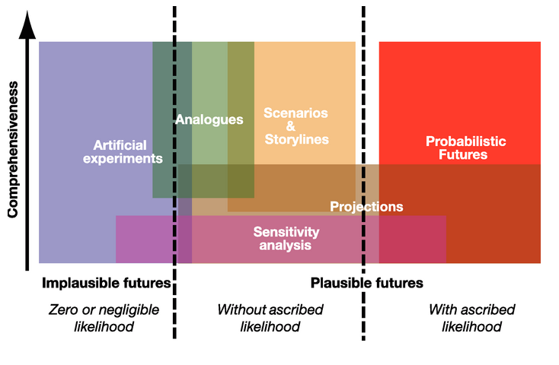
Universe of Futures
Carter et al (2007)
Notes:
There is a whole universe of futures – our challenge is to select one or more methods that are appropriate for the decisions to be made, based on the potential consequences, the potential for long-term unintended consequences, and of course, our other decision-making processes.
As we conduct our evaluations and formulate management plans, we must be careful that we do not prematurely down-select to one future, in a way that reduces our ability to explore potential future conditions to manage risks.
Glossary (definitions from or based on Carter et al 2007 “General guidelines on the use of scenario data for climate impacts and adaptation assessment, version 2,June 2007:”
Scenario
A scenario is a coherent, internally consistent and plausible description of a possible future state of the world (IPCC, 1994).
It is not a forecast; rather, each scenario is one alternative image of how the future can unfold.
A projection may serve as the raw material for a scenario, but scenarios often require additional information (e.g., about baseline conditions).
A set of scenarios is often adopted to reflect, as well as possible, the range of uncertainty in projections. Other terms that have been used as synonyms for scenario are "characterisation", "storyline" and "construction".
Projection.
The term "projection" is used in two senses in the climate change literature.
In general usage, a projection can be regarded as any description of the future and the pathway leading to it.
A more specific interpretation has been attached to the term "climate projection" by the IPCC when referring to model-derived estimates of future climate.
Forecast/Prediction.
When a projection is designated "most likely" it becomes a forecast or prediction.
A forecast is often obtained using physically-based models, possibly a set of these, outputs of which can enable some level of confidence to be attached to projections.

Slide 15
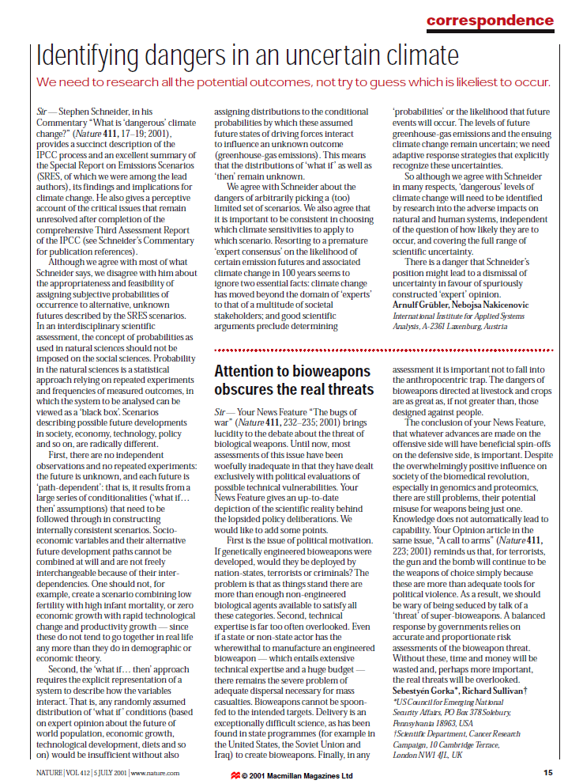
“We need to research all the potential outcomes, not try to guess which is likeliest to occur.”
“Probability in the natural sciences is a statistical approach relying on repeated experiments and frequencies of measured outcomes, in which the system to be analysed can be viewed as a ‘black box’. Scenarios describing possible future developments in society, economy, technology, policy and so on, are radically different.”

Slide 16
Why Scenarios?
Scenarios are appropriate when uncertainties are large, the consequences are significant, and outcomes cannot be bounded
Scenarios are intended to illuminate potential vulnerabilities to the range of outcomes
Once we've identified how and where we are vulnerable, we can evaluate whether we are equipped to deal with the vulnerabilities
Next, we address trade-offs between costs and other effects under each option to address vulnerabilities
Probabilities simplify the math, but don't really help us to explore these kinds of issues – instead, probabilities make it easy for us to ignore these issues
Notes:
In general, scenarios are appropriate when uncertainties are large, the consequences are significant, and outcomes cannot be bounded.
Sea level change (and more broadly, broader climate change) meets the first and last of these three conditions. For the second condition, we use sensitivity testing to determine the potential consequence of sea-level change. That sensitivity test guides our scope of study and the rigor of the scenario analysis.

Slide 17
Why Scenarios for Sea-Level Change?
Remember, scenarios are appropriate when uncertainties are large, the consequences are significant, and outcomes cannot be bounded
Sea level change (and more broadly, broader climate change) meets the first and last of these three conditions.
For the second condition, we use sensitivity testing to determine the potential consequence of sea-level change, and the sensitivity test guides our scope of study and the rigor of the scenario analysis
Notes:
In general, scenarios are appropriate when uncertainties are large, the consequences are significant, and outcomes cannot be bounded.
Sea level change (and more broadly, broader climate change) meets the first and last of these three conditions. For the second condition, we use sensitivity testing to determine the potential consequence of sea-level change. That sensitivity test guides our scope of study and the rigor of the scenario analysis.

Slide 18
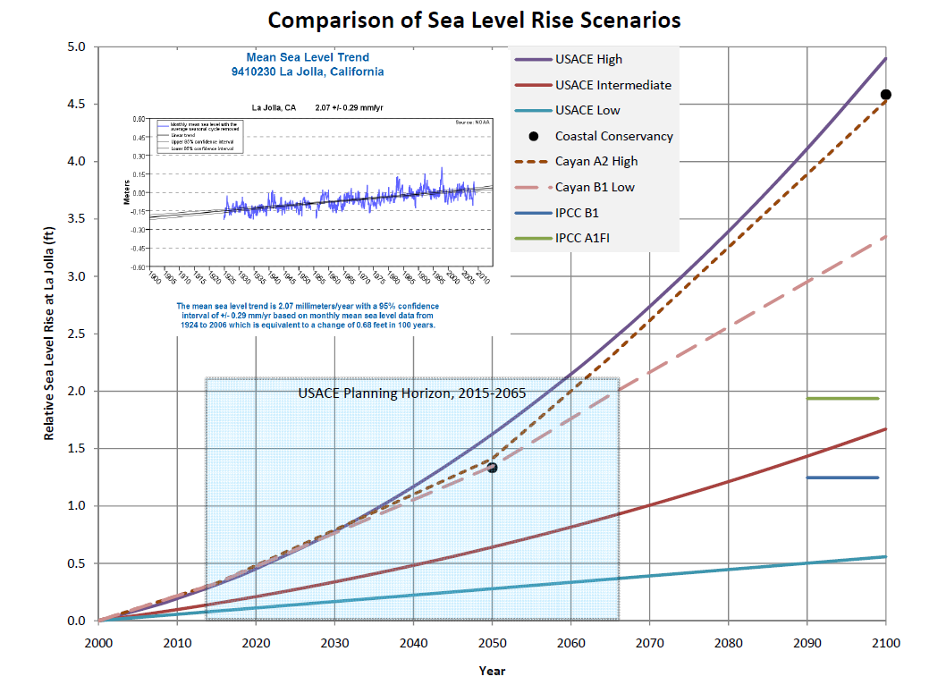
EC 1165-2-211 Incorporating Sea Level Change
Considerations in Civil Works Programs
Three estimates of future SLC must be calculated for all Civil Works Projects within the extent of estimated tidal influence:
  Extrapolated trend
  Modified NRC Curve 1
  Modified NRC Curve III
These curves are scenarios based on different assumptions about physical processes and causes without specific attributions of likelihood
As a result, the scenarios used in the EC represent multiple plausible futures
Notes:
The lowest blue curve is the extrapolated historical trend, which is an extrapolation of the data shown in the inset box. This curve is primarily controlled by regional sea level change projection and land uplift or subsidence.
The red intermediate curve is the updated 1987 National Research Council (NRC) curve 1. The blue and green markers that bound this line indicate the 2007 IPCC SRES low and high estimates (SRES = special report on emissions scenarios, a subset of 6 of the IPCC projections). The IPCC in 2007 does not provide an analytical expression of sea-level change that allows us to develop a curve, but rather a single point in time in the future. The purple line provides the updated NRC curve 3.
We can also represent stakeholder scenarios or projections. For this location, the dotted lines on the graph show locally-generated estimates from Scripps Institution of Oceanography (Cayan). And the black dots denote Coastal Conservancy estimates.
The blue shaded box indicates the Corps’ typical planning horizon.
NOTE: According to the IPCC 2007 Synthesis for Policy Makers: "Because understanding of some important effects driving sea level rise is too limited, this report does not assess the likelihood, nor provide a best estimate or an upper bound for sea level rise. Table SPM.1 shows model-based projections of global average sea level rise for 2090-2099.[10] The projections do not include uncertainties in climate-carbon cycle feedbacks nor the full effects of changes in ice sheet flow, therefore the upper values of the ranges are not to be considered upper bounds for sea level rise. They include a contribution from increased Greenland and Antarctic ice flow at the rates observed for 1993-2003, but this could increase or decrease in the future.[11] {3.2.1}"
So IPCC did not assign likelihoods, nor did it intend to establish an upper bound for the projected 2099 levels.

Slide 19
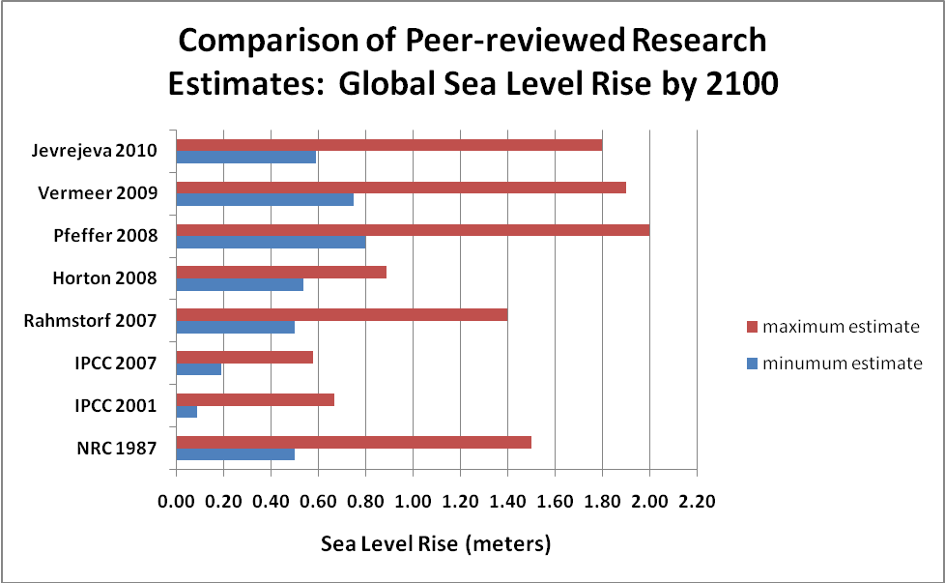
Comparison of EC 1165-2-211, IPCC, and Other Recent Research
Does not include changes in sea level resulting from changes in the large ice sheets covering Greenland and Antarctica
~ EC
Notes:
The EC compares well with recent estimates. Again, as noted previously, "Because understanding of some important effects driving sea level rise is too limited, this report does not assess the likelihood, nor provide a best estimate or an upper bound for sea level rise.“
Recent research has used alternate approaches to explore further the issue of global sea-level change. Their results are presented above for the year 2100 (references are provided below).
The curves used in EC 1165-2-211 are comparable to the results of the recent research.
References:
NRC 1987. Responding to Changes in Sea Level, Engineering Implications, Committee on Engineering Implications of Changes in Relative Mean Sea Level, Marine Board, Commission on Engineering and Technical Systems, National Research Council. National Academy Press, Washington DC 1987, 148pp.
IPCC 2001. Climate Change 2001: The Scientific Basis, edited by J.T. Houghton et al., Cambridge University Press, Cambridge, U.K.
IPCC 2007. Climate Change 2007: The Physical Science basis. Contribution of Working Group I to the Fourth Assessment Report of the Intergovernmental Panel on Climate Change, edited by S. Solomon et al., Cambridge University press, Cambridge U.K.
Rahmstorf, S. 2007. A semi-empirical approach to projecting future sea level rise, Science, 315, no. 5810, pp 368-370.
Horton, R., et al., 2008. Sea level rise projections for current generation CGCMs based on the semi-empirical method, Geophysical Research Letters, Vol. 35, L02715, 2008.
Pfeffer, W.T., et al., 2008. Kinematic constraints on glacier contributions to 21’st-century sea –level rise, Science, 321 , no. 5894, pp 1340-1343.
Vermeer, M., and S. Rahmstorf 2009. Global sea level linked to global temperature, Proceedings of the National Academy of Sciences, Early Edition, October 2009, 6pp.
Jevrejeva, S., et al., 2010. How will sea level respond to changes in natural and anthropogenic forcings by 2100?, Geophysical Research Letters, Vol. 37, L07703, 2010.

Slide 20
Examples of Climate Change Adaptation

Slide 21
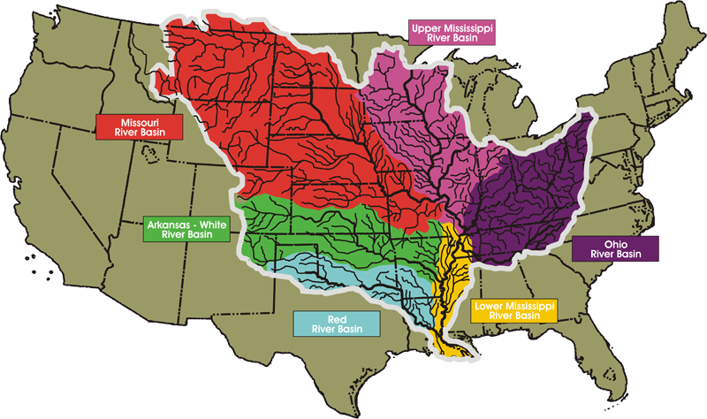
Example: Mississippi Watershed Extremes
Upper Mississippi and
Missouri Rivers
Combined
Ohio River
Flow Contribution to Lower Mississippi River
Notes:
The Mississippi Valley
Theme: Overview of the Mississippi River Watershed
The basin covers more than 1,245,000 sq mi (3,220,000 km²), including all or parts of 32 U.S. states and two Canadian provinces.
The total watershed of the Mississippi River covers nearly 40% of the landmass of the continental United States.
Although only 29% of the watershed, the Ohio Valley, shown in dark purple, contributes 60% of the flow to the lower Mississippi, shown in yellow.
Mississippi River basin is 1.25 million-square-miles (324 million hectares) in size.
It gathers water from 41% of the continental United States … which includes 31 states and 2 Canadian provinces.
It encompasses 3 Corps Divisions and the 3 largest rivers in the United States.
3rd largest watershed in the world behind the Amazon and Congo respectively.
Average flow = 640,000 cfs (18,100 cms)
2011 peak flow = 2.4 million cfs (68,000 cms)
Lower Mississippi River Basin = 35,000 sq. miles
Rhine River Basin = 86,870 square miles = 22.5 million hectares (about 1/14 of the Miss. Basin)
Avg Flow = 80,500 cfs (2,280 cms) or about 1/8 of the Miss.
Lower Rhine delta = 9,650 sq. miles ( 2.5 million hectares)
Current design flow = 530,000 cfs (15,000 cms)
Room for the River design flow = 565,000 cfs (16,000 cms)

Slide 22
Mississippi River Extremes
Flood of 2011 tested system
  Huge volume, long duration, snowmelt and rainfall
  System performed as designed
    Flood risk reduction systems were operated at their maximum capacity, some for the first time ever
    Design demonstrated incredible foresight
Drought of 2012 tested system again
  Impacts to navigation, water supply, recreation, energy production
2011 and 2012 highlighted resilience to extreme events
Notes:
In 1928, MG Edgar Jadwin, then Chief of Engineers, developed a plan to prevent disastrous floods on the Lower Mississippi River.
Because they were dealing with short periods of record and large risks, the engineers who developed the Jadwin plan incorporated what we might today call relatively large uncertainty
In 2011, that plan proved its worth as USACE battled floodwaters similar to those of 1927.
In 2012, the system was tested by extreme events, this time by drought. Again, the system proved relatively resilient to this extreme.

Slide 23
Columbia River Treaty 2014/2024 Climate Change Impact Studies

Slide 24
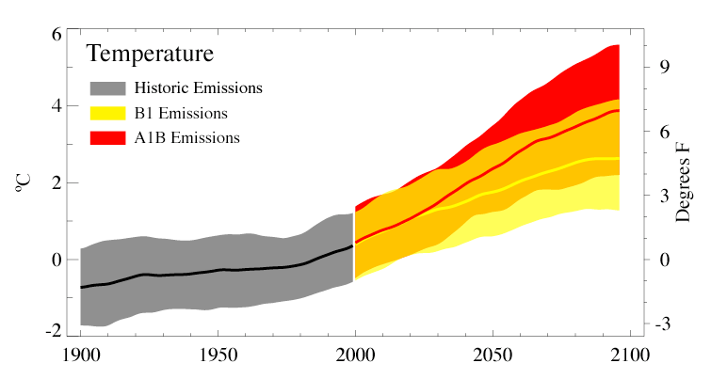
Projected Increases in Annual Temperature
HH
2080s
+5.3ºF
(2.8-9.7ºF)
2040s
+3.2ºF
(1.6-5.2ºF)
2020s
+2.0ºF
(1.1-3.4ºF)
°C
°F
Choice of emissions scenario matter more after 2040s
* Compared with 1970-1999 average
Mote and Salathé, 2010
Notes:
24
Figure 1. Simulated temperature (change this slide) and precipitation (% change, next slide) for the 20th and 21st Century climate model simulations. The black curve for each panel is the weighted average of all models during the 20th Century. The colored areas indicate the range (5th to 95th percentile) for each year in the 21st Century. All changes are relative to 1970-1999 averages.

Slide 25
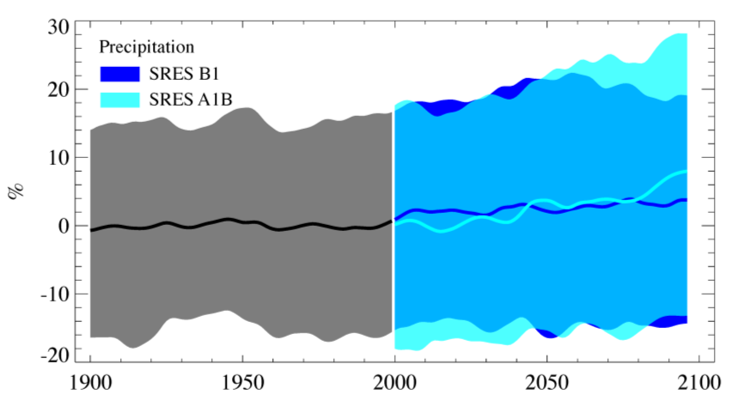
Projected Changes in Annual Precipitation
HH
* Compared with 1970-1999 average
Changes in annual precipitation averaged over all models are small but some models show large seasonal changes, especially toward wetter autumns and winters and drier summers.
Mote and Salathé, 2010
Notes:
25
Figure 2. Simulated temperature (change, previous slide) and precipitation (% change, bottom panel) for the 20th and 21st Century climate model simulations. The black curve for each panel is the weighted average of all models during the 20th Century. The colored areas indicate the range (5th to 95th percentile) for each year in the 21st Century. All changes are relative to 1970-1999 averages.
It is worth noting that, while a few % change in total precipitation may not seem important, the way the precipitation is delivered may change. If that precipitation comes as more storms that are comparable to those in the historical record, then the implications are for more of the same kinds of storms that we have observed and are already prepared for. If, however, that precipitation comes as more intense storms that deliver more precipitation than the strorms with which we are familiar, the meaning changes completely for urban infrastructure and flood risk.

Slide 26
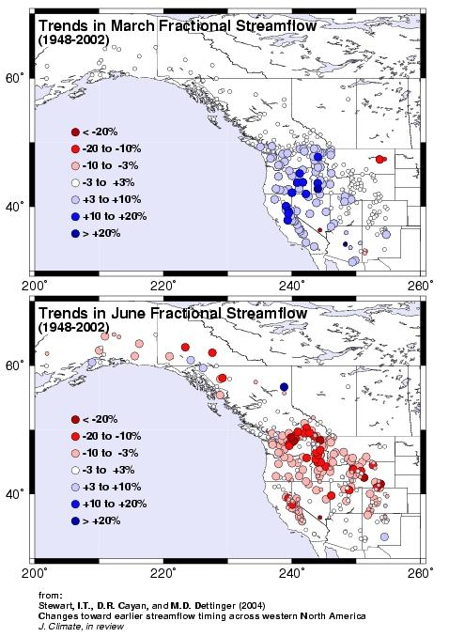
Trends in Fractional Streamflow
HH
As the West warms,
spring flows rise and summer flows drop
Stewart IT, Cayan DR, Dettinger MD, 2005: Changes toward earlier streamflow timing across western North America, J. Climate, 18 (8): 1136-1155
Notes:
Spring snowmelt timing has advanced by 10-40 days in most of the West, leading to increasing flow in March (blue circles) and decreasing flow in June (red circles), especially in the Pacific Northwest.

Slide 27
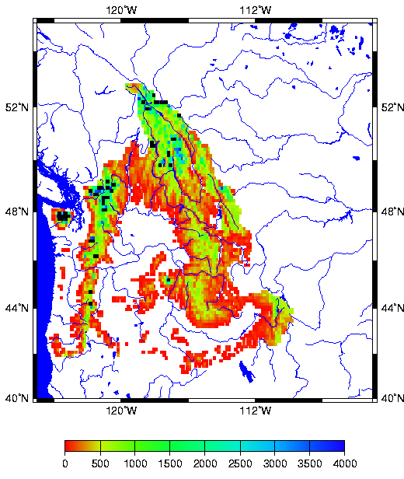
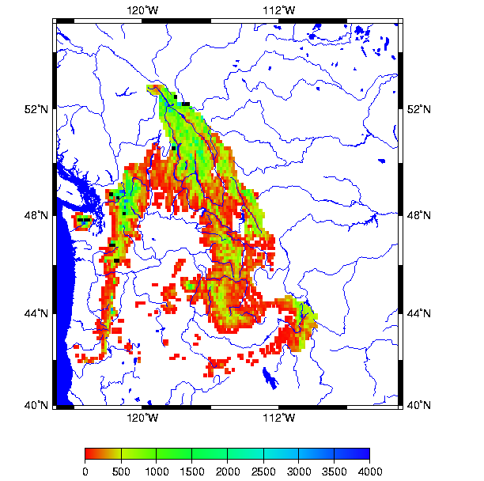
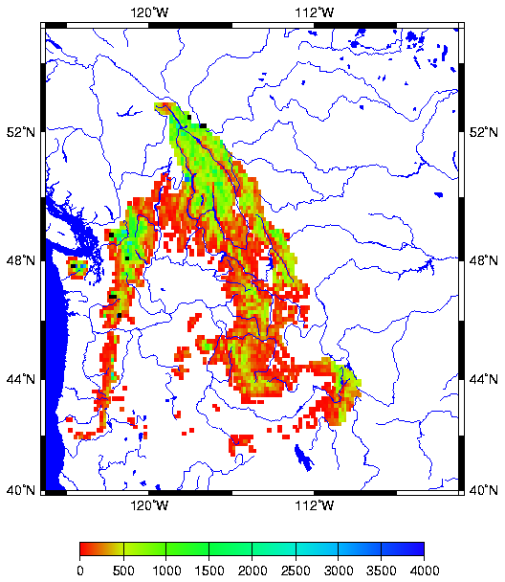
Changes in Simulated April 1 Snowpack
Canadian and U.S. portions of the Columbia River basin
(% change relative to current climate)
20th Century Climate
“2020s” (+1.7 C)
“2040s” (+ 2.25 C)
-3.6%
-11.5%
-21.4%
-34.8%
April 1 SWE (mm)

Slide 28
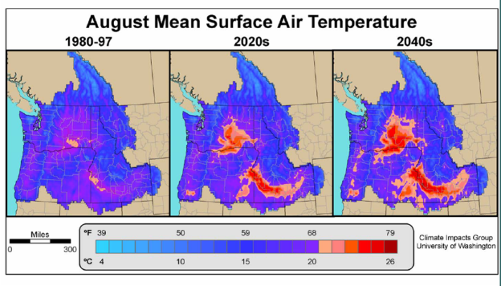
Temperature thresholds for coldwater fish in freshwater
Warming temperatures will increasingly stress coldwater fish in the warmest parts of our region
  A monthly average air temperature of 68ºF (20ºC) has been used as an upper limit for resident cold water fish habitat, and is known to stress Pacific salmon during periods of freshwater migration, spawning, and rearing
+1.7 °C
+2.3 °C

Slide 29

The Dalles Regulated,
Median year at The Dalles
Wet has more volume Nov-May
Peak is slightly earlier, but similar
Base has noticeable more volume in Jul-Sep

Slide 30
Average HydSim Outflows at the Dalles
Early April drop attributed to reduction in Arrow outflows as defined by Treaty operations
Note significant increase in winter flows
Note reduced summer flows

Slide 31
Flood Control vs. Refill
Balance between flood protection and reliability of refill is crucial in the Columbia Basin.
As peak flows move earlier in the year
  flood evacuation schedules may need to be revised
    To protect against early season flooding
    To begin refill earlier to capture the (smaller) spring freshet.
Model experiments (see Payne et al. 2004) have shown that moving flood evacuation two weeks to one month earlier in the year helps mitigate reductions in refill reliability associated with streamflow timing shifts.
Payne, J.T., A.W. Wood, A.F. Hamlet, R.N. Palmer, and D.P. Lettenmaier, 2004, Mitigating the effects of climate change on the water resources of the Columbia River basin, Climatic Change, Vol. 62, Issue 1-3, 233-256

Slide 32
Implications for Transboundary Agreements
Canadian Snowpack is less sensitive to warming then in U.S. portion of Columbia basin
  Streamflow timing shifts will also be smaller in Canada.
Over the next 50 years or so, Canada will have an increasing fraction of the snowpack contributing to summer streamflow volumes in the Columbia basin.
These differing impacts in the two countries have the potential to “unbalance” the current coordination agreements, and will present serious challenges to meeting instream flows on the U.S. side.
Changes in flood control, hydropower production, and instream flow augmentation will all be needed.
Long-range planning is needed to address these issues.

Slide 33
Other Implications of Climate Change

Slide 34


Bulletin 17B Revision
Previous Wording for “Climatic Trends:”
  “There is much speculation about climatic changes. Available evidence indicates that major changes occur in time scales involving thousands of years. In hydrologic analysis it is conventional to assume flood flows are not affected by climatic trends or cycles. Climatic time invariance was assumed when developing this guide.”

Slide 35
Bulletin 17B Revision
Revised Wording for Climate Paragraph:
  “There is much speculation about changes in flood risk over time. Available evidence indicates that major changes may be occurring over decades or centuries. While time invariance was assumed when developing this guide, where changes in climate and flood risk over time can be accurately quantified, the impacts of such changes should be incorporated in frequency analysis by employing time-varying LP3 parameters or using other appropriate and statistically justified techniques. All such methods need to be thoroughly documented and justified.”

Slide 36

Dam Safety Implications
Changes to storm types and magnitudes
Changes to runoff characteristics
Changes to calculations of Probable Maximum Precipitations – Dew Point alterations

Slide 37

Example Effects from Regional Precipitation Shifts
IPCC AR4 model CCSM3
  South regions drier during growing seasons, reducing agricultural productivity
  Extreme storms affect Central America and the Caribbean more than elsewhere
  Shifts in wet/dry seasonality
2050 A1FI Drought Index
Graphic from Ganguly et al., (ORNL) produced for backing the QRD 2009.
http://www.ornl.gov/knowledgediscovery/QDR/
--
Notes:
Precipitation Patterns and Drought
Droughts, like fires, are often associated with warmer conditions. There are certainly cold deserts, such as those of the high Andes, and droughts (in the sense of reduced precipitation) can occur in the Southern Hemisphere (austral) winter. Winter droughts (reduced rain or snow) can have important consequences for municipal and agricultural water supply, but it is often the hot, dry conditions of summer or growing season droughts that come to mind on hearing the word “drought”. Certainly increases in growing season drought raise the risk of decreased food production and the specter of famine. This sense of drought would be associated with drought in the normally wet season of the seasonal wet-dry tropics and sub-tropics of USSOUTHCOM. Seasonal drought could convert presently non-seasonal wet tropics into seasonal wet-dry tropics.
The IPCC AR4 (Christensen et al. 2007) did report moderate warming in the Southern Hemisphere summer of southern (temperate) South America, which could be associated with growing season drought in this part of South America. Drought is, however, more associated with decreases in precipitation than increases in temperature, and the analysis of drought for USSOUTHCOM focuses on those changes in precipitation.
The IPCC AR4 reported that globally averaged precipitation is projected to increase with global warming as part of the general intensification of the global hydrological cycle (Meehl et al. 2007). However, while modeled precipitation generally increases in the tropics, particularly the tropical Pacific, and at high latitudes, there are general decreases in the subtropics and mid-latitudes. Christensen et al. (2007) reported decreased precipitation in the Southern Hemisphere summer/growing season (December, January, February) for southern (mid-latitude) South America. A warmer, dryer southern USSOUTHCOM could experience more growing season drought and the potential loss of agricultural production (e.g., forage for cattle). The CCSM3 projections here are consistent with these patterns with strong droughts over southern Chile and Argentina (QDR Climate Change Support).
The Standardized Precipitation Index (SPI, McKee et al. 1993) is an index of drought beyond just decreases in precipitation, one that incorporates precipitation extremes (Methods). A negative value for SPI indicates drought, a positive value indicates wet conditions. Largely independent of scenario, the patterns of SPI calculated from CCSM3 projections indicate a general wetting of USSOUTHCOM except in Central America where the drought index is high, along the tropical Pacific and Atlantic coasts, and in southern Chile. The wet and dry conditions both increase over time and are at a maximum in 2100 under the A1FI scenario (QDR Climate Change Support). These patterns of drought could have consequences for water resources in the heavily populated coastal region of USSOUTHCOM.
Source: adapted from ORNL Climate Extremes Research Group.

Slide 38

LEARNING OBJECTIVES
Using the course manual, references and lecture notes, the student will be able to understand hydrologic and hydraulic aspects of dam safety program. After this presentation, the student will be familiar with concepts, terminology and inter-relationships between hydrologic, hydraulic and water management considerations essential in the engineering analysis associated with the administration of the USACE Dam Safety program.
QUESTIONS

